Slide 1

感恩遇见，相互成就，本课件资料仅供您个人参考、教学使用，严禁自行在网络传播，违者依知识产权法追究法律责任。
更多教学资源请关注
公众号：溯恩高中英语
知识产权声明

Slide 2
2023年全国高考新课标 Ⅰ & Ⅱ 卷
听力精听课件
瑞安新纪元高中
焦海滨老师制作

Slide 3


影响听力的因素
心理因素学生在进行听力练习或考试时往往表现为听音时感到紧张、焦虑因而导致无法正常听音。
壹
缺乏背景知识由于没有语言环境，学生很少了解听力材料中的背景知识，无法做出正确的判断、推理、猜测。
贰
叁
学生缺乏听力解题技巧研究发现，很多情况下由于听者未能掌握相关的听力技巧，因而不能很好地理解听力材料。
肆
词汇储备不足一个学生的听、说、读、写要达到一定的水平，必须拥有相应数量的必备词汇。

Slide 4

语音知识对听力的影响
在听力理解的过程中，语音是第一位的，听者首先接受的是语音信息，大脑接受了因素，音节，中音等因素构成的单词，短语和句子后使他们在自己的语言图式中“对号入座”，根据已有的知识结构( 图式 ),开始对该信息进行建构，以理解其意义。

Slide 5
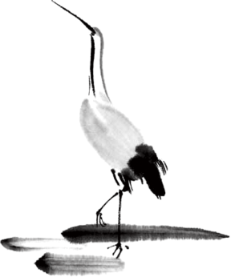
语速的加快主要有一下三种原因
壹
贰
叁
连读
（ 以下用红色标记 )
省音
（ 以下用蓝色标记 ）
音变
（以下用黄色标记 ）

Slide 6



一，连读 （ 以下用红色标记 )
1，“辅音+元音”型连读（异性相吸）
如：I’d like another bowl of rice.
2、“辅音+半元音”型连读英语语音中的/j/和/w/是半元音，如果前一个词是以辅音结尾，后一个词是以半元音，特别是/j/开头，此时也要连读。Thank you .

Slide 7

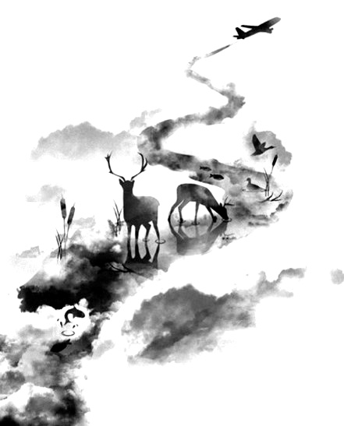

二，省音 （以下用蓝色标记）
01
壹
一、爆破音/b/ /p/ /d/ /t/ /g/ /k/
1.以上任何一个爆破音后面如果紧接着是一个辅音或者半元音，那么这个爆破音将不再发音，仅空半拍就行。如：Good morning!可以发为/gu_'mɔ:niŋ/。
2.以上任何一个爆破音在句尾时，这个爆破音不再发音。如：Good night!最后的/t/音便不再发，整句话可读作/gu_nai_/。

Slide 8
省音 （以下用蓝色标记）
01
二、不完全爆破
① 爆破音中的任何两个爆破音相邻时，前一爆破音失去爆破。如：a big car等。
② 爆破音中的任何一个后接摩擦音f,h,x,sh,s,r时，前面的爆破音失去爆破。
如：I didn't say so.
③ 爆破音后接/t/， /d/， /tr/， /dr /时，前面的爆破音失去爆破。如：a great change等。
④ 爆破音后接/m/, /n/, /l/, /s/时，前面的爆破音失去爆破。如：a bit more expensive等。

Slide 9
省音 （以下用蓝色标记）
01
三、/s/-/z/ /ts/-/dz/ /∫/-/ ʒ / /t∫/-/ dʒ / /θ/-/ ð / ds发/dz以上任何两个音相遇，只读后面的那个音，而前面的音则省略不发。
如：Who is Stone?可把前面一个/z/省掉，只读作/hu i stəun /。

Slide 10
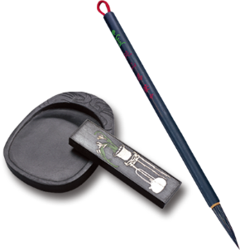
音的变化也是一种连读现象，两个词之间非常平滑的
过渡，导致一个音受临音影响而变化。
主要是以下两种方式：
1、 辅音[d]与[j]相邻时，被同化为[dʒ]：
Would you....?
2、 辅音[t]与[j]相邻时，被同化为[t∫]：
Can’t you？
三，音变
（以下用黄色标记 ）

Slide 11
听力试音材料
M:Hello ! International Friends Club , can I help you ?
W: Oh , hello ! I read about your club in the paper today . And I thought I’d phone to find out a bit more .
M:Yes , certainly . well , we’re a sort of social club for people from different countries . It’s quite a new club .we have about 50 members at the moment but we’re growing all the time .

Slide 12
听力试音材料
W: That sounds interesting .I’m British actually ,and I came to Washington about three months ago ,I’m looking for ways to meet people . . Er ,what kinds of events do you organize ?
M: well , we have social get-togethers ,and sports events ,and we also have language evenings
W: Could you tell me something about the language evenings ?

Slide 13
听力试音材料
M: Yes , every day except Thursday , we have a language evening. People can come and practice their languages .you know , over a drink or something .we have different languages on different evenings . Monday -Spanish; Tuesday- Italian ;Wednesday- German and Friday- French .On Thursday we usually have a meal in a restaurant for everyone who wants to come .

Slide 14
听力试音材料
W:well,that sounds Great , I really need to practice my French .
M: Ok , well if you can just give me your name and address I’ll send you the form and some more information .If you join now ,you can have first month free .

Slide 15


例题
M:Excuse me ,can you tell me how much the shirt is ?
W：Yes, it’s nine-fifteen.
例：How much is the shirt?
A. ￡19.15. B. ￡9.18. C. ￡9.15.

Slide 16


Text 1 周末活动 词数：33 时长：17秒
W: Jack, are you going camping with your friends this weekend?
M: It depends. If it’s sunny, we’ll go.
W: The weatherman says it’s going to rain
M: In that case, we’ll________________ instead. 1. What will Jack probably do this weekend?
A. Go camping. B. Visit a friend. C. Watch a film.

Slide 17

Text 1
W: Jack, are you going camping with your friends this weekend?
M: It depends. If it’s sunny, we’ll go.
W: The weatherman says it’s going to rain
M: In that case, we’ll go to the cinema instead.
1. What will Jack probably do this weekend?( 同义转述 )
A. Go camping. B. Visit a friend. C. Watch a film.= go to the cinema

Slide 18
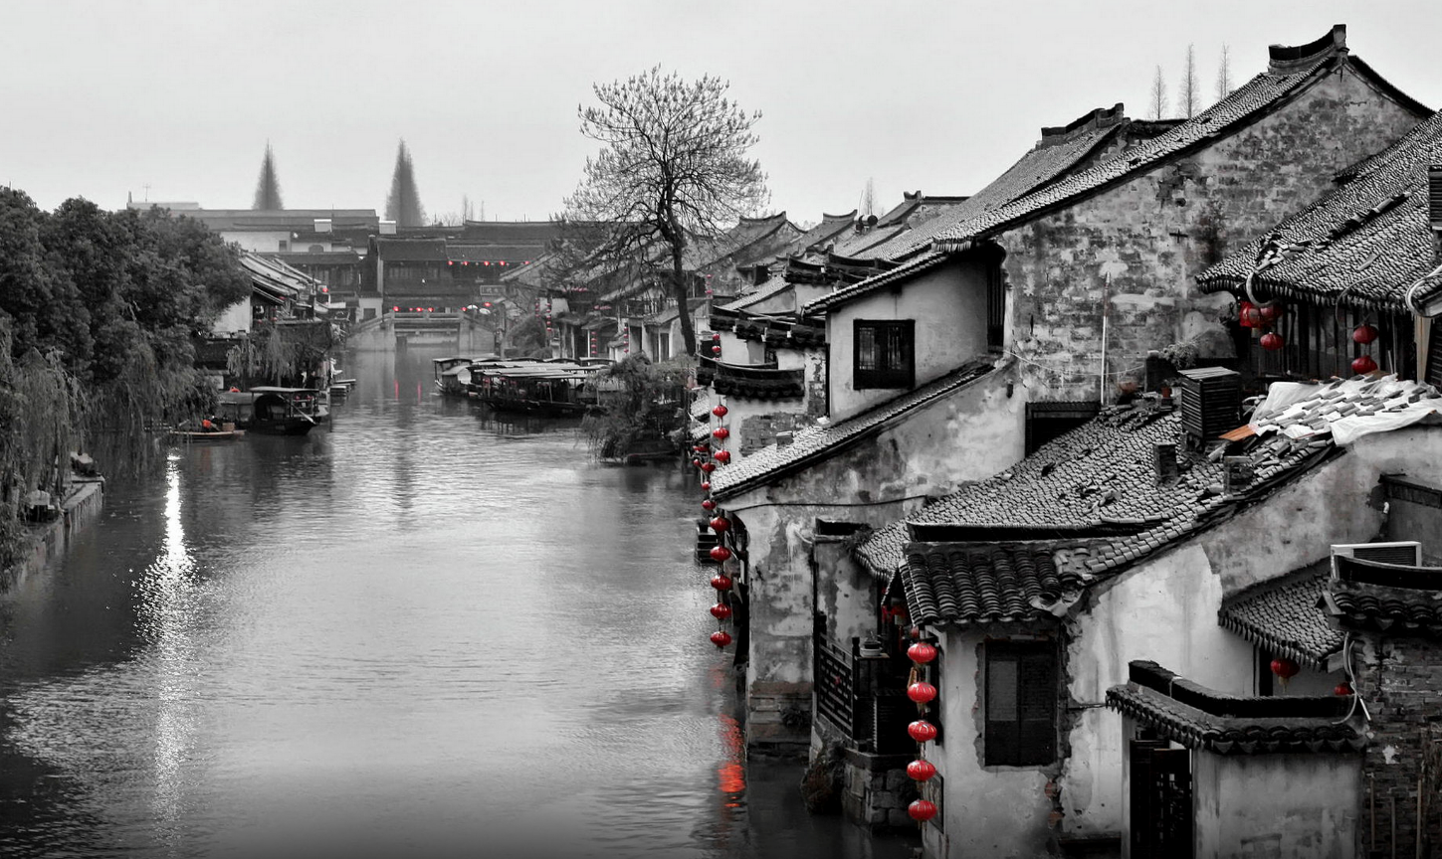
Text 2 火车站求助 词数：36 时长：16 秒
——————————
Text 2
W: Excuse me, ______________________for a moment? I want to buy some food at the convenience store.
M: No problem. But be quick. It was announced that my train will arrive in 10 minutes.
2. What does the woman ask the man to do?
A. Take care of her bags.
B. Pack the food for her.
C. Check the train schedule.

Slide 19

——————————
W: Excuse me, could you mind my bags for a moment? I want to
buy some food at the convenience store.
M: No problem. But be quick. It was announced that my train
will arrive in 10 minutes.
2. What does the woman ask the man to do?( 同义转述 )
A. Take care of her bags. = mind her bags
B. Pack the food for her.
C. Check the train schedule.
convenience store 便利店

Slide 20
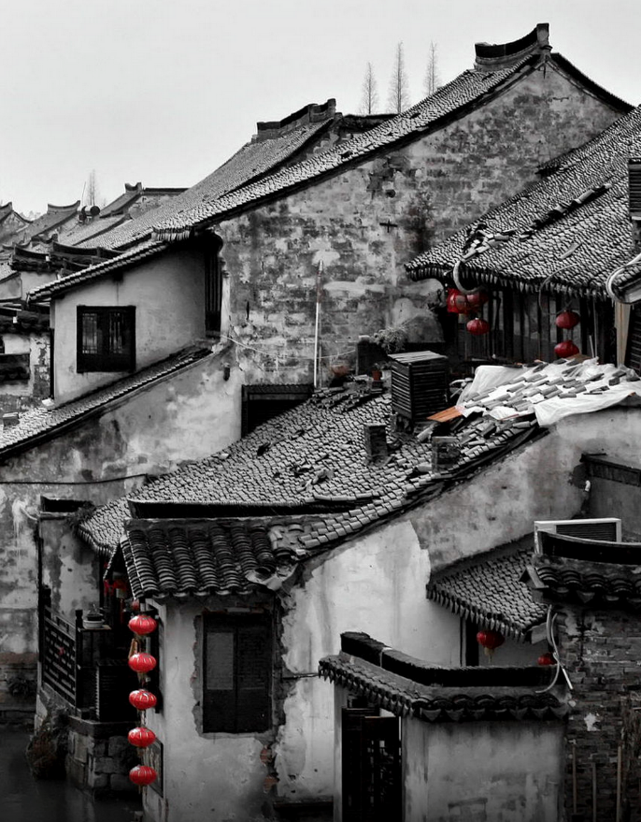
Text 3 看望朋友 词数：37 时长：17秒
W: Bob came out of hospital last Friday. Have you got a chance to visit him?
M: _________________________.
W: Aren’t you going to the conference then?
M: No. It has been rescheduled, the next Monday.
3. When will the man see Bob?
A. This Friday. B. This Saturday. C. Next Monday.
天人合一
天 下 皆 知 美 之 为 美 ， 斯 恶 已
皆 知 善 之 为 善 ， 斯 不 善 已
有 无 相 生 ， 难 易 相 成 ， 长 短 相 形
高 下 相 盈 ， 音 声 相 和 ， 前 后 相 随
恒 也

Slide 21
W: Bob came out of hospital last Friday. Have you got a chance to visit him?
M: I plan to see him this Saturday.
W: Aren’t you going to the conference then?
M: No. It has been rescheduled, the next Monday.
3. When will the man see Bob?( 细节题 ）
A. This Friday. B. This Saturday. C. Next Monday.
天人合一
天 下 皆 知 美 之 为 美 ， 斯 恶 已
皆 知 善 之 为 善 ， 斯 不 善 已
有 无 相 生 ， 难 易 相 成 ， 长 短 相 形
高 下 相 盈 ， 音 声 相 和 ， 前 后 相 随
恒 也
conference 会议
reschedule 重新安排

Slide 22

T Text 4 饭店吃饭 词数：37 时长：17秒
M: Sorry, Miss. We _____________________________. Here is the ten dollars we have to________ you.
W: Oh, I didn’t notice that. It’s OK. Don’t blame the waiter. He’s been really nice.
4. Why does the man apologize?
A. For the terrible food.
B. For the overcharge.
C. For the waiter’s rudeness.

Slide 23
(Text 4)
M: Sorry, Miss. We made a terrible mistake adding up the bill. Here is the ten
dollars we have to return to you.
W: Oh, I didn’t notice that. It’s OK. Don’t blame the waiter. He’s been really nice.
4. Why does the man apologize? （ 推理题 ）
A. For the terrible food.
B. For the overcharge.
C. For the waiter’s rudeness.
overcharge 要价过高
rudeness 粗鲁

Slide 24
Text 5 新年礼物 词数：31 时长：15秒t
W: Do you think we should ___________________________?
M: Books are good. But Steve wouldn’t take just any book. He has to have this particular one on geography.
5. What are the speakers talking about?
A. Writing a book.
B. Holding a celebration.
C. Buying a present.

Slide 25
W: Do you think we should get Steve a book for the new year?
M: Books are good. But Steve wouldn’t take just any book. He has to have this particular one on geography.
5. What are the speakers talking about?( 主旨大意题 ）
A. Writing a book.
B. Holding a celebration.
C. Buying a present.
particular 特别的
geography 地理
hold a celebration 开庆祝会

Slide 26
Text 6 紧急情况不能赴约 词数：88 时长：86秒
M: Hello, Sara.
W: Hello, David. ________________________. Sorry.
M: Oh, what happened?
W: We’ve got a new case and things get pretty crazy here in the office.
M: Well, then I’ll come to you.
W: No, no, not tonight. Let me see if I can arrange another night.
M: Sara, please. We need to talk. It’s about my job.
W: Then tell me on the phone.
M: No, _______________________. How about tomorrow night?
W: I’m not sure. You can give me a call tomorrow afternoon.
M: OK.

Slide 27

M: Hello, Sara.
W: Hello, David. I can’t come for dinner tonight. Sorry.
M: Oh, what happened?
W: We’ve got a new case and things get pretty crazy here in the office.
M: Well, then I’ll come to you.
W: No, no, not tonight. Let me see if I can arrange another night.
M: Sara, please. We need to talk. It’s about my job.
W: Then tell me on the phone.
M: No, it’s better if we do it in person. How about tomorrow night?
W: I’m not sure. You can give me a call tomorrow afternoon.
M: OK.
6. Why does Sara make the phone call?（ 推理判断题 ）
A. To ask for advice. B. To arrange an outing. C. To cancel an appointment.
7. What does David want to do? ( 细节题 ）
A. Go to a dinner party. B. Talk to Sara in person. C. Work on the new case.

Slide 28
Text 7 朋友来访 词数101 时长：84秒
W: Jim will call on us this afternoon. Do you know where he is now?
M: Er … wait. Let me see. He has sent two messages saying that he’s done with his work at the office and _______ and ... and he’ll arrive in twenty minutes.
W: We can’t keep him waiting outside our home. We have to hurry.
M: But it takes at least half an hour to get at the city center by bus. Look at the traffic.
W: Let’s get off. We can ________________________ by ____________________.
M: Are you sure?
W: Yes. A hundred percent.

Slide 29
W: Jim will call on us this afternoon. Do you know where he is now?
M: Er … wait. Let me see. He has sent two messages saying that he’s done with his work at the office and got a taxi and ... and he’ll arrive in twenty minutes.
W: We can’t keep him waiting outside our home. We have to hurry.
M: But it takes at least half an hour to get at the city center by bus. Look at the traffic.
W: Let’s get off. We can save at least twenty minutes by walking through the park.
M: Are you sure?
W: Yes. A hundred percent.
8. Where is Jim now? （ 推理判断题 ）
A. In a taxi. B. On a bus. C. In his office.
9. What is the woman’s suggestion?( 推理判断题 ）
A. Going to the city center. B. Taking a short cut home.C. Meeting Jim in the park.

Slide 30
Text 8 分享周末时光 词数：176 时长：90秒
W: Morning, Mark.
M: Morning, Clara. How was your weekend?
W: Great. I ______________. He invited us to pick vegetables on his farm. My daughter had a great time there. What about you?
M: Oh, I had a truly incredible experience. I dropped by a yard sale on Saturday and got several books. W: Novels?
M: A novel and two poetry collections. As I leafed through the novel, a piece of paper fell out. It was ______________ from 2012. The flight was from Los Angeles to Chicago and the name on the ticket was Ashley Louis.
W: Was it?
M: Yes! Ashley, ____________! In 2012, she lived in Los Angeles and her husband worked in Chicago. Both of them often flew between the two cities. I asked the seller where he got the book. He said it was bought at a second-hand bookstore in Los Angeles three years ago. Last year, he and his family moved from Los Angeles to _____________.
W: So, all the way across the country, your sister’s old book landed in your hands. That’s really crazy.

Slide 31

10. What did Clara do at the weekend?( 细节题 ）
A. She planted vegetables.
B. She went to a yard sale.
C. She visited her grandpa.
11. What did Mark find inside one of the books he bought?（ 语音题 ）
A. A plane ticket. B. A family photo. C. A post card.
12. Where does Mark live? ( 推理题 ）
A. Los Angeles. B. Chicago. C. Philadelphia.
13. What is the relationship between Mark and Ashley? （ 推理题 ）
A. Brother and sister.
B. Husband and wife.
C. Father and daughter.
incredible experience 难以置信的体验
drop by 顺便拜访
a yard sale 院子销售
poetry collections 诗集
leafed through the novel 翻阅小说

Slide 32
W: Morning, Mark.
M: Morning, Clara. How was your weekend?
W: Great. I went to my grandpa’s. He invited us to pick vegetables on his farm. My daughter had a great time there. What about you?
M: Oh, I had a truly incredible experience. I dropped by a yard sale on Saturday and got several books. W: Novels?
M: A novel and two poetry collections. As I leafed through the novel, a piece of paper fell out. It was an air ticket from 2012. The flight was from Los Angeles to Chicago and the name on the ticket was Ashley Louis.
W: Was it?
M: Yes! Ashley, my sister! In 2012, she lived in Los Angeles and her husband worked in Chicago. Both of them often flew between the two cities. I asked the seller where he got the book. He said it was bought at a second-hand bookstore in Los Angeles three years ago. Last year, he and his family moved from Los Angeles to Philadelphia.
W: So, all the way across the country, your sister’s old book landed in your hands. That’s really crazy.

Slide 33
Text 9 大学生活 词数：167 时长：154秒
W: Victor, you’ve been here in Indiana for six weeks now. How are you feeling?
M: I think I’ve got used to college life, going to classes, working out and hanging out with my friends. Though there’s pressure to meet deadlines, life here is never boring.
W: What’s been hard about being an Indiana basketball player?
M: Well, __________________ — weightlifting and running every day. It’s not like high school. In high school, I really didn’t have to do that. I’m just trying to get used to it. And I think I am.
W: At this point, how do you see yourself fitting into this group?
M: I think we are all different. George is from______. Chris and Leo are from _________. I’m from ________. And the rest are __________. But I get along with everybody. You know, we are really starting to bond. It’s great to see___________________ as a team.
W: Thanks, Victor. I wish you a very happy and fruitful stay in Indiana.

Slide 34
14. What is probably the woman? （ 推理判断题）
A. A teacher. B. A journalist. C. An athlete.
15. What does Victor find difficult as a member of the basketball team?
A. Adapting himself to the intense training. ( 同义转述 ）
B. Dealing with the pressure from the coach.
C. Regaining the skills learned in high school.
16. What does Victor say about the players on the team? ( 细节题 ）
A. They are of the same age.
B. They are similar in character.
C. They are from different countries.
17. How does Victor feel about his team now? ( 同义转述 ）
A. It’s about to break up.
B. It’s the best in Indiana.
C. It’s getting stronger.
adapt oneself to 适应 intense training 紧张的训练
regain the skill 重获技能 similar in character 性格类似

Slide 35
W: Victor, you’ve been here in Indiana for six weeks now. How are you feeling?
M: I think I’ve got used to college life, going to classes, working out and hanging out with my friends. Though there’s pressure to meet deadlines, life here is never boring.
W: What’s been hard about being an Indiana basketball player?
M: Well, the training is very competitive — weightlifting and running every day. It’s not like high school. In high school, I really didn’t have to do that. I’m just trying to get used to it. And I think I am.
W: At this point, how do you see yourself fitting into this group?
M: I think we are all different. George is from Britain. Chris and Leo are from Australia. I’m from France. And the rest are Americans. But I get along with everybody. You know, we are really starting to bond. It’s great to see how we grow each day as a team.
W: Thanks, Victor. I wish you a very happy and fruitful stay in Indiana.
meet deadlines 在截至日期前完成任务 bond 增强（ 与某人的信任关系）
weightlifting 举重 fit into 适应 get along with 与。。。和睦相处

Slide 36
Text 10 介绍杂志 词数：160 时长：160秒、
W: Good evening, dear listeners. When was the last time you enjoyed leisure activities? Do you want to live a full and happy life? Today, I’m going to introduce to you a _______ that features the art of living. The Idler was _______ by Tom Hokinson, back in 1993. With the intention of providing a bit of fun, freedom and achievement in a busy world, it is now published bimonthly. In every issue, you’ll find an interesting mix of interviews and essays on the good ___, ______, ______, ______ and ______ _______. You’ll find much to laugh at and much useful stuff as well, from recipes for making bacon to guides to housekeeping. If you’ve ever felt that there is more to life than boring jobs, then -_____________________? The Idler is a cheering read that makes you feel better about life. You can download the application and subscribe today to get your first issue free.

Slide 37
18. Who is Tom Hokinson?
A. Founder of a magazine.
B. Publisher of a novel.
C. Editor of a newspaper.
19. What do we know about the content of The Idler?
A. It’s old-fashioned.过时的
B. It’s wide-ranging.广泛的
C. It’s student-targeted.针对学生的
20. Why does the speaker give the talk?
A. To do a promotion.做促销活动
B. To discuss an issue.讨论一个问题
C. To introduce a lecturer.介绍讲师

Slide 38
W: Good evening, dear listeners. When was the last time you enjoyed leisure activities? Do you want to live a full and happy life? Today, I’m going to introduce to you a magazine that features the art of living. The Idler was launched by Tom Hokinson, back in 1993. With the intention of providing a bit of fun, freedom and achievement in a busy world, it is now published bimonthly. In every issue, you’ll find an interesting mix of interviews and essays on the good life, history, philosophy, arts and fashion photography. You’ll find much to laugh at and much useful stuff as well, from recipes for making bacon to guides to housekeeping. If you’ve ever felt that there is more to life than boring jobs, then why not subscribe to it? The Idler is a cheering read that makes you feel better about life. You can download the application and subscribe today to get your first issue free.
launch 发动，发起；上市，发行 With the intention of 目的是 bimonthly两月一次的 issue 议题，争论点。发表，颁布
fashion photography时装摄影 useful stuff有用的东西
subscribe to 订阅 a cheering read 令人振奋的阅读
download the application 下载应用程序

Slide 39
欢迎指导

