Slide 1

感恩遇见，相互成就，本课件资料仅供您个人参考、教学使用，严禁自行在网络传播，违者依知识产权法追究法律责任。
更多教学资源请关注
公众号：溯恩高中英语
知识产权声明

Slide 2


2023年6月全国新课标I/II卷应用文
基于评分标准的应用文解析
杭州二中树兰高级中学 郭合英

Slide 3
Examine the topic carefully
认真审题
Plan the structure
谋篇布局
contents
Expand Language competence
语言能力
Comments on some students’ compositions
习作点评
Appreciate fantastic works
佳作欣赏

Slide 4
依据评分标准，探究写作要求
根据评分标准，引导学生从以下几个方面进行思考，朝着第五档作文出发……
研读试题信息，完善写作内容
用词得体贴切，实现交际功能
巧妙增加细节，彰显思维能力
使用有效衔接，凸显文章脉络

Slide 5



第五档写作要求 （13-15） | ① 完全完成了试题规定的任务。 ② 覆盖所有内容要点。 ③ 应用了较多的语法结构和词汇。 ④ 语法结构或词汇方面有些许错误，但为尽力 使用较复杂结构或较高级词汇所致；具备较 强的语言应用能力。 ⑤ 有效地使用了语句间的连接成分，使全文结 构紧凑。 ⑥ 完全达到了预期的写作目的。
第五档写作要求

Slide 6

1
Examine the topic carefully
依照评分标准①②认真审题

Slide 7

试题呈现
认真审题
①完全完成了试题规定的任务。
②覆盖所有内容要点。
第五档写作要求 （13-15） | ③应用了较多的语法结构和词汇。 ④语法结构或词汇方面有些许错误，但为尽力 使用较复杂结构或较高级词汇所致；具备较 强的语言应用能力。 ⑤有效地使用了语句间的连接成分，使全文结构 紧凑。 ⑥完全达到了预期的写作目的。
主要问题
次要问题
假定你是李华，外教Ryan准备将学生随机分为两人一组，让大家课后练习口语，你认为这样分组存在问题。请你给外教写一封邮件，内容包括；
1. 说明问题；
2. 提出建议
注意：
1. 写作词数应为80左右；
2. 请按如下格式在答题
卡的相应位置作答。
外教Ryan
文章体裁：
交际对象：
文章要点：
时态：
人称：
回复：
说明问题
告知信
提出建议
建议信
拓展细节
一般现在时和一般将来时
审题完成后，学生需要根据第五档作文的评分标准完成①和②，确保体裁正确，写作目的明确且涵盖所有要点。
Dear Ryan, I'm Li Hua from a Class 3. Your sincerely Li Hua
第一人称和第二人称
根据交际原则，建议信需回复

Slide 8
2
Plan the structure
谋篇布局

Slide 9

Plan the structure 谋篇布局
The ending
Para 3: ask the receiver to consider the suggestions and take them
The body
Para 2: explain the problem
+
reasonable suggestions
注意事项：
语言要委婉、礼貌，
顾及对方感受。
The beginning
Para 1: self-introduction
+
writing purpose

Slide 10
3
Expand Language competence
依照评分标准③④使用地道语言，丰富句式句型

Slide 11

①完全完成了试题规定的任务。
②覆盖所有内容要点。
第五档写作要求 （13-15）
③应用了较多的语法结构和词汇。
④语法结构或词汇方面有些许错误，但为尽力
使用较复杂结构或较高级词汇所致；具备较
强的语言应用能力。
词汇运用方面：
准确、地道，符合交际
句式句型的丰富性表达口诀：
⑤有效地使用了语句间的连接成分，使全文结构
紧凑。
⑥完全达到了预期的写作目的。
否定好于肯定句，倒装妙于陈述句。
被动胜于主动句，非谓优于状从句。
定从名从要多用，with结构很吸睛。
强调虚拟省略赞，独立主格更是靓。
修辞格言是点睛，穿插应用更是牛。

Slide 12

话题词汇
to express in different stytles
1. 准备做某事
be ready to do sth.
be prepared to do sth.
2. 随机
at random
randomly
in a random manner
arbitrarily
stochastic [stɒˈkæstɪk] 随机的
willy-nilly 不管愿意不愿意
3. 两人一组
work in pairs
pair (sb) off
group of two
4. 口语
spoken English
verbal English
oral English
5. 说明问题
explain the problem
what needs to be explained is....
6. 提出建议
offer a proposal
put forward suggestions

Slide 13
话题词汇
to express in different stytles
It is beneficial for you to do sth.
ought to do sth.
should
If I were you, I would do sth.
be supposed to do sth.
It is high time that sb. did sth.
Why not do sth?

Slide 14
话题词汇
to express in different stytles
if you ask me
in my opinion
from the opinion of me.
I think
to my mind
in my view
From my point of view
I reckon
as far as I’m concerned
Personally speaking
from my perspective

Slide 15
话题词汇
to express in different stytles
cannot wait to
intend to do sth.
be dying to
want to
feel like doing
long to do sth.
would like to do
be eager to do sth.
plan to do sth.
desire to do sth.

Slide 16
话题词汇
to express in different stytles
incredible
fantastic
great
good
fabulous
wonderful
superb
excellent
terrific
brilliant

Slide 17

话题词汇
to express in different stytles
be a far cry from
be
different
from
differ from
be far removed from
vary
翻译：随机分组与特意安排的效果大相径庭。
The group in pairs assigned arbitrarily is so far removed
in effect from that group by design.
翻译：Tom的口语与玛丽的口语相差甚远。
Tom's spoken language is a far cry from Mary's.

Slide 18
话题词汇
to express in different stytles
make much of
call/draw sth to sb's attention
play a high valuable on
pay attention to
be much concerned about
attach great importance to
pay high attention to
give top priority to
take sth. seriously
give/attach due weight to

Slide 19
话题词汇
to express in different stytles
push forward a immense influence on
exert a enormous function on
play a part in
play a role in
at a crossroads
in one's life
make a difference
be crucial to
be of great importance to
act on
take effect

Slide 20
The beginning
Para1：自我介绍+写作目的
1. 我真的欣赏您的教学风格，但是，我个人认为随机分配两人一组练
习口语并不是一个能提高我们学习的好方法。
to my mind
1. I really your teaching style, but ,
pairing the students off to practise spoken English __________________
isn’t a way to .
appreciate
at random/randomly
fabulous
expand our study
2. 非常抱歉地打扰你，但是, 关于你的随机两人一组练习口语的建议，
我迫不及待地想和你分享我的一些想法。
2. sorry to excuse you, but I share my ideas
your proposal that you allow the students to practise verbal English in pairs .
Terribly
can’t wait to
regarding/concerning/consdiering
willy-nilly

Slide 21

3. 在上节课中，你做了一个决定：每两个学生随机被分成一组练习口
语，我想表达一下我个人的一点看法，所以我给你写这封信。
3. The last class your decision every two students
were randomly divided into groups, to my mind differs from
my thoughts. , I’m determined to drop you the line.
found
that
which
Therefore
4. 我向你道歉因占用了你的宝贝时间去读我的信。我想让你知道我
的一些想法。如果我是你，我不会随机分配两人一组去练习口语。
4. I’m supposed to you for occupying
your to read my proposal to you. I’ll keep
you my thoughts. , I
wouldn’t allow my students to to practise
spoken language in a random way.
make an apology to
precious time
informed of
were I you
work in pairs

Slide 22
The body + expanded details
Para2：问题说明+具体建议+ 细节拓展
1. 随机两人一组没有根据学生的兴趣和爱好分组。倘若两个不同爱好的人被分在一起，他们因没有共同的爱好而让口语练习陷入无话可说的境地。
With the groups of two divided in a random way, Students' interests and hobbies are not taken into account. If two people with different interests were put together, they would have no common interest, leaving the oral practice into a state of silence.
…… If two people with different interests were put together, they would be at a loss how to practise their oral English.
…… If two people with different interests were put together, they would be stuck in an awkward situation.

Slide 23
The body + expanded details
2. 我不赞成的地方就是随机。老师应该根据学生的水平分组，为他们搭建一个平台，以强带弱，快速提高学生的口语水平, 也能起到加强友谊的作用。
What I don't approve of is randomization. Students are supposed to work in pairs according to their level, which puts up a platform where the students who speak well can help those speaking poorly. At the same time, it also serves to strengthen their friendship.
What I don't approve of is randomization. Students ought to work in pairs according to their level, which not only can it improve the students’ spoken ability, but also it can play a role in strengthening their friendship.

Slide 24
The body + expanded details
3. 由于每个学生的性格不同，毫无疑问随机分组并不是一个好的方法让学生去练习口语。为什么不根据学生的爱好和他们的成绩去分组呢？
个人认为非常有必要把这些因素考虑在内，这不仅有助于口语的提高；而且还有助于增强他们之间的友谊。
Given that every student has different personalities, there is no denying the fact that pairing off in random isn’t a brilliant way to practice spoken English. Why not group students according to their hobbies and their grades?
From my perspective, it is very necessary to take these factors into account, which will not only help to improve their spoken English, but also aid them in strengthening their friendship.

Slide 25
The body + expanded details
4. 倘若你能给我们布置一些口语练习的作业那再好不过了，比如有关小视频的练习，这能给我们的学习带来动力。
It would be wise if only you would give us some oral practice assignments, such as some short videos concerning verbal English, which will bring us motivation to study.
5. 我想提出我个人的看法：让学生自己挑选他们的合作伙伴是个不错的主意。这可以让他们在快乐中学习，更能提高学习的效率。
I can’t wait to offer my personal opinion: it is a fablous idea to enable students to choose their own partners freely. It allows them to learn in a happy moment, which can improve the efficiency of learning.

Slide 26
The body + expanded details
6. 我个人认为四到五人一个小组会更好，口语练习的氛围会更热烈，避免两人无话可说的尴尬。
Personally, it would be better if you divided four to five students into a group, which makes oral practice atmosphere warm and rousing and avoids the embarrassment of having nothing to say.
7. 我的个人建议是五人一组比较好，如果他们中有人是口语大咖，他就可以帮助其他学生快速进步。
What puts my suggestion at advantage is to work in groups of five.
If one of them were a hot shot（高手；达人；大亨）in spoken language, he/she would assist other students in making rapid progress.

Slide 27
The ending
1. 虽然说熟能生巧，但是高的效率需要好的方法。希望我的建议能引起你的共鸣。
Although practice makes perfect, high efficiency requires fantastic solutions. Hope my suggestion hits your mind.
2. 希望我的建议能让口语练习达到到事半功倍的效果。期待你的回复。
I hope my suggestion will exert a enormous function on spoken drill and get twice the result with half the effort. Your prompt reply will be highly appreciated.
3. 希望我的提议有意义，能让彼此共赢。期待着你的早日回复。
I hope my suggestion will make a difference and make us get a win-win result. Looking forward to your early reply at your ealiest convenience.

Slide 28
The ending
4. 如果你能考虑我的建议我将不胜感激。
Words fail me when I try to express my heartfelt gratitude if you would consider my suggestion.
5. 如果我的建议被采用了，我将会非常感激的。我坚信如果采用自愿结合的方式，我们的口语一定能提高的。期待着你的早日回复。
I will be overwhelmed with gratitude if my suggestion is adopted. I firmly hold the belief that our spoken English will be improved if we pair off voluntarily. Looking forward to your early reply.

Slide 29
4
comments on the students' composition
依照评分标准⑤⑥点评学生的习作

Slide 30
①完全完成了试题规定的任务。
②覆盖所有内容要点。
第五档写作要求 （13-15）
③应用了较多的语法结构和词汇。
④语法结构或词汇方面有些许错误，但为尽力
使用较复杂结构或较高级词汇所致；具备较
强的语言应用能力。
在陈述理由时，学生可借助有效衔接词使文章结构紧凑，层次清晰。
因果：for, because, since, as, so, therefore, thus, hence, accordingly, as a result, consequently, in that, now that…
首先：to begin with/to start with, first and foremost, first of all,
what comes first is that …, for one thing …for another (thing),
on one hang … on the other hand, in the first place, imprimis (adv, 首先)
first relative explainations
其次：in the next place, in the next place, what’s more, in addition, additionally, moreover, furthermore, plus
最后: finally, eventually, ultimately, in a word, in conclusion, in the end
at last, last but not (the) least, in closing, at length
⑤有效地使用了语句间的连接成分，使全文结构
紧凑。
⑥完全达到了预期的写作目的。
递进：also， not only …but also…，for one thing, for another , furthermore ; moreover; what's more; besides; apart from; additionally; in addition to; …
转折：though, but, however, yet, in spite of, despite, instead, while, nonetheless, on the other way round, on the contrary, by contrast,
by comparison, conversely；as …

Slide 31
评分标准
评分标准依据准确性，地道性，交际性和得体性
而制定
阅卷老师根据学生习作的语言、内容和结构初步确定所属档次，让后依据该档次的具体要求确定该生的得分。

Slide 32
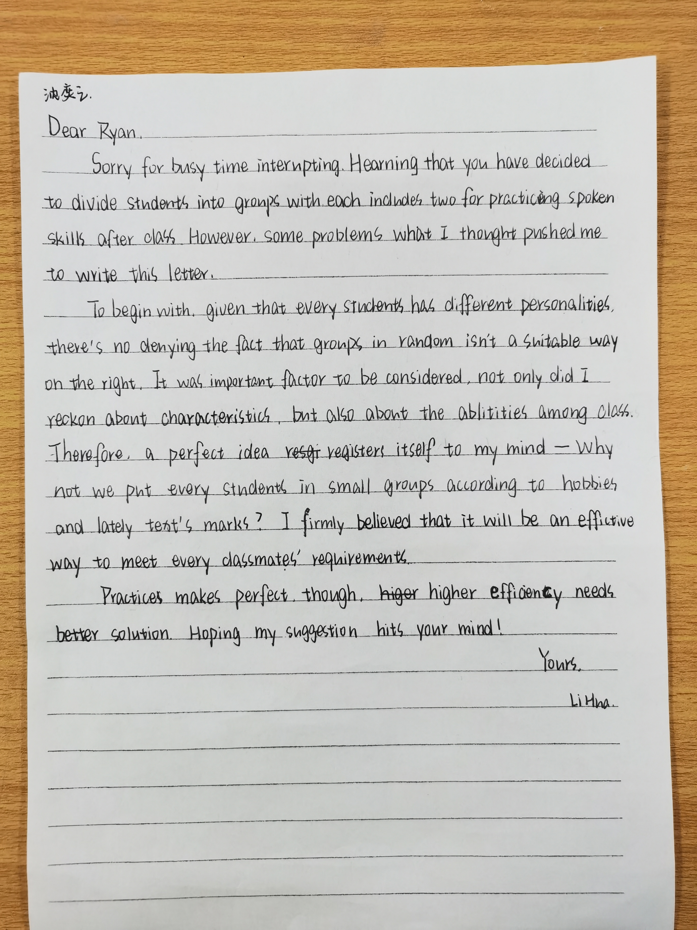
少了李华的介绍
语气委婉，交际得体
习作点评：
1.该生写作思路清晰，结构合理。
2.开门见山提出写信目的，且语气委婉，符合交际原则。
3.要点无遗漏，语言和句型丰富多样，只是个别句子表达欠准确。
4.结尾是靓点，且用语地道。
该生作文在第四档11分左右。
写信目的
问题
建议
希望对方考虑自己的建议

Slide 33
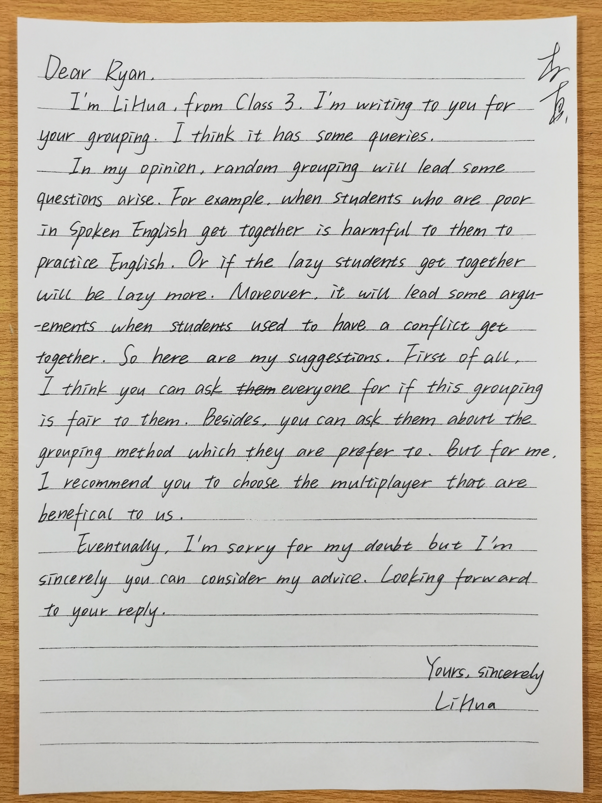
习作点评：
1.该生的靓点在于通过举例说明问题所在，彰显学生的思维品质。
2.该生提三个建议，个人认为如果能写出为什么要提出这样的建议会更好。
3.结尾用语委婉，符合交际原则。
4.语言的丰富性和多样性欠了点。
该生作文在第四档10分左右。
举例说明问题，不仅使内容详实，而且彰显学生的思维品质
开门见山写出目的，只是语气欠委婉
问题
建议
向对方表示歉意并希望对方考虑自己的建议，符合交际

Slide 34
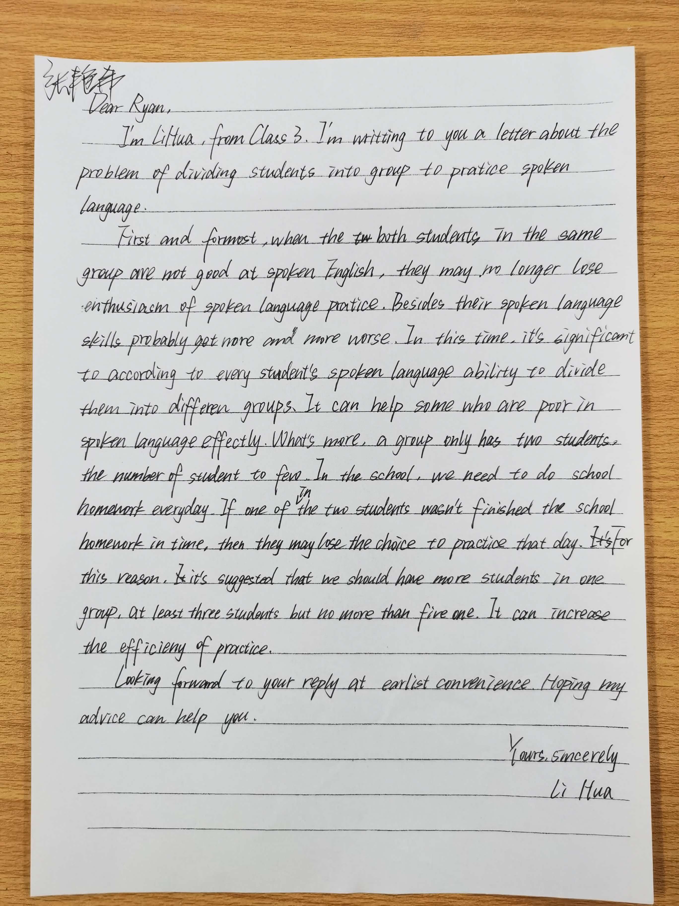
写出了分组问题，但不清楚具体是什么问题，从下文来看，这里应该是“随机问题”
习作点评：
1.该生的主要问题没有表达清楚,少了“随机”。
2.该生在表述理由时，能够合理地进行细节拓展。
3.虽能做到衔接的，但语言的丰富性和多样性欠缺。
4.语言不够委婉，尤其是结尾不太符合交际原则。
该生作文在第三档和第四档之间，等9分左右。
说明问题
提出建议
语言不够委婉

Slide 35
5
Appreciate fantastic works
佳作欣赏

Slide 36
Dear Ryan
I am LiHua from class3. Aimed at sharing my suggestions relate to the grouping method in a random way with the purpose of getting our oral English enhanced, I’ll drop you the line.
What comes first is that pairing off arbitrarily may not necessarily serve to promote
its original effect due to lack for scientific method. Providing two students with poor spoken language were put together, they would be stuck in improving their spoken level.
Additionally, Students' interests and hobbies are not taken into account. If two students with different interests are divided together, they have no common interest, leaving the oral practice into a state of silence. Therefore, I can’t wait to offer my personal opinion: it is a fablous idea to enable students to choose their own partners freely. It allows them to learn in a happy moment, which not only can it improve the students’ spoken ability, but also it can play a role in strengthening their friendship.
Hope my suggestion will exert a enormous function on spoken drill and get twice the result with half the effort. Your prompt reply will be highly appreciated.
Yours,
Li Hua

Slide 37


