Slide 1

感恩遇见，相互成就，本课件资料仅供您个人参考、教学使用，严禁自行在网络传播，违者依知识产权法追究法律责任。
更多教学资源请关注
公众号：溯恩高中英语
知识产权声明

Slide 2
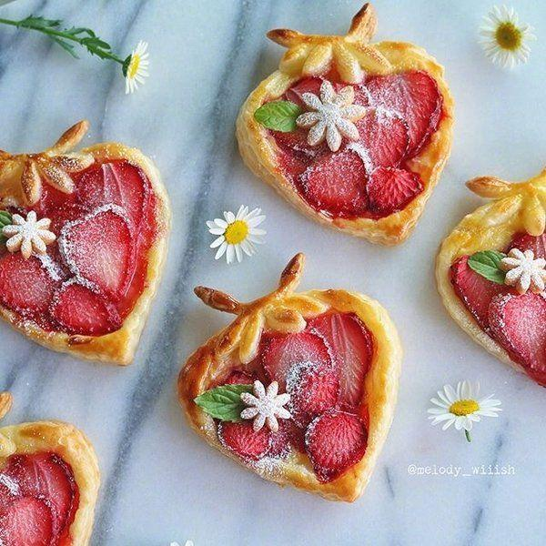
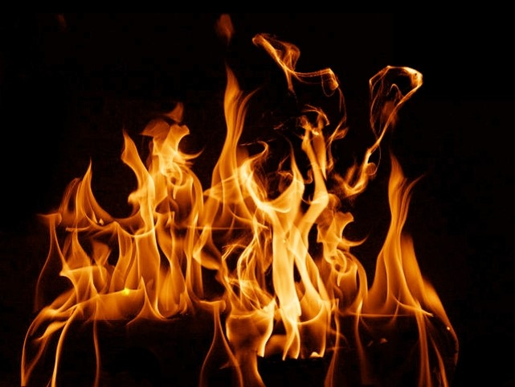
UNIT 3
FOOD
AND
CULTURE

Slide 3
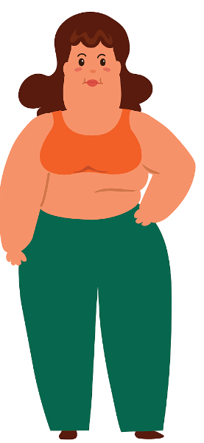
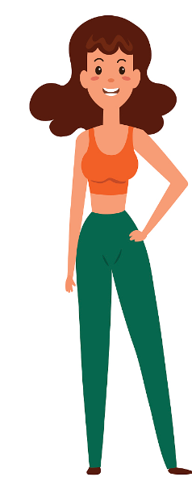
After
Before

Slide 4
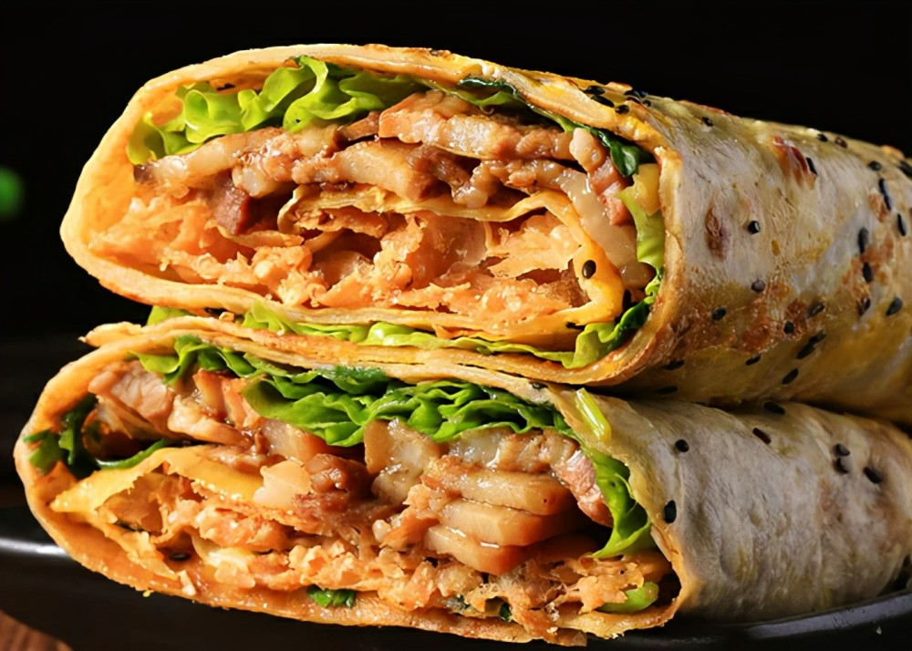
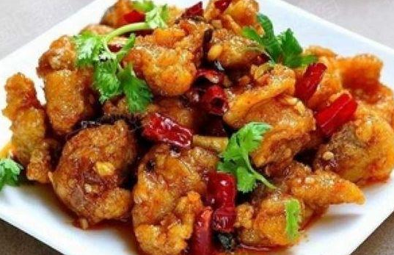
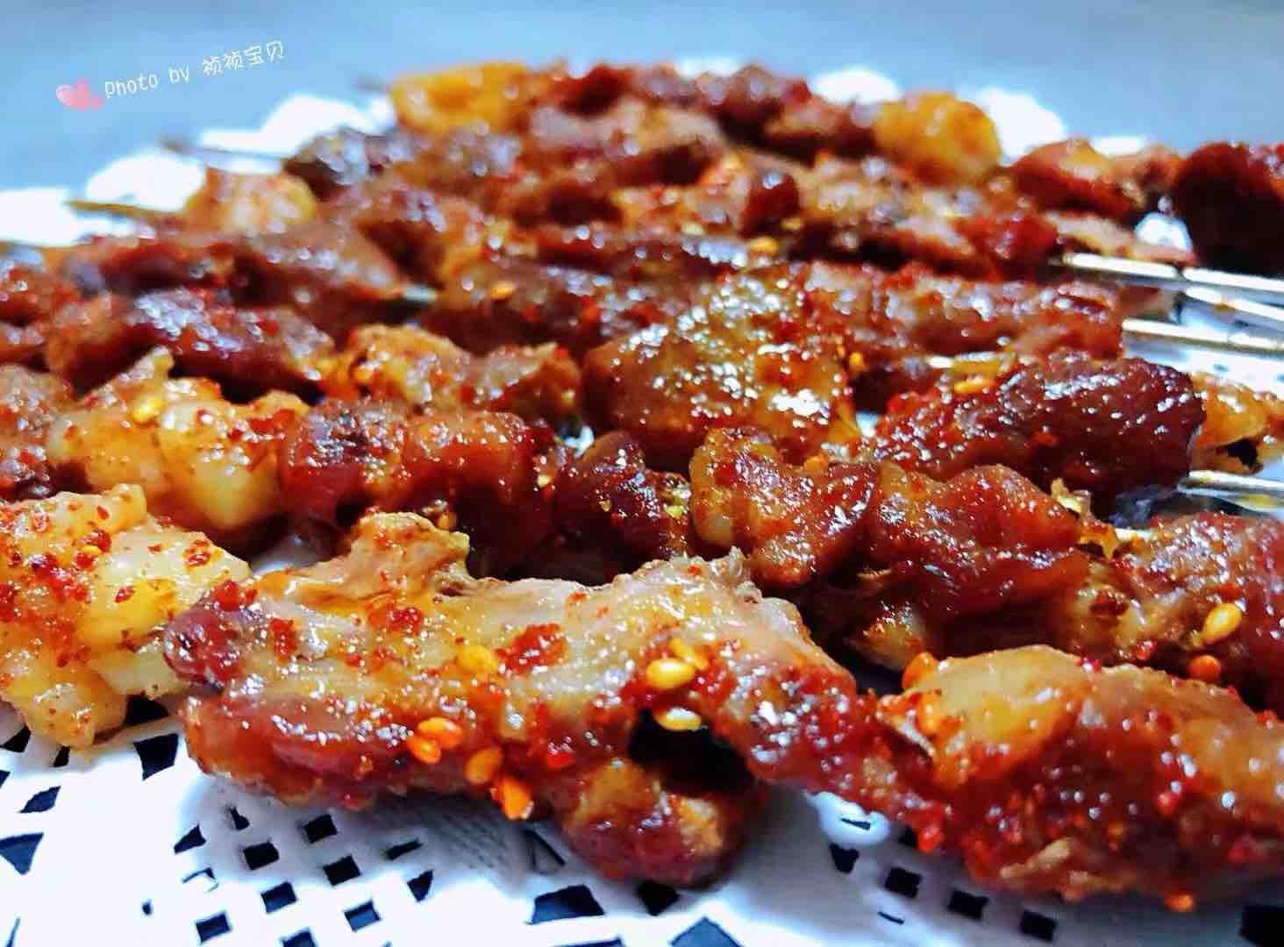
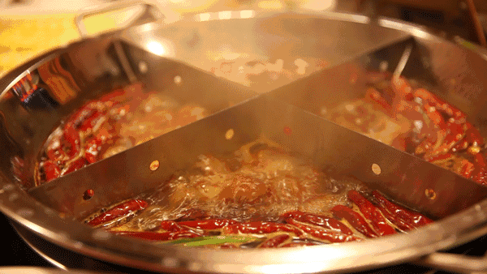
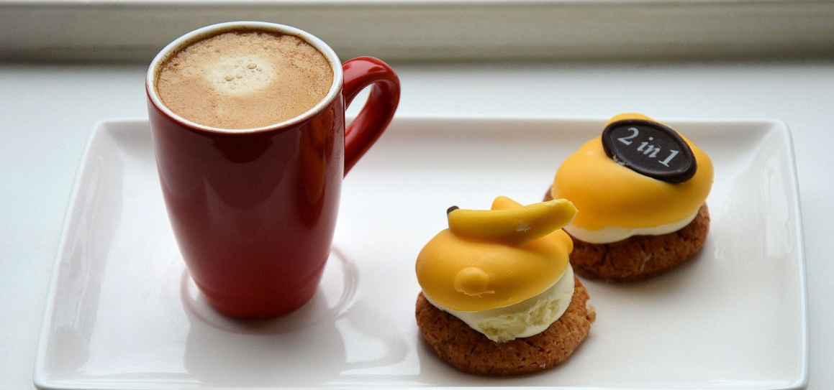
recipe
fried chicken covered in a spicy sauce
General Tso’s chicken
左宗棠鸡
Pancake rolls （煎饼）
Midnight snack
dim sum （点心）
hot pot
dessert
Lamb kebab

Slide 5
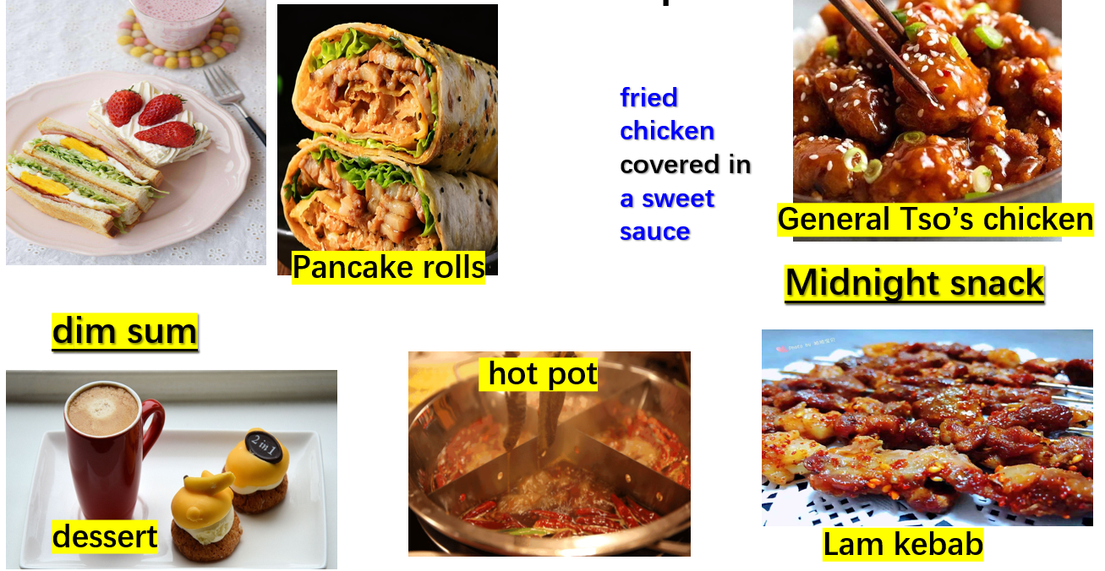
I am what I eat
What I eat
what I am now
cause
effect

Slide 6
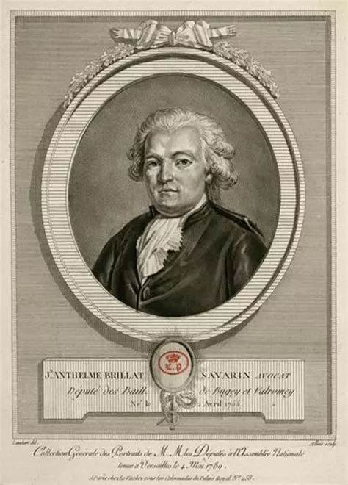

Jean Anthelme Brillat-Savarin
[法]让·安泰尔姆·布里亚-萨瓦兰
French Gourmet in 19C
[ˈɡʊəmeɪ] n.美食品尝家，美食家
“Tell me what you eat, and I will tell you what you are”
Notes:
Let us see whether the author agree to his and how the author develops his writing.

Slide 7
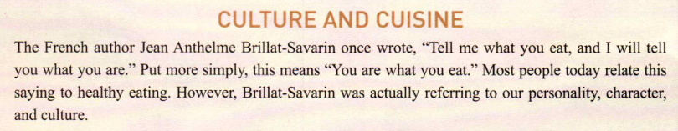
Para 1
cause
Personality
Character
Culture
What you eat
effect

Slide 8
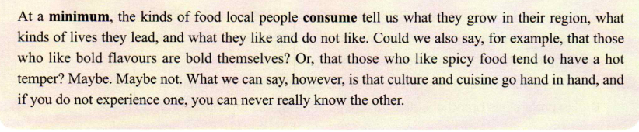
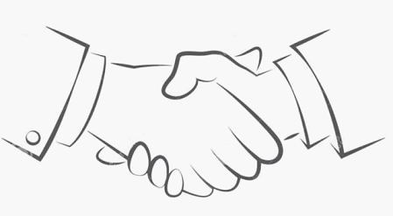
Para 7
Can you find a topic sentence in para7?
culture
cuisine

Slide 9
cause
effect
How does author experience cuisine and know the culture？
Para7 echo with Para1

Slide 10
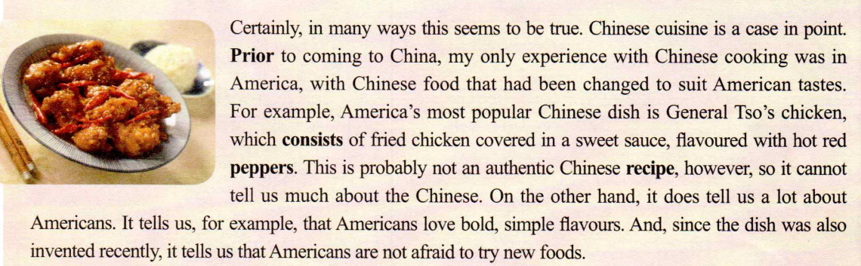
Para 2
cause
effect
cause
effect
cause
effect
cause
Personality
character
culture
Where
Cuisine
effect
America
General Tso’s chicken
Chinese food in America is changed to suit American tastes.
Americans love bold, simple flavours, and are not afraid to try new foods.
cause
effect
The flavour preferences of Americans often differ from those of the Chinese

Slide 11
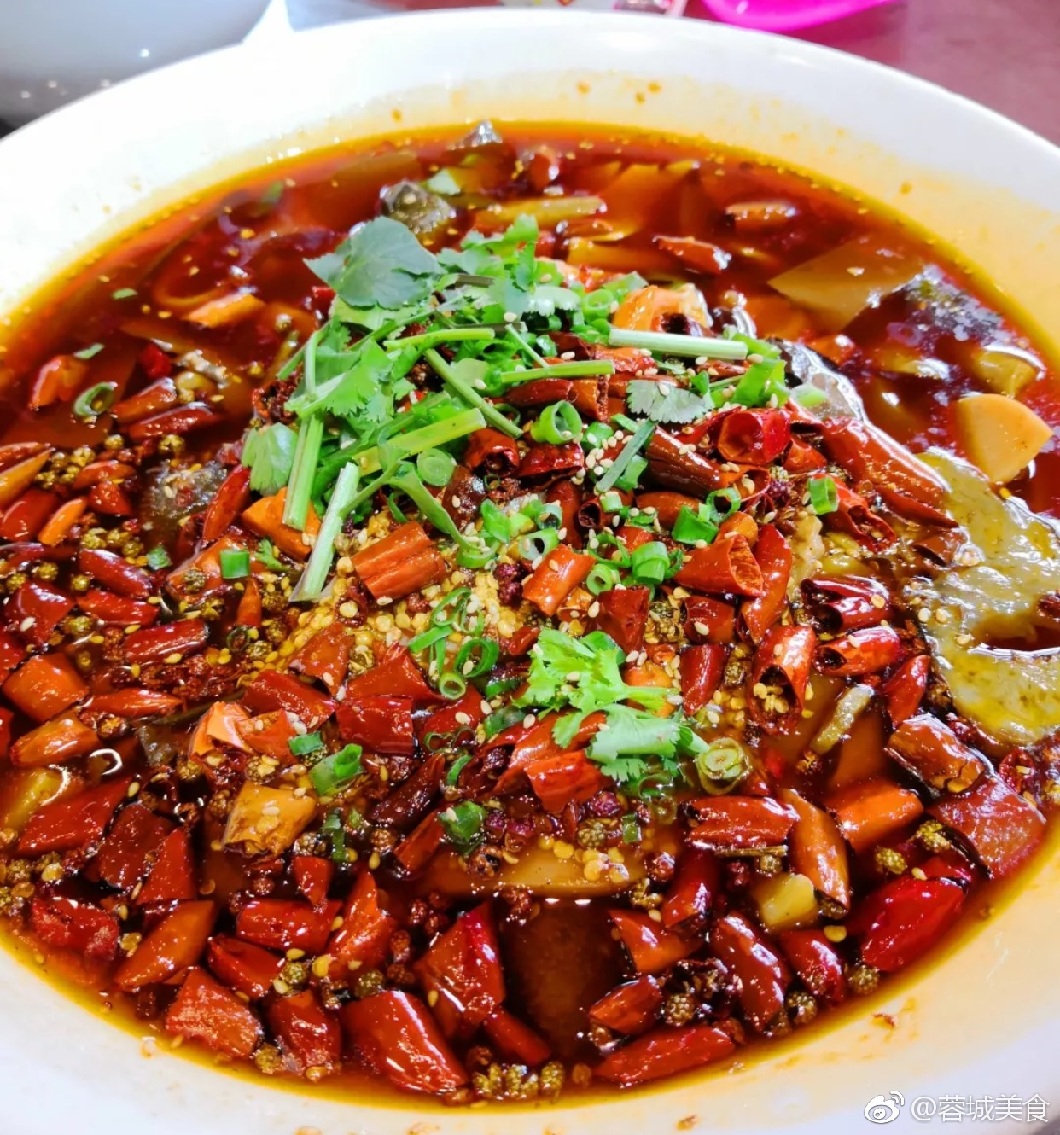
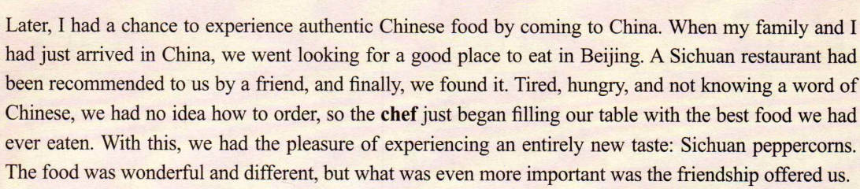
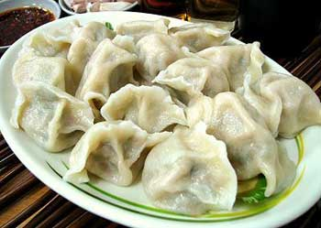
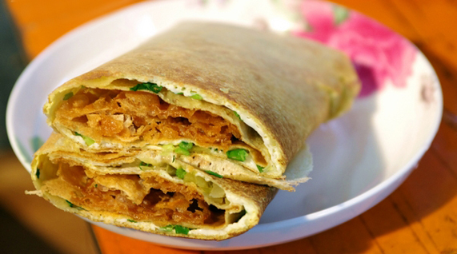
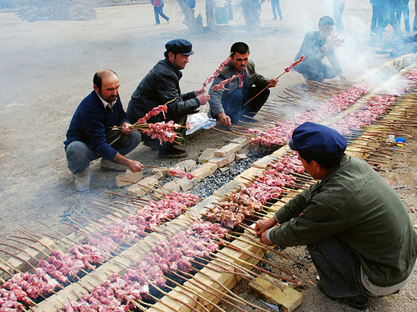
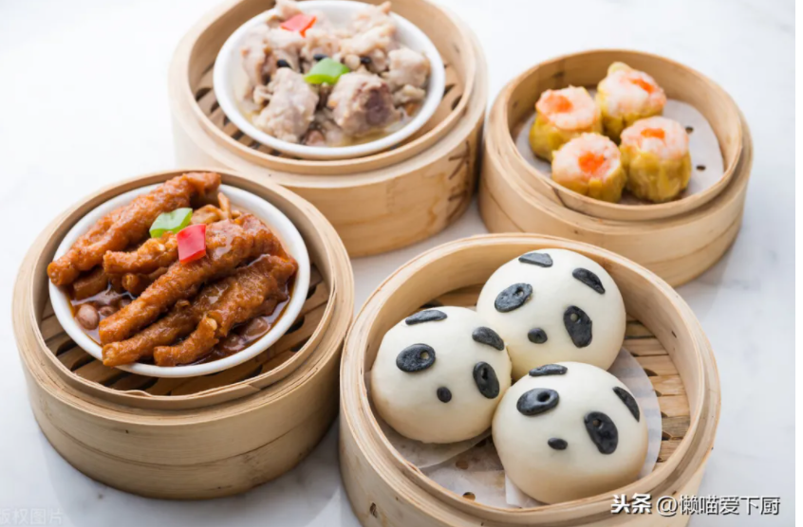
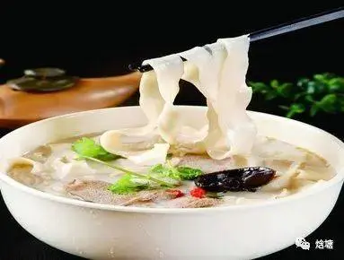
Para 3-6
Where
Cuisine
Personality
character
culture
Beijing
People there offered them good friendship.
Family is important to the people there
Shandon
People there traditionally wandered the open range on horses so their traditional foods are what you can cook over an open fire.
Northern Xinjiang
Through food, Chinese people everywhere show friendship and kindness.
South &
central China

Slide 12
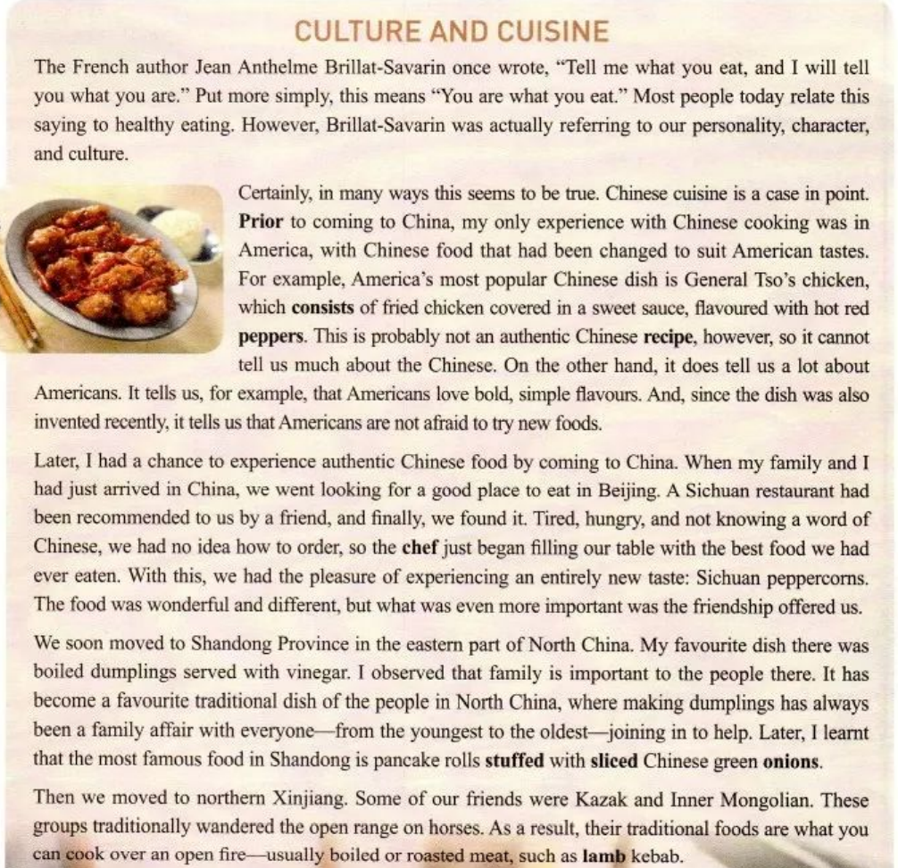
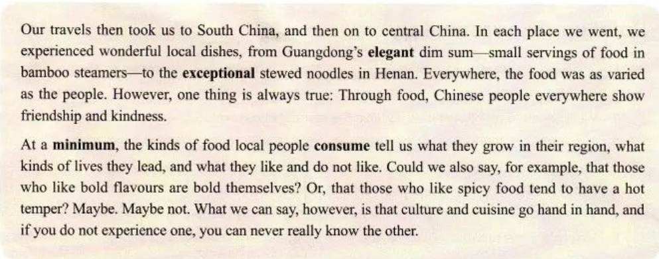
Topic（Para.1）
You are what you eat.
Body(Para.2-Para. 6)
different experiences
My _________________ with Chinese food.
People live in different places and eat different kinds of food, so they share different cultures.
Conclusion(Para.7)
Culture and cuisine go hand in hand.

Slide 13
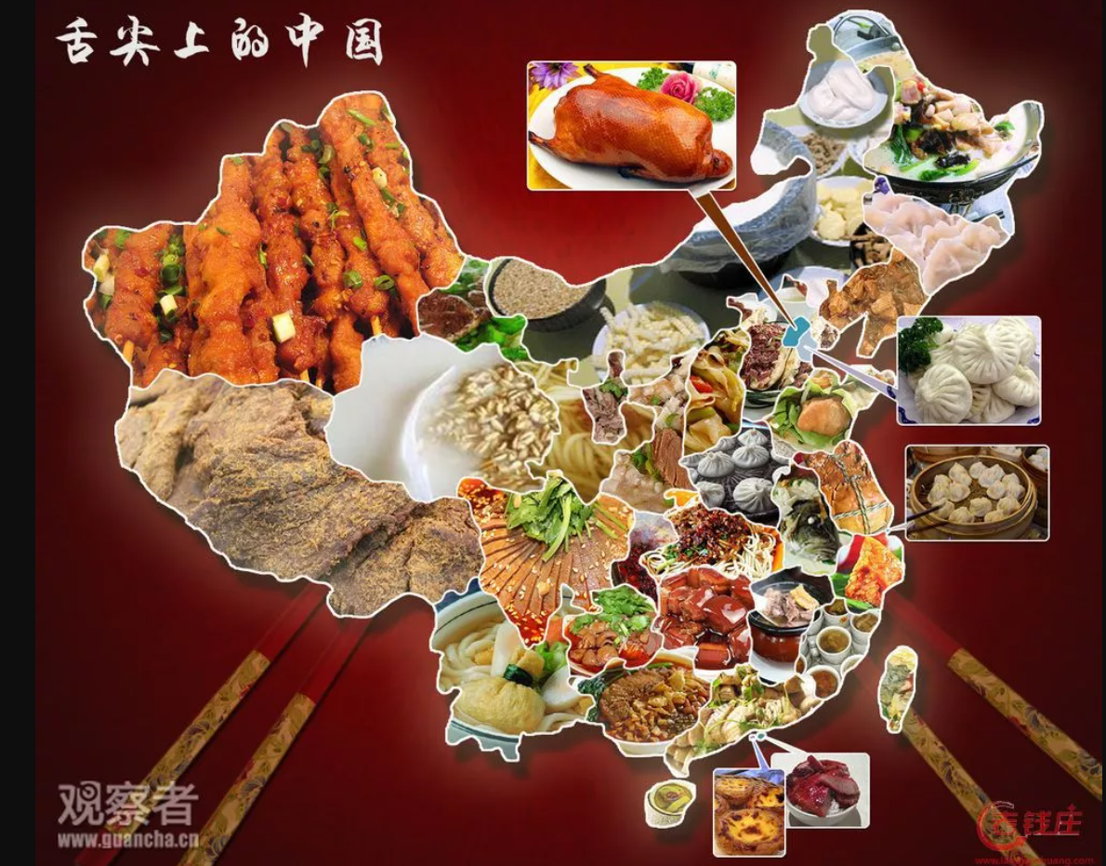
I decide to go to Xinjiang to experience authentic Xingjian cuisine,
Summer vacation plan
cause1
effect2
effect1
cause2
because I like lamb kebab which is my favorite snack .
Besides, their traditional foods are what you can cook over an open fire.
cause
cause
effect
effect
It makes me interested in it and I can make friends with locals who are bold and friendly.
I believe my journey will be meaningful and unforgettable!
cause
effect

Slide 14
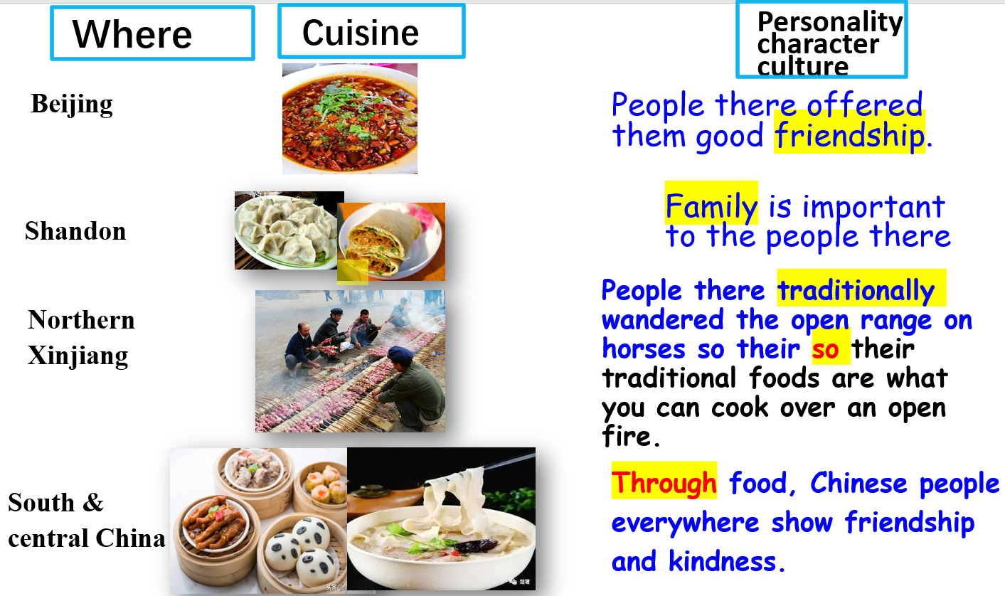
Consolidation
If you have a chance, which place will you choose to experience?
Cause——effect

Slide 15
In your opinion ，what kind of person the author is？
Because of the different experiences with Chinese food ，
I get to know he is a typical American-bold and adventurous，
since he is not afraid to try new things.
He is what he eats！

Slide 16
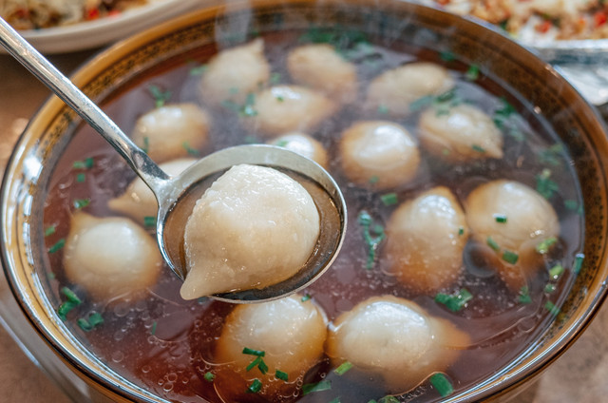
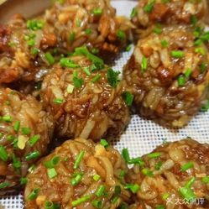
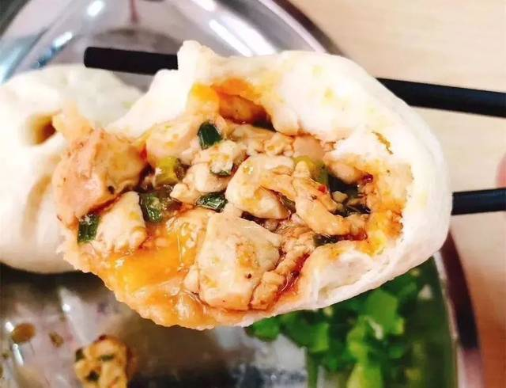
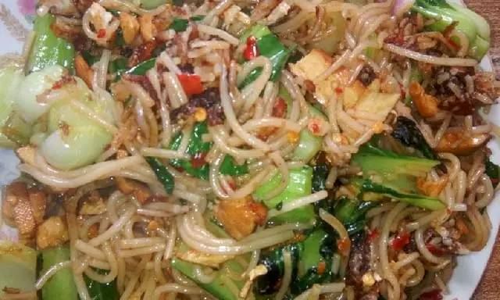
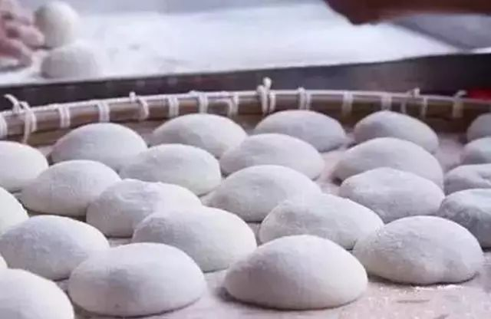
Assignment：
The author wants to visit Jiande.
What kind of cuisine will you recommend？
State your reasons in a short passage within 80 words.

Slide 17

Jiande steamed-toufu-bun

