Slide 1

感恩遇见，相互成就，本课件资料仅供您个人参考、教学使用，严禁自行在网络传播，违者依知识产权法追究法律责任。
更多教学资源请关注
公众号：溯恩高中英语
知识产权声明

Slide 2
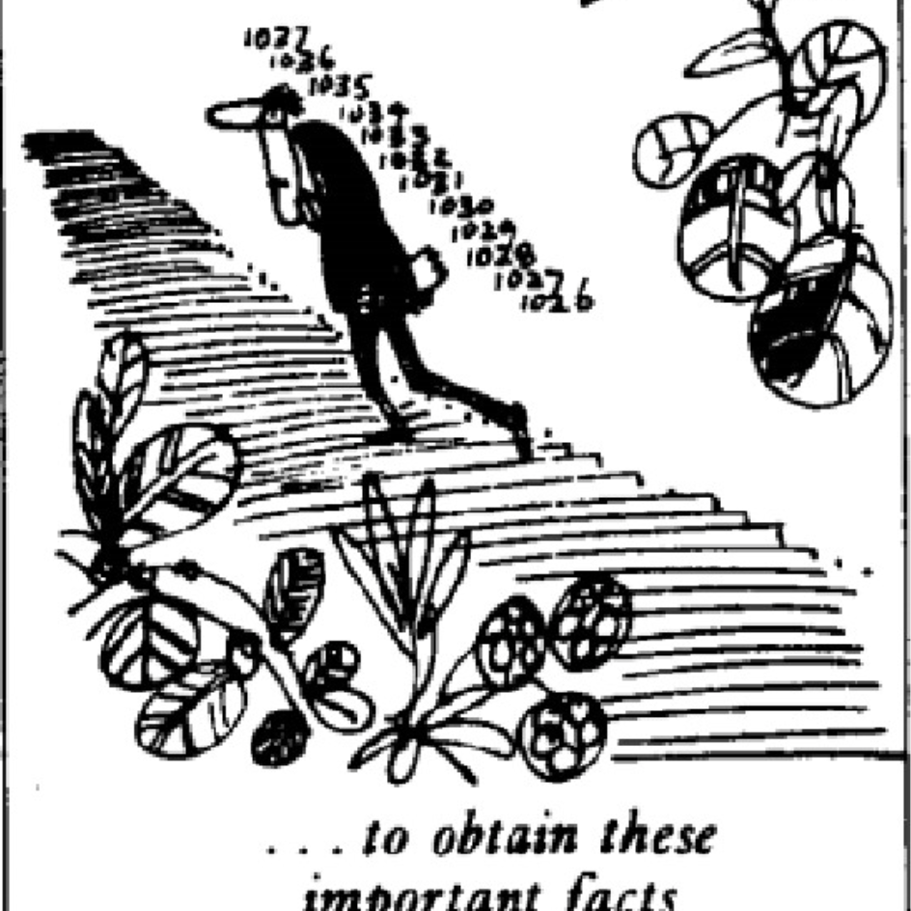
Lesson 5
The facts

Slide 3
Target vocabulary
1

Slide 4

Match each word with the best meaning.
1.____ fax A. the person who determines the final content of a text
2.____ journalist B. to make a work available to the public
3.____ palace C. the furthest point or limit of something
4.____ editor D. a method of transmitting documents electronically
5.____ reluctantlyE. numerical data about a particular subject
6.____ impatient F. having little patience
7.____ publish G. a person who reports and writes news
8.____ extreme H. at the beginning, in the first place
9.____ originally I. a grand residence or official building
10.___ statistics J. in an unwilling manner, with hesitation
D
G
I
A
J
F
B
C
H
E

Slide 5
Reading the passage
2

Slide 6
Reading the passage
Editors of newspapers and magazines often go to extremes to provide their readers with unimportant facts and statistics. Last year a journalist had been instructed by a well-known magazine to write an article on the president's palace in a new African republic. When the article arrived, the editor read the first sentence and then refused to publish it. The article began: ‘Hundreds of steps lead to the high wall which surrounds the president's palace.’ The editor at once sent the journalist a fax instructing him to find out the exact number of steps and the height of the wall.
The journalist immediately set out to obtain these important facts, but he took a long time to send them. Meanwhile, the editor was getting impatient, for the magazine would soon go to press. He sent the journalist two more faxes, but received no reply. He sent yet another fax informing the journalist that if he did not reply soon he would be fired. When the journalist again failed to reply, the editor reluctantly published the article as it had originally been written. A week later, the editor at last received a fax from the journalist. Not only had the poor man been arrested, but he had been sent to prison as well. However, he had at last been allowed to send a fax in which he informed the editor that he had been arrested while counting the 1, 084 steps leading to the fifteen-foot wall which surrounded the president's palace.

Slide 7
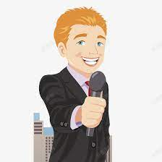
What was the consequence of the editor's insistence on facts and statistics?
The journalist was arrested and sent to prison.

Slide 8
Reading comprehesion
3

Slide 9
Reading comprehension
1. The editor acted as he did because _______.
A. he wanted an excuse to fire the journalist
B. he had not read the article beyond the first sentence
C. he was dissatisfied with the factual content of the article
D. he wanted to please the president of the new African
republic

Slide 10
Reading comprehension
2. The journalist took a long time to send the details required
because _______.
A. it took him a long time to count all the steps
B. he had not been allowed to fax the information he had obtained
C. he did not realize how soon the magazine would go to press
D. he had been arrested before he had had time to obtain the facts

Slide 11
Reading comprehension
3. Why had the journalist been arrested?
A. Because his activities must have appeared suspicious.
B. For having gone to extremes to provide unimportant facts.
C. For climbing the palace wall in order to measure its height.
D. Because the article was published in its original form.

Slide 12
Structure imitation
4

Slide 13
Structure imitation
1. … often go to extremes to do...
John often goes to extremes to maintain his physical fitness, waking up early every day to exercise and following a strict diet.
Some parents often go to extremes to provide their children with a good education, such as enrolling them in expensive private schools, hiring tutors, or even moving to better school districts.
Some students often go to extreme to get good grades, spending long hours studying, attending tutoring sessions, and completing extra credit assignments to improve their academic performance.

Slide 14
The old book I found buried in my grandmother’s attic at one time must have been a treasured possession, for it was adorned with a delicate cover of gold and precious jewels that shone brilliantly in the dim light.
Structure imitation
2. When … failed to …, … reluctantly did… …
When John failed to complete his project on time, his boss reluctantly did the work himself to meet the deadline.
When the software update failed to fix the bugs, the developers reluctantly had to roll back to the previous version.
When the original plan failed to gain approval, the project manager reluctantly proposed an alternative plan.
When the students’ behavior failed to improve, the teacher reluctantly had to implement stricter rules and consequences.

Slide 15
Structure imitation
3. Not only had …, but… as well. However,…
Not only had Sarah finished the project ahead of schedule, but she also exceeded the client’s expectations as well. However, she still felt like she could have done better.
Not only had the team won the championship game, but they also broke several records in the process as well. However, they knew they couldn’t rest on their laurels and had to keep improving for the next season.
Not only had John completed all of his assignments on time, but he had also scored the highest in his class on the midterm exam as well. However, he knew that the final exam would be more challenging and he needed to study even harder to maintain his performance.

Slide 16
Structure imitation
3. …can give rise to …as it did in the case of …who / which...
The misuse of social media can give rise to numerous problems as it did in the case of the company’s PR department, who accidentally posted a compromising photo on the company’s official account.
Excessive screen time can give rise to various health problems as it did in the case of John, who experienced dry eyes, headaches, and difficulty sleeping after spending too much time on his computer.
Unchecked deforestation can give rise to climate change and loss of biodiversity as it did in the case of the Amazon rainforest, which experienced significant deforestation and changes to its ecosystem.

Slide 17
Story telling
5

Slide 18
Story-telling
1. editor refused to publish article
2. It began: ‘Hundreds of steps…’
3. journalist ---- find out ---- exact number of steps ----height of wall
4. dditor ---- two faxes ---- no reply
5. another fax ---- journalist would be fired
6. journalist failed to reply ---- article published
7. week later ---- fax from journalist
8. arrested ---- prison as well
9. counting steps ---- fifteen-foot high wall ---- president's palace

Slide 19
Summary writing
6

Slide 20
Answer the following questions with complete sentences.
1. Did the journalist immediately set out to get the facts after receiving instructions from his editor or not?
2. Did he send them at once or not?
3. Was the editor getting impatient or not?
4. How many faxes did the editor send?
5. What did the editor threaten to do?
6. Was the last fax answered or not?
7. Was the article omitted from the magazine, or was it printed in its original form?
8. When did the journalist send a fax?
9. Why had he been imprisoned?

Slide 21
1. Did the journalist immediately set out to get the facts after receiving instructions from his editor or not?
The journalist immediately set out to get the facts after receiving the instructions from his editor.
2. Did he send them at once or not?
He didn’t send them at once.
1+2:
Though the journalist immediately set out to get the facts after receiving the instructions from his editor, he didn’t send them at once.

Slide 22
3. Was the editor getting impatient or not?
The editor was getting impatient.
4. How many faxes did the editor send?
He sent three faxes.
5. What did the editor threaten to do?
He threatened to fire the journalist.
3+4+5:
Meanwhile, the editor was getting impatient, so he sent three faxes, finally threatening to fire the journalist.

Slide 23
6. Was the last fax answered or not?
The last fax was not answered.
7. Was the article omitted from the magazine, or was it printed in its original form?
The article was published in its original form.
6+7:
When the last fax was unanswered, the article was published in its original form.

Slide 24
8. When did the journalist send a fax?
The journalist sent a fax a week later.
9. Why had he been imprisoned?
Because he had been imprisoned after counting the steps and measuring the height of the wall.
8+9:
The journalist sent the editor a fax a week later explaining he had been imprisoned after counting the steps and measuring the height of the wall.

Slide 25
Occasion describing
7

Slide 26
Occasion describing
The journalist counted the number of steps as he___________________.
On arriving outside the main gate, he __________________________. He then ____________________________________in order to measure the wall. While he was busy measuring the wall, a policeman ________________
______________________________________________________________. Though the journalist ____________________________________________, the policeman refused to believe him. He was arrested and sent to prison because the police thought that ____________________________________. When the journalist ______________________________________________, he made things worse for himself. This proved to the police that__________.

Slide 27
A possible version:
Though the journalist immediately set out to get the facts after receiving the instructions from his editor, he didn’t send them at once. Meanwhile, the editor was getting impatient, so he sent three faxes, finally threatening to fire the journalist. When the last fax was unanswered, the article was published in its original form. The journalist sent the editor a fax a week later explaining he had been imprisoned after counting the steps and measuring the height of the wall.

Slide 28
The journalist counted the number of steps as he ______________
___________________________________________. On arriving at the main gate, he _____________________________. He__________
________in order to measure the wall. While he was busy measuring the wall, a policeman ________________________________________.
Though the journalist_______________________________________
___________________________________________ , the policeman refused to believe him.
wearily climbed up
to the high wall surrounding the president's palace
sat down to get his breath back.
produced a tape
measure
approached him and asked him what he was doing
explained he was a reporter and his editor had
asked him to find out the exact height of the wall

Slide 29
He was arrested and sent to prison because the police thought that__
__________________________________________________________.
When the journalist_______________________, he made things worse for himself. This proved to the police that__________________________
______________________________________.
he might be a spy or might even want to assassinate the president
insisted he was innocent
the man certainly was guilty
and deserved to stay in prison indefinitely

Slide 30
Story development
8

Slide 31
Reading the passage
Editors of newspapers and magazines often go to extremes to provide their readers with unimportant facts and statistics. Last year a journalist had been instructed by a well-known magazine to write an article on the president's palace in a new African republic. When the article arrived, the editor read the first sentence and then refused to publish it. The article began: ‘Hundreds of steps lead to the high wall which surrounds the president's palace.’ The editor at once sent the journalist a fax instructing him to find out the exact number of steps and the height of the wall.
The journalist immediately set out to obtain these important facts, but he took a long time to send them. Meanwhile, the editor was getting impatient, for the magazine would soon go to press. He sent the journalist two more faxes, but received no reply. He sent yet another fax informing the journalist that if he did not reply soon he would be fired. When the journalist again failed to reply, the editor reluctantly published the article as it had originally been written. A week later, the editor at last received a fax from the journalist. Not only had the poor man been arrested, but he had been sent to prison as well. However, he had at last been allowed to send a fax in which he informed the editor that he had been arrested while counting the 1, 084 steps leading to the fifteen-foot wall which surrounded the president's palace.

Slide 32
Para 1：
The editor was stunned by the news of the journalist’s arrest and imprisonment.
Para 2：
To make up for their mistake, the editor employed the journalist as a staff writer.

Slide 33
One possible version:
The editor was stunned by the news of the journalist’s arrest and imprisonment. His heart raced as he pictured his friend’s ordeal behind bars and the danger he might be in. The editor quickly sprang into action and made every possible effort to get in touch with authorities and secure his colleague release. Days were spent on tenterhooks, negotiating with officials and working relentlessly to secure his friend’s freedom. Finally, the news they had been waiting for came in --- the journalist was going to be released. The editor breathed a sigh of relief, grateful beyond words. Although the experience had left him shaken, he persisted as a journalist with a newfound respect for the work.
To make up for their mistake, the editor employed the journalist as a staff writer. The journalist accepted the offer and went on to pen several successful articles for the publication. Through this experience, the editor learned an invaluable lesson and made a promise never to resort to extreme measures in pursuit of trivial facts and statistics again. He came to realize that great journalism requires more than just a dedication to the facts --- it requires a deep connection to the human experience and a willingness to tell stories that matter. He vowed never to resort to extreme measures in his pursuit of the truth, recognizing that the most powerful stories are often the ones that resonate on a personal and emotional level.

Slide 34
Vocabulary reiforcement
9

Slide 35
A. Word spelling
1. Tom grew i________ waiting in line for the concert tickets.
2. The e______ weather conditions made it difficult to travel.
3. She r________ agreed to go on the camping trip with her friends.
4. She was finally able to o______ a visa to travel to the United States.
5. The castle was s_________ by a high wall to protect it from invaders.
mpatient
xtreme
eluctantly
btain
urrounded

Slide 36
A. Word spelling
6. The e____ revised the manuscript before it was sent to the publisher.
7. The p_______delivered a speech about his plans to improve the economy.
8. The s_______ show that crime rates have been steadily decreasing in the city.
9. Mary was devastated when she was f____ from the job she had worked at for over a decade.
10. O_______, the building was designed to be a hospital, but it was later converted into a school.
ditor
resident
tatistics
ired
riginally

Slide 37
B. Gap filling
receive no reply provide…with lead to go to press find out
write an article on be sent to prison fail to go to extremes set out
1. I sent an email to my boss, but I ________________.
2. If you commit a crime, you could _______________.
3. She didn’t want to _____________ to prove her point.
4. If you _____ prepare for the exam, you may not do well.
5. The organization ________ the refugees ____ food and shelter.
received no reply
be sent to prison
go to extremes
fail to
provided
with

Slide 38
B. Gap filling
receive no reply provide…with lead to go to press find out
write an article on be sent to prison fail to go to extremes set out
6. She wanted to _________ more information about the new project.
7. They ________ early in the morning to hike to the top of the mountain.
8. Skipping breakfast can ________ a drop in energy levels later in the day.
9. The newspaper decided to ___________ early to cover the breaking news story.
10. The journalist was asked to _______________ the impact of social media on mental health.
find out
set out
lead to
go to press
write an article on

