Slide 1

感恩遇见，相互成就，本课件资料仅供您个人参考、教学使用，严禁自行在网络传播，违者依知识产权法追究法律责任。
更多教学资源请关注
公众号：溯恩高中英语
知识产权声明

Slide 2

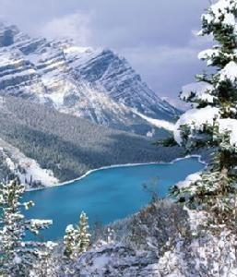
U4 Journey Across
A Vast Land
Reading and Thinking
Longquan NO.1 Senior High School
兰建珍 (*^▽^*)

Slide 3
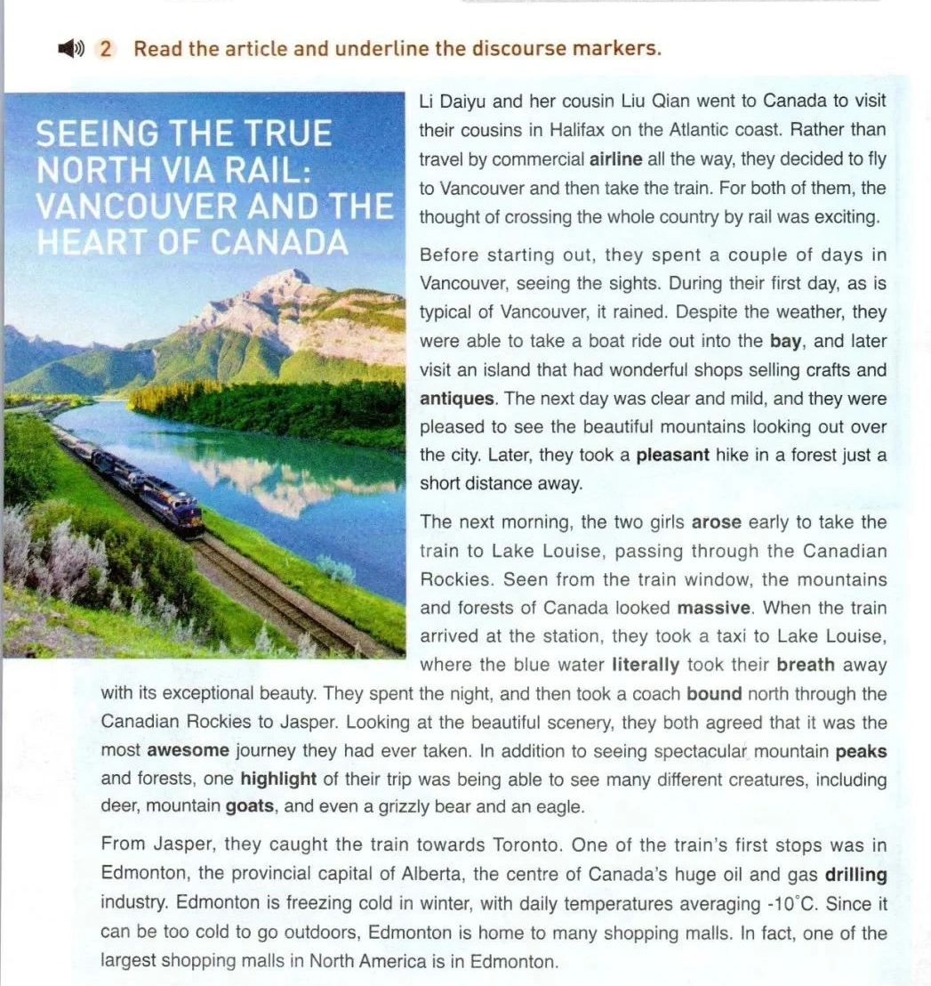
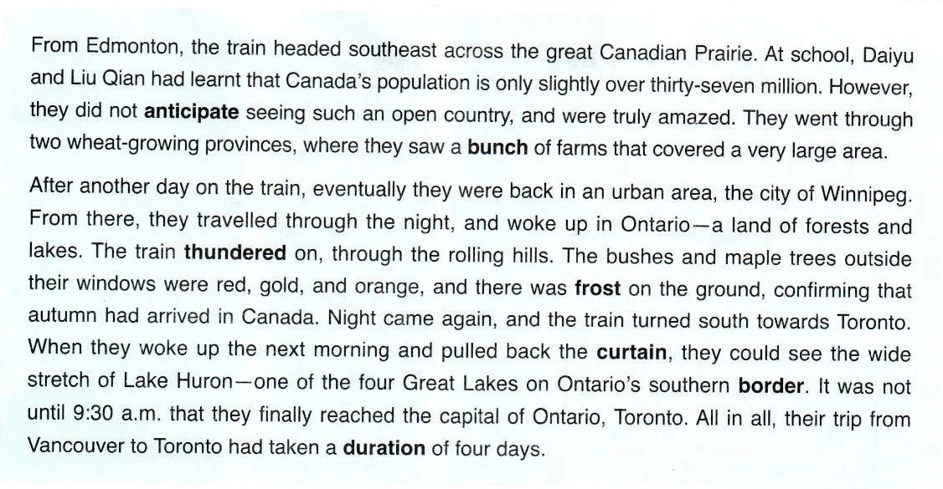





Slide 4
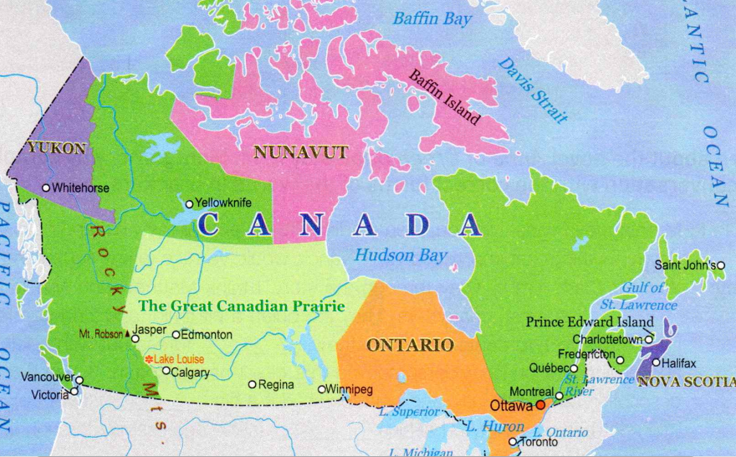
Notes:
Let’s see their travel routes.
As you can see… their journey starts from the east coast to the west coast.
Now can you answer the question I raise at the beginning? What is the heart of Canada?
And now let’s come to the second question. What did they see?

Slide 5
While-reading Para.1
background
Li Daiyu and her cousin Liu Qian went to Canada to visit their cousins in Halifax on the Atlantic coast. Rather than travel by commercial airline all the way, they decided to fly to Vancouver and then take the train. For both of them, the thought of crossing the whole county by rail was exciting.
Who? what? where? why?
How?
How?

Slide 6
Para.2
their sightseeing (esp.doings) in Vancouver
Before starting out, they spent a couple of days in Vancouver, seeing the sights. During their first day, as is typical of Vancouver, it rained. Despite the weather, they were able to take a boat ride out into the bay, and later visit an island that had wonderful shops selling crafts and antiques. The next day was clear and mild, and they were pleased to see the beautiful mountains looking out over the city. Later they took a pleasant hike in a forest just a short distance away.
time
＋what they did
discourse markers/linking words
Tip 1: logic!（G——S）
function: order of time
Logic?

Slide 7
Para.3
The next morning, the two girls arose early to take the train to Lake Louise, passing through the Canadian Rockies. Seen from the train window, the mountains and forests of Canada looked massive. When the train arrived at the station, they took a taxi to Lake Louise where the blue water literally took their breath away with its exceptional beauty. They spent the night, and then took a coach bound north through the Canadian Rockies to Jasper. Looking at the beautiful scenery, they both agreed that it was the most awesome journey they had ever taken. In addition to seeing spectacular mountain peaks and forests, one highlight of their trip was being able to see many different creatures, including deer, mountain goats, and even a grizzly bear and an eagle.
How do you appreciate this paragraph?
What did they see in this paragraph?

Slide 8
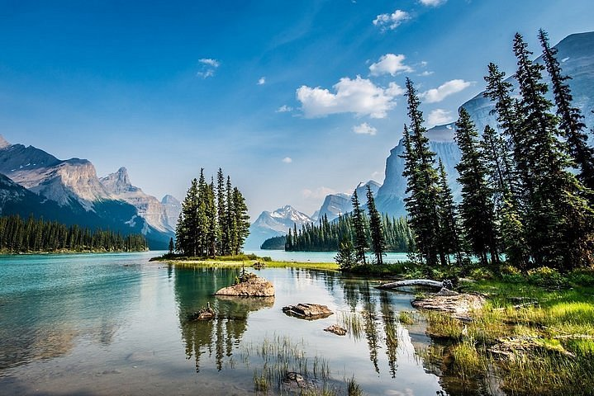
the mountains and forests of Canada
Tip 2: Picture the scenery/imagination and go into details
—— to show not just to tell.
Down by the lake, the sound of rippling water and chirp of the seabirds literally make up the music of the bay.
at a close distance
The peaceful landscape is a true feast for the eyes, with its rolling green hills dotted with goats and deer.
Seen from the train window, the mountains and forests of Canada looked massive.
at a distance
In addition to seeing spectacular mountain peaks and forests,...

Slide 9
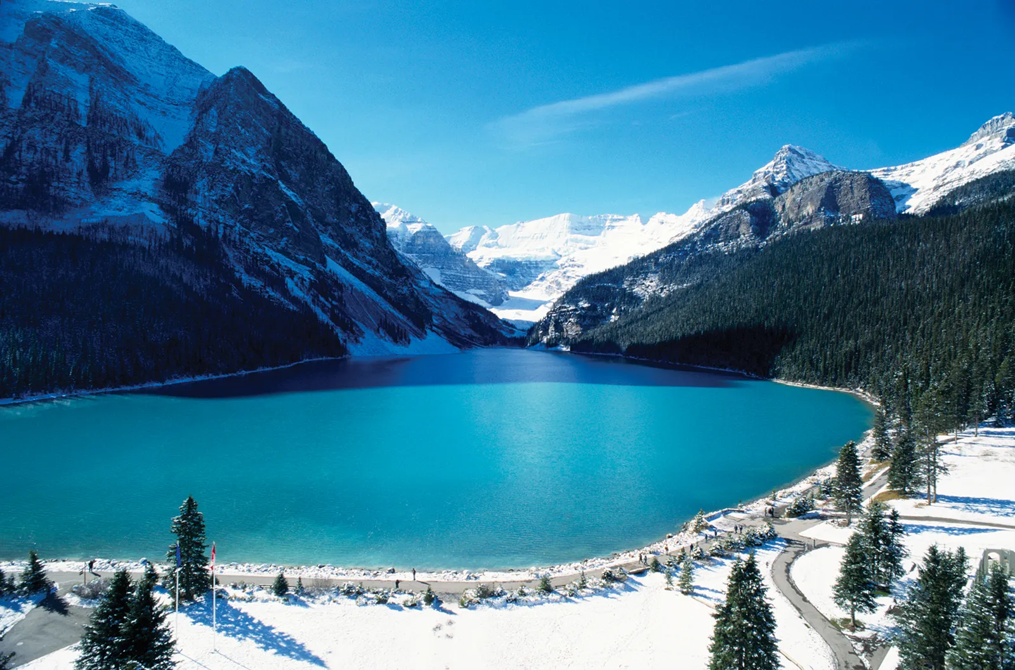
the blue water of the Lake Louise
impressive/breathtaking/spectacular
When the train arrived at the station, they took a taxi to Lake Louise where the blue water literally took their breath away with its exceptional beauty.

Slide 10
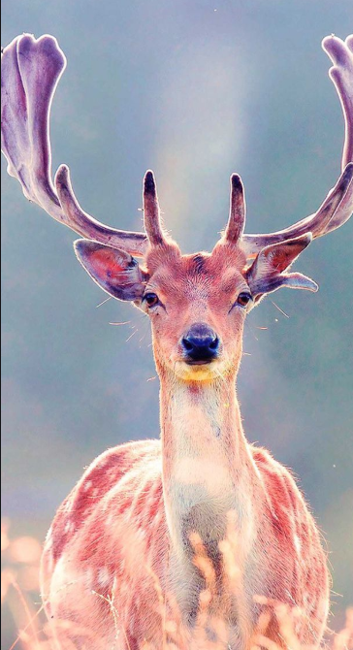
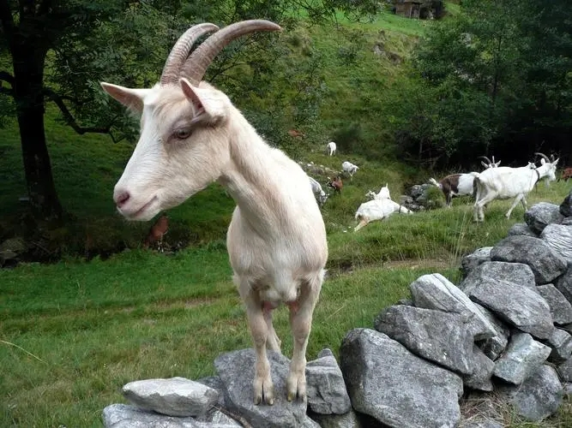
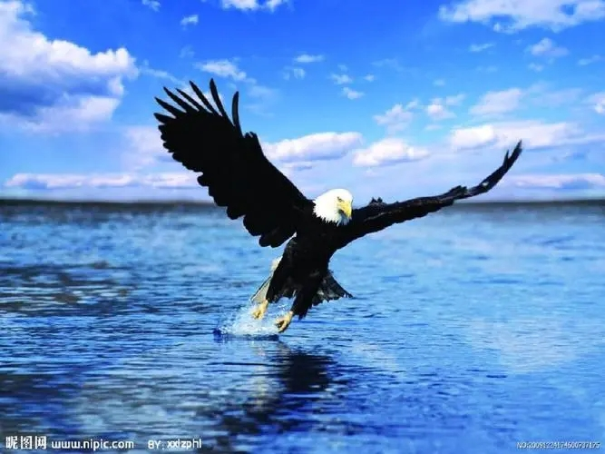
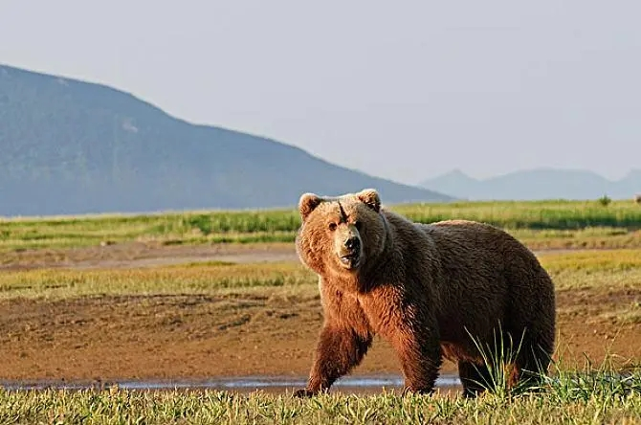
different creatures:
deer
eagle
mountain goats
As the train thundered on, we found an eagle hovering over the surface of the blue water, which literally took my breath away. S
grizzly bear
In addition to seeing spectacular mountain peaks and forests, one highlight of their trip was being able to see many different creatures, including deer, mountain goats, and even a grizzly bear and an eagle.
G

Slide 11
Para.3
their seeings and feelings through Lake Louise to Jasper
The next morning, the two girls arose early to take the train to Lake Louise, passing through the Canadian Rockies. Seen from the train window, the mountains and forests of Canada looked massive. When the train arrived at the station, they took a taxi to Lake Louise where the blue water literally took their breath away with its exceptional beauty. They spent the night, and then took a coach bound north through the Canadian Rockies to Jasper. Looking at the beautiful scenery, they both agreed that it was the most awesome journey they had ever taken. In addition to seeing spectacular mountain peaks and forests, one highlight of their trip was being able to see many different creatures, including deer, mountain goats, and even a grizzly bear and an eagle.
Looking
they
awesome
function: adding
How did they feel? Why?

Slide 12
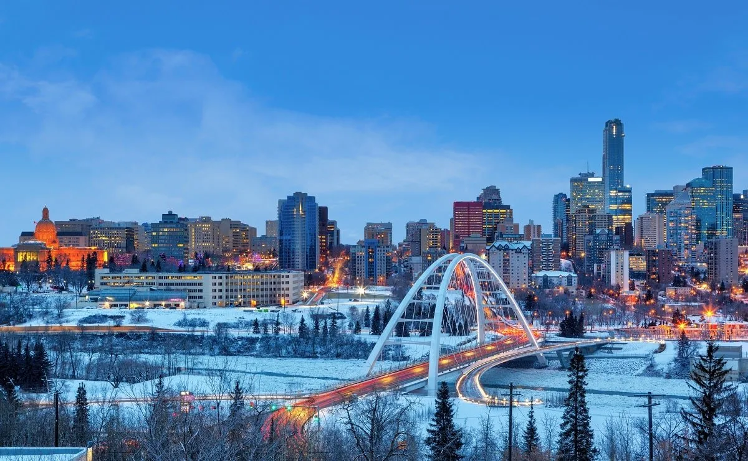
Para.4
Edmonton
politics
What do you know about Edmonton after reading this paragraph?
It’s the provincial capital of Alberta.
It’s the centre of Canada's huge oil and
gas drilling industry.
＋
natural resources
Edmonton is freezing cold in winter, with daily temperatures averaging-10.
＋
climate
Since...Edmonton is home to many shopping malls. In fact, one of the largest shopping malls in North America is in Edmonton.
＋
economics

Slide 13
Para.5
their seeings and feelings across the great Canadian Prairie
From Edmonton, the train headed southeast across the great Canadian Prairie. At school, Daiyu and Liu Qian had leant that Canada's population is only slightly over thirty-seven million. However, they did not anticipate seeing such an open country, and were truly amazed. They went through two wheat-growing provinces, where they saw a bunch of farms that covered a very large area.
amazed
How did they feel? Why?
function: conrast
Tip3: Use proper discourse markers to show relationships.

Slide 14
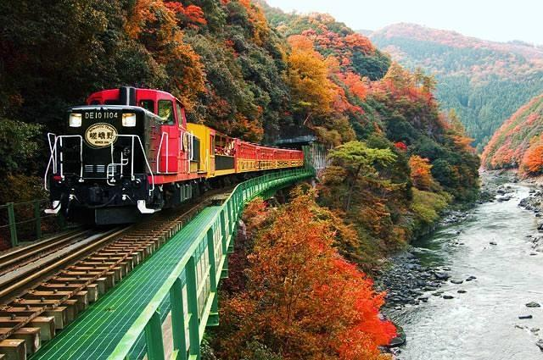
Para.6
their sightseeing from Winnipeg to Toronto
After another day on the train, eventually they were back in an urban area, the city of Winnipeg. From there, they travelled through the night, and woke up in Ontario — a land of forests and lakes.The train thundered on, through the rolling hills. The bushes and maple trees outside their windows were red, gold, and orange, and there was frost on the ground, confirming that autumn had arrived in Canada. Night came again, and the train turned south towards Toronto. When they woke up the next morning and pulled back the curtain, they could see the wide stretch of Lake Huron—one of the four Great Lakes on Ontario's southern border. It was not until 9: 30 a m. that they finally reached the capital of Ontario, Toronto. All in all, their trip from Vancouver to Toronto had taken a duration of four days.

Slide 15
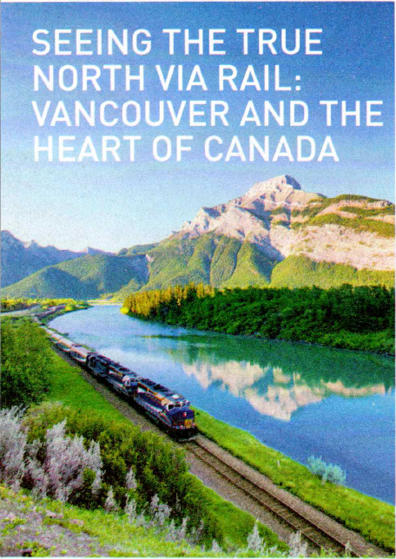













After-reading
What might be talked about next in the journal?
Para.2
Paras.3-6
Notes:
Let’s see their travel routes.
As you can see… their journey starts from the east coast to the west coast.
Now can you answer the question I raise at the beginning? What is the heart of Canada?
And now let’s come to the second question. What did they see?

Slide 16
After-reading: Assignments
Write a paragraph about the “pictures” of your sightseeing tour of any place you have visited.
Requirements:
1. Put the tips given in class into practice;
Tip 1: logic!（G — S; at a distance/at a close distance）；
Tip 2: Picture the scenery/imagination and go into details；
Tip3: Use proper discourse markers ——coherence.
2. Make your paragraph impressive using beautiful language
(word—phrase—sentence);
3. in order of time or space.

Slide 17
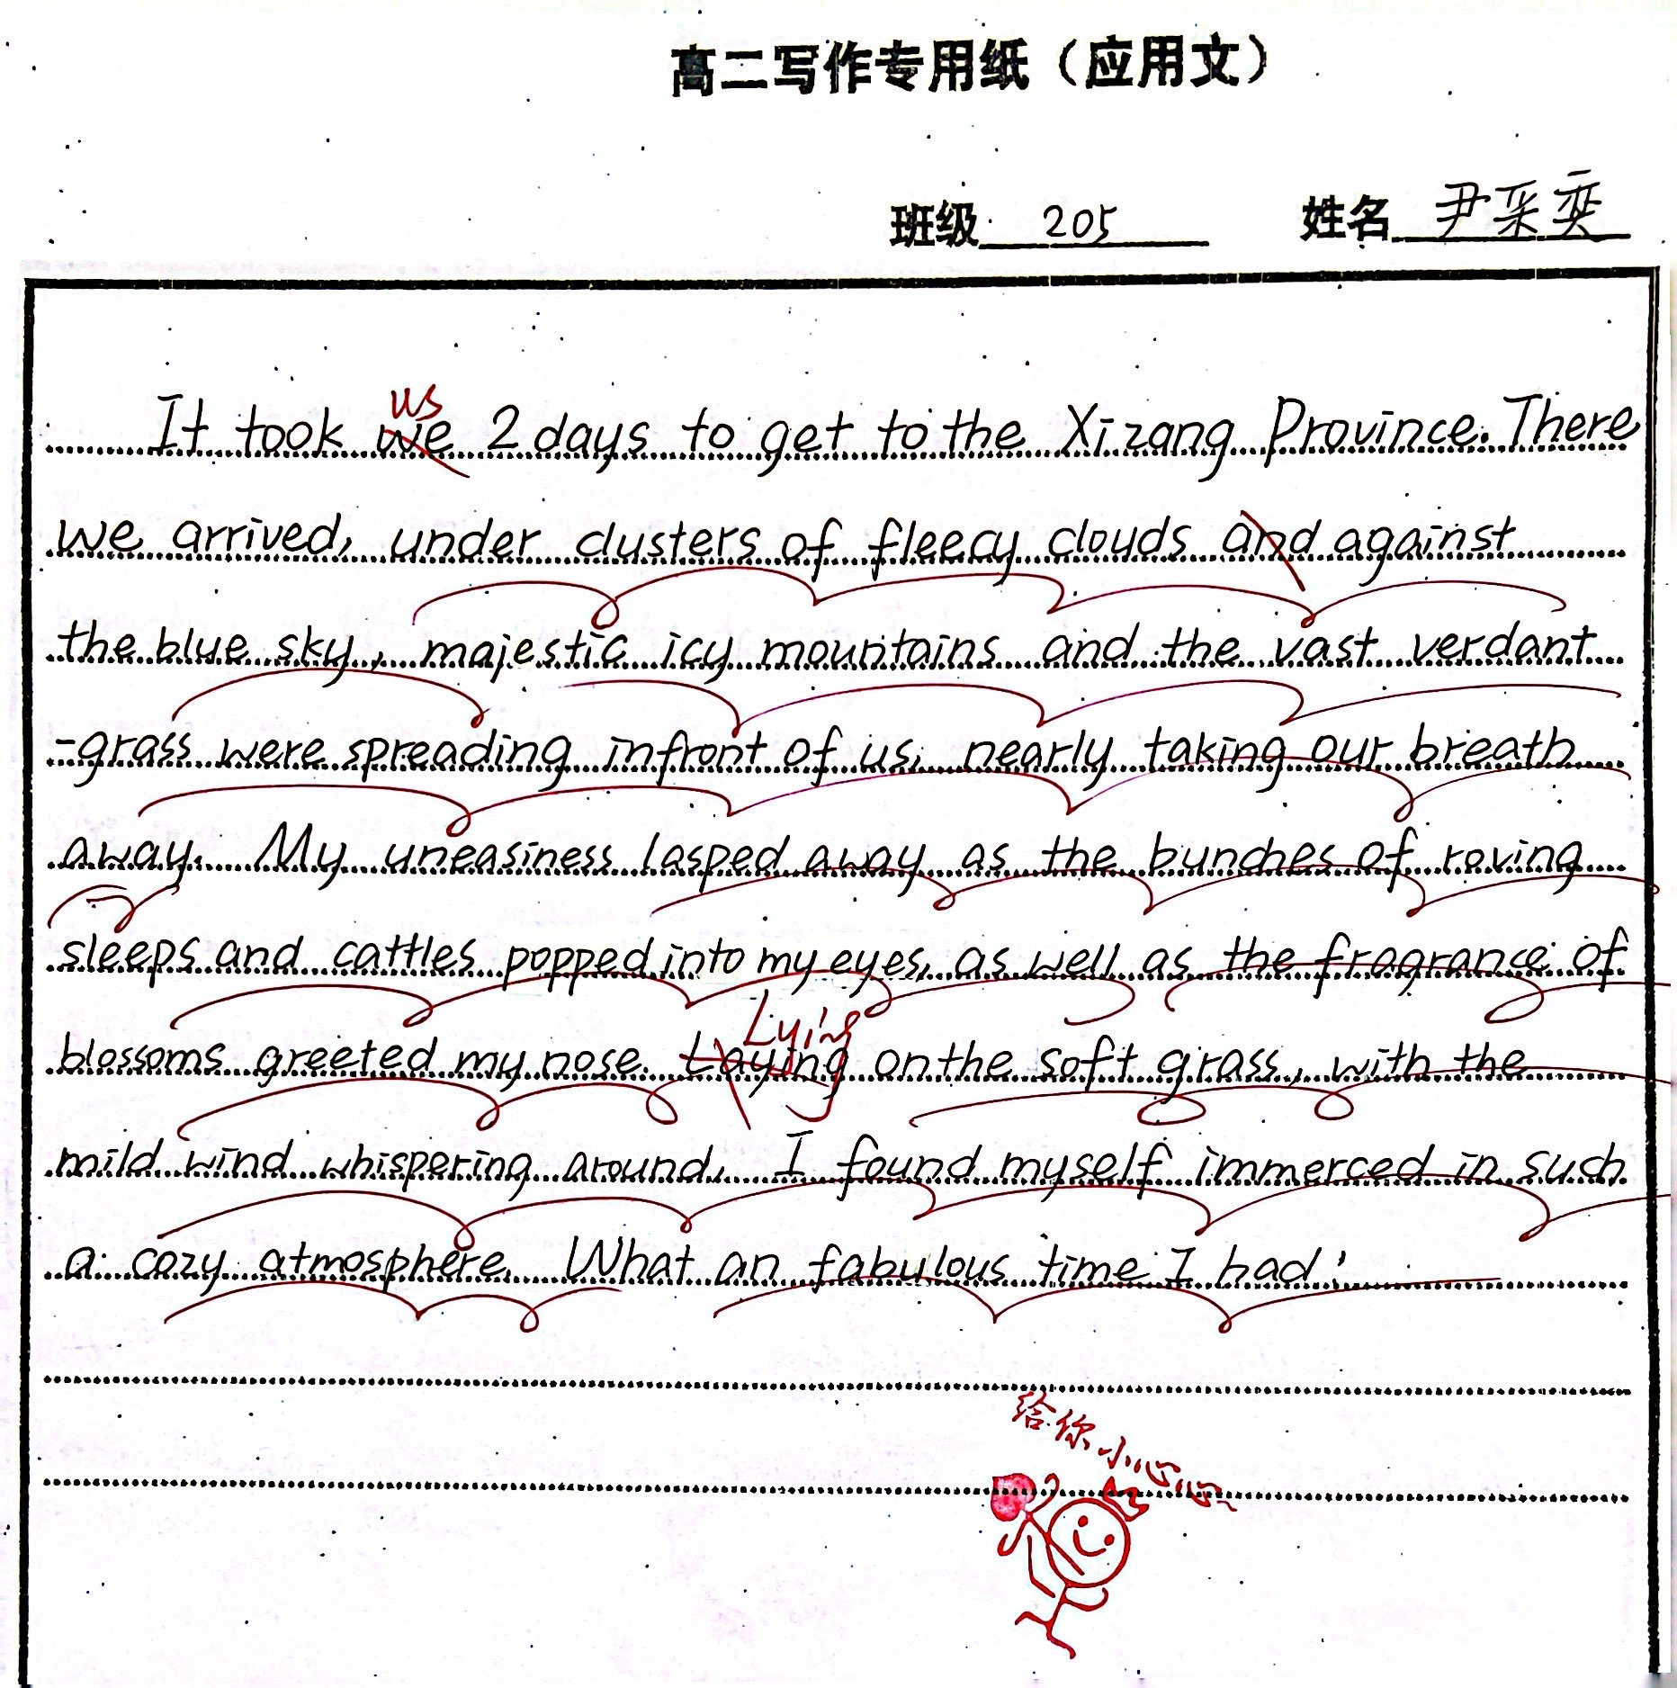
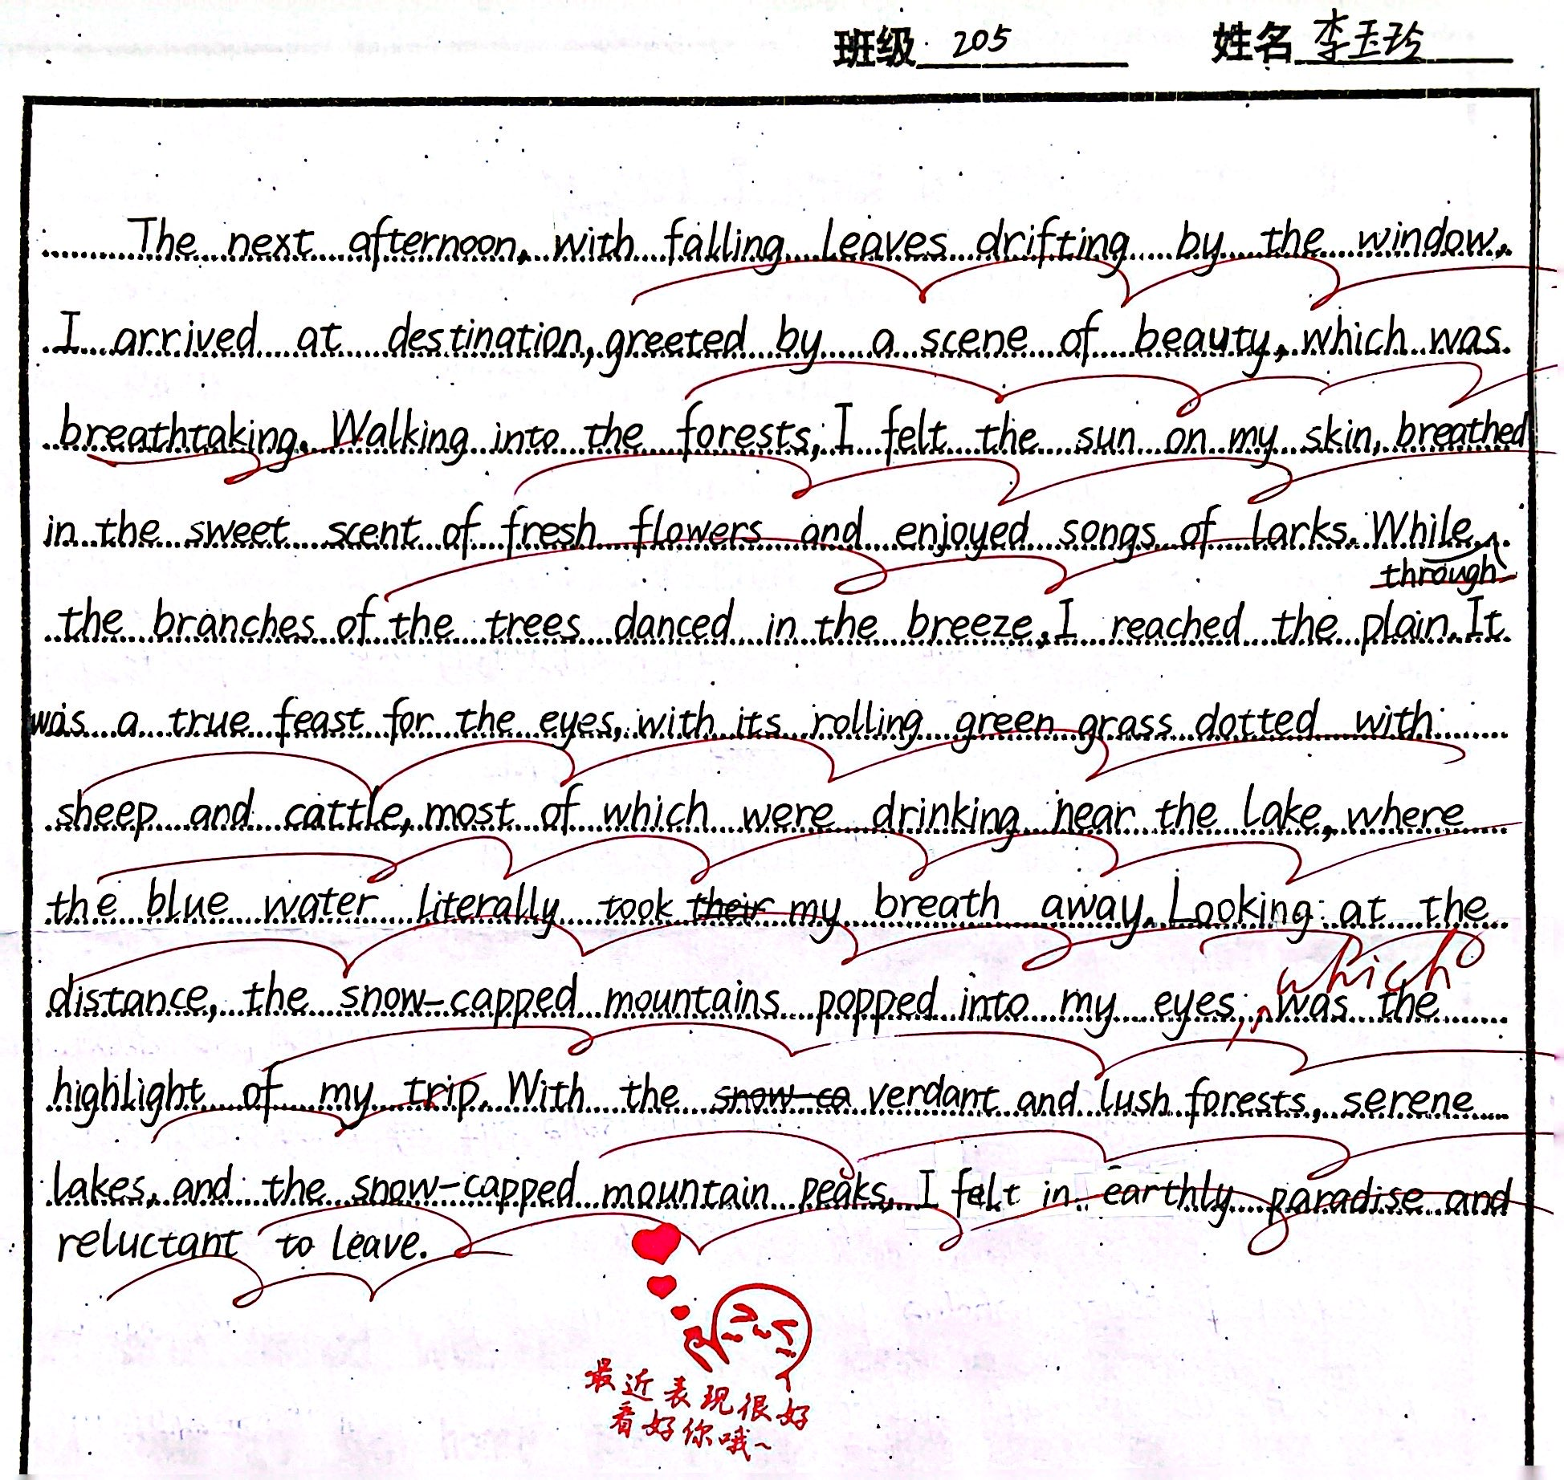
1. in order of time/space;
2. good language(尤其是能对课文中的语言进行高效地迁移，很棒！);
3. vivid picture（rich imagination）.

Slide 18
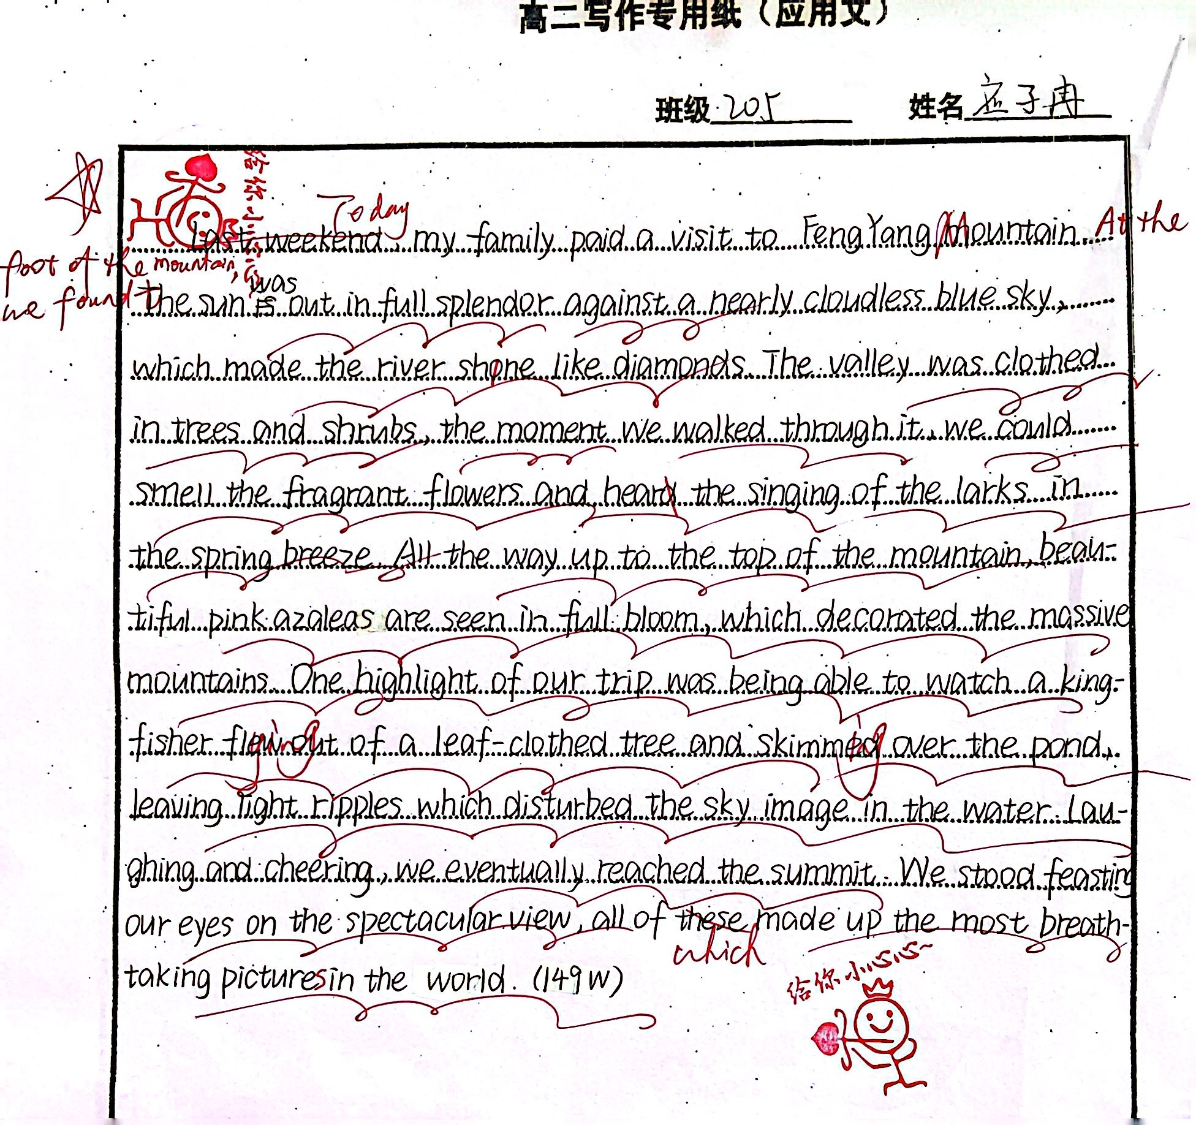
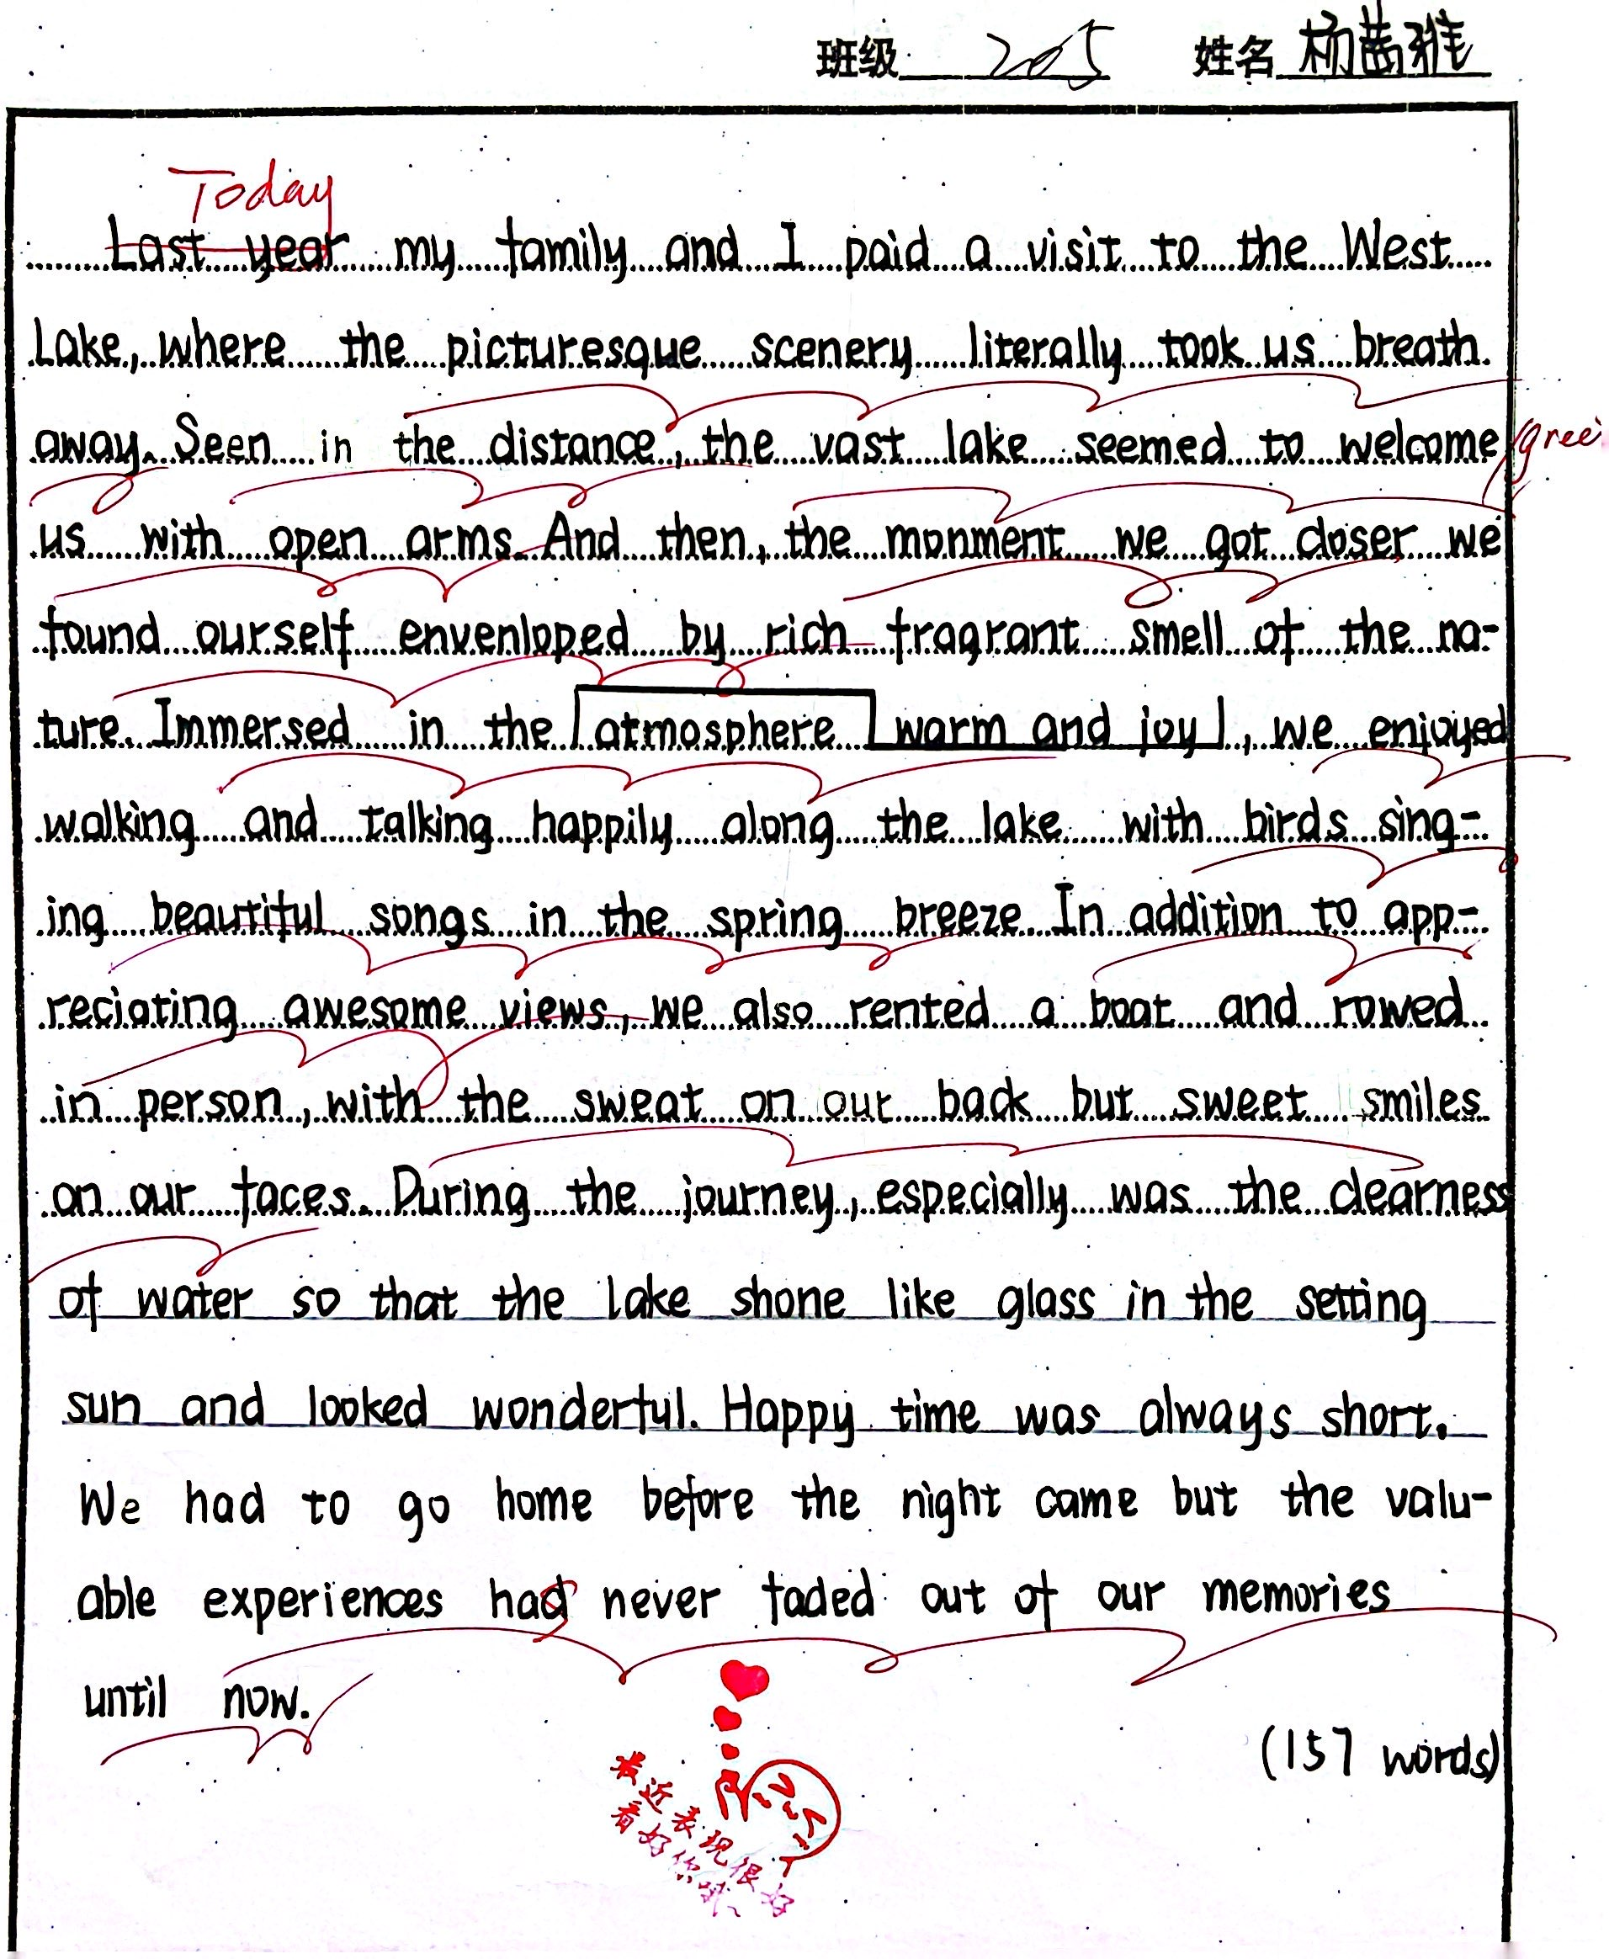

1. in order of time/space(日志的时间应该是当天);
2. good language(尤其是能对课文中的语言进行高效地迁移，很棒！);
3. vivid picture（rich imagination）.

Slide 19
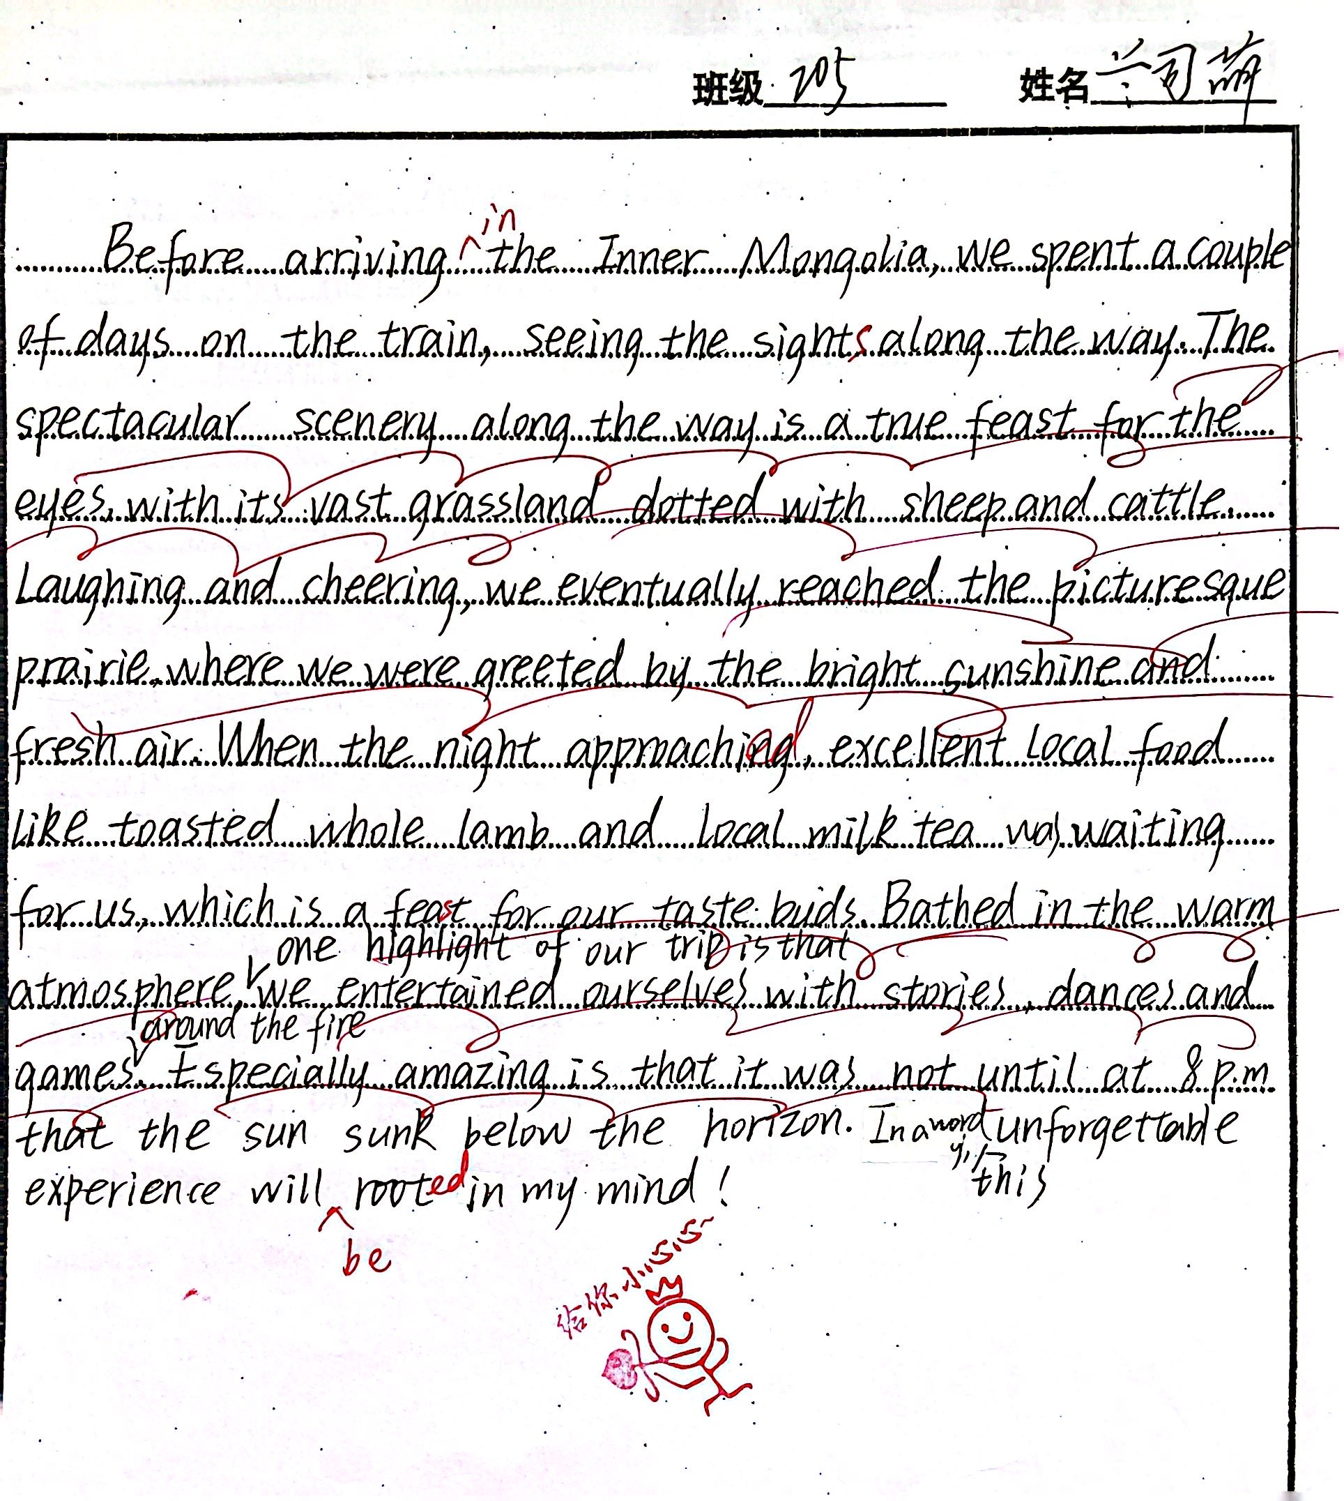
1. in order of time/space;
2. Good language(对文本语言和课堂生成语言做到高效迁移，棒！);
3. Vivid picture.

Slide 20
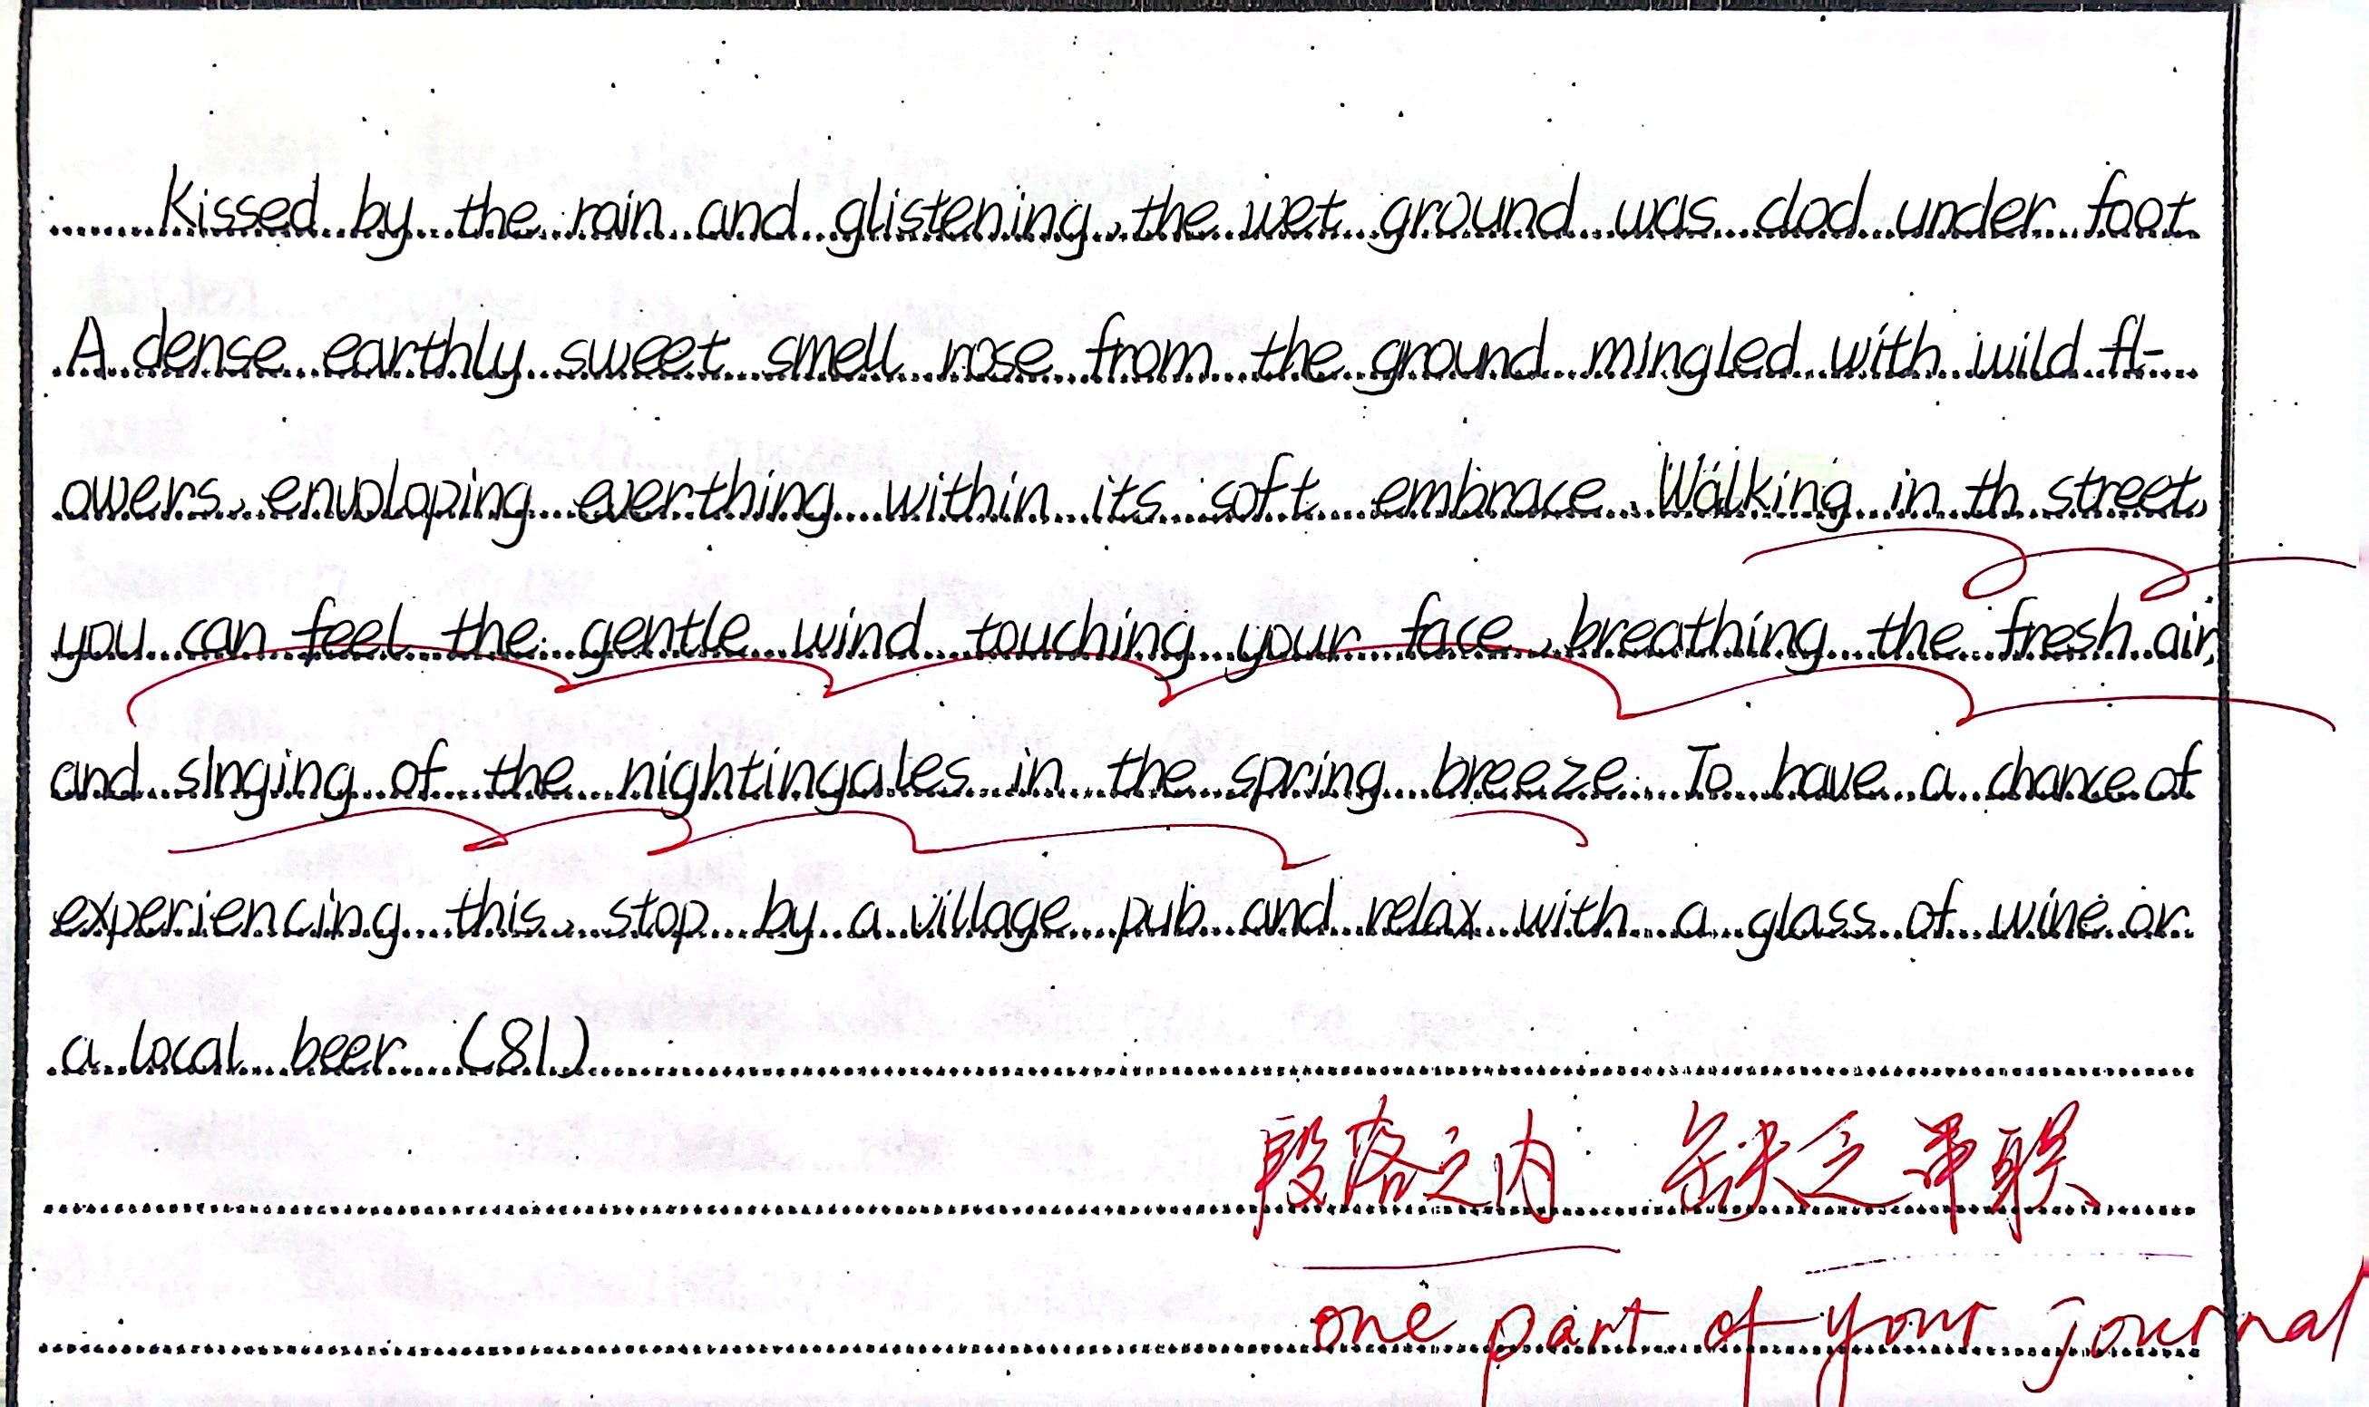
1. 整个段落似乎是几个场景的堆砌，缺乏时间线或空间线索的串联;
2. 有在尽力丰富语言，而且划线句式写得挺好，要是对于文本语言有更多的模仿和迁移便是锦上添花了);
3. 确有些画面，但不够丰富、生动和清晰.“to show,but not to tell”,此段描述的是你的旅游日志的一部分，so show your seeing,doing and feeling.

