Slide 1

感恩遇见，相互成就，本课件资料仅供您个人参考、教学使用，严禁自行在网络传播，违者依知识产权法追究法律责任。
更多教学资源请关注
公众号：溯恩高中英语
知识产权声明

Slide 2




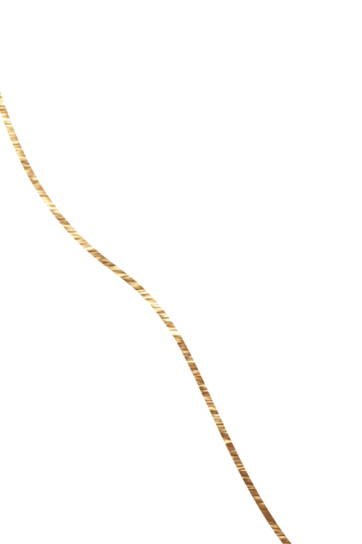
2023年6月新课标I&II卷
读后续写讲评
——个人成长类主题

Slide 3

读后续写——what to read?
2C2P1L
01
02
Characters
Plot
03
Clues
04
POV (point of view)
05
Language

Slide 4
审题训练：
❶ When I was in middle school, my social studies teacher asked me to enter a writing contest, I said no without thinking. I did not love writing. My family came from Brazil, so English was only my second language. Writing was so difficult and painful for me that my teacher had allowed me to present my paper on the sinking of the Titanic by acting out a play, where I played all the parts. No one laughed harder than he did.
❷ So, why did he suddenly force me to do something at which I was sure to fail? His reply: “Because I love your stories. If you’re willing to apply yourself, I think you have a good shot at this.” Encouraged by his words, I agreed to give it a try.
❸ I chose Paul Revere’s horse as my subject. Paul Revere was a silversmith (银匠) in Boston who rode a horse at night on April 18, 1775 to Lexington to warn people that British soldiers were coming. My story would come straight from the horse’s mouth. Not a brilliant idea, but funny, and unlikely to be anyone else’s choice.
❹ What did the horse think, as sped through the night? Did he get tired? Have doubts? Did he want to quit? I sympathized immediately. I got tired. I had doubts. I wanted to quit. But, like Revere’s horse, I kept going. I worked hard. I checked my spelling. I asked my older sister to correct my grammar. I checked out a half-dozen books on Paul Revere from the library. I even read a few of them.
❺ When I handed in the essay to my teacher, he read it, laughed out loud and said, “Great. Now, write it again.” I wrote it again, and again and again. When I finally finished it, the thought of winning had given way to the enjoyment of writing. If I didn’t win, I wouldn’t care.
Para. 1 A few weeks later, when I almost forgot the contest, there came the news.
Para. 2 I went to my teacher’ office after the award presentation.

Slide 5


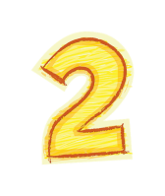
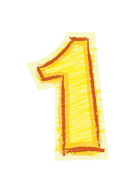
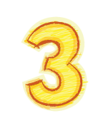
01
Characters
English- Brazilian
writing- so difficult and painful
did not love writing
Everyone exists for a reason.
I
began to love writing
growth
Main
characters
innovative, humorous
inquisitive
hard-working, persistent
人物的个性怎么样？
personality
had allowed
No one laughed harder than he did.
“Because I love your stories. If you’re willing to apply yourself, I think you have a good shot at this.” Encouraged by his words…
… he read it, laughed out loud and said, “Great. Now, write it again.”
有哪些人物？
quantity
tolerant and flexible
love to laugh
be good at motivating, encouraging
strict
my teacher
人物会有什么样的变化？
change
My story would come straight from the horse’s mouth. Not a brilliant idea, but funny, and unlikely to be anyone else’s choice.
What did the horse think, as sped through the night? Did he get tired? Have doubts? Did he want to quit?
But, like Revere’s horse, I kept going. I worked hard. I checked my spelling. I asked my older sister to correct my grammar. I checked out a half-dozen books on Paul Revere from the library. I even read a few of them.
I wrote it again, and again and again.
Paul Revere was a silversmith (银匠) in Boston who rode a horse at night on April 18, 1775 to Lexington to warn people that British soldiers were coming.
What did the horse think, as sped through the night? Did he get tired? Have doubts? Did he want to quit? I sympathized immediately. I got tired. I had doubts. I wanted to quit. But, like Revere’s horse, I kept going.
人物的互动关系怎么样？
interaction
Minor
characters
Paul Revere and his horse

Slide 6




02
Plot
Everything changes for the better.
Para. ❶ I didn’t love writing because English was only my second language and writing was so difficult and painful.
I love writing and have been making progress both in English and writing.
Para. ❶ I didn’t love writing because English was only my second language and writing was so difficult and painful.
externally
Para. ❷ my teacher’s encouragement
internally
What does the author want to highlight?
Para. $❸$ my innovation
Para. $❹$ ❺ my endeavor and persistence
Para. ❺ my teacher’s strictness
Thanks to my teacher’s encouragement and strictness, I won a prize in the writing contest.

Slide 7
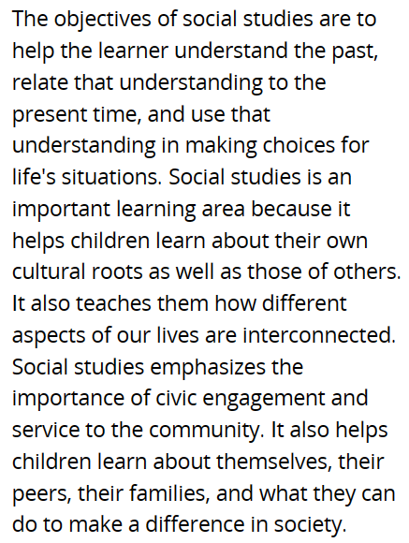
03
Clues
Everything happens for a reason.
1. social studies teacher
Why did the social studies teacher want me to enter the contest?
“So, why did he suddenly force me to do something at which I was sure to fail? His reply: ‘Because I love your stories. If you’re willing to apply yourself, I think you have a good shot at this.’ Encouraged by his words, I agreed to give it a try.” ❷
Any other reasons? (dig deeper)
guide me to make right decisions by boldly facing, embracing and overcoming difficulties in life
enable me to know more about English and English culture by practicing writing and learning British history
help me see my own strength (humor & creativity) and exploit my potential to the full
…

Slide 8
2. laugh
“No one laughed harder than he did.” ❶
“When I handed in the essay to my teacher, he read it, laughed out loud and said…”❺
→ The teacher loves to laugh.
→ My acting/ story is funny.
“Not a brilliant idea, but funny, and unlikely to be anyone else’s choice.” ❸
→ funny, unique, novel
win? fail?
What can you learn from these two sentences?
What else can show the story is funny?
What might be the result of the contest? Why?

Slide 9

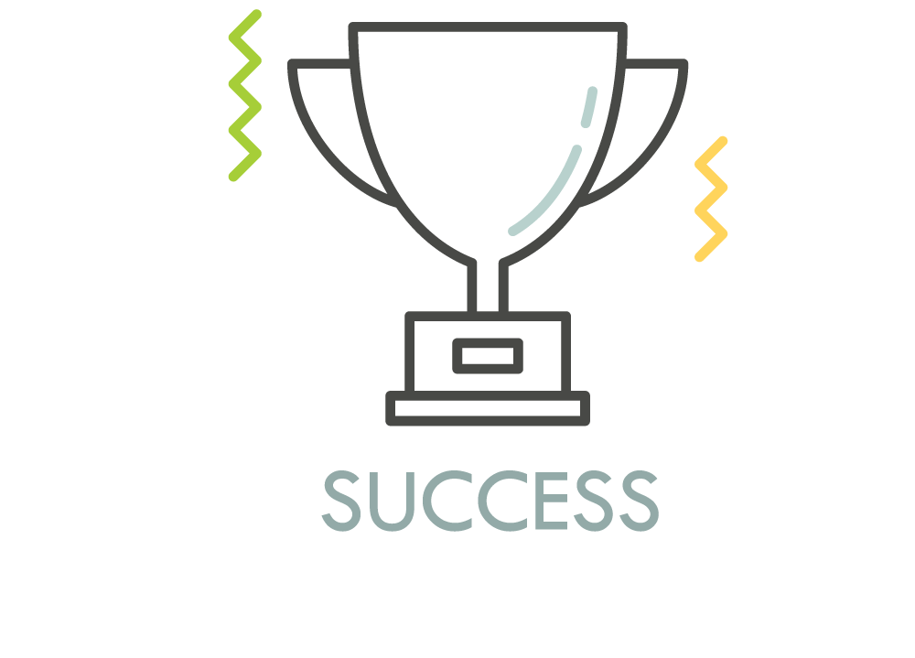
2. result?
What can I learn from the result?
“His reply: ‘Because I love your stories. If you’re willing to apply yourself, I think you have a good shot at this.’” ❷
“Not a brilliant idea, but funny, and unlikely to be anyone else’s choice.” ❸
“… like Revere’s horse, I kept going. I worked hard. I checked my spelling. I asked my older sister to correct my grammar. I checked out a half-dozen books on Paul Revere from the library. I even read a few of them.”❹
“I wrote it again, and again and again.”❺
“I said no without thinking. I did not love writing… Brazil, so English was only my second language. Writing was so difficult and painful for me that… where I played all the parts. No one laughed harder than he did.” ❶
“So, why… I was sure to fail?” ❷
“When I finally finished it, the thought of winning had given way to the enjoyment of writing. If I didn’t win, I wouldn’t care.”❺
I got a prize (1st/ 2nd/ Engagement Award…)
My hard work paid off.
My talent got recognized.
harvest the sweetness of victory
finally understand: No pain, no gain./ Nothing is impossible to a willing heart./ Nothing can stop a person from achieving his/her goals if he/she is ready or eager to go for it.
know how to better tackle difficulties in life
I failed
I enjoyed the process of writing.
have a better understanding of the British language and history
know how to better tackle difficulties in life

Slide 10
04
POV (point of view)
How did this experience influence my choice?
1st person limited
a middle school student
→ a college student? an adult?
major in writing
become a bilingual writer
...
05
Everything is told from “my” perspective.
Language
“When I was in middle school, my social studies teacher asked me to enter a writing contest, I said no without thinking. I did not love writing.” ❶
“What did the horse think, as sped through the night? Did he get tired? Have doubts? Did he want to quit? I sympathized immediately. I got tired. I had doubts. I wanted to quit. But, like Revere’s horse, I kept going.” ❹
long and short sentences
colloquial expressions
being simple and natural

Slide 11
Plot development
logical reasoning
Para. 1 A few weeks later, when I almost forgot the contest, there came the news.
Para. 2 I went to my teacher’ office after the award presentation.
result of the contest
my feelings, action
my feelings, action & reasons for winning
& the audience’s reaction
What’s the news?
How did I react to the news?
The news also said I had an award presentation to take part in.
How was the award presentation?
I wanted to extend my thankfulness to my teacher.
Why did I go to my teacher’s office?
How did the teacher react?
What did I gain from this experience?
reason—my action
the teacher’s reaction- gestures, facial expressions, words
victory? lesson? reflection?

Slide 12
读后续写——how to write?
01
02
Characters
Plot
03
Clues
04
POV (point of view)
05
Language
Echoing
Cohesion and coherence
Synergy 协同

Slide 13
Focus on the characters while writing
Main characters | I
 | my teacher
Minor characters | Paul Revere’s horse
What hasn’t changed?
What has changed?
witnessed my endeavor, my change, my growth
--words matter
symbolic meaning—embodiment of “I”

Slide 14
Cohesion and coherence
语法衔接、词汇衔接
Echoing
Para. 1 衔接句
Though I said I wouldn’t care about whether I could win or not, I really didn’t want to finish up nowhere in the match. So I held my breath when our monitor was announcing the result. (延续原文结尾对比赛结果不在意)
It turned out I was the top winner! How could it be possible? I was dumbfounded to the spot when my classmates all came over to congratulate me. (延续对自己能力的不自信+获得第一的惊讶；能力的体现——获奖)
The moment I knew I won the writing contest, I was overwhelmed by a strong sense of astonishment mingled with exhilaration, yelling at the top of my lung excitedly. Never in my wildest dream had I imagined that my painstaking effort in polishing my essay would one day yield to sweet fruit. (得知获奖后的难以置信、喜悦的心情和表现)

Slide 15
Para. 1 领奖场景（紧张+兴奋+观众反应）
Upon stepping onto the stage, I felt my throat tightened and hands sweaty. Not until the headmaster handed over the trophy to me did I believe I was not daydreaming.
Shortly afterwards, I found myself on the stage in the school hall where the award presentation was held. It being the first time for me to win a prize, I could feel my palms were sweating and my heart was pounding fiercely.
During the award presentation, a strong sense of ecstasy, excitement and pride gripped me as I stood in front of so many people for the first time of my life.

Slide 16
Para. 1 段尾衔接句
Holding the award tight to my chest, I accidentally met my teacher’s approving smile in the crowd, the same as always. (见到)
When the host asked me who I’d like to thank, the one coming to my mind first was my teacher, who had successfully transformed the least person to win into an acknowledged writer. (想到)

Slide 17
Para. 2 衔接句（老师祝贺、我感谢）
No sooner had I seen him than I trotted and gave him a big embrace. “Without you, I wouldn’t have accomplished the mission impossible and reaped so much!” I choked gratefully.
Warmly inviting me to sit down, he gave me a thumbs-up and said, “Congratulations to you! I knew you can make it!”
On seeing him, I could barely contain my gratitude, repeating “thanks” and showing him the golden trophy with my hands slightly trembling.

Slide 18
Para. 2 结尾升华
My love for writing in English sprouted, grew and blossomed in my heart, so did my bravery in facing whatever would be in store for me in the future.
Ever since, never have I seen writing as something tough; instead, I found the real delight in the writing process and ended up a bilingual writer.
Like accomplishing the impossible writing task, when faced with other difficulties in the years to come, I am firmly convinced that this experience could see me through all of them.

