Slide 1

感恩遇见，相互成就，本课件资料仅供您个人参考、教学使用，严禁自行在网络传播，违者依知识产权法追究法律责任。
更多教学资源请关注
公众号：溯恩高中英语
知识产权声明

Slide 2

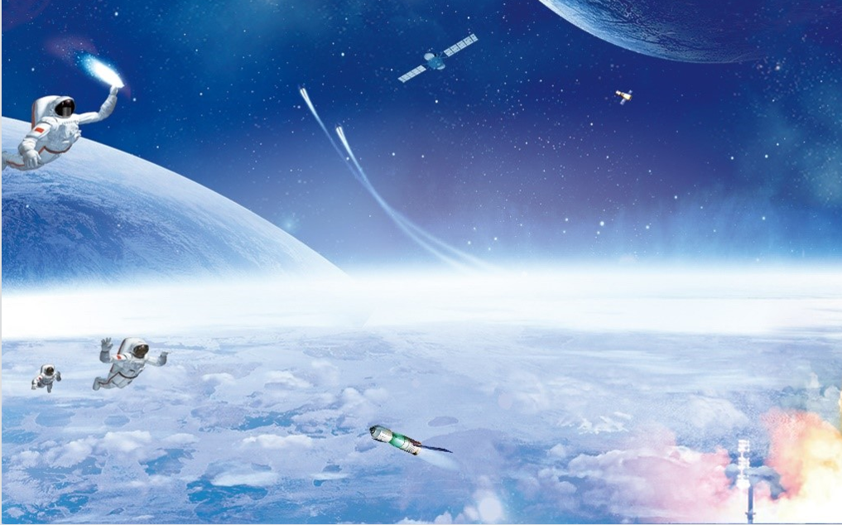
B3 U4
Reading for Writing
Present an argument about Space Exploration
阐述有关太空探索的论点

Slide 3

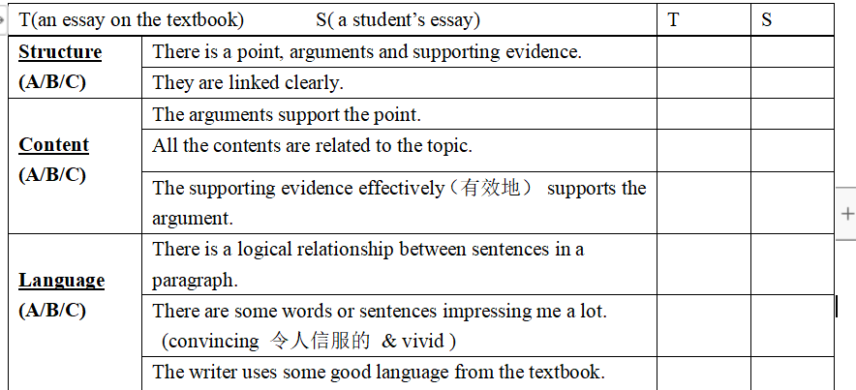
Enjoy Our Exploration-Assessing an Essay (作文评价）
Rules about the Exploration:
1. Cooperate with the group members. (1 leader & 3 members)
2. Raise your hands to express your ideas. (more volunteers)
3. Appreciate others’ essays or ideas and give them a big clap.
Welcome to Belinda’s class!

Slide 4

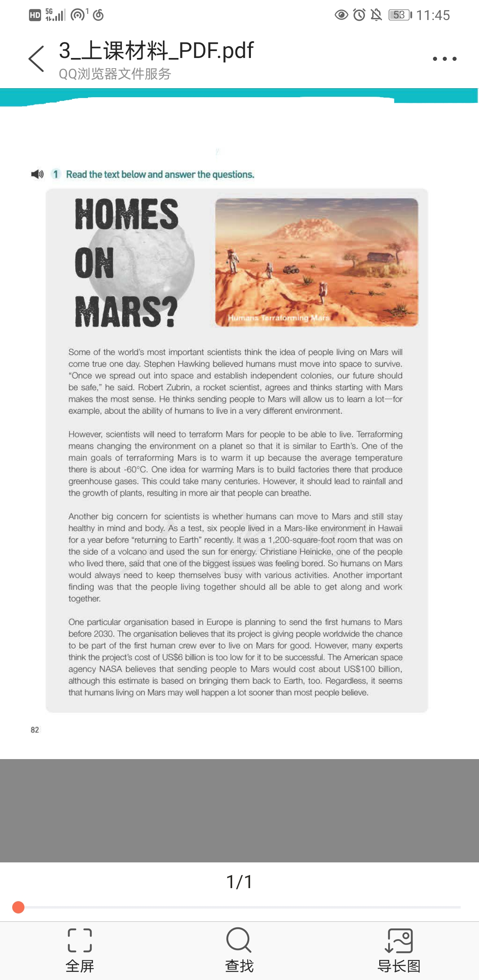


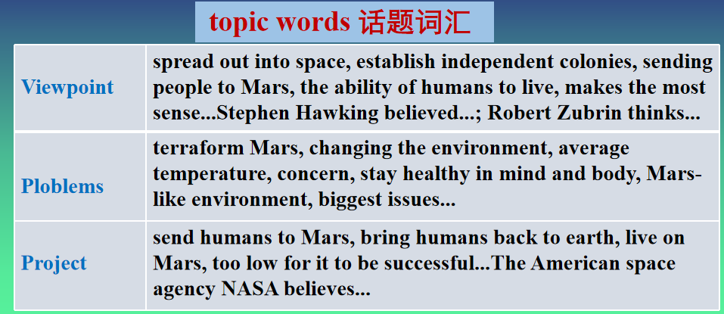
Activity 1: Exploring the detailed points for assessment
Arguments
positive
scientists' ______ attitudes to living on Mars (Para.1)
Arguments
Point
Supporting evidence
Homes on Mars?
the possible problems and
_______ of living on Mars (Paras.2-3)
solutions
Yes!
echo(呼应)
project
the _______ we are making to
send humans to Mars (Para.4)

Slide 5
Activity 1: Exploring the detailed points for assessment
Does the supporting evidence effectively support the argument?
Para.1 Some of the world’s most important scientists think the idea of people living on Mars will come true one day. Stephen Hawking believed humans must move into space to survive. “Once we spread out into space and establish independent colonies, our future should be safe,” he said. Robert Zubrin, a rocket scientist, agrees and thinks starting with Mars makes the most sense. He thinks sending people to Mars will allow us to learn a lot--for example, about the ability of humans to live in a very different environment.
is the most practical

Slide 6
Activity 1: Exploring the detailed points for assessment
Is there a logical relationship between sentences in a paragraph?
Para.2 ①However, scientists will need to terraform Mars for people to be able to live. ②Terraforming means changing the environment on a planet so that it is similar to Earth’s. ③One of the main goals of terrafroming Mars is to warm it up because the average temperature there is about -60ºC. ④One idea for warming Mars is to build factories there that produce greenhouse gases. ⑤This could take many centuries. ⑥However, it should lead to rainfall and the growth of plants, resulting in more air that people can breathe.
① State a problem
Explain
② _______ the problem
solution
③ ④ Put forward the _______
disadvantage
⑤ Tell the ____________ of the solution
good effect
⑥ Show the ________ of the solution

Slide 7
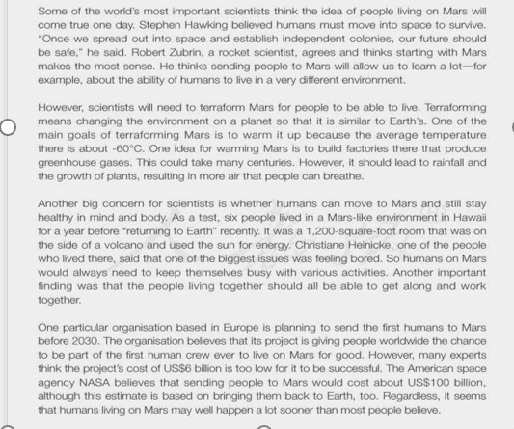
Activity 1: Exploring the detailed points for assessment
Do any words or sentences impress you a lot?(convincing & vivid)
Para 4. Line 1
One particular organisation based in Europe is planning to send the first humans to Mars before 2030.
continuous tense进行时态
To show that people are working on the exploration of Mars these days.

Slide 8
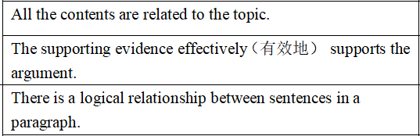
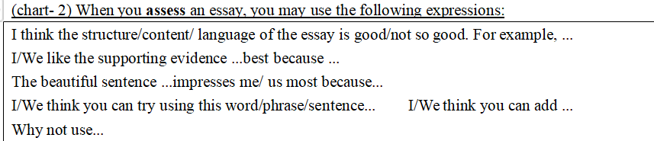

Activity 2: Assessing the peer’s works in group
Rules about Assessing:
1.Read together at first.
2.Group members should put forward ideas actively according to the Evaluation Sheet and the leader collects the members’ ideas.
2. During the discussion, the leader should map out (标注) some places that you think need polishing (提升，润色) on the essay.
3. You can turn to me for help if necessary.

Slide 9
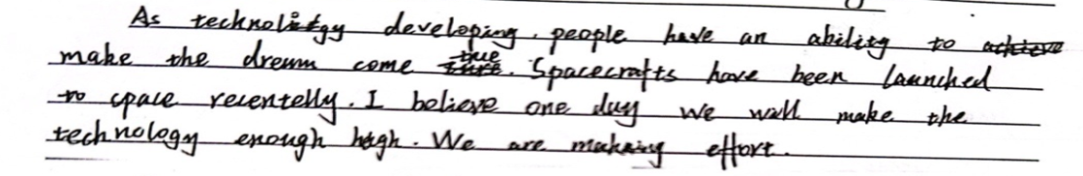
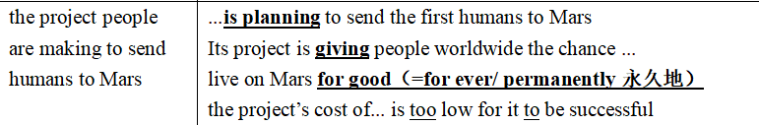
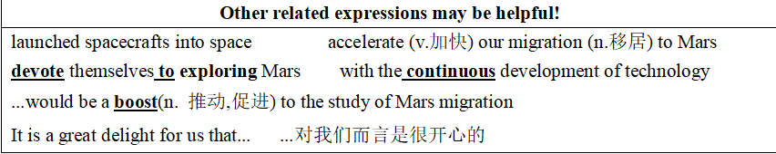
Activity 3: Polishing (提升，润色) the essay all together
Does the supporting evidence effectively support the argument? (Para.2)
How can we make these sentences logical in a paragraph? (②-③-④)
①
①
②
③
③
the dream of living on Mars
④
If we want to add details, why not use...
③there is now an organization based in Europe that plans to send the first humans to Mars.
④ it will be a boost to the study of Mars migration.
More importantly, there is now an organization based in Europe that plans to send the first humans to Mars
, resulting in a boost to the study of Mars migration.

Slide 10
Activity 3: Polishing the essay all together
Let’s compare the polished one with the original one:
①
③
All the contents should be related to the topic.
With the continuous development of technology, we can make the dream of living on Mars come true. It is a great delight for us that some countries have launched spacecrafts into space. More importantly, there is now an organization based in Europe that plans to send the first humans to Mars, resulting in a boost to the study of Mars migration .

Slide 11
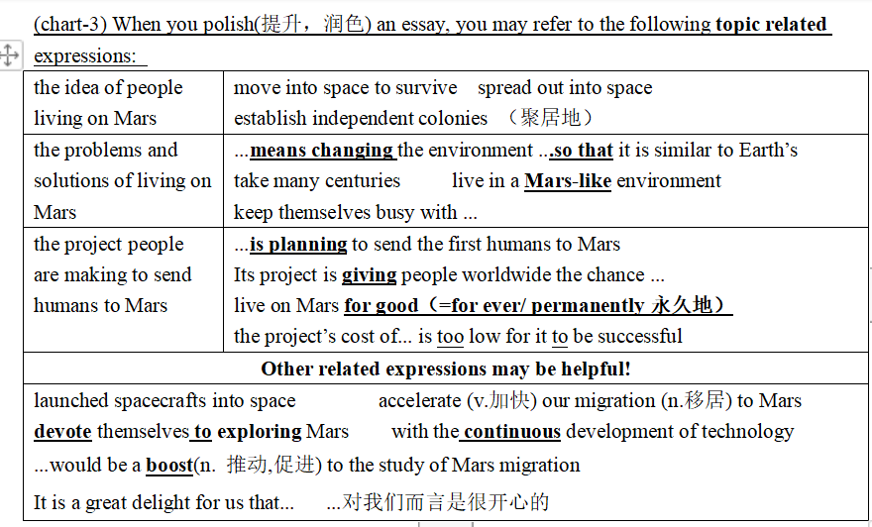

Activity 4: Polishing the essays in group
Rules about Polishing:
1. Decide on one paragraph to polish.
2. Group members should put forward ideas about how to polish it.
3. The leader directly polishes the places need improving with different colors.
3. You can turn to me for help if necessary.

Slide 12
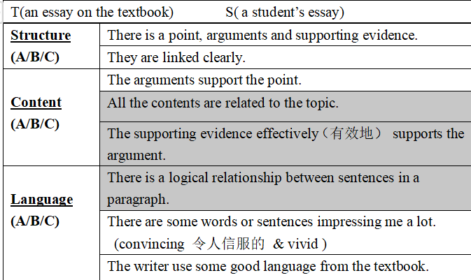
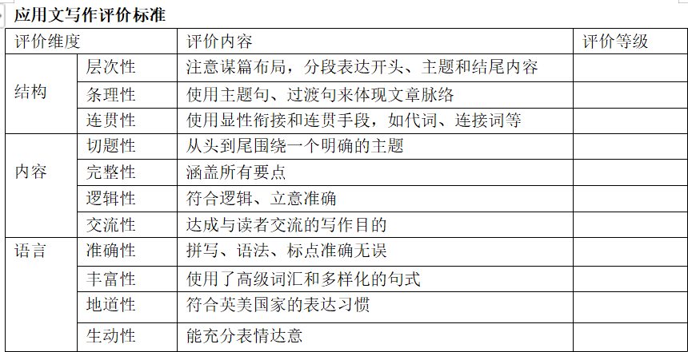
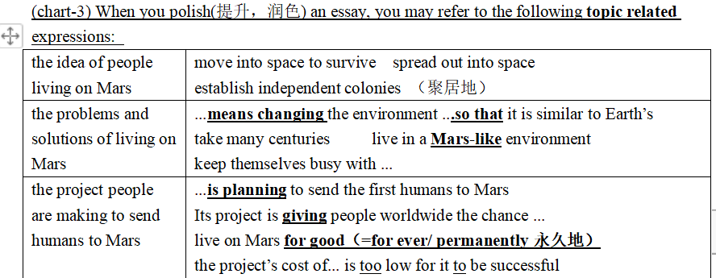
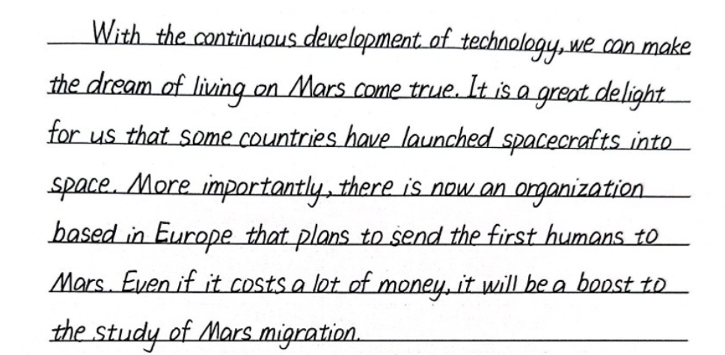
Activity 5: Summarizing what we have explored in the class
Accumulate（积累) some related expressions based on different topics
Bettering your handwriting also matters!

Slide 13
Enjoy Our Exploration-
Assessing an Essay (作文评价）
We are the explorers. We don’t know what new discoveries lie ahead. But this is the very reason we must go.
Thanks for your great cooperation!

Slide 14

Assignment:
1. Please write an essay that gives your opinion about the idea of humans living on Mars independently. (You can find more evidence about Mars exploration on the Internet to make your essay more persuasive).
2.Please independently assess your essay according to the Evaluation Sheet on Writing and exchange it with your group members.

