Slide 1


感恩遇见，相互成就，本课件资料仅供您个人参考、教学使用，严禁自行在网络传播，违者依知识产权法追究法律责任。
更多教学资源请关注
公众号：溯恩高中英语
知识产权声明

Slide 2

Book3 Unit 1
Festivals and Celebrations
Reading for Writing
My Amazing Naadam Experience
Notes:
MS中插入视频

Slide 3

Round 1 A quiz on festvals
Hubei TV
节日知多少
Chinese Festival Meeting
Round 2 Experience a festival
节日初体验
Who can be the Festival ambassadors(大使） ?
Round 3 Write about a festival
节日我来写
Hostess: Cindy
Round 4 Award festival ambassadors
颁奖节日大使
Notes:
MS中插入视频

Slide 4

ROUND 1 A quiz on festivals
节 日 知 多 少
Notes:
MS中插入视频

Slide 5


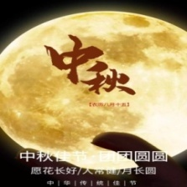
... is celebrated on
... takes place on...; ... falls on... , (lasting...)
What
& When:
the Lantern Festival
A. the 15th day of the 8th lunar month
the Dragon Boat Festival
B. the 15th day of the 1st lunar month
the Mid-Autumn Festival
C. the 5th day of the 5th lunar month

Slide 6
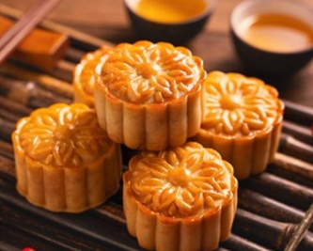
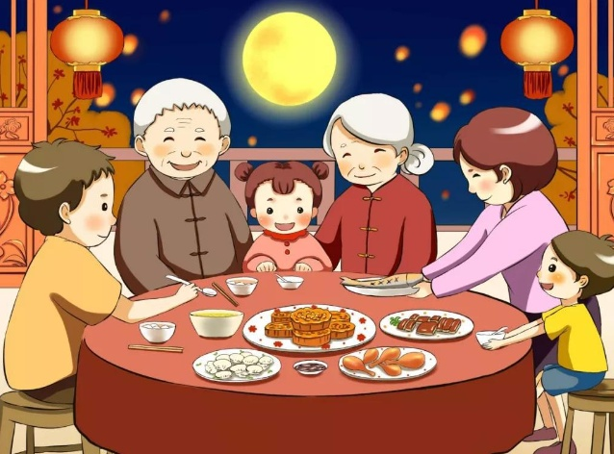
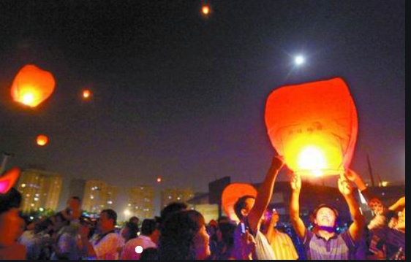
How:
The Mid-Autumn Festival is a time of happiness when people...
eat mooncakes,
admire the moon,
put Kongming light
enjoy family dinner,

Slide 7
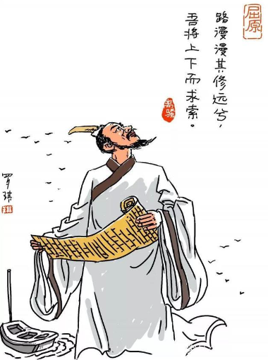
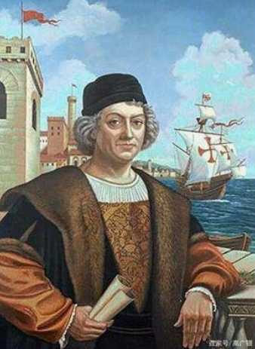
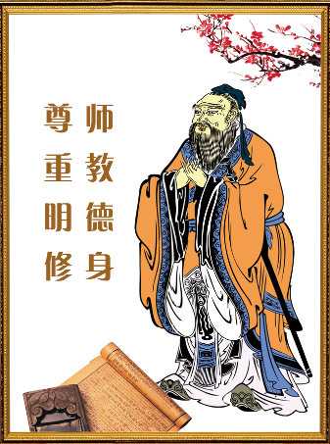
Why：
... is (celebrated) to honor ...., who...
A. The Dragon Boat Festival
B. Columbus Day
C. Teachers’ Day
Confucius
the greatest Chinese educator
a patriotic poet
found the New World

Slide 8
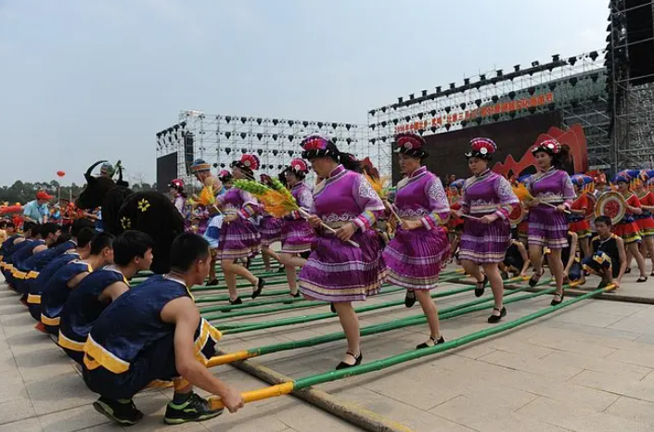
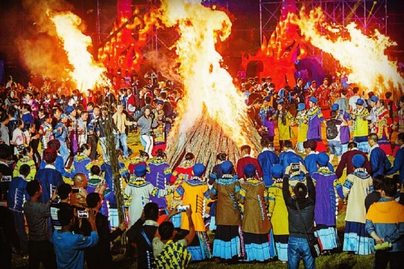
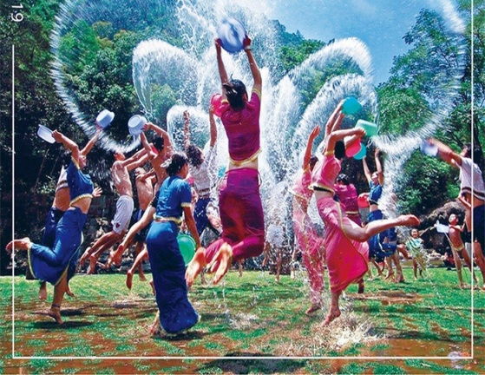

province/ …autonomous region，
Where:
ethnic festivals (minority)
傣
A. Water splashing Festival（____族）
B. Torch festival（___族）
C. the Sanyuesan Festival (_____族）
彝
壮

Slide 9
ROUND 2 Experience a festival
节 日 初 体 验
Notes:
MS中插入视频

Slide 10
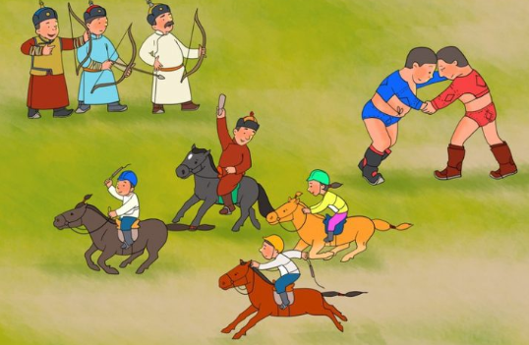
Skimming Para1. for basic festival information
“games”
Inner Mongolia Autonomous Region
What?
meaning
falls on the 4th day
of the sixth month
of the lunar calendar，
lasting (for) 3 days
When?
time
Where?
place
Naadam
Festival
How?
celebrations
Why?
purpose
horse racing,
wrestling
and archery... ...
Notes:
MS中插入视频

Slide 11

A diary
Activity 1: Skimming for the passage structure
My amazing Naadam experience
first person(人称）
mainly past tense
(present tense 时态)
detailed experience
brief
festival
introduction
Where is the topic sentence of each paragraph?
What activities did he experience ?
In what order were the activities organized?

Slide 12
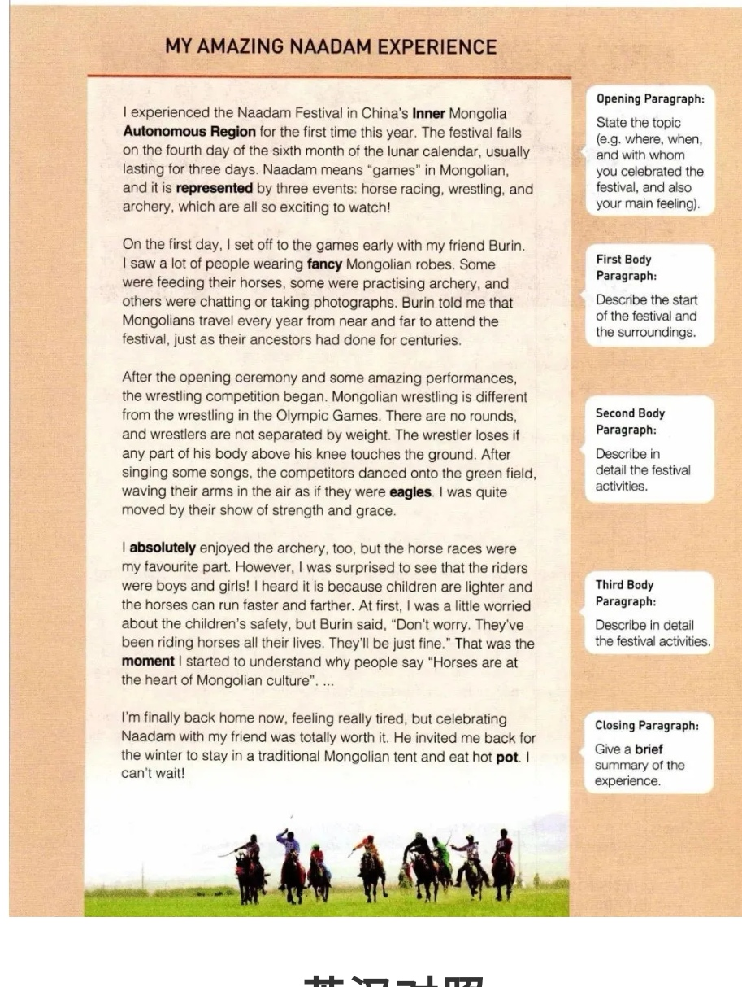
Locate the topic sentence of each paragraph.
(where?)
the beginning or the end ?
The first sentence of each paragraph.
What activities ?
The text is organized in
the order of ______?
time

Slide 13

Activity 2: Explore diary & Spot skills
logical: Topic sentence &Time order
do
(Para.2)What did he see when he arrived?
(para.3) How did the wrestlers appear onto the green field?
see
logical
experience
vivid
logical
feel
vivid
(Para.2-5)How did the writer’s feelings develop ?
think
learn
(Para.5)What did the writer think of his experience?

Slide 14
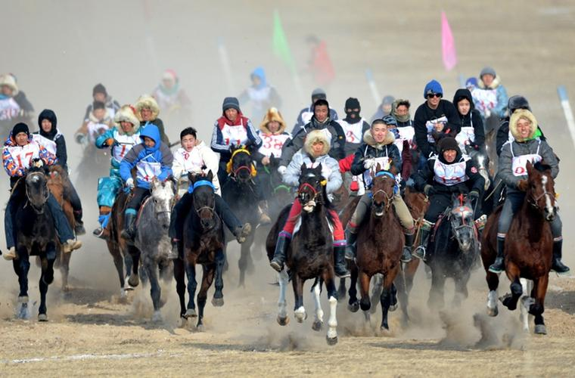
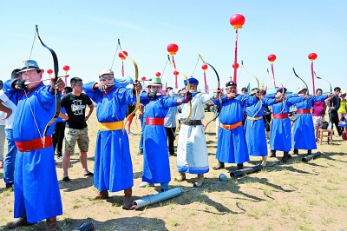
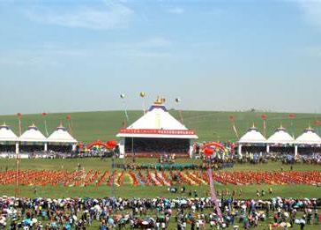
What did he see ?
(Para.2)What were the people doing when he arrived ?
(para.3) How did the wrestlers appear onto the green field?
He saw a lot of people wearing fancy Mongolian robes.
Some ____________ their horses, some ____________ archery, and others ___________ or taking photographs.
were feeding
were practising
were chatting
danced
After singing some songs, the competitors _______
onto the green field, ________ their arms in the air as if they were _______.
waving
eagles

Slide 15
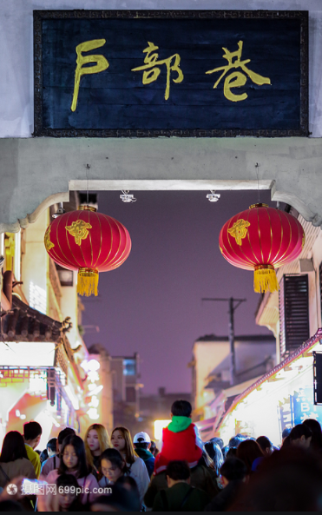
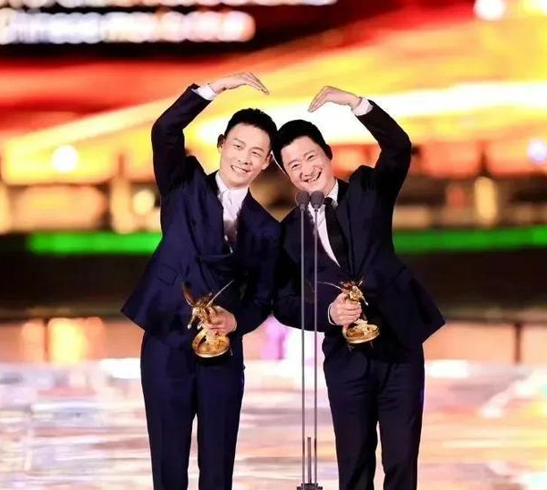
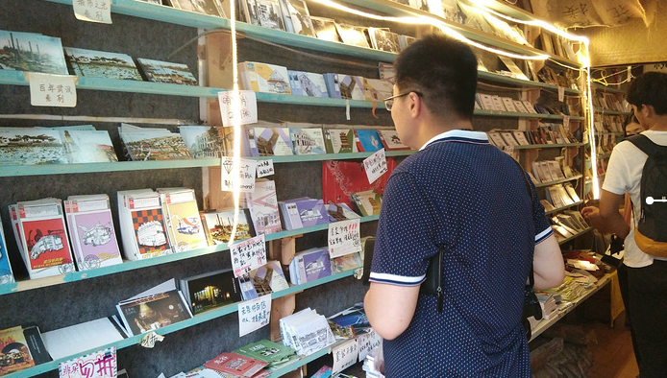
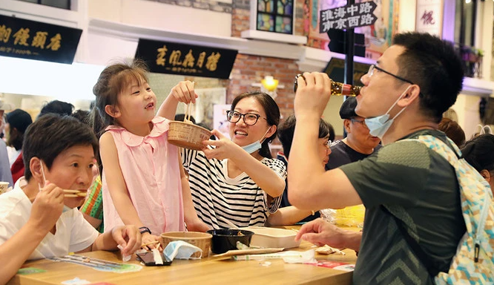
Micro-writing of what you saw
scene
1
scene
2
美食街(The snack street)里挤满了来自五湖四海的游客。一些在津津有味的尝美食，一些在忙于拍照，还有一些在兴奋地挑礼品.
The snack street _____________
tourists from all over the world. Some __________ delicious food , some ____________photos and others ____________gifts excitedly.
在发表完获奖感言后，张译和吴京分别举起左右手放于头顶，合做成了一个心的形状，好像两只可爱的小兔子在给大家送祝福.
(After doing.., sb did …, doing… as if …)
After ________ the acceptance speech , Zhang Yi and Wu Jing _______ their hands ,_________a shape of heart as if _________________________________.
was flooded with
were enjoying
delivering
raised
were busy taking
were selecting
making
they were two lovely rabbits delivering wishes

Slide 16
Activity 3 Explore diary Activity 4 Spot skills
do
logical: Topic sentence &Time order
see
Vivid : Scene description
logical
experience
vivid
logical
feel
vivid
think
learn

Slide 17
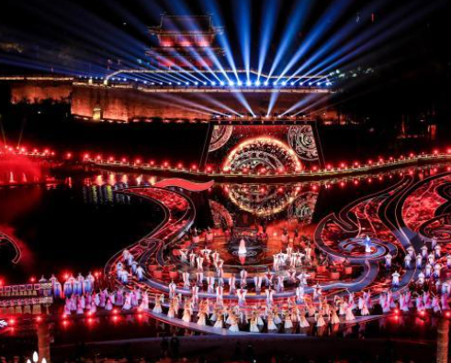
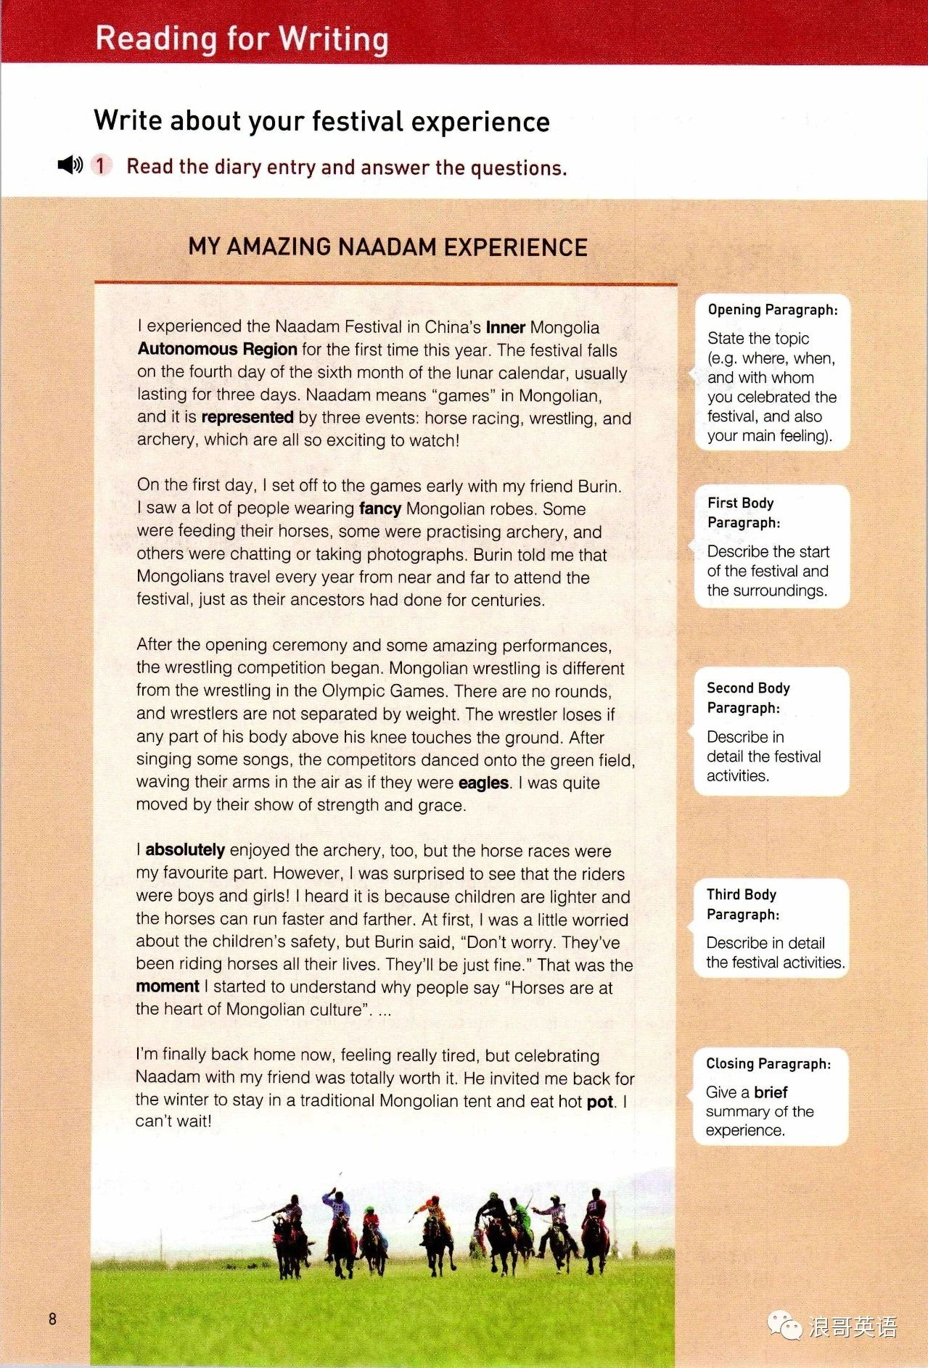
How did the writer’s feelings develop ?
Micro-writing of how you felt
excited
practice
3
amazed
When watching the ___________ performances of Chu style in the opening ceremony, I was ___________ .
moved
breath-taking
delighted
surprised
Skill
3
worried
filled with pride
relieved
tired
satisfied
eager

Slide 18
Explore diary Spot skills
do
logical: Topic sentence &Time order
see
Vivid : Scene description
logical
experience
vivid
logical
feel
Convincing: Emotion development
vivid
think
learn

Slide 19
What did the writer think of his experience?
What do you think of it ? (use some adjectives形容词 )
worthwhile
satisfying
impressive
comments
rewarding...
unforgettable...
… …

Slide 20
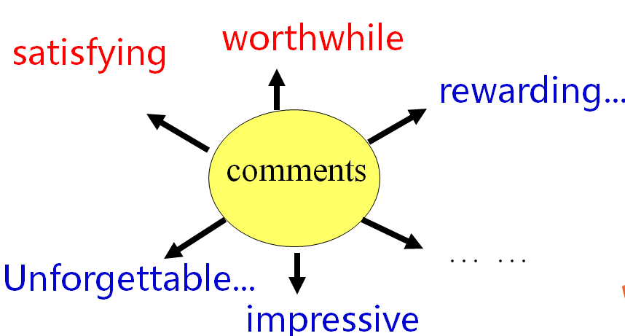
Micro-writing: Expand the topic sentence： event
+ comment
(Para.1) I experienced the Naadam Festival in China's Inner Mongolia Autonomous Region for the first time this year. The festival falls on the fourth day of the six month of the lunar calendar, usually lasting for three days. Naadam means "games" in Mongolian, and it is represented by three events: horse racing, wrestling, and archery, which are all so exciting to watch!
I will never forget the experience of celebrating the Naadam Festival in China’s Inner Mongolia Autonomous Region, because it was truly _______________________ .
impressive and rewarding

Slide 21
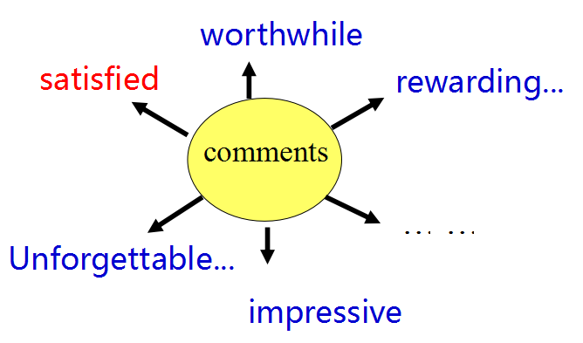
Micro-writing of improving the ending:
result
+ comment
(Ending)I’m finally back home now, feeling really tired, but celebrating Naadam with my friend was totally worth it. He invited me back for the winter to stay in a traditional Mongolian tent and eat hot pot. I can't wait!
Celebrating the festival not only __________________________,
but also made me realize ___________________________________.
filled my heart with pride
the importance of traditional festivals

Slide 22
Explore diary Spot skills
do
logical: Topic sentence &Time order
see
Vivid : Scene description
logical
experience
vivid
logical
feel
Convincing: Emotion development
vivid
Meaningful: General comments
think
learn
Inspiration /significance ?

Slide 23
ROUND 3 Write a festival
节 日 我 来 写
Notes:
MS中插入视频

Slide 24

Activity 5 Writing & presenting
Festival Ambassadors Wanted
首届楚文化节近期刚在荆州圆满举办, 请根据节日介绍与节日庆祝视频, 感受节日氛围, 以一名参加者的视角写一篇日记来介绍首届楚文化节的举办情况以及庆祝感受,并进行朗诵, 参加节日大使选拔, 欢迎踊跃参加, 当场颁发奖杯。
Notes:
MS中插入视频

Slide 25
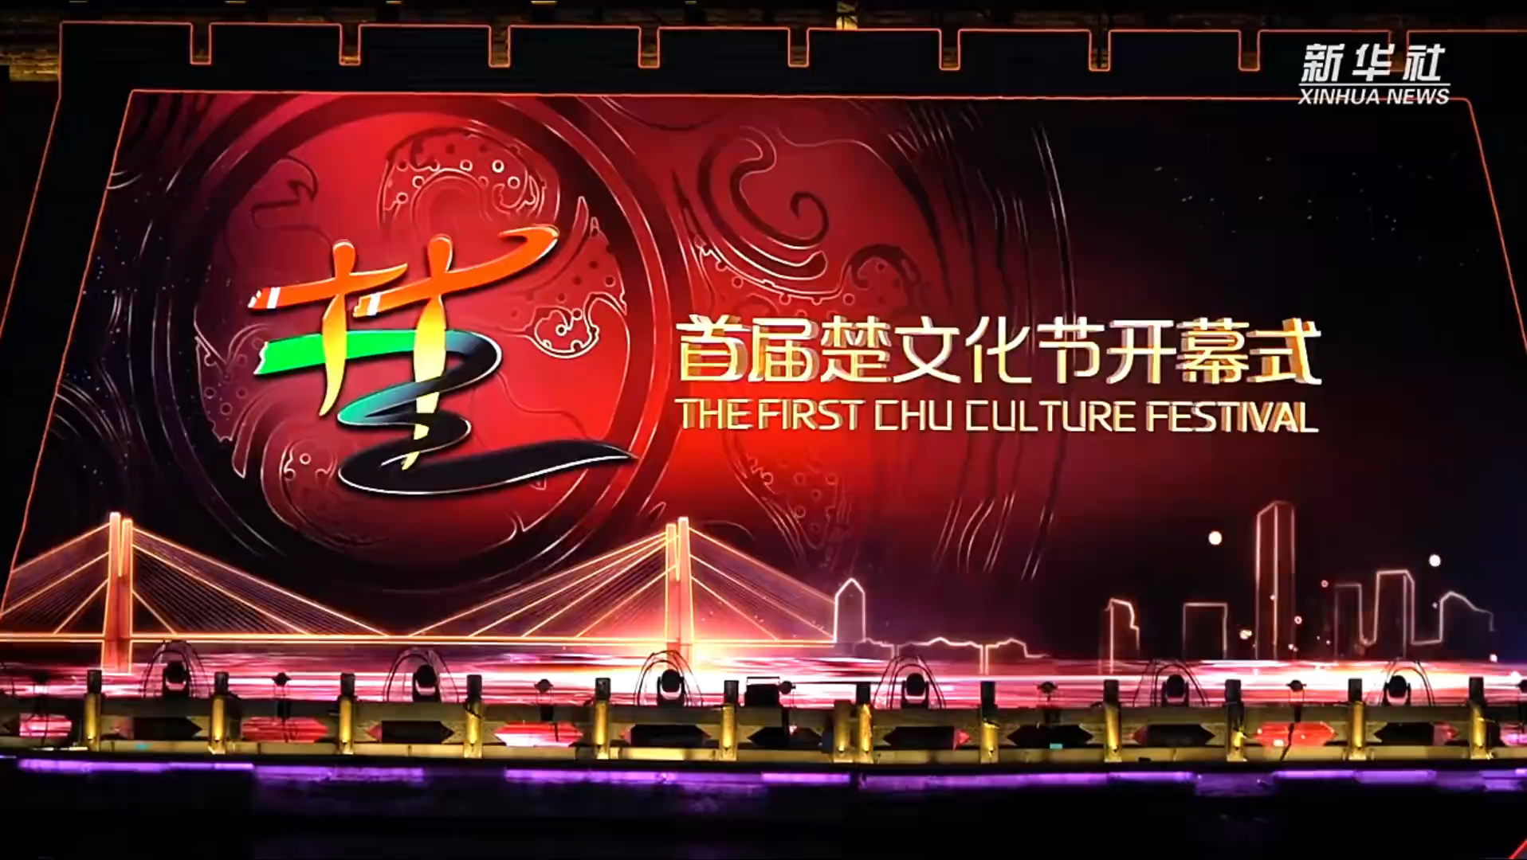

Slide 26
名称： 首届楚文化节 The First Chu Culture Festival
举办时间： 3月18日至4月9日
地点： 湖北荆州 古城东门宾阳楼护城河
（By the moat of Binyang Tower at the East Gate of the ancient city）
主要活动：
1. 楚文化节开幕式： （4月8日晚各类楚风楚韵类文艺汇演）
2. 2022中国电影大数据盛典（The ceremony of Chinese movie data）: （4月9日晚, 众多明星齐聚荆州，演员张译和吴京也上台领奖了，发表完获奖感言后，张译和吴京分别举起手放头顶，合做成了个心的形状，好像两只可爱的小兔子在给大家送祝福）
3. 游历美食街: （美食街The snack street里挤满了来自五湖四海的游客。一些在津津有味的尝美食，一些在忙于地标处拍照打卡，还有一些在兴奋地挑礼品。)
要求：
根据文字与视频介绍，写一篇日记描述你的节日体验，从而进行朗诵参选楚文化节日大使。

Slide 27
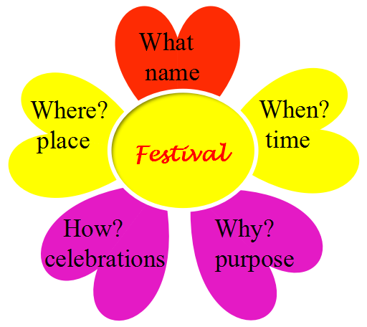

Reference
Structure
（topic sentence）
※ useful expressions
※ micro-writing practice
（materials on the paper)
Skills
(details)
descriptions
emotions
time order
descriptions
time order
emotions
Theme Comments

Slide 28
Checklist---- Assess & appreciate
 Is the writing well-organised (topic sentence+ time line)?
 Is there an opening sentence in the first paragraph?
 Does each paragraph include the necessary details?
 Does the writer describe his/her feelings and emotions?
 Does the writer use vivid language descriptions correctly in the
writing?
 Are there any grammar, spelling, or punctuation errors?
Notes:
MS中插入视频

Slide 29
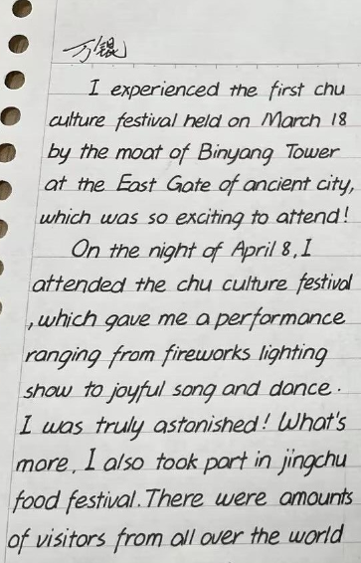
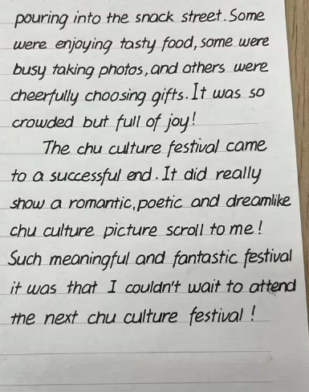
My first Chu Culture Festival Experience
A possible version

Slide 30
Award
We are all Festival Ambassadors!
Notes:
MS中插入视频

Slide 31
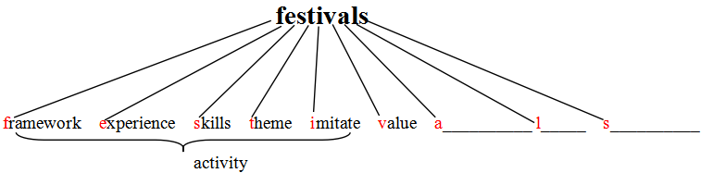
Activity 6 Summary
1. What do festivals mean? What should we learn to do?
ppreciate
pread
ove
beauty
duty
culture
Notes:
MS中插入视频

Slide 32
Homework
1.Revise the draft written in class based on the checklist.
2.Explore more information about ethnic festivals as well as Chu culture.
Notes:
MS中插入视频

Slide 33
Assessment : Learning Aims
By the end of this period, are you able to
1. enrich knowledge about festival
2. figure out the structure and language features of a festival
experience
3. write a festival experience using the structure and skills of this
passage
4. appreciate and treasure the colourful national cultures and
develop the cultural awareness
Notes:
MS中插入视频

Slide 34

Have a good day !
Thank you !

