Slide 1

感恩遇见，相互成就，本课件资料仅供您个人参考、教学使用，严禁自行在网络传播，违者依知识产权法追究法律责任。
更多教学资源请关注
公众号：溯恩高中英语
知识产权声明

Slide 2
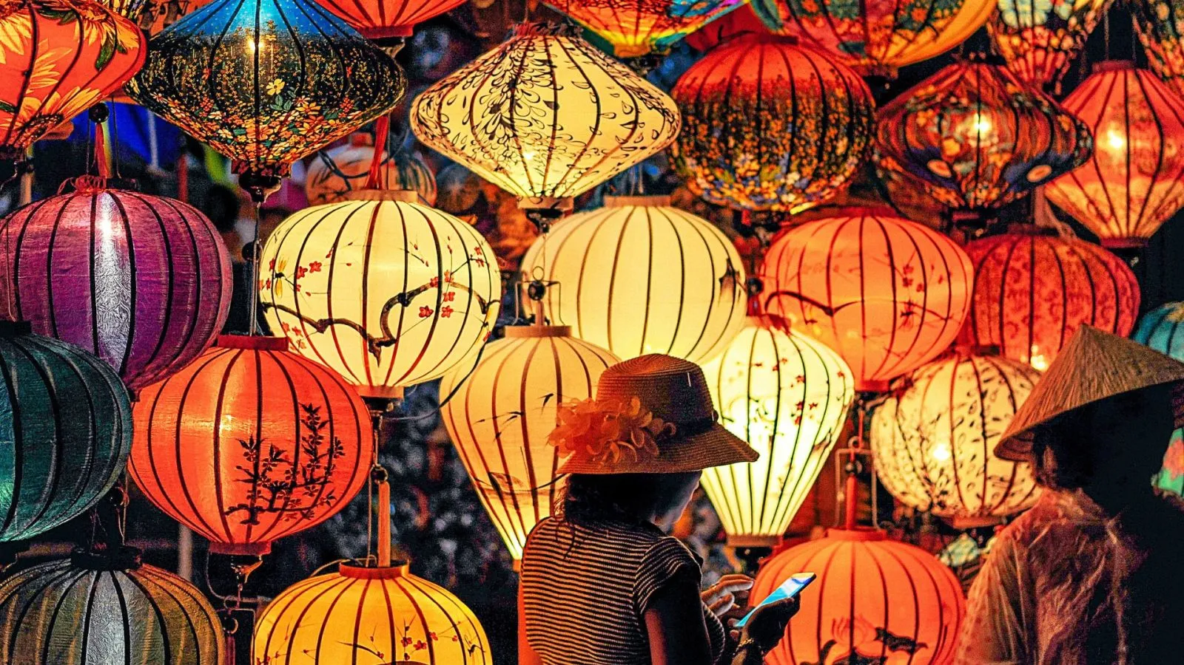
What festivals do you celebrate with your family each year?
Why do you think people celebrate different festivals?
B3U1 Reading and Thinking
WHY DO WE CELEBRATE FESTIVALS?
Notes:
talk about two pictures on the page

Slide 3
Step 1: Skimming for main ideas(2mins)
Do you know how to identify the main ideas of each paragraph?
Use topic sentence.
Where can we usually find the topic sentence?
It is often the first sentence, but sometimes it is found elsewhere in the paragraph.
Please underline the topic sentence and circle the key word(s) of each paragraph and think about the function of each paragraph.

Slide 4
 | topic sentence | key word(s) | function
Para 1 | Festivals are celebrated all around the world. | all around the world | introduction
Para 2 | Of all the traditional festivals, the harvest festival can be found in almost every culture. | harvest festival | demonstrate the common spirit of showing gratitude in festival celebration
Para 3 | Customs plays a significant role in festivals, but sometimes they can change over time. | customs can change | talk about the changes of customs
Para 4 | Festivals are becoming more and more commercial, with businesses taking advantage of the celebrations. | commercialized festivals | discuss the phenomenon of commercialised festivals
Para 5 | Festivals are an important part of society. | important | conclusion

Slide 5
Step 2: Scanning for details
Activity 1: Read Paragraph 1 and answer the following questions
different
1. What are the different origins for differert festivals?
2. What are the common spirit in all festivals around the world?
the seasons of the year, religions, famous figures, important events
same
the spirit of sharing joy, gratitude, love or peace

Slide 6
Q: What is the function of last sentence in paragraph 1?
However, no matter how different they may seem, all over the world, the spirit of sharing joy, gratitude, love, or peace is common in all festivals.
transition sentence, used for connecting paragraph 1 and paragragh 2. It suggests that although festivals are different in origins and customs, their spirits are the same.
Q:Which example does the author use to demonstrate the spirit of gratitude we share in common?
support
Of all the traditional festivals, the harvest festival can be found in almost every culture.
support
Moreover, the author uses another three examples to show that people are grateful for the years’ supply of food.

Slide 7
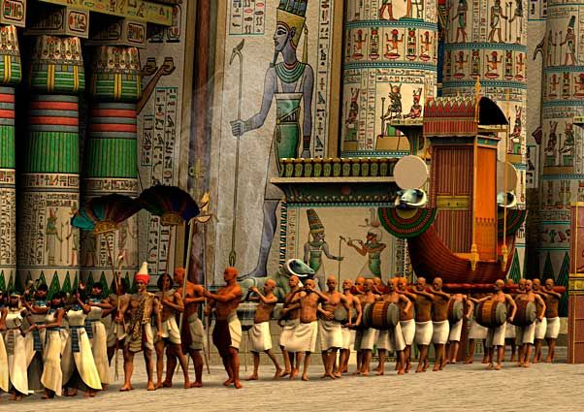
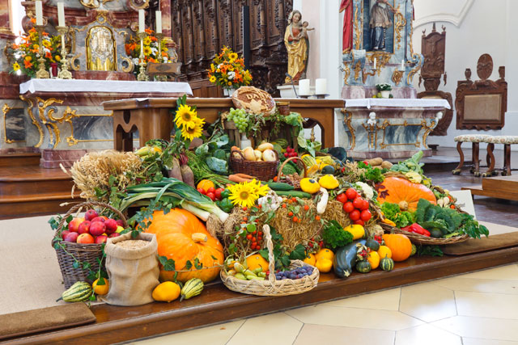
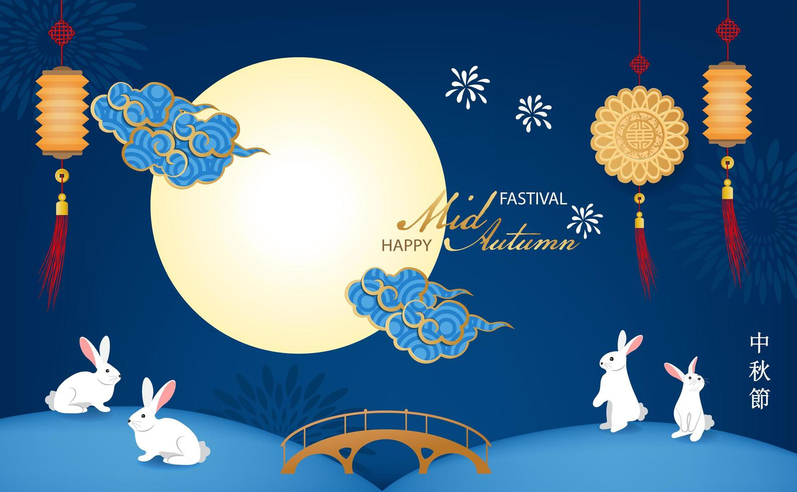
Activity 2: Read Paragraph 2 and fill in the mind map
Time: __________
Features:① ______
② __________________________
springtime
Ancient Egypt
a parade
a great feast with music, dancing and sports.
_________ festival in every culture
The harvest
Features: ①_____________________________.
② get together to ___________________.
decorate churches and town hlls
Euro
celebrate over a meal
Mid-Autumn Festival
Time: ____________________
Features: ①____________________
② _______________________.
China
admire the shining moon
enjoy delicious mooncakes
common spirit shown in agricultural festivals:
They are grateful for the year’s supply of food.

Slide 8

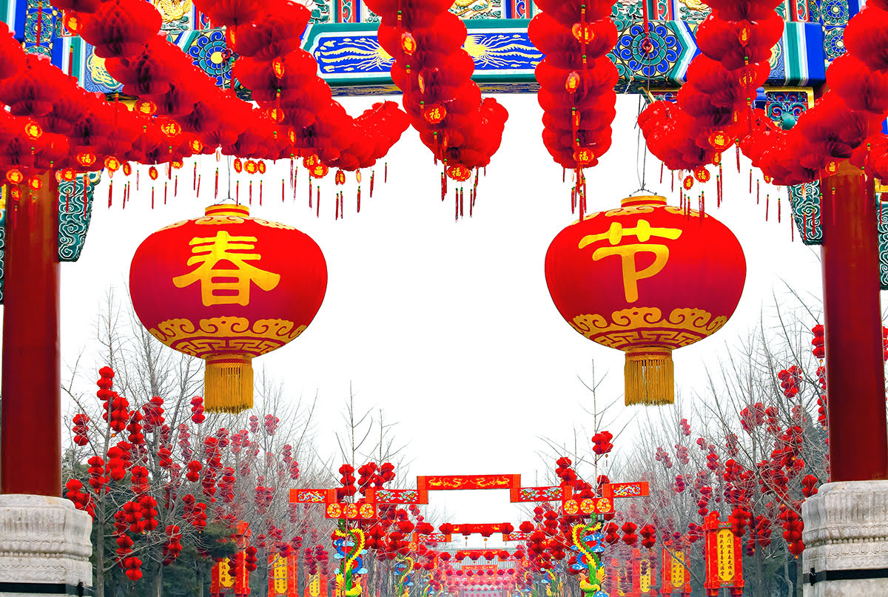
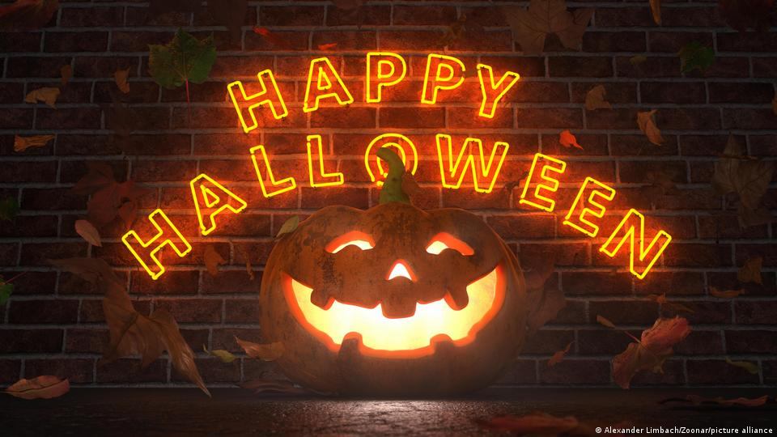
Activity 3: Read Paragraph 3, then complete the chart.
Examples
In the past
Nowadays
Why change
Lighting
firecrackers
Chinese Spring Festival
Avoid air pollution
Given up
Religious origins
A festival for children
New ideas
Halloween
Notes:
the technique of providing examples has proved that this writing is categorized as exposition.

Slide 9
Activity 4: Read Paragraph 4, then complete the chart.
The fact
 | Reasons | What might be the author’s attitude?
Although some believe festivals should not be commercialised, others believe the increase in spending is good for the economy and public happiness.
Festivals are becoming more commercial.
1. Bussiness takes advantages of the celebrations.
negative?
positive?
2. Online shopping and social media makes it easier to spend money.
Notes:
attitude towards festival commercialisation: should and shouldn’t.

Slide 10





Slide 11
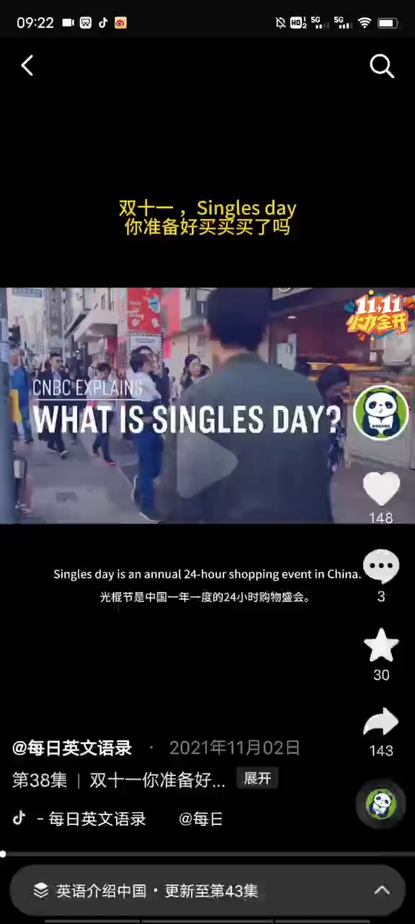
Double 11
a.k.a
Singles’ Day

Slide 12

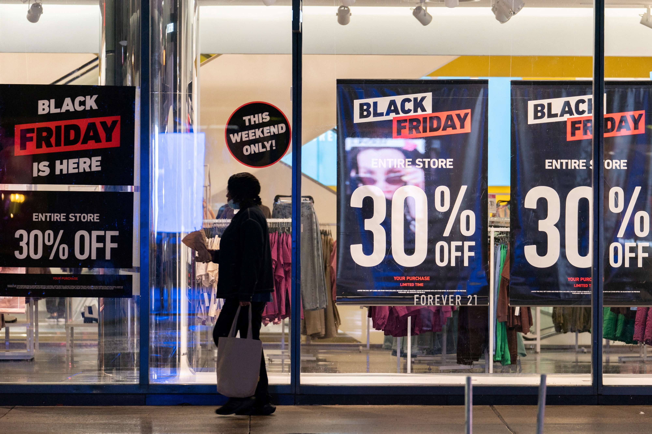
Black Friday
Question:
What’s your attitude to the commercialisation of festivals?

Slide 13

Attitude to the commercialised festivals
Group Work
Pros | Cons
promote economy | waste of resources e.g. over packaging
provide opportunies to show love and care for others | overpriced products
increase sense of happiness | environmental pollution because of excessive use of packages
... | ...

Slide 14
Activity 5: Read paragraph 5 and answer the following questions.
What type of rhetorical device is applied this paragraph?
Parallelism. They reflect.... They are occasions....They help us....
Why festivals are an important part of society?
a. They reflect people’s wishes, beliefs, faiths and attitudes towards life.
b. They are occasions that allow us to relax and enjoy life and forget about work for a while.
c. They help us understand where we came from, who we are, and what to appreciate.

Slide 15
Structure of the text
How does the writer convey the main idea in the passage?
WHY DO WE CELEBRATE FESTIVALS?
Para1. Different festivals with common spirit
Introduction
Para2.
the harvest festivals
(three Examples)
Para3.
the change of Customs
(Reasons + two Examples)
Para4.
the Commercialisation
of festivals
(Reasons + different attitudes)
Conclusion
Restate the reasons for celebrating festivals
Para 5. Different festivals with the common values

Slide 16
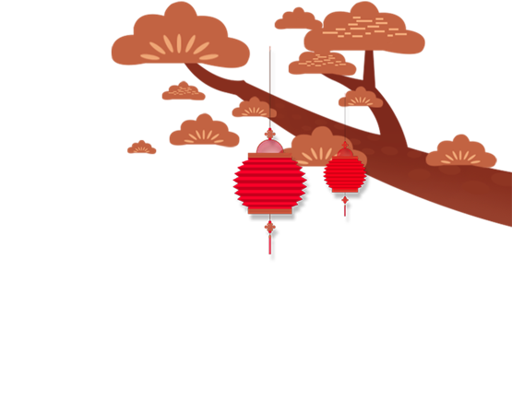

Step 3: Review and fill in the blanks
range
Today’s festivals have a wide _____ of origins, including the seasons of the year, famous _______, important events, and religions. The _______ festival is one of the most popular festivals and is celebrated in many cultures. ________ play a significant role in festivals, but they can change over time. For example, some Chinese cities no longer allow firecrackers during the Spring Festival, as they can increase air pollution.
These days, festivals are becoming more __________, with people spending more money on gifts. Festivals ______ people’s wishes, beliefs, faiths, and attitudes towards life. They are _________ to spend time with family, and to relax and enjoy life.
figures
harvest
Customs
commercial
reflect
occasions

Slide 17

Homework
Find the information that festival customs have already faded away over the time on the Internet, and then make a short speech to introduce the change, the reasons for the change, and your opinions on that.

Slide 18
one possible version
With the development of modern society, some traditional customs are fading away, one of which is burning joss paper(烧纸) in Qingming Festival. This custom is widely seen in different places in China especially those rural areas. Chinese people share this custom to commerorate and show respect to their ancestors. Though some believe it can lead to severe air pollution with a large quantity of joss paper burnt, I personally oppose banning it given its economic effect and essence of being a solid part of traditional culture.

