Slide 1

感恩遇见，相互成就，本课件资料仅供您个人参考、教学使用，严禁自行在网络传播，违者依知识产权法追究法律责任。
更多教学资源请关注
公众号：溯恩高中英语
知识产权声明

Slide 2
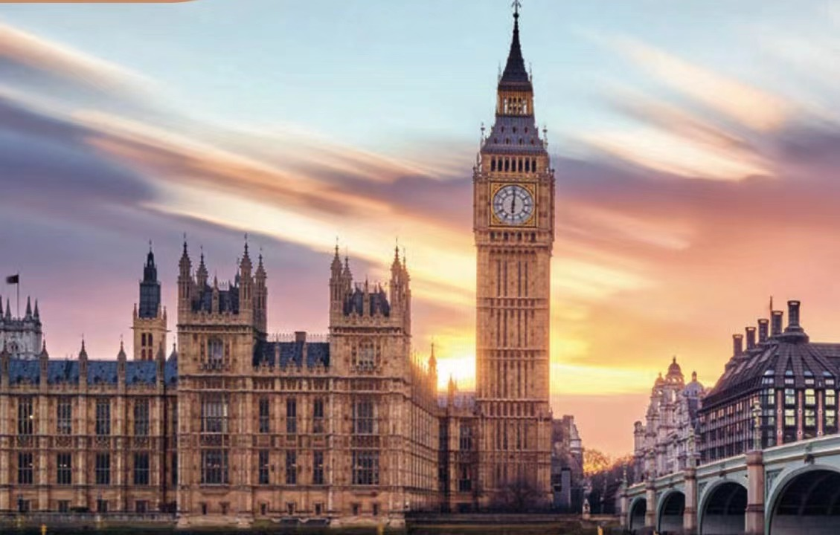
HISTORY AND TRADITIONS
Big Ben
The Palace of Westminster
浙江省淳安县汾口中学 方肖娟

Slide 3
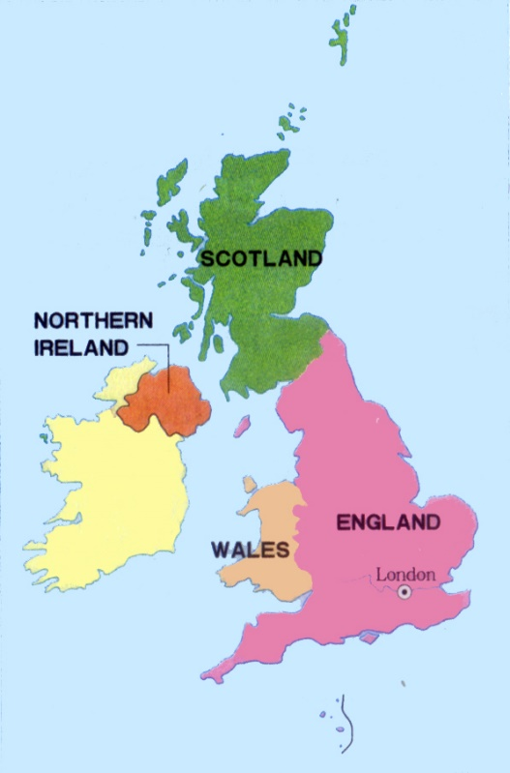
What’s in a name?
Why are there different names?
What do these different names mean?
What’s the function of the title?
the United Kingdom?
the UK?
Britain?
Great Britain?
England?
Puzzled?
Confused?

Slide 4
Q: What advice has been given in para.1?
The United Kingdom, Great Britain, Britain, England—many people are confused by what these different names mean. So what is the difference between them, if any? Getting to know a little bit about British history will help you solve this puzzle.
Predict: What will be talked about next?
Q: When it comes to history, how will the author organize the information?

Slide 5
Read Para.2 and sort out the information according to the timeline.
In the 16th century the nearby country of Wales was joined to the Kingdom of England. Later, in the 18th century the country Scotland was joined to create the Kingdom of Great Britain. In the 19th century the Kingdom of Ireland was added to create the United Kingdom of Great Britain and Ireland.Finally, in the 20th century the southern part of lreland broke away from the UK which resulted in the full name we have today:the United Kingdom of Great Britain and Northern Ireland. Most people just use the shortened name:“the United Kingdom”or the UK”. People from the UK are called “British” which means the UK is also often referred to as Britain or Great Britain.

Slide 6
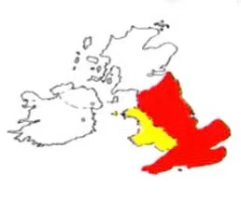


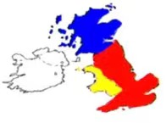

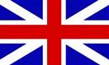
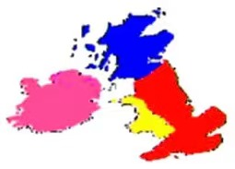




Read Para.2 and sort out the information according to the timeline.
16th century
＋
=
Wales
England
England
18th century
=
＋
Scotland
Great Britain
19th century
＋
=
Ireland
The United Kingdom of Great Britain and Ireland
20th century
－
=
Republic of Ireland
The United Kingdom of Great Britain and Northern Ireland

Slide 7

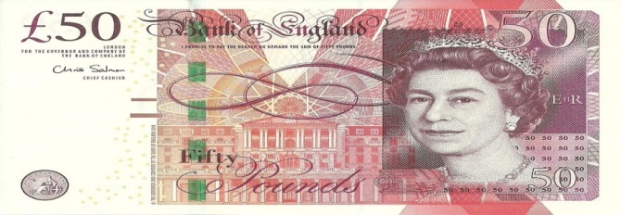

Read Para.3 and find out the relationship among 4 countries.
The four countries that belong to the United Kingdom work together in some areas.They use the same flag, known as the Union Jack, as well as share the same currency and military defence.However, they also have some differences.For example, England,Wales, Scotland, and Northern Ireland all have different education systems and legal systems.They also have their own traditions,like their own national days and national dishes. And they even have their own football teams for competitions like the World Cup!
The author supported his points by giving examples.
Q: How did the author support his points?
Q: How did the author show his points?
The author showed his points by making a contrast.
similarities
☛
education and legal systems
differences
traditions(national days and national dishes)
☛
football teams

Slide 8
Read Para.4 and sort out the information according to the timeline.
The United Kingdom has a long and interesting history to explore which can help you understand much more about the country and its traditions.Almost everywhere you go in the UK, you will be surrounded by evidence of four different groups of people who took over at different times throughout history.
Q: Who are they?
When did they take over the UK?
What evidence did they leave behind?

Slide 9
The first group, the Romans came in the first century. Some of their great achievements included building towns and roads. Next the Anglo-Saxons arrived in the fifth century.They introduced the beginnings of the English language, and changed the way people built houses.The Vikings came in the eighth century,left behind lots of new vocabulary, and also the names of many locations across the UK. The last group were the Normans.They conquered England after the well-known Battle of Hastings in the 11th century.They had castles built all around England and made changes to the legal system. The Normans were French, so many French words slowly entered into the English language.

Slide 10
When? | What happened? | What changed?
 | Romans arrived
 | Anglo-Saxons came
 | Vikings came
11th century
1st century
towns and roads were built
language was introduced
and the way of building houses
were changed
5th century
vocabulary and names of
locations were left behind
8th century
Normans conquered
England after the Battle
of Hastings
had castles built, legal system
changed and new words
from French introduced

Slide 11
The United Kingdom has a long and interesting history to explore which can help you understand much more about the country and its traditions.Almost everywhere you go in the UK, you will be surrounded by evidence of four different groups of people who took over at different times throughout history.
Q: What is the chief advantage of studying history?
Studying history will help you understand much more about the country and its traditions.

Slide 12
Para.5
Q: What is the other chief advantage of studying history?
There is so much more to learn about the interesting history and culture of the United Kingdom.Studying the history of the country will make your visit much more enjoyable.The capital city London is a great place to start as it is an ancient port city that has a history dating all the way back to Roman times.There are countless historic sites to explore ano lots of museums with ancient relics from all over the UK. The UK is a fascinating mix of history and modern culture with both new and old traditions.If you keep your eyes open you will be surprised to find that you can see both its past and its present.

Slide 13
There is so much more to learn about the interesting history and culture of the United Kingdom.Studying the history of the country will make your visit much more enjoyable.The capital city London is a great place to start as it is an ancient port city that has a history dating all the way back to Roman times.There are countless historic sites......
Q: Why is London a great place to start?
an ancient port city with a history dating back to Roman times
countless historic sites;museums with ancient relics
understand the country and its traditions

Slide 14
Reading & Further thinking
If you keep your eyes open, you will be surprised to find that you can see both its past and present.
Q: Who does the word “you” refer to?
☛
Visitors to the United Kingdom.
Q: What’s the writer’s purpose of writing this passage?
☛
To inroduce the facinating history of the UK and attract people to visit the country.

Slide 15
Thinking & Summarizing
Task 1: Draw a mind-map to summarize the structure and content of the passage.
Task2: Retell the passage according to the mindmap.

Slide 16
Thinking & Summarizing
Draw a timeline.
Para.2&3: help us understand the relationship among these names and the relationship among these four countries.
advantages
puzzle
(para.1)
history
history
Para.4: help us understand culture and traditions of the UK.
Para.5: make your visit more enjoyable.
Reflect on the significance of studying history.

Slide 17
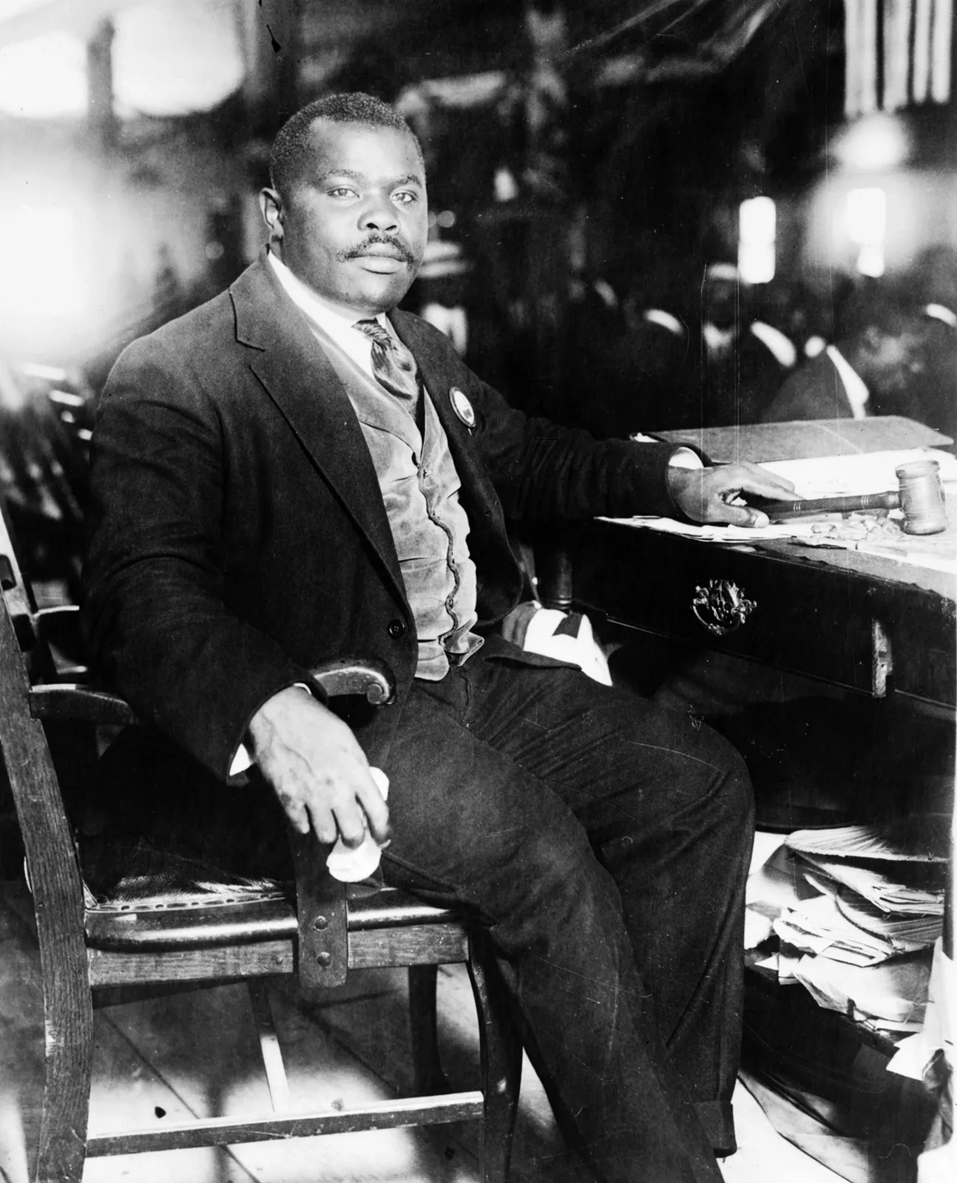
Appreciating a quote
A people without the knowledge of their past history, origin and culture is like a tree without root.
_{——Marcus Garvey}

Slide 18
Group Work
情境描述：你的朋友Henry想利用暑假来浙江旅行，请你写封Email给他，简要介绍需要做的准备工作并推荐一座城市作为主要的旅行地。
Group discussion:
Q: If you were to give Henry some suggestions on visiting Zhejiang province, what preparations should he make before coming ?
Q: Which city do you think is a great place for him to start in Zhejiang? Why?

Slide 19
Assignment
1.Retell the passage by referring to the mind-map;
2.Finish writing the email after class.
Thanks for listening!

Slide 20
Possible Version
Dear Henry,
Hearing that you are planning to visit Zhejiang province during the coming summer holiday, I am so excited and can’t wait to offer you some suggestions to make your trip more enjoyable and unforgettable.
Making good preparations before coming will make a difference. First of all, learning to read different kinds of maps will benefit you a lot during the trip. You can refer to the geographical map of Zhejiang province to have a better knowledge of its natural features. You can also refer to a tourist map of Zhejiang which will show you all the tourist attractions directly. Secondly, getting to know the history of Zhejiang will help you to have a better understanding of its culture and traditions. You can surf on the Internet to find some related information. I will send some useful introduction to you as well. Thirdly, as it’s impossible to visit all the attractions in such a short vocation, making a careful selection is quite necessary. Have you heard about the phrase “Up above there is heaven; down below there are Suzhou and Hangzhou”? As a local resident , I strongly recommend Hangzhou to you. Hangzhou is a capital city of Zhejiang province and is regarded as “ a land of fish and rice, home to silk and tea, a place of rich cultural heritage, and a paradise for tourists”.
I hope the suggestions above are of help to you. I’m sincerely looking forward to your arrival.
Yours,
Li Hua

