Slide 1

感恩遇见，相互成就，本课件资料仅供您个人参考、教学使用，严禁自行在网络传播，违者依知识产权法追究法律责任。
更多教学资源请关注
公众号：溯恩高中英语
知识产权声明

Slide 2

The World
May 1st-31st, 2023

Slide 3
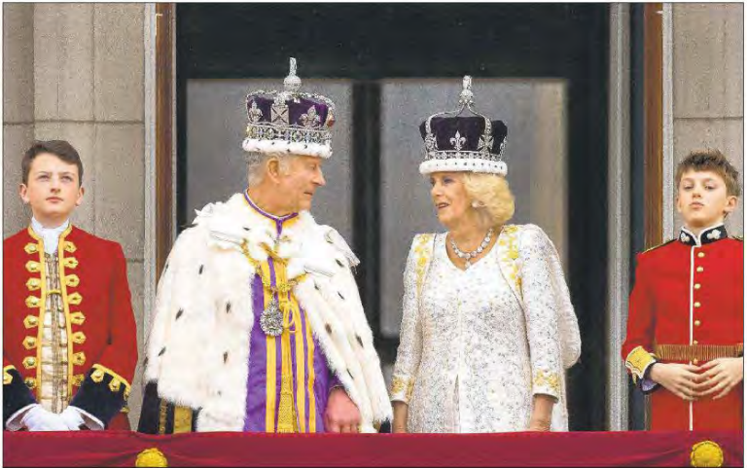
1. At long last, Charles III wears his crown
查理三世终于戴上了他的王冠

Slide 4
语篇填空
（《洛杉矶时报》2023年5月7日 A3版面）
King Charles III ___________ (crown) Saturday as Britain’s sovereign in a sumptuous, ritual-in fused display of pageantry, _______ (take) the helm of a centuries-old monarchy that has often struggled, like his homeland, to find its place in the modern world.
Chants of “God save the king!” echoed off the ornate walls of Westminster Abbey before ____ 5-pound weight of the jewel-encrusted St. Edward’s Crown, ______ is used only for coronations, was lowered onto his white haired head in the culmination of Charles’ seven-decade-long journey to the throne.
Britain pulled out all the ___________ (ceremony) stops for its first royal coronation since Charles’ late mother, Elizabeth II, ________ (formal) assumed the throne in 1953. Before some 2,300 _______ (invite) VIPs at Westminster Abbey — and an audience of millions worldwide — Charles and his wife, Camilla, enacted the arcane centuries-old rites of coronation.
Despite the traditional display of homage to the king as Charles symbolically received a variety of sacred _______ (object) — orb and scepter, ring and vestments — the ceremony’s carefully choreographed language was designed ________ (evoke) a note of humility.“I come not to be served, ____ to serve,” he declared to the gathered assemblage.
was crowned
taking
the
which
ceremonial
formally
invited
objects
to evoke
but

Slide 5
词汇讲解
1. sumptuous: very expensive and looking very impressive 华贵的；豪华的；
He lay down upon a sumptuous divan, and proceeded to instruct himself with honest zeal.
他躺在一张豪华的长沙发上，开始全神贯注地研习礼节。
2. evoke: to bring a feeling, a memory or an image into your mind 引起，唤起（感情、记忆或形象）
The music evoked memories of her youth.
这乐曲勾起了她对青年时代的回忆。
翻译句子
我们在富丽堂皇的环境中用餐。
We dined in sumptuous surroundings.
翻译句子
他的情况不大可能引起公众的同情。
His case is unlikely to evoke public sympathy.

Slide 6
句子翻译
King Charles III was crowned Saturday as Britain’s sovereign in a sumptuous, ritual-infused display of pageantry, taking the helm of a centuries-old monarchy that has often struggled, like his homeland, to find its place in the modern world.
周六，英国国王查尔斯三世在一场盛大的奢华仪式中加冕为英国君主，正式执掌一个有着数百年历史的君主制国家。像他的祖国一样，常常艰难地在现代世界中找到自己的位置。
翻译
Chants of “God save the king!” echoed off the ornate walls of Westminster Abbey before the 5-pound weight of the jewel-encrusted St. Edward’s Crown, which is used only for coronations, was lowered onto his whitehaired head in the culmination of Charles’ seven-decade-long journey to the throne.
翻译
“上帝保佑国王!”在威斯敏斯特教堂华丽的墙壁上回响着，5磅重的圣爱德华王冠(仅用于加冕典礼)被戴在他白发苍苍的头上，标志着查尔斯70年的王位之旅达到了顶峰。

Slide 7
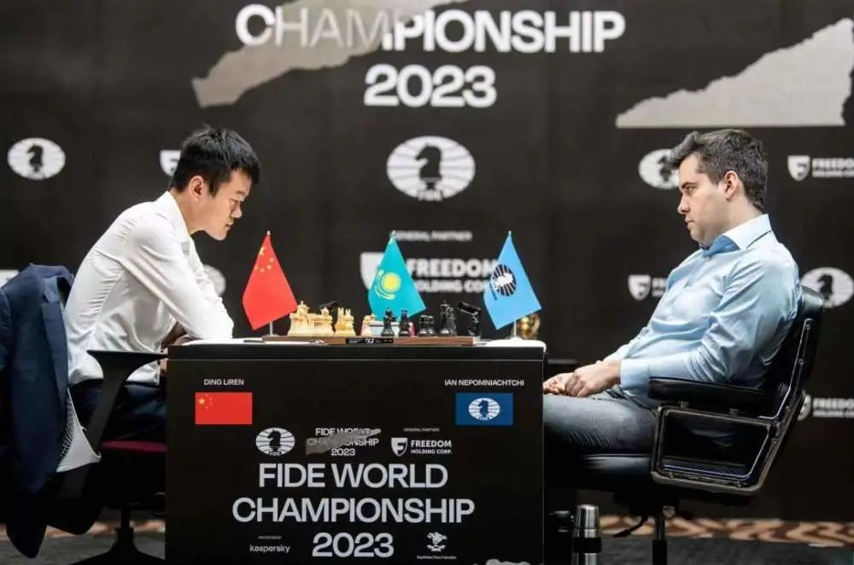
2. Beijing acclaims its first male chess champion
丁立人勇夺国际象棋男子个人世界冠军

Slide 8
语篇填空
（《泰晤士报》2023年5月2日 28页）
China has its first male chess world champion after Ding Liren claimed the title by —________ (beat) Ian Nepomniachtchi, the Russian grandmaster.
An emotional Ding, 30, from Wenzhou — known ___ “the city of chess” —promised _______ (shed) tears after his victory in Astana, Kazakhstan. He succeeded Magnus Carlsen of Norway, the five times champion who __________(choose) not to defend his title.“____ moment Ian resigned the game was a very emotional moment. I couldn’t control my feelings.” The Chinese government praised Ding for “winning glory for the motherland”.
Ding secured victory in a play-off. He and Nepomniachtchi, a critic of the war in Ukraine ____ played under a neutral flag, finished on seven points each after the 14 first-stage games. Each won three _____ the others ended in a draw. For the tiebreak, the contenders had only 25 minutes to make their moves, plus an __________ (addition) ten seconds for each move played.
A €2 million (£1.8 million) prize will be split 55-45 between the _______ (finalist). Carlsen will remain the world’s top rated player. China ____________ (dominate) women’s chess and the current world champion is Ju Wenjun from Shanghai.
beating
as
to shed
had chosen
The
who
while
additional
finalists
has dominated

Slide 9
词汇讲解
1. shed: to let sth fall; to drop sth. 使落下；使掉下
Luke shed his clothes onto the floor.
卢克把衣服脱在地板上。
2. split: to divide, or to make sth divide, into two or more parts 分开，使分开（成为几个部分）
She split the class into groups of four.
她按四人一组把全班分成若干小组。
翻译句子
他们的血没有白流。
Their blood was not shed in vain.
翻译句子
结果恰巧分成两类。
The results split neatly into two groups.

Slide 10
句子翻译
An emotional Ding, 30, from Wenzhou — known as “the city of chess” —promised to shed tears after his victory in Astana, Kazakhstan.
30岁的小丁来自被称为“国际象棋之都”的温州，在哈萨克斯坦阿斯塔纳获胜后，他激动地流下了眼泪。
翻译
For the tiebreak, the contenders had only 25 minutes to make their moves, plus an additional ten seconds for each move played.
在决胜局中，参赛者只有25分钟的时间来走棋，且每一步棋最多只有10秒。
翻译

Slide 11
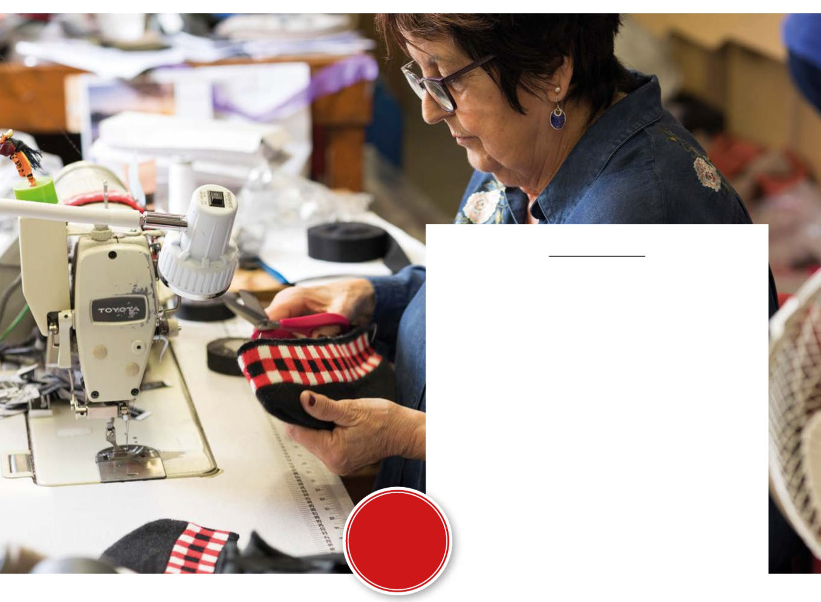
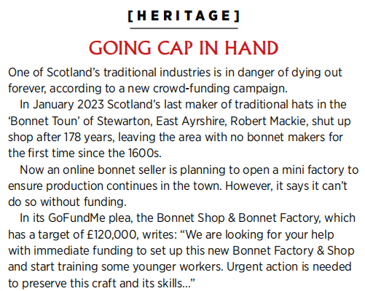
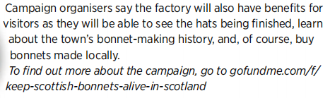
3.GOING CAP IN HAND
拯救苏格兰手工帽

Slide 12

语篇填空
（《苏格兰》2023年5月刊 8页）
industries
One of Scotland’s traditional _________ (industry) is in danger of dying out forever, according to ___ new crowd-funding campaign.
In January 2023 Scotland’s last maker of traditional hats in the ‘Bonnet Toun’ of Stewarton, East Ayrshire, Robert Mackie, shut up shop after 178 years, _______ (leave) the area with no bonnet makers ____ the first time since the 1600s.
Now an online bonnet seller __________ (plan) to open a mini factory to ensure production continues in the town. However, it says it can’t do so _______ funding.
In its GoFundMe plea, the Bonnet Shop & Bonnet Factory, ______ has a target of E120,000, writes:“We are looking for your help with immediate funding to set up this new Bonnet Factory & Shop and start training some ________ workers. Urgent action is needed __________ (preserve) this craft and its skills...”
Campaign organisers say the factory will also have benefits for visitors as they will be able to see the hats being finished, learn about the town’s bonnet-making history, and, of course, buy 3 bonnets made _______ (local).
a
leaving
for
is planning
without
which
younger
to preserve
locally

Slide 13
词汇讲解
1. campaign: a planned group of especially political, business, or military activities that are intended to achieve a particular aim (有计划的) 活动; 运动
During his election campaign he promised to put the economy back on its feet. 竞选活动期间，他许诺要致力于恢复经济。
2. plea: an urgent emotional request 请求；恳求
She made an impassioned plea for help. 她恳切地求助。
翻译句子
他停止了对我们运动的支持。
He withdrew his support for our campaign.
翻译句子
他对她声泪俱下的恳求置之不理。
He refused to listen to her tearful pleas.

Slide 14
句子翻译
Now an online bonnet seller is planning to open a mini factory to ensure production continues in the town. However, it says it can’t do so without funding.
现在，一家在线的帽子卖家正计划开设一家迷你工厂，以确保该镇的生产继续进行。然而，该公司表示，没有资金就无法做到这一点。
翻译
Campaign organisers say the factory will also have benefits for visitors as they will be able to see the hats being finished, learn about the town’s bonnet-making history, and, of course, buy 3 bonnets made locally.
活动组织者表示，工厂也会给游客带来好处，因为他们可以看到帽子的制作过程，了解该镇的帽子制作历史，当然，还可以购买3顶当地生产的帽子。
翻译

Slide 15
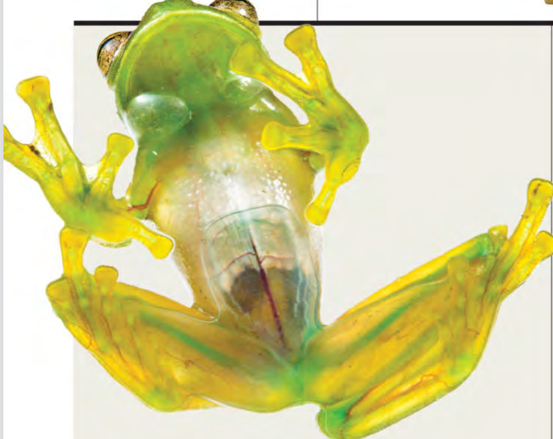
4. Disappearing Act 玻璃蛙的隐身术

Slide 16
语篇填空
（《国家地理》2023年5月刊 BREAKTHROUGHS版面）
With translucent skin and muscles, the glass frogs of Central and South America blend in with the green ______ (leaf) they rest on during the day. ____ the camouflage is even more complicated than scientists _______ (realize), a study published in Science reveals. When Fleischmann’s glass frogs (Hyalinobatrachium fleischmanni) sleep, they store up to 89 percent of their ______ (dark) colored red blood cells within crystal-covered livers. The crystals seem to act ___ a mirror, reflecting incoming light rather than allowing blood cells to absorb it. With their red blood cells ______ (store) away, the sleeping frogs become two to three times more transparent than the wakeful ones, by the study’s measurements. Particularly _________ (intrigue): The H. fleischmanni frogs seem to suffer no ill effects from hours with those cells in one place—and still clot normally when wounded. Perhaps this could hold clues to _____ has been a holy grail of hematology: treatment that prevents excessive bleeding and excessive clotting in humans. “Blood clots kill around one in four people,” says Jesse Delia, __ National Geographic Explorer and study co-author. What if the secret to ______ (save) them is hiding inside a glass frog’s discoball-like liver?
leaves
But
realized
darkly
as
stored
intriguing
what
a
saving

Slide 17
词汇讲解
1. blend in: (with sth/sb) If something blends into the background, it is so similar to the background that it is difficult to see or hear it separately. 与…融为一体
The toad had changed its colour to blend in with its new environment.
蟾蜍已经变色，和新的环境融为一体。
2. holy grail: If you describe something as a grail or a holy grail, you mean that someone is trying very hard to obtain or achieve it 努力追求的目标
The discovery is being hailed as the holy grail of astronomy.
这一发现圆了天文学界的一个梦想。
翻译句子
小偷很快混入人群逃跑了。
The thief soon blended in with the crowd and got away.
翻译句子
这是任何有全球野心的电话公司努力追求的目标。
That is the holy grail for any telephone company with global ambitions.

Slide 18
句子翻译
With translucent skin and muscles, the glass frogs of Central and South America blend in with the green leaves they rest on during the day. But the camouflage is even more complicated than scientists realized, a study published in Science reveals.
中南美洲的玻璃蛙拥有半透明的皮肤和肌肉，与它们白天栖息的绿叶融为一体。但《科学》杂志上发表的一项研究显示，这种伪装比科学家们意识到的要复杂得多。
翻译
The crystals seem to act as a mirror, reflecting incoming light rather than allowing blood cells to absorb it. With their red blood cells stored away, the sleeping frogs become two to three times more transparent than the wakeful ones, by the study’s measurements.
翻译
这些晶体似乎就像一面镜子，反射入射光，而不是让血细胞吸收。根据该研究的测量，由于红细胞被储存起来，睡觉的青蛙比醒着的青蛙透明两到三倍。

Slide 19
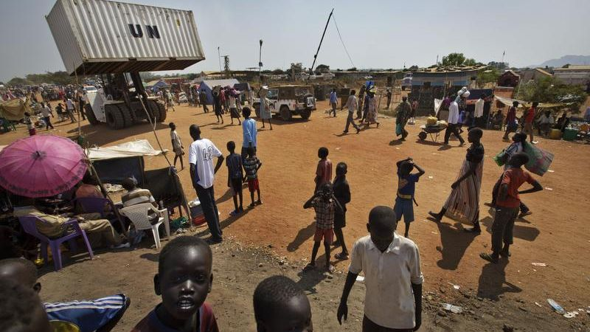
5. Sudan agrees to stop fighting for a week
苏丹同意停火一周

Slide 20
语篇填空
（《青少年周刊》2023年5月27日刊 3页）
The rival sides in Sudan’s civil war (a confict between people ______ (live) in the same country) have agreed to a seven-day ceasefire (an agreement to stop fighting for a certain period). The aim of the ceasefire is to allow aid ___________ (organise) to help people not _________ (involve) in the fighting and restore hospitals and services like electricity and running water. It is too dangerous to do this when there is fighting.
The US and Saudi Arabia arranged the ceasefire, and __________ (announce) that it would start on 22 May and last for a week. Several attempts to stop the fighting have failed. ________, the US and Saudi Arabia will watch the ceasefire ______ (close) to try to make sure that fighting really does stop as planned. If it is _________ (success), the ceasefire could be extended. Antony Blinken, ___ important politician in the US government, encouraged “both sides to uphold this agreement-the eyes of the world are watching”.
Sudan’s army, which runs the country, is fighting against an organisation called the Rapid Support Forces, ______ wants to take over. The fighting started a month ago. Hundreds of people ______________ (kill) and a million have been forced to leave their homes.
living
organisations
involved
announced
However
closely
successful
an
which
have been killed

Slide 21
词汇讲解
1. rival: a person, company, or thing that competes with another in sport, business, etc. 竞争对手
The two teams have always been rivals. 这两个队一直是竞争对手。
2. uphold: to support sth that you think is right and make sure that it continues to exist 支持，维护（正义等）
It is the responsibility of every government to uphold certain basic principles.
每个政府都有责任维护某些基本原则。
翻译句子
日本人是我们最大的经济竞争对手。
The Japanese are our biggest economic rivals.
翻译句子
我们的政策一直是维护法律。
Our policy has been to uphold the law.

Slide 22
句子翻译
The aim of the ceasefire is to allow aid organisations to help people not involved in the fighting and restore hospitals and services like electricity and running water. It is too dangerous to do this when there is fighting.
停火的目的是允许援助组织帮助没有参与战斗的人，恢复医院和电力、自来水等服务。打仗的时候这样做太危险了。
翻译
Several attempts to stop the fighting have failed. However, the US and Saudi Arabia will watch the ceasefire closely to try to make sure that fighting really does stop as planned. If it is successful, the ceasefire could be extended.
几次停止战斗的尝试都失败了。然而，美国和沙特阿拉伯将密切关注停火协议，以确保战斗真的按计划停止。如果成功，停火可能会延长。
翻译

Slide 23
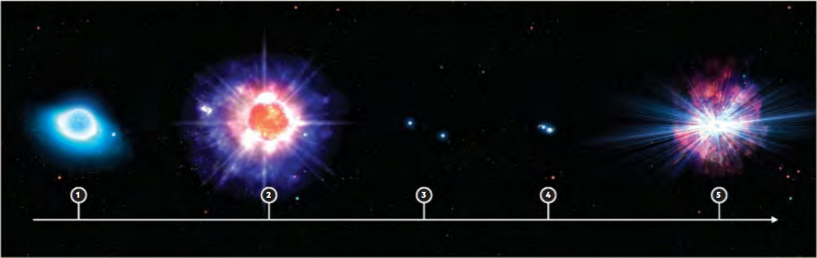
6. Countdown to a Kilonova
千新星

Slide 24
语篇填空
（《国家地理》2023年6月刊 BREAKTHROUGHS版面）
Most of the elements that fill up the universe (and our periodic table) come from extreme cosmic explosions. One such kablooey, the “kilonova,” yields many of the ________ (element) heavier than iron, including much of the universe’s gold. __________ (trigger) a kilonova, though, takes a specific scenario: the ________ (collide) of two neutron stars, the ultradense leftovers from stars that died in supernovae. What are these collisions’ origin stories?
In a first, ___ study in the journal Nature has shown that a star system within the Milky Way is doomed ______ (end) in a kilonova. The system, _______ (know) as CPD-29 2176, is 11,000 light-years from us in the Milky Way’s outskirts. It _______ (consist) of a neutron star with a circular 60-day orbit around a hot, spinning star 18 times more massive than our sun. Astronomers estimate that only 10 such systems are in our galaxy right now—making CPD-29 2176 a one-in-10 billion find.
Over the next few million years or so, the gravity of the system’s neutron star will strip off and eject much of ____ (it) partner star’s mass. The partner will then die in a supernova, ____ its remnants will form a second neutron star. Over another billion years, the two neutron stars will spiral into each other until they merge and trigger a kilonova. This galactic fireworks display will create its own confetti: a sprinkling of ______ (new) formed heavy elements.
elements
Triggering
collision
a
to end
known
consists
its
and
newly

Slide 25
词汇讲解
1. scenario: a description of how things might happen in the future 设想；方案；预测
The worst-case scenario is an aircraft will crash if a bird destroys an engine.
如果小鸟毁坏了一部发动机，最坏的情形是飞机坠毁。
2. eject: to force sb to leave a place 驱逐；逐出；赶出
This safety invention will eject the pilot from a burning plane.
这个安全装置会把飞行员从燃烧着的飞机中弹出。
翻译句子
最坏的情况可能是工厂关闭。
The worst-case scenario would be for the factory to be closed down.
翻译句子
警察将一些暴力抗议者赶出了会议厅。
Police ejected a number of violent protesters from the hall.

Slide 26
句子翻译
Triggering a kilonova, though, takes a specific scenario: the collision of two neutron stars, the ultradense leftovers from stars that died in supernovae.
翻译
然而，触发千新星需要一个特定的场景:两颗中子星的碰撞，中子星是在超新星中死亡的恒星的超密集残留物。
It consists of a neutron star with a circular 60-day orbit around a hot, spinning star 18 times more massive than our sun.
翻译
它由一颗中子星组成，它绕着一颗比太阳大18倍的热旋转恒星运行60天的圆形轨道。

Slide 27

7. BBC News 05/11/2023

Slide 28

听力填空
Tens of thousands of people have joined a ______ in the Serbian capital Belgrade after two mass shootings in the country last week. Thousands more rallied in the city of Novi Sad. The demonstrators demanded the __________ of top officials. They also ________ television stations and newspapers they accuse of promoting violent content to be shut down.
London’s Metropolitan police forces said it ______ that six anti-monarchy campaigners were unable to protest at the coronation of King Charles on Saturday after they were arrested. Officers _______ suspected the members of the Republic campaign group intended to ______ events by locking themselves onto fixed objects. That’s now an offense under new legislation that _____________ last week. The Met said there was no proof of this and confirmed no charges would be brought against the six.
Earlier, the prime minister Rishi Sunak _______ the way the Metropolitan police had handled protesters. “The police are operationally independent of government. They’ll make these decisions based on what they think is best. And actually, I’m _______ to the police and everyone who played a part in ensuring that this weekend has gone so well, so successfully and so safely. That was an ___________ effort by so many people. And I’m grateful to them for all their hard work.”
protest
resignation
called for
regrets
initially
disrupt
came into force
praised
grateful
extraordinary

Slide 29
词汇讲解
1. rally: When people rally to something or when something rallies them, they unite to support it. 一致支持；团结起来
His supporters have rallied to his defence.
他的拥护者团结起来为他辩护。
2. coronation: the ceremony at which a king or queen is crowned 加冕典礼
the coronation of Her Majesty Queen Elizabeth II
女王伊丽莎白二世陛下的加冕典礼
翻译句子
他把自己的拥护者召集起来准备斗争。
He rallied his own supporters for a fight.
翻译句子
加冕典礼从早上11点开始。
The coronation ceremony began at 11 a.m.

Slide 30
句子翻译
The demonstrators demanded the resignation of top officials. They also called for television stations and newspapers they accuse of promoting violent content to be shut down.
翻译
示威者要求高级官员辞职。他们还呼吁关闭电视台和报纸，他们指责这些电视台和报纸宣扬暴力内容。
London’s Metropolitan police forces said it regrets that six anti-monarchy campaigners were unable to protest at the coronation of King Charles on Saturday after they were arrested. Officers initially suspected the members of the Republic campaign group intended to disrupt events by locking themselves onto fixed objects.
翻译
6名反君主制活动人士被捕后，无法在周六查尔斯国王的加冕典礼上抗议，伦敦大都会警察局对此表示遗憾。警察最初怀疑共和国竞选小组的成员试图通过将自己锁在固定物体上来破坏活动。

