Slide 1

感恩遇见，相互成就，本课件资料仅供您个人参考、教学使用，严禁自行在网络传播，违者依知识产权法追究法律责任。
更多教学资源请关注
公众号：溯恩高中英语
知识产权声明

Slide 2
Infinitives(to do…) as the attribute and the adverbial

Slide 3
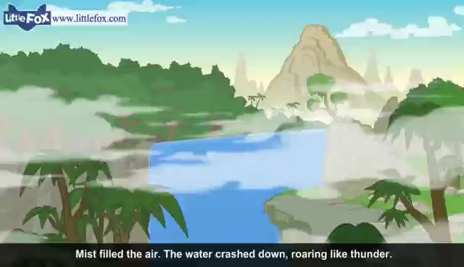
Enjoy a video from the Journey to the West

Slide 4
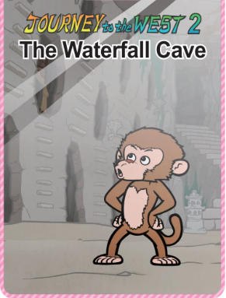
The functions of the Infinitives
To find out what’s behind the waterfall was all monkeys’ idea. Only Wu Kong decided to take a risk, so he took a deep breath and leaped into the waterfall. Wu Kong was seen to leap into the waterfall without hesitation. Because Wu Kong was the first one to go into the waterfall, he was elected to be the King. However, his dream is to learn something from sages. To find a sage, he built a raft and took a journey.
subject 主语
object 宾语
object complement宾语补足语
attribute 定语
predicative 表语
adverbial状语

Slide 5
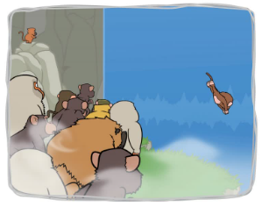
What is “to do” as the attribute?
Wu Kong was a brave and smart monkey.
Wu Kong was the only one who stood out.
Wu Kong was the only one to stand out.
Structure: 名词/代词+ to do

Slide 6
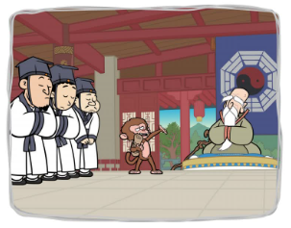
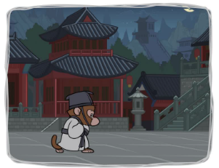
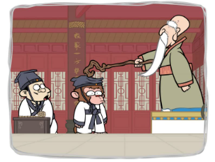
Monkey said ,” I have something to say. I want to be your student, Master.”
当修辞词为something, anything, nothing 等不定代词时，用to do 做后置定语。
Wu Kong was the first student to come and the last one to leave.
当被修辞词前有序数词或者形容词最高级时，用to do 做后置定语。
Wu Kong was the only student to be knocked by Master.
当被修辞词前有 the only, the next, the very, the last时，用to do 做后置定语。

Slide 7
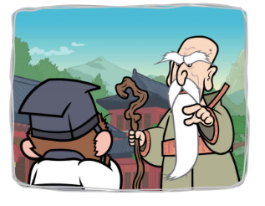
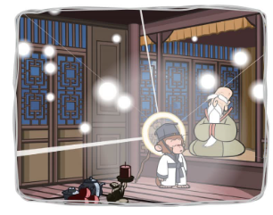
Master asked Wu Kong to go to his room this evening and said “The matter to be discussed this night is very important.”
当表示尚未发生的动作是，通常用to do做后置定语。
Wu Kong realized his dream to live forever.
当被修辞词是一些抽象名词如：ability, ambition, attempt, chance, courage, desire, decision, effort, promise, right, wish时，用to do 做后置定语。

Slide 8
Infinitives as the attribute
口诀：
代高序
四姐妹
（the very, the only, the next, the last）
抽象名词
(ability, ambition, attempt, chance, courage, desire, decision, effort, promise, right(权力), wish)
未完成

Slide 9
Exercise：
to go
1.Women and children were the first ________ (go) into the lifeboats.
2. The ability ___________ (express) an idea is as important as the idea itself.
3. The astronaut has something important ____________ (say).
4. The airport _______________ (complete) next year will help promote tourism in this area．
5. The best way __________(improve) your English is to join an English club．
6. Carol was happy that she had the chance ___________
(experience) the life in the city．
7. He would be the only one _________(have)no costume as he stood in front of the room.
to express
to say
to be completed
to improve
to experience
to have

Slide 10
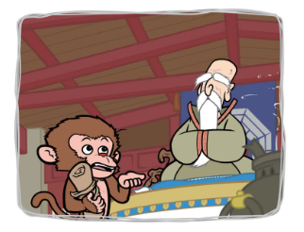
What is to do as the adverbial?
Wu Kong decided to study with a sage so that he could realize his dream.
To realize his dream, Wu Kong decided to study with a sage.
Structure: to do sth, 句子.
句子 to do sth .

Slide 11
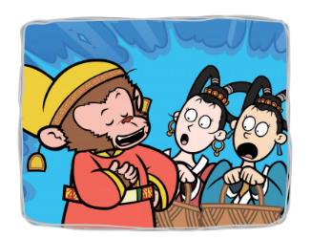
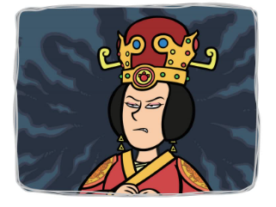
The maids were shocked to learn that Wu Kong ate every single peach.
sb be adj（情感类 happy/sad/excited…） to do 结构中，to do 做原因状语
The queen was too angry to contain his rage and then asked people to arrest Wu Kong.
too….to…; enough to …; so/such…as to…;结构中，to do 做结果状语

Slide 12
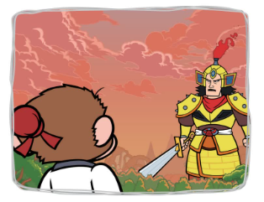
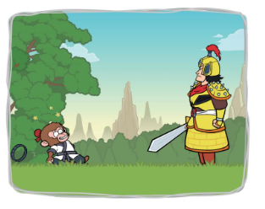
To arrest Wu Kong , Emperor appointed Erlang to fight with Wu Kong.
to do sth置于句首或句末做目的状语。
Wu Kong tried his utmost to defend, only to be caught by Erlang.
only to do sth 表意料之外的结果的发生。

Slide 13
Infinitives as the adverbial
目的状语：
结果状语：
原因状语：
to do sth
only to do sth （出人意料的结果）
too….to…;
enough to …;
so/such…as to…
sb be adj（情感类） to do

Slide 14
Exercise
He went back home, only ___________(find) his house had been broken into.
___________ (pass) the college entrance exam, we must work hard.
The Californian ship arrived too late _____________（save） more people．
The boy is old enough _____________（take） care of himself．
She is so proud as _____________（ look） down upon others．
I’m disappointed ____________（hear）that you lack the patience.
to find
To pass
to save
to take
to look
to hear

Slide 15
难点一:to do sth &doing &done 作状语的区别
_____________（give）more time, he’ll finish the task on time.
___________（give）him more time, I found it possible for him to finish the task on time.
_____________（give）him more time, I had to apply to the boss for it.
Given
Giving
To give
当非谓语与主语是主动关系时 用doing
当非谓语与主语是被动关系时用 done
当非谓语是主句的谓语动词动作的目的时 用 to do

Slide 16
难点二:to do sth &doing &done 作定语的区别
visiting
Today, there are many people ________(visit) the park every day.
Tomorrow, there are many people ________(visit) the park.
There were many activities_________(arrange) by Student Union.
to visit
arranged
当非谓语与被修饰词是主动关系时 用doing
当非谓语与被修饰词是被动关系时用 done
当非谓语 表示尚未发生的事情时用 to do

Slide 17
1. The first pill __________(design) to treat Covid-19 has been approved by the UK medicine department. （2021-2022 第一学期 高一）
2. During the spring festival, people will wander along the streets _________(decorate) with red lanterns .(2021-2022第二学期 高一)
3. _________ (form) by some teenagers, the band is quite popular among students .（2022-2023 第一学期 高一）
4. China launched Shenzhou-14 in 2022, __________ (send) 3 astronauts to space.（2022-2023第一学期 高二）
5. We are quite satisfied with the activities _________ (arrange) by the travel agency. （2019-2020 第一学期 高二）
6. He lifted a rock with all his strength, only _________ (drop) it on his own feet. （2019-2020 第一学期 高二）
7. Dongguan, a city ________(locate)in the greater Bay Area, is a rising star in hi-tech industry. （2021-2022第一学期 高二）
designed
decorated
Formed
sending
arranged
to drop
located

Slide 18
1. In 2012, Liu Yang became china’s first female astronaut who travelled into space.(用不定式改写)
In 2012, Liu Yang became china’s first female astronaut ___ ____ ____ astronaut space.(2021-2022第二学期 高一)
2. The project which will be conducted next year is meeting with argument.(用不定式改写)
The project ______ ______ ______ next year is meeting with argument .(2020-2021第二学期 高一)
3. Fred decided to settle in Beijing because he was strongly attracted to its culture. (用分词改写)
Strongly _________ ______ its culture, Fred decided to settle in Beijing. （2022-2023 第一学期 高一）
to travel into
to be conducted
attracted to

Slide 19
1.Picking up her “Lifetime Achievement” award, proud Irene declared she had no plans ______ (retire) from her 36-year-old business. (2019·全国II卷)
2.Eric woke up a little later when he heard children playing outside. He pushed a chair onto the balcony, and climbed up ________ (see) them. (2022新高考全国Ⅱ卷)
3.A visually-challenged man from Beijing recently hiked (徒步) 40 days to Xi’an, as a first step ______________ (journey) the Belt and Road route (一带一路路线) by foot. (2022全国甲卷)
4. __________ (cover) an area about three times the size of Yellowstone National Park, the GPNP(大熊猫国家公园) will be one of the first national parks in the country. (2022新高考全国Ⅰ卷)
to retire
to see
to journey
Covering

Slide 20
Conclusion: draw a mindmap
代高序
四姐妹
（the very, the only, the next, the last）
抽象名词
(ability, ambition, attempt, chance, courage, desire, decision, effort, promise, right(权力), wish)
未完成
To do as attribute
To do as adverbial
to do sth
目的状语：
结果状语：
原因状语：
only to do sth （出人意料结果）
too….to…;
enough to …;
so/such…as to…
sb be adj（情感类） to do

Slide 21
思考：
To strengthen
__________ (strengthen)the connection with young people, the event included a number of public promotional activities on social media, ______ (invite) twenty-nine tea professionals from around the world to have thirty-six hours of uninterrupted live broadcasts. (2022全国乙卷)
inviting

Slide 22
homework
小黄本P94 维度一 、二、三

