Slide 1

感恩遇见，相互成就，本课件资料仅供您个人参考、教学使用，严禁自行在网络传播，违者依知识产权法追究法律责任。
更多教学资源请关注
公众号：溯恩高中英语
知识产权声明

Slide 2

2019新人教高中英语 必修二 Unit 5 Music Reading for Writing

Slide 3


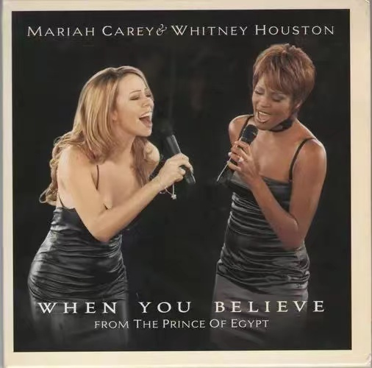
Music Appreciation
When you believe
There can be miracles when you believe.
只要你相信奇迹就会发生.
Though hope is frail.尽管希望渺茫.
It's hard to kill.却难以抹杀.
Who knows what miracles you can achieve谁能预料到你会达成什么奇迹.
When you believe, somehow you will
只要你相信，奇迹自然会发生!
You will when you believe!
只要你相信它，它就会发生

Slide 4
Free Talk
1. After enjoying the song, how do you feel?
2. Like or not？When will you listen to music?
3. How can music benefit your life? Give one example.
Energetic/powerful

Slide 5
How can music help us and benefit our life?
calm us down
make us strong in mind
bring us happiness/joy/relief
relax and refresh ourselves
help us overcome all the difficulties
How can music benefit your life?
give us strength and hope
inspire us to be positive and optimistic
offer us comfort and company
......
release our stress/pressure

Slide 6
It seems that music has magic power.
1. Music is the medicine of the mind.
2. Music sounded, happiness flows to the face.
3. Music washes away from the soul the dust of everyday life.
4. Without music，life is a mistake.
5. Music is the universal language of mankind.

Slide 7
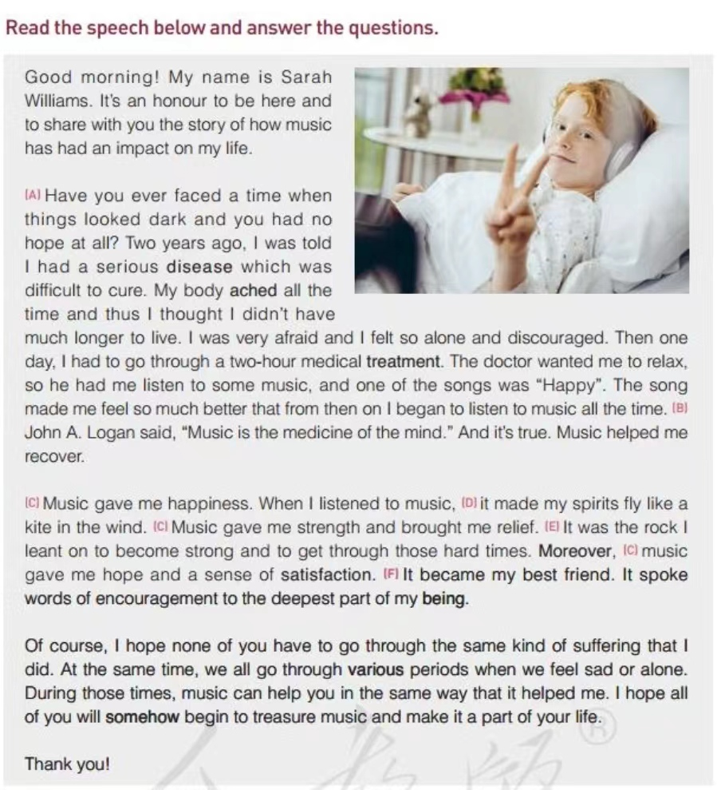
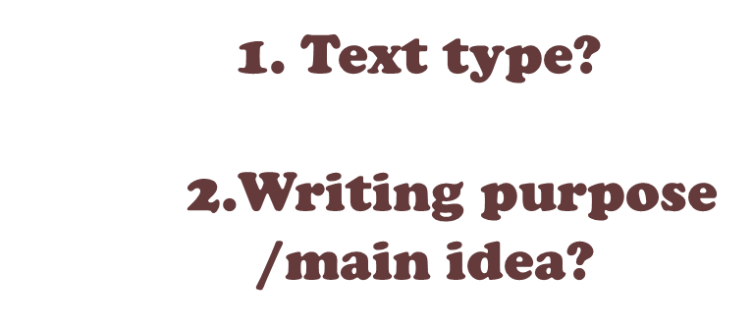
Reading for genre and gist
A speech
the topic of the speech

Slide 8
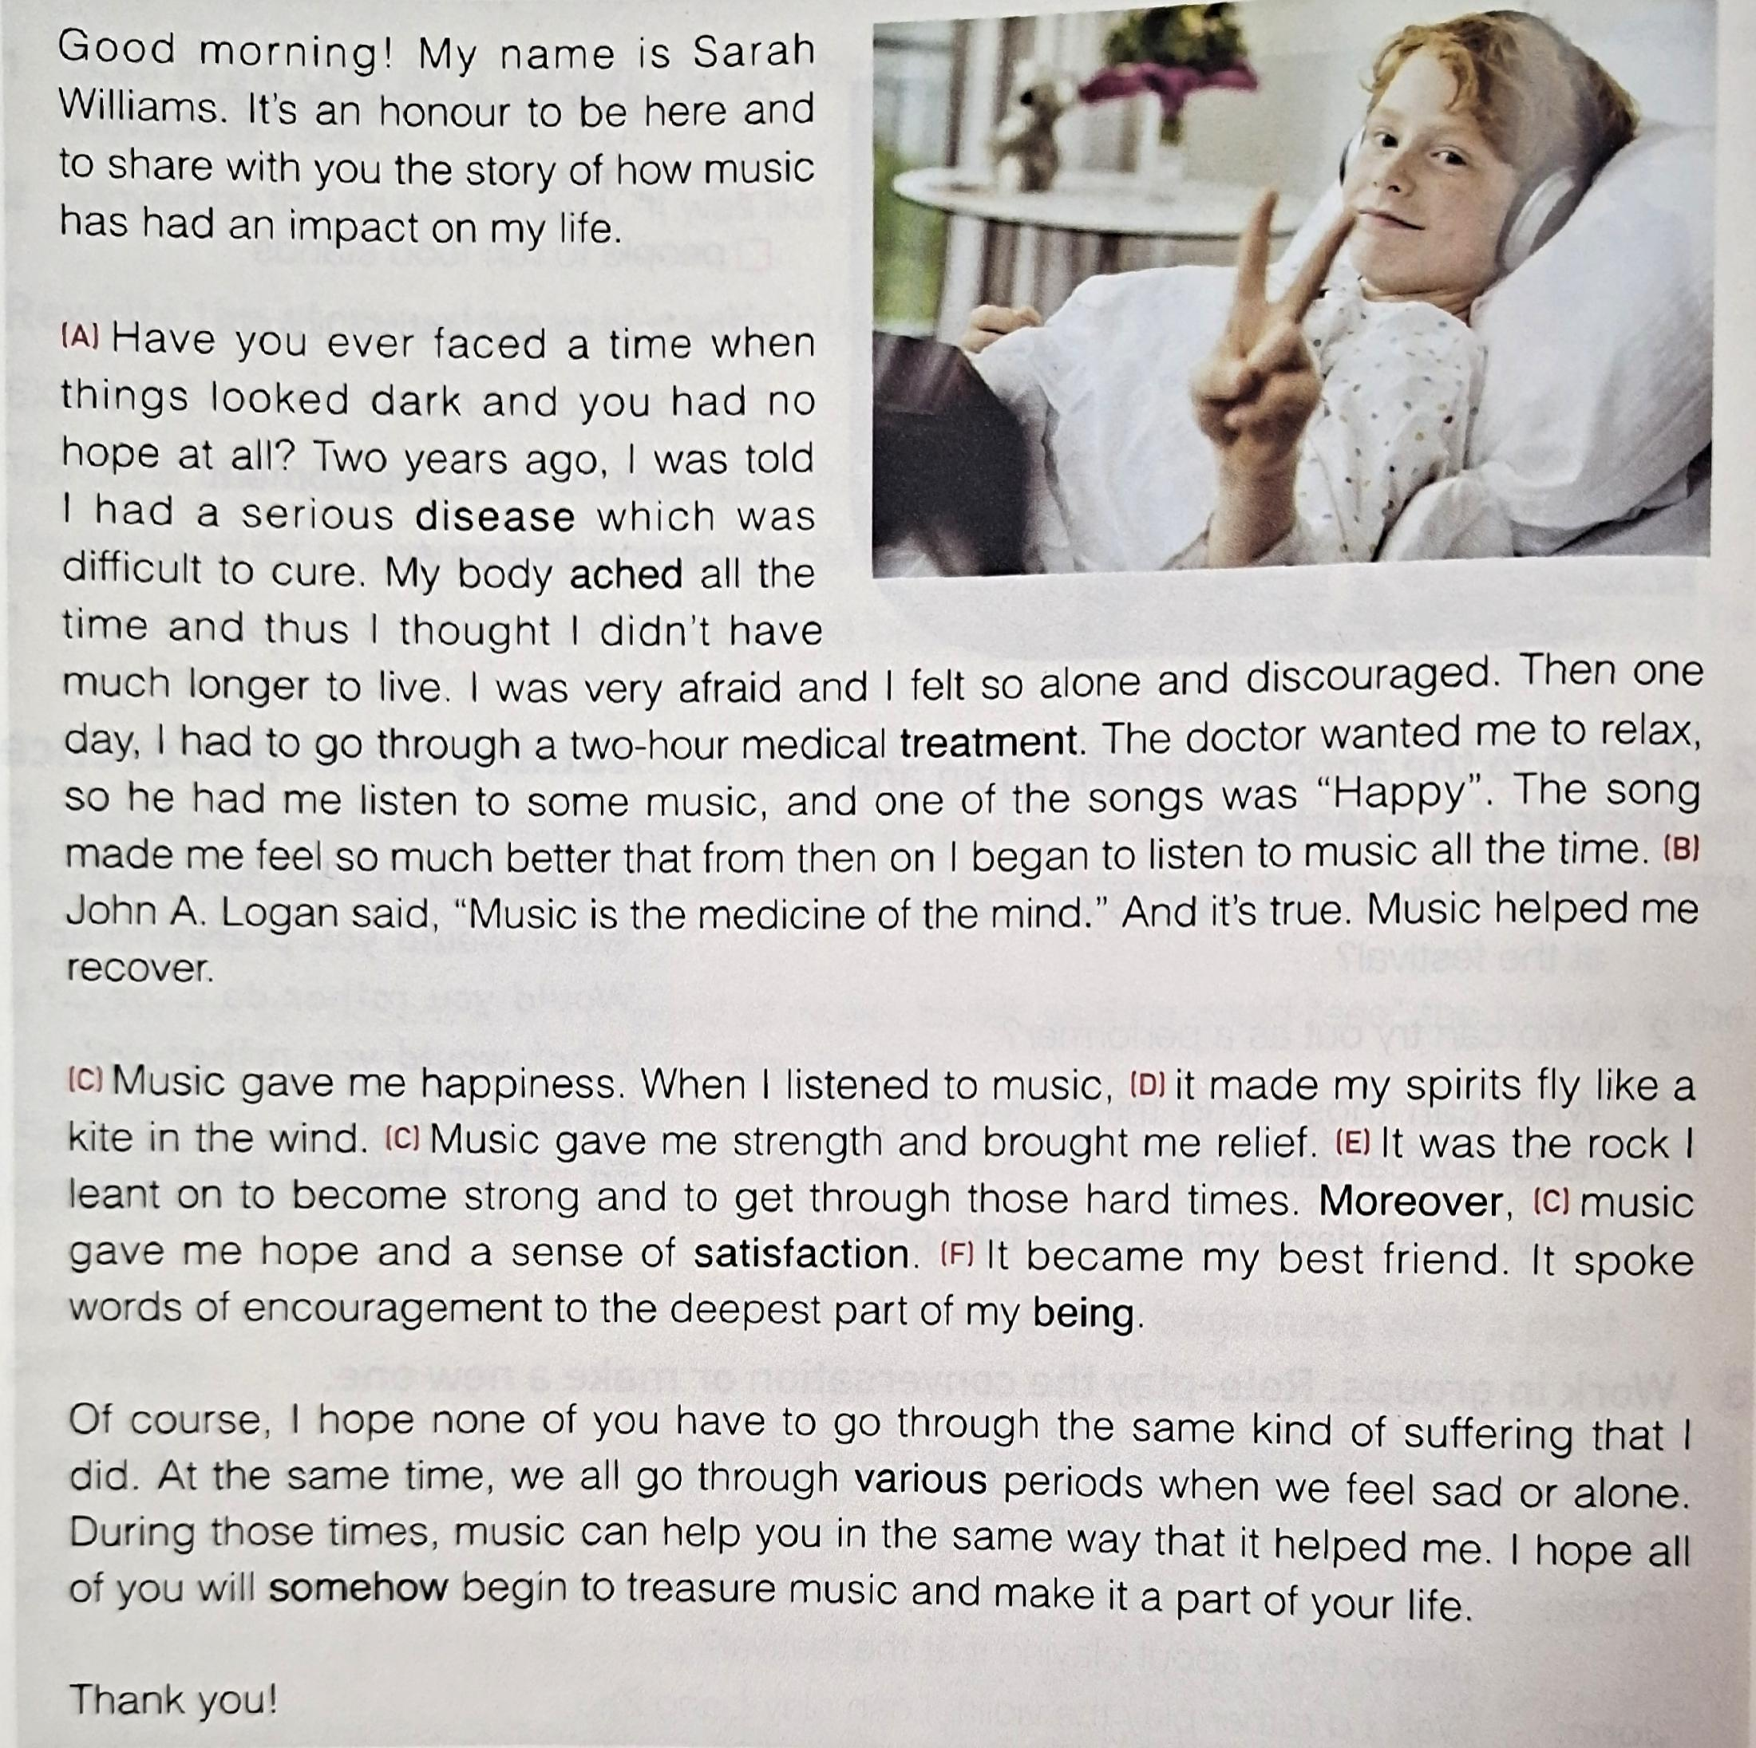
Read for the structure
Welcome the audience
Introduce oneself
Start
Propose the topic
Sarah's personal anecdote（story/experience）about the topic(music)
Body
Sarah's personal feeling about the topic(music)
Sarah's advice to the audience
Ending
Thank the audience at the end

Slide 9
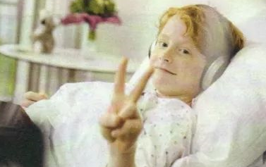
Reading for information
Read the speech and answer the questions.
1. What was Sarah’s problem?
2. How did music help her during her difficult time?
3. What is her advice to others?
Sarah had a serious disease that was difficult to cure.
It made her feel much better because it is the “medicine of the mind”.
Her advice to others is to use music to help when you have problems.

Slide 10


Reading for languages
What expressions does Sarah use to talk about how music made her feel/the impact of music on her ?

Slide 11


Reading for languages
The song made me feel so much better…./help me recover.
Music gave me happiness.
Music gave me strength and brought me relief.
…music gave me hope and a sense of satisfaction.
When I listened to music, it made my spirits fly like a kite in the wind.
It was the rock I lean on to become strong and to get through those hard times .
It became my best friend.
It spoke words of encouragement to the deepest part of my being.

Slide 12
Reading for language features
Match the definitions with the devices
C
1.To repeat the exact words that another person has said or written. 2. Compare two things by using words such as “like”or similar “as”. 3. Compare two unrelated things that actually have something in common. 4. It is a question that isn't meant to elicit an answer, but is asked to make a point. 5. It is when a thing, idea, or animal is given human attributes. 6. Use the same word or phrase in a poem, a speech, etc.
F
E
D
B
A
A. Repetition D. Rhetorical question（设问） B. Personification E. Metaphor（隐喻） C. Quote F. Simile（明喻）
To make the speech touching, the speakers often use rhetoric to let their speeches more powerful.

Slide 13
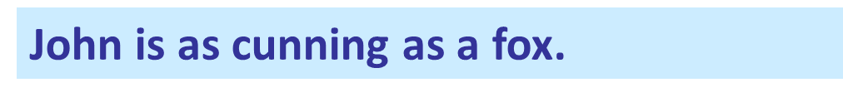
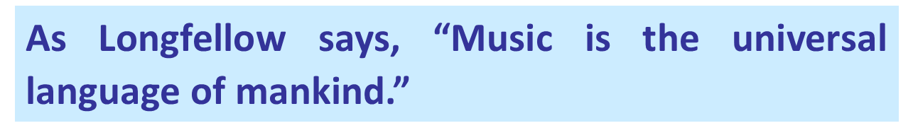

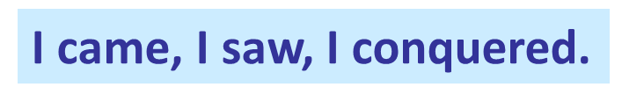
Tell which rhetorical device has been applied to these sentences.
That businessman is a real fox.
I came, I saw, I conquered.
The city of Wuhan cries.
凯撒大帝(Caesar）麾之所及，目之所至，皆臣服于朕

Slide 14
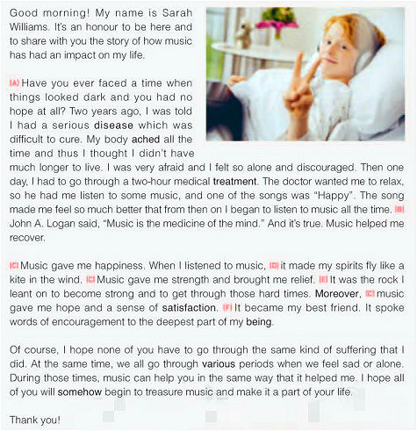
Match the names of rhetorical devices to the lettered sentences in the speech.
metaphor ____
personification ____
quote ____
repetition ____
rhetorical question ____
simile ____
E
F
B
C
A
D

Slide 15


Imitation
Based on the rhetorical devices in the speech, please try more examples of them. Make up as many as you can. (Group work)
Music gave me happiness. Music gave me strength and brought me relief. Music gave me hope and a sense of satisfaction. | Music gave me…
Music made my spirits fly like a kite in the wind. | 1. Music brings me relief like an old friend (like）. 2. Music encourages me to relax my mind and soul , like sunshine always warming my heart.
Music gave me company and comfort. Music gave me strength and hope. Music gave me courage to face all the difficulties.
_______________
_______________________________________

Slide 16
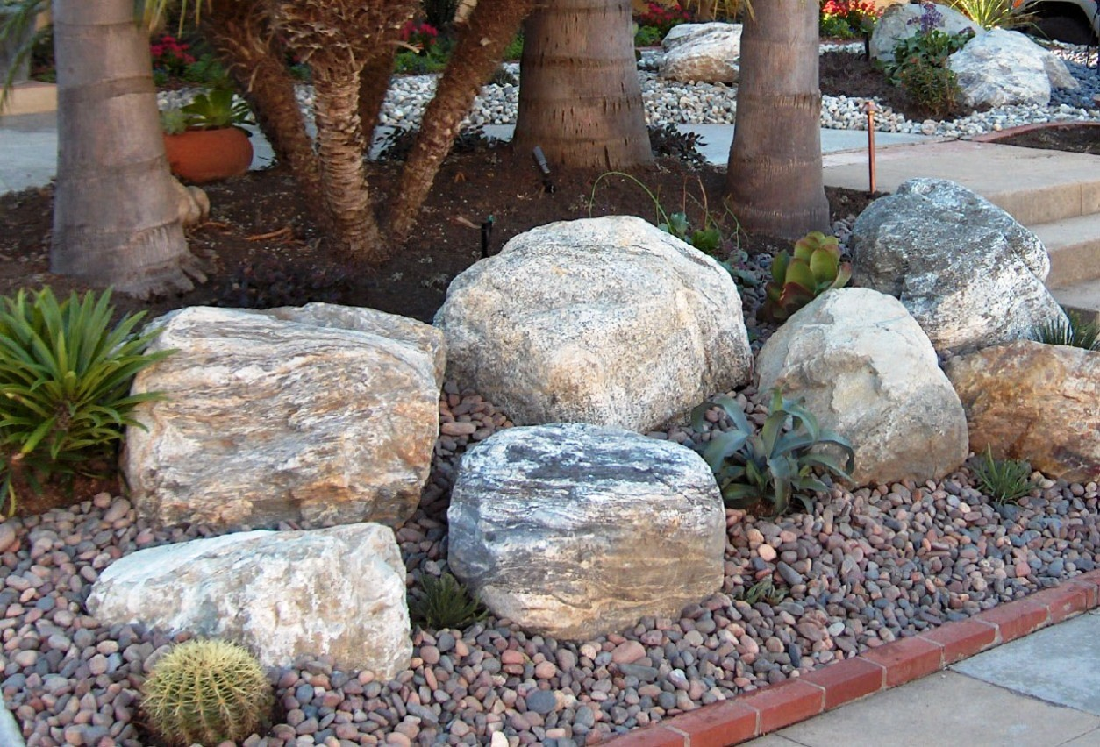

Music was the rock I leant on to become strong and to get through those hard times. | Music was the toy I played with to obtain relaxation and happiness. 2.Music was the stream I sat by to calm me down.
______
_______________________
_________
_____________

Slide 17
Music became my best friend. It spoke words of encouragement to the deepest part of my being. | 1. Music became my companion. It stayed with me and relaxed my mind when I was in trouble. 2. Music was my soulmate. It encourged and inspired me when I felt frustrated
_____________
_____________________________________________
________________
________________________________

Slide 18
Have you ever faced a time when things look dark and you had no hope at all? | Tips: ups and downs/frustrated/discouraged/...) Have you ever experienced/ felt ...? 1.Have you ever experienced the ups and downs of life? 2. Have you ever felt frustrated or discouraged?
John A.Logan said, “Music is the medicine of the mind. ” | Review some mottos we have learnt in this unit. 1. Henry Wadsworth Longfellow said, “ Music is the universal language of mankind.” 2. The philosopher Plato once said, “Music gives a soul to the universe, wings to the mind, flight to the imagination and life to everything.”
______________________________________________
____
_____________________________________________

Slide 19

Writing
Write a speech about music
Make use of what we talk about the speech---the structure, the rhetorical devices and useful expressions, combine them with your own experiences, and then finish your speech about how music changes our life.

Slide 20
A speech about music
Useful expressions in the “Start” part of the speech
1. Good morning, ladies and gentlemen. I’m... Today I'm greatly honored to speak here
to talk about...
2. Good morning, everyone. My name is ... Thank you for giving me the opportunity to
make a speech concerning...
3. Hello, my dearest fellow schoolmates. I'd like to start by introducing myself. My name
is …....
4. Good afternoon, everybody. My name is ... It’s my great honor to have the opportunity
to share with you my opinion regarding ...
5. Hello, ladies and gentlemen. Let me introduce myself. My name is…Today I’d like to
deliver a lecture on ...
6. Good morning, ladies and gentlemen. I’m...It’s my great honor to stand here on behalf of
all the students, and share with you my point of view on...

Slide 21
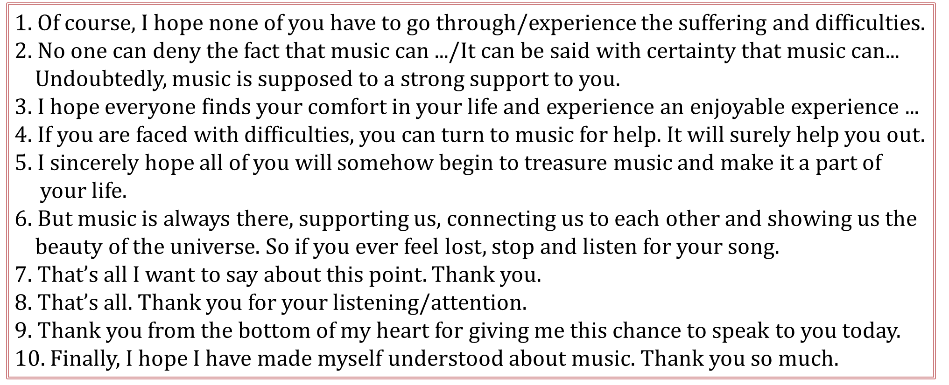
Useful expressions in the “Body” part of the speech
1. Have you ever faced a time when things looked dark and you had no hope at all?
2. Have you ever experienced the ups and downs of life and felt frustrated or discouraged?
3. Two years ago, when I entered the new school, I felt lost and depressed.
Useful expressions in the “Ending” part of the speech
enjoys a joyful experience in music.
Notes:
3 experience 加S/或者改为 enjoys a joyful experience in music

Slide 22
Speech Writing (10 minutes to finish the speech by yourselves)
Option1：
Hello, ladies and gentlemen. My name is________, and ______________
_______________________________.Two years ago, when I entered the new school, I felt lost and depressed. It's like I had been taken out of my natural environment, and put somewhere new. And slowly I began to lose myself, like I was being washed away. But then the next moment. I felt the melody, the song "Count on me' --soft and calming, comforting and powerful._________________________________________________________________Gradually, I adapted to the new school. __________________I do benefit a lot from music.
So next time, if you are faced with difficulties, you can turn to music for help. It will surely help you out. Thanks for your listening!

Slide 23
Option 2：
Hello, ladies and gentlemen. My name is________, and ___________(theme：It’s my great honor to.../ I’m here to talk about...)________________
____( Rhetorical question: Have you ever experienced...?/ Have you ever been...?)Two years ago, when I entered the new school, I felt lost and depressed. It's like I had been taken out of my natural environment, and put somewhere new. And slowly I began to lose myself, like I was being washed away. But then the next moment. I felt the melody, the song "Count on me' --soft and calming, comforting and powerful.____________________________
_____________________________________________________(Repetition：It gave me...gave me...gave me.../Personification：Music became my ... It stayed with me and relaxed my mind when ..../Simile：Music brings me relief like ... .)

Slide 24
Gradually, I adapted to the new school.______________________________
______________________________________________(Quote: Henry Wadsworth Longfellow said, “ Music is the universal language of mankind.”/...) I do benefit a lot from music.
So next time, if you are faced with difficulties, you can turn to music for help. It will surely help you out. Thanks for your listening!

Slide 25
Hello, ladies and gentlemen. My name is Kathy, and I'm here to talk about how music has changed my life.
Welcome the audience
Start
Introduce oneself
Have you ever experienced the ups and downs of life and felt frustrated or discouraged? Two years ago, when I entered the new school, I felt lost and depressed. It’s like I had been taken out of my natural environment, and put somewhere new. And slowly I began to lose myself, like I was being washed away. But then the next moment, I felt the melody, the song “Count on me”---soft and calming, comforting and powerful. It gave me strength and hope, like my old friend. It gave me company and comfort. And also it gave me courage to face all the difficulties. Gradually, I adapted to the new school. The philosopher Plato once said, “Music gives a soul to the universe, wings to the mind, flight to the imagination and life to everything.” I do benefit a lot from mysic.
Propose the topic
Share personal anecdote about the topic
Body
Share personal feeling
Using proper rhetorical devices
Supply advice to the audience
Thank the audience at the end
Ending
So next time, if you are faced with difficulties, you can turn to music for help. It will surely help you out. Thanks!
Close the speech

Slide 26
Thank you!

