Slide 1

感恩遇见，相互成就，本课件资料仅供您个人参考、教学使用，严禁自行在网络传播，违者依知识产权法追究法律责任。
更多教学资源请关注
公众号：溯恩高中英语
知识产权声明

Slide 2
The Practical Application of Good English Textbook in Continuation Writing ——Take the Ultimate Trainer for example
YU JIA PAN

Slide 3
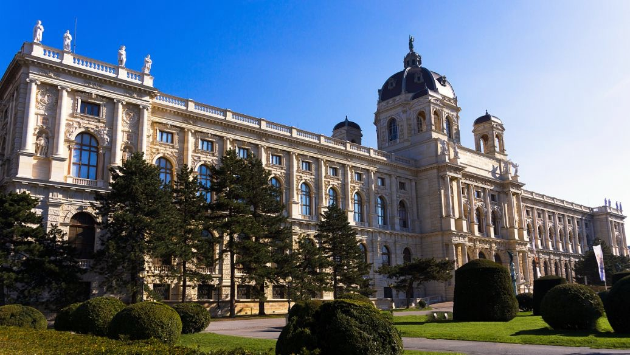

An illustration for my teaching framework
Scaffolding
Guiding Theories
Bloom’s Taxonomy
English Curriculum Standards &Content
Objective
1. lead in
2. read for the structure and genre
Mind Map
Procedure
3. appreciate the plot
4. analyze the character
5. explore the theme
Deliberate Practice
Cross- country race in 2022 Gaokao
Hurdle Race in simulation test of Gaokao in 2023
Evaluation

Slide 4

Guiding theories
Project based Language learning Instruction
A project is an extended task which usually integrates language skills through a number of activities. These activities combine in working towards an agreed goal and may include planning, the gathering ofinformation through reading, listening, interviewing,etc., discussion of the information, problem solving, oral or written reporting, and display.
Hedge,1993:276

Slide 5
Objective
Knowledge aim:
master how to describe actions of running and learn descriptive words to show feelings, instead of telling
have a good command of different writing sentence patterns
Ability aim:
get the hang of writing advanced sentence patterns with scaffolding
able to show runners’ actions and depict changes of characters’ feelings
Emotional aim:
cultivate the spirit of sportsmanship, perseverance and honesty

Slide 6
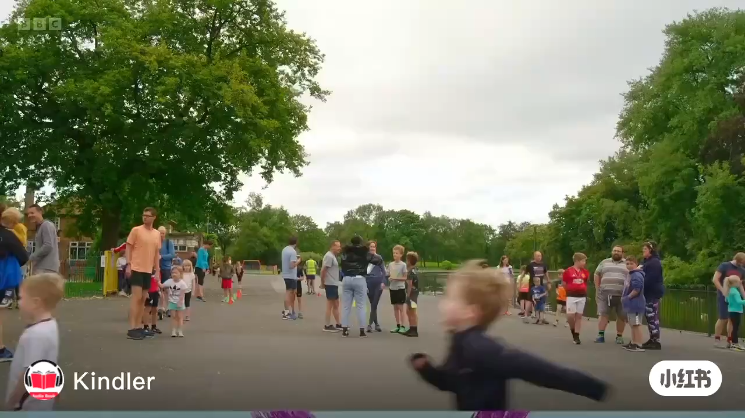

Before Reading – Appreciate the video
do little exercise first
do a big clap, big round circles with your arms
do stretch and warm up muscles
make your way to the starting line
Friends & family came to support runners and helped me keep going
runners crossed the finishing line
Notes:
Have you ever involved in any race?
What kind of sneakers will you wear?
Is it vital to wear a pair of upmarket trainers?
What kind of role does trainers play in big race?

Slide 7

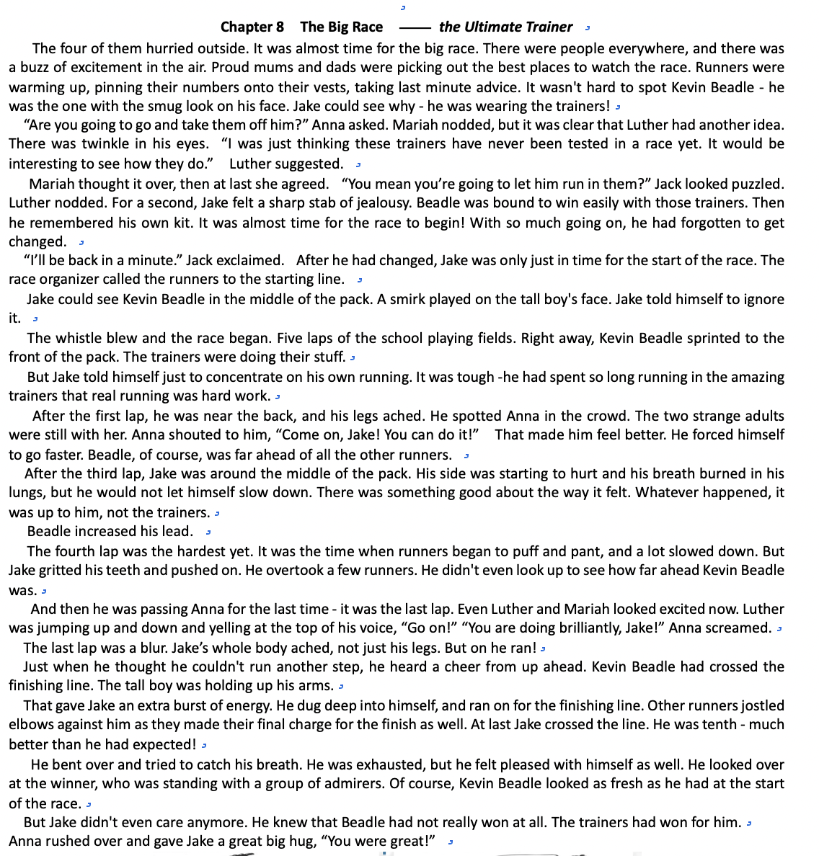
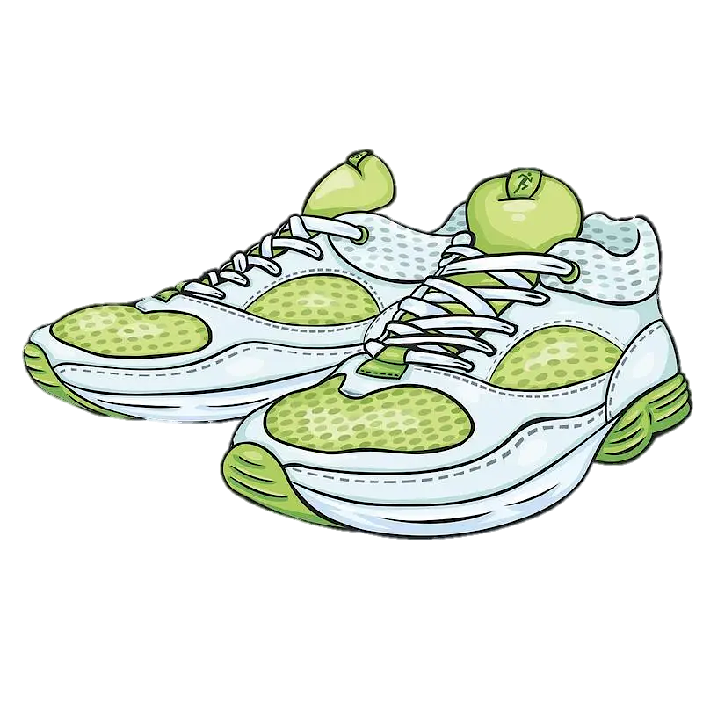
Read for the structure& genre
Q. What is the genre of the passage ?
A. Narration B. Exposition C. Argumentation D. biography
Part 1
Describe the preparation for the race
before the race
Part 2
Describe the duration of the race
- the whistle blew…
- at the first lap…
- after the third lap…
- the fourth lap…
- it was the last lap…
-at last,….crossed the finish line..
time
during the race
in ___________ order/sequence
Part 3
Describe the result of the race
after the race

Slide 8
Read for the setting
The four of them hurried outside. It was almost time for the big race. There were people everywhere, and there was a buzz of excitement in the air. Proud mums and dads werepicking out the best places to watch the race.Runners were warming up, pinning their numbers onto their vests, taking last minute advice. It wasn't hard to spot Kevin Beadle - he was the one with the smug look on his face. Jake could see why - he was wearing the trainers!
“Are you going to go and take them off him?” Anna asked. Mariah nodded, but it was clear that Luther had another idea. There was twinkle in his eyes. “I was just thinking these trainers have never been tested in a race yet. It would be interesting to see how they do. “ Luther suggested.
Mariah thought it over, then at last she agreed. “You mean you’re going to let him run in them? ” Jack looked puzzled. Luther nodded. For a second, Jake felt a sharp stab of jealousy. Beadle was bound to win easily with those trainers. Then he remembered his own kit. It was almost time for the race to begin! With so much going on, he had forgotten to get changed.
“I’ll be back in a minute.” Jack exclaimed. After he had changed, Jake was only just in time for the start of the race. The race organizer called the runners to the starting line.
Jake could see Kevin Beadle in the middle of the pack. A smirk played on the tall boy's face. Jake told himself to ignore it.
The whistle blew and the race began. Five laps of the school playing fields. Right away, Kevin Beadle sprinted to the front of the pack. The trainers were doing their stuff.
But Jake told himself just to concentrate on his own running. It was tough -he had spent so long running in the amazing trainers that real running was hard work.
 | When
 | Characters
 | What
The time for the big race
Setting
Jake, Anna, Kevin, Mariah, Luther and competitors & race organizer & audience
Jake and other competitors participated in the big race.

Slide 9

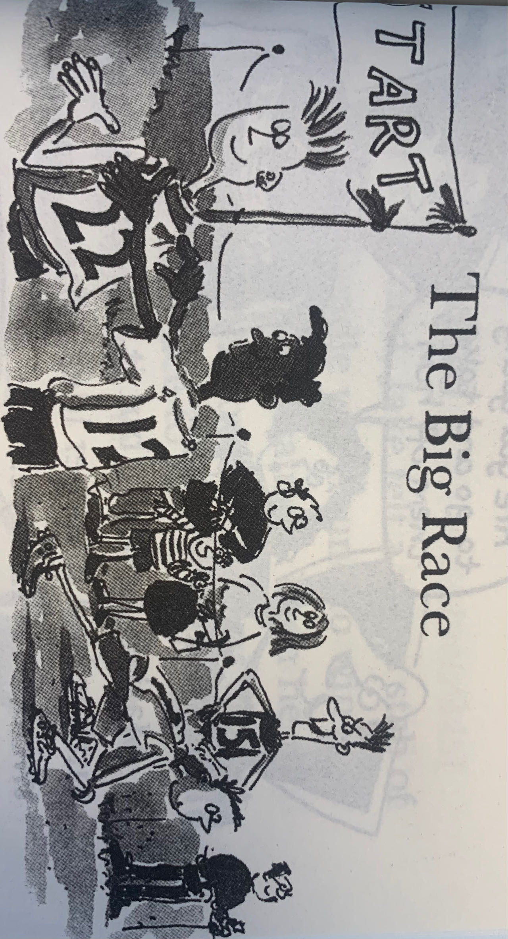
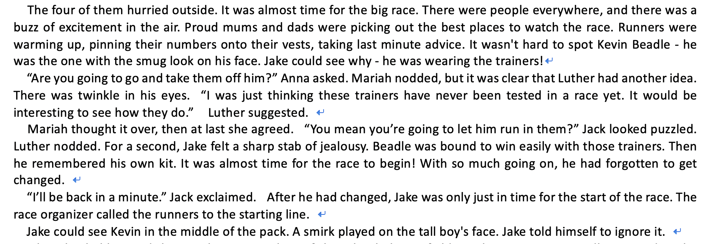
Read for the plot – before the race – following up the tape

Slide 10
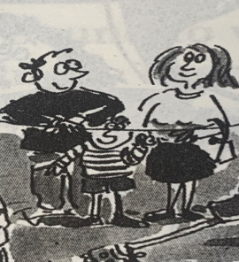
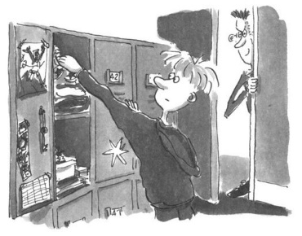
Read for the plot – before the race
There was ________________________.
a buzz of excitement in the air
_______________________watch the race
Feelings?
Picked up the best place to
What did audience do?
Athletes were __________________________, _________________________,
and ______________________. (chain of actions, didA, didB and didC)
pinning their numbers onto vests
doing the warm-up stretches
taking last minute advice
Where
standing on the starting line
They were _________________________, ___________________________.
(using the Non-finite forms of the verb, did A, doing B)
waiting for the whistle blowing
Audience
How did Kevin feel?
Why?
Wearing the ultimate trainers
__________________________, he____________________________,
with __________________. (Composite structure of “with”)
was sure to win the race
character?
a smug/ smirk look
dishonest
malicious
evil
He was ________________________.
Kevin
Athletes

Slide 11
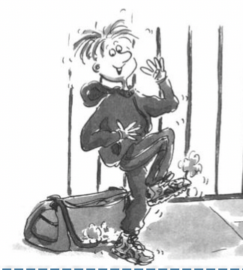
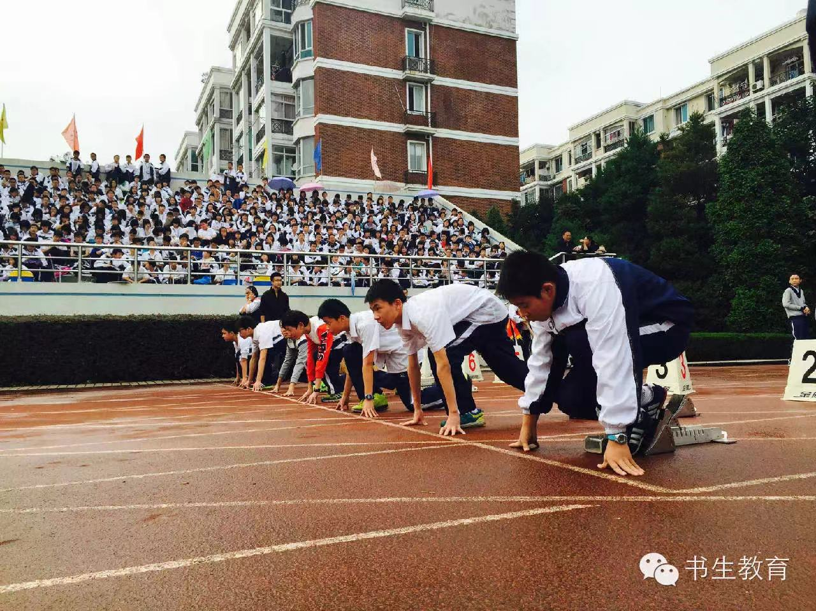
Read for the plot – before the race
Why?
Jake
Did author show the feelings of athletes in the first part?
___________________________________________________________,
Jake felt ______________________________________. (Non-finite forms of the Verb)
Knowing Kevin was bound to / sure to win with slightest effort with the magic sneaker
a stab of jealous
a sense of jealousy flooded over him in waves (inanimate subject)
body bent down
face turned white
throat tight and mouth dry
Pose
lowered their heads
Physical action
heart beat/pounded wildly
straighten arms
hands shaking /legs trembled
How about other feelings of Jake before the race?
nervous/ anxious/ tensed /restless
with butterflies in the stomach
Heart beating/pounding wildly
Mingled with jealous and anxiety,
______________________________,(absolute structure) Jake and other athletes __________________on the starting line, ____________________ and _____________________with ______________________. (Composite structure of “with”)
______________________________,(absolute structure) Jake and other athletes __________________on the starting line, ____________________ and _____________________with ______________________. (Composite structure of “with”)
bent down
lowered their heads
straightened arms
with butterflies in the stomach

Slide 12
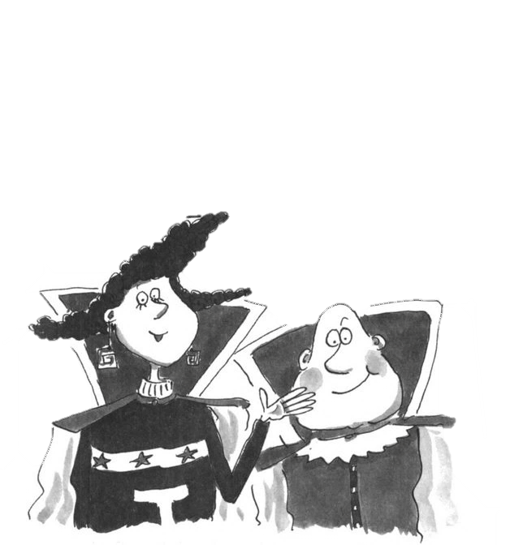
Read for the plot – before the race
Who else?
As the owner of the magic trainers, they didn’t take them back
in order to _______________________.
so as to
test them in the race
Not taking the Ultimate Trainers back, they _______________________________________ test it in the race .
Mariah, Luther
are eager to/are anxious to / long to/desire to
Acts for describing “anxiety”
Descriptive words for ”anxiety”
face whitened
glanced at him anxiously
throat tight and mouth dry
heart beat wildly and legs trembled
with butterflies in the stomach
palms sweating and hands shaking
anxiously backed away
be restless
be worried sick
the worry in his eyes
with growing uneasiness
Tension took hold of her/ flooded over sb.
His heart almost leaped from his body.
There was a touch of nervousness ….

Slide 13
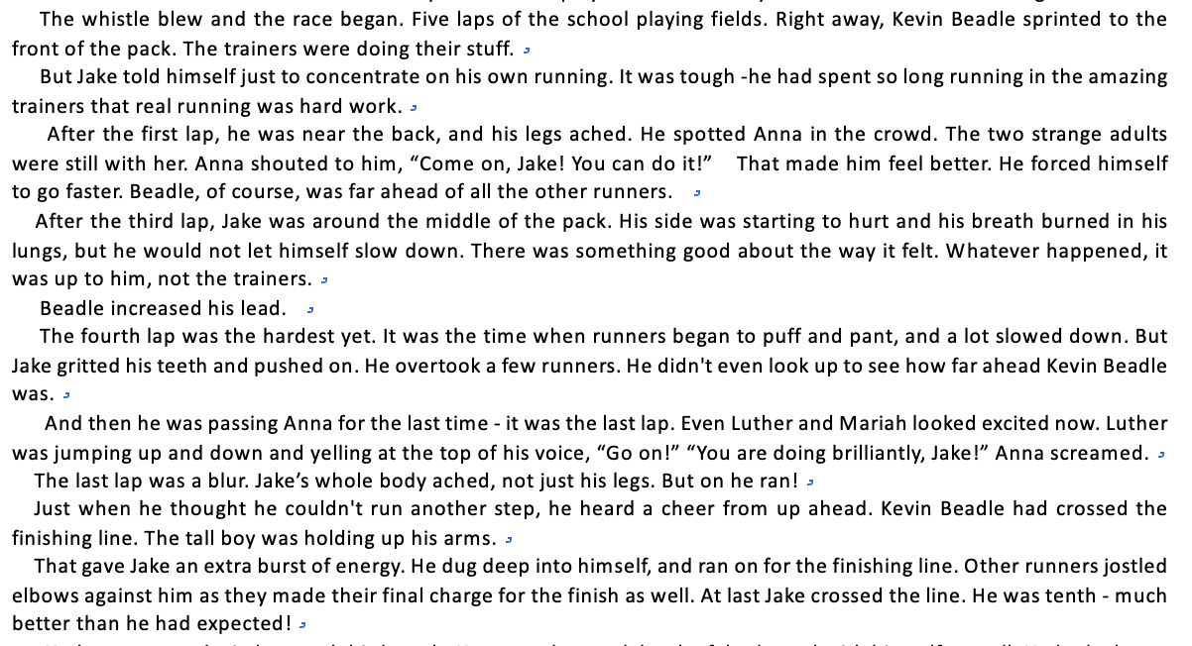
Read for the plot - during the race – following up the tape

Slide 14
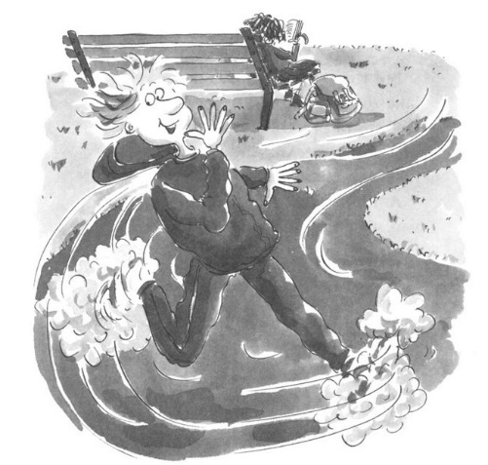
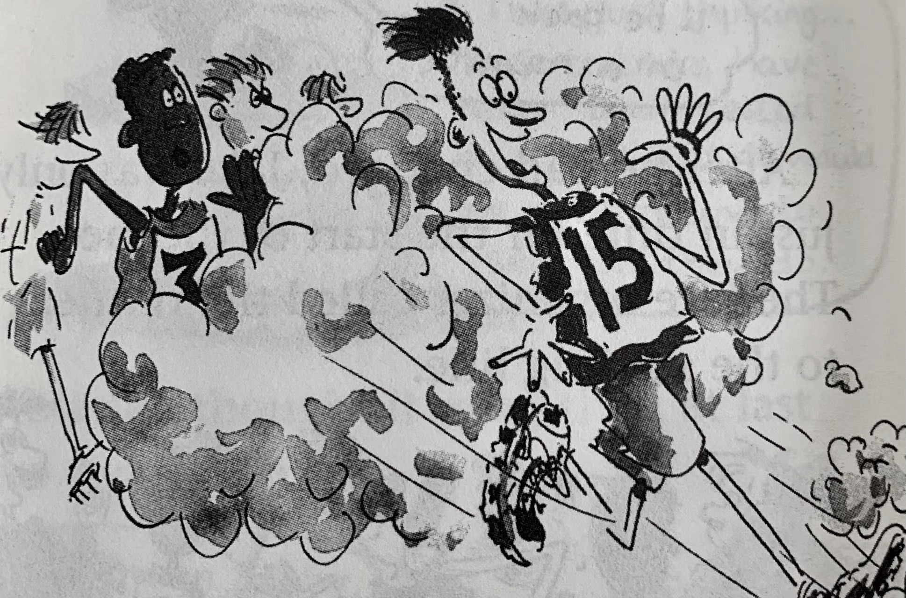
Read for the plot - during the race
Physical reaction
With the help of the magic trainer, Kevin ____________________________.
sprinted to the front of the pack
Tough
concentrated on his own running
______ as the race was, he ___________________________.
No matter how difficult it was
Jake
Despite/In spite of difficulties
focused on his own running
_________________________, he _______________________________.
The whistle blew
rank?
were aching/burning
Though his legs _____________________and _________________, with _____________________,Jake still __________________________.
was near the back
At first lap
Anna’s cheering up
forced himself to run faster
made great progress!
Of course, Kevin Beadle was _________________________ .
far ahead of other runners
After the third lap
side was starting to hurt
In the middle of the pack/runners, though his________________ and __________________, never letting himself down /giving up.
side was hurting
breath was burning
Jake’s
Physical
act
breath burned in his lungs
not let ….slow down
quality?
determination
persistence
perseverance

Slide 15
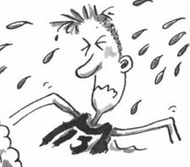
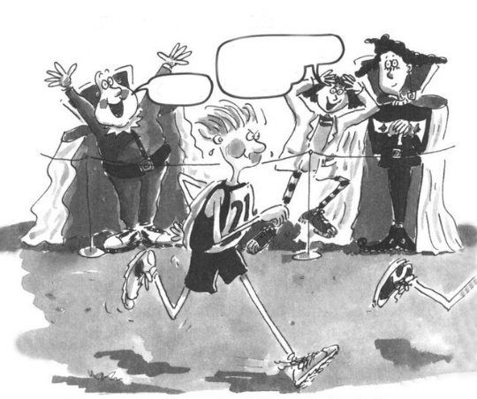
Read for the plot - during the race
made further progress!
rank?
The fourth lap
puff and pant
_________________________, it was time when he began to __________________, _________________ but still_______________.
After overtaking a few runners
gritted his teeth
excited / thrilled!
pushed on /carried on / went ahead
Jake’s physical reaction
How about feelings of Luther and Mariah?
“You are doing brilliantly!”
Came to the last lap
Giving up?
“Go on!”
Not just legs hurting
Jake’s Physical act
On he run!
But whole body ached
Excited /Thrilled
______________, (using adjectives as adverbs) Luther was ________________, and ___________________________.
jumping up and down
yelling at the top of his voice

Slide 16
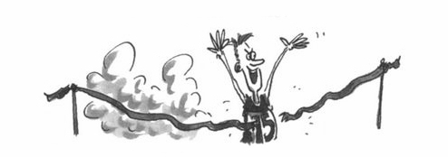
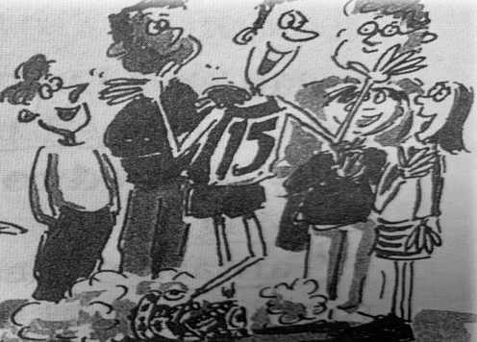
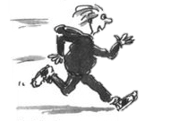

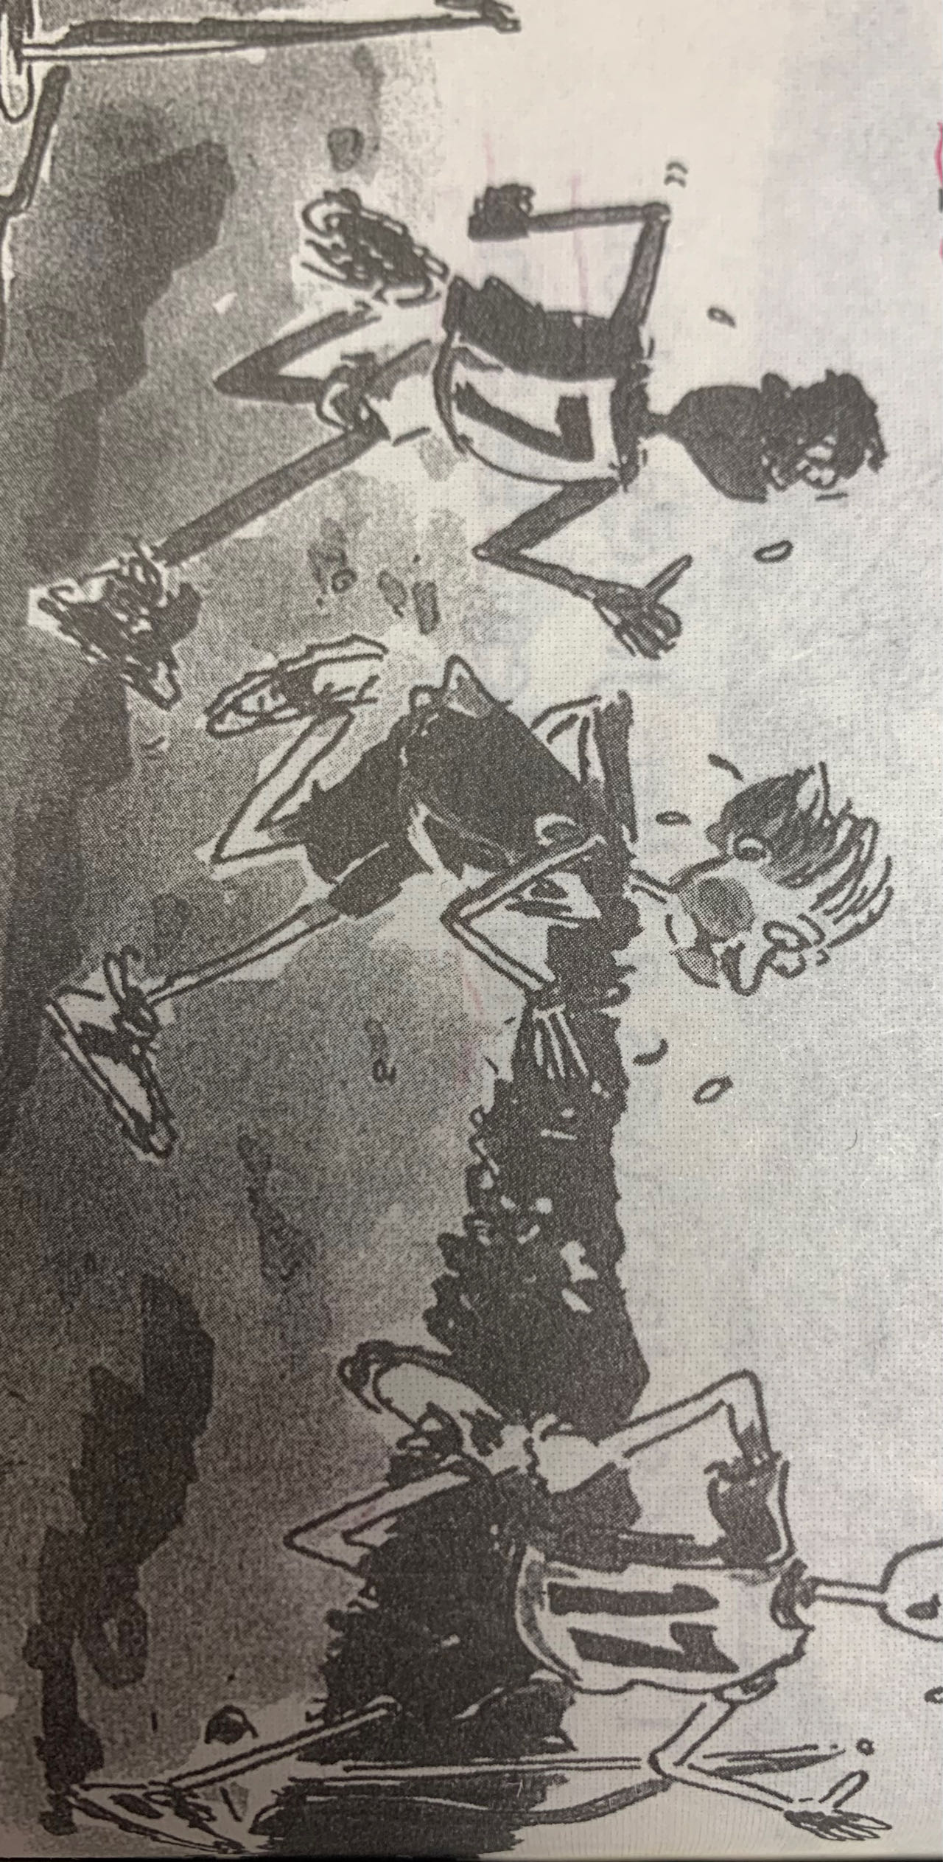
Read for the plot - during the race
While Jake was dashing towards the finishing line, Kevin_________, _______,_______________________________(Composite structure with).
with
holding up his arms
crossed it
raising his arms in triumph
doing as adverbial
____________________________, a pack of admirers _______________________________.
Cheering and applauding for Kevin
audience
surrounded him with full admiration
After hearing the cheering, Jake__________________________.
got an extra burst of energy
rank?
sweat soaked through backs
jostled elbows against runners
Runners____________,
(the absolute construction)
Jake_______________,
____________________and______________.
Physical act
charged for the finishing line
dug deep into himself

Slide 17
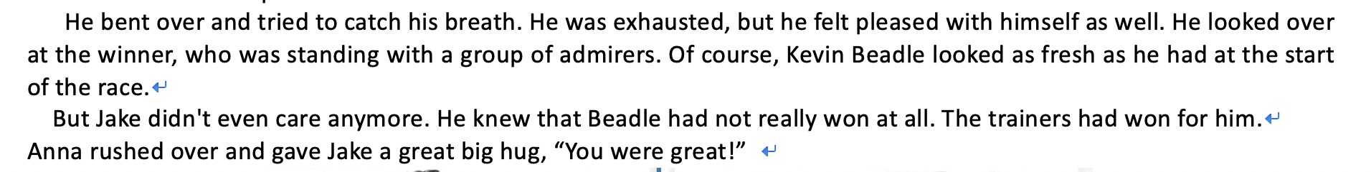
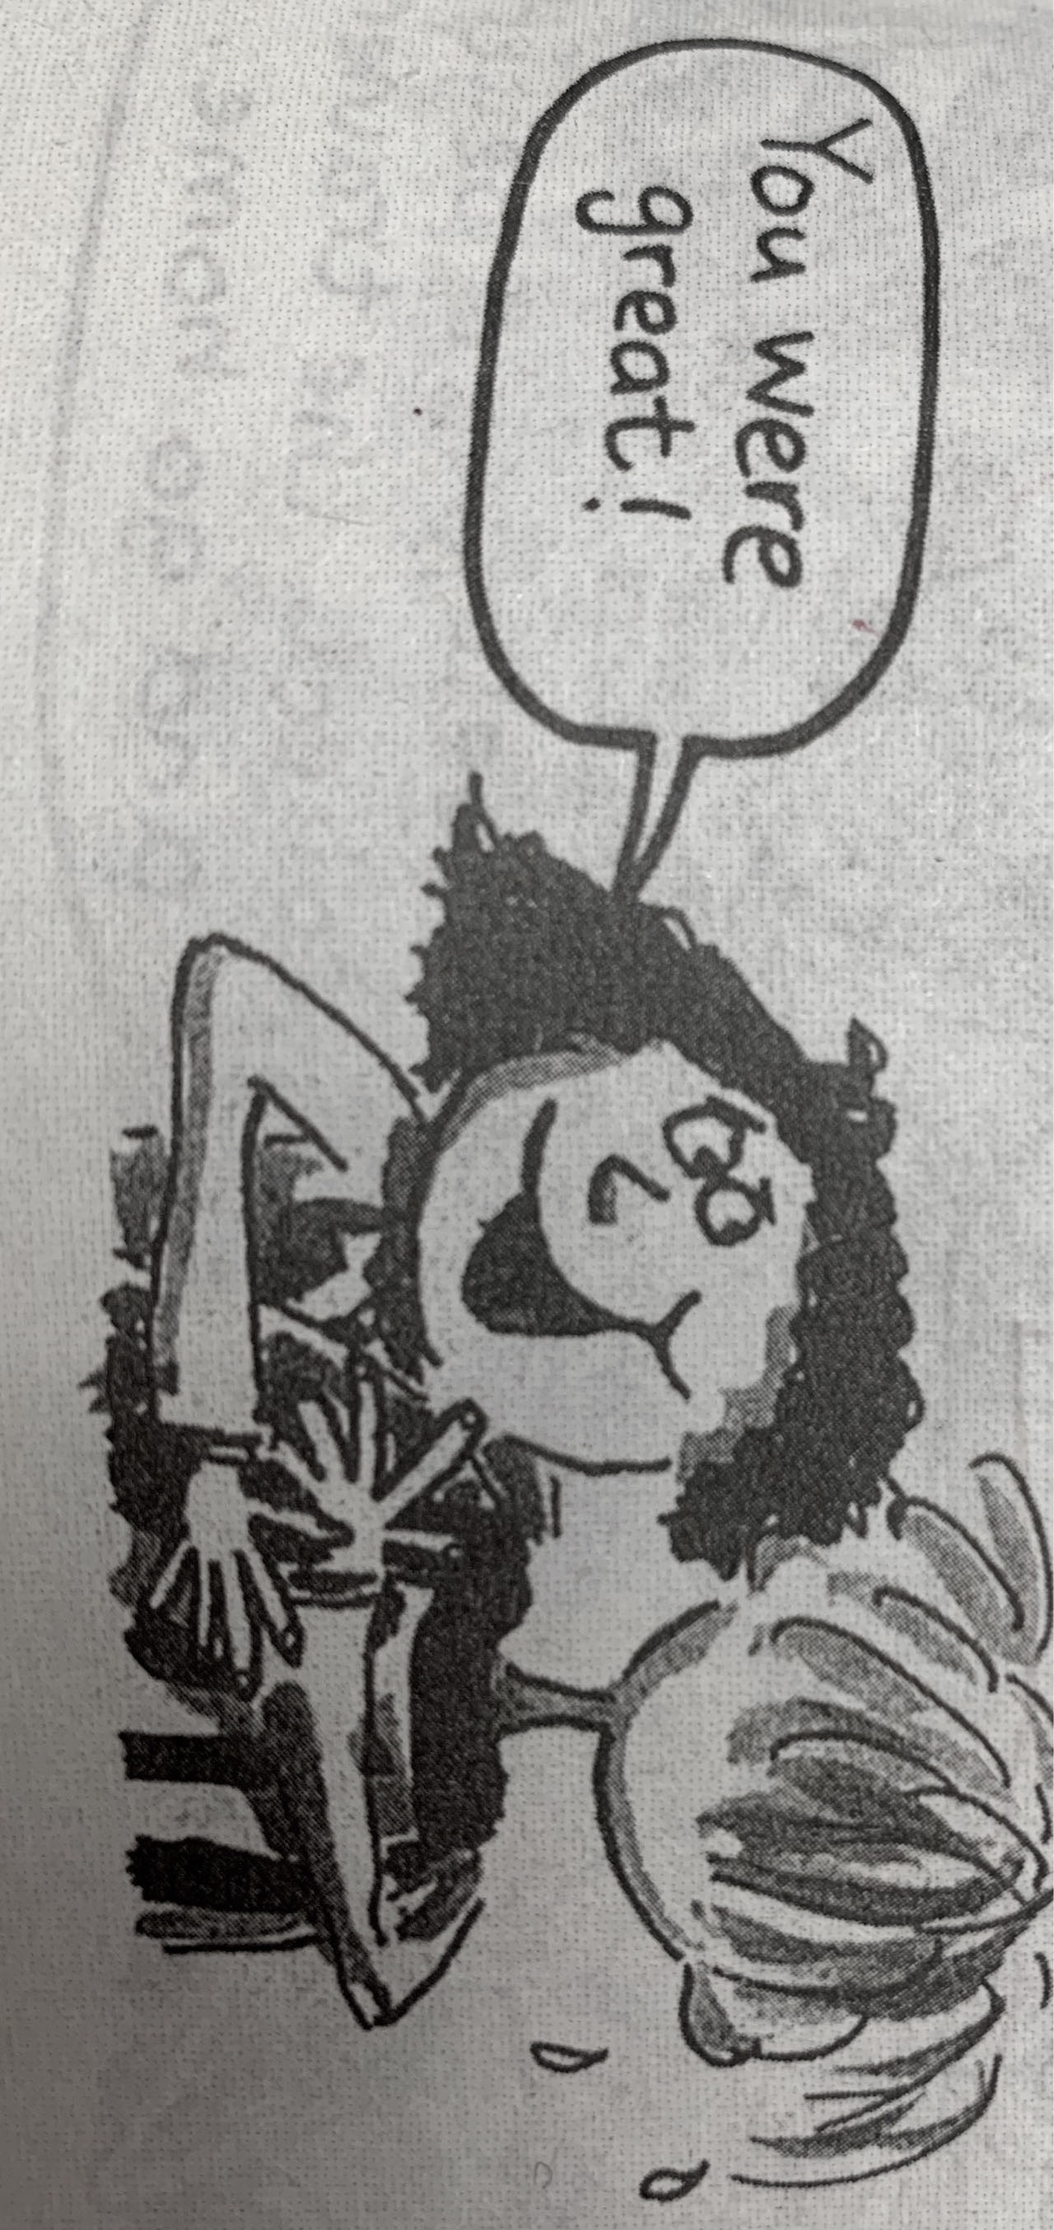
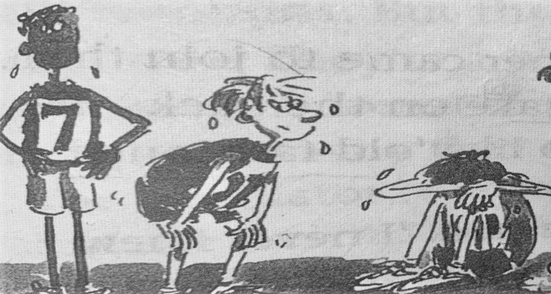
Read for the plot - after the race-follow up the tape
=burnt out=worn out
achievement
Exhausted
pleasure
relief
__________ _as Jake was, he felt nothing else but _________ and a sense of_________.
bent over
rushed over
Physical act
caught his breath
hugged sb. affectionately
Anna’s act
squatted sb. down
slipped an arm around sb. and held sb. close
sweat soaked through backs
Crossing the finishing line, Jake _______________ ,___________ and______________.
Crossing the finishing line, Anna _______________ ,___________ and______________.

Slide 18
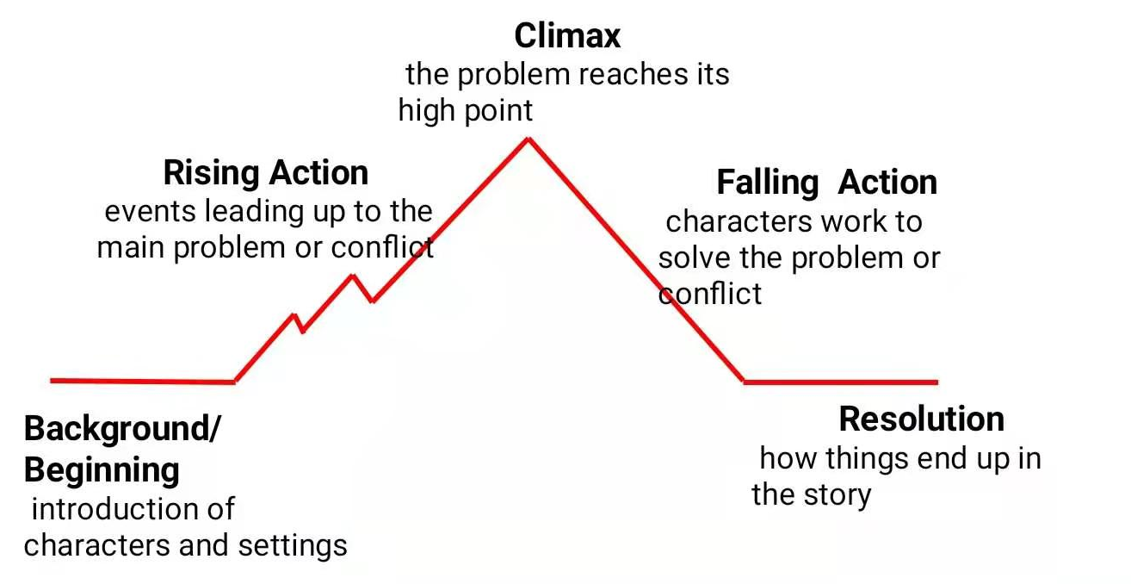
Summary for the plot line & emotion line
exhausted
but determined
In the fourth lap, it was the hardest part for Jack to continue his running.
Tired passionate
Perseverant
In the first lap, Jake was almost at the back. After the third lap, he was in the middle of the pack.
For the last lap , Jake’s whole body ached but on he ran! Kevin won the race with magic trainers!
Theme: Honesty and perseverance outweighs the winning!
Pleased relieved
jealous nervous
All runners crossed the finishing line. Jake got tenth.
Numerous runners were engaged in the Big Race, so did Jack. But he didn’t wear ultimate trainers.

Slide 19
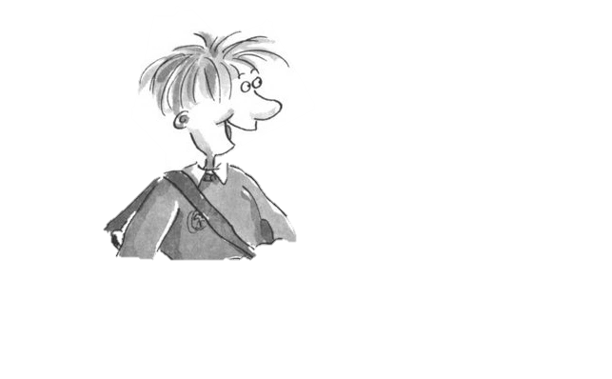
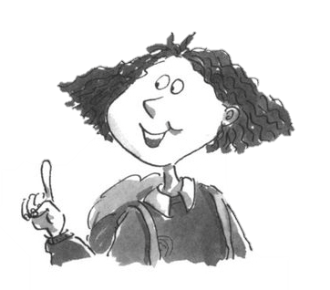
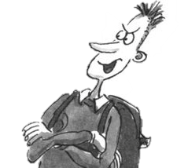
Display – Role Play – following up the tape and imitating the tone of the records
Character analyses
honest
friendly/amicable
supportive
dishonest
evil /malicious
presumptuous
passionate
determined
perseverant /persistent
self-reflective
supportive
approachable
inspiring /uplifting

Slide 20
Deliberate Practice 1
Cross- country race in 2022 Gaokao - Micro Writing
It was the day of the big cross-country run. Students from seven different primary schools in and around the small town were warming up and walking the route（路线）through thick evergreen forest.
I looked around and finally spotted David, who was standing by himself off to the side by a fence. He was small for ten years old. His usual big toothy smile was absent today. I walked over and asked him why he wasn't with the other children. He hesitated and then said he had decided not to run. What was wrong? He had worked so hard for this event!
I quickly searched the crowd for the school's coach and asked him what had happened. "I was afraid that kids from other schools would laugh at him," he explained uncomfortably. "I gave him the choice to run or not, and let him decide."
I bit back my frustration（懊恼）. I knew the coach meant well — he thought he was doing the right thing. After making sure that David could run if he wanted, I turned to find him coming towards me, his small body rocking from side to side as he swung his feet forward.
David had a brain disease which prevented him from walking or running like other children, but at school his classmates thought of him as a regular kid. He always participated to the best of his ability in whatever they were doing. That was why none of the children thought it unusual that David had decided to join the cross-country team. It just took him longer — that’s all. David had not missed a single practice, and although he always finished his run long after the other children, he did always finish. As a special education teacher at the school, I was familiar with the challenges David faced and was proud of his strong determination.
Continuation Writing (around 150 words)
Para1.We sat down next to each other, but David wouldn't look at me.
Para2.I watched as David moved up to the starting line with the other runners.
 | When
 | Characters
 | Plot (what)
The big cross-country run
Setting
David, I, the coach, classmates
David felt inferior and was reluctant to participate in the race.
my encouragement
David’s change in his mind
David’s performance
Audience encouragement
2022年6月普通高等学校招生全国统一考试（新高考Ⅰ卷）

Slide 21
Deliberate Practice 1
Para2.I watched as David moved up to the starting line with the other runners.
____________________________________________________________________________________________________________________________________________________________________________________________________________________________________________________________________________________________________________________________________________________________________________________________________________________________________________________________________________________________________________________________________________________________________________________________________________________________________________________________________________________________________________________________________________________________________________________________________________________________________________________________________________________________________________________________________________________________________________________________________________________________________________________________________________________________________________________________________________________________________________________

Slide 22
Deliberate Practice 2
Hurdle race in simulation test in 2023 - Micro Writing
“Number 7, Jobie Nymble, takes the lead,” cried the announcer. “Just one more hurdle (跨栏) and—” Cheers erupted. “Jobie Nymble from Riverside Middle School takes first place in the girls’ 100-meter hurdles!” The crowd went wild as Jobie’s teammates screamed and yelled.
Determined to go all the way to County Championships, Jobie patted her worn neon-green track spikes (钉鞋). They were bursting at the seams (接缝处), but she didn’t care. They were her lucky shoes and she loved them. “Next Saturday, we’re taking home the gold,” Jobie whispered to her spikes, excitedly retying them.“Don’t forget, guys,” said one of her teammates cheerfully. “My birthday party is next Friday at Hidden Park.”“Beep. Party recorded in calendar,” joked Jobie in her best robot voice.
Jobie brimmed with excitement all week long. At track practice, she leaped over those hurdles faster than she’d ever leaped before.
The day of Marisol’s party, Jobie put on her favorite outfit: her fancy blue shorts, an old track T-shirt from her dad, and her lucky spikes.
The party was in full swing when Jobie arrived at Hidden Park. Music and the smell of grilled food filled the air. Two of Jobie’s teammates rushed toward her, breathless and barefoot, asking her to try the slide. Jobie’s eyes darted toward the party area. Suddenly, she saw it. The BIGGEST inflatable (充气的) slide she had ever seen was on the far side of the park. Smiling kids zoomed down the slide at unspeakable speeds.
Without thinking twice, Jobie took off her spikes and rushed toward the slide. Its ladder stretched to the sky like Jack’s magical beanstalk, but she reached the top in no time. She sat down, slipped to the edge, and closed her eyes as she let go. Jobie couldn’t get enough, conquering the slide over and over again. When it was finally time to go home, she reluctantly made her way back to the track where she’d left her shoes.
Para 1. As she eyed the area from a distance, panic set in.
Para2. The next day, without her lucky spikes, Jobie was among the best track teams gathering for the championships.
 | Where
 | Characters
 | Plot (what)
At Hidden Park
The track
Setting
Jobie, Marisol, teammates
After losing her lucky spikes, Jobie still needed to be involved in the hurdle race.
Jobie searched her lost spikes but in vain.
Jobie’s feelings
Jobie’s running performance
Jobie’s feelings
The result of Jobie’s competition
Jobie’s reflection

Slide 23
Deliberate Practice 2
Para2. The next day, without her lucky spikes, Jobie was among the best track teams gathering for the championships. __________________________________________________________________________________________________________________________________________________________________________________________________________________________________________________________________________________________________________________________________________________________________________________________________________________________________________________________________________________________________________________________________________________________________________________________________________________________________________________________________________________________________________________________________________________________________________________________________________________________________________________________________________________________________________________________________________________________________________________________________________________________________________________________________________

Slide 24
Evaluation
Please exchange your deliberate practice with your partners. Use the checklist to give feedback on your partner’s draft.
1. Proper plot line | uses accurate verbs or phrases into describing runner’s performance
 | uses linking words
 | properly use of advanced sentence pattern
 | use rhetorical devices
2. Appropriate emotion line | shows character’s emotions, not telling
3.Grammar | correct tense
 | correct words spelling
 | correct punctuation
4.Handwriting | neat and clear

Slide 25
Deliberate Practice 1 – Paradigm
Para2.I watched as David moved up to the starting line with the other runners.
With the whistle blew, all runners shot like bullets, except David. Struggling as he was, unfortunately, David tripped and fell down to the ground. “Come on! David! You can make it!” I was yelling at the top of my voice! Encouraged, David got an extra burst of energy, gritted his teeth and picked himself up. Meanwhile, all classmates popped up near the track, cheering for him enthusiastically! Legs burning and aching, he still forced himself to dash forward, never giving up. Puffing and panting, David held up his arms while crossing the finishing line as if he were the champion! Though he was the last one, a pack of students surrounded him with full of respect, applauding for him. A sense of achievement swept over him. It was the spirit of perseverance that mattered!

Slide 26
Deliberate Practice 2 -Paradigm
Para2. The next day, without her lucky spikes, Jobie was among the best track teams gathering for the championships. With butterflies in her stomach, Jobie turned white, heart beating wildly and hands trembling unconsciously. Sensing the worried expression on her face, her teammate walked up, patted her shoulder gently and encouraged, “Don’t worry, you can still be the wonder in the hurdle race!” Inspired, Jobie took a step forward to the starting line. As the signal to run ignited, the little girl dashed forward like a flash. “Come on, Jobie.You are bravo!” her peers exclaimed at the top of their voices. Ignited, the brave girl left self-doubt behind, concentrated on her running and dug deep into herself. Jobie was the first one to cross the finishing line! Suddenly, a burst of deafening applause was on the air. Puffing and panting, Jobie bent down. Meanwhile, she realized that there was no lucky spike in the world. Success always came from her tireless efforts.

Slide 27
Relate Movies with related theme

Slide 28
Heaven revolves, the gentlemen to unremitting self-improvement.
Thank You!
Yujia Pan

