Slide 1

感恩遇见，相互成就，本课件资料仅供您个人参考、教学使用，严禁自行在网络传播，违者依知识产权法追究法律责任。
更多教学资源请关注
公众号：溯恩高中英语
知识产权声明

Slide 2



Slide 3

Hello,everyone. I’m Li Hua. My topic today is Music and Me.
Going from junior high school to senior high school was a really big challenge . I found it so difficult to make new friends that I felt extremely lonely and discouraged. From then on, I buried myself in music which is like an old friend, keeping me company. Music brought me a sense of safety. Besides, music brought me happiness. More importantly, music brought me hope.
So I hope all of you will turn to music while facing difficulities.
That is all. Thank you！
Can you help Li Hua
make it better?

Slide 4
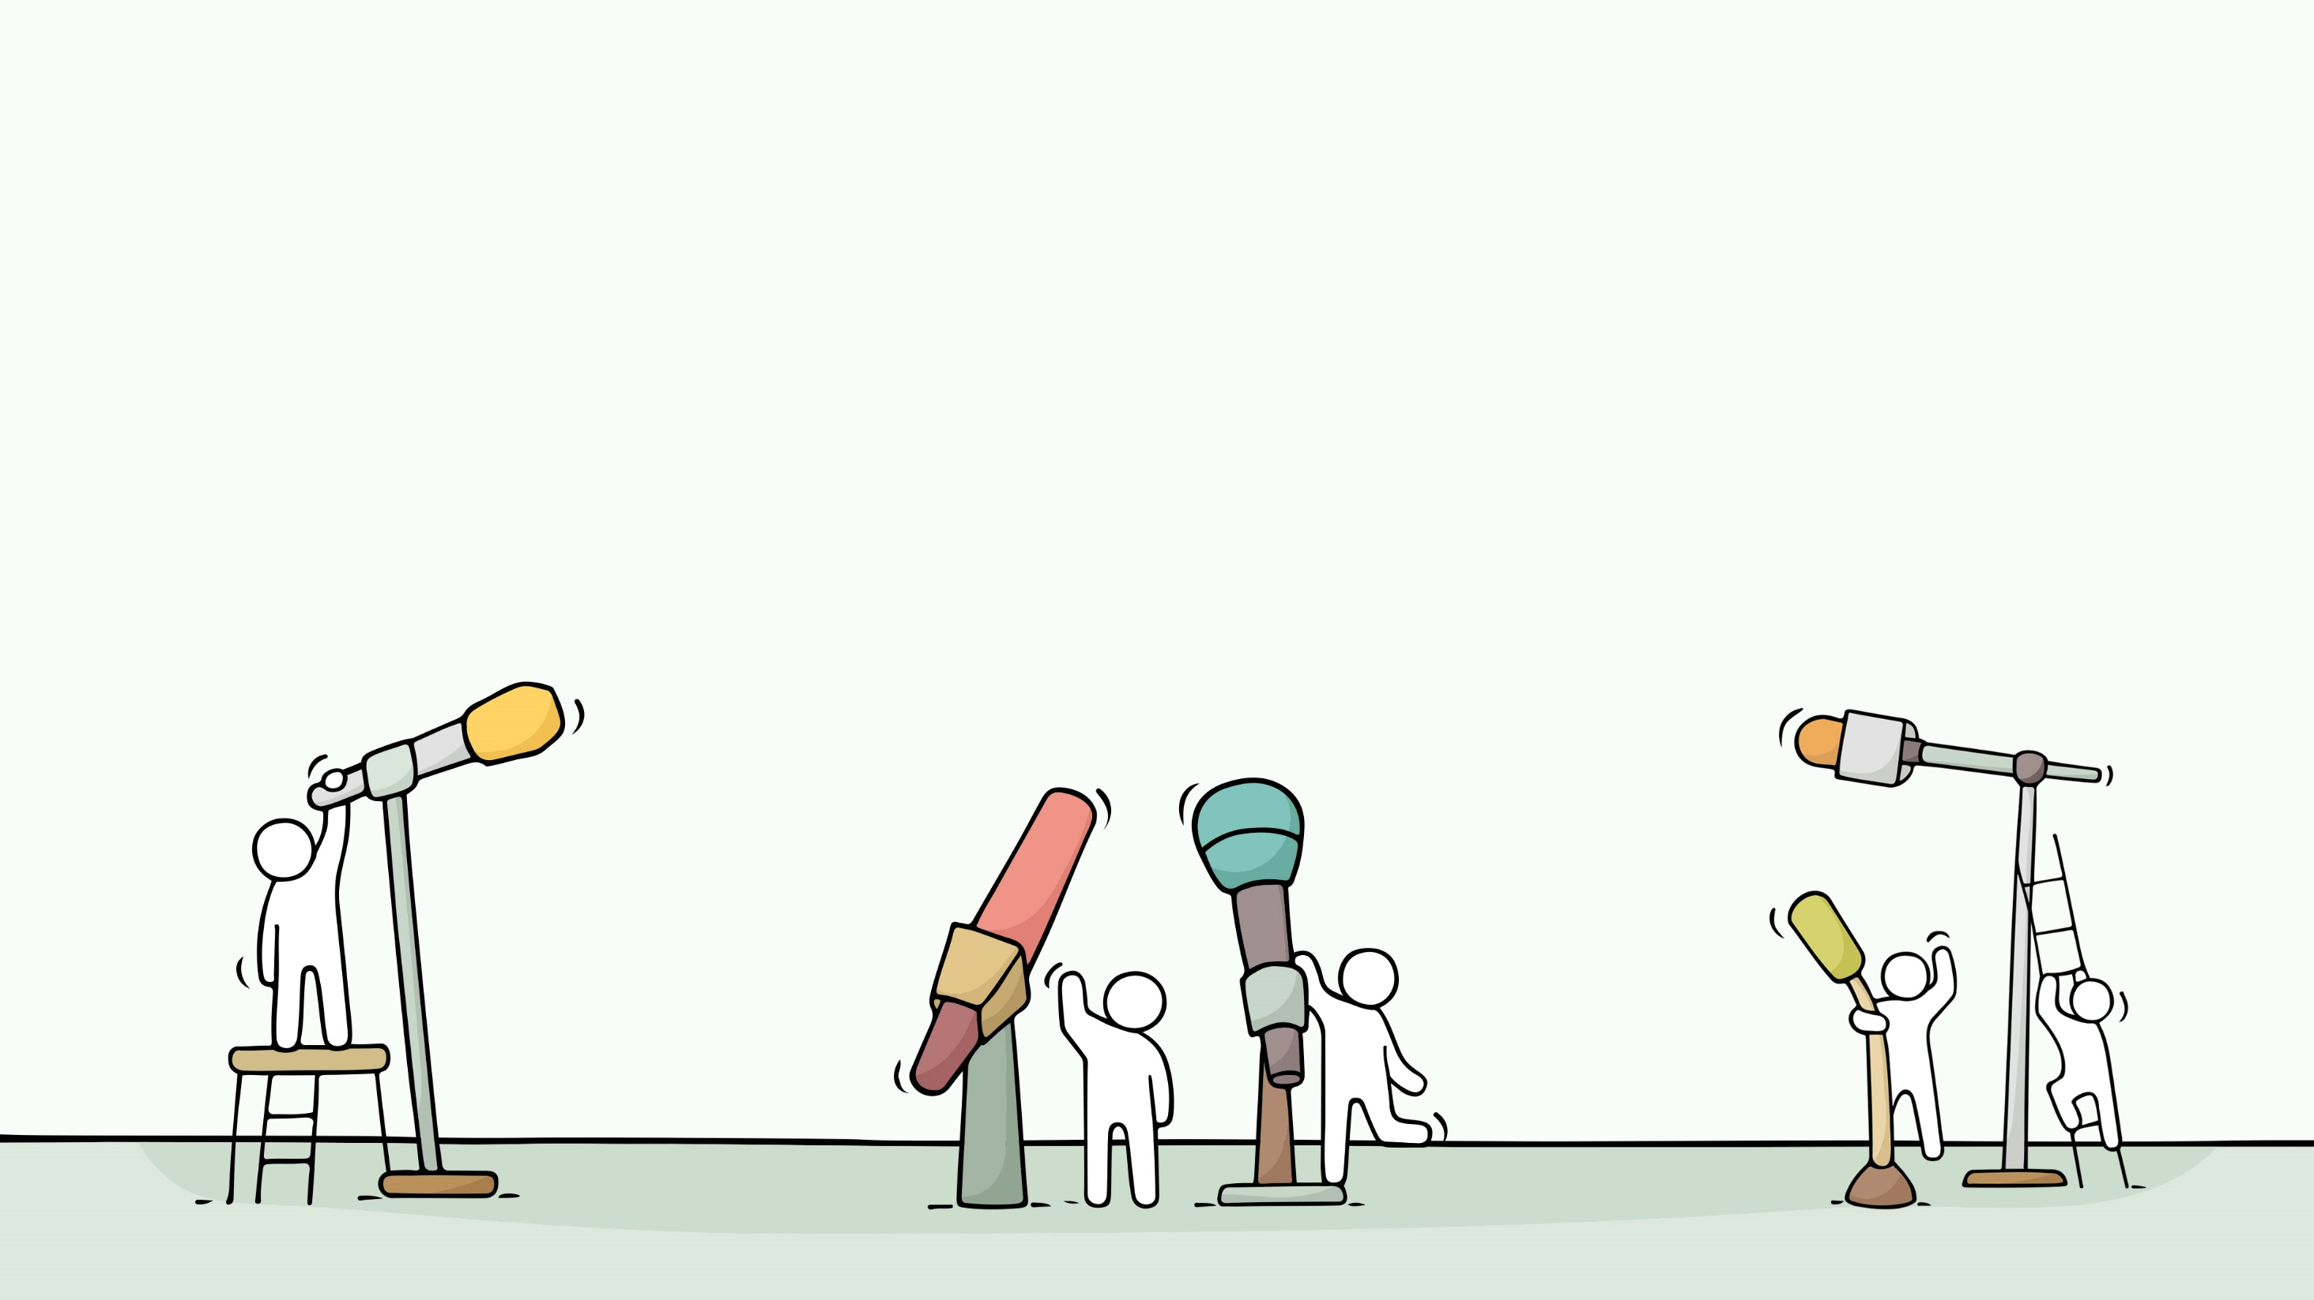
Write a Speech
  B2U5 Music Reading for Writing
景宁中学 毛丽琴 雷卫娟

Slide 5
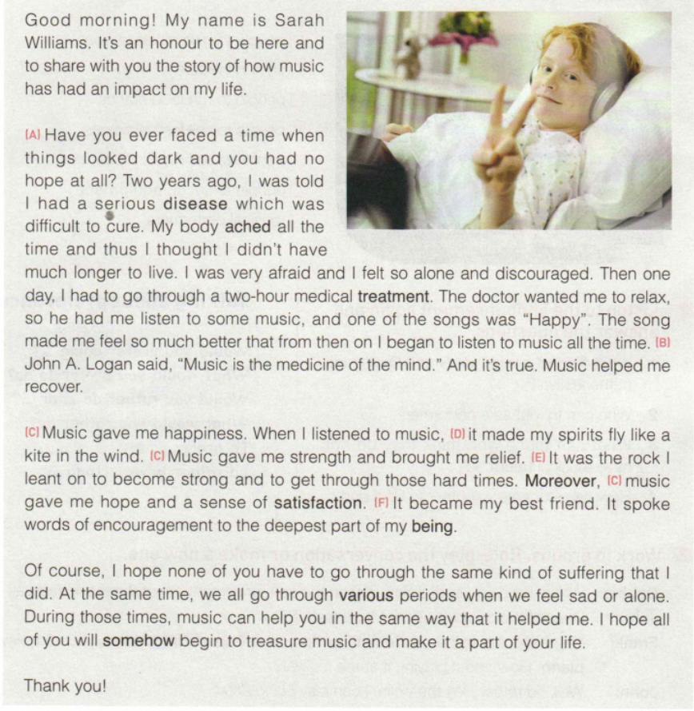
Beginning
greeting
introduction
stating topic
the story of how music has had an impact on Sarah’s life
clear structure
Body
topic-focused
Ending
hopes and thanks

Slide 6
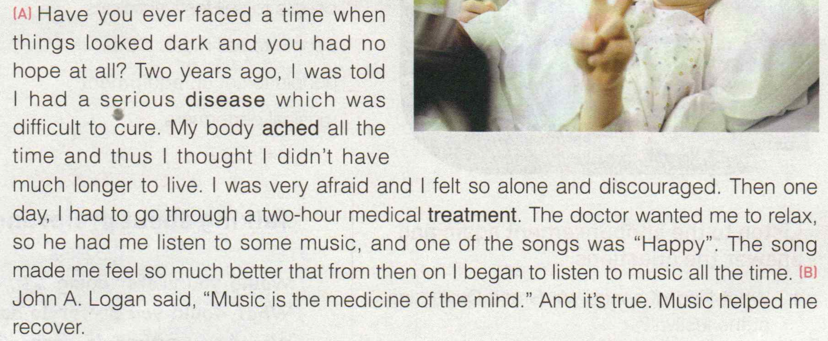

The story of how music has had an impact on Sarah’s life
rhetorical question
Use a rhetorical question as
a transitional sentence to lead
to one’s own experience.

Slide 7
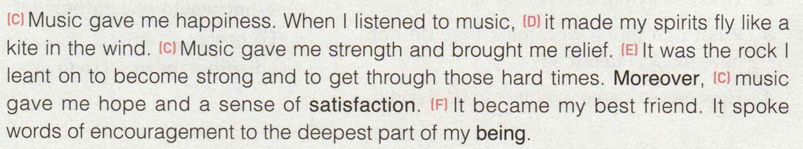
The story of how music has had an impact on Sarah’s life
attractive language
repetition
3 “gave”s
emphasize

Slide 8

“Music is the medicine of mind”
The story of how music has had an impact on Sarah’s life
attractive language
simile 明喻
metaphor 暗喻
general
personification 拟人
specific/vivid

Slide 9
Summarize
structure | content | language
clear
topic-focused
attractive
greeting,self-introduction and topic
rhetorical devices:
repetition,simile,
metaphor,personification
rhetorical question, quote
Beginning
experience with music
feelings about music
Body
Ending
hopes and thanks to the audience

Slide 10

Assess and Polish
clear structure
topic-focused content
Hello,everyone. I’m Li Hua. My topic today is Music and Me.
Going from junior high school to senior high school was a really big challenge . I found it so difficult to make new friends that I felt extremely alone and discouraged. From then on, I buried myself in music which is like an old friend, keeping me company. Music brought me a sense of safety. Besides, music brought me happiness. More importantly, music brought me hope.
So I hope all of you will turn to music while facing difficulities.
That is all. Thank you！
attractive language
general
+specific
rhetorical
devices

Slide 11
Assess and Polish
Hello,everyone. I’m Li Hua. My topic today is Music and Me.
Going from junior high school to senior high school was a really big challenge . I found it so difficult to make new friends that I felt extremely alone and discouraged. From then on, I buried myself in music which is like an old friend, keeping me company. Music brought me a sense of safety. _______________________ Besides, music brought me happiness. _______________________________More importantly, music brought me hope.___________________________________.
So I hope all of you will turn to music while facing difficulities.
That is all. Thank you！
general+specific
rhetorical devices

Slide 12
Checklist:
1. Does each sentence relate to the topic?
2. Is a specific discription given in this sentence?
3. Does this sentence use rhetorical devices, such as metaphor, personification and simile.
4. Are all words spelt correctly?

Slide 13
Hello,everyone. I’m Li Hua. My topic today is Music and Me.
Going from junior high school to senior high school was a really big challenge . I found it so difficult to make new friends that I felt extremely alone and discouraged. From then on, I buried myself in music which is like an old friend, comforting me . Music brought me a sense of safety. ________________________________________________________________ Besides, music brought me happiness. _________________________________________________More importantly, music brought me hope.______________________________________________.
So I hope all of you will turn to music while facing difficulities.
That is all. Thank you！
When I was lonely, it was a companion with whom my thoughts were shared.
With music streaming, a warm current always swept over me
It is like a key that opened the door to a new life.
general+specific
rhetorical devices

Slide 14
Assignment: Create
1.Write a speech draft with the theme of The Power of Music, trying to make the structure clear, the content topic-focused and language attractive;
2. Exchange drafts with a partner. Use checklist on page 57 to help you revise the draft.

Slide 15

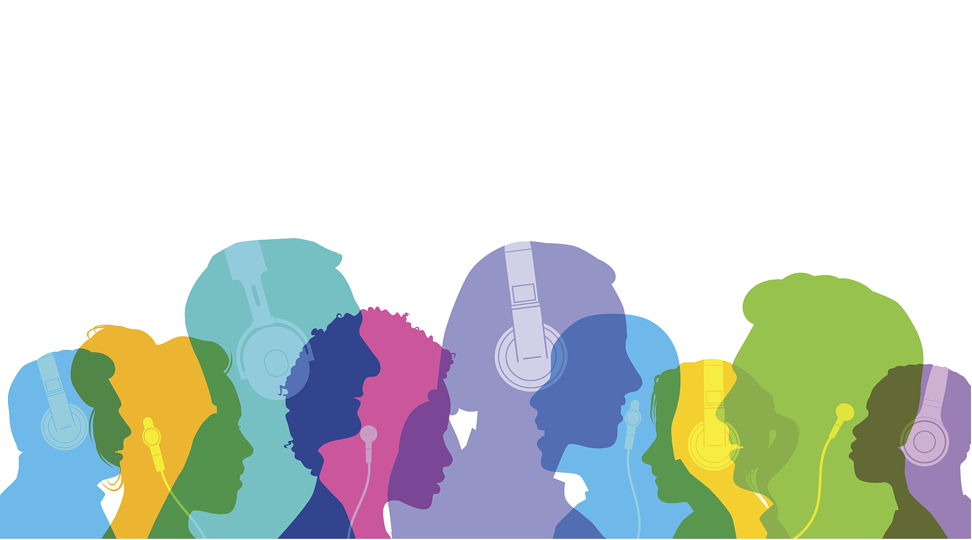
Without music, life is a journey through a desert.
——Pat Conroy

