Slide 1


感恩遇见，相互成就，本课件资料仅供您个人参考、教学使用，严禁自行在网络传播，违者依知识产权法追究法律责任。
更多教学资源请关注
公众号：溯恩高中英语
知识产权声明

Slide 2

让人物在你的笔端鲜活
动作描写

Slide 3
动作&情感描写
在艺术语言中最为重要的是动词。因为全部生活都是运动。要是你找到了准确的动作，那你就可以安心地继续写你的句子。
动作描写体现情感
阿·托尔斯泰

Slide 4
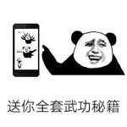
取胜第一招：动作描写要反映人物的思想感情
素材摘录：Her eyes lingered for a moment on Neville’s cloak, which was fastened under his left ear, and on Ron’s smudged nose. Harry nervously tried to flatten his hair.
她的眼睛在内维尔的斗篷上停留了一会儿，那件斗篷系在他的左耳下面，在罗恩那脏兮兮的鼻子上。哈利紧张地试图把头发弄平。
(哈利波特与魔法石Chapter 7)
素材背景：After Professor McGonagall showed the new comers around the school, she led them into the chamber to attend the Sorting Ceremony where the new comers would be sorted into four different houses.

Slide 5
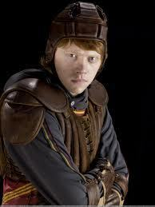
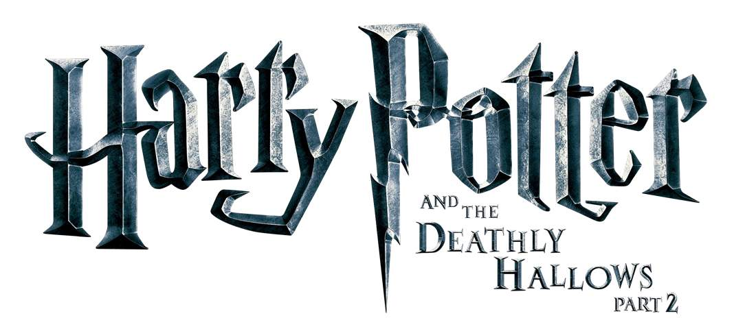
nervousness
Her eyes lingered for a moment on Neville’s cloak, which was fastened under his left ear, and on Ron’s smudged nose. Harry nervously tried to flatten his hair.
面对老师严厉的目光，加上Neville和Ron不满意的外表，让Harry很紧张，所以他不自觉地抚平头发。
lingered on…(眼光)停留在…
smudge(n.)煤灰 脏东西
smudged(adj.) 有煤灰的 脏的
flat(adj.)平滑的
flatten(v.)把…弄平
and the
Sorcerer’s Stone

Slide 6
素材摘录：She left the chamber. Harry swallowed.
她离开了会议室。哈利咽了咽口水。
(哈利波特与魔法石Chapter 7)
素材背景：Professor McGonagall left the chamber while Harry and other new comers were waiting to be sorted into four different houses. They were nervous about the result.

Slide 7
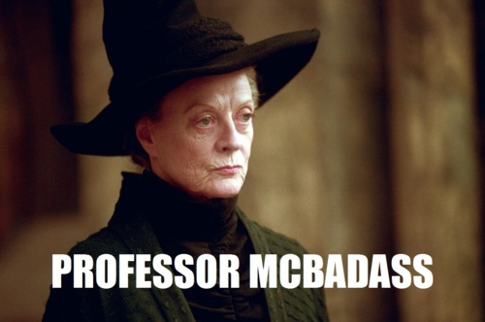

nervousness
She left the chamber. Harry swallowed.
chamber房间
swallow紧张地吞口水
and the
Sorcerer’s Stone

Slide 8
素材摘录：Several boys of about Harry’s age had their nose pressed against a window with broomsticks in it.
几个和哈利差不多大的男孩鼻子紧贴着窗户，里面是魔法扫帚。
(哈利波特与魔法石Chapter 5)
素材背景：The boys were admiring the various broomsticks that they were longing to have outside the shop.

Slide 9
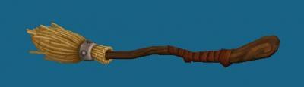
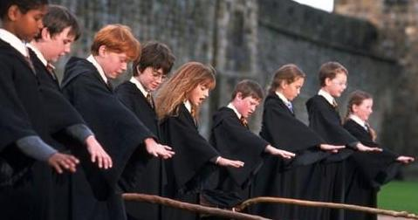
eagerness
Several boys of about Harry’s age had their nose pressed against a window with broomsticks in it.
Broomstick(n.)长柄扫帚
had their nose pressed against a window 迫切的心情
and the
Sorcerer’s Stone

Slide 10
取胜第二招：动作描写与语言描写相结合
素材摘录：“Good wand(魔杖), that one. But I suppose they snapped it in half(折断成两半) when you got expelled(被开除)?” said Mr. Ollivander, suddenly stern(严厉的).
“Er -- yes, they did, yes,” said Hagrid, shuffling (蹭) his feet. “I’ve still got the pieces, though,” he added brightly.
“棒极了，那根魔杖。但我想，当你被开除的时候，他们把它掰成了两半？”奥利万德先生突然严厉地说。
“呃，是的，是的。”海格说，来回蹭着脚。“但是，我仍然留着这些碎片。”他欢快地补充道。(哈利波特与魔法石Chapter 5)
素材背景： Mr. Ollivander, the wand maker, asked Hagrid, about his wand when Hagrid accompanied Harry to make a wand.

Slide 11
embarrassment
“Good wand(魔杖), that one. But I suppose they snapped it in half(折断成两半) when you got expelled(被开除)?” said Mr. Ollivander, suddenly stern(严厉的).
“Er -- yes, they did, yes,” said Hagrid, shuffling (蹭) his feet. “I’ve still got the pieces, though,” he added brightly.
Being asked about the past, Hagrid was feeling a bit embarrassed.
and the
Sorcerer’s Stone

Slide 12
素材摘录：“But you don’t use them?” said Mr. Ollivander sharply.
“Oh, no, sir,” said Hagrid quickly. Harry noticed he gripped(紧抓) his pink umbrella very tightly as he spoke.
“Hmmm,” said Mr. Ollivander, giving Hagrid a piercing (穿透的) look.
(哈利波特与魔法石Chapter 5)
素材背景： Mr. Ollivander suspected that Hagrid was still using his wand after he had been expelled from the school.

Slide 13
nervousness
“But you don’t use them?” said Mr. Ollivander sharply.
“Oh, no, sir,” said Hagrid quickly. Harry noticed he gripped(紧抓) his pink umbrella very tightly as he spoke.
“Hmmm,” said Mr. Ollivander, giving Hagrid a piercing (穿透的) look.
Hagrid was lying.
Mr.Ollivander knew he was lying.
and the
Sorcerer’s Stone

Slide 14
素材摘录：“An’ I’ve also got a letter from Professor Dumbledore,” said Hagrid importantly, throwing out his chest.
“我还带了邓布利多教授的一封信，”海格很神气地说，挺起胸膛。
(哈利波特与魔法石Chapter 5)
素材背景：Hagrid accompanied Harry to take some money from the safe. The goblin needed to see prove first before he gave them the money.

Slide 15
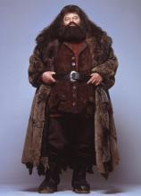
pride
“An’ I’ve also got a letter from Professor Dumbledore,” said Hagrid importantly, throwing out his chest.
importantly
throwing out his chest
Hagrid felt proud.
and the
Sorcerer’s Stone

Slide 16
取胜第三招：动作描写与环境描写相结合
素材摘录：The storm raged more and more ferociously as the night went on. Harry couldn’t sleep. He shivered and turned over, trying to get comfortable, his stomach rumbling with hunger. Dudley’s snores were drowned by the low rolls of thunder that started near midnight.随着夜幕的降临，暴风雨越来越猛烈。哈利无法入睡。他打了个寒战，翻了个身，想舒服一点。他的肚子饿得咕咕叫。达力的鼾声被午夜时分低沉雷声淹没了。
(哈利波特与魔法石Chapter 3)
素材背景：Uncle Vernon took Harry and his family so that Hagrid couldn’t find Harry. They spent the nigh at a hotel on a stormy night.

Slide 17
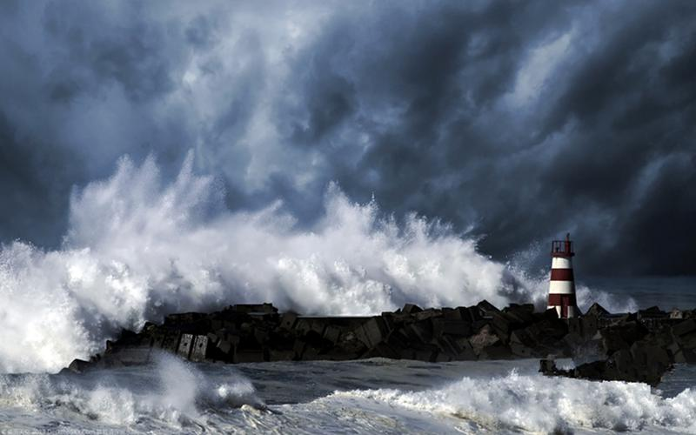
环境描写推动故事情节的发展，体现人物情感，心理；渲染气氛。
Fear
He was frightened, cold and hungry.
The storm raged more and more ferociously as the night went on. Harry couldn’t sleep. He shivered and turned over, trying to get comfortable, his stomach rumbling with hunger. Dudley’s snores were drowned by the low rolls of thunder that started near midnight.
fear
Dudley’s snores???
the night???
the storm???
rolls of thunder???

Slide 18
素材摘录：They were going even deeper now and gathering speed. The air became colder and colder as they hurtled round tight corners. They went rattling over an underground ravine, and Harry leaned over the side to try to see what was down at the dark bottom, but Hagrid groaned and pulled him back by the scruff of his neck.
他们乘小车来得更深，速度越来越快。当他们在狭窄的角落里飞驰时，空气变得越来越冷。他们在一个地下峡谷上嘎嘎作响，哈利靠在一边，想看看黑暗的底部到底是什么，但海格嘟哝着，抓住他的颈背把他拉了回来。(哈利波特与魔法石Chapter 5)
素材背景：Hagrid accompanied Harry to the underground bank to pick up some money for Harry, who was the first time to go there.

Slide 19
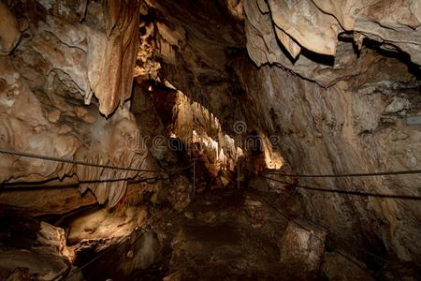
Curiosity
They were going even deeper now and gathering speed. The air became colder and colder as they hurtled round tight corners. They went rattling over an underground ravine, and Harry leaned over the side to try to see what was down at the dark bottom, but Hagrid groaned and pulled him back by the scruff of his neck.
environment
the cart: going deeper; gathering speed; hurtling and ratting
the cave: colder and colder; tight corners
Harry
lean to see
哈利充满好奇
Hagrid
groan and pull

Slide 20
se the boy... Use the boy..."
Part 4
Harry felt as if Devil's Snare was rooting him to the spot. He couldn't move a muscle. Petrified, he watched as Quirrell reached up and began to unwrap his turban. What was going on? The turban fell away. Quirrell's head looked strangely small without it. Then he turned slowly on the spot.
Harry would have screamed, but he couldn't make a sound. Where there should have been a back to Quirrell's head, there was a face, the most terrible face Harry had ever seen.
译文：
哈利觉得自己仿佛被魔鬼网牢牢缠住了，浑身上下丝毫也动弹不得。他呆呆地站在那里，看着奇洛举 起手解下他头上的围巾。这是怎么回事?大围巾落了下来，奇洛裸露的脑袋看上去小得出奇。然后，他慢慢 地原地转过身去。
哈利想放声尖叫，但发不出一点儿声音。在原本该是奇洛后脑勺的地方，长着一张脸，哈利还从来没有看见过这样狰狞恐怖的脸。
讲解：
chalk white 像粉笔一样白的
名词+形容词 像...一样...的
取胜第四招：动作描写与修辞结合
素材摘录：Uncle Vernon made another funny noise, like a mouse being trodden on.
弗农姨父又发出一声滑稽的声音，就像老鼠被人踩了一样。
(哈利波特与魔法石Chapter 4)
素材背景： Uncle Vernon took Harry away so that Hagrid couldn’t find Harry. But he failed.

Slide 21
simile
Uncle Vernon made another funny noise, like a mouse being trodden on.
明喻(simile)是比喻的一种,是一两种具有共同特性的事物或现象进行对比,表明本体和喻体的相类关系,两者都在对比中出现。常用比喻词有: like; as。
tread v. 踏;踩
More example：
Harry often said that Dudley looked like a pig in a wig.
哈利经常说，达德利看起来像戴着假发的猪。

Slide 22
se the boy... Use the boy..."
Part 4
Harry felt as if Devil's Snare was rooting him to the spot. He couldn't move a muscle. Petrified, he watched as Quirrell reached up and began to unwrap his turban. What was going on? The turban fell away. Quirrell's head looked strangely small without it. Then he turned slowly on the spot.
Harry would have screamed, but he couldn't make a sound. Where there should have been a back to Quirrell's head, there was a face, the most terrible face Harry had ever seen.
译文：
哈利觉得自己仿佛被魔鬼网牢牢缠住了，浑身上下丝毫也动弹不得。他呆呆地站在那里，看着奇洛举 起手解下他头上的围巾。这是怎么回事?大围巾落了下来，奇洛裸露的脑袋看上去小得出奇。然后，他慢慢 地原地转过身去。
哈利想放声尖叫，但发不出一点儿声音。在原本该是奇洛后脑勺的地方，长着一张脸，哈利还从来没有看见过这样狰狞恐怖的脸。
讲解：
chalk white 像粉笔一样白的
名词+形容词 像...一样...的
素材摘录：Icy sea spray and rain crept down their necks and a chilly wind whipped their faces.
冰冷的浪花和雨水顺着他们的脖子往下爬，寒风抽打着他们的脸。
(哈利波特与魔法石Chapter 3)
素材背景：Uncle Vernon borrowed a boat, taking Harry and his family to an island on a stormy night. He thought Hagrid couldn’t find them there, but he was wrong.

Slide 23
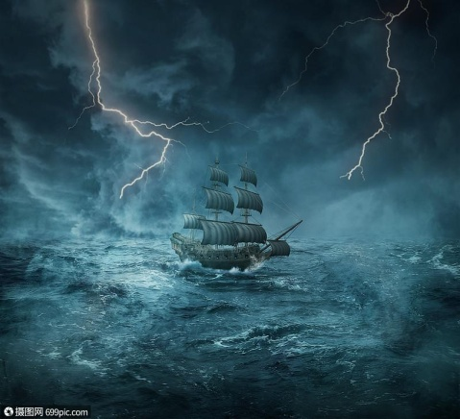
personification
spray : n.水花; 飞沫
Icy sea spray and rain crept down their necks and a chilly wind whipped their faces.
creep: 爬行; 悄悄地缓慢行进
whip: v. 鞭打
拟人修辞方法，就是把事物人格化，将本来不具备人动作和感情的事物变成和人一样具有动作和感情的样子。

Slide 24
取胜第五招：连续动作描写更好地反映人物的思想感情
素材摘录：He laid Harry gently on the doorstep, took a letter out of his cloak, tucked it inside Harry’s blankets, and then came back to the other two. For a full minute the three of them stood and looked at the littele bundle; …
他轻轻地把哈利放在门口台阶上，从斗篷里拿出一封信，塞在哈利的毯子里，然后又回到另外两个人身边。他们三个人站了整整一分钟，望着那小包裹； … (哈利波特与魔法石Chapter 1)
素材背景： Hagrid, McGonagall and Dumbledore put Harry in front of his aunt’s house.

Slide 25
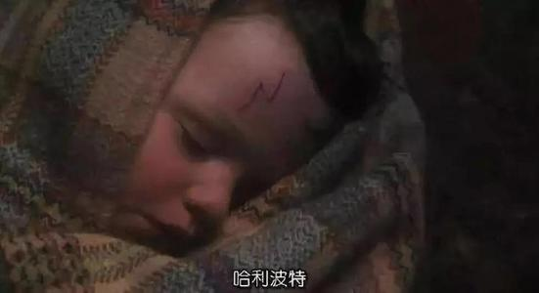
动作&情感描写
He laid Harry gently on the doorstep, took a letter out of his cloak, tucked it inside Harry’s blankets, and then came back to the other two. For a full minute the three of them stood and looked at the littele bundle; …
形容词
动词
Love
副词
介词
and the
Sorcerer’s Stone

Slide 26


Many thanks!
Goodbye!

