Slide 1


感恩遇见，相互成就，本课件资料仅供您个人参考、教学使用，严禁自行在网络传播，违者依知识产权法追究法律责任。
更多教学资源请关注
公众号：溯恩高中英语
知识产权声明

Slide 2
阅读理解改编
A Miraculous Rescue
Yujia Pan

Slide 3
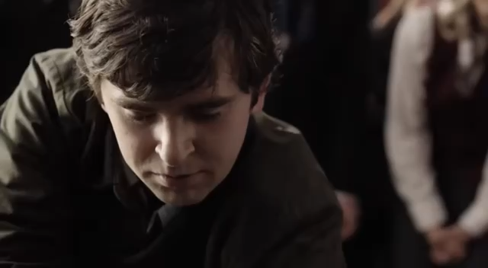
Warming-Up: A short clip from The Good Doctor《良医》

Slide 4

Lead-in: A Miraculous Rescue
What was the rescue about?
Who did the rescue? (main character)
A miraculous
rescue
Where/When/ Why did the rescue happen?
How did he/she perform the rescue?
What is the writing style of this passage?
argue
argument argumentation
A. An exposition (说明文)
B. An argumentation(议论文)
C. A descriptive/ narration(记叙文)
Tip 1:Focus on 6 elements: when/ where/ who/ what/ how/ why

Slide 5

Para1-2: When did the story happen?
=ended up
Did they enjoy the party all night?
When/As the party was wrapped up, the whole family moved inside!
Before moving inside, where were they?
They were having fun in the family’s swimming pool!
How about everyone’s feelings towards family–gathering time?
joyous
joyful
thrilled
excited
delighted
How?
The day started out joyously…(Para1)
Supporting sentences
They had a meal and some fun in the swimming pool.
The adults put on a performance and chatted(Para2)
Tip 2: Infer characters’ feelings with descriptive sentences.

Slide 6

Para2 Which sentence infers you that the plot is going to change?
But in all the commotion, no one remembered to lock the door to the pool area.
1.By the way, what’s the meaning of the word “commotion”?
A. Excitement /Thrill B. Adaptations
C. Delay/Postpone/Put off D. Emergency
How is the sentence developed? (figure of speech)
A.by space B. by contrast C.by classification D.by process
Was it right?
How serious?
It was a mistake!
cost the family dearly!
It was a simple mistake that could have____________________
Actually! It was a costly mistake instead of a small one!
So the unlocked door gives us another hint which means that someone could go to the swimming pool freely, right?

Slide 7
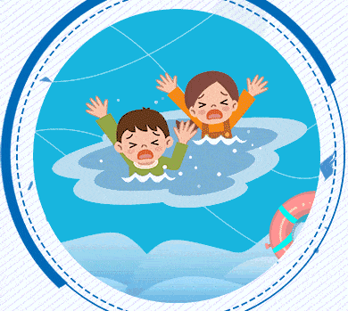
Para3 So who went outside through the unlocked door?
What an emergent/urgent situation!
What a terrifying sight!
Branson’s little sister
It is __________________ that/ who went outside. (强调句型)
2.Hence we can infer that Branson’s mother was______ towards his son?
A.confused/puzzled B.proud C.relaxed D.anxious
What was she doing outside?
Wandering/Roaming around outside!
Only six years old!
Who did notice that?
Branson (our main character)
How old was he?
What else did he spot?
The 2-year-old twins face down in the pool!
It was a miraculous(奇迹般的) thing to know that my son acted immediately!
Well, did Branson just scream and escape from the scene?
Did he just ignore/ neglect it or stand there in shock?
Actually/In fact, he _________________ instantly !
took rescue measures
What about his actions?
Tip 3: Pay attention to the verbs which assist in developing the plot!
Notes:
How did you know that?

Slide 8
Para4-5:What did Branson do when in such an emergent situation?
It’s _____________________ to know the knowledge of first aid which can indeed _______________(起作用)between life and death!
First
He dived into the swimming pool at once/right away.
significant/essential/vital
Fortunately, the drowning twins were saved/rescued rather than ended up in brain death!
Next
He pulled the drowned twins out of the swimming pool.
make a difference
He began performing/operating CPR(心肺复苏) for the twins while crying for help !
Then
How could a 6-year-old boy know how to apply CPR?
What a(n) ________boy!
what
He just copied/imitated _____ he had seen when his mother…
intelligent
After hearing his frightened
cry
running
Adults came ________(run) outside…Steven began applying CPR until drowning boys started_____________ and ___________while Branson’s mom called 911.
coughing up water
breathing

Slide 9
Para6:After emergency responders arrived, what did they do?
3.There is no doubt that it is ________________that made the twin brother quick and full recovery!
doctor’s effective treatment
Branson’s prompt/quick/instant reaction as well as his knowledge about the first aid
C. the timely arrival of the helicopter
D. Their good luck/ fortune
They airlifted the boys to the hospital by helicopter.
Based on doctor’s
remarks
The boys were _______ in the hospital. (期中考Cloze)
A. sent B. taken C. landed D. made
Amazingly, the twins were already showing ________________ (改善的迹象) and absolutely fine before receiving cure/ treatment.
signs of improvement
What’s the first thing to remember when dealing with an emergency?
What adjectives would you use to describe Branson’s actions?
To stay calm and not to be panic!恐慌的
Brave, courageous, fearless, heroic, quick-thinking,
quick-minded, helpful, unselfish, confident, intelligent, smart

Slide 10
Summary: draw a mind map to retell the development of the story
Branson performed a miraculous rescue towards the drowned twins
Dilemma
Climax (高潮)
calm
intelligent
brave
heroic
Branson spotted the 2-year-old twins face down the pool!
frightened
terrified
horrible
dreadful
The twins were saved.
Development
(发展,经过)
The whole family had a happy gathering time!
joyous
cheerful
delighted excited thrilled
Ending (结局)
relieved
grateful
Introduction
(导入)

Slide 11
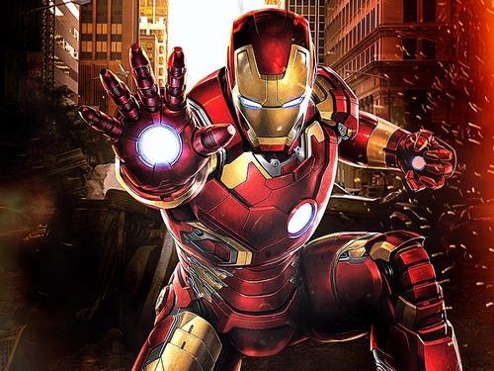
Now, Let‘s apply what we have learned into practice!
Suppose you were a lifeguard, there was a child drowning in the water. Try to describe how to perform your rescue. (Please highlight your heroism by 2 aspects, including the seriousness of the situation and your quick action!)
Writing task

Slide 12
Chance to be a hero/ heroine: one paradigm (典范)
Without thinking twice, I leaped off my chair and dived into the water with a tremendous splash. Meanwhile, a small crowd of the onlookers called emergency service. I swam as quickly as I could towards the the drowning boy. After reaching him, I grabbed him around the chest and pulled him to the water surface. Then we slowly moved to the side of the pool. As soon as we climbed out of the pool, I started performing CPR on the boy. Luckily, the boy coughed up water and started breathing after several minutes! What a positive sign! Meanwhile the crowd burst into applause! After seeing her boy safe and sound, the boy’s mother tottered forward and sank upon the bosom of her son, crying tears of joy. Then she clasped my hands tightly, expressing her thanks over and over again. Today, I really took pride in my brave action and appreciated the value of my job.

Slide 13
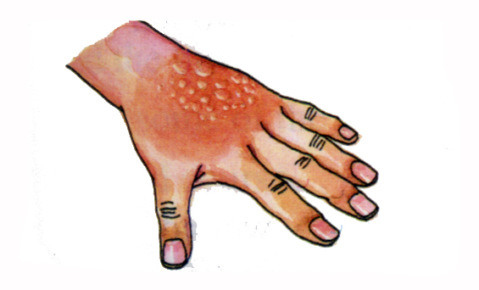
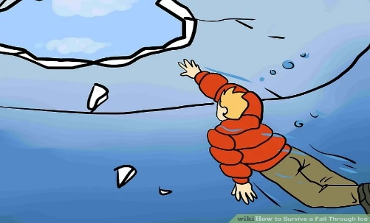
Let’s recall what we ‘ve learned today about First-Aid
Initially
We should keep calm when an accident/emergency occurs.
Secondly
We ought to call 911/ 120/ emergency service right away!
While, in different situations, we perform corresponding First-Aid
What if someone was drowning?
What if someone fell through ice?
Different situations
What if someone was bleeding?
What if someone got burned?

Slide 14
What if someone was drowning? What kind of rescue can we perform?
First
keep calm when an accident/emergency occurs.
Next
Dive into the swimming pool at once/immediately.
Then
Pull the drowned person out of the swimming pool.
Perform /operate CPR(心肺复苏)
copy/imitate what you have learned from the school/ other people until someone coughed up the water and started breathing
Later
Meanwhile
cry for help or ask others to call 911/ emergency service

Slide 15
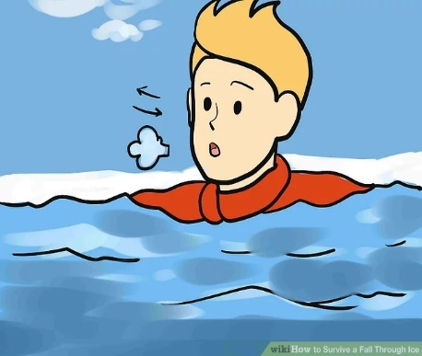
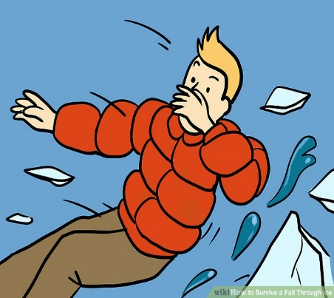
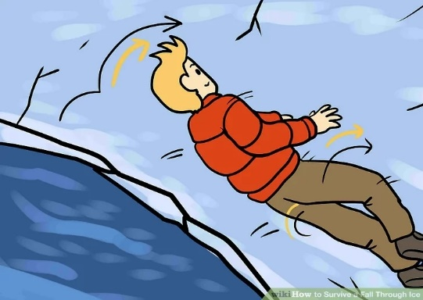
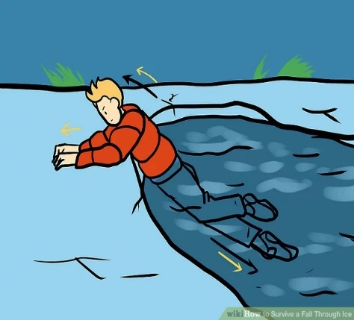
Stay as calm as possible!
get control of your breathing
Locate the thickest area of ice
2
1
How to
Survive
a fall through ice ?
3
Place your arms over the surface of the ice and remain visible for rescue.
Stretch your arms over the surface; get horizontal with surface and kick your legs to climb out of the water
4
5

Slide 16
What if someone was bleeding? How to highlight the heroism?
screaming/shouting/yelling尖叫; shocking; bleeding heavily大出血, severe situation, being stabbed repeatedly 多次被刺伤; almost been cut off几乎被砍断了
The seriousness
of situations
好词: rushed outside冲出去; quick action; bravery; immediately, treat, applying pressure施加压力
好句: 1.约翰立即采取行动，而不是感到害怕和袖手旁观！John immediately took actions instead of feeling frightened and standing by!
The heroes’ quick action

Slide 17
Let‘s recall: What kind of firs aid did John perform? (人教B5U5)
He slowed the bleeding by applying pressure to the wounds until the police and ambulance arrived.
Use the sentence pattern “…not …..until..” to transform
He did not stop applying pressure to the wounds until the police and ambulance arrived.
Use the sentence pattern “Not until….” to paraphrase
Not until the police and ambulance arrived did he stop applying pressure to the wounds.
How about his feeling?
“I am proud of what I did but I was just doing _____ I had been taught.
(引导宾语从句,在从句中做宾语)
what

Slide 18
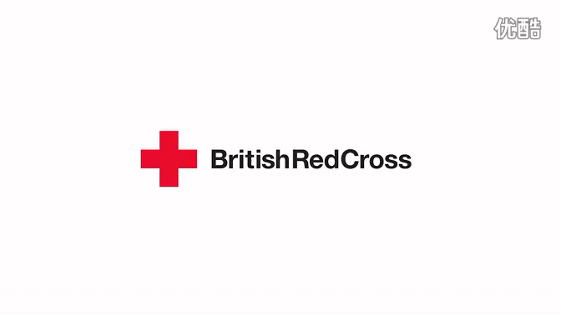
What if someone got burned? What kind of First-Aid can we perform?

Slide 19
What if someone got burned? What kind of First-Aid can we perform?
Initially
keep calm when an accident/emergency occurs.
Next
take off clothing or remove clothing via using scissors
cool burns immediately with cool water & place burns under gently running water for about 10 minutes
Then
dry the burned area gently and cover the burned area with a clean bandage or a plastic bag and fix it with tape.
Later
For a serious burns
call 120/ emergency service immediately and sent the victim to the hospital!

Slide 20
Life is the highest of all the treasures.
Thank You!

