Slide 1

感恩遇见，相互成就，本课件资料仅供您个人参考、教学使用，严禁自行在网络传播，违者依知识产权法追究法律责任。
更多教学资源请关注
公众号：溯恩高中英语
知识产权声明

Slide 2
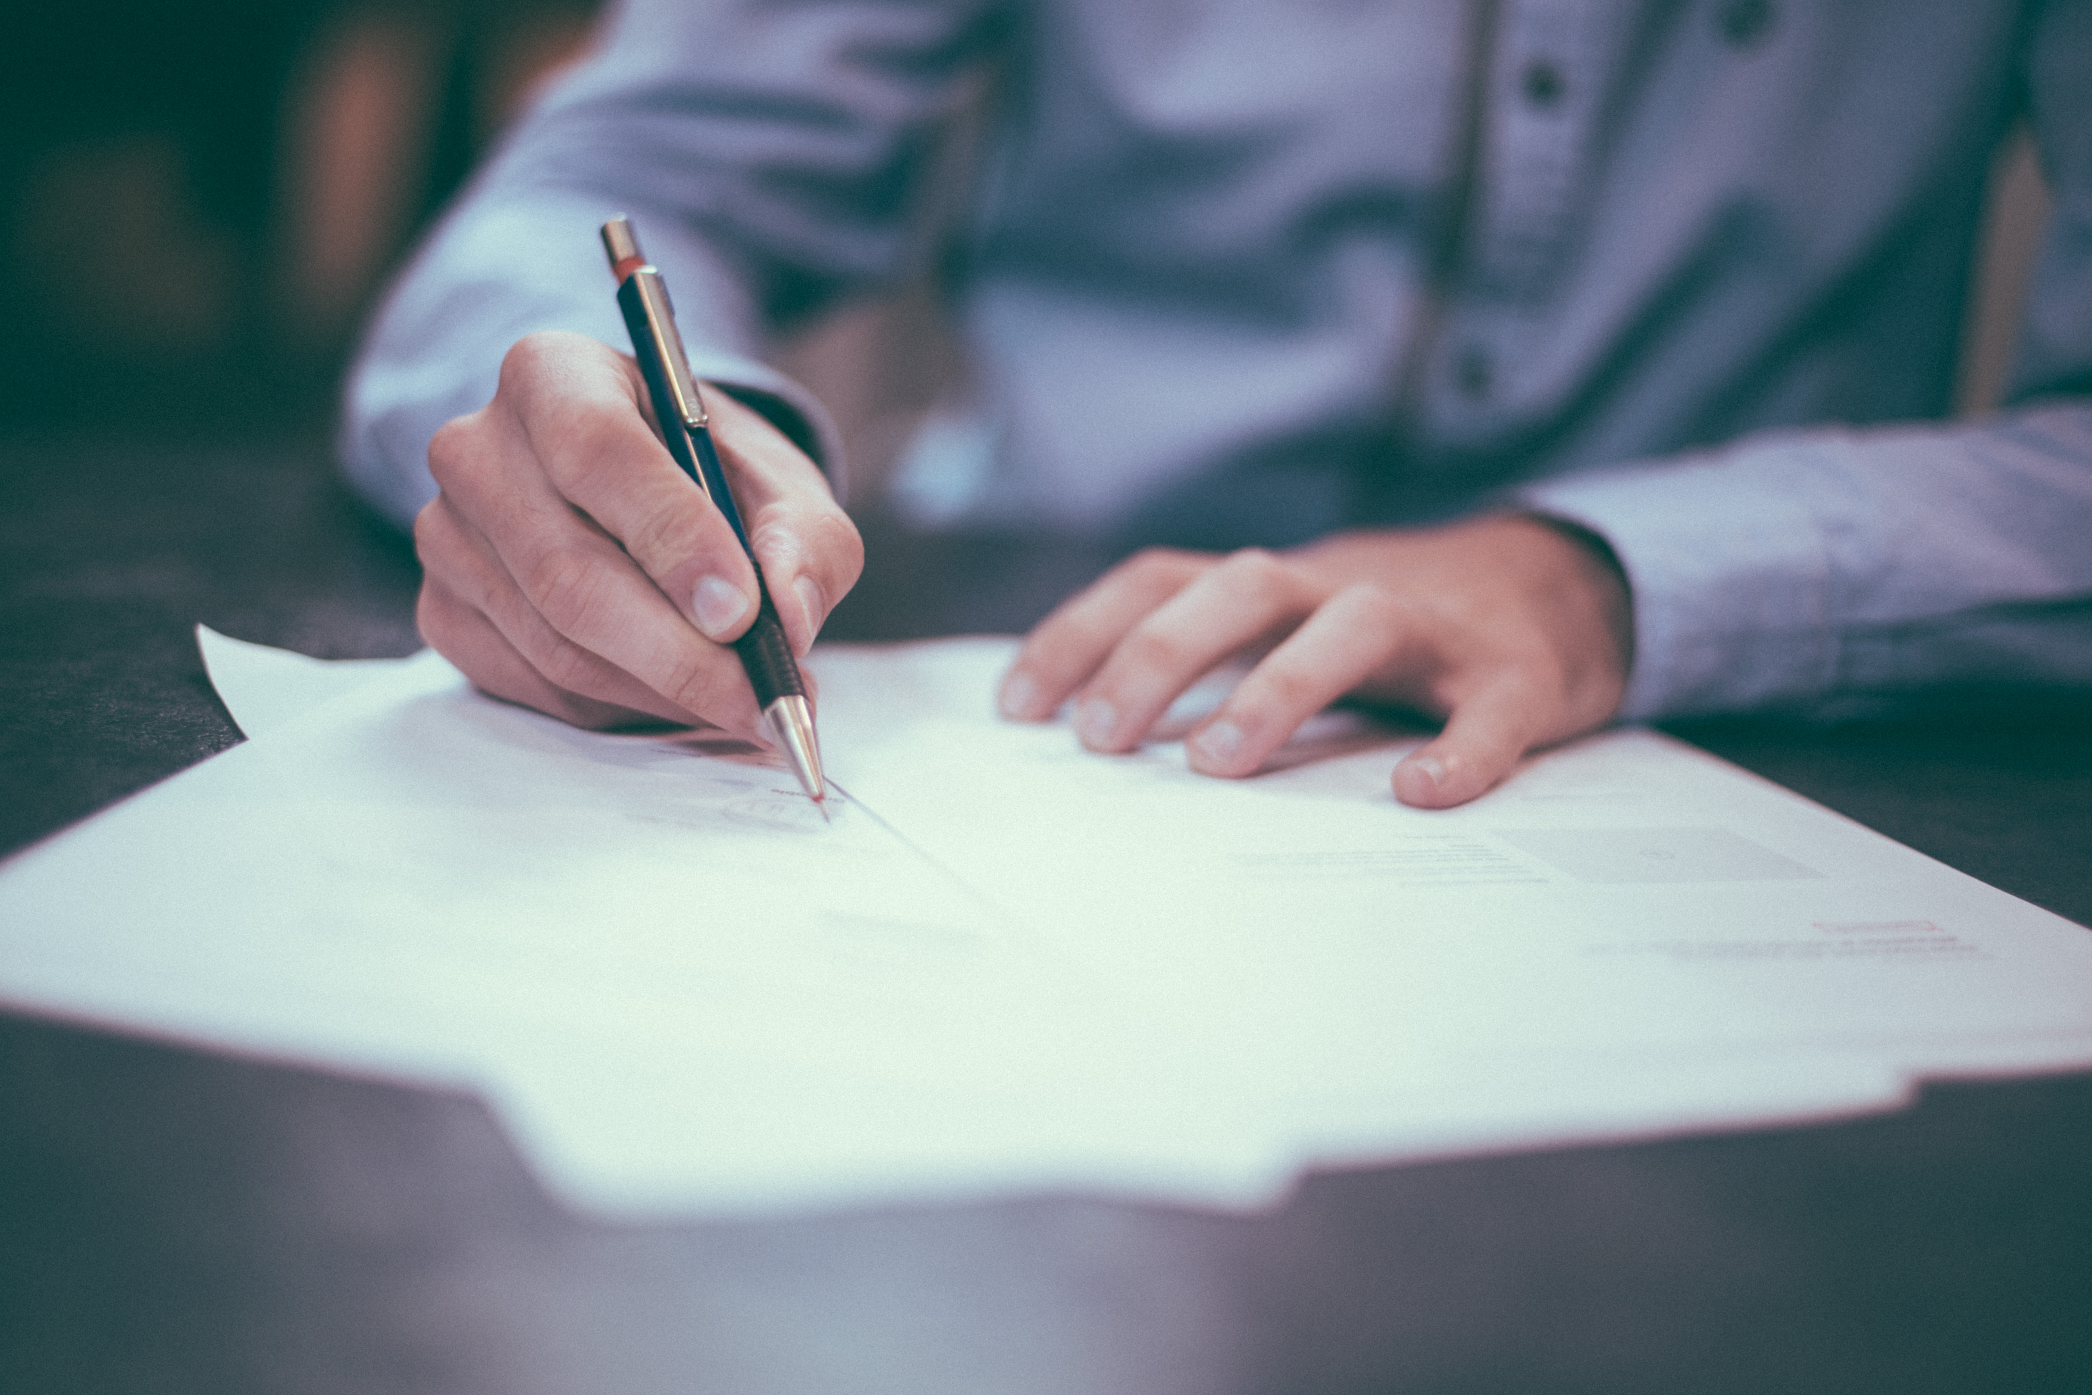
读后续写微专题
---衔接和连贯

Slide 3

About coherence and logic:
记叙体的顺序性：结构紧凑；一气呵成
时间顺序
意识流动顺序
空间顺序
场景的氛围

Slide 4
一、时间顺序：① 时间快慢 ②时间先后
时间慢 | go slowly; drag on 很慢；日长似岁 after what seems an age/ a century 似乎过了一年、一个世纪
时间快 | 短语： 1.go fast/quickly 2. tick away (时间)一分一秒地过去 3. for/in an instant; in a spilt second; in a flash; in the blink of an eye; in the twinkling of an eye 刹那间 副词： 1.immediately/instantly 立刻；马上 2.shortly 不久，马上 句型 1.on/upon (doing) sth 一做某事 2. before 还没来得及，常见句式before sb knew what was happening; 3. The moment +句子； no sooner…than..; hardly/scarcely…when… 一…就…
Notes:
www.515ppt.com

Slide 5
Sentence-appreciation
◆ The rest of the day went very slowly for Anne.
◆ Why do physics lessons always seem to drag?
◆He had to watch the minutes tick away while the emergency services tried to locate him.
◆In that split second, my surfing days as I had known them were over.
◆ Before I could finish my sentence, she burst into tears and began rocking back and forth.
◆ The moment he finished his speech in a magnetic voice, a storm of applause erupted from the audience.
Notes:
www.515ppt.com

Slide 6
一、时间顺序：① 时间快慢 ②时间先后
紧接着/后来 | 句型： 1.时间（the following weeks/days…）witnessed/saw sth doing 接下来得时间，见证了某事得发生。 2. that’s when sth happened. 3. Everything settling down/everything ready, 主句。一切完成/就绪后，…. 4. It 句型：it was /took +时间 before sb did sth 过了一段时间，某人开始做某事 短语： the next minute; followed by; at that; with that; before doing ; after doing; subsequent to that; after that; then following … 副词： subsequently; then; afterwards; later
Notes:
www.515ppt.com

Slide 7
一、时间顺序：① 时间快慢②时间先后
恰好；不料；来不及 | just in time to find/see 恰好发现、看到… …only to do …结果 There is no time do to…. Just as /when sb did…., 主句
Notes:
www.515ppt.com

Slide 8
Sentence-appreciation
◆ The last five minutes saw his dashing to the finish line like wind.
◆ The following weeks saw me dashing home from school each day determined to earn a nickel or dime.
◆Everything ready, the news page was eventually in business.
◆I opened the door just in time to find him watching TV.
◆ With that, she rushed out of the room.
Notes:
www.515ppt.com

Slide 9
二、空间顺序
视觉和听觉 | at the sight of…一看到… shift one’s eyes from…to…
合围 | be surrounded by…被…包围 pull/draw sb aside 把人拉到一边 pull/ gather up sb into one’s arms 把某人拉到怀里
打手势 | gesture/signal sb to to 打手势让某人做
方向移动 | vt（make one’s way; tiptoe; creep; slip;slide…）+ out of/through/down/up/ onto …
Notes:
www.515ppt.com

Slide 10
Sentence-appreciation
◆ His eyes shifted from face to face.
◆ She laughed, ignoring the stares of everyone around her.
◆She pulled out into the street.
◆ We followed him up the steps into a large hall.
Notes:
www.515ppt.com

Slide 11
三、意识流动顺序：思维活动推动故事发展
（突然）想到了什么 | 1.“….”he thought (to oneself). 2. Thoughts/mind raced 大脑极速转动 3. The thought of ….+ 谓语（make; bring） 4. occur to; cross one’s mind; strike/hit sb; come/flash/pop into one's mind 5. at the thought/image of… 一想到
大脑里的声音 | the inner voice told sb to do 2. Sth rings/echos in one’s brain/mind 还在某人的脑海中 3. hear one’s voice in the mind 在脑海里；能听到某人的声音
想象什么 | picture/imagine vt.想象（常做非谓语） 2. daydream about sth…做关于…的白日梦
Notes:
www.515ppt.com

Slide 12
Sentence-appreciation
◆ “How strange!’ he thought to himself.
◆The thought of Nick made her throat tighten.
◆ My inner voice told me to be cautious.
◆All at once an idea popped into her head.
◆I said, picturing the fancy brick house that we passed on our way from school.
Notes:
www.515ppt.com

Slide 13
四、场景的氛围：其他人群的反应
人群的反应 | A murmur of （approval…） came from the crowd. …be greeted with cries of… 3. …produced /caused an awkward silence. 4. …found an echo in her own feelings. 引起了她的共鸣。 5. …struck a chord with his audience. 引起了听众的共鸣 6. A thunderous applause burst out from the audience.
一片 寂静 | 1.There was a moment of complete silence. 2. Silence falls/descends (on/upon sth) 3. …be met with silence/ …be followed by a very long silence, broken by…
Notes:
www.515ppt.com

Slide 14
Sentence-appreciation
◆ Her question was met with an uneasy silence.
◆A sudden silence fell over the room.
◆ His love for her found an echo in her own feelings.
◆Her remarks produced an awkward silence.
◆The speaker had obviously struck a chord with his audience.
Notes:
www.515ppt.com

Slide 15
Consolidation: fill in the blanks
1.时间慢慢地过去，我的状况越来越糟了。
As time ________ on, I gradually got worse.
2. 一眨眼的功夫就完成了。
It was done in a ________/in a ________ second.
3. 他们一路跑到转角处，正好看到公共汽车消失在街尽头。
They ran all the way to the corner just _____ ______ to see the bus disappearing up the street.
4. 我们穿过村庄来到了农场。
We made our way_________ the village to the farm.
dragged
flash
spilt
in
time
through
Notes:
www.515ppt.com

Slide 16
Consolidation: fill in the blanks
5.奇怪的念头在他脑子里转动。
Strange thoughts________ around and around in his mind.
6. 那寒冷黑暗的大海，他想想都吓得发抖。
He trembled ____ the thought of the cold, dark sea.
7. 她脑子里有个小小的警钟响了。
A tiny alarm bell began to _______ in her brain.
8. 我试着想象我们像第一次诊断时那样努力与病魔作战。
I try to_____________ us fighting just as hard as we had during the diagnosis.
raced
at
ring
picture/imagine
Notes:
www.515ppt.com

Slide 17
Application
Mike licked the last of the mint chocolate chip ice cream. It was almost time to leave. He jumped into the car which his parents and headed off to the Olympic-sized pool for the big swim meet.
When his race came up, Mike was confident. He was strong and swift. Mike climbed out the pool, smiling. He had just won first place, making him the fastest boy in his age group.
“Congratulations, son, “ his father said. His mom gave him a hug, even though he was soaking wet.
A week later, it was time for another swim meet, Like before, Mike decided to enjoy his favorite ice cream flavor. Mike remembered that the last time he had won a race, he also ate mint chocolate chip ice cream first. Maybe he'd win again.
He’s taken first place again in his race. Mike was feeling pretty good. As it turned out, Mike decided to have some mint chocolate chip ice cream before every one of the next few swim meets. He began to think of it as his lucky charm. After several months of placing in the top positions of every race he swam. Mike was feeling unbeatable, And he wouldn't admit it, but all that ice cream was adding a few pounds to his athletic swimmer’s build.
Notes:
www.515ppt.com

Slide 18
Application
It didn't take long after that for Mike to start coming in second place -and then third and then last place in his races. The lucky mint chocolate chip ice cream had lost its magic.
On the day of his next swim meet, his mother sat down at the table with him. "Mike, we all love ice cream, but it's not healthy for your body to eat so much of it. Maybe it's time to quit the sweet treats for a while, especially before you go swimming.”
Mike unwillingly agreed. He went to the swim meet, and didn’t perform well. His father offered to go running with him a few days a week to help him feel better and strengthen his muscles. The extra weight soon disappeared, and Mike found himself breathing easier at swim practices. It was the last meet of the season, and Mike wasn't sure what to expect. He felt healthy again, but he didn’t know if he still had any speed in the pool.
Paragraph 1: As he dove into the water, he kicked his legs and stretched his arms as far as he could.
Paragraph 2: His jaw dropped as he realized he had beaten his own best time, and everyone else too.
Notes:
www.515ppt.com

Slide 19
Analyzing the text
Confident—discouraged--uncertain
(Mike; mother; father
feelings
who
Mike was unsure what would happen at the last meet of the season
Swimming pool
where
what
when
the last meet of the season
Notes:
www.515ppt.com

Slide 20
Predicting and Plotting
1. As he dove into the water, he kicked his legs and stretched his arms as far as he could. ______________________________
2. His jaw dropped as he realized he had beaten his own best time, and everyone else too. ____________________
Para 1: Mike拼命游泳---下定决心要赢—对手超过他，努力追赶—超过他人，冲向终点；
Para 2:Mike打破记录，吃惊—感到开心—父母祝贺—领悟胜利的真谛
Notes:
www.515ppt.com

Slide 21
Plotting and predicting
Para.1 As he dove into the water, he kicked his legs and stretched his arms as far as he could. “This is where I belong. I am the winner.” His eyes were fixed on the finish line. Suddenly, two figures whizzed past, which startled him . Fearing to fall behind, he struggled to catch up but in vain. “Do my luck desert me?” he thought in doubt . That was when his hard training in his father’s company occurred to him. He collected himself quickly. The last five minutes saw his dashing to the finish line like wind, followed by the announcement of the result.
时间顺序
意识流动顺序：思维活动推动故事情节发展
时间顺序：紧接着、后来
Notes:
www.515ppt.com

Slide 22
Plotting and predicting
意识流动顺序：内心想法
Para2. His jaw dropped as he realized he had beaten his own best time, and everyone else too. However, deep down, he knew he deserved the honor of championship. His parents came up and gave him a high five, grinning from ear to ear. “Hey, why not try your favorite ice cream and celebrate!” said his father, patting him on the shoulder. “Thanks, dad, but I have given up the ice cream. It’s not such a lucky charm at all.” His eyes shone with wisdom. It was on that day that Mike realized one’s lucky charm was nothing but his diligence.
场景的氛围：喝彩鼓掌欢呼等
Notes:
www.515ppt.com

Slide 23
Summary
时间顺序
时间快慢/时间先后
空间顺序
从一个地方转移到另一个地方
续写中的
衔接和连贯
意识流动顺序
思维活动推动故事发展
场景氛围
人群的反应（或欢呼或喝彩或沉默…）
Notes:
www.515ppt.com

Slide 24

Thank you

