Slide 1

感恩遇见，相互成就，本课件资料仅供您个人参考、教学使用，严禁自行在网络传播，违者依知识产权法追究法律责任。
更多教学资源请关注
公众号：溯恩高中英语
知识产权声明

Slide 2


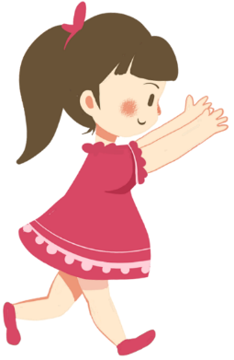

基于深度学习理念的小说整体阅读-以The Secret Garden为例
许丽君
夏超燕

Slide 3

About the author and the novel
Any mystery about the title?
题目带来的神秘感？
A myth or a fairy???

Slide 4
About the author and the novel
written by Famous 20th century female writer
An exploration of the soul and growth
Frances Hodgson Burnett
Friendship and happiness
classic of children's literature
The passion and love of life

Slide 5
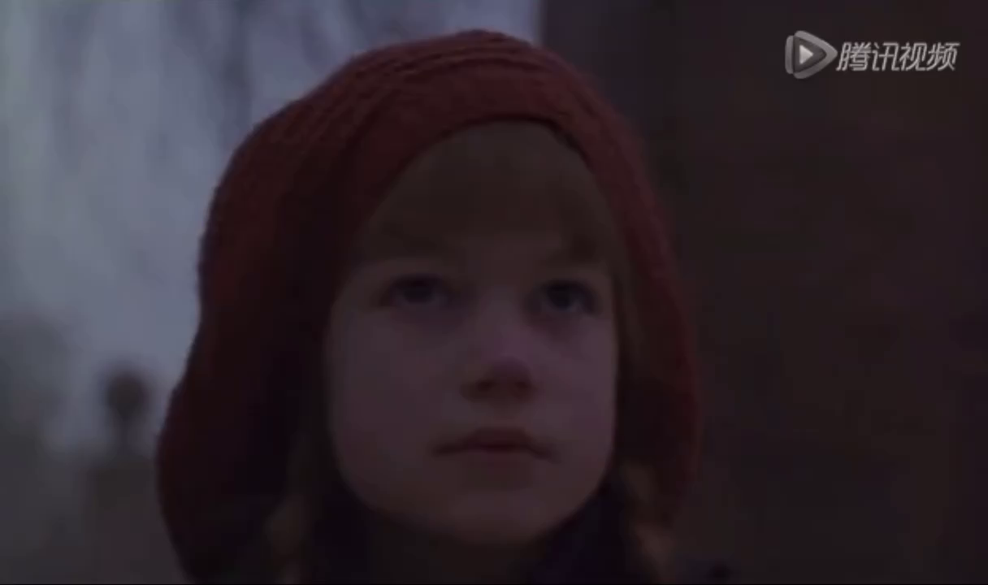
2. Read for the plot:
Important things that happened-Twists:
P19 Mary leaned forward and tugged at it, her heart thudding. It was a key. A long, rusty key.
（在有魔力的知更鸟的引领下，找到了进入花园的钥匙。）
P21 The gust blew only for a second but long enough for Mary to see a doorknob. Taking a deep breath, Mary pushed open the door and stepped inside.
（自然的魔力出现了，一阵风吹拂起常青藤，像一道幕帘升起，风吹得时间不长，但足以让Mary找到进入Secret Garden的门和锁孔。）

Slide 6
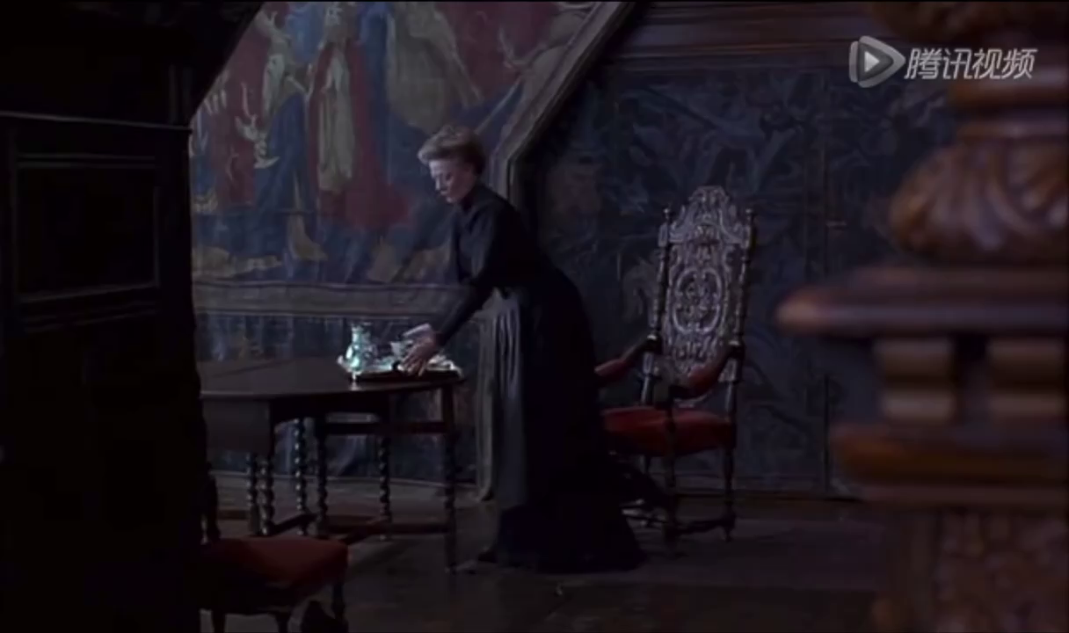
2. Read for the plot:
Learn through events小说中三个角色命运的转变 Great Changes of the three main characters
Think about Mary’s change:
Beginning
P6 very plain looking. Why her face is so pale! Almost yellow.
P7 Mary felt her spirits sink even lower.
Look（Mary无依无靠，心里的悲凄）
Description of her sadness.
P8 With that warm welcome，Mary was left alone.
P10 To prove it, Mary struggled into her new clothes.
To prove herself capable

Slide 7
2. Read for the plot:
Great Changes of the three main characters
Mary’s change: Setting : In the garden:
Cause
Effect
Mary’s personality:
(Small, sad, but strong-minded)
P15 For the first time in months, Mary felt happy.
P16 The days when she saw or heard the robin were the best.
Mary’s Change
Mary从一个孤僻变成了一个善良、纯真、健康向上的女孩，感染了庄园中的另一个人，性格怪癖的Colin, 他们一天天地改变着，正如尘封的秘密花园慢慢地变化着。
花园的清新空气，知更鸟让她忘记了忧愁，忘记了痛苦，Mary脸上泛起了健康的红润
P16 The fresh air put color in her cheeks and she grew stronger.
P24 There was only a calm feeling that made her feel she was wrapped in a warm blanket.
P27 But she wasn’t the old Mary from before and she obeyed.

Slide 8
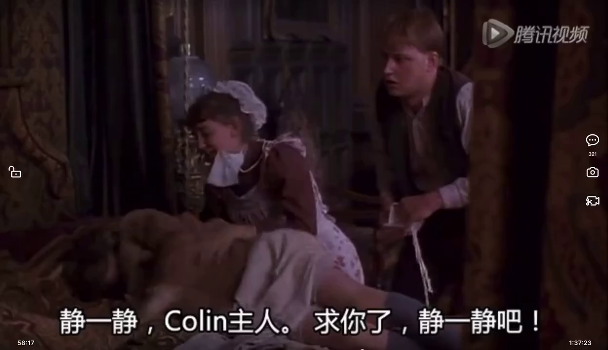
2. Read for the plot:
Great Changes of the three main characters
Colin Craven’s Change:
P36 The boy had huge, dark eyes that seemed too big for his thin, pale face.
（Colin性格怪癖）
P39 Colin stared at Mary crossly. “Because I am so weak and ill.” My father hates me!
（Colin的心理阴影）
P43 Colin said, “Not like here. There’s nothing magical about living here. It’s like a prison.”
P43 He looked so glum. It made Mary want to cheer him up.
P44 Colin’s face lit up. “It does sound wonderful.”
（Mary感染着性格孤僻的Colin）

Slide 9
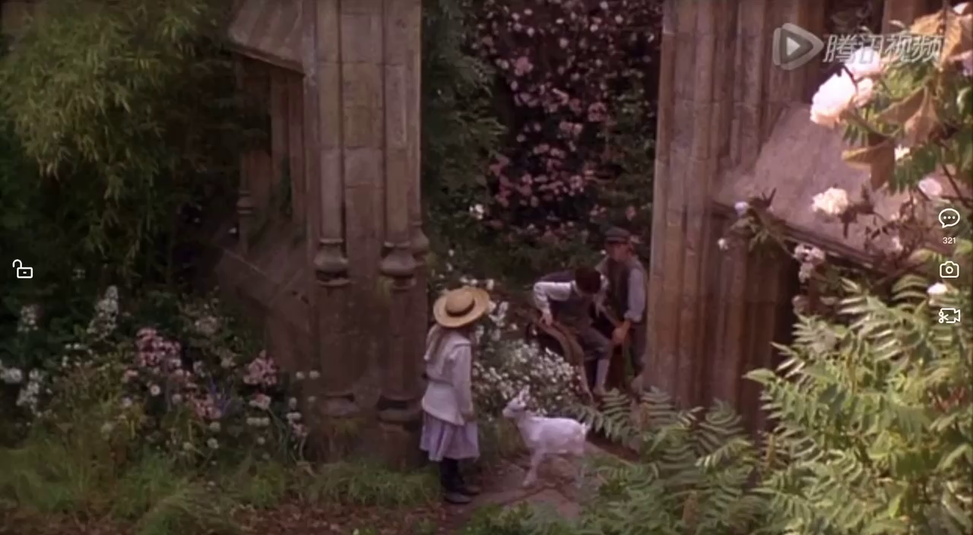
2. Read for the plot:
Great Changes of the three main characters
Colin Craven’s Change:
P45 as sounds of laughter were heard coming from Colin’s bedroom.
What’s Colin Craven’s Change
（不再厌倦生活）
P50 “You come when I say! I am the master of this house. I am more important than some stupid garden and some stupid boy!”
(怕自己和父亲一样驼背，从来没有奢望能站起来的Colin勇敢地在园丁Ben面前站立了起来，走出了生活中巨大的阴影，最终战胜自我，享受快乐，父子相见，过去的阴霾已成过往。)
P52 How dare this boy make everyone do what he wanted?
（面对Colin的粗暴无礼，Mary训斥他，最终以自己的乐观感染了Colin）
P55 The look of relief on the boy’s face was heartbreaking.
（Mary让Colin猛醒，帮助他战胜了“心魔”）
P69 By the time summer turned to autumn, he was not just walking, but running too.
（他们在秘密花园里健康成长）

Slide 10
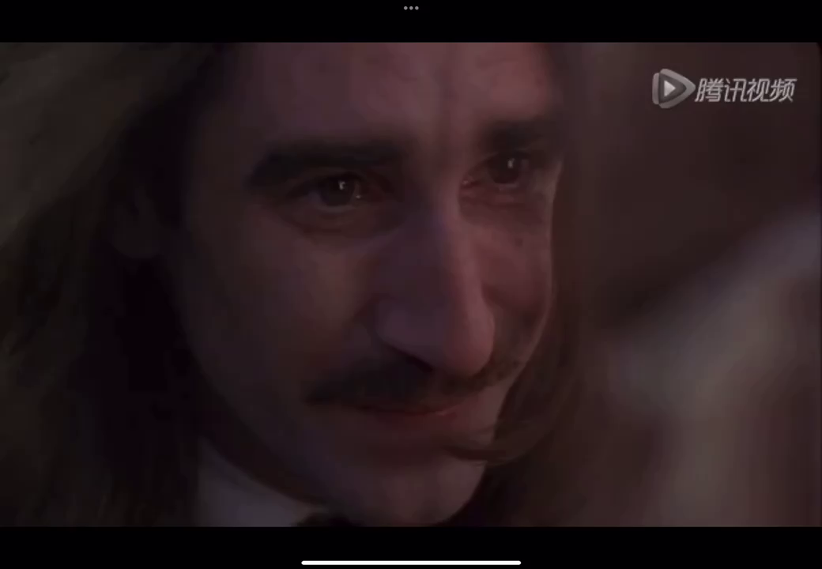
2. Read for the plot:
Great Changes of the three main characters
Mr. Craven’s change:
P6 Mrs. Medlock said Mr. Craven’s as sour as a crab apple.
（在痛苦中封锁自己）
P7 Master doesn’t want to see you.
（脾性孤僻，怪异）
P31 Mr. Craven said, his voice more gentle than she had thought it would be.
P33 She saw her uncle had a kind, almost handsome face, but it was full of sadness.
（逃避快乐）
P33 He smiled a sad smile.
P69 Mr. Craven woke from his dream. It had been so clear, so vivid. In it, he had heard his wife’s voice calling to him.
（魔力唤醒了他的乐观）

Slide 11
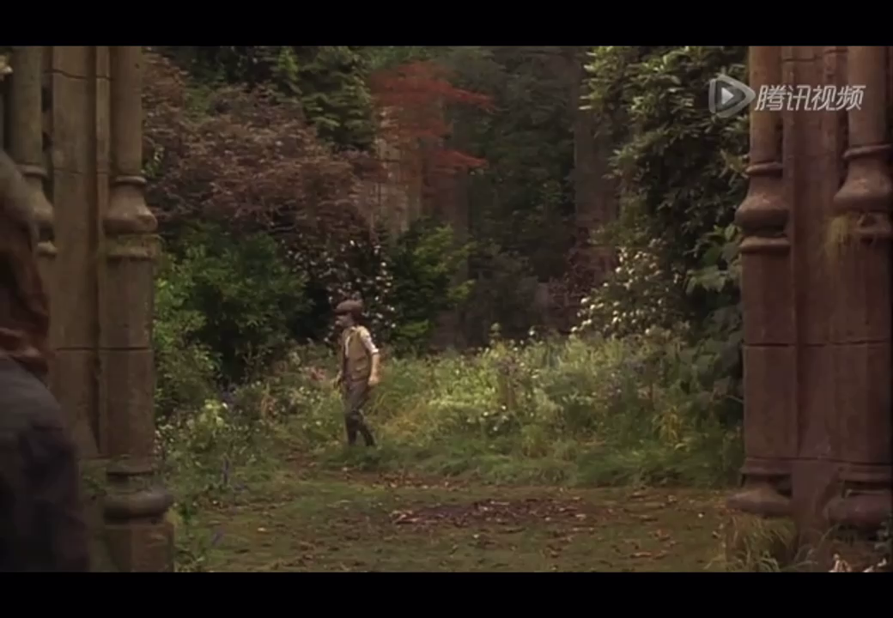
2. Read for the plot:
Great Changes of the three main characters
Mr. Craven’s change:
What’s Mr. Craven’s Change
P72 He went straight to his wife’s garden. It was to here the voice had called him.
（内心的醒悟， 重新走进花园）
每个人都渴望得到快乐，而失去了妻子的Mr. Craven也是如此。他将曾经给妻子修建的花园上了锁，挖了坑把钥匙埋了，或许他认为这样随着时间的流逝，可以把这一切淡忘，但他没有如愿。大多数时候他都出门在外，在庄园里也把自己关在西边楼里。而小说的最后循着妻子的呼唤来到秘密花园的Mr. Craven却感受到了生活的快乐，家庭的温馨。
P74 Mr. Craven just stared. This couldn’t be Colin? This tall, handsome boy?
（从父亲的视角看儿子的巨大转变， 他看到的是一个全新的Colin，像其他孩子一样健康的Colin。）

Slide 12
3. Understand the characters 分析关键人物，梳理角色的性格特征，读懂人物
学生从小说文本中提炼出Mary、Colin、Dickon等的性格特征，引领学生对主要人物进行细致的分析

Slide 13
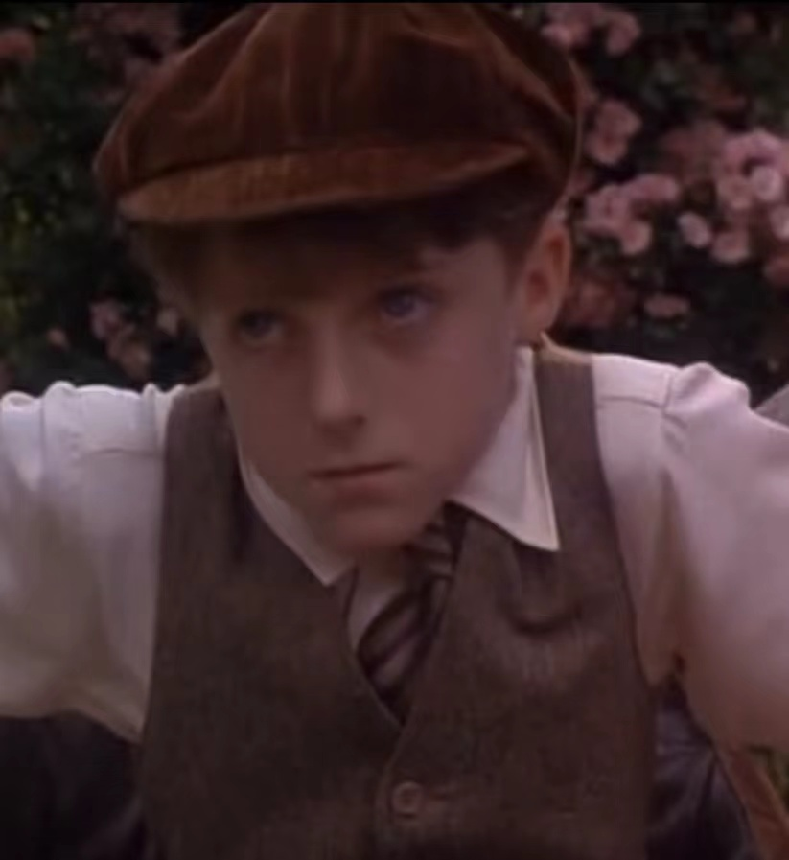
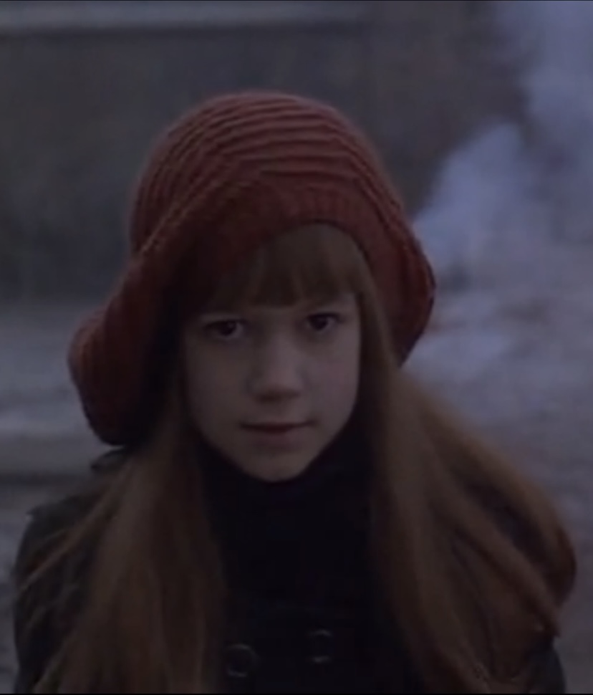
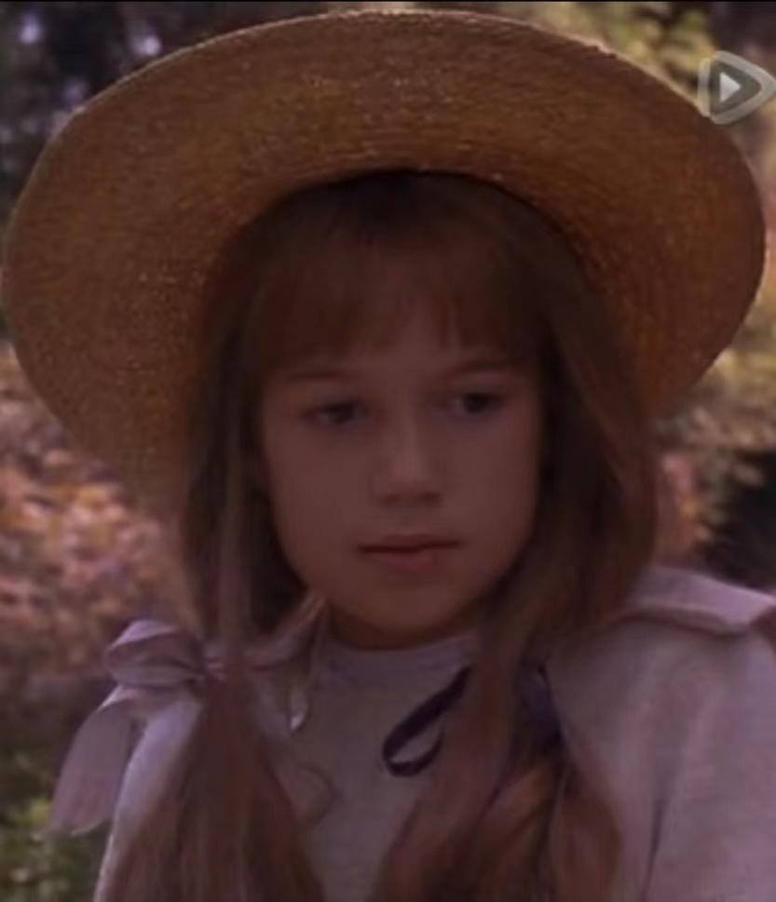
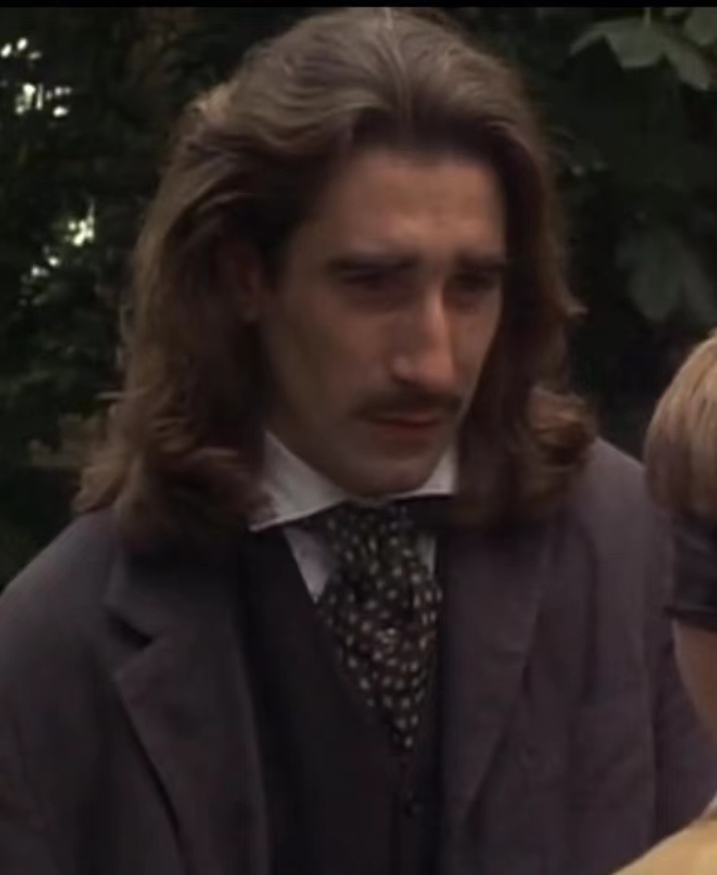
3. Explore and write about the Charactor Profile
Appearance: _________________________________________________
_________________________________________________
Personality: _________________________________________________
_________________________________________________
_________________________________________________
What Does Your Charactor do in the story
_________________________________________________
_________________________________________________
Change
_________________________________________________
_________________________________________________

Slide 14
3. Understand the characters
Colin’s change
Before
After
P36 The boy had huge, dark eyes that seemed to big for his thin, pale face.
P68 That night, Colin slept long and deep. When he woke, refreshed and full of energy, he had a plan.
P43 He looked so glum.
P68 As the trees blossomed and the shoots turned into the most beautiful flowers, Colin, too, changed. His arms grew stronger. His legs grew stronger.
P54 He continued to wail and begin banging his stick-like arms and legs.
Colin因为自己weak and feeble的身体，而不喜他人盯着自己看，还会暴怒到高烧不止。也因为焦虑自己是否会和父亲一样驼背而半夜哭嚎
Dickon和Mary一起帮助Colin摆脱对生活的厌倦，让他第一次站了起来，最后学会了奔跑。

Slide 15
人物(Name)： | 节选(experts) | 身份（Identity） | 所说所为： | 人物性格（Personality）：
Mary | Every chapter（见前分析） | A little orphan girl |  | Plain-looking， In low spirits， ------gentle，lovely
Colin | 见前分析 | Master of the house |  | Lonely
Dickon | P27 He had glorious rust-colored hair and blue eyes the color of the sky. | Martha’s brother |  | Kind-hearted， helpful，caring
Martha | P10 “I hope you like it here, Miss. There’s not much inside but outside-well-there’s a whole world waiting for you.” P16 The only person she had to talk to was Martha. | maid |  | Kind
Mr. Cravon | 见前分析 | Master of the house |  | Lonely-------pleasant
Mrs. Medlock | P8 Mr. Craven won’t have and nor will I! P31 Mrs Medlock stormed in, the usual scowl（怒容）nailed（钉） to her face. | Uncle’s housekeeper |  | Indifferent

Slide 16
3.分析人物对整部小说的发展和结果的影响，促进学生对小说人物的深度思考。（附各类描写整理）
Analyze the Speech:
P58 “May I?” Colin said in awe. The feel of the warm, soft new born lamb through his nightgown filled him with tenderness.
（Dickon带来的刚出生的小羊羔温暖着Colin那颗长时间得不到关爱的心，让他心中充满了热烈的期待。）
P60 “And if the fresh air agrees with me, I’ll be doing the same every day.”
（语言描写Colin感受到了外面世界的精彩，自然的魔力对他产生了影响，他开始期待每天都拥有灿烂的光明和芬芳的空气。）

Slide 17
3. Understand the characters
Analyze the Actions：
P67 They watched Colin put one foot on the ground, then the other, until he was standing upright.
动作描写Colin坚强地站起来了.

Slide 18
4. Read for the gist and the outline小说章节和概要
各章节内容匹配：Match the chapter with the correct content
Chapter 1
Chapter 2
Chapter 3
Chapter 4
Chapter 5
Chapter 6
Chapter 7
Chapter 8
Chapter 9
Chapter 10
Chapter 11
Martha
No One Left
The Friendly Robin
Ben Weatherstaff
The Secret Garden
Coming home
The newborn lamb
Dickon
The Cry In the Corridor
Can You Keep A Secret
A Tantrum
What is your favorite chapter？

Slide 19
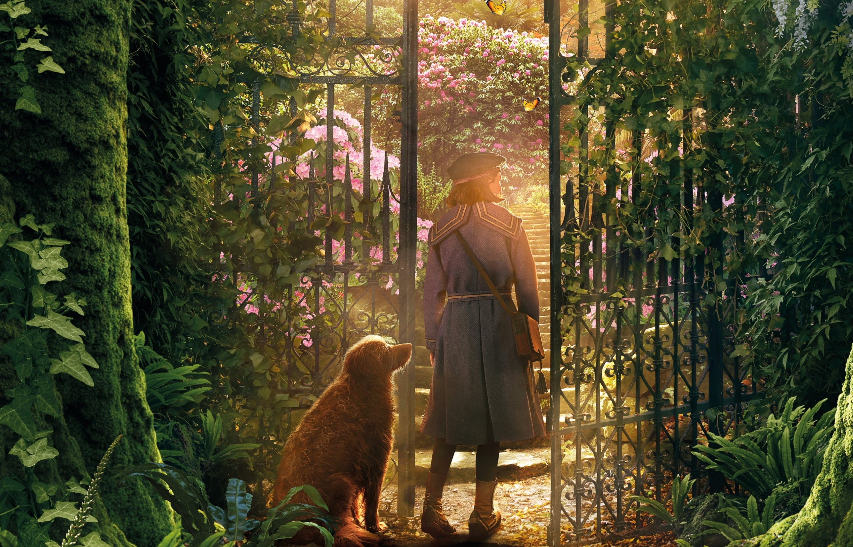
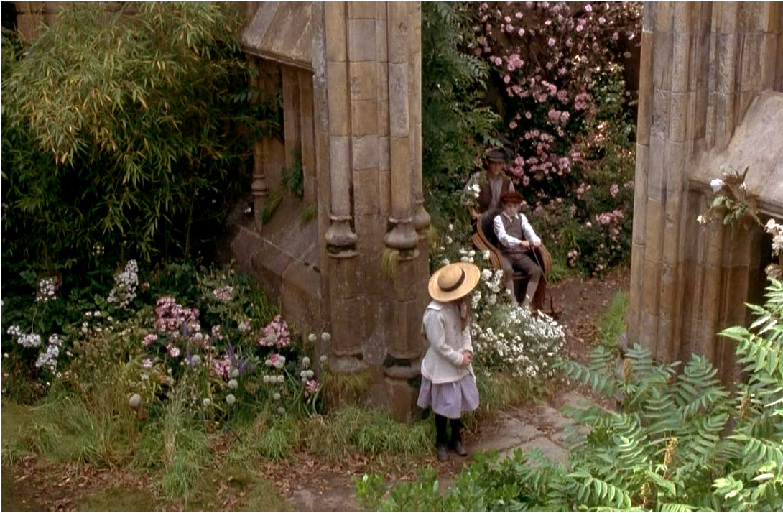
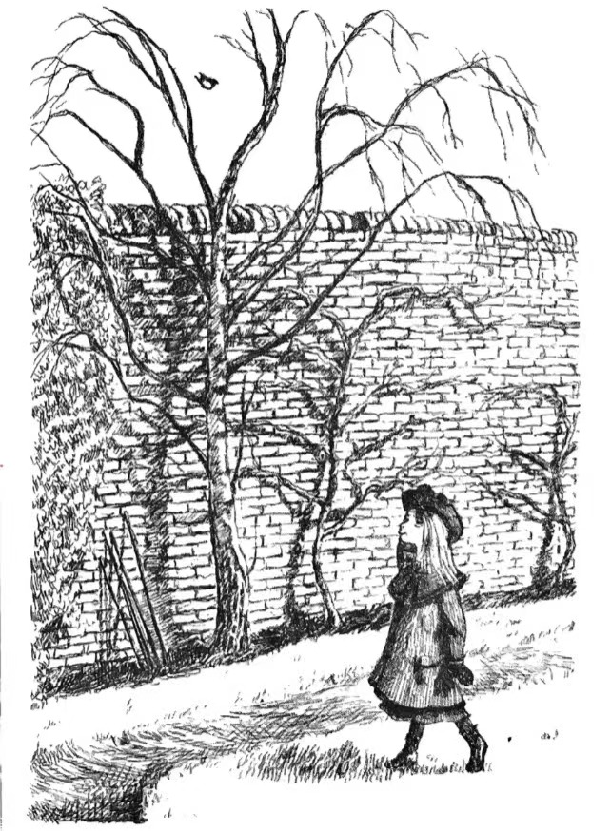
4. Read for the gist and sequence of events 小说章节和概要
A sudden outbreak of cholera left Mary an orphan
She was sent to live with her uncle, Mr. Craven.
In the strange environment, Mrs Medlock, who came to meet her, was serious and indifferent, which made Mary more lonely.
With Martha's company, Mary got to know Dickon, who liked and knew about animals. They planted flowers and grass in the secret garden together, and they gradually became cheerful.

Slide 20
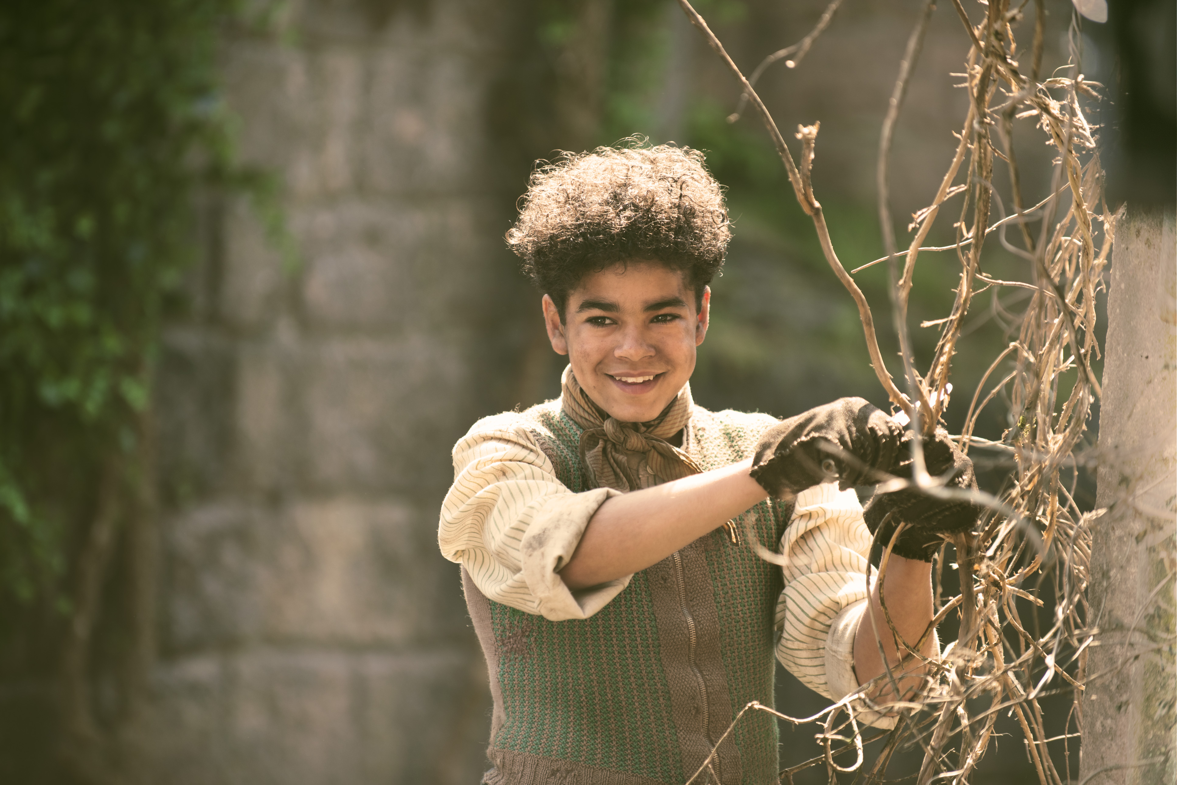
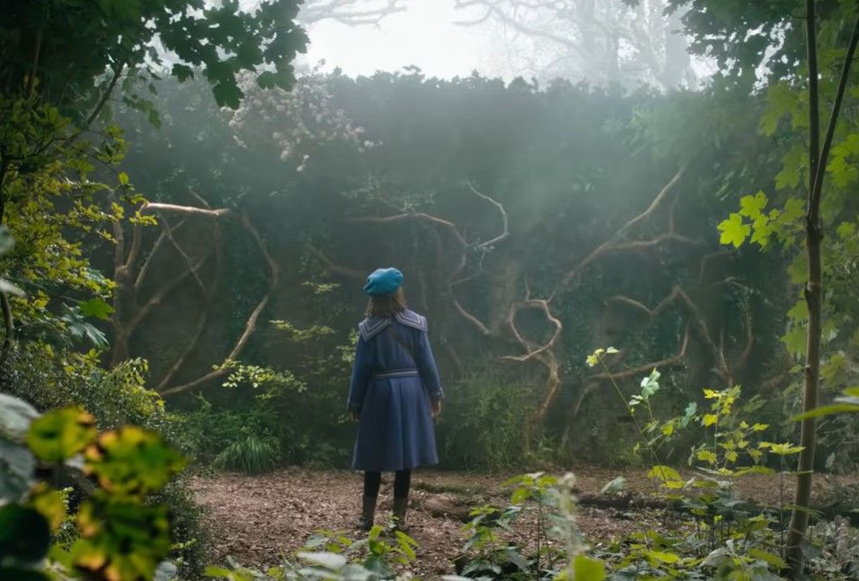
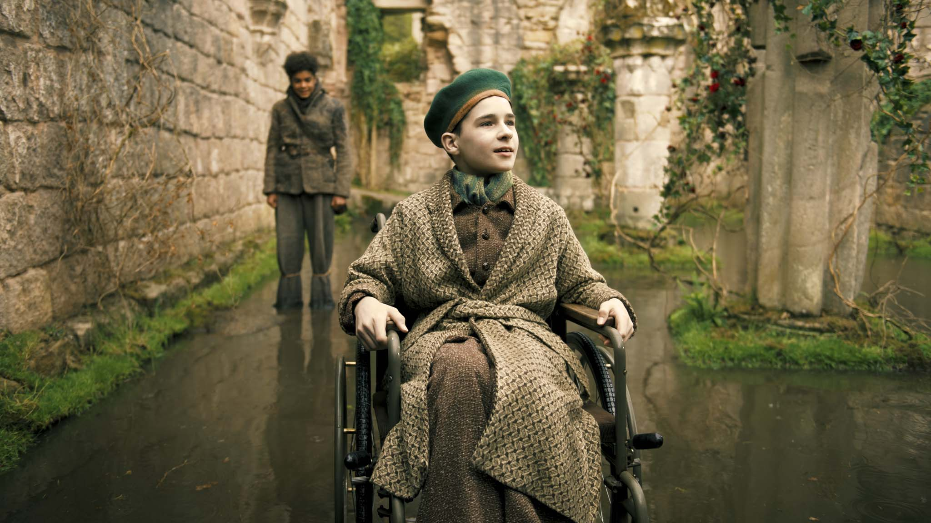
4. Read for the gist and sequence of events 小说章节和概要
Mary found her cousin Colin, the young owner of the manor, who is also weak and feeble in bed all year round.
Mary and Dickon took Colin into the secret garden and played around, watching the plants and plants grow.
Gradually Colin regained his health and confidence. From then on, the whole house was brimming with joy and happiness.
Mr. Craven, who has been away from home, felt the longing call of the secret garden and his late wife, and returned to the manor to share the happiness of life with his family.

Slide 21
5. 归纳整理知识点和培养丰富的语言表达:
Learn about setting：find sentences showing Magic of the Nature：
P15 Instead the ivy grew wild here, trailing like a waterfall down to the ground.
P18 Tiny green shoots were jutting out of the soil.
（花园在他们的辛勤劳动下苏醒了）
P21 What happened next was pure magic. A strong gust of wind lifted the ivy, parting it like a curtain.
P25 You sprinkle（撒） them in the ground and flowers grow.
P48 Green shoots were sprouting everywhere now.
（花园里百花盛开，绿草如茵）

Slide 22
5. 归纳整理知识点和培养丰富的语言表达:
Learn about setting：find sentences showing Magic of the Nature：
P49 The garden was coming alive.
（花园生机勃勃，让人心旷神怡）
P49“It’s nature. All nature’s grand.”
（大自然是一朵含苞待放的花，是绚丽多姿的色彩）
P68 Slowly, over the days and weeks, the garden worked its magic. As the trees blossomed and the shoots turned into the most beautiful flowers, Colin, to, changed. His arms grew stronger. His legs grew stronger.
（他们一天天在改变着，正如尘封的秘密花园在慢慢地变化）

Slide 23
5. 归纳整理知识点和培养丰富的语言表达:
Learn about setting：find sentences showing Magic of the Nature：
P68 “It’s a miracle,” Ben said. But the garden hadn’t finished working its magic just yet.
（大自然的美创造了一个个奇迹）
Get close to nature and may your heart be inspired.
P75 The garden was a feast of autumn yellow and purple, and flaming scarlet. The afternoon sun shone down on the leaves and made everything appear like a temple of gold. “It was the magic of the secret garden.”
（唤醒了Colin求生的意识）

Slide 24
6. Explore the theme:
Discuss the questions:
What led Mary walk out of the sadness into the world of sunlight?
What caused Colin to struggle to his feet from his chair？
Nature

Slide 25
6. Explore the theme:
Further thinking：
What is the feeling of the character?
Mary used to hate the world, but the world responded in kind. When she faced life with joy and changed life with a smile, the world also brought joy to her.
The beauty of nature is deep and intense. When Mary first planted a seed, when Colin first petted a lamb, when Dickon first interacted with a robin, they were already exposed to the beauty of nature.
Nature is not just for Mary, Colin and Dickon, it is for everyone. Only by getting close to nature can we appreciate the beauty of nature.

Slide 26
6. Explore the theme:
Further thinking：
Author’s points of view/my point of view
Stop running away from happiness, stop holding on to pain! We have to liberate ourselves, get rid of the pain, overcome difficulties, overcome life. We should face up to happiness and accept it.
Have you got an expecting garden just like the secret garden?
Have you got friends for company in the secret garden?
Do you have any close friends to show and expose yourself?

Slide 27
6. Explore the theme:
Further thinking：
With the help of this power of nature, it awakened Mary's sleeping childlike spirit, Colin's sense of survival, and Craven's optimism, and he was no longer solitary or hostile to the world.
In chapter 9： “You know, if he can’t see nature, maybe we should take nature to him?”
秘密花园在快乐中降临，在痛苦中封锁，又在快乐中重新开启。正如伯内特说的：“有花园就有未来，有未来生活还会继续。”

Slide 28
6. Explore the theme:
Your reflection:
Q: What impressed you most in the novel? Why do you think so?
"Secret Garden" taught me that pessimistic people tend to be first defeated by themselves, and then defeated by life; Optimistic people conquer themselves and conquer life." The world is beautiful, what we need is the eyes to find beauty.
Sentences extending your thought about what is happening:
I was impressed by…
What impressed me most is that…
I was surprised that …
It astonished me that…
I was inspired by…
It occurred to me that …
It dawned on that…
It was beyond my expectation that …

Slide 29
6. Explore the theme:
Stories help bring out emotions and feelings,
Make the connection between the nature and people：
大自然不仅美在外表，大自然的魔力使人们变得阳光，让人们燃起生命的火花，大自然创造出一个个奇迹。

Slide 30
7. Retell the story in your own words，take some of the key words and make up your own story.

Slide 31
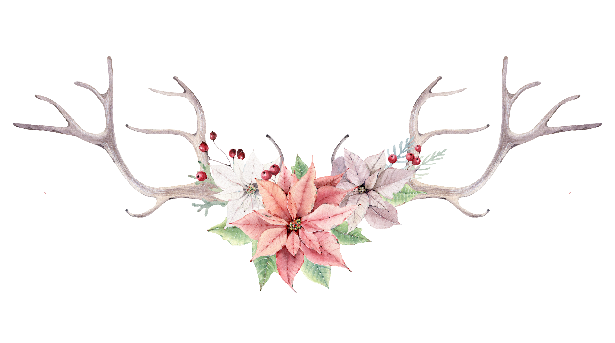
Thanks……

