Slide 1

感恩遇见，相互成就，本课件资料仅供您个人参考、教学使用，严禁自行在网络传播，违者依知识产权法追究法律责任。
更多教学资源请关注
公众号：溯恩高中英语
知识产权声明

Slide 2


Welcome back
Let’s embrace our new semester
Go for it!
Fighting!

Slide 3
01
02
03
04
Holiday
News
Knowledge
rules
What did we do in the holiday?
What has happened in the world ?
What will be done in the coming days?
What should be done for English study?

Slide 4

holiday
What did we do in the holiday?

Slide 5
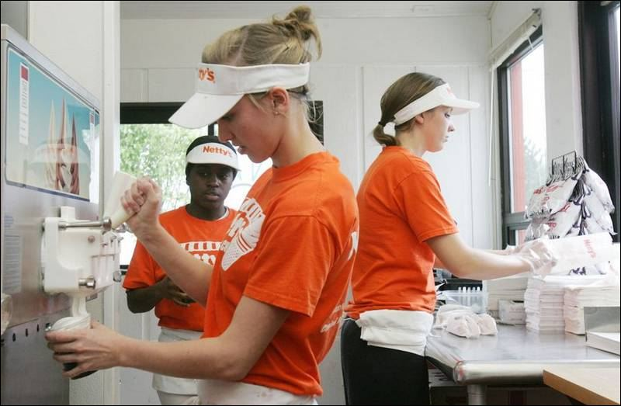



travel?
summer jobs?
learning?
lie flat

Slide 6

It was a/an ___________(adj.) holiday. I ________________(did what) with _____________(who) to ___________________(why).
For example:
It was an impressive and meaningful holiday. I went traveling with my best friend to Gui Zhou to experience the minority culture.

Slide 7
news
What has happened in the world ?

Slide 8

6 rockets launched in July
The FISU World University Games (Chengdu Universiade) held in Chengdu on July 28
The 2023 China Internet Civilization Conference opened in Xiamen Fujian province on July 18

Slide 9


运载火箭
卫星
发射，升空
A Long March 2C carrier rocket carrying a test satellite blasted off from the Jiuquan Satellite Launch Center in Northwest China on July 9, 2023.
液态甲烷和氧气
The Zhuque-2 Y2, a methane-liquid oxygen space rocket, independently developed by LandSpace Technology Co Ltd, blasted off from the Jiuquan launch site in Gansu province, on July 12, 2023.
A Kuaizhou 1A carrier rocket blasted off from the Jiuquan Satellite Launch Center in Northwest China, July 20, 2023.
PPT模板 http://www.1ppt.com/moban/

Slide 10
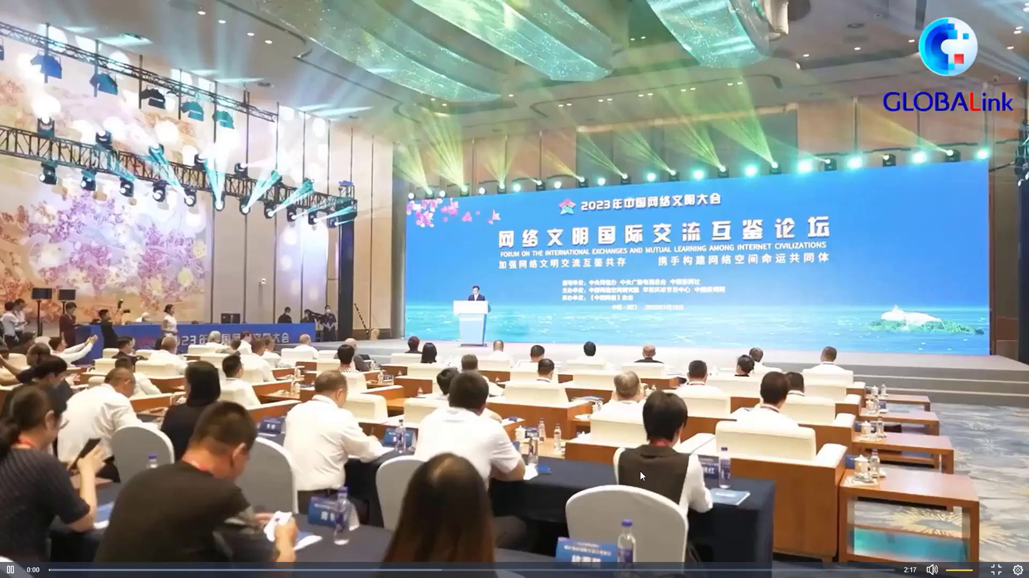

Slide 11

conference
The 2023 China internet civilization ___________ was held in the city of Xiamen in east China's Fujian province from Tuesday to Wednesday. On a forum how to discuss _________ among internet civilizations, many attendees _______________ the great progress China has made in digital development, believing that China can __________________ shaping an increasingly digital world.
exchanges
spoke highly of
play a key role in

Slide 12
I've been ___________ how fast Chinese internet has developed today. I think we have the best internet in the world. I tell my friends that Chinese 30 years ago had no money, today they still have no money because we use the phone to pay for everything. So China, in every respect, _________________________________, and actually many other areas, China has __________ far ahead of the rest of the world.
surprised
as far as the internet is concerned
slipped

Slide 13
Products like (those from) China's gaming companies, the internet companies, the _______________________, Chinese ev, electric cars. This is what actually attracts most foreign __________ to China. And this is a big change happening, I think. During my 20 years here in China, I see that the global young youth is __________ China differently in this now. And it's actually interesting because China has actually built up of and is the _______ in the digital infrastructure now. I think China can add a lot to the next 10 years of the belt and road, where it can actually help with the digital infrastructure for the young generation __________.
online shopping platform
generations
perceiving
pioneer
globally

Slide 14
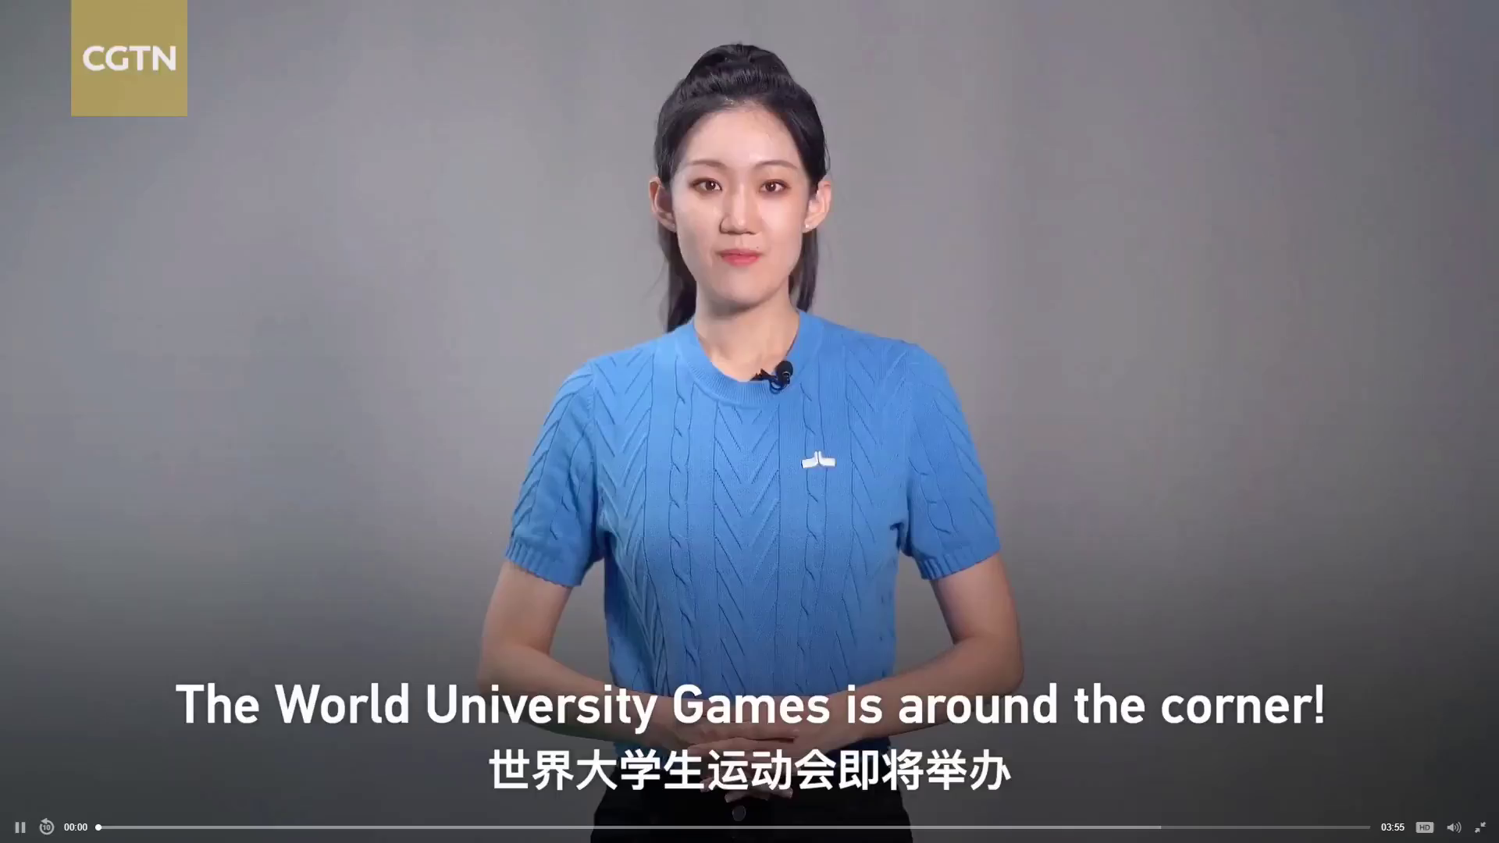

Slide 15
1. What were the key words of The FISU World University Games?
Youth, vigor, high-tech, green
2. What aspects of this Chengdu Universiade are mentioned in this video?
Technological and environmental aspects
3. Which of the following topics are mentioned in the video?
√
the torch
“Rongbao” robots
high pressure water spray equipment
cooling vests
√
low-carbon construction technologies
new energy vehicles
translators
√
√
√
√

Slide 16
Knowledge
What will be done in the coming days?

Slide 17
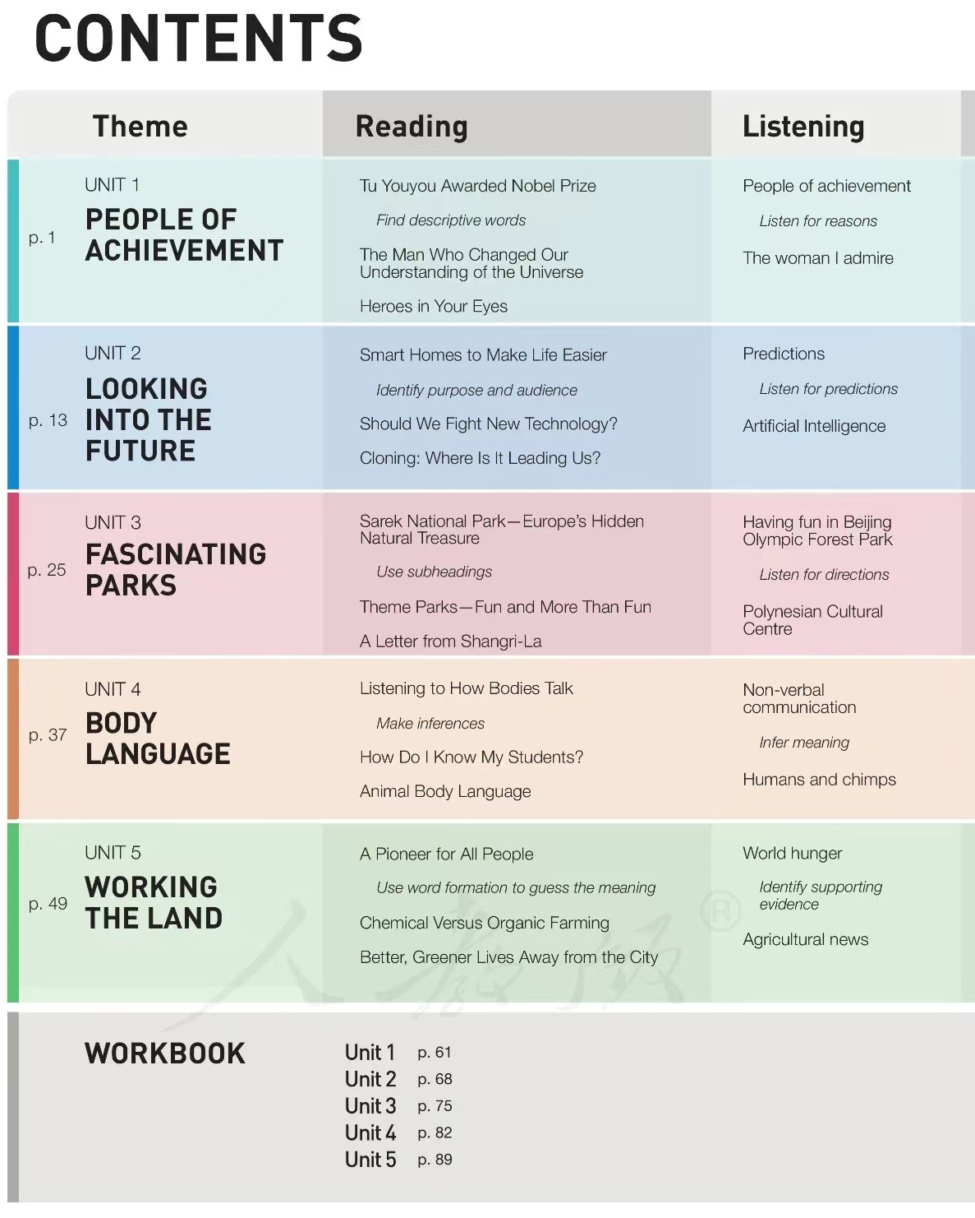
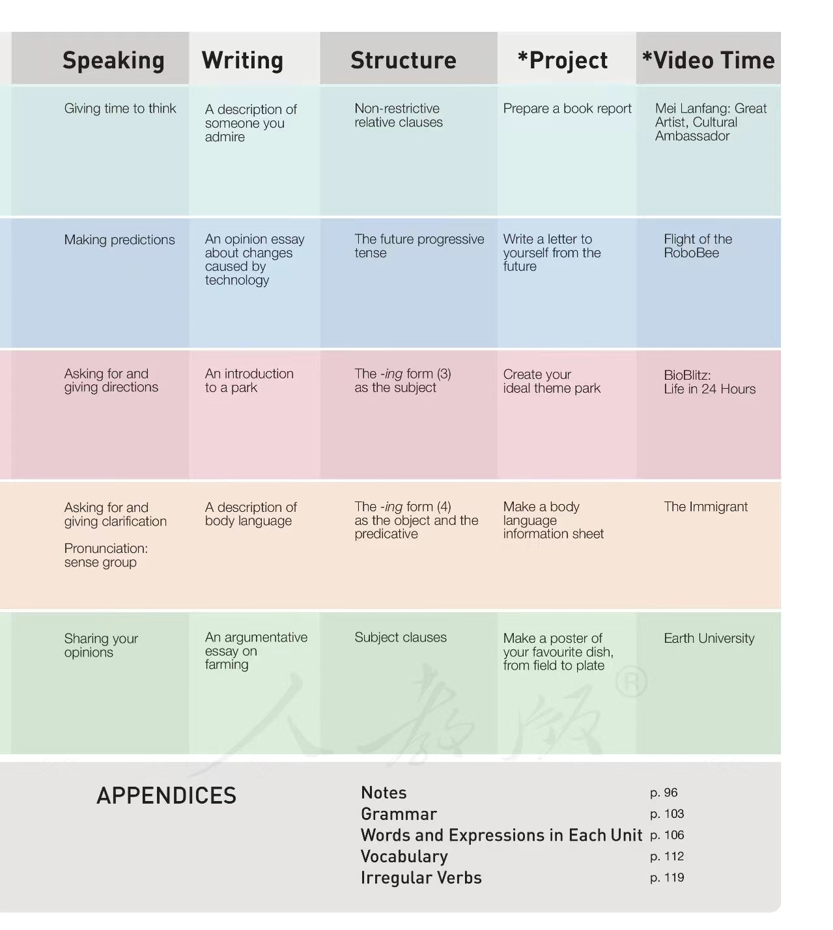
biography
介绍/描述文体
非限制性定语从句
technology
A
议论文体
Please replace text,click add relevant headline modly the text content
also can copy your concent to this.
Please replace text,click add relevant headline modly the text content,also can copy your concent to this.
将来进行时
entertainment
介绍/描述文体
非谓语doing
非谓语doing
communication
B
Please replace text,click add relevant headline modly the text content
also can copy your concent to this.
介绍/描述文体
biography, agriculture
议论文体
主语从句

Slide 18
rules
What should be done for English study?

Slide 19


Reciting Englsih words is a process of self-salvation!
背英语单词是一种自我救赎！

Slide 20
3 notebooks
01
one for homework
02
one for composition
03
one for accumulation

Slide 21
Before the class:
1. 英语课上：认真听讲，做好笔记；积极思维，密切配合；记忆重点，充实高效。
2. 早读两次：维克多英语听力。
3. 英语课下：零碎时间，积极把握；功夫多下，定有收获。
4.年段要求：作业缺交3次，黄牌。
写作禁止零分卷。
必须有二次学习笔记。
讲评完之后的材料空白视为作业没做。
Review the text!
Prepare questions!

Slide 22
During the class:
1. 英语课上：认真听讲，做好笔记；积极思维，密切配合；记忆重点，充实高效。
2. 早读两次：维克多英语听力。
3. 英语课下：零碎时间，积极把握；功夫多下，定有收获。
4.年段要求：作业缺交3次，黄牌。
写作禁止零分卷。
必须有二次学习笔记。
讲评完之后的材料空白视为作业没做。
Listen and take notes carefully!
Get involved and be active!

Slide 23
After the class:
1. 英语课上：认真听讲，做好笔记；积极思维，密切配合；记忆重点，充实高效。
2. 早读两次：维克多英语听力。
3. 英语课下：零碎时间，积极把握；功夫多下，定有收获。
4.年段要求：作业缺交3次，黄牌。
写作禁止零分卷。
必须有二次学习笔记。
讲评完之后的材料空白视为作业没做。
Finish your homework!
Rearrange your notes!
Recite!

Slide 24
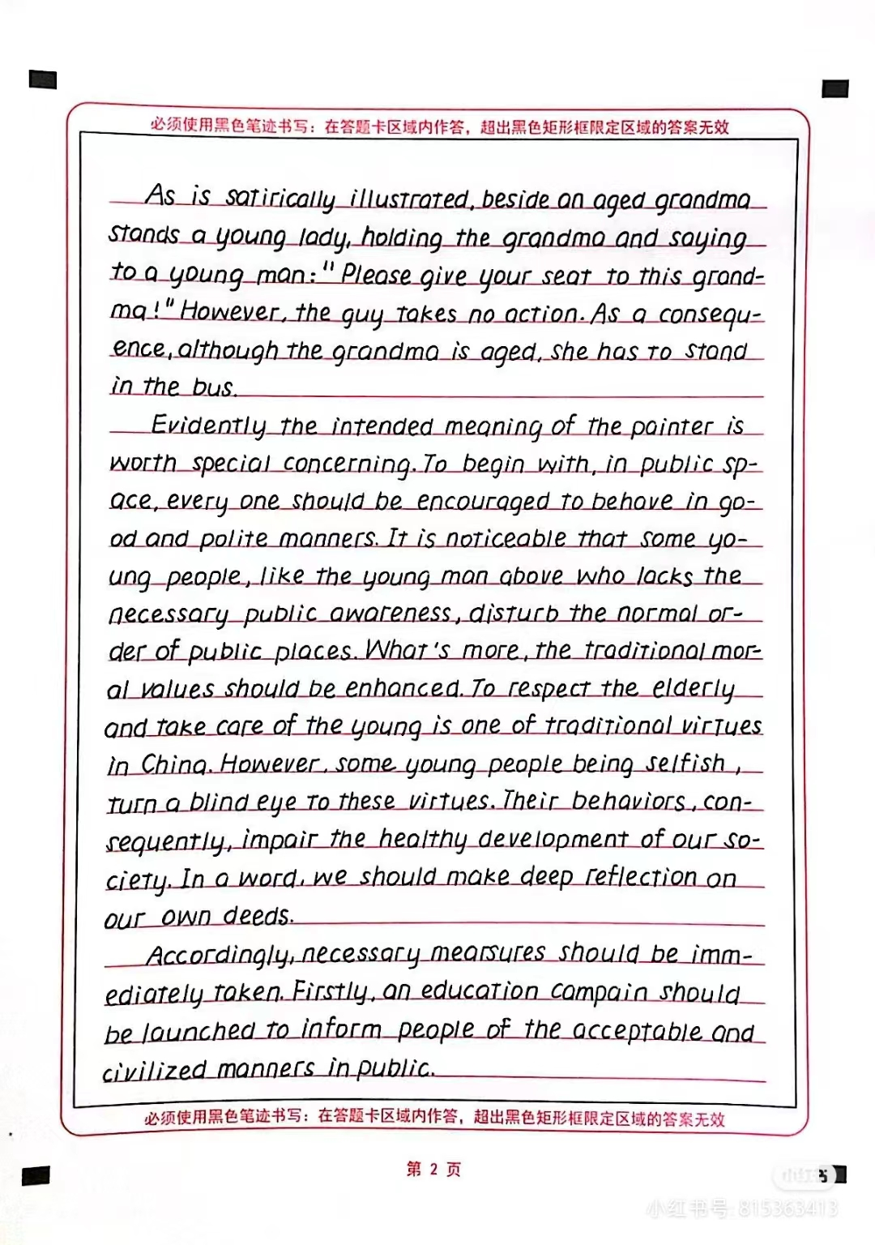
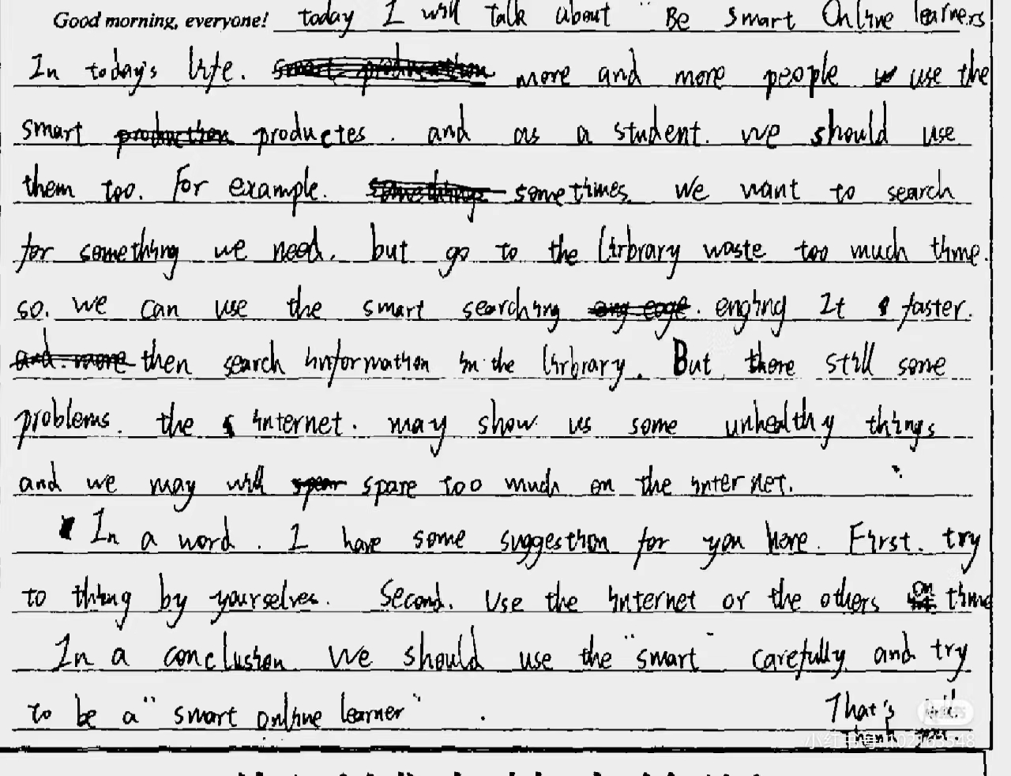
Writing neatly is of great significance!

Slide 25
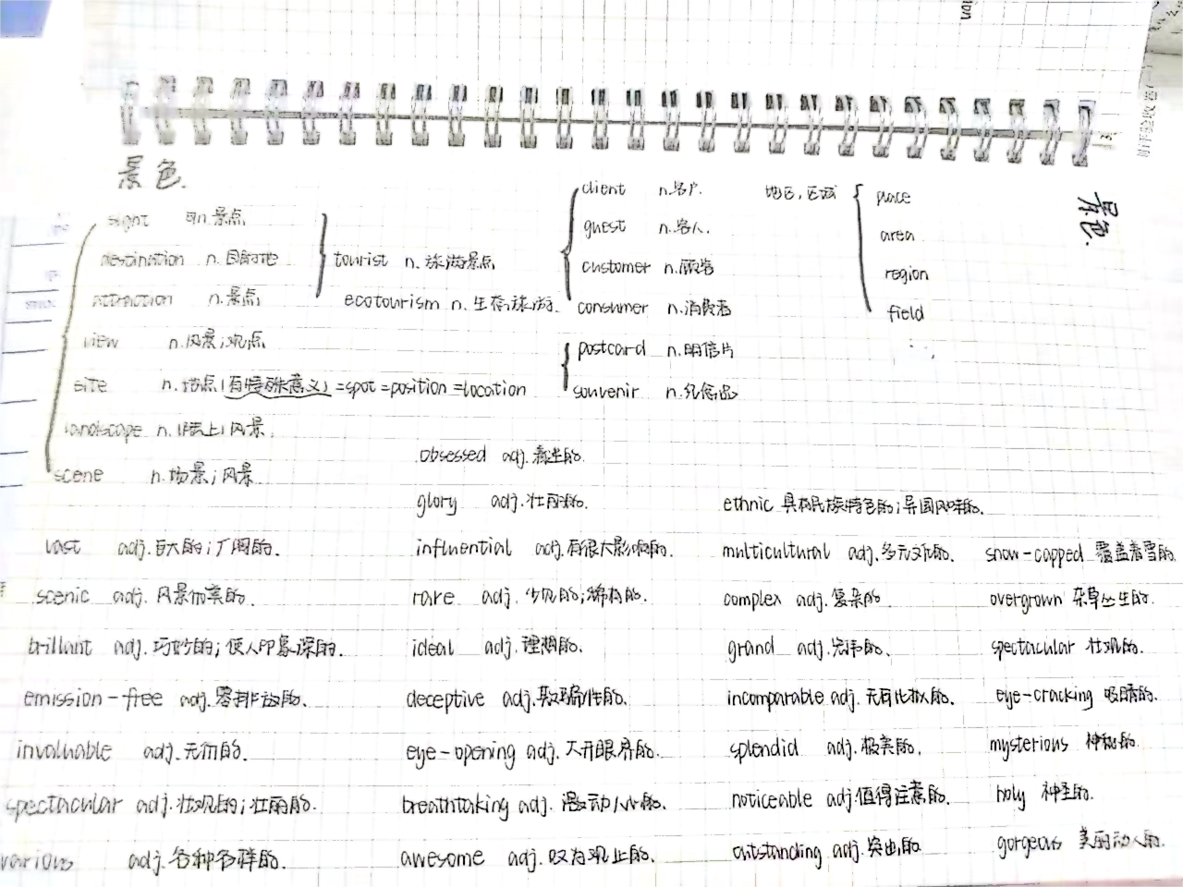
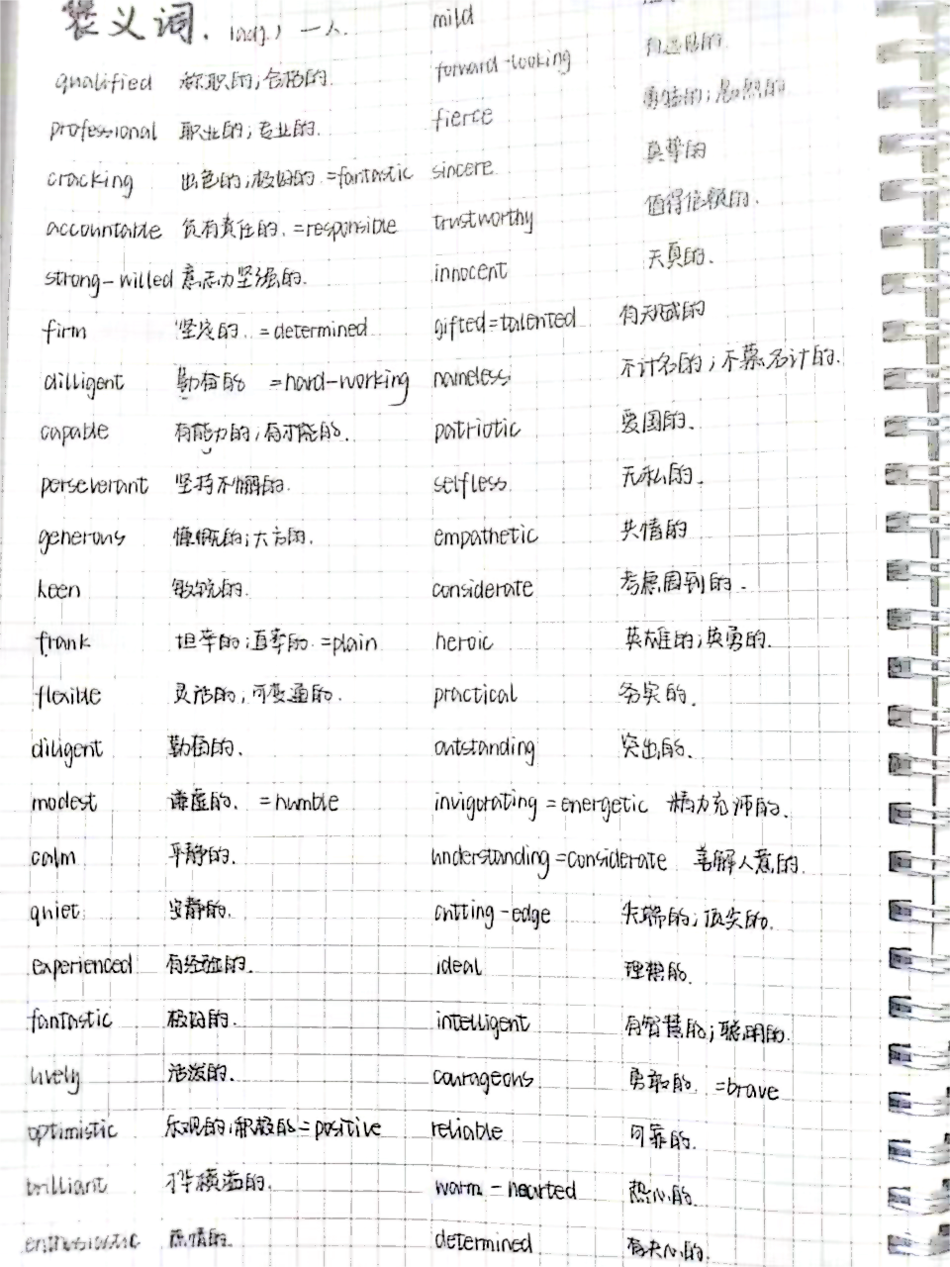
Pay attention to your word bank!
1. 英语课上：认真听讲，做好笔记；积极思维，密切配合；记忆重点，充实高效。
2. 早读两次：维克多英语听力。
3. 英语课下：零碎时间，积极把握；功夫多下，定有收获。
4.年段要求：作业缺交3次，黄牌。
写作禁止零分卷。
必须有二次学习笔记。
讲评完之后的材料空白视为作业没做。

Slide 26
See you next time!
Go for it!
Fighting!

