Slide 1

感恩遇见，相互成就，本课件资料仅供您个人参考、教学使用，严禁自行在网络传播，违者依知识产权法追究法律责任。
更多教学资源请关注
公众号：溯恩高中英语
知识产权声明

Slide 2
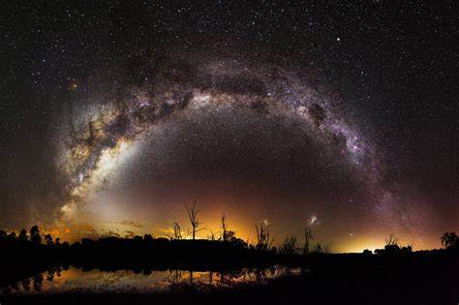

Lace Round The Sky
Cricket 外刊精品原著
by 许丽君、夏超燕

Slide 3
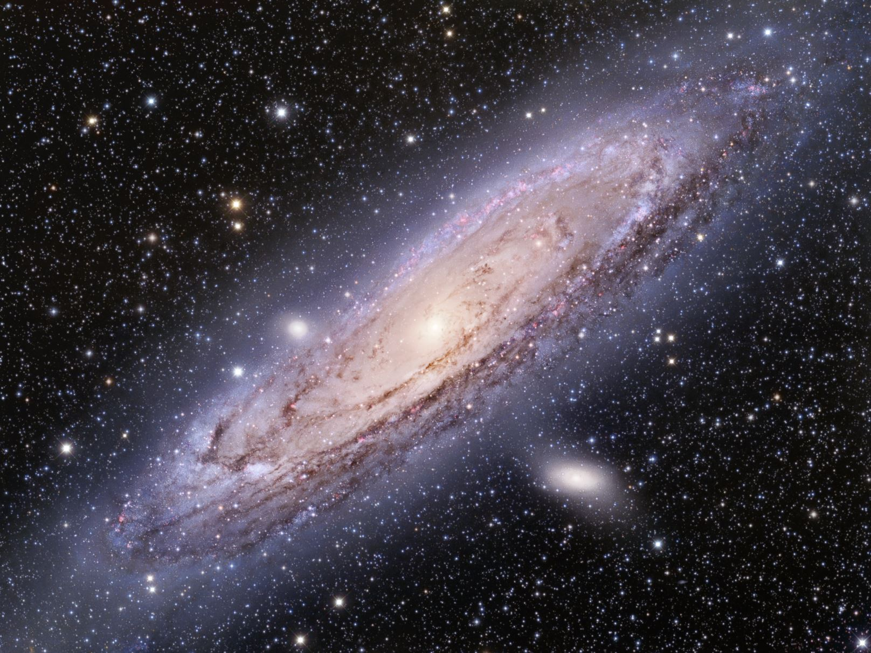
Lace Round the Sky
01
Before Reading
contents
02
While Reading
03
Post-reading

Slide 4

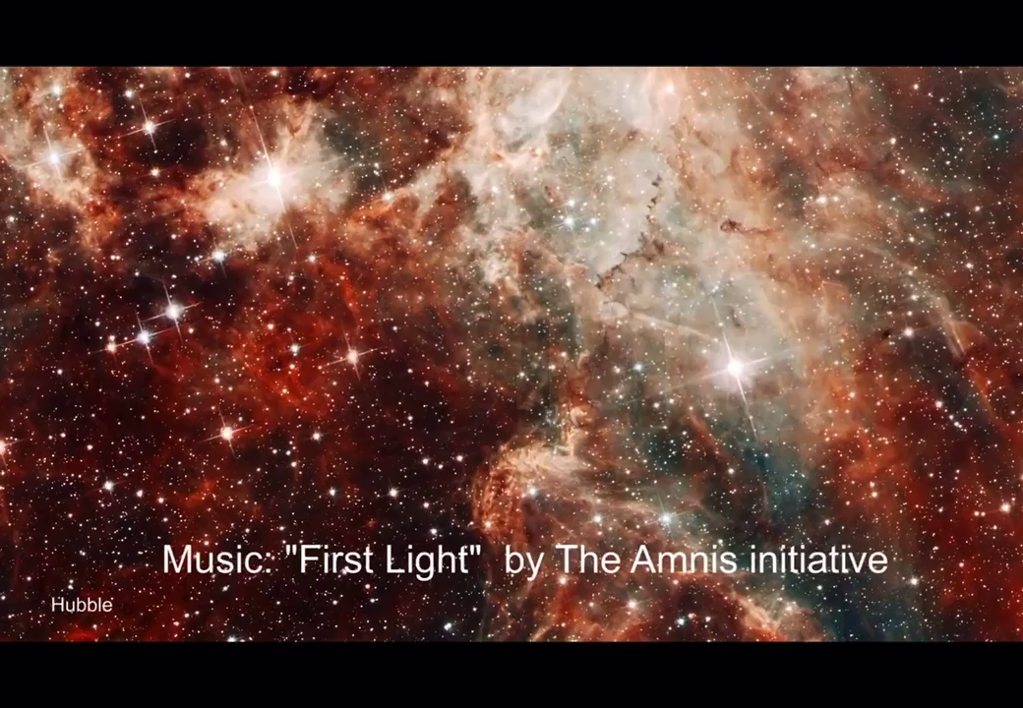
Video Time - Have a glance at the galaxy
What do you know about the galaxy?
Where and how can we observe the galaxy?
What have you done to get to know about the galaxy?

Slide 5
Lace Round the Sky
01
Before Reading
contents
02
While Reading
03
Post-reading

Slide 6
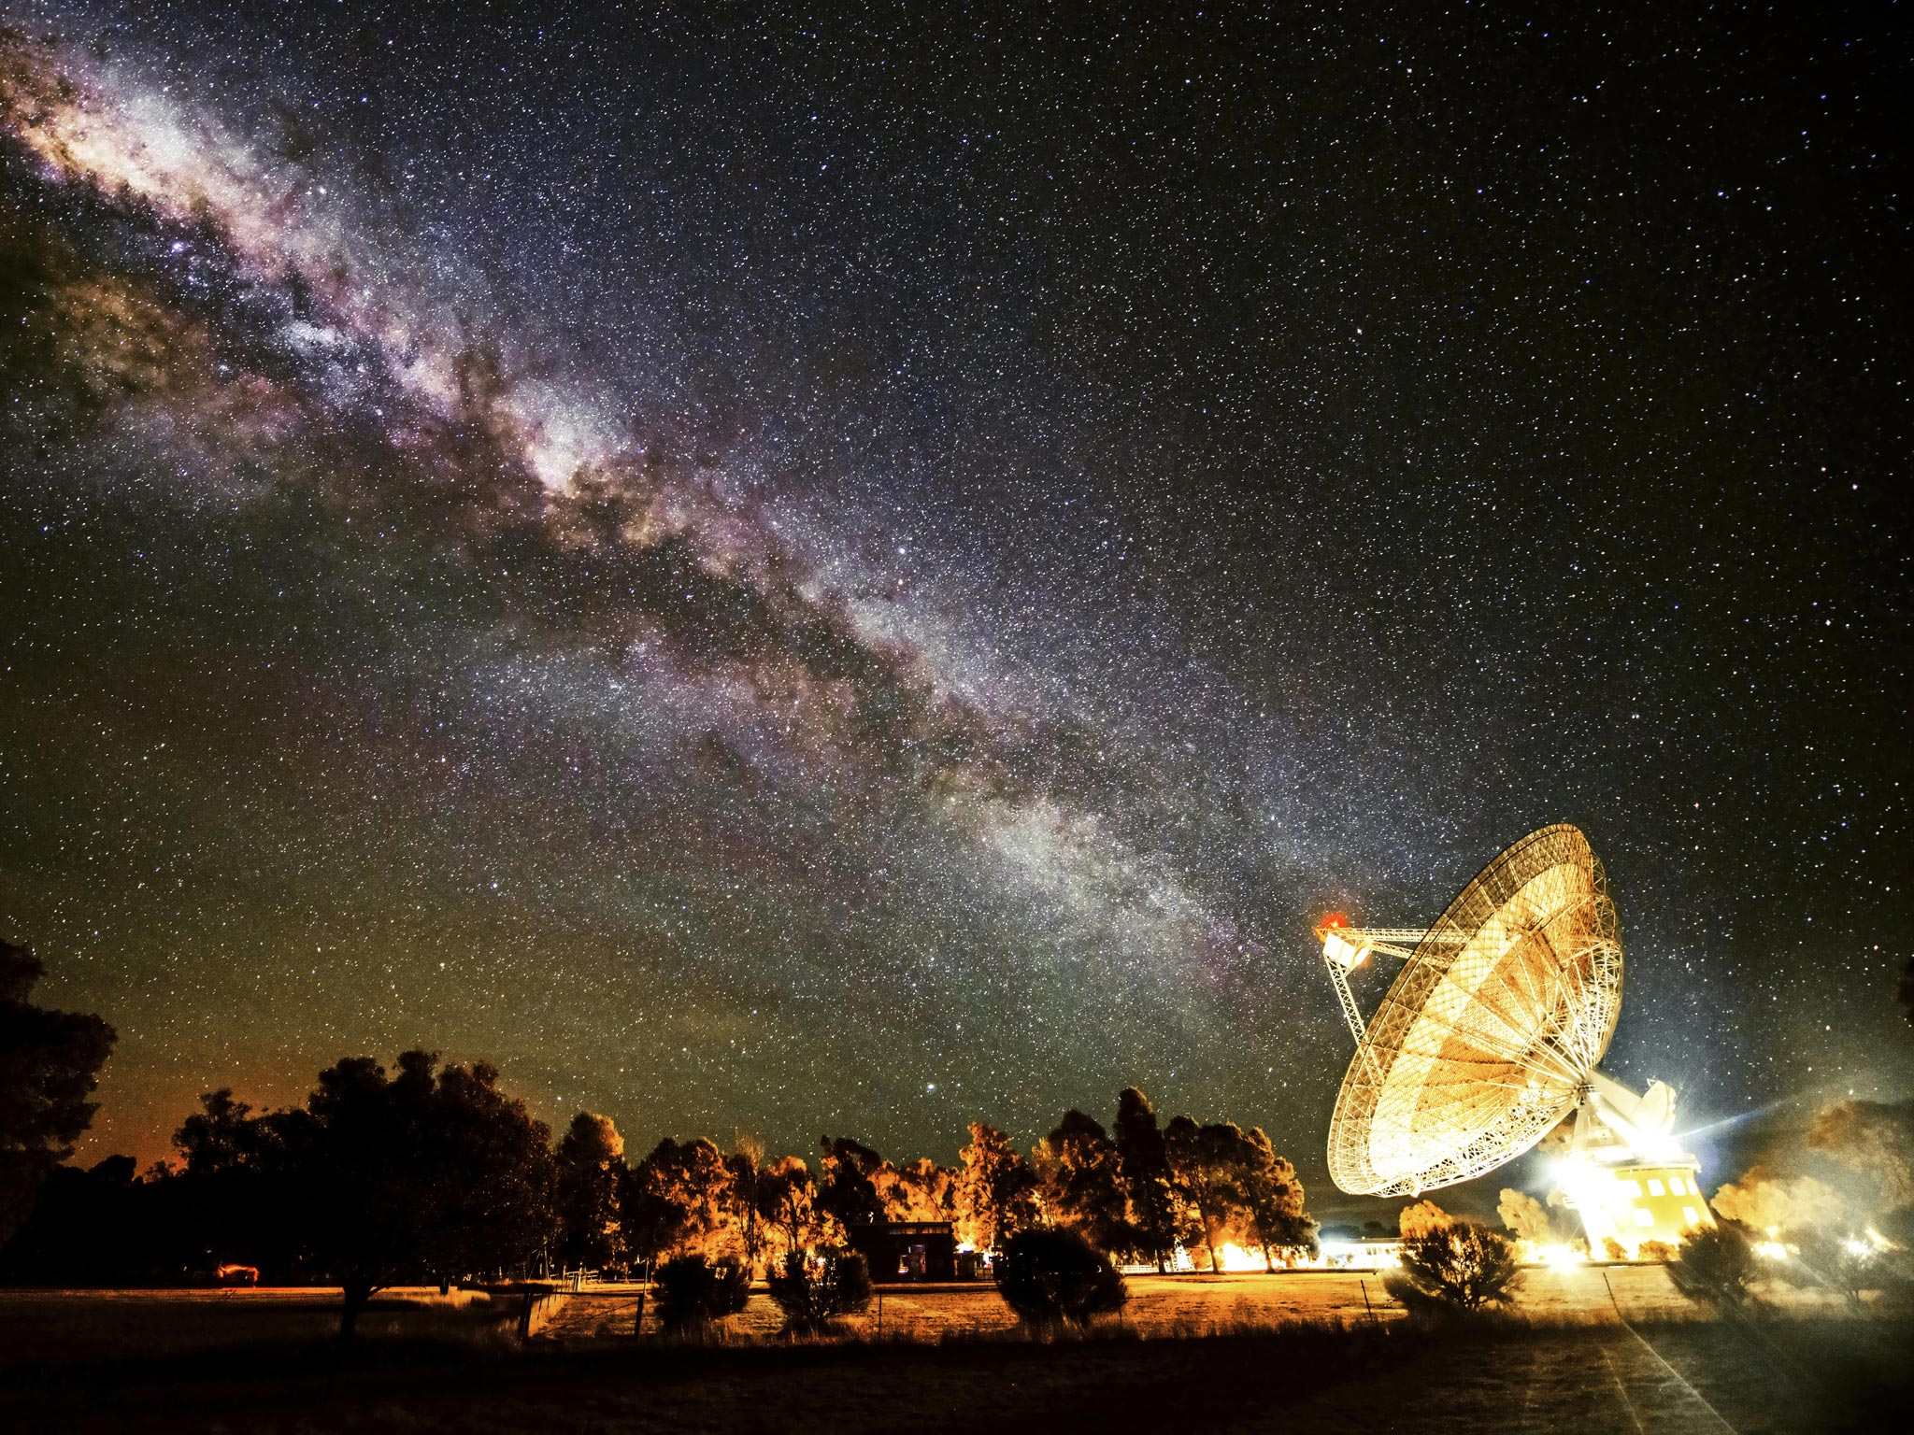
As Papa’s snores boomed off the clapboard walls, Catalina slid from her mattress and groped her way to the front door. The latch clicked softly. The girl waited a moment to see if any of her family would wake, but nobody stirred.
Catalina stood on the doorstep of their Cerro Tololo observatory staff housing, drinking in deep lungfuls of the clear night air under the blazing Southern Hemisphere star shine. The Milky Way sprawled across the sky, a swath of pure white lace shadowed by dark blotches.
Background Information
Analyze the title:
What is the lace round the sky？
The swirling galaxies like this Lace white flower pressed on wax paper, which inspires readers to uncover the mystery.

Slide 7
As Papa’s snores boomed off the clapboard walls, Catalina slid from her mattress and groped her way to the front door. The latch clicked softly. The girl waited a moment to see if any of her family would wake, but nobody stirred.
Catalina stood on the doorstep of their Cerro Tololo observatory staff housing, drinking in deep lungfuls of the clear night air under the blazing Southern Hemisphere star shine. The Milky Way sprawled across the sky, a swatch of pure white lace shadowed by dark blotches.
Background Information
1.boom
2.slide, slid, slid
3.grope her way
4.stir
5.a lungful of
6.a swatch of
7.lace
8.blotch
vt. 使兴旺；发隆隆声 vi. 急速发展；发隆隆声
v 滑；滑动
摸索着前进
v.刺激；搅拌
一大口
一小块
n. 花边；鞋带；饰带
n.(皮肤上的)红斑点；(墨水等)大斑点

Slide 8

As Papa’s snores boomed off the clapboard walls, Catalina slid from her mattress and groped her way to the front door. The latch clicked softly. The girl waited a moment to see if any of her family would wake, but nobody stirred.
Catalina stood on the doorstep of their Cerro Tololo observatory staff housing, drinking in deep lungfuls of the clear night air under the blazing Southern Hemisphere star shine. The Milky Way sprawled across the sky, a swath of pure white lace shadowed by dark blotches.
Background Information
Explore:
Catalina对于星空的渴望
卡塔琳娜站在塞罗·托洛洛天文台员工宿舍的台阶上，在炽热的南半球深吸着夜晚清新的空气。
Find More Example about Catalina’s strong passion for galaxy

Slide 9
Night was her favorite time. During the day the Chilean mountaintop swarmed with tourists, shouting and calling to each other as breezes spun dust into the thin mountain air. While the visitors were there, Papá could not allow her to help polish the brass fittings of the old refractor telescope nor pour smoking liquid nitrogen into the Dewar vessel that kept the Schmidt telescope camera cool. During the day she was no one special, just a kid underfoot among the many who made the pilgrimage to the mountaintop to visit the miraculous devices that let scientists learn about the stars.
Background Information
be swarmed with
spin spun spun
polish
make pilgrimage to
miraculous
device
充满，挤满
v. （使）快速旋转；
v. 擦亮，磨光
朝圣
adj. 奇迹般的，不可思议的
n. 装置，设备；手段，

Slide 10
Night was her favorite time. During the day the Chilean mountaintop swarmed with tourists, shouting and calling to each other as breezes spun dust into the thin mountain air. While the visitors were there, Papá could not allow her to help polish the brass fittings of the old refractor telescope nor pour smoking liquid nitrogen into the Dewar vessel that kept the Schmidt telescope camera cool. During the day she was no one special, just a kid underfoot among the many who made the pilgrimage to the mountaintop to visit the miraculous devices that let scientists learn about the stars.
Background Information
What’s the effect of this sentence?
vivid detailed description of the popular tourist destination

Slide 11
But at night, when everything was quiet, Catalina was one of the few who were allowed beyond the roped-off corridors and the “No Admittance”signs. The night staff all knew her, knew she would keep her hands away from the delicate instruments and could always be counted on to fetch a cup of coffee or grab a toolbox.
She loved helping to service the grand telescopes, the eyes that peered out into the universe—even if it was annoying how she was always told not to disturb the astronomers who directed the telescopes through the night, searching the sky in elaborate pat-terns. Catalina wanted more than anything to confess her secret dream to these great and revered scientists, whose love of astronomy had brought them from all over the world to an isolated mountaintop.
Background Information
1.be counted on
2.to fetch a cup of coffee
3.grab a toolbox
4. confess
5. revere
6. isolated
可靠的，值得信赖的：
拿一杯咖啡
拿工具箱
v. 供认，招供；承认，坦白；
v. 供认，招供；承认，坦白；
adj. 遥远的，偏僻的；与世隔绝的，
Catalina’s strong love for starry night observation

Slide 12
But at night, when everything was quiet, Catalina was one of the few who were allowed beyond the roped-off corridors and the “No Admittance” signs. The night staff all knew her, knew she would keep her hands away from the delicate instruments and could always be counted on to fetch a cup of coffee or grab a toolbox.
She loved helping to service the grand telescopes, the eyes that peered out into the universe—even if it was annoying how she was always told not to disturb the astronomers who directed the telescopes through the night, searching the sky in elaborate pat-terns. Catalina wanted more than anything to confess her secret dream to these great and revered scientists, whose love of astronomy had brought them from all over the world to an isolated mountaintop.
Background Information
What’s the effect of this sentence?
It reveals Catalina’s strong passion for astronomy.

Slide 13
Instead, Señor Alfonso, the accountant, told her that if she bothered the scientists she would be banned from the telescopes. Señora Carmen, the head administrator, frowned and scolded her. “Little girls have no place interfering with important work.”
Even her father, when she said,“Papá, I want to be an astronomer someday,” laughed and tugged at one of her long black braids. “Maybe if you work hard, you'll be hired to clean the offices when you're big enough, like your mother.”
But Catalina was curious. The sky did not merely consist of white dots of stars against a black background, like her schoolbooks said. The sky she saw every night was knotted with patterns, from fuzzy balls of fluff to filaments braided and twirling overhead. What were the bright threads that looped in twisting arcs around dark eyelets? And what secret commands did the astronomers type on their computers to persuade the telescopes to rotate and capture the distant, hidden galaxies?
Background Information
frown and scold her
laugh and tug at
be knotted with
fuzzy
filaments
twirl
loop in twisting arcs
皱眉并且责骂她
笑着并且拉扯着
与...纠缠在一起
adj. 有绒毛的，绒毛状的
菌丝
v.旋转，急转
Main Idea:
Catalina’s curiosity
绕成扭曲的弧线
Detail 1
Detail 2
Detail 3
Detail 4

Slide 14
Beginning
One day last summer, she had been curled up on a dingy green vinyl sofa in the small library. Magazine pages flapped on battered wooden side tables as fans swung back and forth. Flipping through the pages of a botany journal, she had stopped at the picture of an intricate white flower.
“It's called wild carrot, or Queen Anne's Lace.”One of the foreign astronomers, pallid and tall in an expensive suit, stood behind her. His Spanish was heavily accented. She stared up at him, panicked.“Pretty, isn’t it? I've always liked that flower, because I think it looks like a galaxy. Nature repeats itself.”
She looked down at the page. It did look familiar.“A flocculent spiral galaxy,”she whispered.
curl up
dingy
vinyl
flip through
intricate
pallid
pallid and tall
蜷缩
adj. 昏暗的；肮脏的
n.［化］乙烯基，塑料
翻阅，浏览
a.复杂的,错综的,缠结的,难懂的
a.苍白的，没血色的
又高又苍白的

Slide 15
Blond eyebrows climbed his reddened forehead.“Indeed. And what is your name, young lady?” he asked, his light blue eyes focusing on her with disconcerting intensity.
“I’m Catalina Solis.”
“Eduardo Solis’s daughter? The mechanic?”
“Yes.” She slanted a look at him. “I want to be an astronomer when I grow up.”
He laughed genially, no longer meeting her eyes, and patted her on the shoulder.“Yes, of course, my dear. Work hard in school, and it could happen.”
No one believed she would be a scientist one day. But why? She knew she could be a good scientist. She knew it!
She danced along the dirt road, bare feet soundless against the gravel, a practiced eye scanning the half-dozen domes at the mountain top’s summit. Then she stopped suddenly. The one-meter telescope’s dome slit was open, but its angle was unusual. Cautiously, she wandered nearer. The telescope was pointed down, almost at the ground, lower than she had ever seen it.
She bit her lip, shifting from foot to foot.The red light over the entrance door indicated that it was forbidden to enter and disturb the scientists at work.
She looked back along the darkened road. No adults were around. Quickly making up her mind, she ran to the dining hall. Dim yellow light framed blackout curtains behind narrow, wired-glass windows. The cooks must still be cleaning up after dinner.
Build Up
What’s the effect of this sentence?
It reveals Catalina’s strong determination to be an astronomer.
Find more example to describe the Character
Good traits of Catalina: observant and helpful.

Slide 16
Bursting through the door, she cried, “Señora Silvia, I need your help. I think there's a problem with one of the telescopes.”
Inside, dishes clattered loudly against the cast-iron sinks. The head cook put one soapy hand on her apron and glared.“Girl, what does someone like you know about telescopes?”
Catalina explained, but Silvia only shook her head.“Nonsense. I’m sure they’re just doing something different tonight. It's not our place to interrupt. Now shoo!” She flapped her apron at the girl.
Back out under the starlight, Catalina stared at the offending dome. A strand of unease twisted in her gut. Something was wrong, she was sure of it. But what could she do?
She sucked in her breath as the thought came to her. She could check for herself. It was dark outside. Opening the door wouldn't allow too much light into the dome, and she knew how to move in the dark without banging into any of the equipment.
But if she was wrong, the scientists running the telescope would be angry. Staff children did not belong in the off-limits areas.
Build Up
clatter
flap
apron
a strand of
twist
suck
bang
vi. 发出哗啦声
v.摆动，拍打
n. 围裙；
一缕
v. 捻在一起；盘绕，
v. 吸，吮，啜
v. 猛敲，砰然重击；
Good traits of Catalina: observant and helpful.

Slide 17
Gritting her teeth, she gave one last glance around the mountaintop, hoping she could make her plea to a sympathetic adult. But there was no one. So, taking a deep breath, she turned the handle and slipped inside.
It was dark within the dome, and her eyes took a moment to adjust. The telescope mount was emitting a faint grinding noise. That wasn't normal. She took a cautious step forward and saw an irregular shape hunched on the floor.
She inhaled sharply. It was a man.Coming closer, she saw that one leg was bent under him at an awkward angle.
“Señor?”she whispered.“Are you all right?”
The man groaned. He canted his head,skin pale in the low light, eyes glittering beneath half-closed lids. She recognized him: the scientist she had met in the library.“Fell,”he gasped in his accented Spanish, gesturing at the platform above.“I think . . . broke leg. Need to . . . uh . . .”His voice trailed off.
Catalina balanced on the balls of her feet. “I'll run and get the night operator,”she promised, already backing toward the door.
“No!”His voice was sharp.“First, need to... fix the telescope.”He muttered to himself for a moment in English.“In two minutes, the ... scope will move past its limit and ... be damaged. I'll tell you how . . .”
Catalina’s eyes lifted to the clock drive lit by a blinking yellow light. She had often helped her father reset this device. Quickly, she walked to the controller and flipped the two switches her father used to stop the telescope.
Climax-An emergency
Catalina紧张的心理和动作描写
Good traits of Catalina: observant and helpful.
受伤的科学家的神态外貌描写
Catalina利用知识挽救不正常的仪器的动作描写

Slide 18
The man behind her was still gasping out directions.
“Shh, it’s all right,” she soothed, coming to his side.“I fixed it. No more problems, OK?”
“You what . . . ?”he muttered, confused.“Already?” Then his head lolled to one side. Catalina stared at his unconscious figure a moment and then jumped to her feet.
Her braids thumped her back rhythmically as she ran all the way to the night operator's office. She burst into the low brown structure without knocking, for the man could be grumpy sometimes.
“Señor Rojas, there’s an emergency,”she called out as the big man swiveled his beat-up wooden chair to face her.“The astronomer using the one-meter had an accident. He fell and broke his leg. You need to get help!”
Resolution
soothe
mutter
unconscious
braid
thump
rhythmically
swivel
v. 安抚；减轻，缓和（疼痛）
v. 嘀咕，嘟囔；
adj.（尤指因头部受伤）昏迷的，
不省人事的；
n. 发辫，辫子
v. 重击，（心脏）怦怦跳；
adv. 有节奏地
vt. 使旋转
Catalina在解决困境时的动作描写

Slide 19
LATER THAT NIGHT, Catalina crouched behind one of the junction boxes as the astronomer was carried out on a stretcher.
“Wait!” he called as he was about to be loaded into the ambulance. “Wait! Catalina!”
Catalina straightened and crept into the ring of lights. He remembered her name?
The man's leg had been splinted, and his eyes were bright with pain. “How did you know?” he asked.
“Know what?” she whispered, puzzled.
“That something was wrong.” He lifted a hand to gesture vaguely in the direction of the one-meter.
She scuffed the dirt with her toe. “Um, I saw the barrel pointing down, and I knew . .. it wasn't normal.”
His eyes sharpened. “That was observant of you. Then you knew how to shut down the equatorial mount.”
Shyly, she nodded.
His gaze remained on her as they lifted the stretcher and began to slide it into the ambulance. “A good scientist,” he continued, “is always observant.” Then the door slammed behind him.
Resolution
Catalina在解决困境后如释重负的动作描写
crouch creep into
be loaded into gesture
straighten scuff
gaze slam
v. 蹲下，蹲伏
悄悄混进、匍匐进
被装载至
V. 打手势，用动作示意
v.（使）变直，挺直身子
v. 磨损，磨坏；拖着脚走
v./n. 凝视、注视
v.（使）砰地关上；

Slide 20
“MAIL CALL!” YELLED Arturo, Señor Rojas’s son. He tossed a padded envelope plastered with foreign stamps onto Catalina’s doorstep. She was helping Mamá make mote con huesillos, one of her favorite desserts. Scooping up the envelope, she tore open the flap.
Out fell a pressed and dried white flower in wax paper. Queen Anne’s lace, she remembered, tracing the edges with her fingertip. Like a spiral galaxy.
“Dear Catalina,”the letter began,“I wanted to thank you for not only saving (possibly) my life, or at least my dignity, but also something far more valuable: the one-meter telescope mount. In return, I thought I might offer a budding scientist some advice.”
She continued reading, heart pummeling her ribs. He listed several addresses he said were of the best schools in Chile for young scientists. “The scholarship applications aren’t easy, but if you attempt them, I'd be happy to give you my feedback.”
She clutched the letter to her chest, an absurd joy exploding like a supernova. It was going to happen. She would become an astronomer. She knew it now.
That night, when she ran out under the stars, she called,“I’ll discover all your secrets someday!” She spun the delicate, galactic flower in her hand. Patterns in the sky, patterns on the earth; humans laced them together. Circling above her, the intricate sky no longer seemed quite so remote.
Ending
description of Catalina’s excitement when receiving the news
It reveals Catalina’s strong determination to be an astronomer.

Slide 21
Lace Round the Sky
01
Before Reading
contents
02
While Reading
03
Post-reading

Slide 22
Post Reading
Catalina, a ______________little girl who has great ____________ for the boundless and mysterious stars. She has a dream that she can __________the bright Milky Way on the top of a mountain in Chile like astronomers.
Main Character
persistent
passion
observe
It is because of her keen observation and her knowledge about astronomy, she detected an ___________situation of an astronomical telescope at the observatory, and then _______________rescued the injured astronomer.
Key Event:
abnormal
accidentally
Catalina __________saved the kind astronomer's life and received the astronomer's sincere blessing and helpful advice, but also gained herself an _____________to learn about astronomy and realize her dream one day.
Ending:
not only
opportunity

Slide 23
Post Reading - Structure of the Story
Catalina slipped into the dome and found an astronomer had his leg broken
Catalina discovered sth. wrong with the telescope
Climax
-emergency
stopped the telescope， found the night operator and saved the astronomer
Confess her secret dream
observant, helpful
rising action
falling action
Catalina’s deep love of observing the sky
determined
confident
received a mail from the astronomer
background
great passion
ambitious
curious
resolution

Slide 24
Post Reading - Appreciating the language
1. Para 1: As papa's snores ____________off the clapboard walls, Catalina __________ __________ her mattress and _________ ______ __________ to the front door. 爸爸的鼾声从墙板上传来，卡塔琳娜从床垫上滑下来，摸索着走到前门。
2. Para 2: Catalina stood on the doorsteps of their Cerro Tololo observatory staff housing, drinking in _________ _______ ________clear night air under the blazing South Hemisphere. 卡塔琳娜站在塞罗·托洛洛天文台员工宿舍的台阶上，在炽热的南半球深吸着夜晚清新的空气。
Main Character - Catalina对于星空的好奇与渴望
boomed
slid from
groped her way
Curious about the sky
deep lungfuls of
3. Para 3: Night was her favorite time. 晚上是她最喜欢的时光。
3. Para 5: She loved helping to service the grand telescope, the eyes that _________ __________ _____the universe searching the sky in elaborate patterns. 她喜欢帮助维护大望远镜，那双凝视着宇宙的眼睛搜索天空精致的图案。
4. Para 5: Catalina wanted more than anything to confess her secret dream to these ____________and _________scientists, whose love of astronomy had brought them from all over the world to an isolated mountaintop. 卡塔琳娜最想做的就是向这些伟大的、受人尊敬的科学家坦白她的秘密梦想，他们对天文学的热爱把他们从世界各地带到了一个与世隔绝的山顶。
peered out into
great
revered
A great passion about the sky
6. Para 15: She_____ ______ _____ _______ him. “I want to be an astronomer when I grow up.” 她斜眼看了他一眼。“我长大后想成为一名天文学家。”
7. She knew she could be a good scientist. She knew it!
slanted a look at
determined

Slide 25

Post Reading - Appreciating the language
Para 10：她盯着他，惊慌失措。________________________________________
Para 18: She danced along the dirt road, ______ _____ _______ against the gravel, a ___________eye ___________the half-dozen domes at the mountaintop's summit 她沿着土路跳舞，光着脚踩在砾石上无声无声息，一双熟练的眼睛扫视着山顶上的六座圆顶。
Para 19：她咬着嘴唇，挪动着脚步。________________________________________
Para 24: 一股不安在她的肚子里扭曲。____________________
Para 25: She_________ ______ _______ ________ as the thought came to her. 想到这个念头，她吸了一口气。
Para 27: _____________ __________ _________, she _______ _______ _________ ________around the mountaintop, hoping she could _______ _______ ______ ______ a sympathetic adult. 她咬紧牙关，最后看了一眼山顶，希望能向一位同情她的成年人提出请求。
Para 27: _______ _____ ________ _____, she turned the handle and _______ ______. 她深吸一口气，转动把手，溜了进去。
Main Character - Catalina的救援描写
She stared up at him, panicked.
bare feet soundless
practiced
scanning
She bit her lip, shifting from foot to foot.
observant, helpful
A strand of unease twisted in her gut.
sucked in her breath
Gritting her teeth
gave one last glance
make her plea to
Taking a deep breath
slipped inside

Slide 26
Post Reading - Appreciating the language
1.Para 54: She _________ the letter to her chest, an absurd joy ____________like a supernova. It was going to happen. She would become an astronomer. She knew it now.
她把信紧紧抱在胸前，一种荒谬的喜悦像超新星一样爆炸了。这是要发生的。她将成为一名天文学家。她现在明白了。
2. Para 55: That night, when she ran out under the stars, she called, “I’ll discover all your secrets someday! 那天晚上，当她在星空下跑出去时，她喊道:“总有一天我会发现你所有的秘密!
Main Character - Catalina的救援描写
clutched
exploding
ambitious

Slide 27
Post Reading - Appreciating the language
Para 12: He asked, ______ _________ _______ ________ ________ ___________with disconcerting intensity. 他问道，他的蓝眼睛盯着她，带着令人不安的紧张。
Para 16: He laughed ___________, no longer _________her eyes, and ______her on the shoulder.
他不再正视她的目光，和蔼地笑了，拍拍她的肩膀。
Para 22： The head cook put one ________ ________on her apron and ____________. 厨师长把一只涂了肥皂的手放在她的围裙上，怒目而视。
Para 23: She ___________her apron ________the girl. 她向那女孩挥动围裙。
Secondary Character Description
his light blue eyes focusing on her
genially
meeting
patted
soapy hand
glared
flapped
at

Slide 28
Post Reading - Appreciatingthe language
Para 3: During the day the Chilean mountaintop ______ ________ tourists, _____________and ___________to each other as breezes spun dust into the thin mountain air. 白天，智利的山顶上挤满了游客，微风把灰尘吹进稀薄的山区空气中，游客们互相呼喊着。
Para 8: The sky she saw every night ________ _________ __________ patterns, from fuzzy balls of fluff to filaments braided and twirling overhead. 她每天看到的天空都有各种各样的图案，从毛茸茸的绒毛球到在头顶上编织旋转的细丝。
Para 9: Magazine pages ___________ on battered wooden side tables as fans ______ _______ _______ ________. 扇子来回摆动，杂志页在破旧的木制边桌上拍打着。
Para 22: Dishes ________ ________against the cast-iron sinks.
盘子在铸铁水槽上哗啦哗啦地响。
智利星空观测站的环境描写
swarmed with
shouting
calling
was knotted with
flapped
swung back
and forth
clattered loudly

Slide 29
Post Reading - Trace the hidden clue
（文中多处出现的蕾丝边的白花就象征着银河之花，吸引着像Catalina这样有志向的人们）
1. Flipping through the pages of a botany journal, she had stopped at the picture of an intricate white flowers.
2. It’s called wild carrot, or Queen Anne’s Lace.
3. I’ve always liked that flower, because I think it looks like a galaxy. Nature repeats itself.
4. She spun the delicate, galactic flower in her hand. Patterns in the sky, patterns on the earth; humans laced them together.

Slide 30
Post Reading - Explore the theme
1. A swatch of pure white lace shadowed by dark blotches.（一片被黑色的斑点笼罩的纯白色的蕾丝）
2. Queen Anne’s lace, she remembered, tracing the edges with her fingertip. Like a spiral galaxy.（安妮女王的花边就像是漩涡的银河星系）
3. She spun the delicate, galactic flower in her hand. Patterns in the sky, patterns on the earth; humans laced them together.
（Catalina手中精致的银河花，空中的图案和地上的图案，人类把它们连接在了一起。预示着Catalina的梦想一定成真。）

Slide 31
Post Reading - Author’s Note
My family and I visited the Cerro Tololo Inter-American Observatory when I was seven years old. I have never forgotten the astonishing clarity of the night sky at that altitude , so different from what I had known in Indiana, where I grew up the child of immigrants, with a Chilean father and a Filipino mother . The intricate display of stellar clouds , nebula and galaxies sparked a lifelong fascination with astronomy that eventually led to my career as a professor, computer scientist, and developer of astrophysics software.
在我七岁的时候，我和家人参观了塞罗·托洛洛美洲天文台。我永远不会忘记，在那个海拔高度，那令人惊叹的清澈夜空，与我在印第安纳州所知道的截然不同。我在印第安纳州长大，是一个移民家庭，父亲是智利人，母亲是菲律宾人。恒星云、星云和星系的错综复杂的展示激发了我对天文学的终身迷恋，最终使我成为一名教授、计算机科学家和天体物理学软件开发人员。

Slide 32
Post Reading - Author’s Note
Like Catalina in my story. I encountered resistance to studying astronomy. In both Chile and the US, only 1 5 percent of astronomers are female. Coming from a working class family, a girl like Catalina would normally attend a very mediocre school and not be expected to acquire much education. Although public universities are free in Chile, the best ones draw almost all of their students from private school s that prepare their pupils to do well on the national entrance exams.
就像我故事里的卡特琳娜。我在学习天文学方面遇到了阻力。在智利和美国，只有15%的天文学家是女性。来自工人阶级家庭，像卡塔琳娜这样的女孩通常会上一所非常普通的学校，不会被期望获得多少教育。虽然智利的公立大学是免费的，但最好的大学招收的学生几乎都来自私立学校，这些私立学校的学生可以在全国入学考试中取得好成绩。

Slide 33
Post Reading - Author’s Note
Catalina has a long road ahead of her. But with a sponsor who can give her advice on how to write her scholarship applications, she has the chance to rise above the cultural expectations of her class and gender. The good news is that she is not only highly intelligent , but feisty and not easily cowed. I think her chances are pretty good.
卡塔琳娜还有很长的路要走。但是有了一个可以给她建议如何写奖学金申请的担保人，她就有机会超越她所在阶级和性别的文化期望。好消息是，她不仅非常聪明，而且精力充沛，不容易被吓倒。我觉得她的机会很大。

