Slide 1

感恩遇见，相互成就，本课件资料仅供您个人参考、教学使用，严禁自行在网络传播，违者依知识产权法追究法律责任。
更多教学资源请关注
公众号：溯恩高中英语
知识产权声明

Slide 2
New Term Begins
Well begun is half done.

Slide 3
Part One
Can you share something about yourself and talk about some of your unforgettable experiences during this summer holiday?

Slide 4
Sentence structures for reference
Start by ‘Wh …’ questions:
Who … ? Where … ? What … ? When … ? Why … ? Which … ? How … ?
Where did you go?/Where did you stay?
Who did you go with?
Why did you go there?
What was the best part of your holiday?
Improve the sentences:
Was there anything unusual, impressive, or amusing about your holiday?
Try to convey how you felt at the various times and places: astonished, appalled (shocked), fascinated, enchanted, disappointed, overwhelmed.

Slide 5
Part Two
What events happened during the summer holiday?

Slide 6
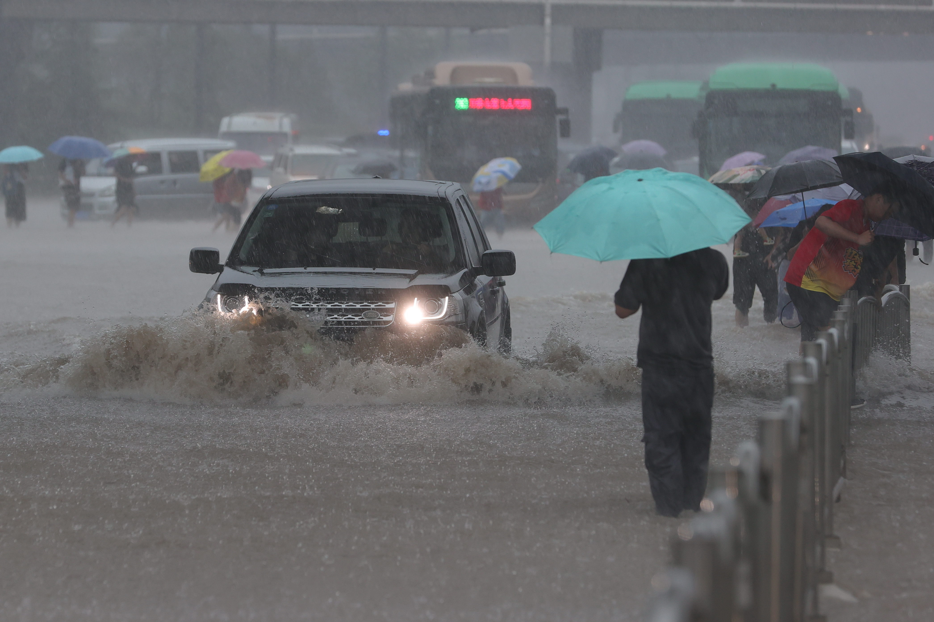
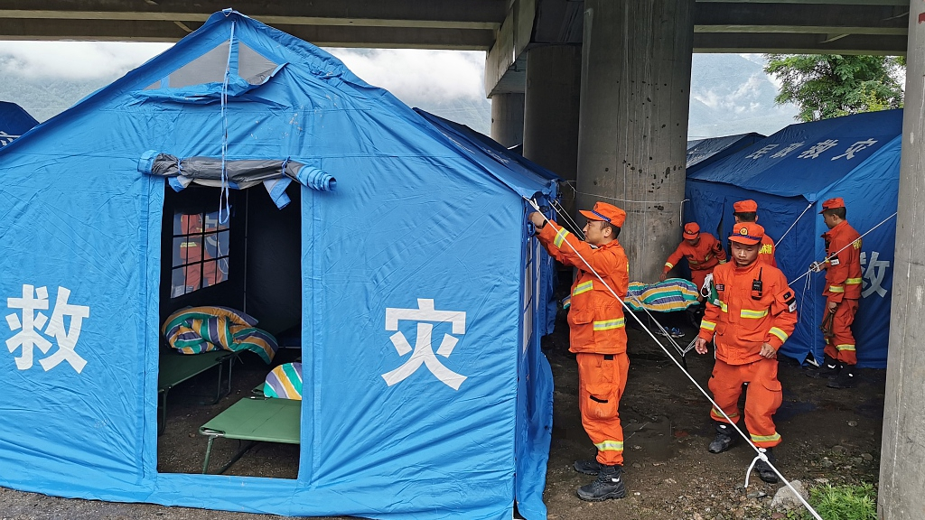
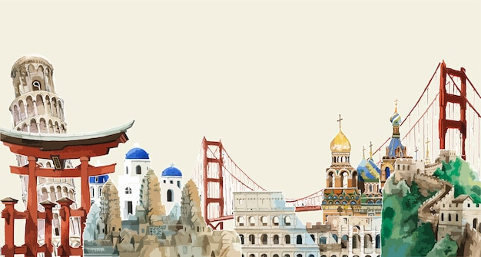
1. Authorities issue rainstorm alert across China
Heavy downpours and rainstorms hit Hebei, Beijing, Tianjin....
China’s recent weather has been extraordinary, from historic rainfall in Beijing and surrounding areas leading to fatalities and missing persons, to record heatwaves just before.

Slide 7
Questions:
What results in the extreme weather events according to the speaker?
When will negative trends in weather patterns end?

Slide 8
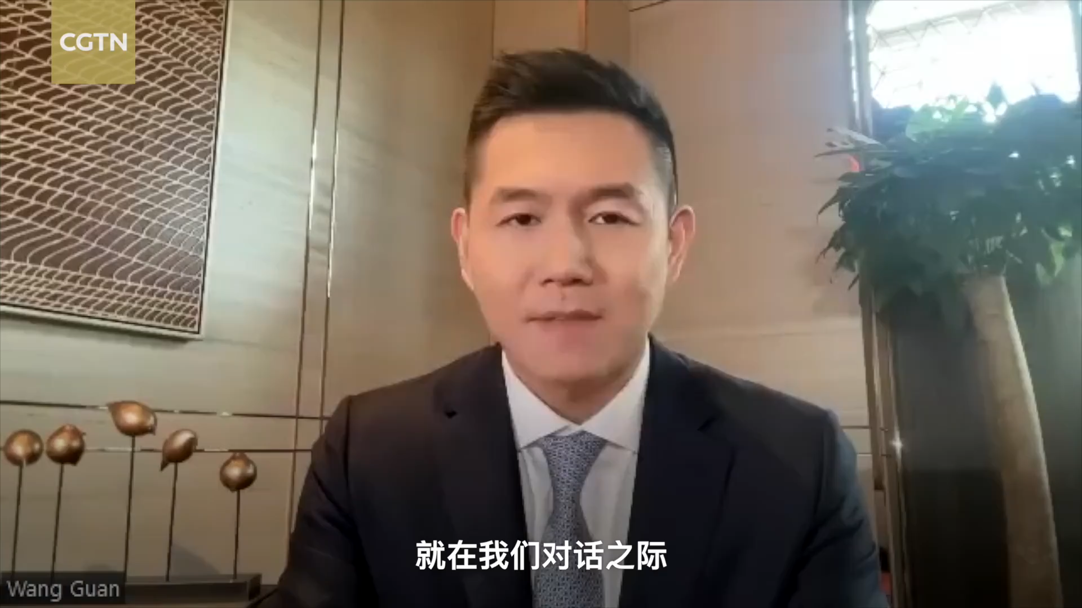

Slide 9
What results in the extreme weather events according to the speaker?
When will negative trends in weather patterns end?
because of the increased carbon emissions from burning fossil fuels
until the 2060s

Slide 10
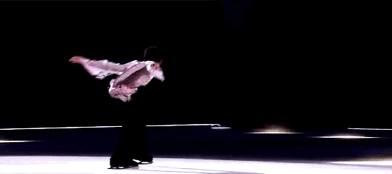
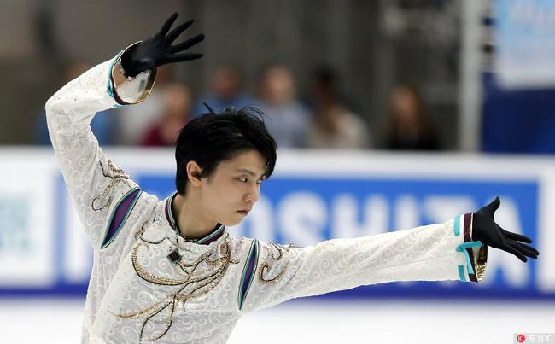
2. Japanese figure skater Hanyu marries, making fans happy and sad
“幸得识卿桃花面，从此阡陌多暖春。”
Fortunately to know the peach blossom of the monarch, since then the terraces will be warmer in the spring.

Slide 11
Japan’s Olympic gold-medal winning figure skater Yuzuru Hanyu announced his marriage late Friday, drawing congratulations from his fanbase, though some seemed sad that the photogenic 28-year-old would no longer be romantically available.
Hanyu did not say who his partner was when declaring his new marital status on X, the social media messaging platform formerly as Twitter.
“Thanks (to everyone) for supporting me always ... I’ve decided to get married this time,” he said in the post. “As I’ve lived with skating for 24 years, I’ve thought about various things particularly in the past several years over the fast-changing world including COVID-19 and natural disasters,” he added.
Hanyu, who won Olympic gold medals in both the 2014 and 2018 Winter Games, could not be reached immediately for direct comment.
There was a clear sense of loss in the reaction among many fans both in and outside Japan, as “Hanyu loss” became a fast trending hashtag on social media.
“I’m taking Monday off due to ‘Hanyu loss’,” read on post on X, while another predicted many more fans would be doing the same.
On China’s Weibo messaging app, another fan wrote “the world has become empty.”

Slide 12
Questions
1. How is the public sentiment towards Hanyu’s marriage announcement?
A. Anger.
B. Mixed feelings of joy and sorrow.
C. Indifference.
D. Unanimous (一致通过的，获得全体支持的) celebration.
2. Based on the text, how can Hanyu’s attitude towards his fans be described?
A. Disinterested and distant.
B. Grateful and considerate.
C. Demanding and critical.
D. Ambivalent (矛盾的) and inconsistent.
题目来源参考：LearnAnd Record Official Account

Slide 13
words and phrases
figure skater
photogenic
figure skater:“花样滑冰运动员”，figure skating:“花样滑冰”
拓展词汇：
冰雪运动：sports on snow and ice
短道速滑：short-track speed skating
越野滑雪：cross-country skiing
跳台滑雪：ski jumping
冰球：ice hockey
大跳台：big air
/ˌfəʊ.təˈdʒen.ɪk/ having a face that looks attractive in photographs
上镜的，上相的

Slide 14
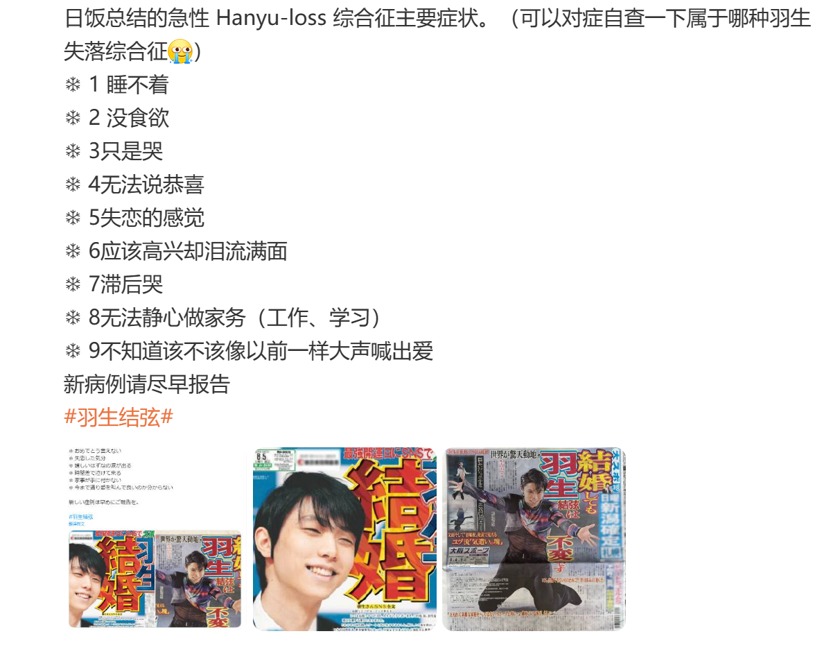
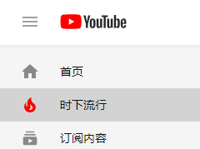
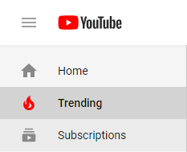
marital status
trending hashtag
adj. /ˈmær.ɪ.təl/ 婚姻的
marital breakdown 婚姻破裂
v.“（某一时刻在社交媒体或网站上）被提及最多的词语（主题或名字）”
n. “趋势；趋向；倾向；动态；动向；热点”
trending hashtags/a trending topic

Slide 15
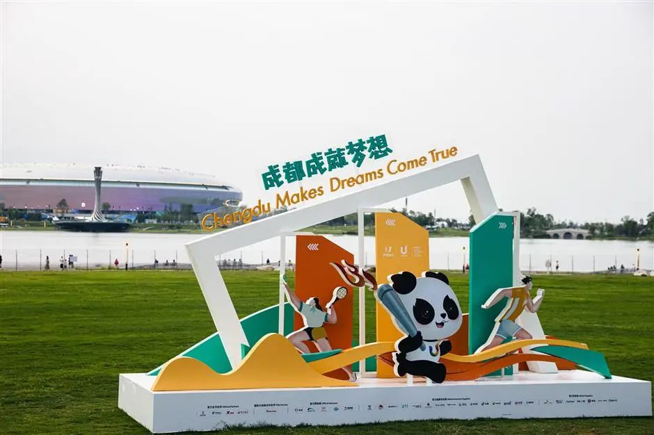
3. Chengdu in full swing for Summer World University Games
The 31st FISU World University Games is set to run from July 28 to August 8 in Chengdu, becoming the third city in the Chinese mainland to host the biennial Summer Universiade, following Beijing in 2001 and Shenzhen in 2011.
“Universiade”一词由“Universität”和“Olympiade”组成，意为大学奥林匹克运动会，更加官方的说法是“世界大学生运动会”。
The Slogan of the 31st FISU World University Games is "Chengdu Makes Dreams Come True."

Slide 16
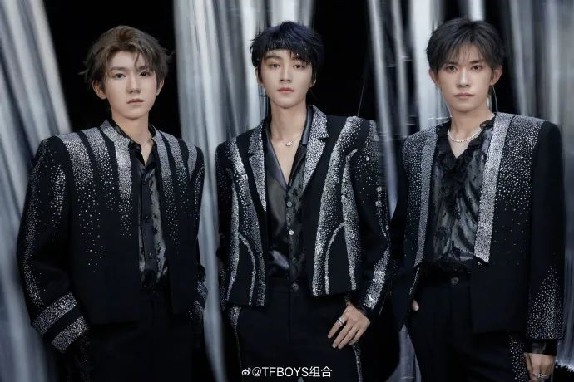
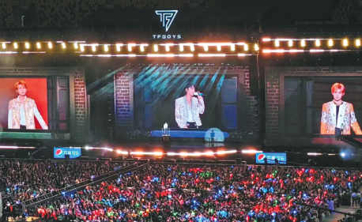
4. Crazy fans flock to decennial (/dɪˈsen.i.əl/ 表示“每十年一次的”) concert of Chinese idol group, with tickets, merch and hotels all selling out
Fans gather in Xi’an Olympic Sports Center for the 10th anniversary concert of the hit Chinese band TFBoys on Sunday in Xi’an, Shaanxi province. CHINA DAILY

Slide 17
语法填空
With their boyish charm and bubblegum beats (“泡泡糖”音乐), the members of Chinese pop group TFBoys are driving the popularity of Xi’an, Shaanxi province, they held a concert to mark the band’s 10th anniversary.
As a legion of (大批的) fans flocked to the Xi’an Olympic Sports Center to hear Wang Junkai, Wang Yuan and Yi Yangqianxi croon (吟唱) onstage, revenue (收入) from concert ticket sales reached 35.76 million yuan, which in turn drove the city’s tourism revenue to 416 million yuan.
The TFBoys was founded in 2013. As one of the first Chinese homegrown boy bands to reach and sustain global popularity, TFBoys (call) a cultural phenomenon, and the group’s concerts anywhere are powerful crowd magnets.
“I like to watch my favorite band’s tours in other cities. Each time, the experience is unique because the songs are a bit different and they share onstage their feelings about the hosting city,” said Wu Ying, 26, from Shanghai. The steady influx of (devote) fans to Xi’an prompted the trio to make an online plea (恳请), urging supporters to abstain from gatherings and activities at venues, hotels and other locations, and be mindful of the city’s capacity.
where
is called
devoted

Slide 18
Xi’an authorities, on their part, concentrated on measures such as strengthening security, prolonging (延长) public transportation operating hours and releasing official guidelines for fans.
Qiao Chengwei, business manager of travel portal Tuniu, attributed the rush partly
the strategic approach of Xi’an culture and tourism authorities.
“Xi’an has always been one of the most popular inter-provincial travel destinations. Family trips and study tours is leading to a huge demand for high-speed train tickets and museum (admit),” he said.
Feng Rao, dean of the tourism research academy at Mafengwo, said, “Concerts not only bring economic benefits to tourism, but more importantly, they enhance the hosting city’s popularity and showcase its (unique) and charm.” For first-tier and second-tier cities, larger and higher-quality concerts attract more audiences, drive consumption and increase tourism appeal.
For smaller cities, it is ideal to balance scale and quality. When it is challenging to support large concerts, lower-cost music festivals are better choice, he said.
to
admissions
uniqueness
a

Slide 19
Song Changyao, head of the tourism management department at Beijing International Studies University, said: “Concerts and music festivals bring tourists to the hosting city, especially overnight tourists, which contributes to the overall tourism revenue.” Song, however, pointed out that such big-ticket events put extra pressure on a city’s normal operations. “It is necessary to make provisional (临时的) arrangements and emergency plans, focusing on crowd management, traffic routes, emergency (evacuate) and price stabilization during such events,” he said. “ (compare) with traditional sightseeing, such events represent a form of fan economy, creating emotional connections for fans and visitors. These events provide young people memories, emotional resonance or stress relief, reflecting the diverse, personalized and emotion-driven trends in tourism demand,” he added.
evacuation
Compared

Slide 20

5. Barbie vs Oppenheimer

Slide 21

5. Barbie vs Oppenheimer

Slide 22
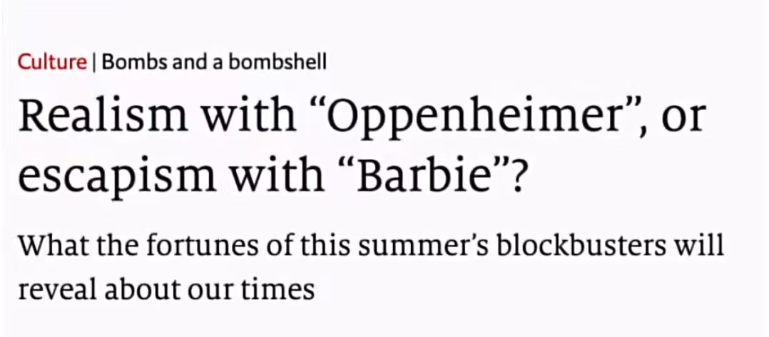
炸弹;爆炸装置
A 100-pound bomb exploded/went off today, injuring three people.
a sudden and often unpleasant piece of news（常指令人不快的）出人意料的消息;爆炸性新闻
a very attractive person美女 (a blonde bombshell金发美女)
fortune: 命运
blockbuster: a blockbuster movie/novel 电影大片／风靡一时的小说

Slide 23
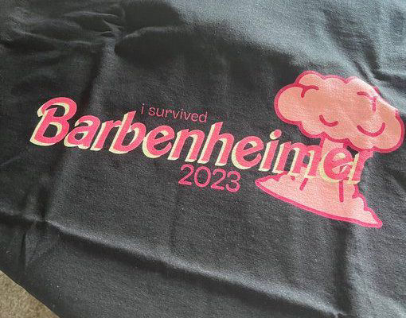


Slide 24
Part Three
How to study English in new term?

Slide 25
Listen carefully
Speak bravely
Read loudly
Recite actively
Write beautifully
课堂上
早晚自修+课后
输入单词+高质量语言
平时+周末
基本的素材一定需要背！背！背！
底层动词、细节（神态、心理...）描写
背诵默写放在常规的听写中

Slide 26
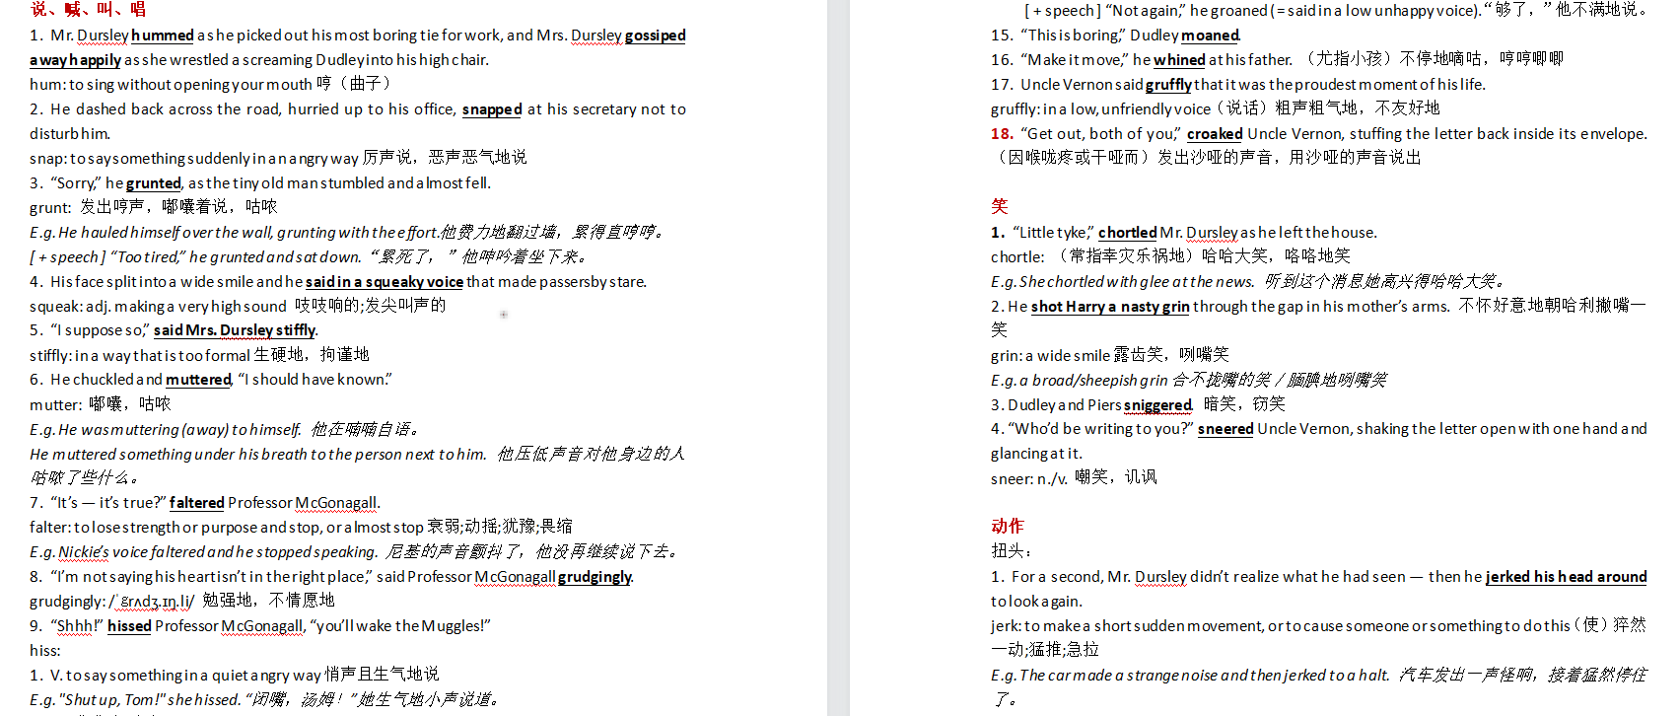
哈利波特1素材积累

