Slide 1

感恩遇见，相互成就，本课件资料仅供您个人参考、教学使用，严禁自行在网络传播，违者依知识产权法追究法律责任。
更多教学资源请关注
公众号：溯恩高中英语
知识产权声明

Slide 2
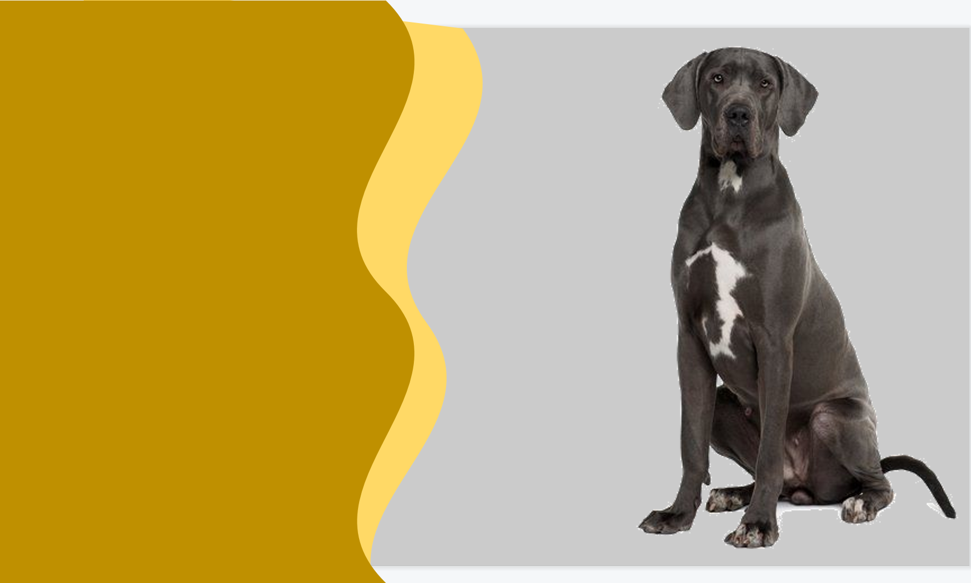
A Four-legged Guardian Angel
--树立伏笔意识，连贯全文
读后续写讲评
Z20名校联盟24届高三第一次联考

Slide 3
How to practice CONTINUATION in writing?
A narrative device in which a storyteller gives an advance hint of what is to come later in the story
FORESHADOWING
Where is it?

Slide 4
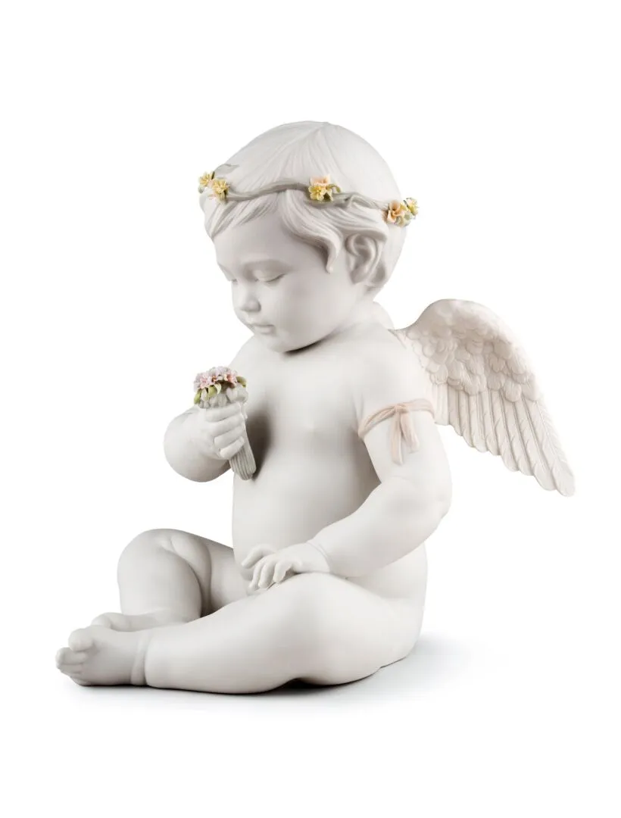
A Four-legged Guardian Angel
①Snow had just melted off the ground that April day at our house in Regina Beach, Saskatchewan. I had just cleaned up the pool in preparation for selling the house. The year before, I had lost my job with the provincial government, and now our financial situation was grim. In despair, I had finally put the home on the market, and a real estate agent was due to show up later that day. Even worse, I would have to give up my beloved Great Dane (大丹犬), Brigitte, because I could no longer afford the cost of feeding it. The thought of losing the dog and our beautiful home was almost more than I could bear.
②Deep in despair, I sat typing up resumes and cover letters. Out of the corner of my eye I could see my thirteen-month-old son, Forrest, as he lay on the carpet, playing near our big, gentle nanny-dog, Brigitte. It seemed as if Brigitte was always meant to be in this family and she turned out to be a perfect companion.
③Brigitte came to our Rouse on Christmas eve when the doorbell rang and I was sure some of my Christmas packages had arrived. I ran to the door and swung it open, but no one was there. I sensed something and looked down, only to find a beautiful Great Dane sitting there, looking up at me with big, intelligent eyes. There was no way that she could have rung the doorbell by herself, was there? Perhaps, someone had found the puppy somewhere and left her there, and then rang the doorbell and ran away. They accurately guessed I would welcome an additional family member and take care of her.
④Thinking of these, I couldn't help heaving a sigh and went straight back to work. However, I hadn't typed more than two sentences when Brigitte began barking furiously and running back and forth to the sliding glass door overlooking our pool.
⑤I raced to see what was happening and noticed that the sliding door was slightly open. Suddenly, I realized Forrest was nowhere to be seen. In panic, I opened the door and ran outside.
Para.1: There I was surprised to see Brigitte, who was terrified of water, dive into the pool.
Para.2: Finally, the doctor said Forrest was all right and could be released from hospital.
A Four-legged Guardian Angel

Slide 5
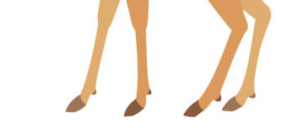
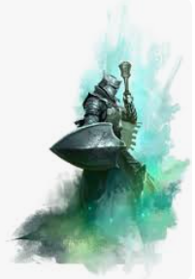

What can we read from the title?
Theme ？
Human& Nature
Human& Self
A certain animal
Guard what/who?
How to guard?
What is angel like?
An angel to whom?
Why is it called so?
Foreshadowing
A Four-legged
Guardian
Angel
“They are personal beings who demonstrate intellect, will, and emotions. They are glorious beings who often appear in a shining light. They are powerful beings—much more powerful than humans. They are functional beings who worship God, execute his commands, and serve believers. And, finally, they are organized beings, which allows them to effectively serve God and help people.”
--From: bible.org
Are these traits relevant to our story？

Slide 6
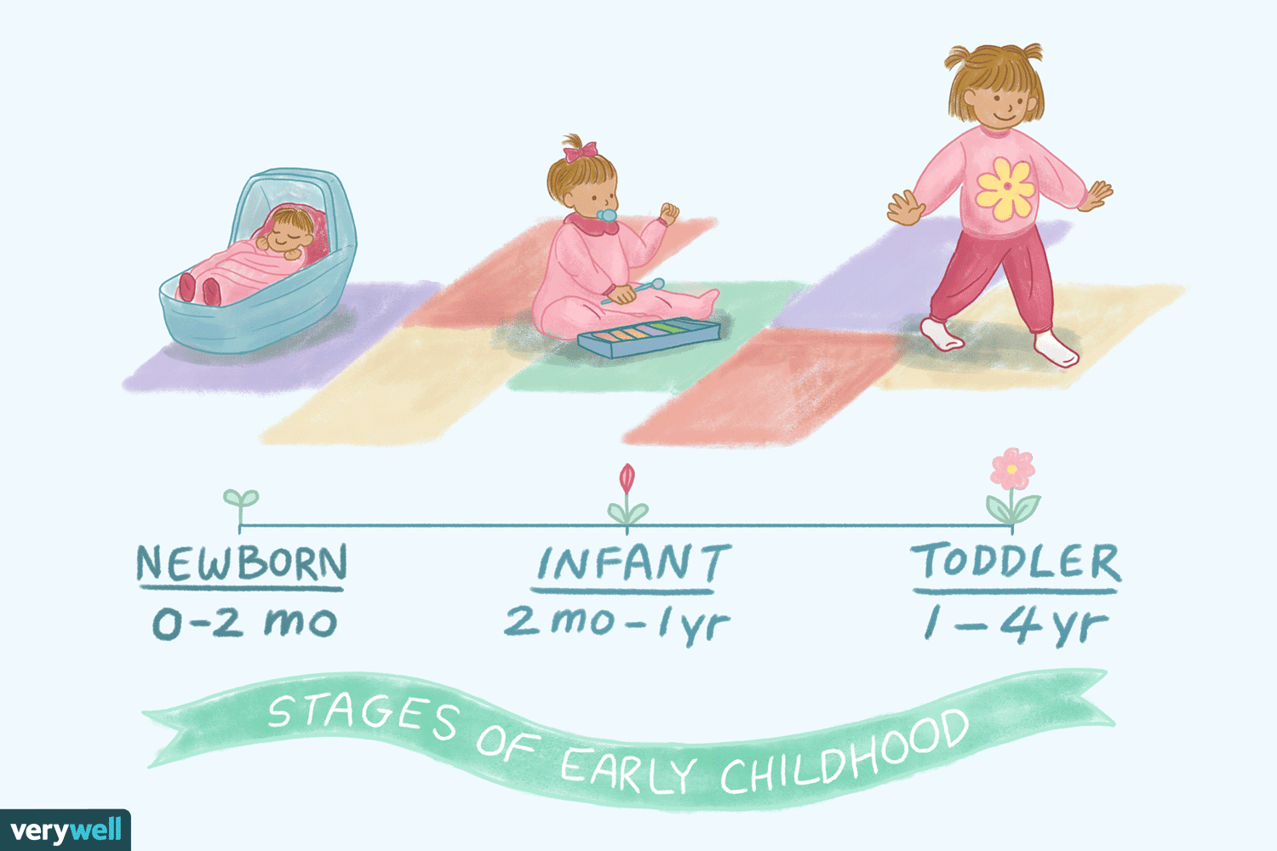
Read for the plot:
When:
Where:
Who:
What:
Why:
“Snow had just melted off the ground that April day at our house in Regina Beach, Saskatchewan”
I
Brigitte
Forrest(my son, thirteen months)
a real estate agent
“when Brigitte began barking furiously and running back and forth to the sliding glass door overlooking our pool.
I raced to see...and noticed.... Suddenly, I realized Forrest was nowhere to be seen. In panic, I opened the door and ran outside.
“Snow had just melted off the ground that April day at our house in Regina Beach, Saskatchewan”
-Anything caught your attention?
- lost my job; financial situation was grim; in despair
- my beloved Great Dane; our big,gentle nanny-dog
came... on Christmas eve; with big, intelligent eyes
It seemed as if Brigitte was always meant to be in this family and she turned out to be a perfect companion.
- Can he talk fluently?
“when Brigitte began barking furiously and running back and forth to the sliding glass door overlooking our pool.
I raced to see...and noticed.... Suddenly, I realized Forrest was nowhere to be seen. In panic, I opened the door and ran outside.
-Was it usual to Brigitte and me?
- What may happen next?
Para.1: There I was surprised to see Brigitte, who was terrified of water, dive into the pool.

Slide 7
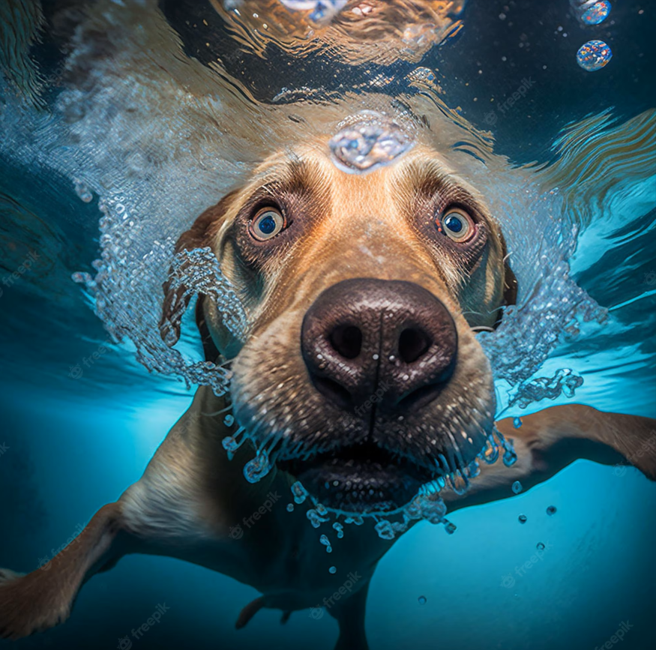
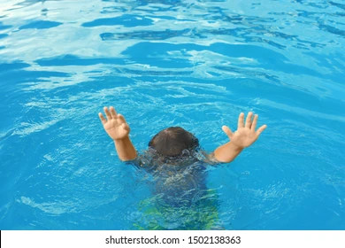
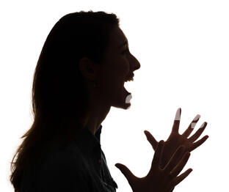
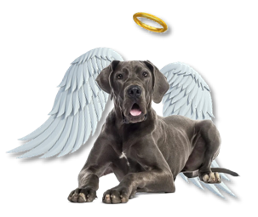
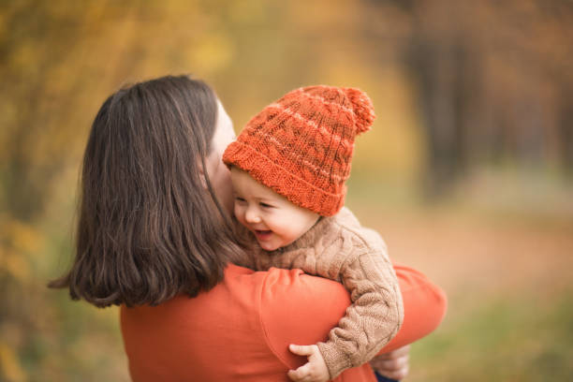
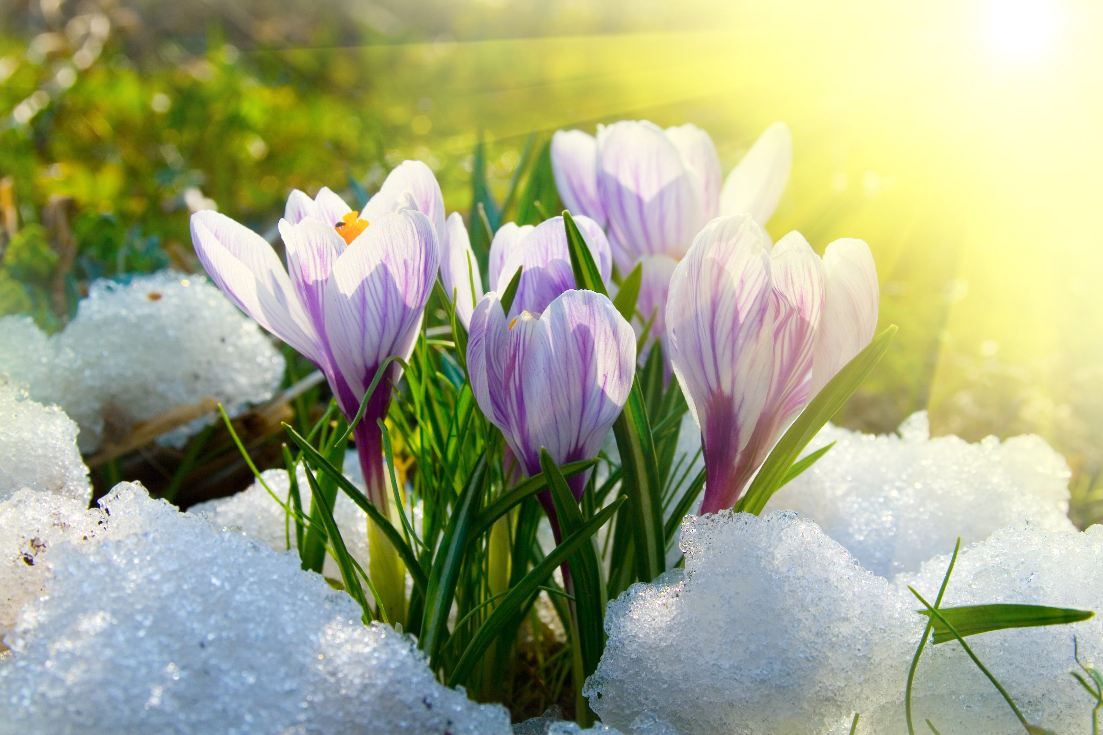

Plan our writing:
Para.1: There I was surprised to see Brigitte, who was terrified of water, dive into the pool.
Para.2: Finally, the doctor said Forrest was all right and could be released from hospital.
Why did Brigitte dive into the terrifying pool?
What did I find out?
Brigitte’s efforts
My reaction?
struggle for his owner/ pal/ family?
frozen to stand still ? do anything but wait?
dived into the pool to save....
to find a stick/ net or some other tools?
called 120/ 911/ the doctor/ the ambulance?
(Contact... and/or) Sent Forrest to the hospital
What’s my reaction?
How about Brigitte?
My thought and/ or further action
(reflecting the theme)
relieved and grateful(emotion, action, remarks)
barks, behaviors... to greet us home
Would I give up Brigitte? If not, what made me change my decision?
, accompanying Forrest
merely gave up a dog?
Obstacls?

Slide 8
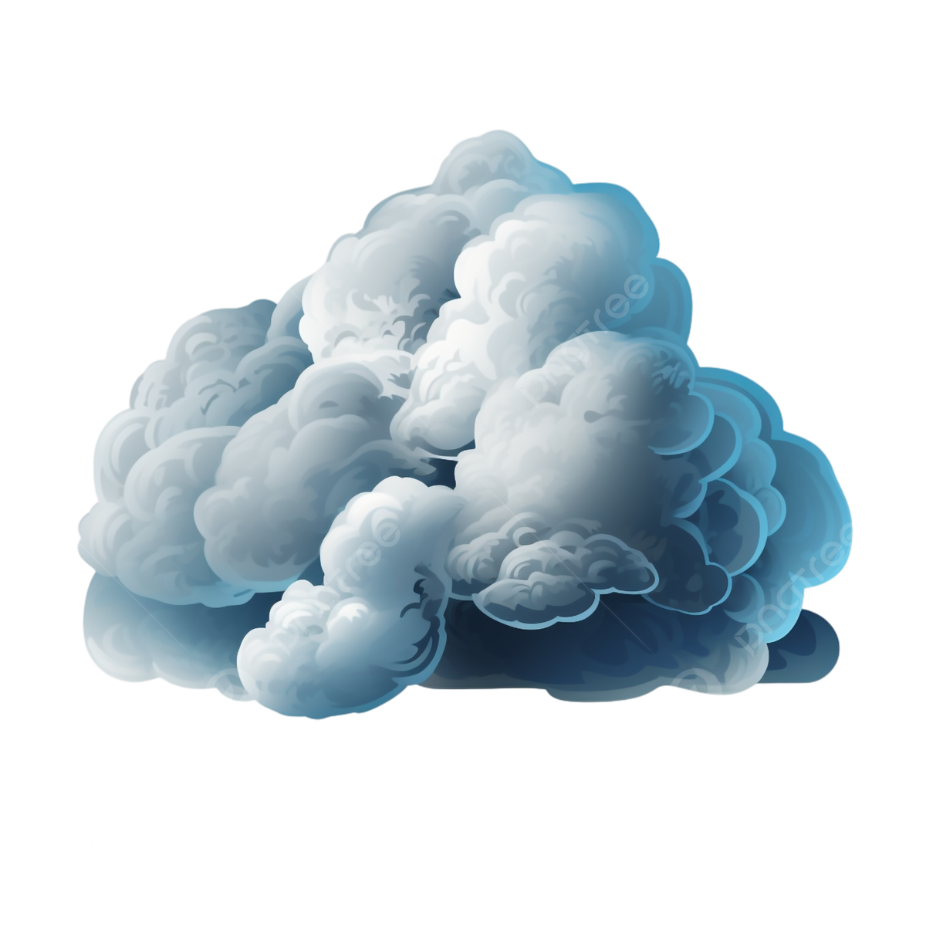

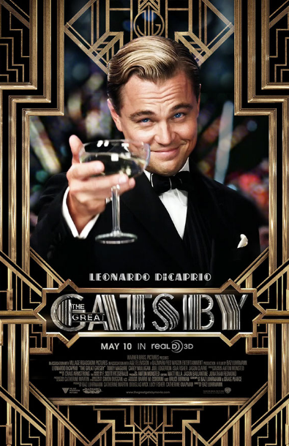
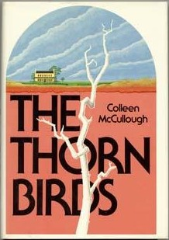
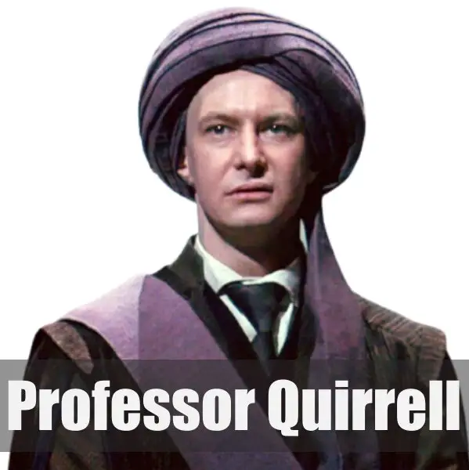
Where does foreshadow lies in?
Title: The Four-legged Guardian Angel, The Great Gatsby, The Thorn Birds....
Setting: weather, atmosphere, surrounding environment....
Character traits: apprearance, clothes, behaviours....
Metaphor/Simile: guardian, angel....
Dialogue: a joke, a comment, or even something unsaid....
Thought: a flashback/recall...
....
Benefits：
- Establish a mood
- Expand characterization
- Prepare for plot twists
- Lead in the dramatic finish
- Reinforce themes
....
suspicious turban头巾

Slide 9
Practice it in writing:
As I ran after her to the pool, what came into my sight swept over me with extreme shock. My thirteen-month-old son was struggling in the water/sinking to the bottom!
The moment I dashed to the poolside, I thought my boy was floating at the first glance.Yet, then I noticed that Brigitte was underneath him, holding his head above the water with its struggling crawl motions.
Seeing her playmate sinking in the water, Brigitte seemed to forget the fright and coldness, putting herself straight into the protector mode. She practiced crawling motions repeatedly, firmly took hold of Forrest’s collar, and dragged him back towards dry land!
Without a second thought, I splashed right in and embraced my boy onto the land.
Hardly had I reached the poolside when I took a mighty leap into the pool and paddled to their rescue.
His face is pale. His lips were blue. His eyes were rolled back. Obviously, he had swallowed too much water and got choked!
- Connection with location and behaviours
- Echo with the setting
- Brigitte’s a guardian.
- Brigitte’s a guardian.
- Echo with the title
- Personification
- Character traits
- Description of Action
- Description of Drowning

Slide 10
Practice it in writing:
- Connection with emotion
- Metaphor
-Brigitte’s an angel
- Brigitte’s our family.
- Brigitte’s a guardian.
- Brigitte’s an angel.
- Echo with the setting.
- Simile
- Description of Distress
- Flashback
- Brigitte’s an angel.
- Reflect the theme
- Metaphor& Personification
The good news blew past me, whipping away all worries and stress.
Stiff posture loosing and palms pressing to the heart, I murmured “Thank Brigitte!” again and again with beaming tears.
No sooner had Brigitte spotted us than she charged towards, nervously wagging her tail and sniffing at Forrest anxiously to check on him.
The instant the door opened, Brigitte’s grinning eyes and bright barks were telling her exhilaration, which was infectious/ contagious throughout the house like the warm April sunlight.
Crounching by Forrest, Brigitte didn't move a muscle or make a sound until he woke up.
My mind, however, doesn't seem to be going with the steady rhythm of Forrest and Brigitte’s breathes. It is juggling between all the past, present and future thoughts.
The stars in Brigette’s big, intelligent eyes directly glared into my soul, making me set my mind. There is an unsaid bravery and courage all around.

Slide 11
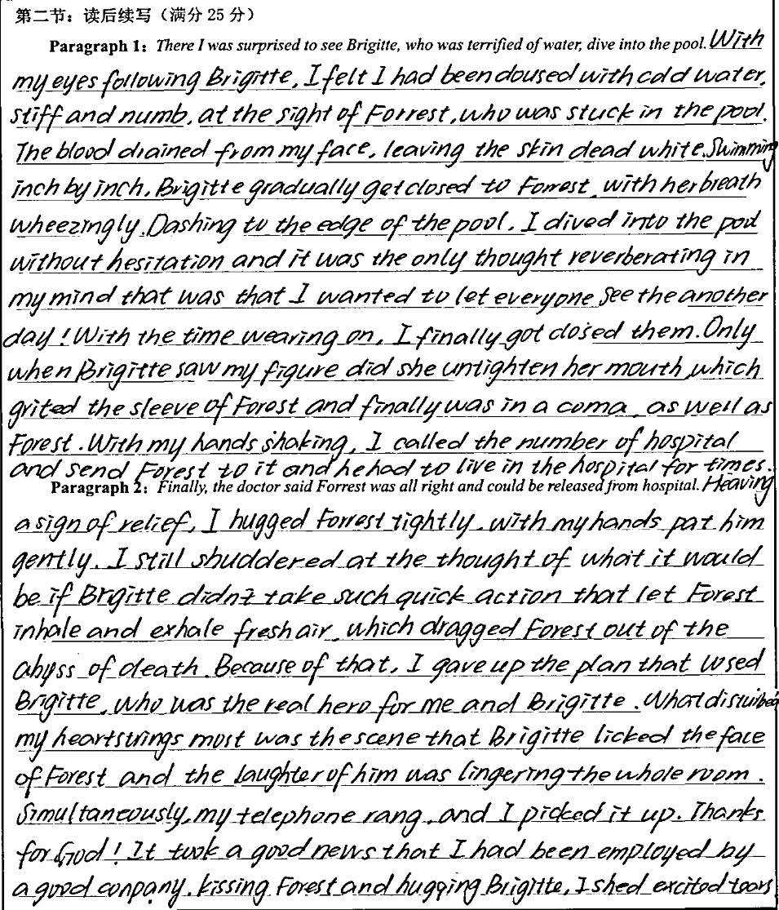
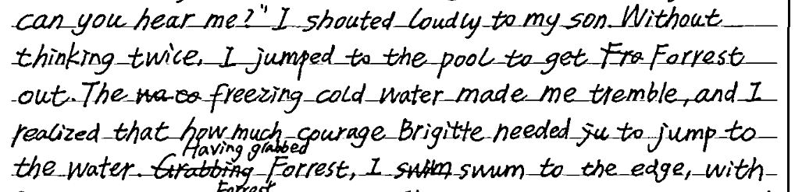
Learn from peers
- Effective connection with the given sentence
- Echo with the setting
- Simile
- Brigitte’s a part of our family
- Reflect the theme
- Flashback
- Brigitte’s a guardian
- Brigitte’s an angel

Slide 12
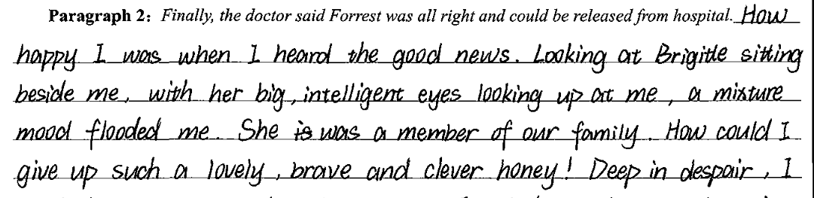
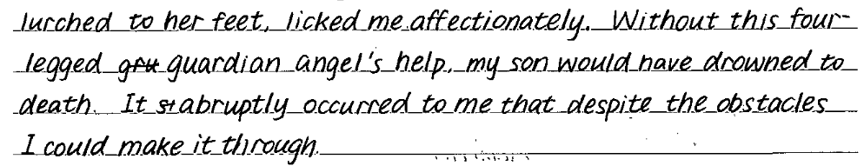
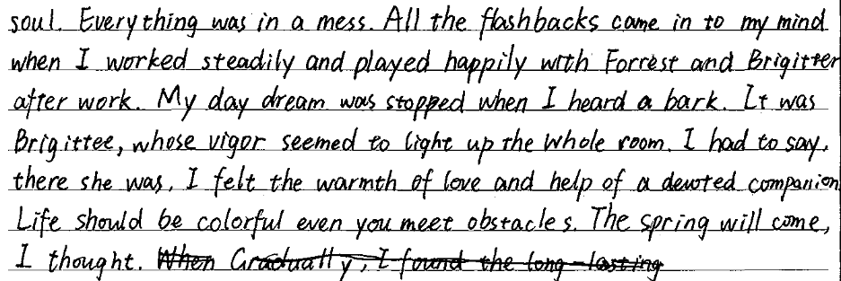
Learn from peers
- Brigitte’s as innocent as an angel
- Brigitte’s a part of our family
- Reflect the theme
- Flashback
- Reflect the theme
- Flashback
- Metaphor
- Brigitte’s a perfect companion
- Brigitte brought warmth as a family member
- Echo with the setting, reflect the theme

Slide 13


There I was surprised to see Brigitte, who was terrified of water, dive into the pool. Then to my horror, I caught sight of Forrest’s yellow sleeper. Brigitte was bravely doing her best to keep him afloat(floating) by holding on to his sleeper with her mouth. At the same time, she was desperately trying to swim to the shallow end. Only then did I realize that Forrest had somehow opened the door, wandered out and fallen into the pool. In a split second, I dove in, lifted my precious baby out and carried him inside. Hands shaking, I called 911 and we were rushed to the hospital immediately, where the doctor kept him for observation for one night.
Finally, the doctor said Forrest was all right and could be released from hospital. Back home, once Brigitte saw him, she barked with apparent joy and wouldn’t let Forrest out of her sight. In time she settled down, but remained dedicated to Forrest and followed him everywhere, concerned about his safety. Even when Forrest was asleep, Brigitte crammed herself under the crib, keeping a vigil. Our dog was indeed an angel, erasing any despair I might have had about losing our home. A house could always be replaced, but knowing we had each other around was the greatest blessing of all. I was grateful she was part of our lives, who I would never give up.
1. Circle the foreshadowing in the writing.
2. Attach importance to the connection, sentence patterns and good expressions.
3. Polish your own version.

Slide 14

There I was surprised to see Brigitte, who was terrified of water, dive into the pool. As I ran after her to the pool, what came into my sight swept over me with extreme shock. My thirteen-month-old son was struggling in the water. Seeing her playmate sinking, Brigitte seemed to forget everything, putting herself straight into the protector mode. She practiced crawling motions repeatedly, firmly took hold of Forrest’s collar and dragged him back towards the poolside. Without a second thought, I splashed right in and embraced my boy from Brigitte’s mouth onto the dry land. Forrest’s face pale and lips blue, I wrapped him into the car and rushed to the hospital anxiously.
Finally, the doctor said Forrest was all right and could be released from hospital. Stiff posture loosing and palms pressing to the heart, I murmured “Thank Brigitte!” again and again with beaming tears. Before long, Forrest and I went back home. The instant the door opened, Brigitte’s grinning eyes, bright barks and wagging tails were telling her exhilaration, which was contagious throughout the house like the warm April sunlight. The stars in Brigette’s big, intelligent eyes directly glared into my soul, making me set my mind. There is an unsaid bravery and courage all around our sound and sweet family. Brigette is a genuine gift and integral guardian angle to us!

