Slide 1

感恩遇见，相互成就，本课件资料仅供您个人参考、教学使用，严禁自行在网络传播，违者依知识产权法追究法律责任。
更多教学资源请关注
公众号：溯恩高中英语
知识产权声明

Slide 2
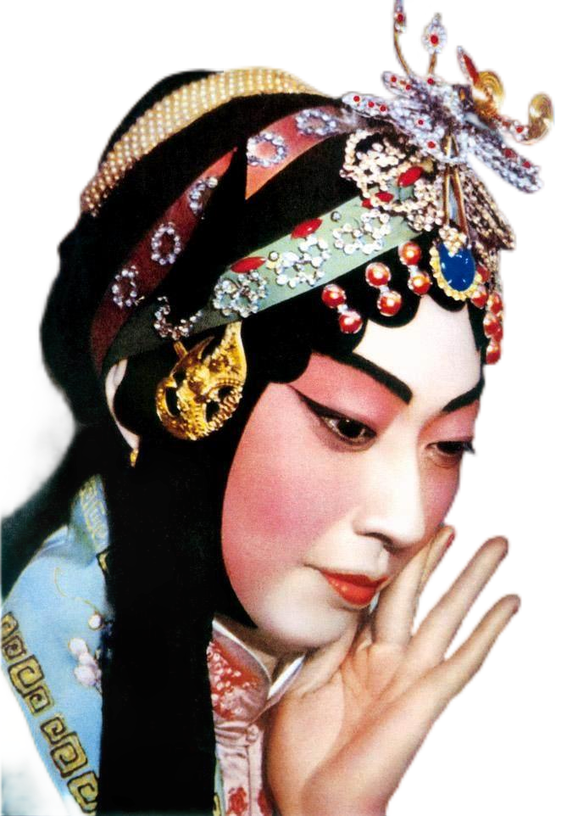

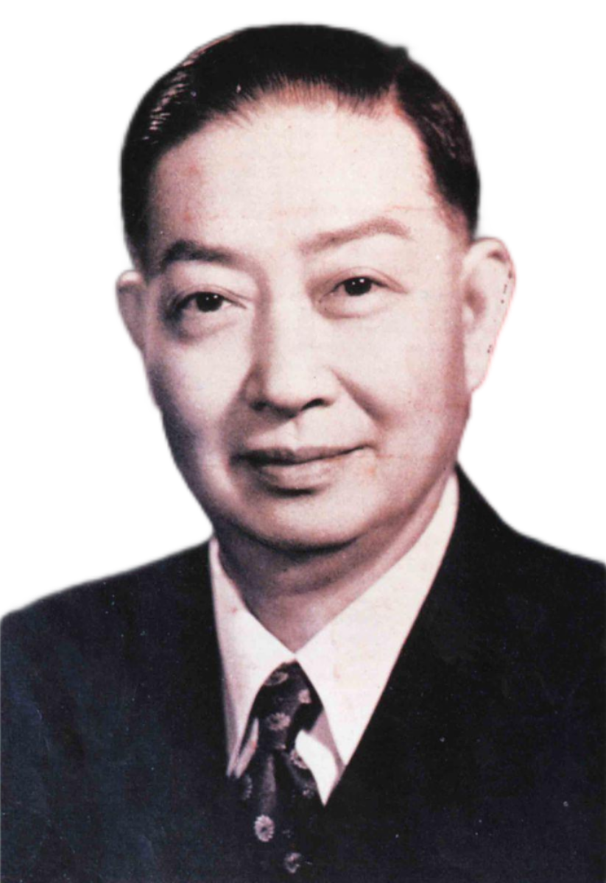
Mei Lanfang
中国情怀系列课程
The Queen of Peking Opera
Great Artist
Cultural Ambassador

Slide 3

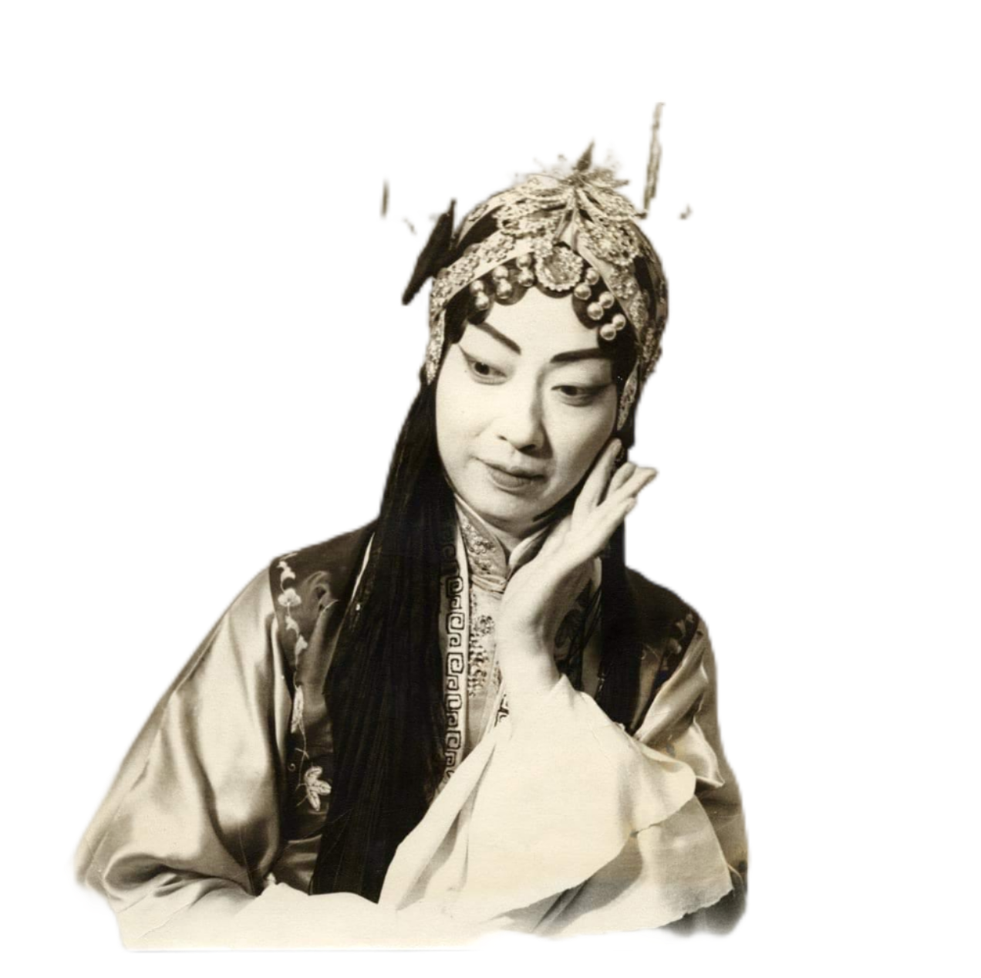
Why Mei Lanfang was acknowledged as the “Queen” of Peking Opera?
Because he played the female dan role in Peking opera wonderfully and was remembered as the best of his era's Four Great Dan.

Slide 4
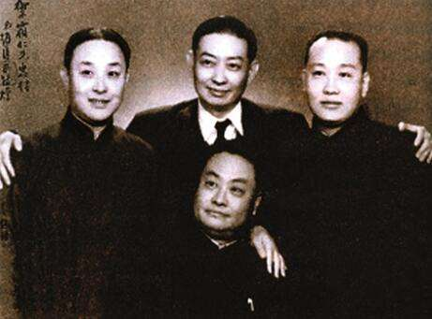
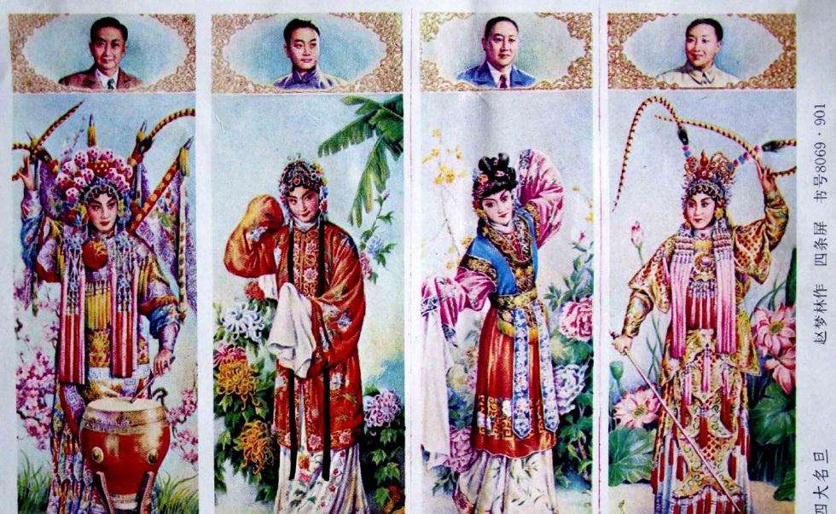
The Four Great Dan of Beijing Opera
Mei Lanfang
Cheng Yanqiu
Shang Xiaoyun
Xun Huisheng
Among them, Mei Lanfang is acknowledged to be the symbol of China's performing art.

Slide 5
Before You Watch
An ambassador is an important official who lives in a foreign country and represents his or her own country’s interests there.
Mei Lanfang: Great Artist, Cultural Ambassador
Mei Lanfang is still known today as one of the masters of Beijing Opera. He played a key role in bringing Beijing Opera to the world, leading to the international status and recognition that it has today. Mei Lanfang is still widely remembered for his skill, his kindness, and his deep love for his country.

Slide 6
Before You Watch
Try to match the time phrases with the events in Mei Lanfang’s life.
1. at age 8
2. in his 20s
3. in1919
4. after eight years of attempt
5. over 50 years on stage
6. in 1961
7. in 1894
A. born in Beijing
B. succeeded in taking Beijing Opera to the USA
C. died of heart disease
D developed a style called the “Mei Lanfang School”
E began to travel and perform abroad
F started to learn Beijing Opera
G. became known internationally for his acting skill
Watch the video and check whether your matching is correct.
Pay special attention to the time phrases in the video.

Slide 7
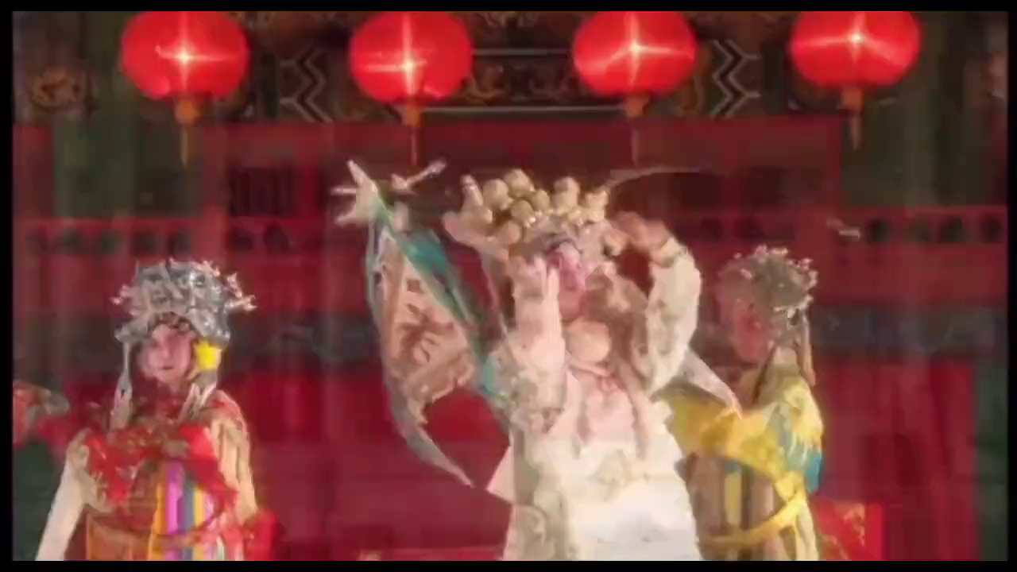

Slide 8
While You Watch
Check your answers in Before You Watch.
F
1. at age 8
2. in his 20s
3. in1919
4. after eight years of attempt
5. over 50 years on stage
6. in 1961
7. in 1894
A. born in Beijing
B. succeeded in taking Beijing Opera to the USA
C. died of heart disease
D developed a style called the “Mei Lanfang School”
E began to travel and perform abroad
F started to learn Beijing Opera
G. became known internationally for his acting skill
G
E
B
D
C
A

Slide 9
While You Watch
Watch the video clip and complete the sentences.
Take notes while watching the video.
1 The great Indian author Rabindranath Tagore ____________________ about Mei Lanfang.
2 In the USA, many fans __________________________ after the performances to shake his hand.
3 Mei Lanfang brought Beijing Opera abroad so that more people could ___________________________ of Chinese culture and art.
4 When Japanese troops invaded China, Mei Lanfang ____________________________________.

Slide 10


Slide 11
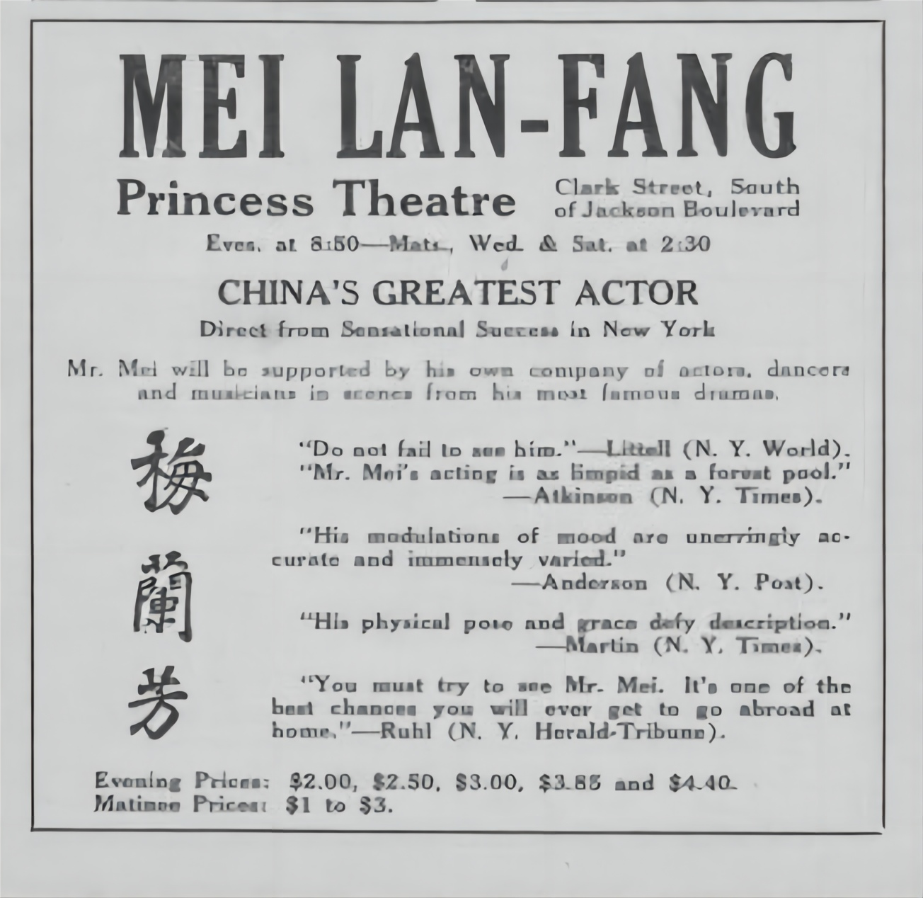
While You Watch
Check the answers.
Take notes while watching the video.
1 The great Indian author Rabindranath Tagore ____________________ about Mei Lanfang.
2 In the USA, many fans __________________ after the performances to shake his hand.
3 Mei Lanfang brought Beijing Opera abroad so that more people could ___________________________ of Chinese culture and art.
was inspired to write a poem
stood in long queues
understand and appreciate the beauty

Slide 12
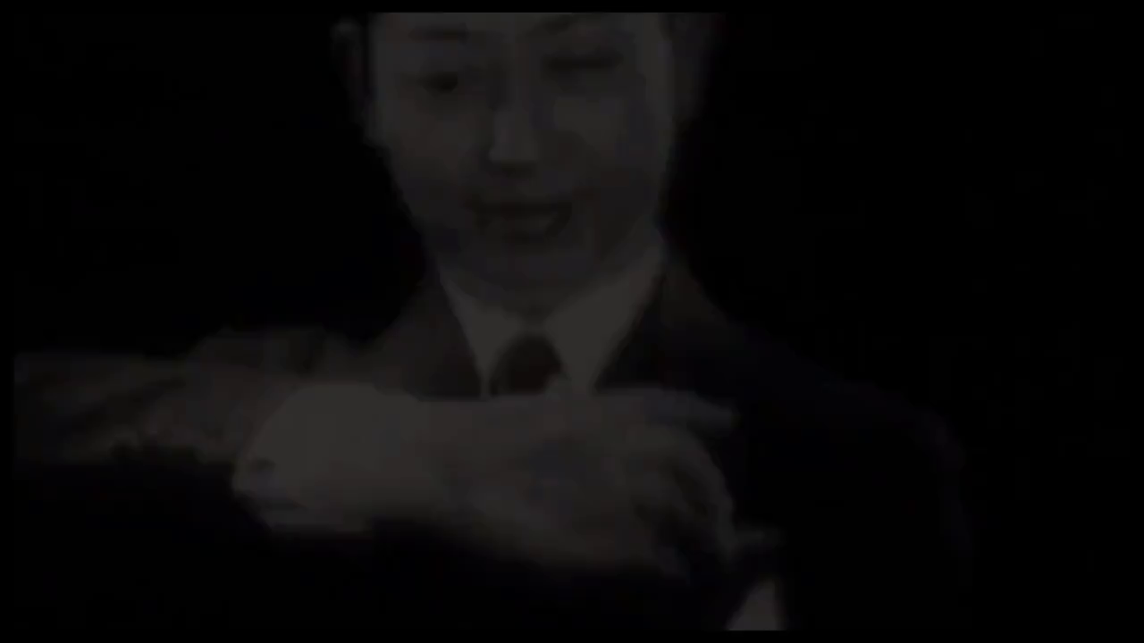
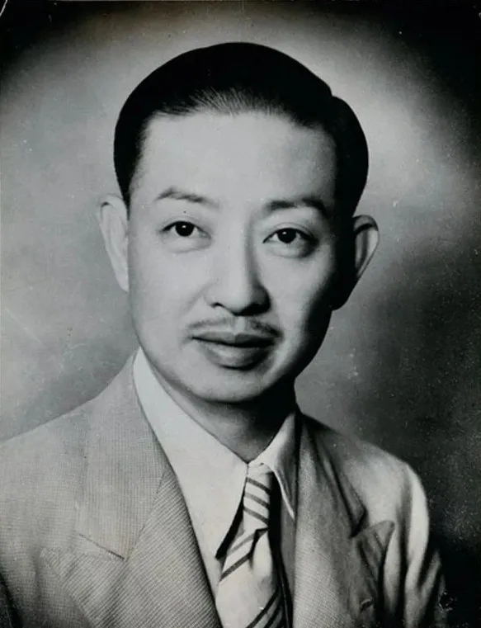
4. When Japanese troops invaded China, Mei Lanfang ___________________________________________
refused to do any performances for their entertainment.
He even started to grow a mustache!
梅兰芳蓄须

Slide 13
After You Watch
Watch the video again and think about the following questions.
1. How did Mei Lanfang become a legend in the art of Beijing Opera?
2. Why is Mei Lanfang greatly loved by so many people?

Slide 15
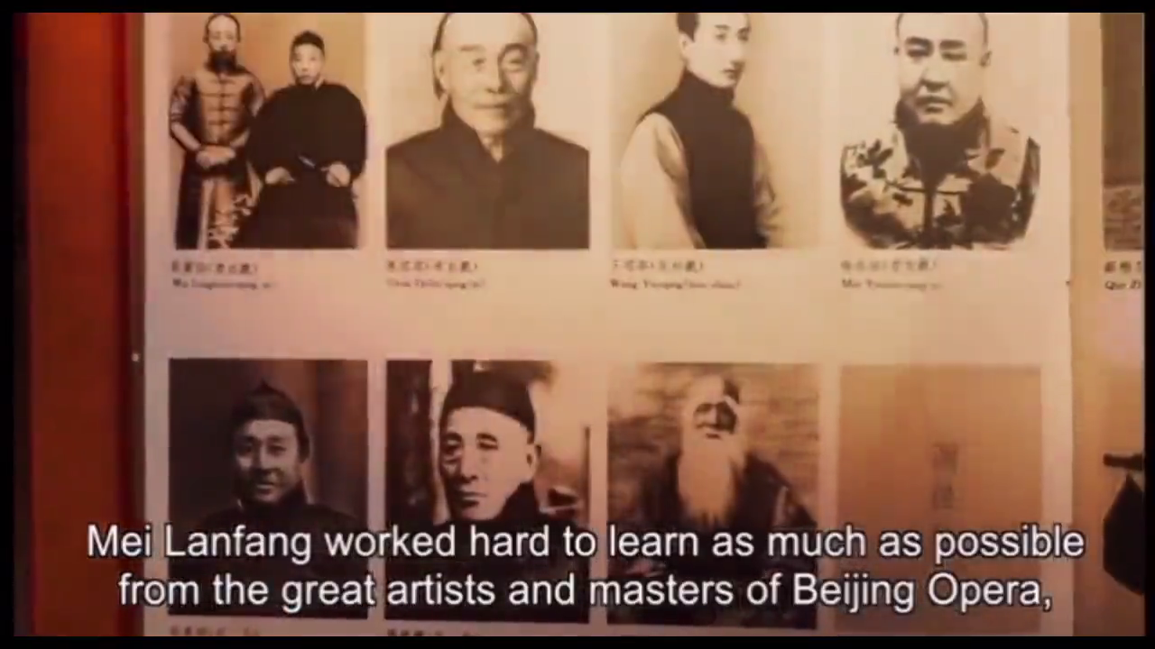
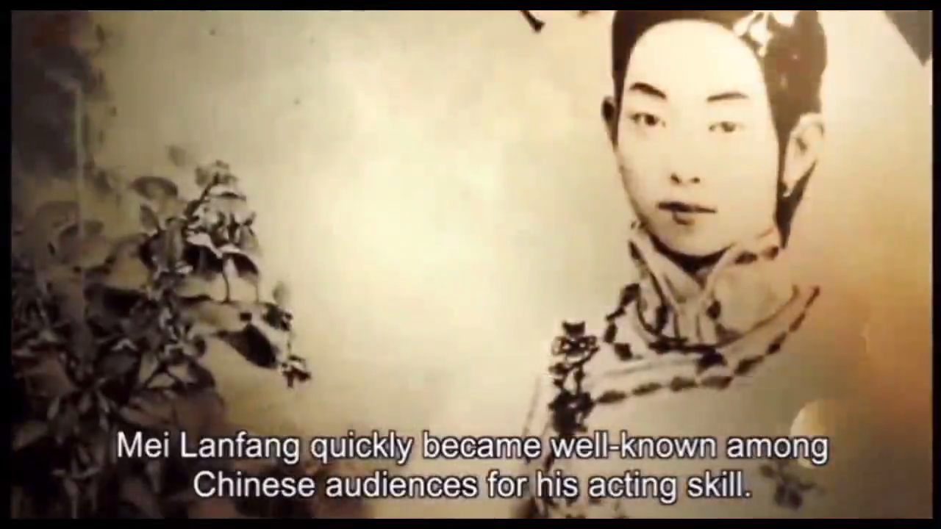
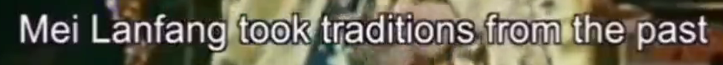
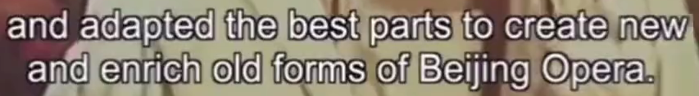
After You Watch
1. How did Mei Lanfang become a legend in the art of Beijing Opera?
diligent
creative
had a strong desire to learn
skillful

Slide 16
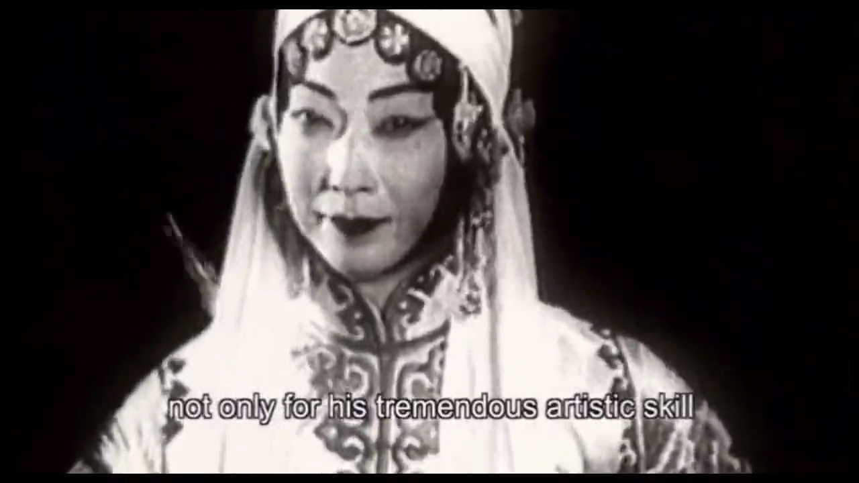
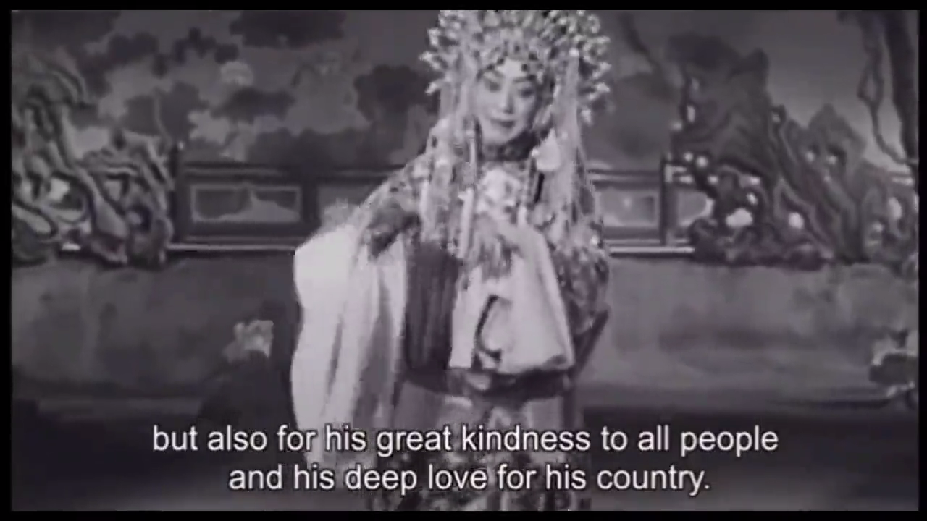
After You Watch
2. Why is Mei Lanfang greatly loved by so many people?
patriotic

Slide 17

假设你是李华，你得知校英文报《名人论坛》正在征集介绍京剧大师梅兰芳及其成就和影响的文章，请你写一篇文章投稿。
注意：字数为80词左右。

Slide 18
写作要点
Layout
Paragraph 1
Paragraph 2
Paragraph 3
Content
The most important achievements and influences of Mei Lanfang
More details of Mei Lanfang’s life.
Summative criticism

Slide 19
写作要点
Mei Lanfang’s achievements and influences
把...带上国际舞台
让人们理解和欣赏
改编升华
形成...风格
开创
让...意识到
闻名于海内外
verb phrases
bring...to the global stage
make people understand and appreciate
adapt and elevate
form a ... style
create/give birth to
make sb realize that...
become known domestically and internationally

Slide 20
写作要点
Mei Lanfang’s achievements and influences
文化大使
中国文化的瑰宝
梅派
绝妙的表演
戏剧形式
文化和艺术价值
noun phrases
cultural ambassador
Chinese cultural treasure
The Mei Lanfang School
brilliant performaces
theatrical form
cultural and artistic value

Slide 21
写作句型
Not only...but also 半倒装句
不仅...而且...
Not only 放句首, Not only 后面的句子半倒装
例：
Not only is Tu Youyou a committed researcher, but also a perseverant scientist.
梅兰芳不仅是一位伟大的艺术家，还是中国的文化大使。
Not only was Mei Lanfang a great artist, but also a cultural ambassador.

Slide 22
写作句型
强调句
It is/was + 强调部分 + that + 句子剩余部分。
例：
It was Tu Youyou’s contributions that saved millions of lives.
正是梅兰芳绝妙的表演震惊了观众。
It is Mei Lanfang’s brilliant performances that shock the audience.

Slide 23
Possible version
Mei Lanfang was the queen of Peking Opera. Not only was he a great artist, but also a cultural ambassador. He brought the Peking Opera to the global stage and helped more people understand and appreciate this Chinese cultural treasure.
Mei Lanfang started to learn Peking Opera at the age of 8. In his over 50 years on stage, he became known domestically and internationally. Adapting and elevating the traditional Peking Opera, Mei Lanfang shaped a style of his own, giving birth to “The Mei Lanfang School”.
It is Mei Lanfang’s brilliant performances that shock the audience, and make people realize that the Peking Opera is a theatrical form of great cultural and artistic value.

Slide 24
