Slide 1

感恩遇见，相互成就，本课件资料仅供您个人参考、教学使用，严禁自行在网络传播，违者依知识产权法追究法律责任。
更多教学资源请关注
公众号：溯恩高中英语
知识产权声明

Slide 2






Senior 3
The 1st Class

Slide 3



01
What happened during the summer holiday?
02
What to expect in the coming year?
03
What can you do to achieve your goal?

Slide 4
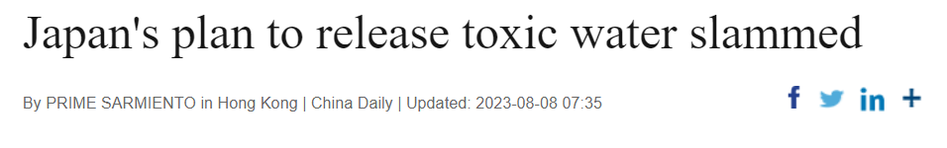
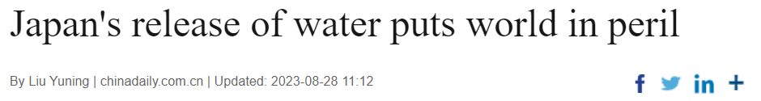

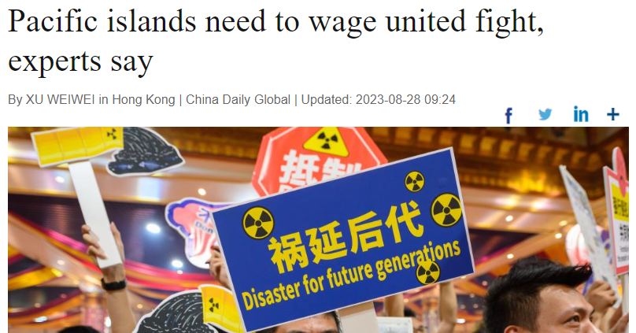
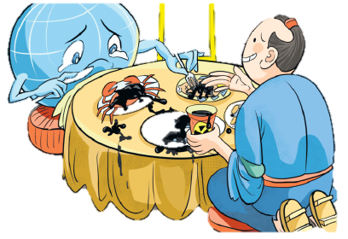
To develop a correct life outlook
to criticize sb./ sth. very strongly 猛烈抨击
to begin and continue a war, a battle, etc. 开始，发动

Slide 5

To gain a wider international perspective
China-Africa ties surge despite global hurdles
China-Africa ties surge despite global hurdles
China-Africa relations have reached new heights across politics, economics, and culture, despite challenges posed by geopolitical conflicts and unilateralism worldwide, according to a report released on Tuesday.
In addition to the close exchanges between senior officials, economic and trade cooperation between China and Africa has deepened continuously and reached unprecedented levels, the report said.
China has been Africa's largest trading partner for 14 consecutive years. Chinese imports from Africa in the past 23 years have accumulated to $1.42 trillion, while the figure for exports to Africa was $1.58 trillion, official data showed.
The report said Africa's economy confronted challenges amid global economic deceleration, increasing inflation, and geopolitical crises. These factors caused a dip in Africa's growth rate from 4.8 percent in 2021 to 3.8 percent in 2022.
Another significant concern often overlooked is the toll from natural disasters caused by climate change in African nations, said the report.
The report also envisioned Africa's economy rebounding this year due to the gradual relaxation of pandemic restrictions and heightened international market demand.
While traditional areas such as infrastructure and trade have showcased excellent Sino-African collaboration, the potential is also seen in healthcare, green economy, and artificial intelligence, it said.
As collaborative mechanisms continue to evolve, the future holds vast prospects for furthering China-Africa cooperation, he added.
China-Africa relations have reached new heights across politics, economics, and culture, despite challenges posed by geopolitical conflicts and unilateralism worldwide, according to a report released on Tuesday.
In addition to the close exchanges between senior officials, economic and trade cooperation between China and Africa has deepened continuously and reached unprecedented levels, the report said.
China has been Africa's largest trading partner for 14 consecutive years. Chinese imports from Africa in the past 23 years have accumulated to $1.42 trillion, while the figure for exports to Africa was $1.58 trillion, official data showed.
The report said Africa's economy confronted challenges amid global economic deceleration, increasing inflation, and geopolitical crises. These factors caused a dip in Africa's growth rate from 4.8 percent in 2021 to 3.8 percent in 2022.
Another significant concern often overlooked is the toll from natural disasters caused by climate change in African nations, said the report.
The report also envisioned Africa's economy rebounding this year due to the gradual relaxation of pandemic restrictions and heightened international market demand.
While traditional areas such as infrastructure and trade have showcased excellent Sino-African collaboration, the potential is also seen in healthcare, green economy, and artificial intelligence, it said.
As collaborative mechanisms continue to evolve, the future holds vast prospects for furthering China-Africa cooperation, he added.

Slide 6
To be a cultural ambassador
Living Heritage: Porcelain
Fine, crisp and translucent. Many years ago, a dance between clay and fire 1. gave (give) rise to a tangible piece of art: porcelain. 谓语动词（一般过去式、主动语态）
Flames in kilns around China have been burning since the Xia and Shang dynasties (c. 21st century-11th century BC). Along the way, porcelain 2. was born (bear).谓语动词（一般过去式、被动语态）
Porcelain is ceramic made by heating raw materials, often a mix between China stone and kaolin clay, in a kiln (窑炉 ) 3. at a temperature as high as 1,200 degree Celsius. 介词 Temperature is key to making porcelain. 4. Going (go) through the fire of reinvention at a high temperature bestows porcelain with greater strength, more translucence and a feast of colors. 非谓语动词（现在分词做主语）
Celadon produced in Longquan, Zhejiang province, a technique passed down for more than 1,600 years, is a typical example of craftsmen’s 5. pursuit (pursue) of the perfect green glint (光亮). Plum green and light green, or tianqing (the color of the sky after a rain), are two colors of the best quality. 词性转换（动词变名词）
Porcelain has also been a 6. carrier (carry) for cultural exchanges.词性转换（动词变名词）Along with China‘s silk and tea, porcelain was one of the first 7. commodities (commodity) to receive worldwide trade. 名词复数
As it travelled around the globe through the ancient Maritime Silk Road, porcelain enjoyed great popularity among royal families and upper classes in Europe, who were enamored (迷恋的；倾心的) by these beautiful vessels (器皿) they named after China, 8. a product that could be produced only in the far East.
Porcelain began as a practical utensil (器具) and evolved into pieces of art. Even when 9. shattered (shatter) into pieces and buried deep in mud, cultural values attached to porcelain would never dissipate (消散). 非谓语动词（过去分词）
As a memory that can be felt with both hands, porcelain is 10. touchable (touch) history.词性转换（动词变形容词）
Fine, crisp and translucent. Many years ago, a dance between clay and fire gave rise to a tangible piece of art: porcelain.
Flames in kilns around China have been burning since the Xia and Shang dynasties (c. 21st century-11th century BC). Along the way, porcelain was born.
Porcelain is ceramic made by heating raw materials, often a mix between China stone and kaolin clay, in a kiln at a temperature as high as 1,200 degree Celsius. Temperature is key to making porcelain. Going through the fire of reinvention at a high temperature bestows porcelain with greater strength, more translucence and a feast of colors.
Celadon produced in Longquan, Zhejiang province, a technique passed down for more than 1,600 years, is a typical example of craftsmen's pursuit of the perfect green glint. It takes 72 steps to produce Longquan celadon's jade-like green. Plum green and light green, or tianqing (the color of the sky after a rain), are two colors of the best quality.
Porcelain has also been a carrier for cultural exchanges. Along with China's silk and tea, porcelain was one of the first commodities to receive worldwide trade.
As it travelled around the globe through the ancient Maritime Silk Road, porcelain enjoyed great popularity among royal families and upper classes in Europe, who were enamored by these beautiful vessels they named after China, a product that could be produced only in the far East.
Porcelain began as a practical utensil and evolved into pieces of art. Even when shattered into pieces and buried deep in mud, cultural values attached to porcelain would never dissipate.
As a memory that can be felt with both hands, porcelain is touchable history.
Fine, crisp and translucent. Many years ago, a dance between clay and fire 1. __________ (give) rise to a tangible piece of art: porcelain.
Flames in kilns around China have been burning since the Xia and Shang dynasties (c. 21st century-11th century BC). Along the way, porcelain 2. ____________ (bear).
Porcelain is ceramic made by heating raw materials, often a mix between China stone and kaolin clay, in a kiln (窑炉 ) 3. ________ a temperature as high as 1,200 degree Celsius. Temperature is key to making porcelain. 4.__________ (go) through the fire of reinvention at a high temperature bestows porcelain with greater strength, more translucence and a feast of colors.
Celadon produced in Longquan, Zhejiang province, a technique passed down for more than 1,600 years, is a typical example of craftsmen’s 5. ___________ (pursue) of the perfect green glint (光亮). Plum green and light green, or tianqing (the color of the sky after a rain), are two colors of the best quality.
Porcelain has also been a 6. ____________ (carry) for cultural exchanges. Along with China's silk and tea, porcelain was one of the first 7.___________________ (commodity) to receive worldwide trade.
As it travelled around the globe through the ancient Maritime Silk Road, porcelain enjoyed great popularity among royal families and upper classes in Europe, who were enamored (迷恋的；倾心的) by these beautiful vessels (器皿) they named after China, 8. ________ product that could be produced only in the far East.
Porcelain began as a practical utensil (器具) and evolved into pieces of art. Even when 9. ________________ (shatter) into pieces and buried deep in mud, cultural values attached to porcelain would never dissipate (消散).
As a memory that can be felt with both hands, porcelain is 10. _____________ (touch) history.

Slide 7


02
What to expect in the coming year?
a larger vocabulary 3500+
a better command of English grammar
a broader sense of vision and goals
a higher score
a better school
to learn to analyze long and complicated sentences;
to read difficult articles of different styles from different angles;
to apply in practical writing and continuation writing properly.

Slide 8

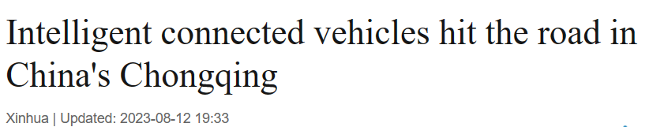
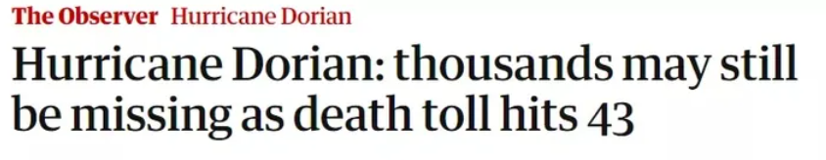
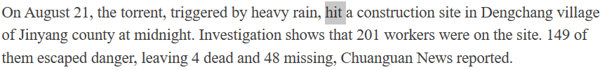
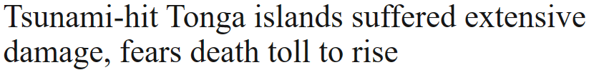
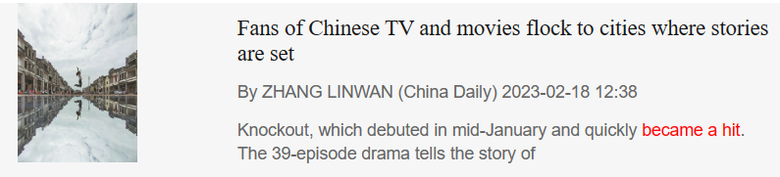
Vocabulary
polysemy 一词多义
v. reach a place
v. reach a number
v. attack
n. a person or thing that is very popular

Slide 9
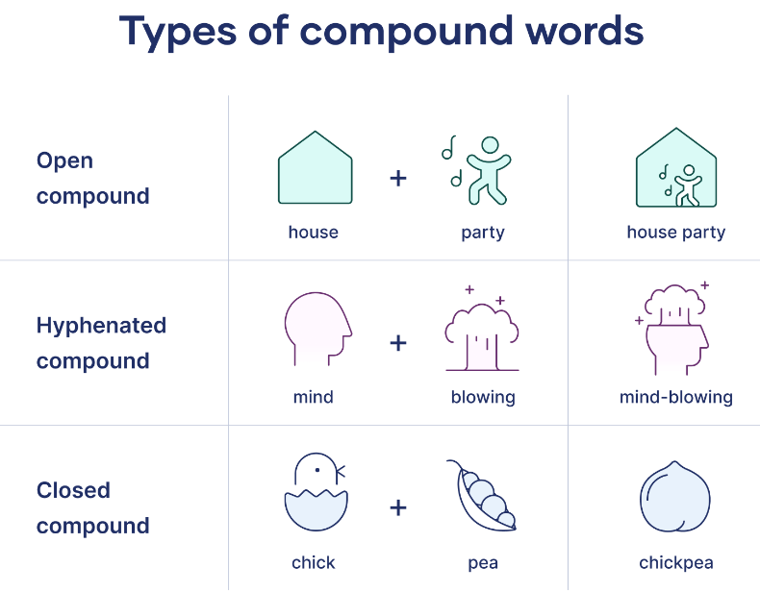
Vocabulary
compound 合成词
非处方的 adj.
You could see what over-the-counter medication is available, or there’s a walk-in clinic down the street.
步入式的，可预约的 adj.
Few people want to babysit a newborn child.
临时照顾 v.
新生的 adj.
She’s gone to test-drive a new car.
试驾 v.

Slide 10

Vocabulary
词性转换n./ v./ adj./ adv./ 反义词
comfort n./ v. –adj. _________________ – adv. ___________________– 反义词______________
thought n. – adj. _______________ – adv. ________________
space n. – adj.________________
curious adj. – n._____________
oppose v. – n. _______________ – adj. _________________
change v./ n. – adj. _______________
challenge v./ n. – adj. ____________________
comfortable uncomfortably uncomfortable
thoughtful thoughtfully
spacious
curiosity
opposition opposite
changeable
challenging

Slide 11
Grammar
Analyzing long and complicated sentences
Temples have fewer proprietary parts and so are serviceable in any bike shop.
Stylish as they may be, the VanMoofs and the Cowboys can be a bit more complex to get back-up and service.
Every weekend this is “Wales” premier comedy club where having a great time is the order for both audiences and comedy stars alike.
The realization that this is a precious land to be respected by humans, was one of the biggest things that hit home to (击中要害；impress) Ginni.
Despite being an obvious attempt to make us passionate about her subject, it really is true that learning a new language can change your personality.
1. 抓句子主干：主谓宾、主谓、主系表 2. 判断是否为特殊句式

Slide 12
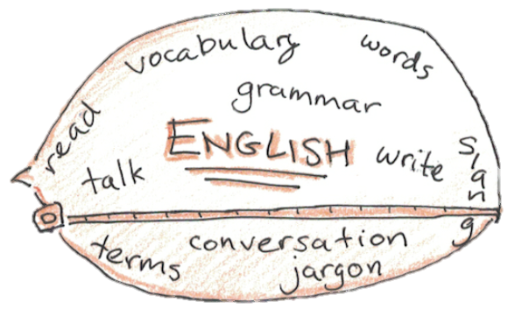

03
What can you do to achieve your goal?
accuracy
accumulation
application

Slide 13
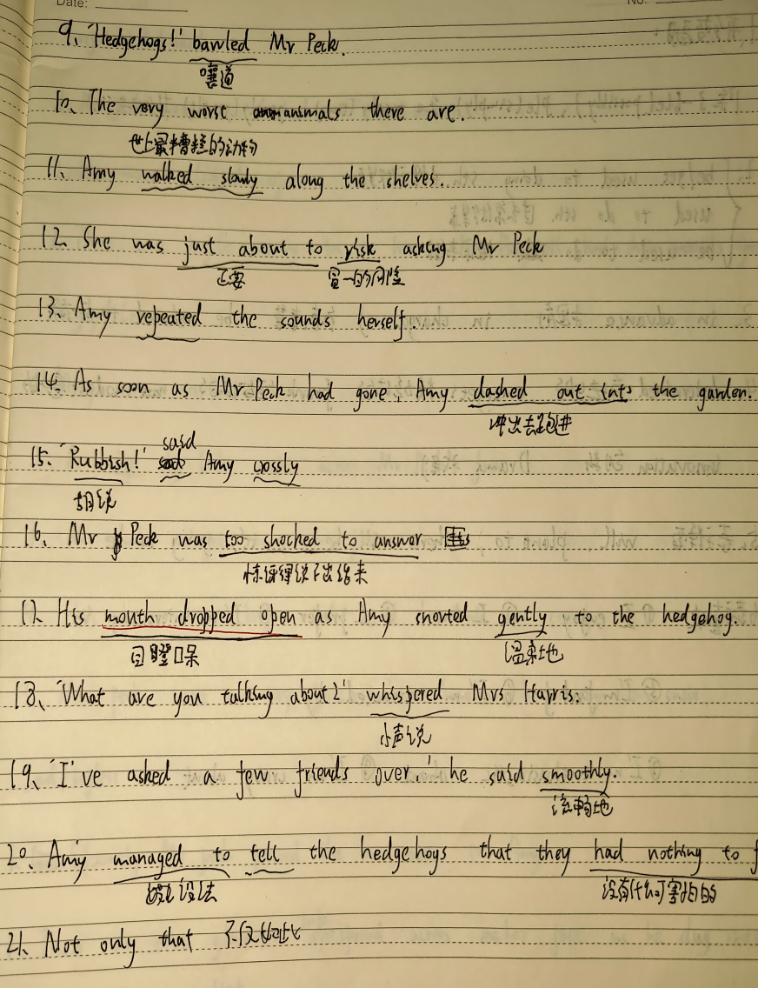
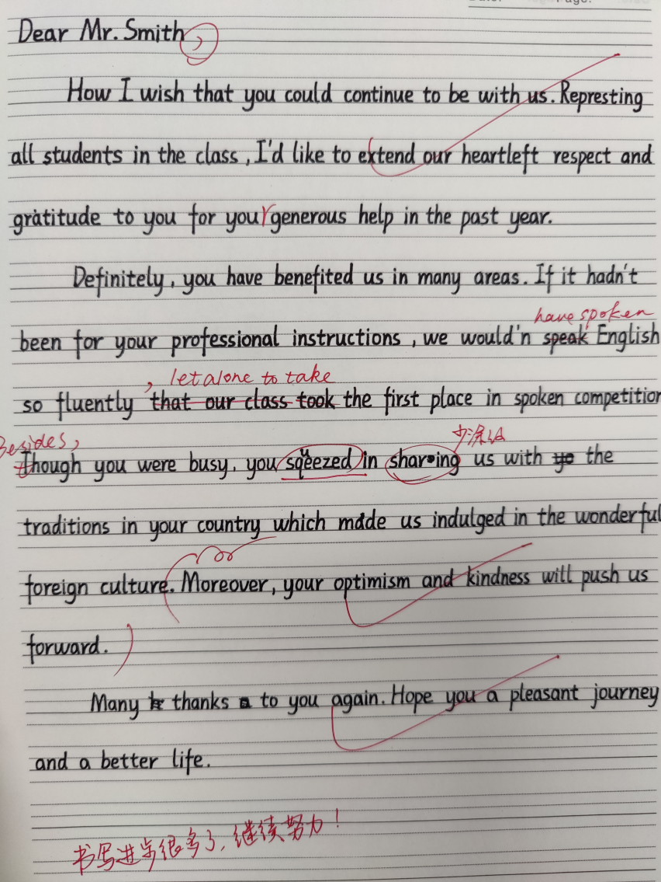
accuracy
handwriting/ spelling/ pronunciation/ usage/ collocation
truth true truly
facial beneficial financial
It is high time that sb. did/ should do regret to do vs. regret doing
what to do with
how to deal with
mop the floor
cut the steak with a knife
首考114 高考129

Slide 14
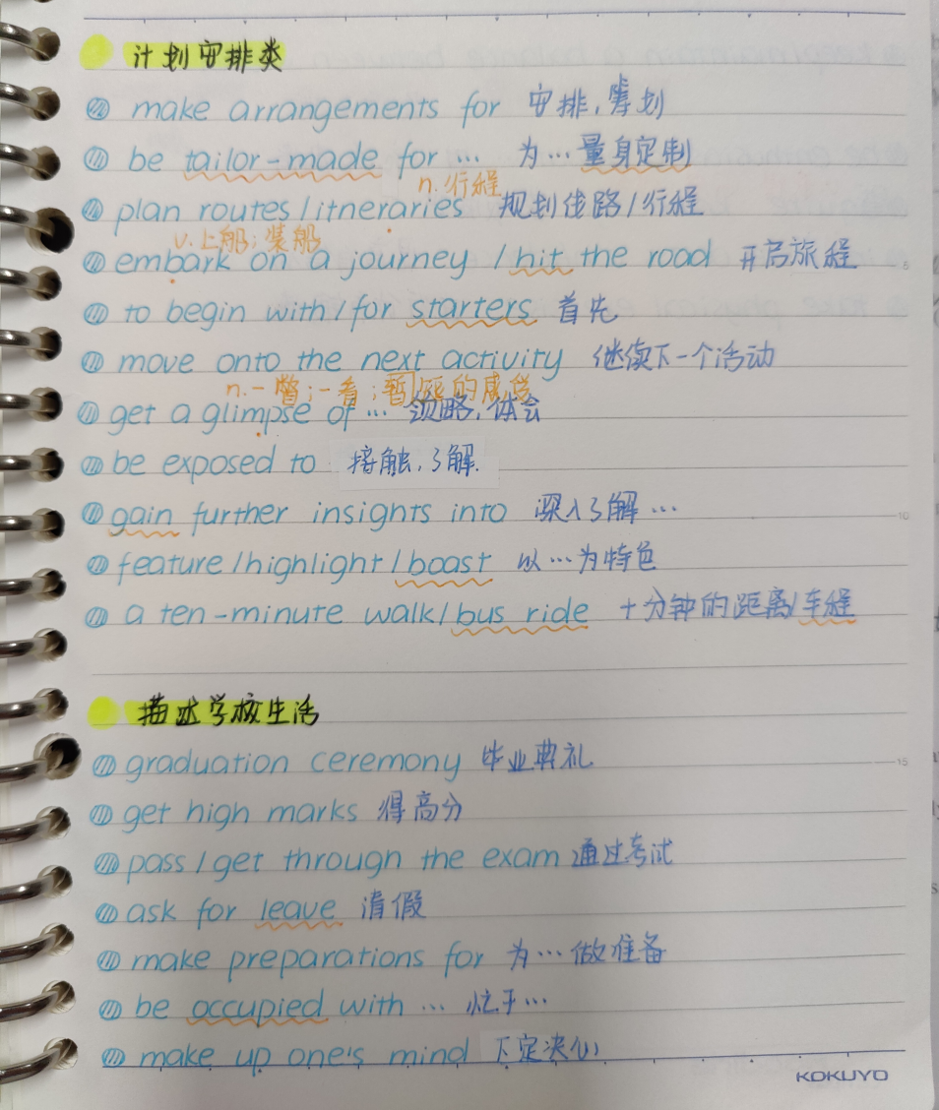
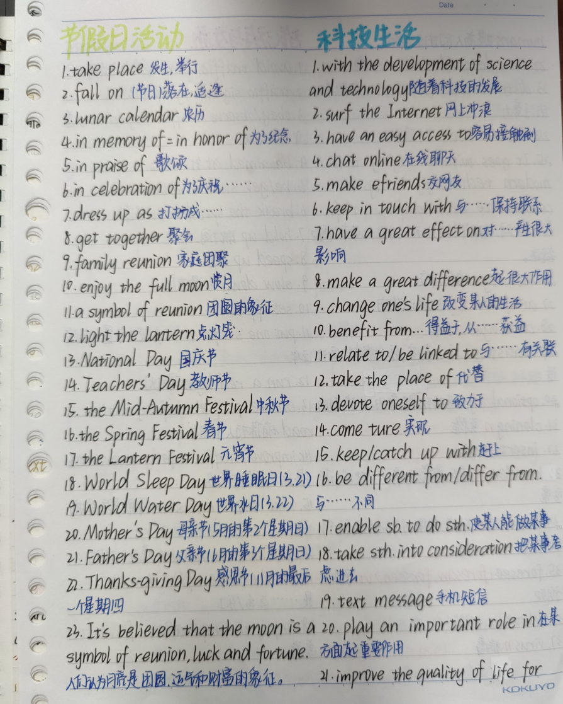

accumulation
words- antonym反义词/ synonym近义词/ hyponym下义词
chunks- correct collocation
sentence patterns
text
conjunctions
cohesive devices
rhetorical devices

Slide 15
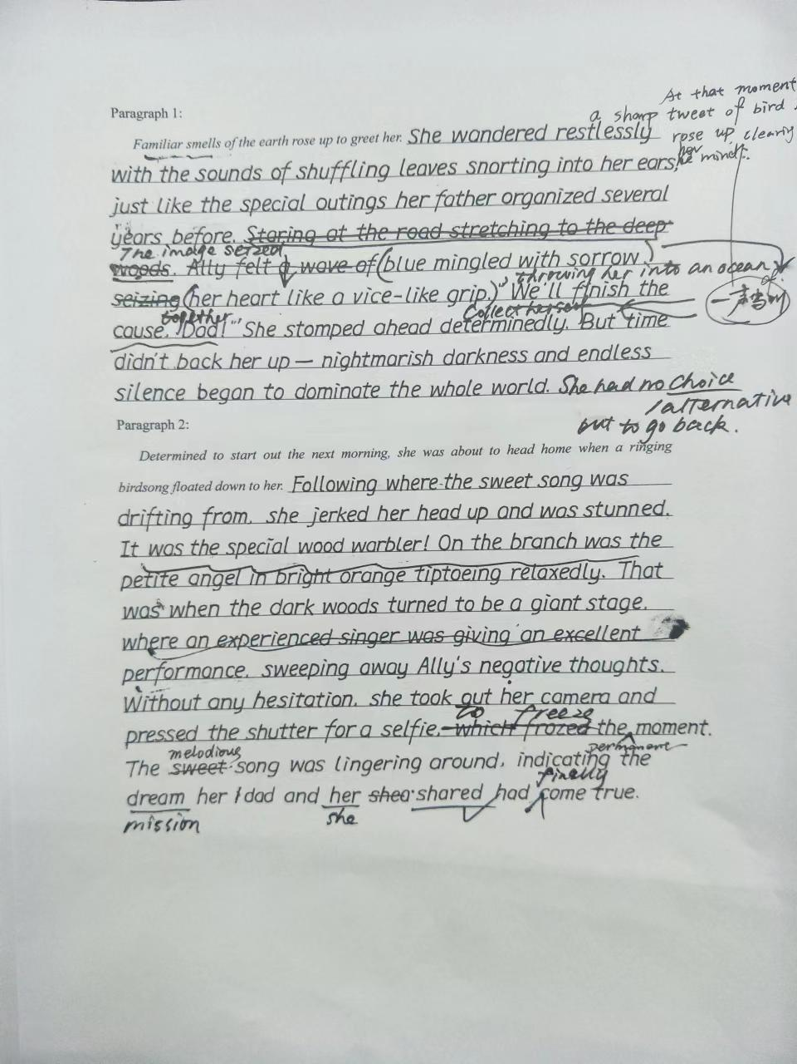
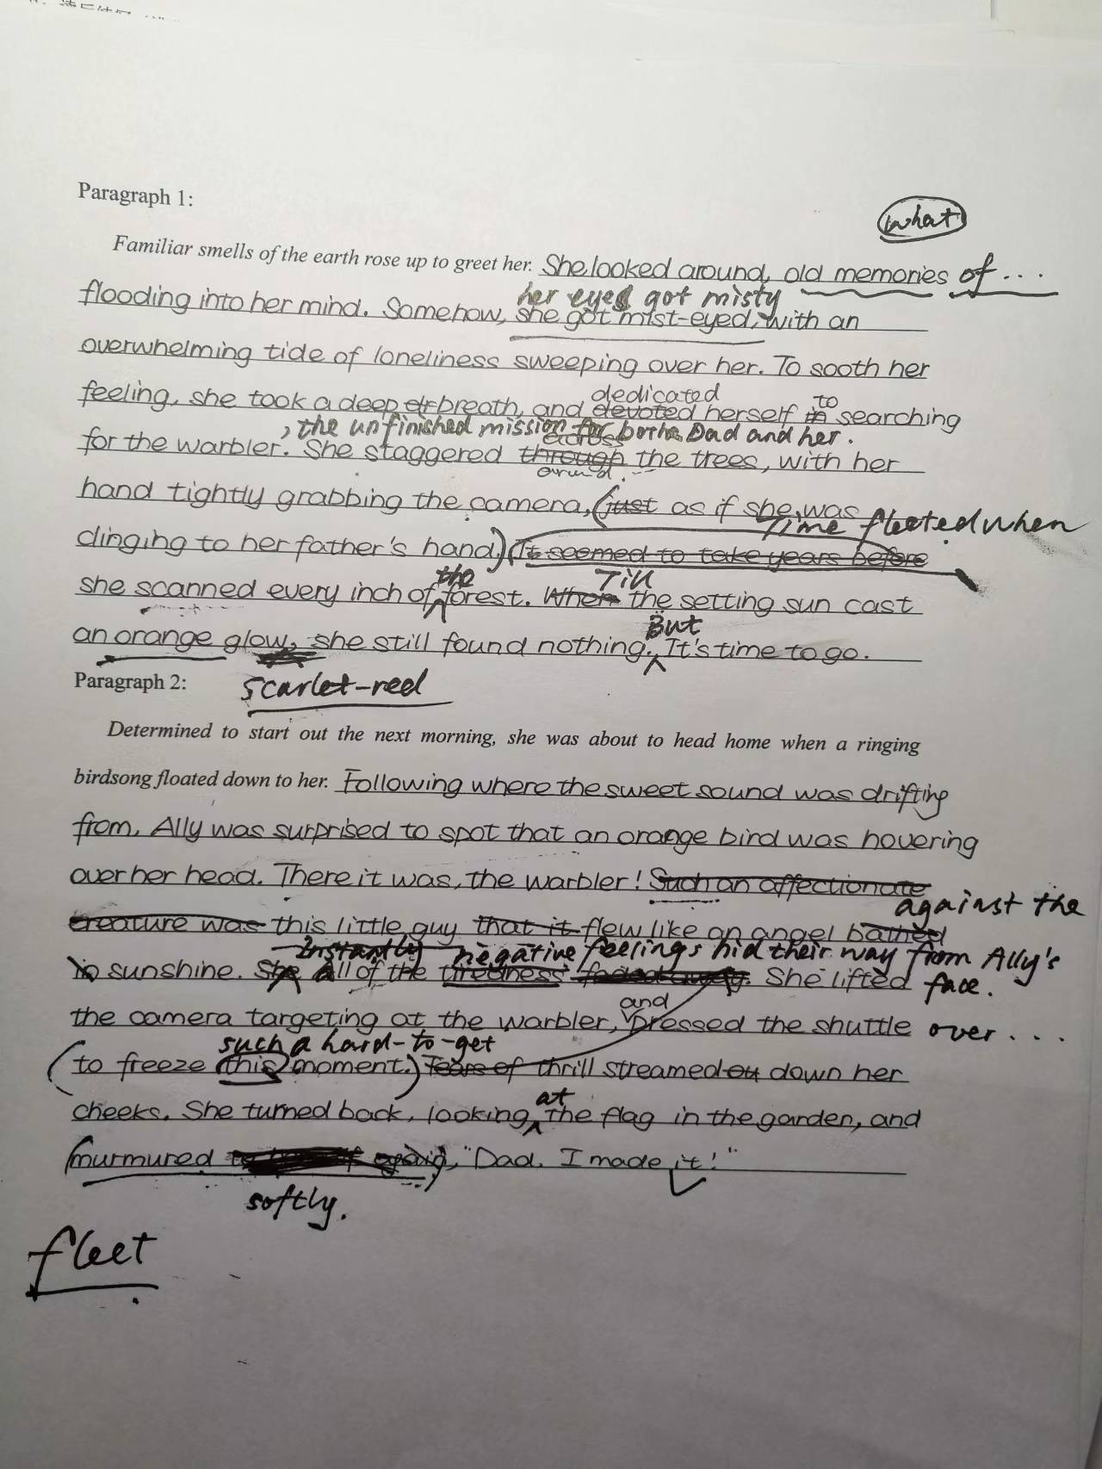
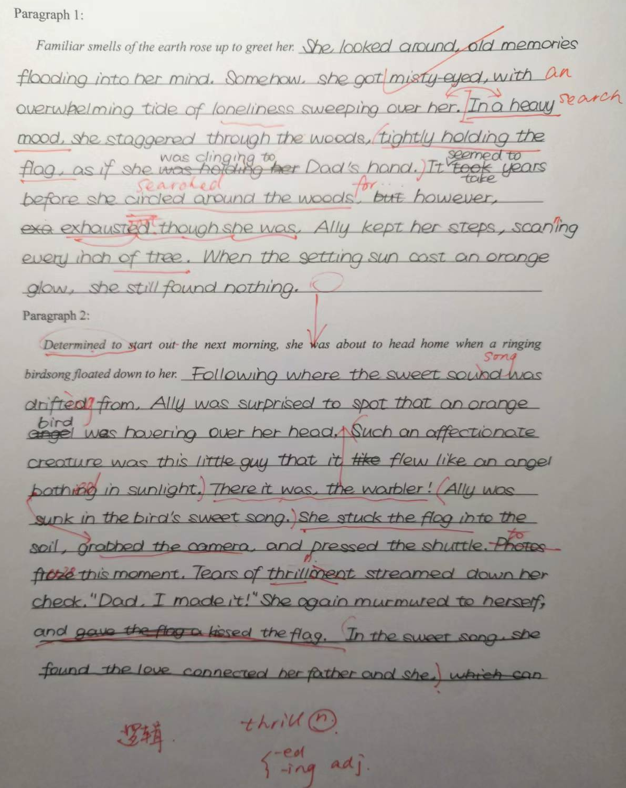
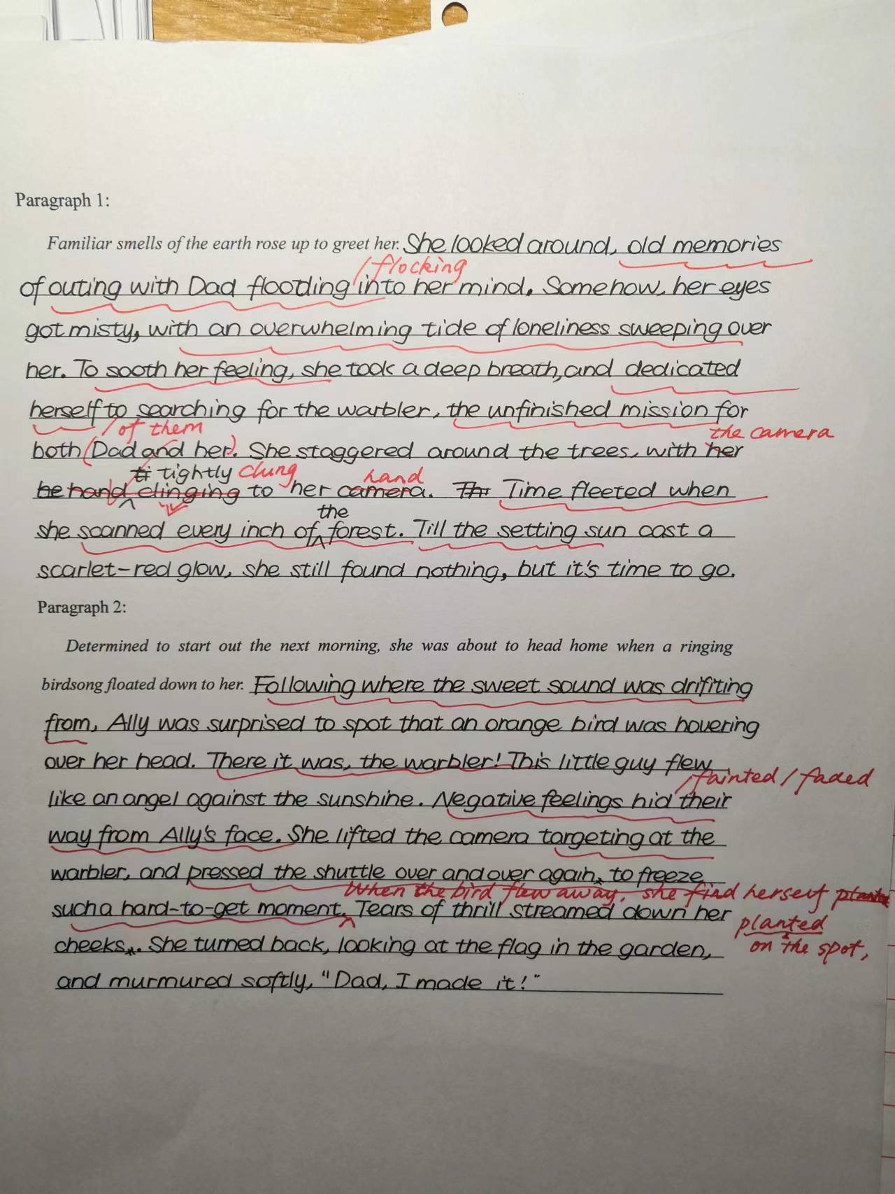
application
Rome wasn’t built in a day.
It takes effort, patience, and the courage to deny yourself.
一稿 二稿 三稿 四稿

Slide 16
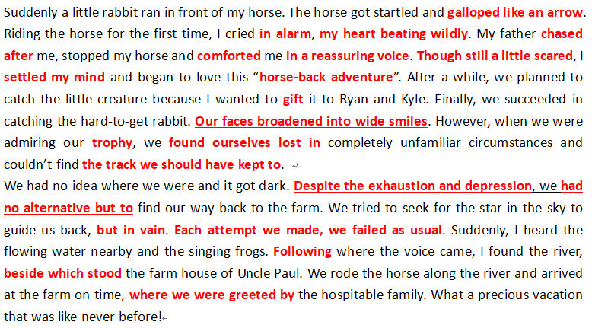
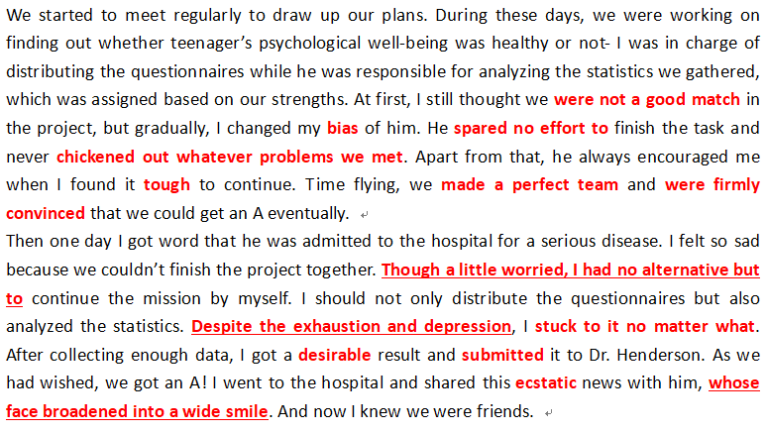
application
positive transfer
同一位同学的两篇文章
划线部分为正迁移

Slide 17
Best wishes!

