Slide 1

感恩遇见，相互成就，本课件资料仅供您个人参考、教学使用，严禁自行在网络传播，违者依知识产权法追究法律责任。
更多教学资源请关注
公众号：溯恩高中英语
知识产权声明

Slide 2


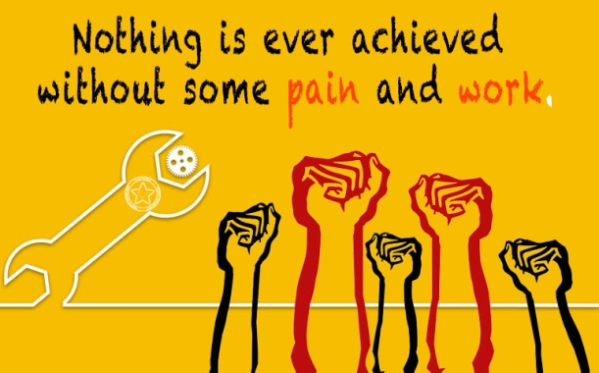
Proposal
Labor is the Most Beautiful

Slide 3
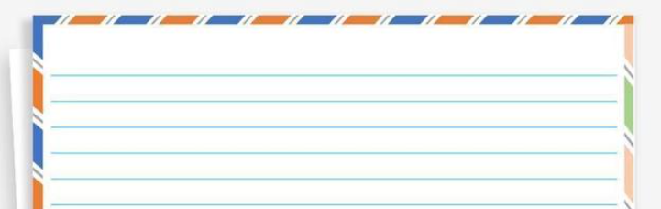
审题关：
假定你是校学生会主席李华，你校将于下周开展以“Labor is the Most Beautiful”为主题的劳动周活动，请你以学生会的名义发起倡议，内容包括：
1. 学生目前对劳动的态度； 2. 劳动的意义； 3. 呼吁参加。
Dear fellow students,
The Student Union
an appeal
3rd & 1st person (most students-they; we)
urgent; encouraging; convincing
present & future tense
necessity+ significance+ appeal
审题五步法：
文体
人称
语气
时态
要点
对象

Slide 4



Nowadays/ Currently,
as+从句, we are in urgent/ desperate need of doing sth.
with+ n., it’s high time that we should do sth.
独立主格, it’s highly suggested/ imperative that we do sth.
格式关：
Dear fellow students,
The Student Union
Para. 1 necessity
Para. 2 significance
Para. 3 appeal
sth. should be attached great importance to in that it can…
sth. plays a major/ decisive role in
sth. is beneficial to/ of benefit to sth.
sth. can contribute to/ make a big difference to sth.
否定+比较级
Nothing is more important than doing sth. in terms of sth.
The importance of sth. cannot be emphasized too much.
It is sth. that can… 强调句
Let's do sth. and take immediate action.
It’s time that we should….
Join us and do sth.
Get engaged in…!
Other formats of an appeal:
Para. 1 necessity+ significance
Para. 2 coping methods
Para. 3 appeal

Slide 5



语言关：
necessity—problem
客观：
作业负担重
Currently, most students are buried in/ occupied with heavy homework load, which hinders them from (阻止) doing labor in person, let alone attaining the delight from labor.
忽视劳动教育
In such a competitive world, many parents have been only focusing on students‘ academic scores/ performance and ignored/ overlooked/ neglected teaching students basic social and life skills, which could otherwise be fostered/ cultivated through labor education.
主观：
不愿意劳动
With the rapid socioeconomic development, students are way too early exposed to social media and electronic games, thus depriving them of (剥夺) the interest to actively accept labor education at home and school.

Slide 6

语言关：
significance—benefits
status
China’s labor education policy has placed labor education on the same level as that in morality, intellect, sports, and aesthetics, thereby endowing labor education with new meaning. Labor education seeks to cultivate workers with all-round physical and mental development. Becoming more varied over time, labor education now involves the cultivation of skills, technological capacities, creative thinking, labor habits, and emotional development. Approaches and methods include formal programs and teaching, education in daily life at home and school, as well as practical activities outside of school.
aim
methods
content
It is a trait/ spirit we Chinese have been promoting for generations in that labor can…
develop an interest in doing labor and cultivate a right view of the world, life and values;
enrich our life experience, temper our will (磨炼意志) and cultivate a positive view of labor and hard-working spirit;
help students master necessary skills and learn to appreciate the value of labor.
More importantly, labor education can also improve students' mental and physical health. Otherwise, students with good academic performance and few life skills are unlikely to be successful.
Moreover, learning the spirit of China’s model workers about their craftsmanship, diligence, the sense of responsibility, and innovation can lay a solid foundation for our future work and life.

Slide 7
语言关：
appeal
theme-related
Come and join us! We have curated (筹办、策划) a list of fun-filled and fulfilling/ engaging yet entertaining Labor Week activities that you should try out!
As Labor Day approaches, we hope that everyone can carry forward (发扬光大) such spirit, work to improve ourselves, and make the world a better place.
Come and explore the long-lost (失落已久的) delight/ beauty of labor!

Slide 8
结构关：
Format/ Theme
Dear fellow students,
Currently, labor education has been increasingly attached great importance to, but some students just bury themselves in books, believing that labor is a waste of time. However, it is necessary for us to do it.
Actually, time spent laboring is rewarding. It can promote our practical skills, strong will, unity and cooperation. Meanwhile, we will also be given the precious chances to contribute our share and rewarded with a spiritual fulfillment.
Therefore, actively engage in labor and take our obligation both at home and at school. It will turn out to be very beneficial and essential.
The Student Union

Slide 9
Homework
假定你是国际学校学生李华，4月22日“世界地球日”即将来临，请你代表学生会写一封倡议书，呼吁大家关爱地球。内容包括：
1. 现状说明
2. 具体措施
3. 发出倡议
你校英文报正在征集以“劳动使人快乐”为主题的文章。请你写一篇短文投稿，内容包括：
1. 一次劳动经历；
2. 你的感受；
3. 发出倡议。

Slide 10
学生习作1
Boys and girls,
With Earth Day approaching, the Student Union of our school hereby calls on everyone to take care of the earth.
It’s clear that the condition of the earth is far from satisfying. The endangered animals are losing their habitats and clean water is nowhere to be found. In order to protect our motherland from being destroyed, riding bikes to school is highly recommended. What’s more, on no account can we ignore the importance of recycling.
Only when we make joint efforts can we restore the earth. Join us and heal the world!
The Student Union

Slide 11
学生习作2
Dear fellow students,
Nowadays, the earth is becoming warmer and warmer and the environment gets worse, which risks human beings and other creatures in the earth greatly. With Earth Day approaching, it’s high time that our students get involved in protecting the earth.
First of all, it’s necessary for us to raise the awareness of environmental protection and develop a good habit of low-carbon life. Besides, saving resources like water and electricity can’t be stressed too much. And we should voluntarily turn off the lights and fans when there is no one in the classroom.
In all, if everyone does his or her bit responsibly in protecting the earth, our earth will become better and better.
The Student Union

Slide 12
学生习作3
A Fulfilling Cleaning Experience
Last Saturday, I spent all morning in cleaning up my house, which was exhausting but rewarding.
First of all, I cleaned the room with a vacuum and mopped the floor, without skipping a single corner of each room. After that, in order to remove the stain on the windows, I had to climb onto chairs and wiped those windows carefully, leaving them spotless. Sore as my back was, everything became worthwhile when I stepped into a neat and orderly house.
If you are seeking a sense of fulfillment and satisfaction as well, labor will be a good choice.

