Slide 1

感恩遇见，相互成就，本课件资料仅供您个人参考、教学使用，严禁自行在网络传播，违者依知识产权法追究法律责任。
更多教学资源请关注
公众号：溯恩高中英语
知识产权声明

Slide 2
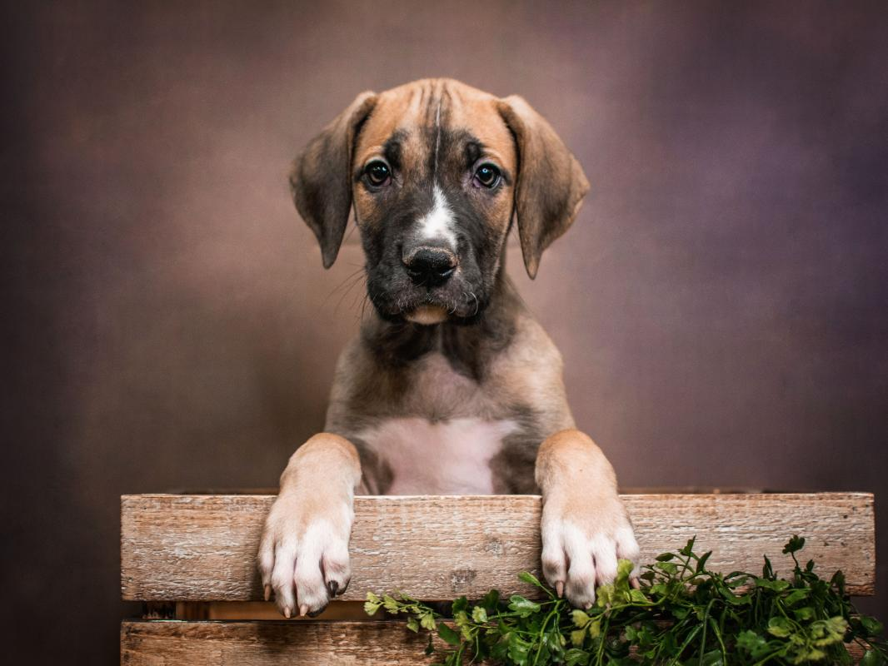
A Four-legged Guardian Angel

Slide 3






A Four-legged Guardian Angel
Snow had just melted off the ground that April day at our house in Regina Beach, Saskatchewan. I had just cleaned up the pool in preparation for selling the house. The year before, I had lost my job with the provincial government, and now our financial situation was grim. In despair, I had finally put the home on the market, and a real estate agent was due to show up later that day. Even worse, I would have to give up my beloved Great Dane (大丹犬), Brigitte, because I could no longer afford the cost of feeding it. The thought of losing the dog and our beautiful home was almost more than I could bear.
Deep in despair, I sat typing up resumes and cover letters. Out of the corner of my eye I could see my thirteen-month-old son, Forrest, as he lay on the carpet, playing near our big, gentle nanny-dog, Brigitte. It seemed as if Brigitte was always meant to be in this family and she turned out to be a perfect companion.
Brigitte came to our house on Christmas eve when the doorbell rang and I was sure some of my Christmas packages had arrived. I ran to the door and swung it open, but no one was there. I sensed something and looked down, only to find a beautiful Great Dane sitting there, looking up at me with big, intelligent eyes. There was no way that she could have rung the doorbell by herself, was there? Perhaps, someone had found the puppy somewhere and left her there, and then rang the doorbell and ran away. They accurately guessed I would welcome an additional family member and take care of her.
Thinking of these, I couldn't help heaving a sigh and went straight back to work. However, I hadn't typed more than two sentences when Brigitte began barking furiously and running back and forth to the sliding glass door overlooking our pool.
I raced to see what was happening and noticed that the sliding door was slightly open. Suddenly, I realized Forrest was nowhere to be seen. In panic, I opened the door and ran outside.
注意：
1. 所续写短文的词数应为150左右；
2. 请按如下格式在答题卡的相应位置作答。
Para. 1 There I was surprised to see Brigitte, who was terrified of water, dive into the pool.
Para. 2 Finally, the doctor said Forrest was all right and could be released from hospital.

Slide 4
3 Basics to consider when reading
1. Setting
Time & Place
Natural & Cultural Environment
2. Characters
Who are they?
What happened to them?
What are the characteristics?
(age, gender, health condition, social status, personality, etc.)
How do they interact with each other?
3. Plot-Theme
What is/ are the problem(s)? What might be the solution?
People and Nature/ Society/ Self
What does the title suggest?

Slide 5

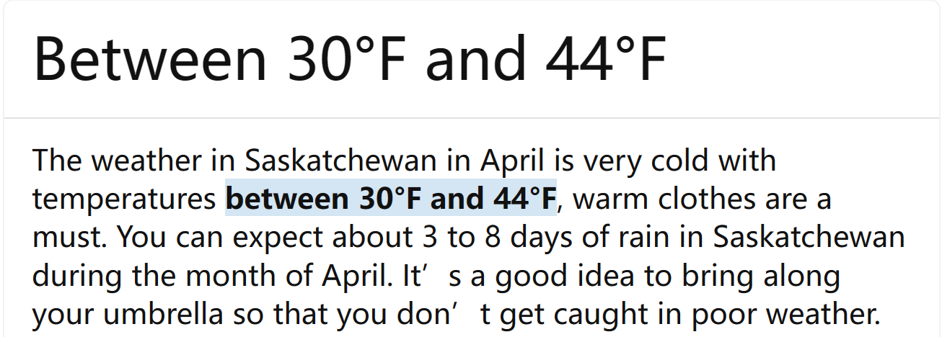


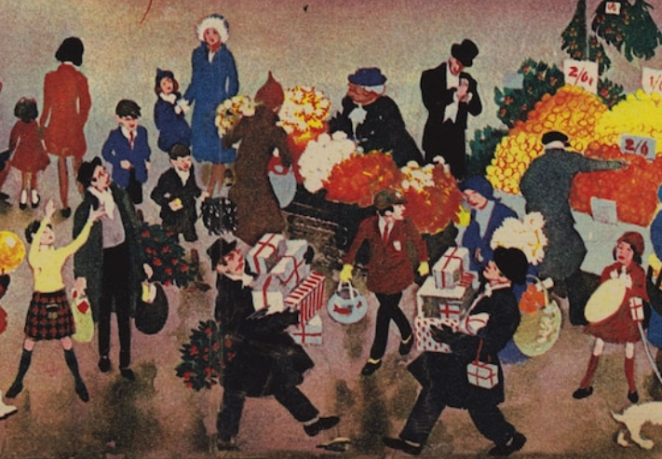
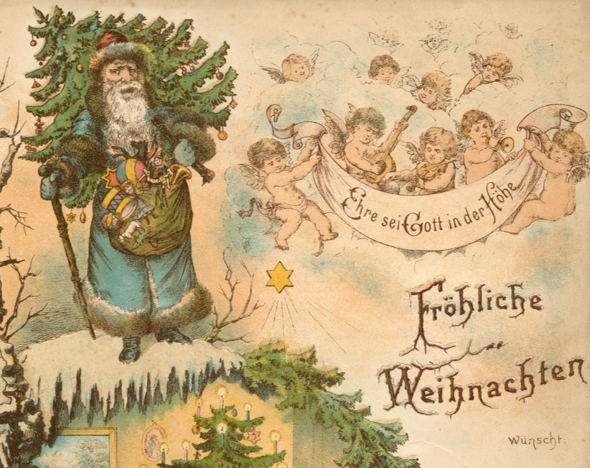
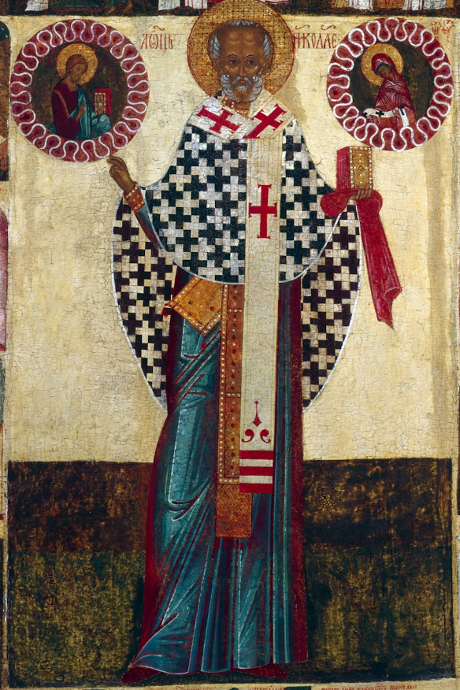
urgent
difficult
freezing cold water
“Snow had just melted off the ground that April day at our house in Regina Beach, Saskatchewan.”
“Brigitte came to our house on Christmas eve when the doorbell rang and I was sure some of my Christmas packages had arrived.”
People around the world celebrate the birth of Jesus Christ on December 25.
an unexpected Christmas gift from Santa Claus
an angel sent by Jesus Christ

Slide 6

Use one sentence to introduce each character.
lacking in
I
Brigitte
Forrest
was ____________ money because I had lost my job the year before, so I had to sell the house and my b________ Great Dane.
eloved
an additional family
be meant to be in this family
turned out to be a perfect companion “she”
care-giver/ keeper
a rescuer?
big/ intelligent/ gentle/ loyal/ courageous
was a _________________ puppy who accidentally/ unexpectedly came to our family on Christmas Eve and attempted to save my son in the pool despite her ______ of water.
fear
nanny-dog
four-legged guardian angel
was a ______________________ son who fell into the pool.
thirteen-month-old
can barely speak fluently

Slide 7



A Four-legged Guardian Angel
Main idea:
Brigitte, the dog which came to my family on Christmas Eve and I intended to ____ ___ for l___ of money, came to my son’s r_____ when he was trapped in pool at our house.
give up
ack
escue
Para. 1 There I was surprised to see Brigitte, who was terrified of water, dive into the pool.
Para. 2 Finally, the doctor said Forrest was all right and could be released from hospital.
How did I feel when figuring out what had happened?
What did Brigitte do to save my son?
What did I do to help them?
Forrest was rushed to the hospital.
How did Brigitte react to my son’s coming back?
Forrest was back at home.
What other things did Brigitte do to safeguard my son?
change of setting
How did I feel and what decision did I make?
not to give up
change of feeling
development of plot
change of attitude

Slide 8
Para. 1 开头衔接句
She swam swiftly toward the center of the pool, where my son, Forrest was stuck.
押头韵 主位推进
Inches away was my thirteen-year-old son, struggling frantically in the water.
In the middle of the pool was Forrest, struggling and screaming wildly.
倒装句 主位推进
It was then that I realized what had happened before- My curious son had crawled at the edge of the pool and accidentally slid into it.
强调句 代词的衔接
Following her zooming figure, I was heart-wrenched (揪心的；心如刀绞的) to see my little son, who should have been inside the house, paddling crazily in the middle of the pool.
非谓语动词（视角的移动） 主位推进

Slide 9
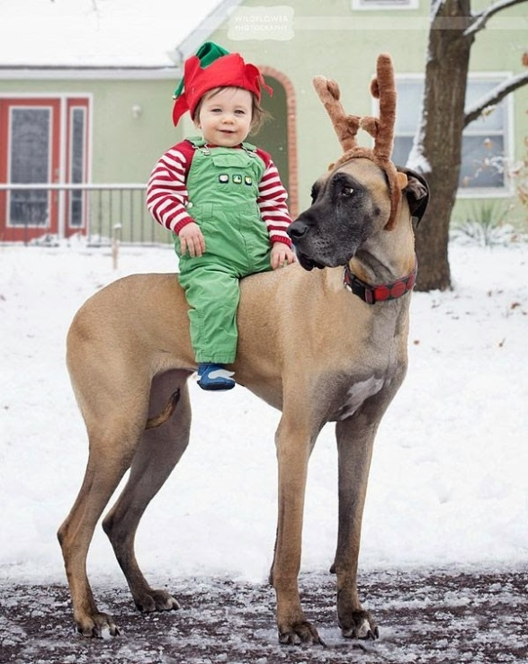
Para. 2 结尾主题句：Theme—— Human and Dogs (Quotes)
Humorist Josh Billings once said, “a dog is the only thing on Earth that loves you more than he loves himself.” Never is that sentiment more obvious than during a life or death emergency. Time after time, dogs display loyalty, bravery, and intelligence in the face of imminent (迫在眉睫的) danger to protect their family members.
Dogs are a man’s best friend for a reason. They’re the loyal and loving companions that never leave your side and always have your back.
Whether they’re elderly, blind, scared or hurt, dogs have repeatedly taken split-second action to rescue people—most times, the very person who rescued them. From car accidents and house fires to near-drownings and overseas combat, countless humans owe their lives to the bravery and determination of their dogs, a neighbor's dog or even a four-legged stranger.
Time and time again, these courageous companions have prevented the worst from happening by saving their owners’ life. When it comes to protecting families, a loyal dog cannot be deterred by (望而却步) any threat – no matter how big or scary.

Slide 10
Para. 2 结尾主题句
I regretted even having the thought of giving Brigitte away. Hard/ Tough as it would be, I would try my utmost to keep her in that she was a family member, a best companion for my son, a real heroine in my heart, and the most important, a four-legged guardian angel sent by Jesus Christ to our family.
直接点题 重复，强调原文中小狗出现的身份
Thanks to our four-legged guardian angel, all the previous despair vanished like ashes, which was replaced by regained/ rekindled hope and anticipation for a brand-new life.
直接点题 强调影响
Despite the loss of job and house, I still felt blessed to have Brigitte by our side/ it was a blessing to have Brigitte by our side, who was destined to guard our family as a real angel.
对比点题

Slide 11




Rescue work (verbs/ verb phrases/ nouns)
Pronouns!!!
Brigitte became noticeably upset when my son was found struggling to keep his head above the water. She barked furiously as if encouraging him not to give up and tried hard to push him toward the pool’s edge/ remove him from the water.
Forrest paddled frantically/ flailed (使大幅波动) in the water and constantly attempted to get out of the pool. However, he was quite too weak to get out on his own. Fortunately, our intelligent warrior, despite her fear of water, came to the rescue.
For 34 agonizing (痛苦的; 折磨人的) minutes, our heroine worked diligently to rescue my son. She repeatedly tried to grab hold of Forrest with her mouth, but my poor baby kept slipping out of her grasp/ grip.
Brigitte zoomed to where my son was and tried to grab him in her jaws. However, Forrest always slipped from her clutches.
Finally, after several failed attempts, she succeeded in grasping Forrest’s collar and pushing him out of the pool. She even placed a big paw on her friend’s back to hold him in place and make sure he didn’t slide back into the water.
Nonetheless, Brigitte never gave up and still attempted to pull the dog out of the water. After several attempts, she eventually succeeded/ proved herself a heroine.

Slide 12
学生佳作：
There I was surprised to see Brigitte, who was terrified of water, dive into the pool. Inside the pool was my baby Forrest crying helplessly! However, when Forrest beheld Brigitte swimming bravely toward him, he stopped his desperate scream, as if clutching a straw. It was not long before Brigitte swam alongside Forrest and nudged him toward my direction with her paws placing gingerly on my son’s back. After the successful rescue, I promptly held Forrest in my arms and dashed toward my car with Brigitte following me anxiously as well. On the way to hospital, a complex feeling mingled/ coupled with gratitude and tenseness stroke my head. It was my dog that saved my boy!
Finally, the doctor said Forrest was all right and could be released from hospital. When I heard this exhilarating news, I hugged my dog in the corridor excitedly and yelled, which intrigued the doctor’s zest inside. Words of gratitude to my dog gushed from my mouth when I explained all to the doctor, but when it came to the future of the dog, I felt a sense of sadness. Moved by my story, the doctor said affectionately, “She is a real four-legged guardian angel. How about I recommending you a vet who is kind to animals?” To my great relief, the vet agreed to adopt Brigitte and treated her well. It was great that my angel met another angel.
该生语言储备丰富，用词较为准确，语言上唯一的不足就是代词使用单一。
情节上不同于大部分学生“不放弃小狗”的选择，该生另辟蹊径，给小狗找了一个好归宿，也不失为是一种两全其美的选择。
逻辑连接较为顺畅，详略得当，适当留白，把篇幅留给重要的描写，主题也有体现，处理的也比较成熟。

Slide 13
One possible version:
There I was surprised to see Brigitte, who was terrified of water, dive into the pool. Then to my horror, I caught sight of Forrest's yellow sleeper. Brigitte was bravely doing her best to keep him afloat by holding on to his sleeper with her mouth. At the same time, she was desperately trying to swim to the shallow end. Only then did I realize that Forrest had somehow opened the door, wandered out and fallen into the pool. In a split second, I dove in, lifted my precious baby out and carried him inside. Hands shaking, I called 911 and we were rushed to the hospital immediately, where the doctor kept him for observation for one night.
Finally, the doctor said Forrest was all right and could be released from hospital. Back home, once Brigitte saw him, she barked with apparent joy and wouldn‘t let Forrest out of her sight. In time she settled down, but remained dedicated to Forrest and followed him everywhere, concerned about his safety. Even when Forrest was asleep, Brigitte crammed herself under the crib (婴儿床), keeping a vigil (守夜). Our dog was indeed an angel, erasing any despair I might have had about losing our home. A house could always be replaced, but knowing we had each other around was the greatest blessing of all. I was grateful she was part of our lives, who I would never give up.

