Slide 1

感恩遇见，相互成就，本课件资料仅供您个人参考、教学使用，严禁自行在网络传播，违者依知识产权法追究法律责任。
更多教学资源请关注
公众号：溯恩高中英语
知识产权声明

Slide 2
活用教材词汇，靶向高考写作
M2U1单词拓展
Culture Heritage

Slide 3

heritage /ˈherɪtɪdʒ/ n.遗产(国家社会长期形成)
写作词汇
Category：
Tangible Cultural Heritage(物质文化遗产) ：the Great Wall、Imperial Palaces、Maogao Caves (莫高窟)、Terra-Cotta Warriors (兵马俑) 、Temple of Confucius,Cemetery of Confucius and the Kong Family Mansion (孔府孔庙孔林)、Ancient City of Ping Yao、Summer Palace、Classical Gardens of Sunzhou、The Grand Canal、Mount Taishan etc.
Intangible Cultural Heritage(非物质文化遗产):Paper-cut、Chinese calligraphy、Shadow puppetry(皮影)、Taijiquan、Kun Qu opera、Beijing opera、Engraved block printing(雕版印刷术)、Zhusuan、Handicrafts of making Xuan paper etc.
1. 它不仅提高了我们队文化遗产的保护意识，而且还为我们的后代保留了遗产。(应用文之活动意义)
It not only raises our awareness of cultural heritage protection but also passes the heritage down to our future generations.
2. 京剧，中国非物质文化遗产的重要组成部分，以其服装和脸谱在世界享有极高的知名度。(应用文之介绍中国传统文化)
Beijing Opera, an important part of Chinese intangible cultural heritage, enjoys great popularity in China with its costumes and facial masks.

Slide 4
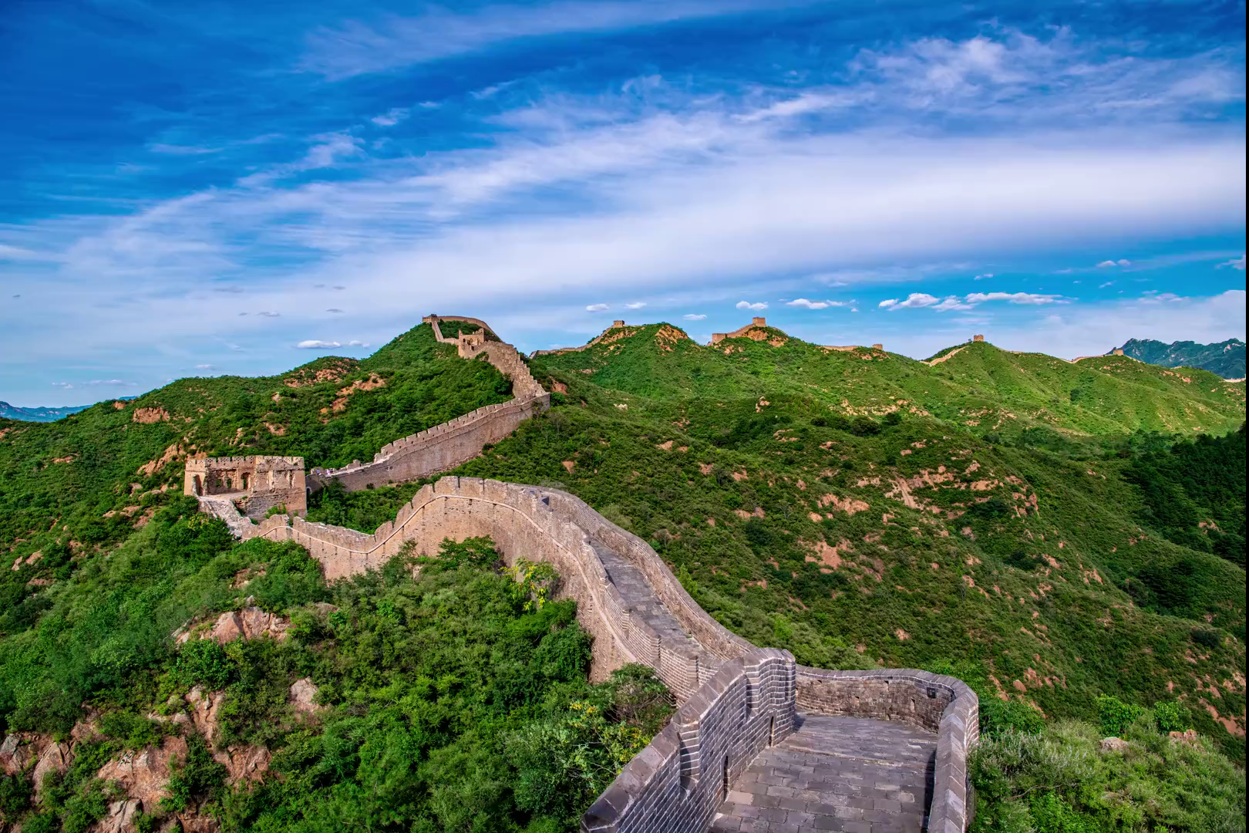
preserve /prɪˈzɜ:v/ vt.保存;保护 n.保护区
写作词汇
1. preserve ...from/against 保护...免受伤害
在我看来，的确到了世界各地的海洋部门组织各种各样志愿活动保护海洋免受破坏的时候了。(2022年全国甲卷应用文之海洋保护)
From my point of view, it is high time that the ocean departments from all over the world conducted various voluntary activities to preserve oceans from/against being destroyed.
2. be well preserved 保存完好；保养得好
长城保存完好，成为了中国最受欢迎的旅游景点之一。
(应用文之中国著名景点介绍)
The Great Wall is well preserved, making it one of China's most popular tourist attractions.

Slide 5

promote /prəˈməʊt/ vt.促进;提升;推销;晋级
写作词汇
1. promote Chinese cultures 弘扬中国文化
展览的目的是通过有趣且轻松的方式向外国学生介绍传统节日从而弘扬中国文化。（应用文之活动安排）
The purpose of the exhibition is to promote Chinese cultures by introducing traditional festivals to foreign students.
2. promotion n. 晋升，提升，晋级
我们应该牢记：如果我们为了晋升而忽略了我们的健康，疾病便会借助疲劳乘虚而入。
We should always bear in mind that if we are ignorant of our health for promotion, disease will gradually approach us with the help of tiredness.

Slide 6

take part in /teɪk pɑ:t ɪn/ 参与(某事);参加(某活动)
写作词汇
“参加”
take part in 参加群体活动，并发挥作用
join in/join sb. in (doing) sth. 加入到某人当中(做)某事
join 加入团体或组织，并成为其中的一员
attend 参加会议、仪式、婚礼、葬礼；上学、上课、听报告等
1. 据说500多名学生参加了上周举行的五千米越野赛。（2020全国I 应用文之报道5公里越野赛）
It is said that more than 500 students took part in the 5-kilometer cross-country running race held last week.
2. take part in/join/join in/attend
(1) I will ________ an important meeting on establishing a club next Monday.
(2) You can enjoy matches without _________ a club or belonging to a team.
(3) Would you please __________ us in parading for winning the football match.
(4) Ten of my classmates __________the boat race last week.
attend
join
join
take part in

Slide 7

balance /ˈbæləns/ n.平衡;均匀 vt.使平衡
写作词汇
1. keep a balance between A and B 保持A与B之间的平衡
为了更有效地学习，你最好在线上学习和线下学习之间保持平衡。(2021全国乙卷be smart online learners 发言稿)
To study more efficiently, you’d better keep a balance between online learning and offline learning.
2. balance A and B 平衡 A 和 B
权衡利弊之后，大卫擦掉眼泪，挣扎着站起来，向起跑线走去，脸上露出轻松的微笑。（2022全国I 读后续写之身残志坚男孩勇于战胜自我）
After balancing the advantages and disadvantages, David wiped away the tears, struggled to his feet and made his way to the starting line, a relaxed smile appearing at the corners of his mouth.

Slide 8

balance /ˈbæləns/ n.平衡;均匀 vt.使平衡
写作词汇
3. a balanced diet 均衡的饮食
众所周知，均衡的饮食和每天适度的运动对我们的健康有益。
As is known to all, a balanced diet and moderate exercise everyday are beneficial to our health.
4. lose one’s balance 失去平衡
我踩到了香蕉皮，失去了平衡，趴在了地上，路人看到后立马把我扶了起来。(读后续写之动作链)
I stepped on a banana skin, lose my balance and fell flat on the ground. Passers-by saw me and helped me up immediately.

Slide 9
lead to /li:d tə/ 导致
写作词汇
1. lead to 导致
不幸的是，许多学生挣扎于职业规划，脑子里只有几个想法，会导致出现压力或缺乏动力。（应用文之英文网站公开征集”中学生职业规划稿件）
cause
result in
bring about
Unfortunately, many students struggle with career planning with just a few ideas bouncing around in their heads, leading to stress or lack of motivation.
导致
contribute to
lead to
2. lead to 通向
虽然通往农场的路很窄，但我们很高兴找到了回去的路。
account for
Though the path leading to the farm was narrow, we were delighted to find our way back.

Slide 10

lead to /li:d tə/ 导致
写作词汇
3. lead the way 带路
lead a ...life过着...的生活
那位老人带路，把我们领到了一个村庄，在那里我们发现当地人过着幸福的生活。
The old man led the way and led us to a village where we found the local people led a happy life.
4. lead sb to do sth. 使某人做某事
在课上，我将会把学生分成小组，让他们以一种有趣的方式练习英语口语。(应用文之英语口语课堂)
In class I will divide the students into small groups and lead them to practice speaking English in an interesting way.

Slide 11

proposal /prəˈpəʊzl/ n.提议;建议
make a proposal /meɪk ə prəˈpəʊzl/ 提出建议
写作词汇
1. research proposal: 研究计划；研究计划书；研究提案；开题报告
2. marriage proposal: 求婚
3. make a proposal that sb (should) do 建议某人做某事
他建议她应该休息一会儿。
He has made a proposal that she should take a rest for a while.
4. propose that sb (should) do 建议某人做某事
最终，我建议给poppy 再要一直小狗，看到自己又有了伙伴，Poppy 开心地笑了，温柔的叫着，高兴的直摇尾巴。(2020浙江1月读后续写A Puppy for Poppy)
Finally, I proposed that we get a little dog for Poppy. Seeing that she had a playmate again, poppy smiled happily, barked gently and wagged her tail cheerfully and constantly.

Slide 12
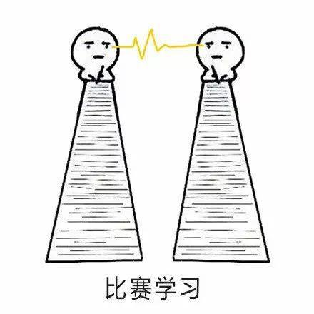
protest /ˈprəʊtest/ n.抗议 vi.&vt.(公开)反对
写作词汇
1. 她一直坚持说自己是无辜的。
She has always protested her innocence .
2. “你当初不是这么说的！”简争辩说。
‘That's not what you said earlier!’ Jane protested.
3. protest against: 反对，对…提出抗议
参赛者对比赛安排提出反对，但是没有成功。
The competitors protested against the agreement of the competition, but in vain.
4. 她写了一封抗议信。
She composed a letter of protest.

Slide 13
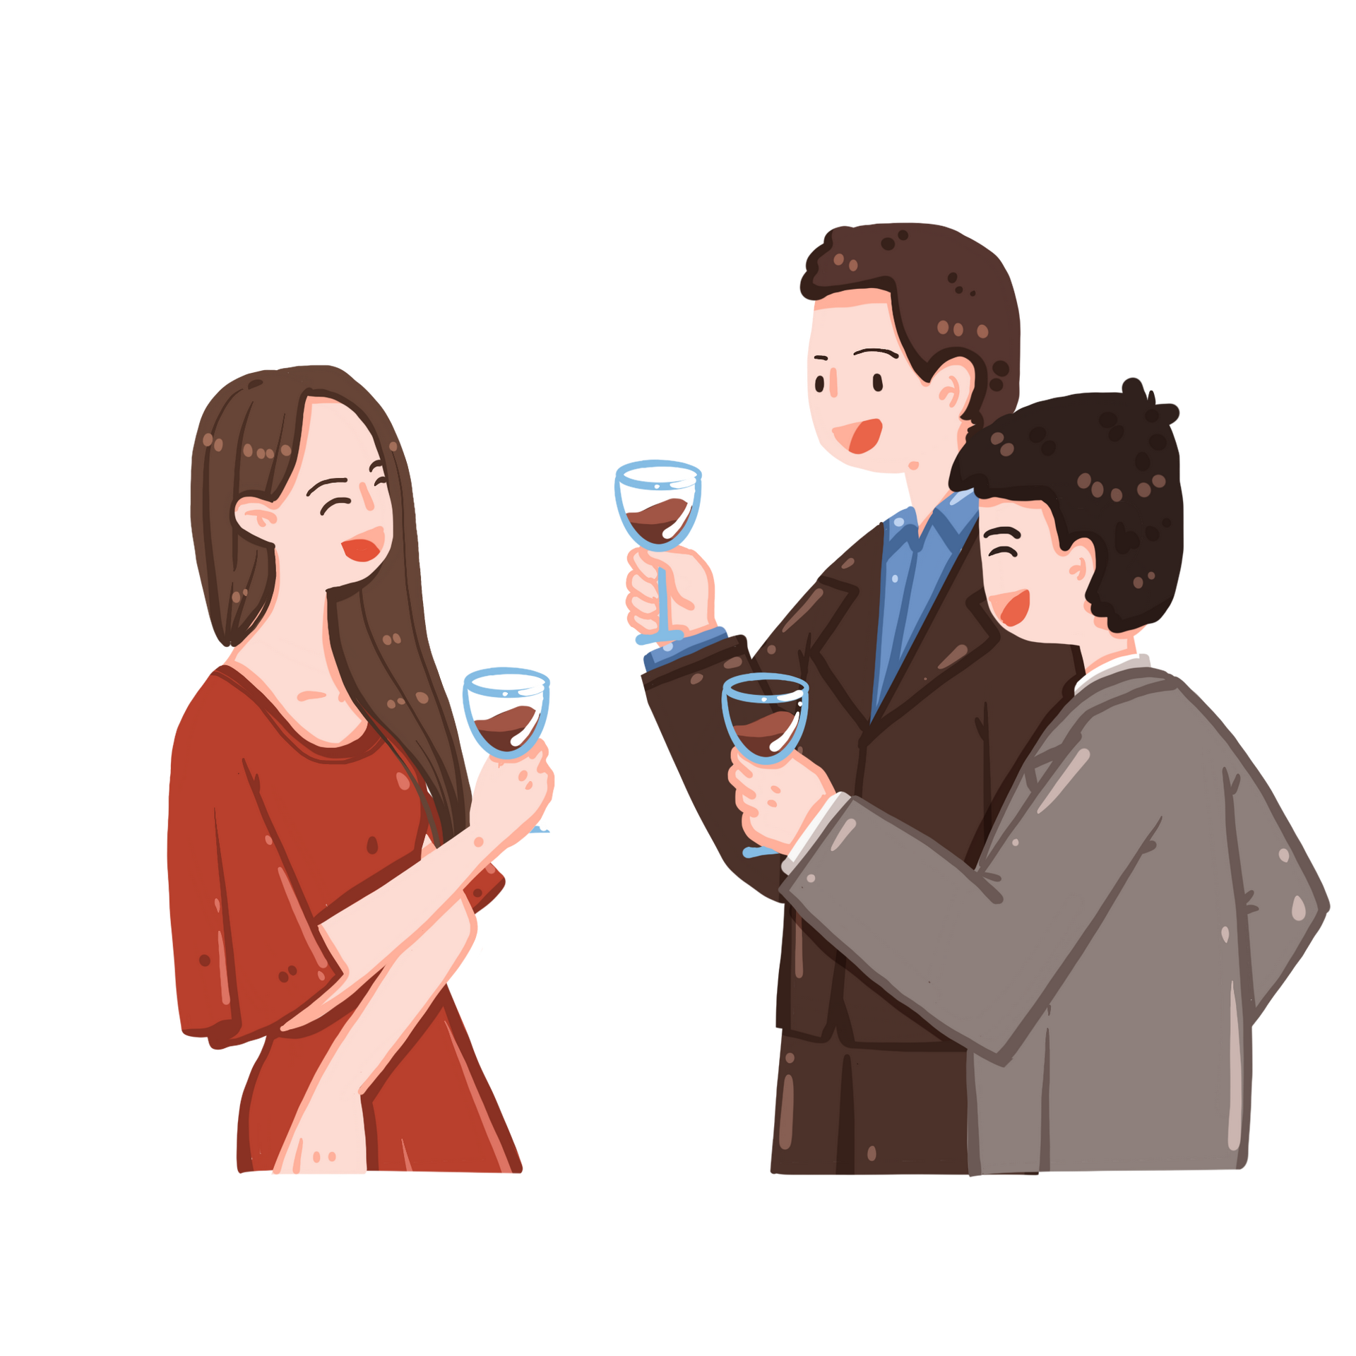
likely /ˈlaɪkli/ adj.可能的 adv.可能地
写作词汇
1. it is likely that 可能....
凶猛的野兽很可能藏在黑漆漆的灌木丛中,简顿时感到脊背发凉。(读后续写之恐惧心理描写)
2.sb./sth. be likely to do sth 某人/某物有可能做某事
如果你不懂中国的餐桌礼仪，你可能会使你的朋友感到尴尬。(2018年全国卷Ⅰ应用文向外国友人介绍中国餐桌礼仪)
It was likely that fierce wild beasts were hiding in the dark bushes and a shiver ran down Jane’s spine.
You are likely to make your friends feel embarrassed if you don't know Chinese table manners.
3. 一个小小的善意之举可能会融化人们内心的孤单。
It is likely that a small act of kindness can melt people’s loneliness.
=A small act of kindness is likely to melt people’s loneliness.

Slide 14

establish /ɪˈstæblɪʃ/ vt.建立;创立
写作词汇
1. establish the reputation 确立声誉
这部小说确立了他至今仍为美国伟大作家之一的声誉。(应用文之介绍喜爱的作家）
This novel established the reputation that he still enjoys today as one ofAmerica’s greatest writers.
2. establish a relationship 建立关系
我们学校与一所国际建立了良好的关系。
Our school has established a successful relationship with an international school.

Slide 15
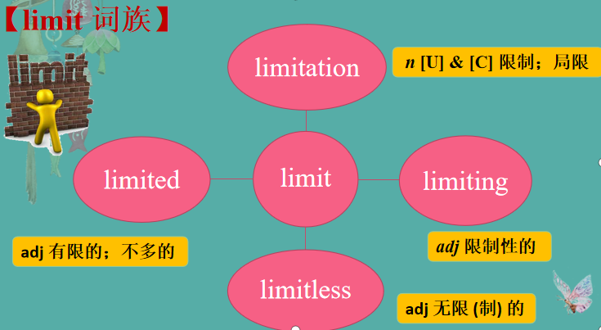
写作词汇
limit /ˈlɪmɪt/ n.限度;限制 vt.限制;限定
1. There is a/no limit to.... 对...是有限制的/无限制的
我从这次事件中学到：一个人的能力是无限的。
I have learned from the incident that there is no limit to one's ability.
2. be limited to 局限于
没有爱/友谊/家人，你的世界将局限于一片荒芜。（读后续写之文末升华）
Without love/friendship/family, your world would be limited to wildness.
值得你特别注意的是，你的作品应该限制在3分钟内。(应用文之征集短视频)
What deserves your special attention is that your work should be limited to 3 minutes.

Slide 16

写作词汇
limit /ˈlɪmɪt/ n.限度;限制 vt.限制;限定
3. without limit 无限制地
自然资源如此有限，我们没有理由无限制地浪费它们。（应用文之倡议信保护自然资源）
The natural resources are so limited that we have no reason to waste them without limit.
4. limit...to... 把...限制在...内
此外，文章应限制在500字以内，且只能用英文撰写。(应用文之征稿启事)
Besides, you are supposed to limit your essays to 500 words and write in English only.

Slide 17
prevent /prɪˈvent/ vt.阻止;阻碍;阻挠
prevent ... from ... /prɪˈvent frəm/ 阻止;不准
写作词汇
1. prevent ...from ... 不准；阻止……
大卫患有使他不能像其他孩子一样走路或跑步的脑部疾病，但在学校他的同学们把他当做正常的孩子。(2022全国I 续写原文身残志坚男孩勇敢战胜自我)
1. prevent ...from ... 不准；阻止……
2. stop/keep ...from (doing) ... 制止……
3. protect ...from/against (doing) ...
保护……免受……伤害
David had a brain disease which prevented him from walking or running like other children, but at school his classmates thought of him as a regular child.
2. 她父母的目的是使她不受任何坏影响的干扰以便她能养成良好的习惯和礼貌。
Her parents’ aim is to prevent her from any bad impact so that she can form a good habit and have graceful manners.
3. protect...against 保护……免受……伤害
多亏了他在疫情中的努力，他保护了市民免遭感染。（应用文之感动人物介绍）
Thanks to his efforts in epidemic, he protected the citizens against infection.

Slide 18

contribution /ˌkɒntrɪˈbju:ʃn/ n.捐款;贡献;捐赠
contribute /kənˈtrɪbju:t/ vi.&vt.捐献;捐助
写作词汇
1.contribute to 有助于
就我而言，定期阅读英文报纸的确有助于提高我的英语水平。(应用文之学习英语的方法)
As far as I’m concerned, reading the English newspaper regularly does contribute to improving my English level.
2. make a contribution to 对...做出贡献
一旦你学会了利用失败，失败就能为你的生活做出积极贡献。(读后续写之学会利用失败)
Failure can make a positive contribution to your life once you learn to make use of it.

Slide 19

investigate /ɪnˈvestɪgeɪt/ vi.&vt.调查;研究
写作词汇
1. investigate the matter/incident 调查此次事件
2. 警方正在调查凶手之间可能的联系。
Police are investigating possible links between the murders.
3. 侦探凭感觉去调查码头边的仓库。果然，他在那里找到了失窃的货物。
The detective played a hunch and went to investigate the warehouse by the docks. Sure enough, that's where he found the stolen goods.

Slide 20

issue /ˈɪʃu:/ n.重要议题 vi.宣布;公布
写作词汇
1. issue 问题
这个讲座既有趣又有教育意义。它涵盖了一系列与水上安全有关的问题，包括独自游泳的危险，穿救生衣的重要性，以及对事先热身运动的忽视。最后，演讲者还演示了在紧急情况下如何进行心肺复苏术。(应用文之安全讲座)
The lecture was both interesting and instructive. It covered a range of issues related to water safety, including the dangers of swimming alone, the importance of wearing life jackets, and the ignorance of warming-up exercises beforehand. At last the speaker also demonstrated how to perform CPR in case of an emergency.
2. issue （报纸、杂志等的）期,号
我期待读Youth的每一期。(2021·新高考Ⅰ卷应用文之Youth and Me)
I look forward to reading every issue of the Youth.
3. issue a statement 发表声明
4. issue warm clothes to the survivors/issue the survivors with warm clothing 给幸存者分发御寒衣物

Slide 21
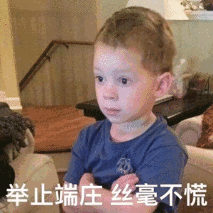
conduct /kənˈdʌkt/ n.行为;举止 vt.组织;安排
写作词汇
1. conduct activities 组织活动
近日，我校开展了各种户外活动，从采摘水果到越野跑，吸引了同学们的积极参与。(应用文之活动安排)
Recently, our school conducted various outdoor activities ranging from picking fruits to cross-country race, which attracted students’ active participation.
2. conduct an experiment/an interview/ a survey/a test 进行实验/面试/调查/试验
3. conduct oneself 表现自己，行为举止
确保你的行为举止是一个好邻居应该有的。
4. a principle for the conduct of life 生活行为准则
孔子提出一项生活行为准则:“己所不欲勿施于人。”
Make sure you conduct yourself as a good neighbor should.
Confucius suggested a principle for the conduct of life:” Do not do to others what you would not want others to do you.”

Slide 22

donate /dəʊˈneɪt/ vt.(尤指向慈善)捐赠;赠送
donate ... to ... /dəʊˈneɪt tə/ 向……捐赠……
写作词汇
1. donate sth. 捐赠...
当得知被卡车撞倒的女孩由救护车送往了医院，许多人自发地献血。
On hearing the girl struck by a truck has been sent to hospital by ambulance, many people volunteered to donate blood.
2. donate...to...向...捐赠...
回顾我的三年校园生活，我发现当我在网上卖掉我的第一幅画，并把钱捐给山区的孩子们的那一刻，真的把我塑造成了一个更加成熟和负责任的人。(应用文之高中难忘时刻)
Looking back on my three years on campus, I found the moment when I sold my first painting online and donated the money to the children in mountainous area, really shaped me into a more mature and responsible individual.
3. donation 捐赠，捐献 make donations/a donation to 向...捐赠
人们笑着涌了进来，交上了用于建造避难所的捐赠。
Exploding into wilder laughter, people came flooding in, handing their donations to build the shelter.

Slide 23
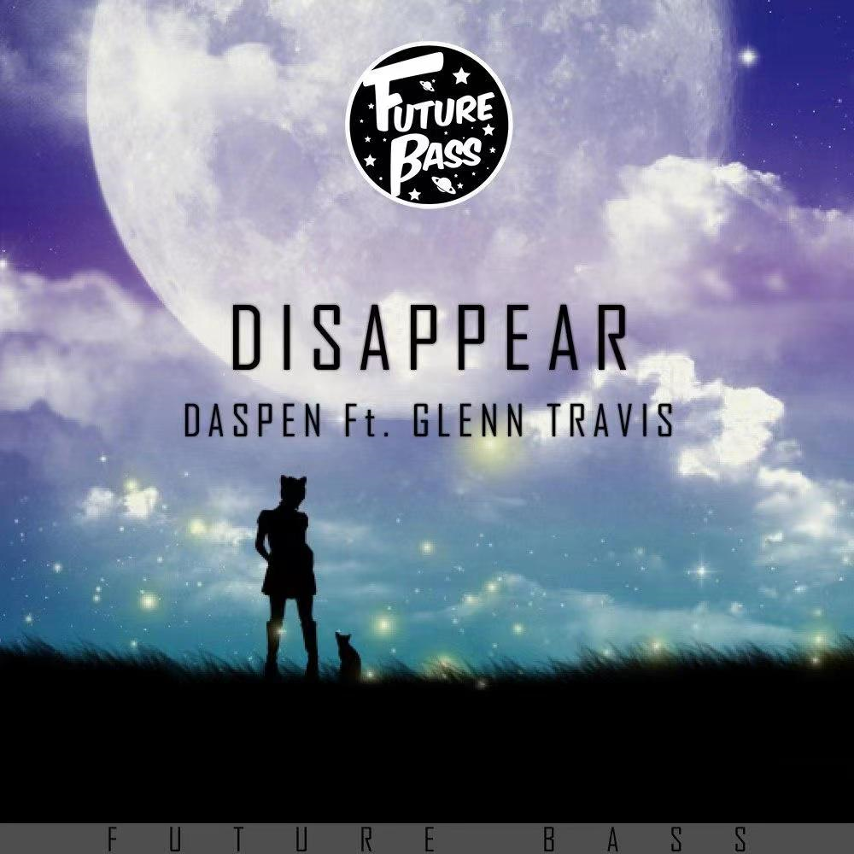

disappear /ˌdɪsəˈpɪə(r)/ vi.消失;灭绝;消亡
写作词汇
1.莉萨一直看着火车从视线中消失。
2.她一走上台紧张情绪便迅速消失了。(续写之紧张情绪描写)
Lisa watched until the train disappeared from view .
Her nervousness quickly disappeared once she was on stage.
3. appear 出现，出场，似乎，表现得
(1) 她听到这消息时一点也没有显得吃惊。
(2) 地平线上升起了烟雾。
(3) 她竭力表现得比她感觉的更为自信。
She didn't appear at all surprised at the news.
Smoke appeared on the horizon.
She did her best to appear more self-assured than she felt.

Slide 24

attempt /əˈtempt/ n.&vt.企图;试图;尝试
写作词汇
1. attempt to do sth 尝试做某事
在接下来的几天里，我们尝试到处寻找我们的爱犬Spotty， 但都一无所获。(2020浙江1月读后续写A Puppy for Poppy)
In the next few days, we attempted to search for our beloved dog Spotty in each and every corner, but in vain.
2. at the first attempt 第一次尝试
我们第一次尝试没能把爆米花卖出去，这使我们既沮丧又难过。(2020全国I卷读后续写助人为乐—爱心爆米花)
We failed to sell popcorn at the first attempt, which made us depressed and sad.
3. make an attempt to do/at doing sth 尝试/试图做...
这对夫妇试图和解但未成功。
她试图强忍住不笑出来。
The couple made an unsuccessful attempt at a compromise.
She made a valiant attempt not to laugh.

Slide 25
worthwhile /ˌwɜ:θˈwaɪl/ adj.值得做的;值得花时间的
写作词汇
1. it is worthwhile doingsth./to do sth. 做某事是值得的
读有趣的汉语新闻是值得的，这能够帮助你提高对汉语的兴趣。(应用文之向外国友人学汉语提建议)
It is worthwhile reading/to read attracting Chinese news, which can help you increase your interest in Chinese.
2. be (well) worth doing (非常)值得被做
因为你对中国文学感兴趣，所以我认为汉语读写很值得一学。(应用文之向外国友人学汉语提建议)
Since you are interested in Chinese literature, I think Chinese reading and writing is well worth learning.
3. be worthy of being done/to be done 值得被做
泰山是一个很值得参观的旅游景点。(应用文之介绍中国旅游景点)
Mount Tai is a tourist attraction which is well worthy of being visited.
=Mount Tai is a tourist attraction which is well worthy to be visited.

Slide 26

process /ˈprəʊses/ n.过程;进程 vt.处理;加工
写作词汇
1. the process of ...的过程
我知道她很享受“做母亲”的过程，也懂得什么叫责任，什么叫担当。(读后续写之母爱
I knew she enjoyed the process of "being a mother", and moreover she understood and shouldered what is called responsibility.
2. in the ...process 在...过程中
此外，如果你能在背诵过程中指导我，并分享一些如何表现好的建议，我将不胜感激。 (应用文之求助如何学习英语)
Besides, I would be grateful if you could guide me in the recitation process and share some tips on how to perform well.
3. process sth. 加工... 加工我们所吃的食物需要有油和盐。
Fat and salt are required to process the food that we eat.

Slide 27

写作词汇
exit /ˈeksɪt/ n.出口;通道 vi.&vt.出去
exit n. 出口;通道
1.这栋建筑每层楼都有个消防通道。
2.我匆忙离开并设法打开了大门。
exit v. 出去
3.我从侧面的一扇窗户钻了 出去。
4. 演员们从剧院退场时，(剧院里的)灯光便关了。(读后续写之剧场表演)
There is a fire exit on each floor of the building.
I made a hasty exit and managed to open the gate.
I exited through a side window.
As the actors exited the theater, the lights went off.

Slide 28
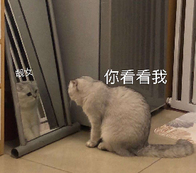
mirror /ˈmɪrə(r)/ n.镜子
写作词汇
1. 他心不在焉地走进了浴室，照着镜子看了看自己。
2.我乘机瞥了一眼镜子。
He went into the bathroom absent-mindedly and looked at himself in the mirror.
3. mirror v. 映照，反射
我发现那突然的闪光，使新近被水淹没的田地映出了天空。(读后续写之环境描写)
I snatched a glance at the mirror.
I found the sudden glitter where a newly flooded field mirrors the sky.

Slide 29
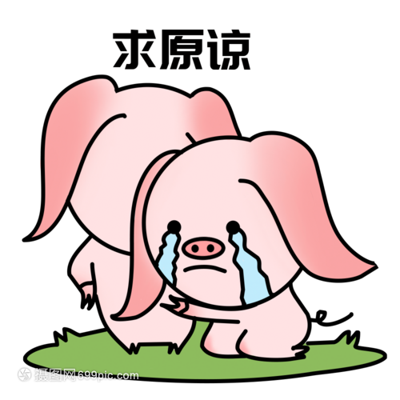
forgive /fəˈgɪv/ vt.&vi.原谅;宽恕;对不起
写作词汇
1. forgive sb. 原谅某人
那个淘气的男孩撒谎说母鸡生了两个蛋。他的父母决定斥责而不是原谅他。
2. forgive sb. for (doing) sth. 原谅某人(做了) 某事
汤姆向她道歉并希望她可以原谅他的鲁莽。
The naughty boy lied that the hen had laid 2 eggs; his parents resolved to scold him rather than forgive him.
Tom apologized to her and hoped she could forgive him for being rude.
3. forgiveness 原谅，宽恕
我们不用再说别的了;我们都知道，宽恕是治愈创伤最重要的一步。
(读后续写之原谅他人)
We didn't have to say anything else; we all knew it was forgiveness that was the most important step in healing.

Slide 30
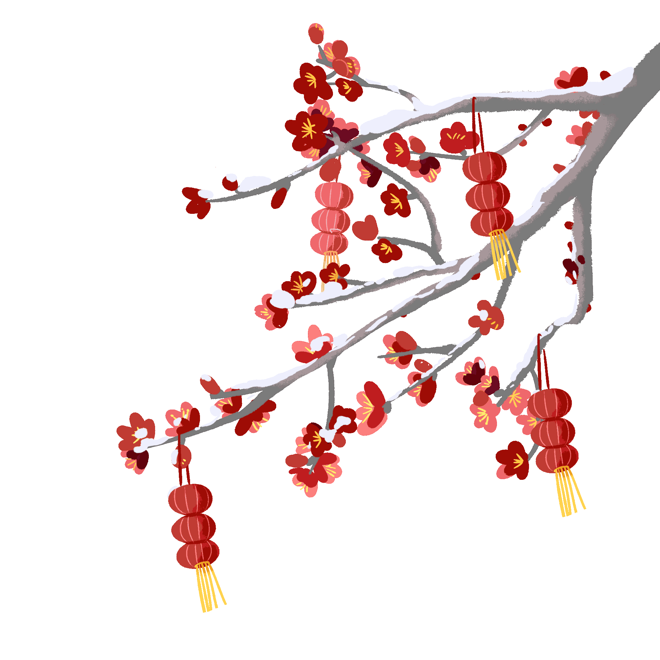
写作词汇
tradition /trəˈdɪʃn/ n.传统;传统的信仰或风俗
1. tradition 传统信仰或风俗
有一天，我看到一张老照片，照片上父亲站在一个漂亮的房间里，房间里摆满了金色的家具和丝绸墙纸。因此，出于好奇，我找到了父亲，请求他与我分享他过去的经历。他描述了他小时候在中国是如何庆祝春节的。他的话非常生动，我完全被这些传统迷住了。就在那时，我下定决心要回国寻根。(读后续写之中国传统文化传承)
One day, I spotted an old photo where my father stood in a beautiful room full of golden furniture and silk wall papers. Therefore, out of curiosity,I came to my father, begging him to share his past experience with me. He described how the Spring Festival was celebrated in China when he was a little child. So vivid were his words that I was completely fascinated by the traditions. It was then that I made up my mind to go back to China and seek my root.

Slide 31

写作词汇
tradition /trəˈdɪʃn/ n.传统;传统的信仰或风俗
2. traditional Chinese culture 传统中国文化
为了介绍中国传统文化，我们学校将举行主题班会，并在英文网站上进行展示。(2021年全国甲卷应用文之了解吸引外国人的中国传统文化)
3. traditional dress 传统服饰
我们学生穿着传统服装，按计划在体育场集合。(应用文之活动安排
To introduce traditional Chinese culture, our school will hold a theme class meeting, which be exhibited on the English website.
We students, wearing traditional dress, gathered at the stadium as scheduled.

Slide 32
in one’s opinion 在某人看来
写作词汇
1. 在我看来，经常读英文报纸的确有助于提高我的英语水平。（2021年全国I之应用文Youth and Me）
In my opinion, reading English newspaper regularly does contribute to my English level.
“在某人看来”
in one’s opinion
in one’s view
as far as sb. be concerned
personally speaking
from my perspective

Slide 33

all over the world /ɔ:l ˈəʊvə(r) ðə wɜ:ld/ 在世界各地
写作词汇
1. tourists from all over the world 世界各地的游客
来自世界各地的游客纷纷造访敦煌、欣赏洞窟；位于洛杉机的盖蒂博物馆甚至复制了这些洞窟和壁画的照片，供人们在美国欣赏。
Tourists from all over the world visit Dunhuang to see the caves, and the Getty Museum in Los Angeles has been reproduced a copy of the caves and paintings for people to admire in America.

Slide 34

sheet /ʃi:t/ n.一张(纸);床单;被单
写作词汇
1. sheet 被子
他钻进被子里，闭上了眼睛。
He slid between the sheets and closed his eyes.
2. a sheet of 一层，一张
路面结了一层冰。(读后续写之环境描写)
The road was covered with a sheet of ice.
3. in sheets 大雨倾泻
大雨倾盆而下。(读后续写之环境描写)
The rain was coming down in sheets (= very heavily) .

Slide 35
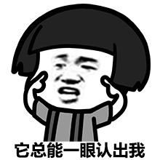
identify /aɪˈdentɪfaɪ/ vi,确认;认出;找到
写作词汇
1. identify faces 认出面孔
他离得太远，认不出那些面孔。
2. identify a link 发现关联
科学家们已经发现了饮食与癌症之间的关联。
3. identify sb/ sth with sth 认为某人 /某物等同于某物
你不应该把财富与幸福等同起来。
4. identify with sb./sth. 认同某人/某物;与某人/某物有同感
我不喜欢这本书，因为我无法与其中任何一个主角产生共鸣。
5. identity 身份
进入校门也需要以显示你的身份。
He was too fat to be able to identify faces.
Scientists have identified a link between diet and cancer.
You should not identify wealth with happpiness.
I didn’t enjoy the book because I couldn't identify with any of the main characters.
Entering into the school is also needed to show your identity.

Slide 36

creative /kriˈeɪtɪv/ adj.创造性的;有创造力的
写作词汇
1. creative pursuits 创意追求
他的艺术造诣提醒我们文字的力量，敦促我们从事自己的创造性追求，用我们独特的声音塑造世界。 (2023 年高考全国甲卷-历史人物)
His artistic mastery reminds us of the power of words, urging us to engage with our own creative pursuits, shaping the world with our unique voices.
2. creative problem-solving abilities 创造性的解决问题的能力
此外，我具有出色的组织能力和创造性的解决问题的能力，使我成为该职位的优秀候选人。 (应用文之求职信)
In addition, I'm equipped with remarkable organizational skills and creative problem-solving abilities, making me a good candidate for the position.

Slide 37

mount /maʊnt/ n.山峰 vt.爬上;骑上 vi.爬
写作词汇
1. mounting excitement/concern/tension 越来越兴奋╱关注╱紧张
2. 她慢慢地爬上台阶。
3. 他登上讲台对人群发表演说。
4. 他骑上马走了。
She slowly mounted the steps.
He mounted the platform and addressed the crowd.
He mounted his horse and rode away.

Slide 38

application /ˌæplɪˈkeɪʃn/ n.申请(表);用途;应用程序
写作词汇
1. application form 申请表
如果您对此感兴趣，请将申请表通过电子邮件发送到APA@qq.com。(应用文之申请信)
2. 如果您能在方便的时候考虑我的申请，我将不胜感激。(应用文之申请信)
If you are mterested in it, please send your application form by email to APA@qq.com.
I'd appreciate it if you could take my application into account at your convenience.
3. apply for 申请...
我写信申请这份志愿工作,我认为我能够胜任该工作。
I'm writing to apply for the voluntary job, which I think I am qualified for.

Slide 39

application /ˌæplɪˈkeɪʃn/ n.申请(表);用途;应用程序
写作词汇
4. apply to...申请做...
得知我们学校的英语协会现在需要一些志愿者，我写信申请加入。(应用文写作之申请信)
Learning that the English Association of our school is now in need of some volunteers, I’m writing to apply to join it.
5. apply...to...把...应用到...
他在森林里的经历为他做好了充分的准备，这使得他能够运用他所学到的知识来帮助动物收容所的动物。(读后续写之救助野生动物)
His experience in the forest had prepared him well, which made him able to apply what he had learned to help the animals in the animals shelter.

Slide 40
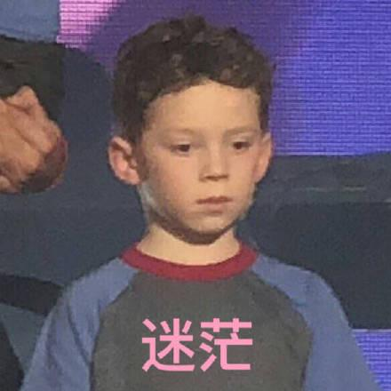
写作词汇
loss /lɒs/ n.丧失;损失
1. a sense of loss 失落感
她去世后我心里充满了失落感。
2. loss 去世；逝世
他妻子去世对他是个巨大的打击。
3. at a loss 不知所措；困惑
他的评论让我不知说什么才好。
When she died I was filled with a sense of loss.
The loss of his wife was a great blow to him.
His comments left me at a loss for words .

Slide 41
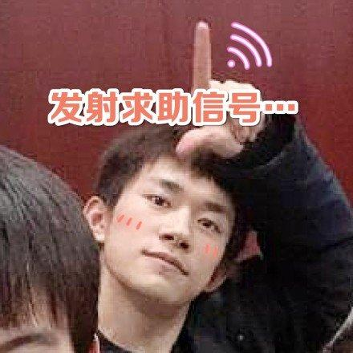
turn to /tɜ:n tə/ 向……求助；致力于；翻到；查阅；转向，开始从事
写作词汇
1. turn to sb for 向某人求助
得知你对中国文化感兴趣，我不得不向你征求一些关于班会话题的建议。(2021年全国甲卷询问外国友人感兴趣的中国传统文化)
Learning you are interested in Chinese culture, I have to turn to you for some advice on the topics of the class meeting
2. turn to sb 转向某人
听了我的话，大卫的眼泪顺着脸颊滚落下来，他转向我，坚定地表达了他完成越野跑的决心。（2022全国I 读后续写之身残志坚男孩勇于战胜自我）
At my words, with tears rolling down his cheeks, David turned to me and firmly expressed his determination to finish the cross-country run.

Slide 42
3. The twins slid into the kitchen, turn_____ the stove and began to cook porridge. But soon the porridge boiled over. Thankfully, Jeff stayed salm and turn_____the gas quickly.
4. My proposal got turn _____, which bathed me in extreme sadness.
5. We waited for him in the sun anxiously, but he never turn_____.
6. Though picking apples was tiring, it turned_____ to be rewarding and intersting.
on
“turn” 家族
turn on 打开
turn off 关上
turn down 调小，拒绝
turn up 出现，露面，调大
turn out 证明是，结果是
off
down
up
out

Slide 43
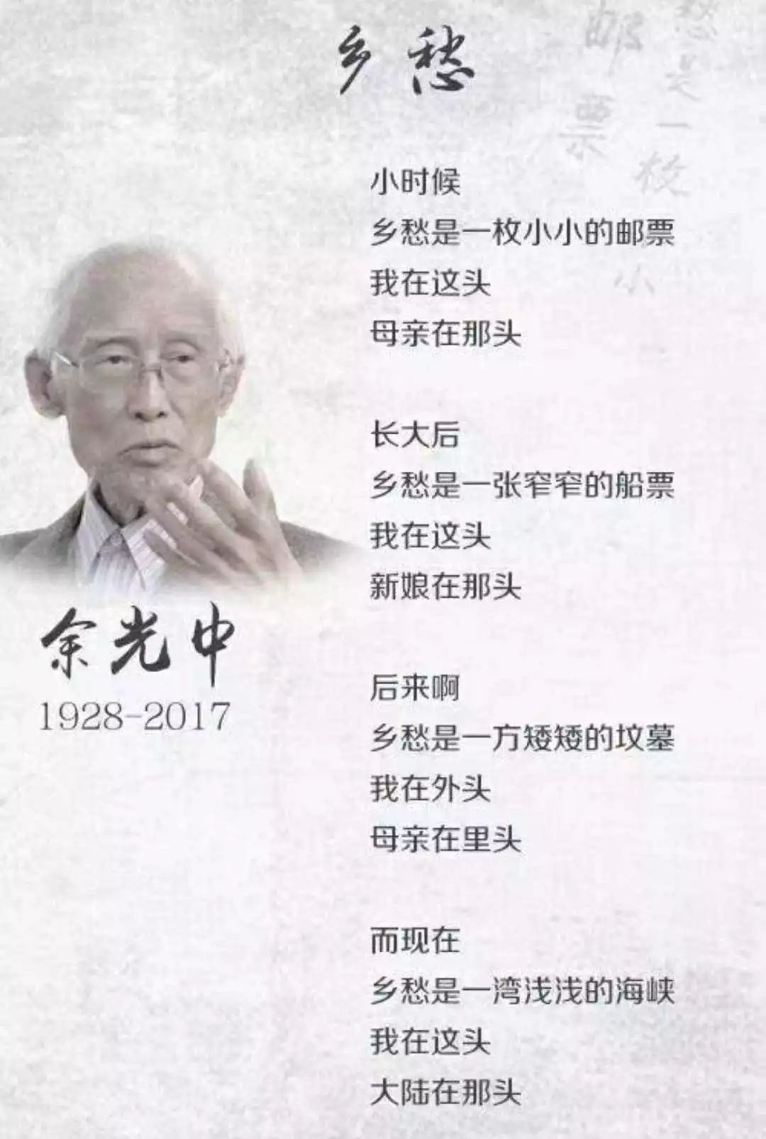
quote /kwəʊt/ vt.引用
写作词汇
1. an often quoted poem 一首脍炙人口诗
《乡愁》是余光中脍炙人口的一首诗，它生动地讲述了两岸人民的血肉关系。(应用文之诗歌评论征集活动)
Nostalgia is an often quoted poem by Yu Guangzhong, which vividly tells the flesh and blood relations between people on both sides of the Taiwan Straits.

Slide 44
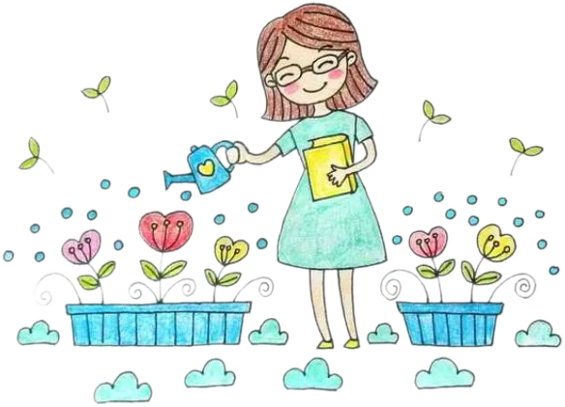
comparison /kəmˈpærɪsn/ n.比较;相比
写作词汇
1. make a comparison 进行对比
这本书很难与他的前一本书作比较——它们完全不同。
2. by comparison 相比之下
相比之下，今年花在教育上的钱增加了。
It is difficult to make a comaprison with his previous book—they are completely different.
By comparison, money spent on education increased this year.
3. compare A to B 把A 比作B
人们常把老师比作悉心照料各种植物的园丁。
People often compare a teacher to a gardener who takes great care of various plants.

Slide 45
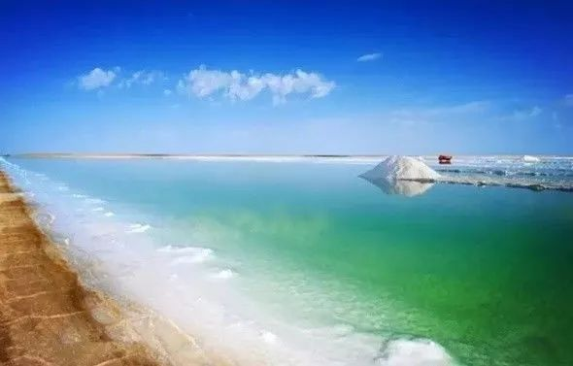
comparison /kəmˈpærɪsn/ n.比较;相比
写作词汇
4. compare A with B 把A 和B 相比较
许多父母喜欢拿自己的孩子和朋友的孩子进行比较。
5. compared with 与...相比
与逃逸的司机相比，我为我所做的事情感到骄傲。
6. beyond compare 无与伦比
此地风景之优美无与伦比。（读后学写之环境描写）
Many parents like comparing their own children with/to their friends' children.
Compared with the escaped driver, I am proud of what I did.
The beauty of the landscape here is beyond compare．

Slide 46

image /ˈɪmɪdʒ/ n.形象;印象
写作词汇
1. 这首诗结构相同，用词不同，听起来很有音乐感。更巧妙的是，诗人用简单而独特的形象来表达他在不同人生阶段的思乡之情，引起了那些经历分离和团聚的人的共鸣。(应用文之以“传承中华优秀文化”为主题的诗歌评论征集活动)
The poem sounds musical with the same structure and some invariant words. More skillfully, the poet employs simple but unique images to express his homesickness in different stages of life, striking a chord with those who are experiencing separation and reunion.
2. 她凝视着自己在水中的倒影。
She stared at her own image reflected in the water.

Slide 47

clue /klu:/ n.线索;提示
写作词汇
1. give sb. a clue 给某人提供线索
这件事给我提供了找出问题根源的线索。
This gave me a clue as to the source of the problem.
2. have no clue 毫无线索
我们对她离家后去往何处毫无线索。
We have no clue as to where she went after she left home.

Slide 48

professional /prəˈfeʃənl/ adj.&n.专业的(人);职业的
写作词汇
1. professional n. 专业人士
我们还在展览入口处邀请了一位专业人士，他向我们解释了建造如此困难的结构的过程。（应用文之活动安排）
We have also invited a professional at the entrance of the exhibition , who explained to us the process of building such a difficult structure.
2. professional a. 专业的
毫无疑问，你的专业而渊博的英语知识将使学生受益匪浅。(2022全国卷I 应用文对外教进行访谈)
Undoubtedly, your professional and profound knowledge of English will benefit the students greatly.

Slide 49

There comes a time when ...的时代已经到来
写作词汇
1.There comes a time when ...的时代已经到来
发令枪一响，参赛者们都知道必须挑战自我的时候到了（2020全国I 之应用文新闻报道五公里越野赛）
When the starting gun rang, all the participants knew there came a time when they had to challenge themselves..
2. There are times when...有...的时候
我清楚地记得，曾经有段时间，湛蓝的天空、鸟儿的歌唱，月光和鲜花从未令我心醉神迷过。（读后续写之环境描写）
I can well remember that there was a time when a deep blue sky, the song of the birds, moonlight and flowers could never have kept me spellbound.

Slide 50
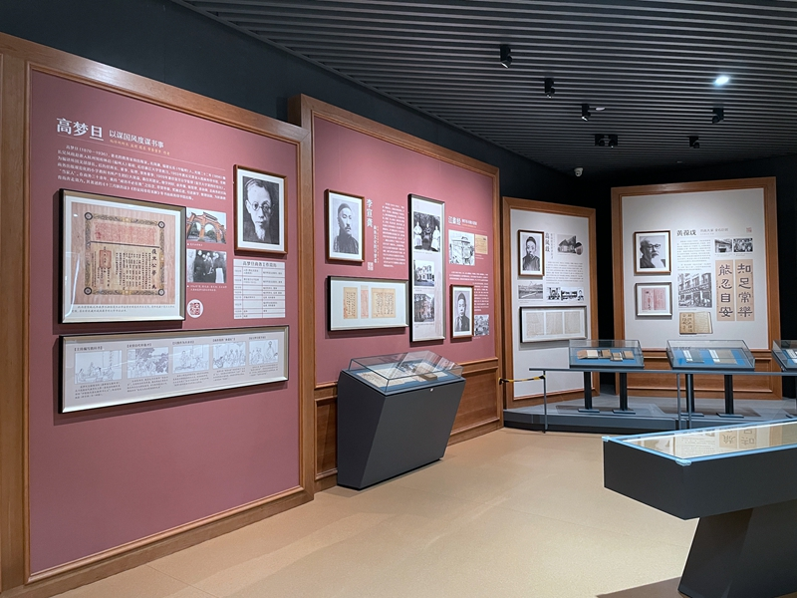
写作词汇
not only...but also 不仅...而且...
1. 表示并列关系
这次展览不仅提高了我们的审美能力，而且给了我们很多历史文化知识。（应用文之举办展览意义）
The exhibition not only improved our beauty-appreciation ability, but also gave us a lot of historical and cultural knowledge.
2. not only位于句首，句子部分倒装
通过参加这次比赛，我们不仅锻炼了身体，而且增强了意志力。（2020全国I 之应用文新闻报道五公里越野赛）
By taking part in the race, not only did we build up our body, but also strengthened our willpower.

