Slide 1

感恩遇见，相互成就，本课件资料仅供您个人参考、教学使用，严禁自行在网络传播，违者依知识产权法追究法律责任。
更多教学资源请关注
公众号：溯恩高中英语
知识产权声明

Slide 2

七彩阳光 应用文解析 2023.9
Fay

Slide 3
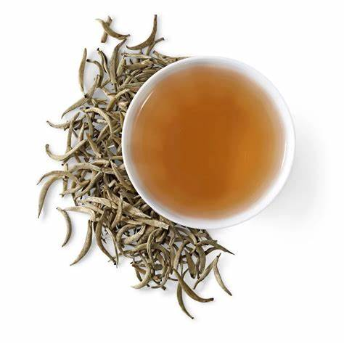
假定你是李华，你的新西兰朋友Luke非常喜欢中国茶文化。近期你市文化馆将举办中国茶文化展。请写一封信告知Luke这一消息。
内容包括：
1. 时间地点;
2. 展览内容。
注意：
1. 写作词数应为80左右；
2.请按如下格式在答题卡的相应位置作答。
Dear Luke,
Yours sincerely,
Li Hua
主线任务
文体类型 | 信件/告知
目标受众 | 你的新西兰朋友Luke
语言风格 | 轻松愉悦，展示友谊
篇章结构 | 开头+主体+结尾
内容要点 | 写信目的 告知内容：基本信息&具体内容&收获 期待对方参与
审题
隐藏任务：传播茶文化
时态 | 一般现在时/将来时
语气 | 骄傲，欢快，热烈（欢迎/期待）
人称 | I ,You
展览 | 基本信息直接清晰；内容具体实际
意义 | 高评价高期待
细节

Slide 4
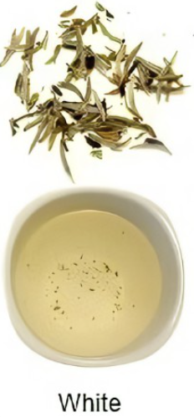
文体激活
Begin with a casual greeting
Acknowledge your friend
开头
Hope this letter finds you well!
I hope everything is good with you.
Tell your friend why you are writing (purpose)
Knowing /Hearing/Learning that you are keen on/are interested in/are passionate about /have a strong passion for/are enthusiastic about/have an obsession with/are obsessed with …, I’m writing in delight/more than happy to tell/inform you that…
主体
Time/place…
Details/highlights
(summary)
Plan the main points of the letter.
结尾
Bring your letter to a close
The XXX will surely live up to/never fail your expectation.
You will surely enjoy the experience and gain a deeper understanding of ….
I bet you’d be amazed here.
I can’t wait to show you around.
…
(a warm or affectionate ending fits the type of relationship you have with your friend.)

Slide 5


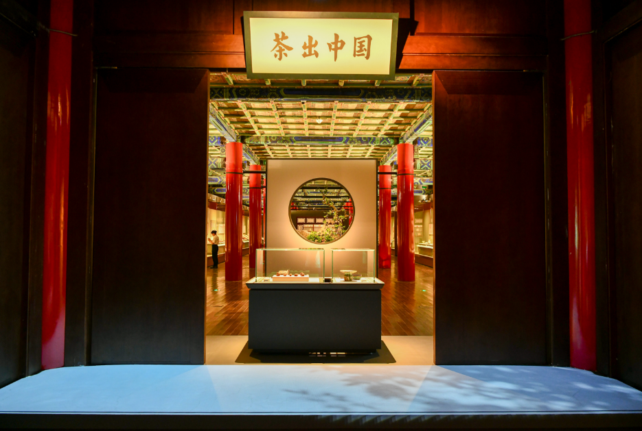
难点突破
展览内容--中国茶文化展
Exhibition
Activities
A public display of works of art or items of interest, held in an art gallery or museum or at a trade fair
Knowledge learning
A traditional exhibition is a largescale event that uses a variety of media and means to promote products, corporate image and establish good public relations
visualized
interactive communicating
Practical
Chinese Tea Culture
A tool if used to create awareness, enhance reputation as well as to sell products.

Slide 6
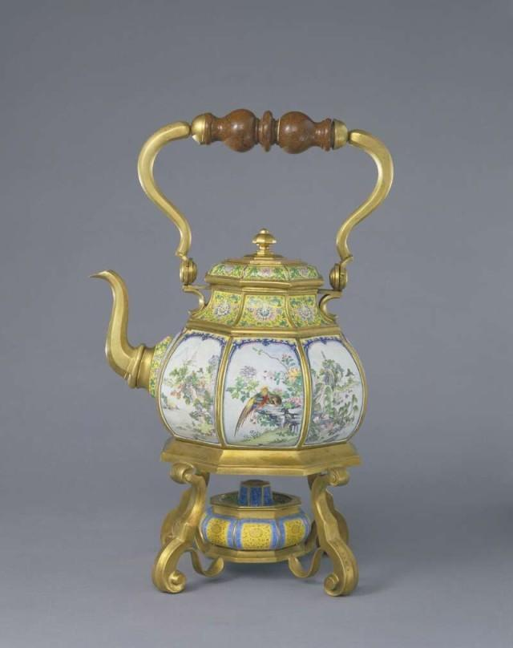
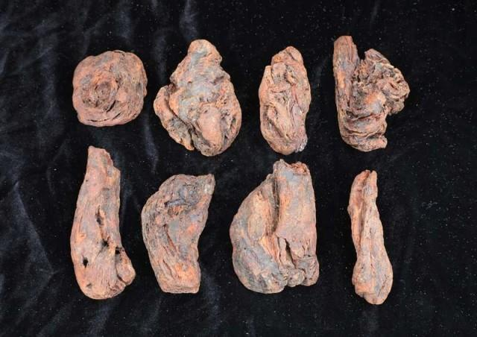
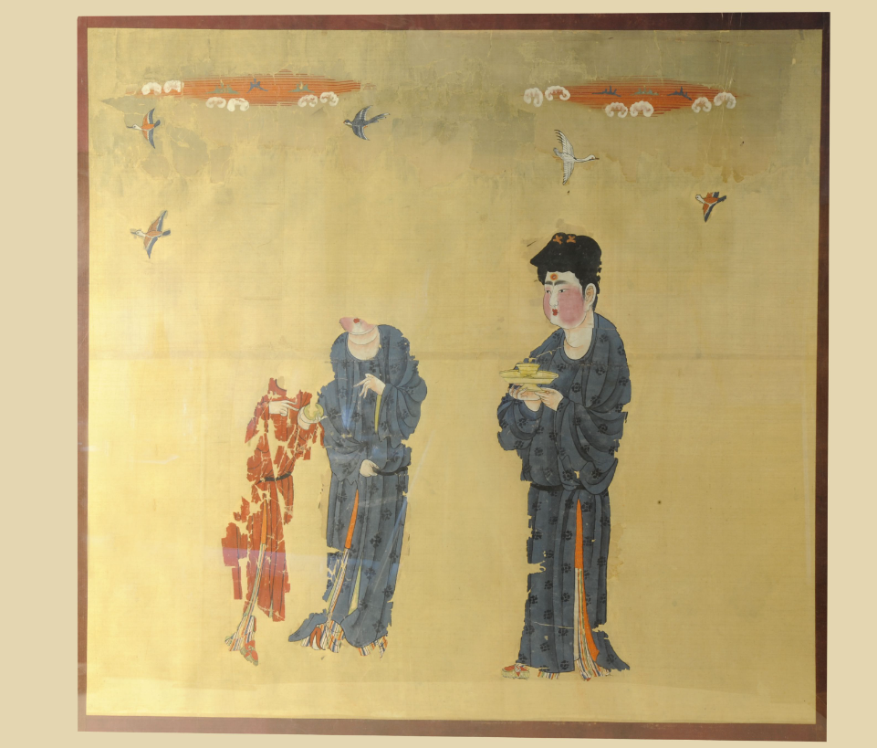
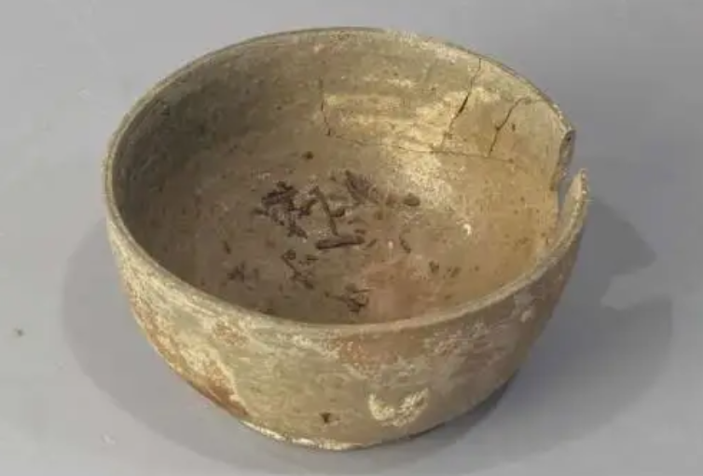
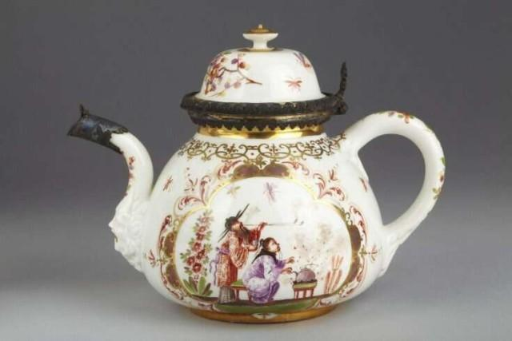
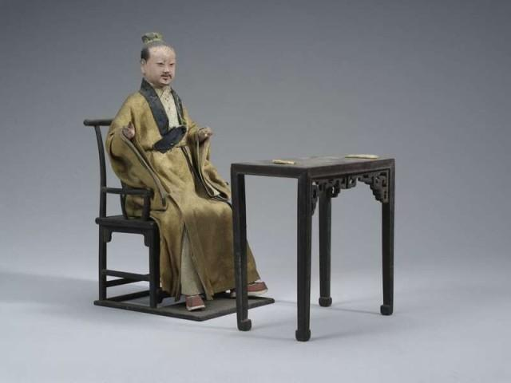
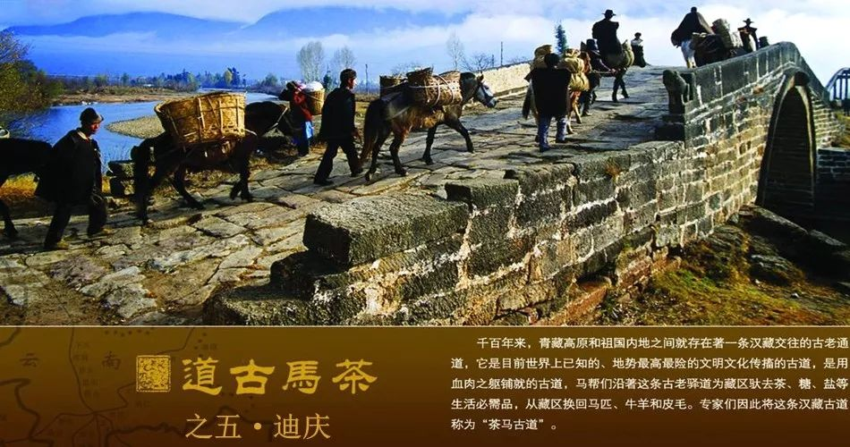
--中国茶文化展
display of works of art
Exquisite Tea set
乾隆款画珐琅八棱开光山水花鸟图提梁壶
唐《托盏侍女图》
古茶树根遗存
Cup-holding maid
Remains of ancient tea tree roots
loop-handled teapot
茶叶遗存的原始瓷碗
the handled ewer
Tea fairy statue
Tea remains in ancient bowl
珐琅彩人物图执壶1732
清/泥人张塑彩绘茶仙人像
Tea Horse Road

Slide 7
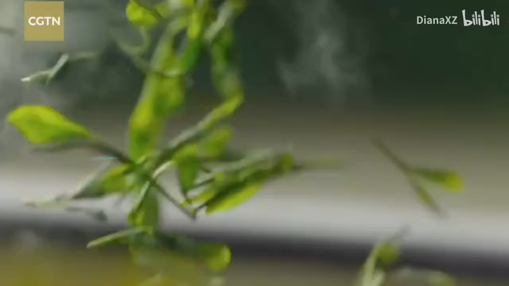
--中国茶文化展
Video display

Slide 8
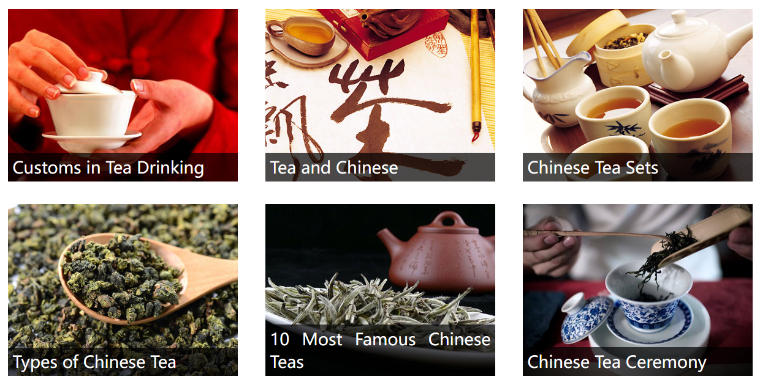
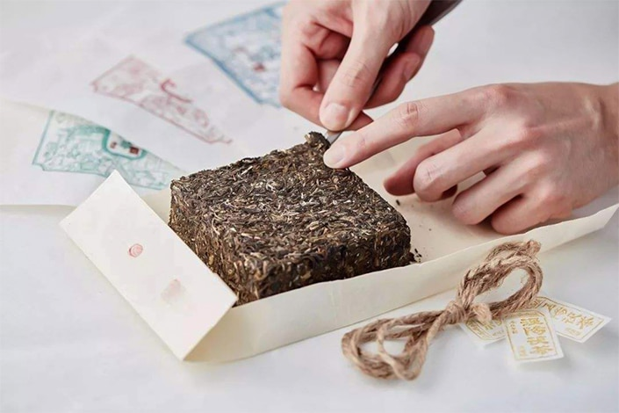
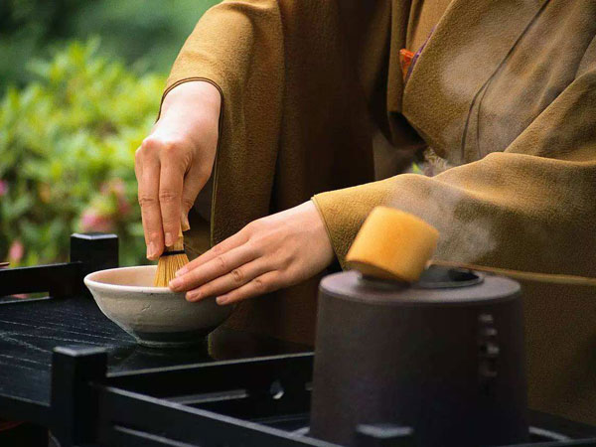
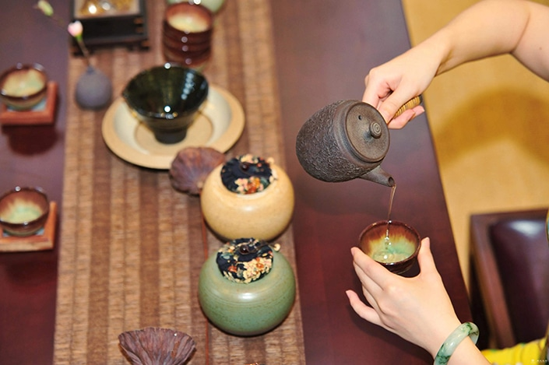
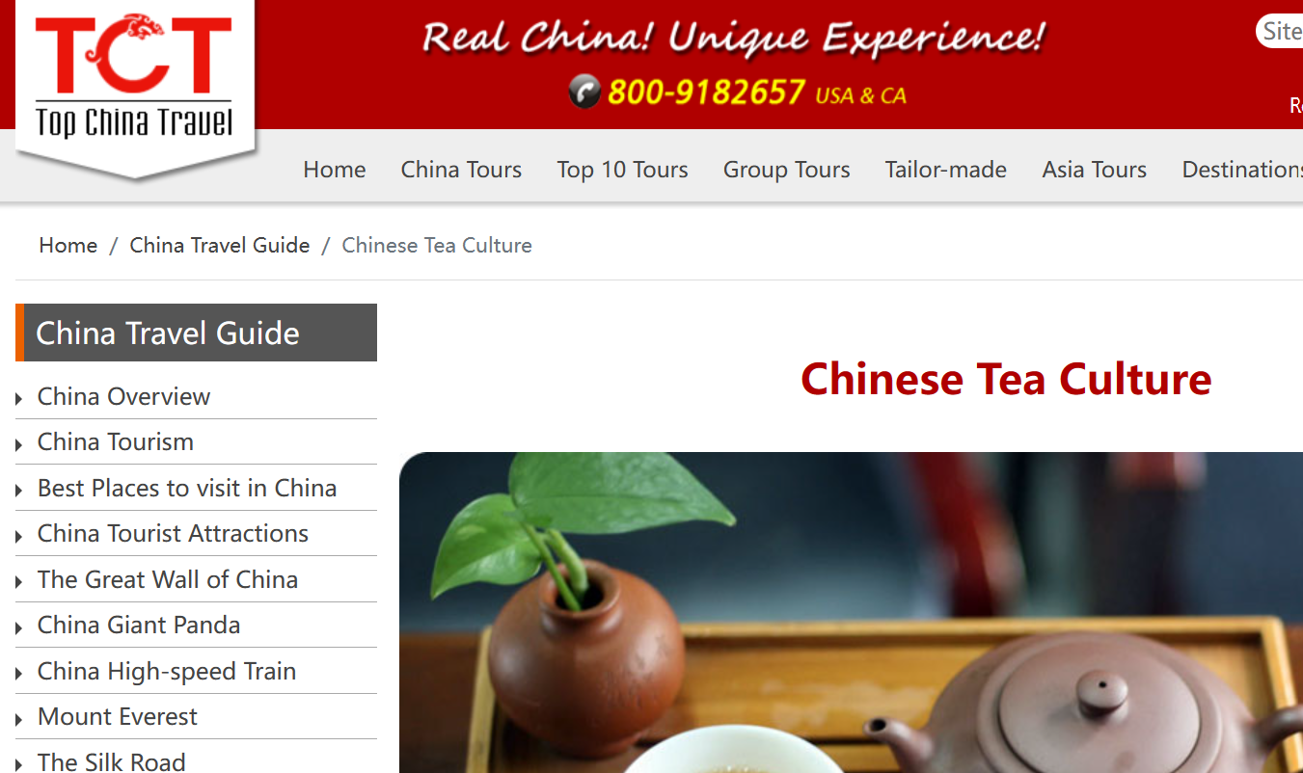
--中国茶文化展
Chinese Tea Culture Expo
Knowledge learning
interactive communicating
Making tea
preparing tea
tasting tea
click here

Slide 9
--中国茶文化展
Chinese Tea Culture Expo
further understand the history of tea in China
explore the exhibits, attend seminars, and engage in discussions
present with the opportunity to experience the tea-making process
promote understanding of the tools used in picking and producing it and the varieties of tea leaf along with their methods of production
be treated to a diverse selection of tea types available for exploration.
have an in-depth tea culture experience, such as..
witness fascinating tea ceremonies, learn about the complex art of tea preparation, and experience firsthand the harmonious blend of tradition and innovation that characterizes the tea industry.
With its expansive exhibition area, diverse range of products, and opportunities for knowledge exchange, the expo is bound to be …
Tea food products, tea apparel, purple clay, ceramics, tea utensils, and crafts are all displayed, offering attendees a comprehensive glimpse into tea culture’s rich and multidimensional world.
……

Slide 10
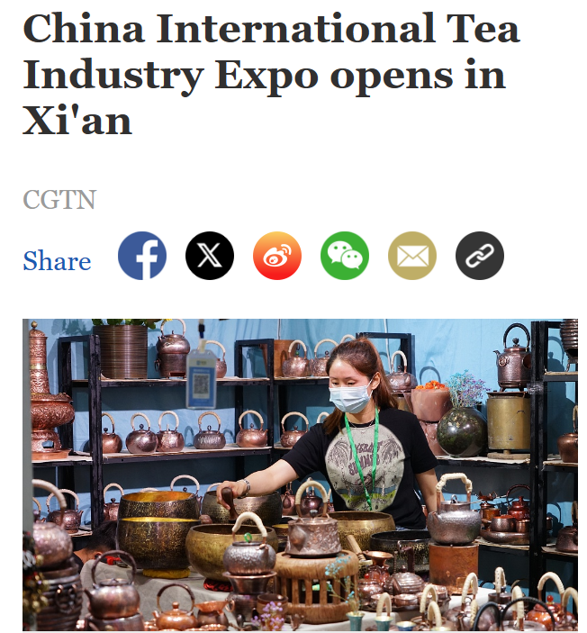
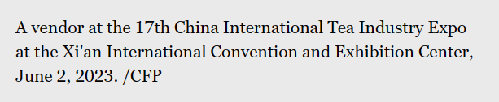
Learn real English in context
The 17th China International Tea Industry Expo commenced on Friday at Xi'an International Convention and Exhibition Center in Shaanxi, marking the beginning of an extraordinary event.
This year's expo promises to be even more remarkable, featuring an expanded exhibition area of 36,000 square meters and an impressive 1,800 booths. With eight main exhibition areas, one of the highlights is the newly-introduced "National Supply and Marketing Tea Zone," which brings together supply and marketing cooperatives from 13 provinces and cities across China.
This year's expo seeks to explore innovations and promote the development of north-south tea trade. Throughout the event, arrangements are set to be made for inspection visits and exchange, facilitating cooperation and communication between tea industries across different provinces.
The 17th China Xi'an International Tea Expo will continue until June 5, providing ample time for tea enthusiasts and industry professionals to partake in this remarkable event.

Slide 11
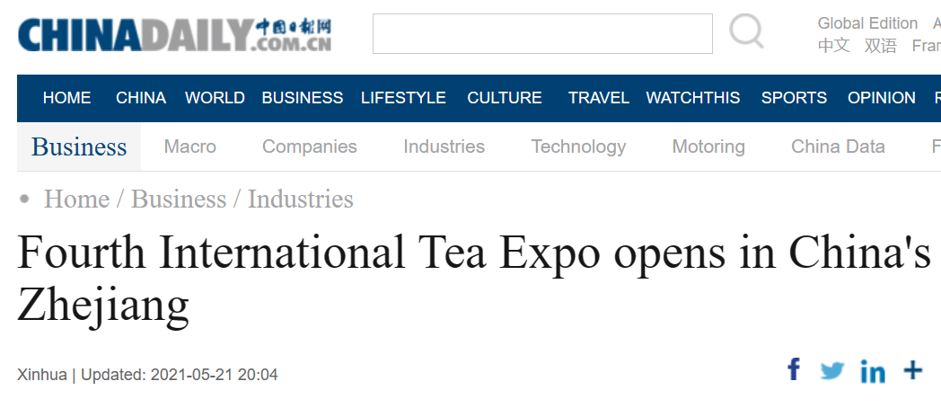


Learn real English in context
HANGZHOU -- The Fourth China International Tea Expo kicked off on Friday in Hangzhou, the capital city of East China's Zhejiang province.
Themed "Tea and the World Share Development," the expo launched in the Hangzhou International Expo Center on Friday, May 21, also observed as International Tea Day.
With an area of 70,000 square meters, the expo set up 3,423 booths and attracted more than 1,500 exhibitors and over 3,600 professional buyers from home and abroad.
On Friday, 20 countries' ambassadors to China, including Kenya, Morocco, the Netherlands, Russia, Chile, Vietnam, and Sri Lanka, as well as the United Nations resident coordinator in China, also attended the expo.
During the five-day expo, a series of activities will take place. These include a tea summit forum, tourism conference, and over 70 tea promotion events.

Slide 12
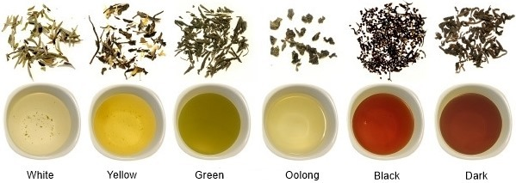
功能词句
⬥ As scheduled/As arranged
⬥ Tea enthusiasts
⬥ Kick off
⬥ Commence/launch
⬥ Promise to
Seek to
range from… to..
a variety of/a series of
on display
Partake in
…
With …, one of the highlights is ….
What highlights the exhibition is …
…,featuring an expanded exhibition area of
Arrangements/activities are set to be made for inspection visits and exchange, facilitating…
providing ample time for tea enthusiasts to partake in this remarkable event.
……
主体

Slide 13
知识激活1
主体
熟悉你是一个者茶文化爱好者，我很高兴写信告知你我市文化馆将于下周举办中国茶文化展
_______________________________________________________________
该展涵盖了与茶有关的各种要素。(to be specific ; ranging from…to…)
_______________________________________________________________
此外，展览最大的亮点是参观者将有机会体验…
_______________________________________________________________
毫无疑问，此次展览必将会是一场视听盛宴。
_______________________________________________________________

Slide 14
衔接词
知识激活1
主体
熟悉你是一个者茶文化爱好者，我很高兴写信告知你我市文化馆将于下周举办中国茶文化展
Knowing that you are a tea enthusiast, I’m writing in great delight to tell you that the cultural center in our city is going to launch a Chinese tea culture exhibition next week.
语法句式
该展涵盖了与茶有关的各种要素。(to be specific ; ranging from…to…)
To be specific, the exhibition covers a diverse range of tea culture on display, ranging from videos of Tea Horse Road, exquisite tea set of different dynasty to varieties of teas from different regions of China.
此外，展览最大的亮点是参观者将有机会体验…
What’s more, what highlights the exhibition is that visitors have the opportunity to experience the tea-making process.
毫无疑问，此次展览必将会是一场视听盛宴。
Surely , the exhibition is bound to be a feast of eyes.

Slide 15
知识激活2
衔接词
主体
根据安排，中国茶文化展将会在下周于文化中心举行。
_______________________________________________________________
语法句式
来自全国各地，各色各样的茶将会被展出。
_______________________________________________________________
参观者不仅能够进一步了解中国茶文化的历史更有机会亲自参与制茶品茶过程。
_______________________________________________________________
凭借其多样化的展示以及知识交流的机会，博览会必将会是一场视听盛宴。
_______________________________________________________________

Slide 16
衔接词
知识激活2
语法句式
主体
As scheduled, a China Tea Culture Expo will kick off next week from Monday to Friday.
_______________________________________________________________
As scheduled, a China Tea Culture Expo will kick off at the cultural center next week, running from Monday to Friday.
A variety of teas from different areas of China will be on display.
_______________________________________________________________
This year’s exhibition promises to be much more remarkable, featuring an expanded exhibition area of a variety of teas from different regions of China and many cultural relics related with tea such as remains of ancient tea tree roots, ancient tea set and etc.
Visitors can not only gain a further insight of the history of Chinese tea culture but also present with the opportunity to experience the tea-making process.
Thus,
With diverse range of display, and opportunities for knowledge exchange, the exhibition is bound to be a feast of eyes.

Slide 17
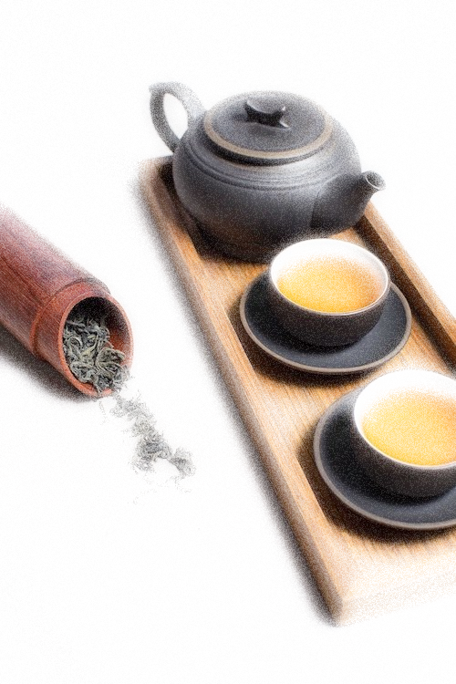
A possible version1
Dear Luke,
Hope this letter finds you well!Knowing that you are a tea enthusiast, I’m writing in great delight to tell you that a China Tea Culture Expo will kick off at the cultural center next week, running from Monday to Friday.
To be specific, the exhibition is going to show the charm of Chinese tea culture from different dimensions , ranging from videos of Tea Horse Road, exquisite tea set of different dynasty to varieties of teas from different regions of China. Visitors can not only gain a further insight of the history of Chinese tea culture but also present with the opportunity to experience the original tea-making process. Thus, with diverse range of display, and opportunities for knowledge exchange, the exhibition is bound to be a stunning feast of both your eyes and ears.
Surely, the exhibition will live up to your expectation. I do hope you can come and pay a visit!
Yours sincerely,
Li Hua

Slide 18
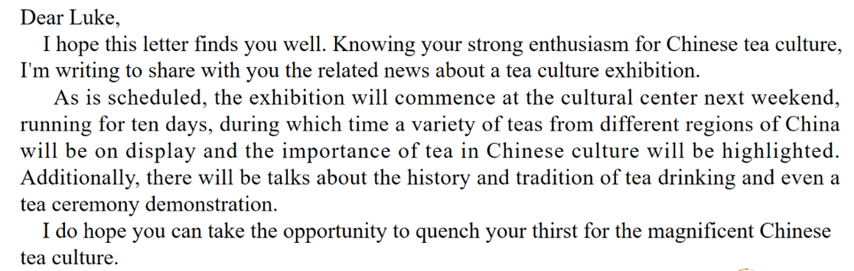
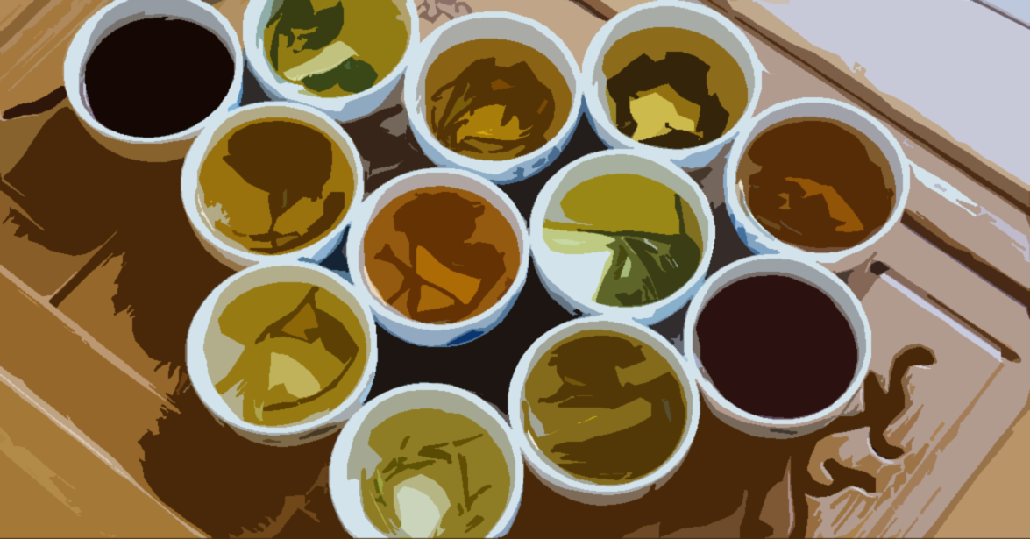
A possible version2
Yours sincerely,
Li Hua

Slide 19
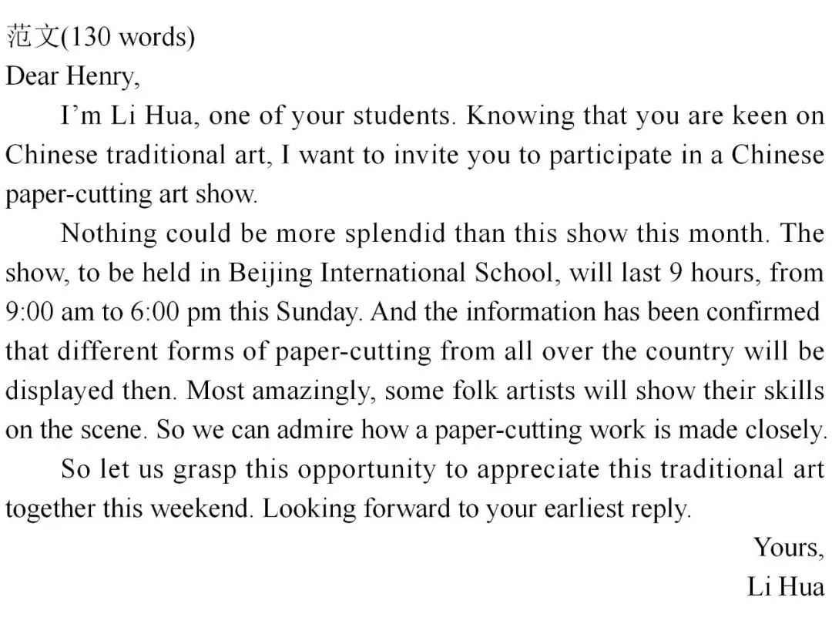
review1
2017全国卷Ⅱ
假定你是李华，想邀请外教Henry一起参观中国剪纸（paper-cutting）艺术展。请给他写封邮件，内容包括：
1. 展览时间、地点；
2. 展览内容。
注意：
1. 词数100左右；
2. 可以适当增加细节，以使行文连贯。

Slide 20
review2
An Unforgettable Exhibition
2021年6月浙江卷
昨天你去学校参观了中国画的展览，请你为学校英语报写一篇宣传稿：
1. 时间和地点；
2. 你的感受；
3. 强烈推荐。
注意：
1. 词数80左右；
2. 开头和结尾已给出，不计入总词数。
To promote Chinese culture, a students’ Chinese painting exhibition is being held in Central Library from June 1st to June 30th. I went there yesterday, and was suitably impressed.
The paintings covered a range of themes including figures, flowers, landscapes and animals. The details were so natural that it felt like the paintings were alive. It had never occurred to me that Chinese paintings could astound me in such a profound
way. For anyone who likes Chinese art, this is definitely the perfect place to go.

Slide 21
review3
（2023浙江杭州高三二模）你是某国际学校学生会主席。你校准备组织一次“让文物活起来”（Bring Cultural Relics to Life）的活动，请你用英语写一篇开幕辞，欢迎参加活动的师生。内容包括：
1．表示欢迎；
2．活动目的；
3．活动内容。
注意：
1．写作词数应为80左右。
2．参考词汇：手工艺品artifact。
Dear teachers and fellow students,
Welcome to our "Bringing Cultural Relics to Life" event. As president of the Student Union, I'm honored to have the opportunity to open this wonderful occasion.
The purpose of this event is to encourage everyone to explore the history and culture behind the artifacts and appreciate their beauty. There will be an exhibition featuring various cultural artifacts brought by students which have been passed down through their families. Also, we will be holding a workshop where students are encouraged to create their own cultural artifacts that look like cultural relics in ancient times.
Thank you for your attendance, and I wish you all a meaningful and enjoyable experience.

Slide 22
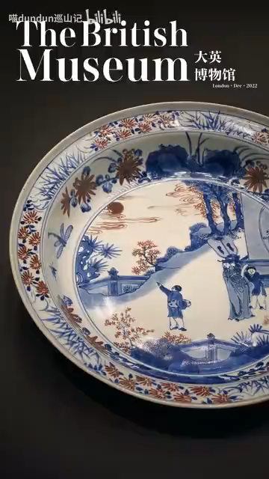
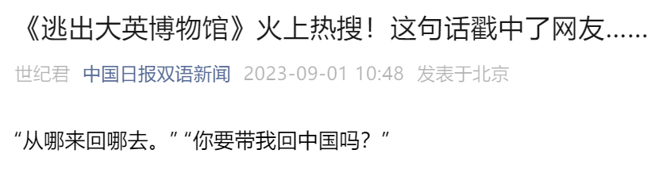
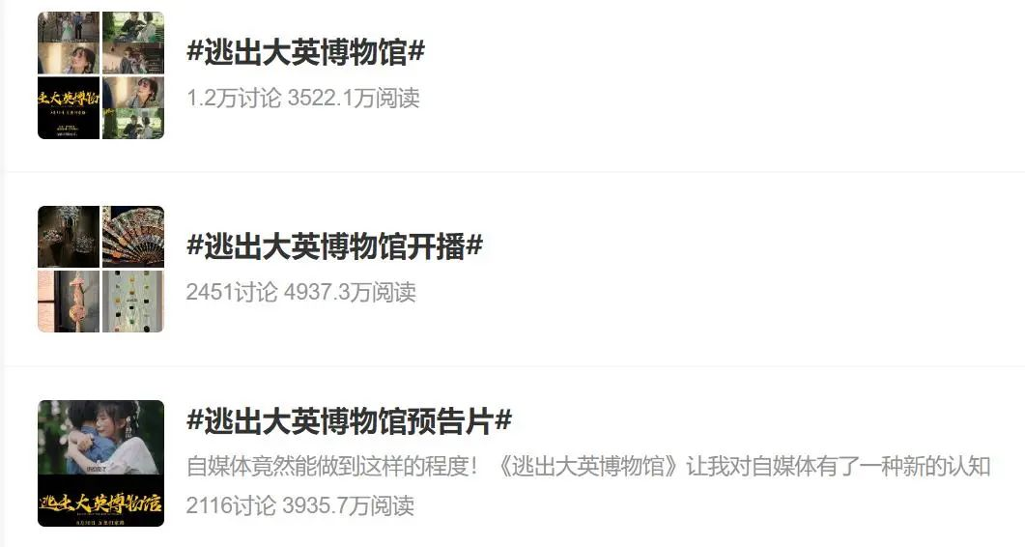
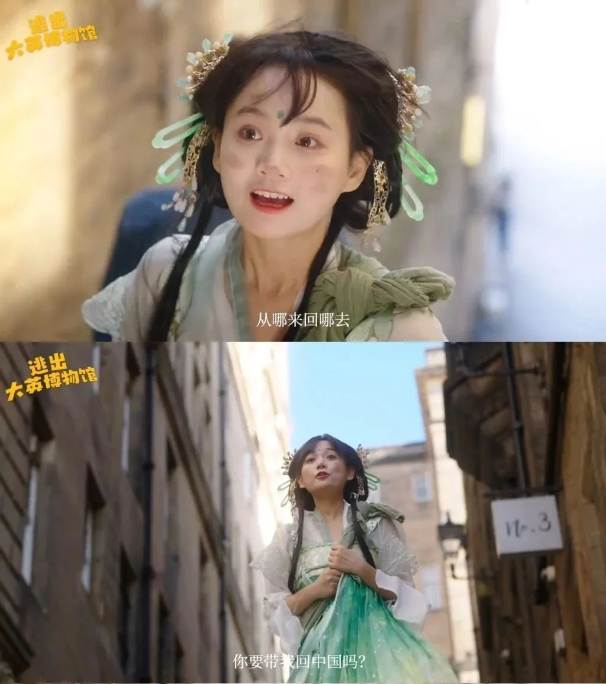
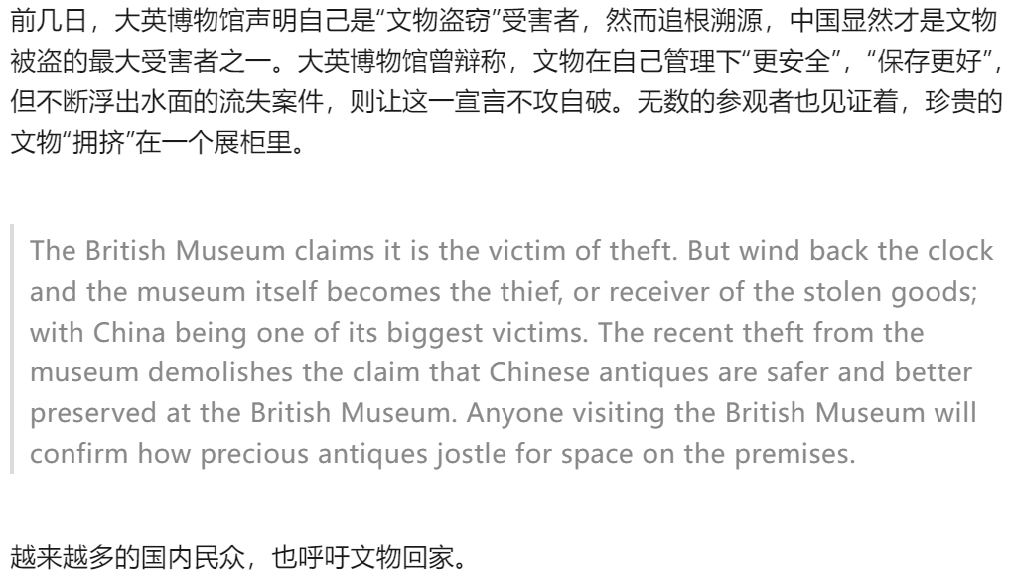
Hot topic
近来，一段名为《逃出大英博物馆》的视频火了。网络上流传着相关剧照和台词，令网友纷纷围观。
A video series namedEscape from the British Museumwas released on Wednesday, with its trailer having sparked a lot of discussion in China's social media recently.
Directed by two Chinese vloggers, the three-episode series tells the story of how a Chinese cultural relic escapes from the British Museum and finds its way back to China.
The duo went to the UK in June and spent three months shooting the video. They said the story is based on historic facts and aims to draw attention to the Chinese cultural relics held abroad.
Currently, the museum has a total of 23,000 Chinese relics, while about 2,000 Chinese relics are on long-term display. The Chinese objects, spanning from the Neolithic age to the present, include paintings, prints, jade and ceramics

Slide 23
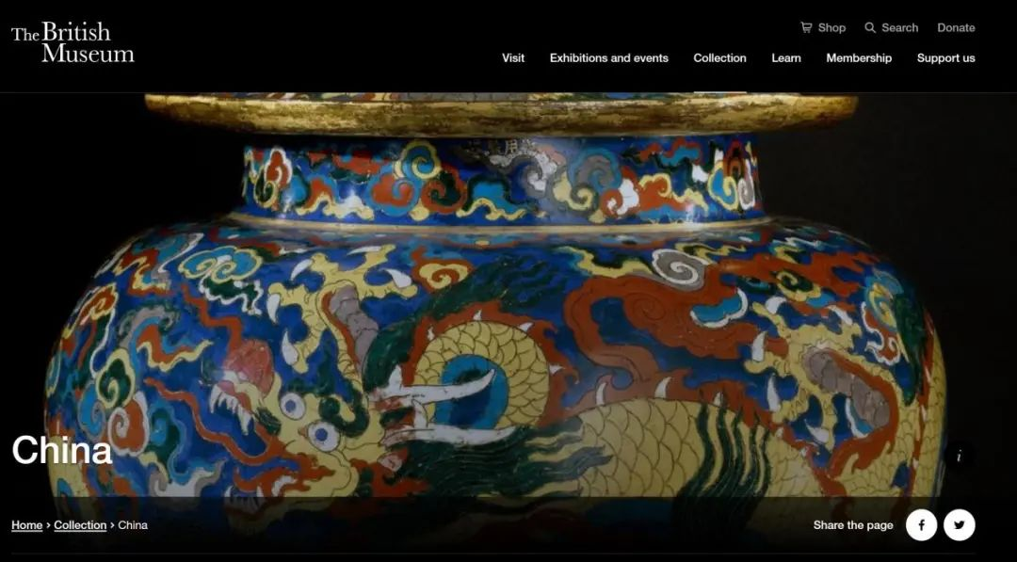
It is important to a nation can create culture, but more important is the ability to protect the culture.

