Slide 1


感恩遇见，相互成就，本课件资料仅供您个人参考、教学使用，严禁自行在网络传播，违者依知识产权法追究法律责任。
更多教学资源请关注
公众号：溯恩高中英语
知识产权声明

Slide 2
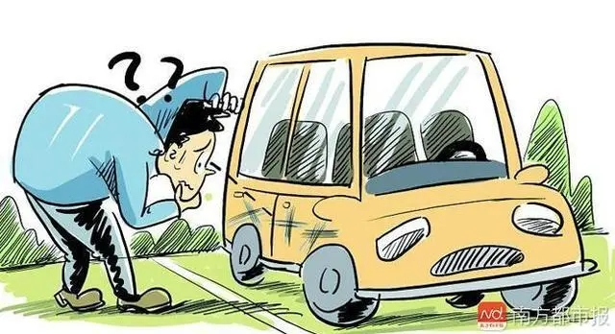
通过3D描写 提升叙事质感
——2023年9月名校协作体读后续写讲评 “真诚或友情的选择”
金琼瑶
浙江省杭州第四中学

Slide 3
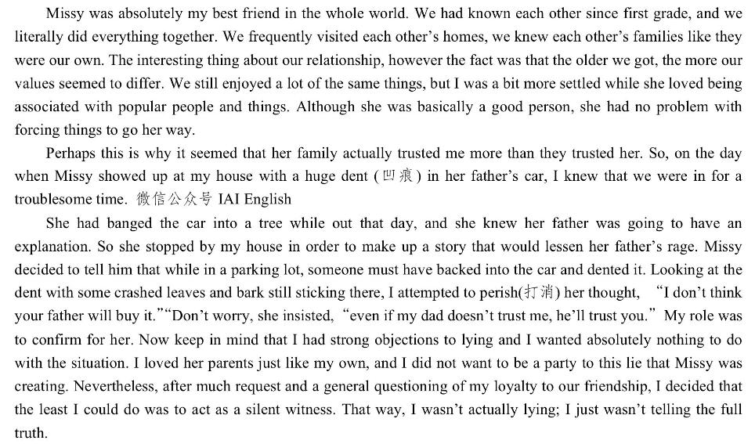
文本呈现

Slide 4
锚定伏笔
“契诃夫之枪”原则在文本解读的应用
伏笔1
伏笔2
伏笔3
伏笔4

Slide 5
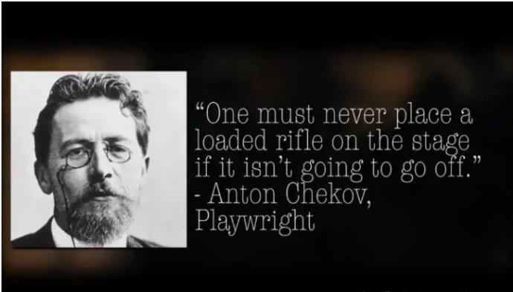

理论简介
Chekhov's Gun ——“契诃夫之枪”
“如果一支上了膛的枪不会开火，就不能把它放在台上。”
简单地说，铺垫和回报(Setups and payoffs)就是“契诃夫之枪”理论在实践中的运用。
铺垫是在第一幕中展示枪，而回报 是在第三幕中开火。
同样的模式也适用于故事叙述的任何组成部分。
原文的伏笔在续写中要有回应

Slide 6
回应伏笔、锁定情绪
P1: An hour or so later, we presented Missy’s father with the car and the inquiry began.
情节
核心情绪
回应伏笔1
1. Missy told a lie to her father calmly.
Pretending to stay calm
Trying to be persuasive
回应伏笔3
2. Missy’s father didn’t buy it for the dent with crashed leaves and bark .
suspicious
P2: Her father looked at me with great disbelief.
回应伏笔2
1. Missy’s father turned to me to confirm.
Expectant\belief in me
Disappointed or Convinced
回应伏笔4
2. I kept silent.
Awkward\at a loss\panic
Guilty
OR
Awkward\at a loss
Take up courage and feel relieved
回应伏笔2
2. I chose to tell him the truth at last.

Slide 7
情绪汇总
3D描写烘托核心情绪：表情、内心、动作
核心情绪
P.1
强装镇定
怀疑
失望
表情描写？
内心描写？
动作描写？
（环境描写?）
P.2
慌张
愧疚
鼓起勇气
释然、开心

Slide 8
语料积累
有关强装镇静的3D描写
表情描写
1.他完全没有显示出一丝慌乱不安。
He showed no sign of panic or restlessness at all.
动作描写
2.他得心应手地编制着一个看似很有说服力的故事。
Missy was in his element making up a seemingly
persuasive story.
他挤挤眉毛朝我看了一眼，示意我该出手相助了。
He eyed me with raised eyebrows, indicating it was my
time to stand up for him.

Slide 9
语料积累
有关怀疑、失望的3D描写
动作\表情描写
1. “是真的吗?”他忽然扭头看向我,追问道:“我知道你是最不可能撒谎的。”
“Is that true?” he jerked his head in my direction and enquired,
“I know you are the last person to tell a lie.”
2. Missy爸爸一步步朝我走来，眯起眼睛盯着我看。
Missy’s father advanced on me, squinting fixedly at my face.
3. 我的犹豫不决令他的期待一扫而空，他转过身，一言不发地走了。
My lingering hesitation having wiped expectation off his face, he
turned and walked off without another word.
环境描写
4. 接下来的几秒钟，周围一片安静。
For a few seconds, there was complete silence.

Slide 10
语料积累
有关慌张、愧疚的描写
动作描写
1. 我拽着自己的衣角，不敢看他。
I tugged at the corner of my overcoat, keeping my eyes off his face.
2.我站在原地一动不动，吓出一声冷汗。
I stood rooted to the ground, breaking into a sweat.
表情\内心描写
3. 我如实的解释让Missy发毛。 我发现他高高地抬起了眉毛，看上去十分惊讶。
My genuine explanation gave Missy the creeps. I spotted him
look stunned and raised his eyebrows.

Slide 11
语料积累
有关慌张、愧疚的描写
表情描写
4.他满怀期待的眼神消耗了我之前所有的勇气。
His expectant eyes strained all my previous guts.
内心描写
5. 一阵针尖般的疼痛灼烧着我的内心。
A needle-sharp pain seared across my heart.
6. 我原本以为可以不发一言的决定，正经受着一场意外的挑战。
My previous resolution not to say anything was put to an
unexpected test.

Slide 12
语料积累
有关鼓起勇气、如释重负的描写
内心描写
1. 我鼓足勇气。
I screwed up my courage.
2. Missy爸爸了解事情真相后，稍微开心了一点。
Missy’s father cheered up a bit when he found out the truth.
3. 听到了他的谅解以后，我们内心感到一阵激动。
On hearing his forgiveness, we felt a great leap of excitement.
动作描写
4. Missy掩藏不住自己的高兴，他朝我看了一眼，还竖起了大拇指。
Missy had difficulty hiding his glee. He caught my eyes and gave
me the thumbs-up.

Slide 13
教师下水作文与解析
Finally we presented Missy’s father with the car and the inquire began. I stood rooted to the ground, lost for words while Missy, who looked as if full of poise_{(看上去非常沉着)}, was in his element blurting out_{(脱口而出)} his seemingly persuasive story. Hardly did he show any sign of panic or restlessness. After his vivid explanation, there was complete silence for a few seconds. Unexpectedly, however, the pieces of bark sticking to the dent fell out in the nick of time_{(关键时刻)}, which caught her father’s attention immediately. He stepped forward to take a closer look at the dent. “Is that true?” Jerking his head in my direction, he enquired, “ I know you are the last person to lie to me.”
创作意图
第1处通过描写“我”的慌张来凸显Missy的镇定自若，回应原文中所说的：Missy总能想到方法让事情按照她的意图进展。通过对Missy表情和动作的描写使得人物性格跃然纸上。
1
2
第2处通过周边环境描写，从侧面来烘托“我”内心的慌张与无措，同时承上启下，为真相的败露埋下伏笔。
第3处没有直接说明父亲的怀疑，而是通过一系列动作和语言的描写，让读者自然体会到父亲已经心生疑虑，同时与第二段第一句自然衔接。体现了小说创作中 “To show it，not to tell it.”的创作原则。
3

Slide 14
Her father looked at me with great disbelief. Tugging at the corner of my overcoat, I kept my eyes off his face and broke into a sweat. Missy’s father advanced on me, squinting fixedly at my face, whose expectant stares strained all my previous guts. It was not long before I told him the whole story. My genuine explanation gave Missy the creeps, who looked stunned and raised his eyebrows. To our surprise, her father nodded his understanding and simply asked us to get the car repaired in no time. On hearing this, we both felt a great leap of excitement and relief. It was not until then did I realize it was actually a clear breezy_{(微风送爽)} day and the grass was glistening _{（闪闪发光）}in the sunlight.
创作意图
第1处仍然是没有直接交代“我”的慌张与不安，而是通过“我”的动作、表情和父亲的动作、表情的对比描写，让人物的核心情绪一目了然，同时又增加了情节的可读性。
1
2
第2、3处通过三位人物内心、表情的对比描写，烘托出了Missy与“我”在真相暴露时的紧张情绪与得到原凉后的欣喜之情。内心戏的描写增添了紧张效果，提升了叙事的质感。
3
4
第4处通过环境描写，对于叙事结果进行适当留白，自然点题，回味无穷。

Slide 15
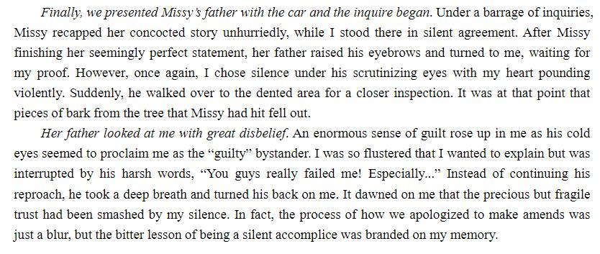
范文展示

Slide 16

Thank you!

