Slide 1

感恩遇见，相互成就，本课件资料仅供您个人参考、教学使用，严禁自行在网络传播，违者依知识产权法追究法律责任。
更多教学资源请关注
公众号：溯恩高中英语
知识产权声明

Slide 2

活用教材词汇，靶向高考写作
B5U5单词拓展
武汉开发区汉阳三中：廖英

Slide 3


technique/tekˈni:k/ n.技能;技术;技艺
1.为了学习更多的急救技巧，我呼吁你加入急救社区宣讲员团队。这样，你将有助于提高人们的急救意识，并增加他们获得信息的机会。
To learn more first-aid techniques, I appeal to you to join the team of First Aid Community Advocates. That way, you'll help to raise people's awareness of giving first aid and increase their access to the information.
2.通过推动人们学习救生技术，你将有助于建立一个更好的社区，在那里人们可以在关键时刻正确而自信地进行急救护理。
By motivating people to learn life-saving techniques, you will contribute to building a better community where people may perform emergency care correctly and confidently at critical moments.

Slide 4
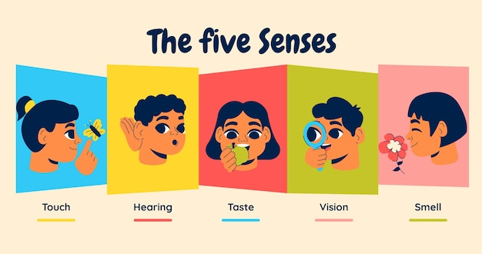
sense of touch/sens əv tʌtʃ/ 触觉
1.失落感/负罪感/幽默感/方向感/责任感
sense of loss/guilt/humor/direction/responsibility
2.我的责任感会让我成为一位合格的自愿者。
My sense of responsibility will make me a
qualified volunteer.
3.她对大自然的力量和人类的脆弱感到敬畏和惊奇。_{2023年湖南猜题卷 “山中徒步救人”}
She felt a sense of awe and wonder at the power of nature and the fragility of human beings.
4.当我停好车，踏上长满黑莓的小路时，一种熟悉的感觉涌上心头。_{2023年1月浙江高考读后续写“蜂鸟情”}
As I parked my car, stepped onto the blackberry-lined path, a sense of familiarity washed over me.
5.充满了成就感，我意识到我必须接受新的挑战来挖掘我的潜力。_{2023年全国卷I读后续写“参加作文比赛”}
Filled with a sense of accomplishment, I realized I must take on new challenges to explore my potentials.

Slide 5
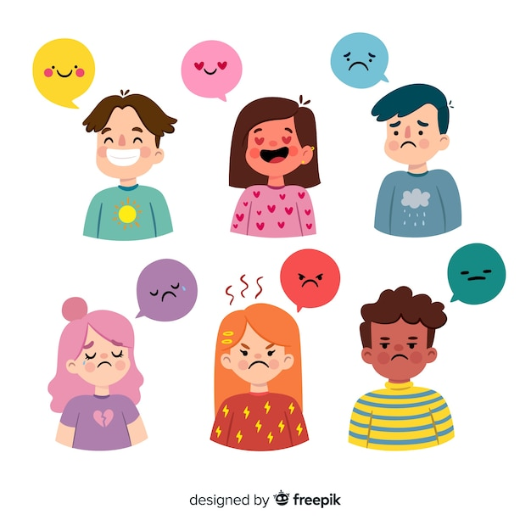
sense of touch/sens əv tʌtʃ/ 触觉
“感到一阵 ……”：
feel a sense of...=feel a flush of...= feel a wave of...
[joy_{(高兴)}, excitement_{(兴奋)}, pride _{(骄傲)}, anger_{(愤怒)}, rage_{(狂怒)}, panic_{(惊慌)}, alarm_{(惊慌)} , terror_{(恐惧)}, horror_{(恐惧)}, fear_{(恐惧)}, unease _{(不安),} sorrow _{(悲伤)}, sadness_{(悲伤)}, grief_{(悲伤)}, embarrassment_{(尴尬)}, disappointment_{(失望)}, shame_{(羞愧}), guilt_{(愧疚)}]。
她感到一阵惊慌，但是强迫自己镇静地离开了房间。
She felt a wave of panic, but forced herself to leave the room calmly.

Slide 6
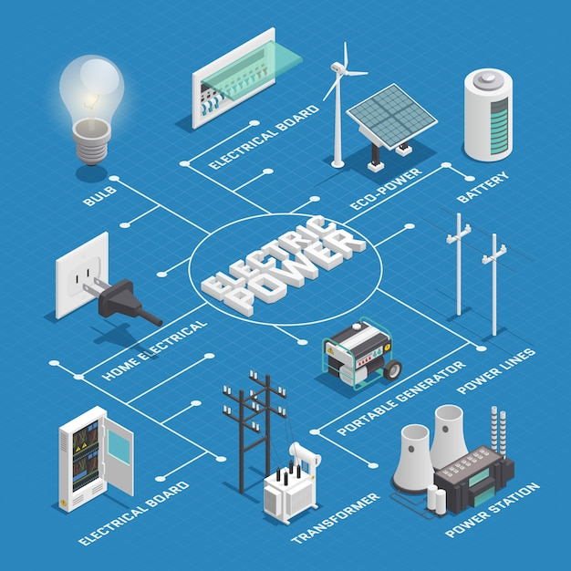
electric/ɪˈlektrɪk/ adj.电的；用电的；电动的
1.触电；电击/电力设备/电流/电水壶
electric shock/device/current/kettle
2.触电造成的伤害很常见。
Injuries caused by electric shock are
fairly common.
3.恐慌就像电击一样，震过身体。
The panic is like an electric shock pulsing
through you.
4.不使用电热毯时拔掉插头。
Unplug electric blankets when not in use.
5.4小时前停电了，不过现在又来电了。
The electricity went out 4 hours ago, but it is
on again now.
6.电线/电源/插头电器
electrical wires/ outlets /appliance

Slide 7

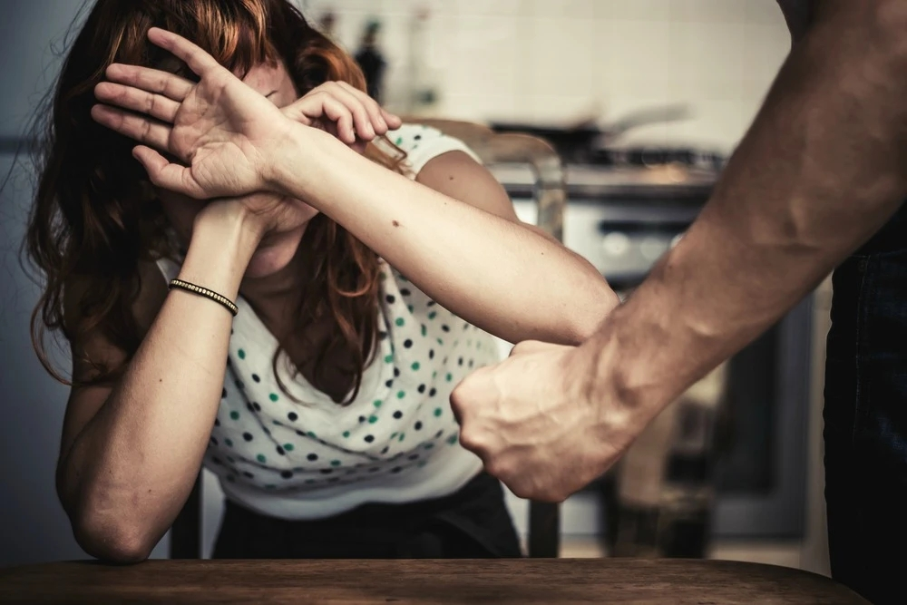
victim/ˈvɪktɪm/ n.受害者;患者
1.校园欺凌肯定会威胁到个人成长与社会和谐。它会给受害者造成严重的心理创伤，使他们遭受长期的抑郁。
School bullying can definitely threaten individuals’growth and social harmony. It causes
severe psychological trauma to the victims, subjecting them to long-term depression.
2.学校应为受害者和欺凌者提供沟通渠道，这样他们就不会压抑自己的感受。
It is urged that schools should maintain clear channels of communication for both victims and bullies so that they do not bottle up their feelings.
3.这个可怜的男孩成为了校园暴力的受害者。
The poor boy has fallen victim to school bullying.

Slide 8
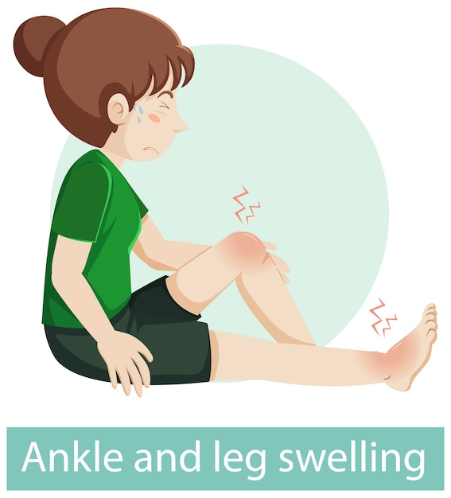
swell/swel/ vi膨胀；肿胀
1.一个小女孩靠着一棵大树坐着，她掉进一个洞里，脚踝扭伤了，有点肿。
There against a tall tree sat a little girl, whose ankles got sprained and became a little bit swollen when she tumbled into a hole.
2.当玛利亚想起孩子的时候，她的内心充满了自豪。这种自豪感变得愈来愈强烈，直到所有的失落、悲伤、孤寂和卑微都被驱赶。
When Mariam thought of this baby, her heart swelled inside of her. It swelled and swelled until all the loss, all the grief , all the loneliness and self-abasement of her life washed away.
3.当我遇到这只可爱的兔子时，我的心充满了兴奋。
My heart was swelled with excitement when I came
across the lovely rabbit.

Slide 9

nerve/nɜ:v/ n.神经
1.他身上的每一根神经都在向他尖叫，疼痛紧攥着他的头部像紧握的拳头一样。
Every nerve in his body screamed at him, as the pain gripped his head like a clenched fist.
2.我们竭尽全力划船，终于看到了我祖母的房子。
Straining every nerve to row, we eventually saw my grandmother’s house.
3.我累了，浑身是汗，躺在座位上，吸气，呼气，让自己的安定一会儿。
Tired out and all sweaty, I lay back on the seat , breathed in and out to steady my nerves for a while.

Slide 10

urgent /ˈɜ:dʒənt/ adj.紧急的；急迫的；急切的
1.学生自身加强自律是当务之急，家长和老师加强引导也是当务之急。
It is urgent for students themselves to improve their self-discipline, and also for parents and teachers to strengthen the guidance.
2.得知你迫切需要一个称职的导游，我写信推荐我的同学李明，
他绝对可以满足你的一切要求。
Learning that you are in urgent need of a qualified tour guide, I’m
writing to recommend my classmate Li Ming who will definitely
meet all your demands.
3.因此，我迫切要求退款，或者换货。
Therefore, I urgently request a refund or at least anexchange for perfect ones.
4.作为全球公民，我们每个人都应该关心全球粮食问题，我敦促每一位学生和老师积极参与到这一有意义的庆祝活动中来。
As global citizens, each of us should care about global food issue, and I urge every student and teacher to actively engage in such meaningful celebration.
5.请紧急处理此事，并尽快给我们答复。
Please look into the matter as one of urgency and let us have your reply as early as possilble.

Slide 11

ease/i:z/ v.（使）宽慰；减轻n.容易
1.她的眼睛如此明亮，我能感觉到我的紧张有所缓解。
So bright were her eyes that I could feel my tension eased a little bit.
2.我有很好的英语口语，这使我能够轻松地与外国学生交流。
I have a good command of oral English, which enables me to communicate with foreign students with great ease.
3.当然，最通用的面部表情是微笑，它的功能是显示快乐，使人放松。
The most universal facial expression is, of course, the smile, whose function is to show happiness and put people at ease.
4.玛雅似乎注意到了我的不安，她停了下来，关切地看了我一眼。
Seeming to notice my unease, Maya stopped and cast a
concerned look at me.
5.挤满观众的大厅让我更加紧张起来,我的心扑通扑通地好像要
跳出来了。
The hall crowded with audience made me even
more uneasy. My heart was pounding/thumping hard,
as if it were about to pop.

Slide 12
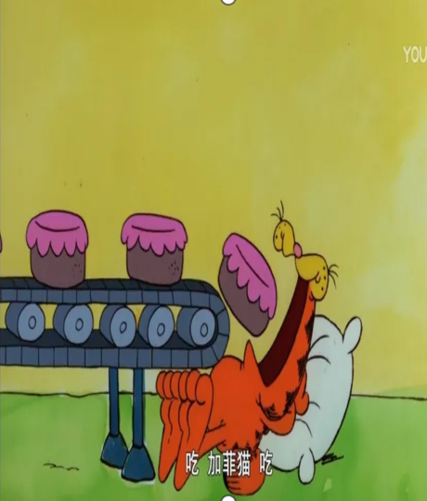
swallow/ˈswɒləʊ/ vt.&vi.吞下;咽下
1.致命的烟雾无情地吞噬着它所经过的一切。
The deadly fumes were preying on mercilessly, swallowing everything in its path.
2.有些书可浅尝，有些书可囫囵吞枣，少数书则需细细咀嚼消化。
Some books are to be tasted,others to be swallowed, and some few to be chewed and digested.
3.注意到玛丽泪眼汪汪的眼睛，汤姆把想说的话咽了下去。
Noticing Mary’s teary eyes, Tom swallowed what he had intended to say.

Slide 13
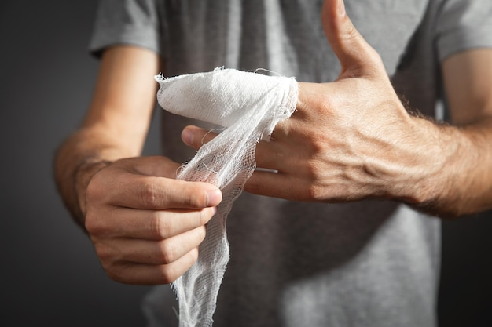
wrap/ræp/ vt.包、裹;(用手臂等)围住
1.她清洗了膝盖，在伤口上涂了药，用绷带包扎起来。
She cleaned her knee, applied medicine to the wound,
and wrapped it with bandages.
2.在荒无人烟的地方，我感到一阵恐惧包围了我。
In the middle of nowhere, I felt a wave of fear wrap around me.
3.听到这个消息，她瘫倒在地上，绝望地尖叫着，双手抱住自己。
Hearing the news, she collapsed onto the ground and screamed in desperation, wrapping her arms around herself.
4.我们呆着自己地小公寓里，幸福地拆一件又一件地礼物。
We just sat in our small apartment, unwrapping the gifts one by one in happiness.
5.在母亲的指导下，我搅拌了一些猪肉末、白菜末和其他配料。然后把一些馅料放进饺子皮里，然后把它用力地叠起来。2023高考英语全国乙卷“学习新技能的经历投稿--疫情期间包饺子”
Under the guidance of my mother, I stirred some minced pork and cabbage with other ingredients.Then put some fillings into the wrapper and folded it hard.

Slide 14

bath/bɑ:θ/ n.洗澡 vt.给…洗澡
1.看着我冷得发抖，她赶紧脱下我的湿外套，给我洗了个热水澡。
Look at me shivering with coldness, she quickly took off my wet coat and gave me a hot bath.
2.沐浴在阳光下，三年级的球员们在足球场上与他们的老师比赛。
Bathed in sunshine, players from Grade 3 competed against their
teachers in the football field.
3.颁奖典礼后，我去了老师的办公室。他沉浸在喜悦中，
向我挥手表示祝贺。_{2023年全国卷I读后续写“参加作文比赛”}
I went to my teacher’s office after the award presentation.
Bathed in enjoyment, he waved at me expressed his
congratulations.

Slide 15
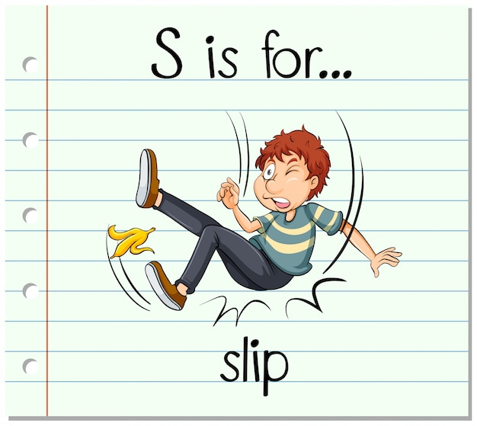
slip/slɪp/ vi.滑倒;滑落 n.滑倒
1.我猜钱包一定是在飞行途中从我口袋里滑了出来。
I guess the wallet must have slipped out of my pocket during the flight.
2.她伸手去拿其中一只，但不幸的是，那只精致的花瓶从她手中滑了下来，顷刻间就摔成了碎片，倒在了地板上。
She reached for one of them, but unfortunately, the delicate vase slipped off her hand and next moment it lay in pieces on the floor.
3.他显然已经忘了我的来意。
The reason for my visit had obviously slipped his mind.
4.他羞愧难当，满脸通红，趁人不注意溜了出去。
His face flaming with shame , he slipped away without
being noticed.

Slide 16
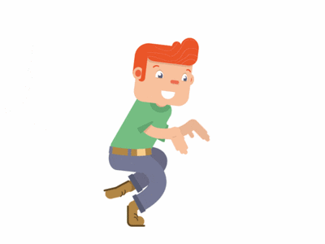
[“悄悄、轻轻地走”的其他表达]
1.他偷偷溜出家。
He sneaked out of his house.
2.树林开始起雾了。
Fog began creeping into the forest.
3.“妈妈?爸爸?”他们在哪里? 莫莉从床上爬起来,
踮着脚尖下楼。
“Mom? Dad?” Where were they? Molly crawled
out of bed and tiptoed downstairs.
4.他溜进汽车时，汗水和泪水顺着脸颊流下来。
Sweat mixed with tears run down his cheeks as he slid into the car.

Slide 17

elderly/ˈeldəli/ a.年纪较大的;上了年纪的
1.当我们到达那里时，我们将成群结队地去老人的房间看望他们，向他们献上鲜花和自制的卡片，以表达我们的尊重和爱。
When we get there, we will visit the elderly in their rooms in groups, presenting them with flowers and self-made cards to show our respect and love.
2.重阳节是中国老年人的传统节日，在农历九月初九。
在中国，“九”与“永远”谐音，象征着长寿。
尊老爱老是中华民族悠久的传统美德。
Chongyang, the traditional Chinese festival for the elderly,
falls on the ninth day of the ninth lunar month. In China,
nine has the similar pronuciation with the word meaning
‘ forever’, symbolizing longevity. It is a long-cherished
traditional virtue of Chinese people to respect and take
good care of the eldely.

Slide 18


ambulance/ˈæmbjələns/ n.救护车
1.最后，救护车来了，把西蒙送到了医院。
Ultimately, ambulance arrived and rushed Simmon to the hospital.
2.叫了救护车后，保罗开始进行人工呼吸。
Having called the ambulance, Paul began rescue breathing.

Slide 19
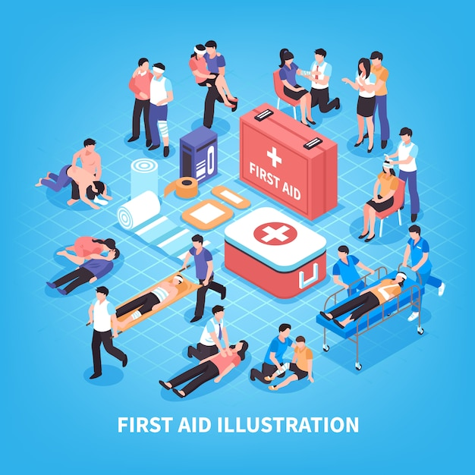
[急救动作相关表达]
1.让受害者仰面躺下
lay the victim on his back
2.检查是否意识清醒/检查脉搏/检查呼吸/检查反应
check if conscious/check for a pulse/check for breathing/check for response
3.叫救护车
call for an ambulance
4.清除他嘴里的任何草或沙子/清理气道
remove any grass or sand from his mouth/
clear the airway
5.进行人工呼吸
perform mouth-to-mouth rescue breathing
6.向受害者的嘴里吹气
blow air into the victim’s mouth
7.抬起他的下巴
lift up his chin

Slide 20
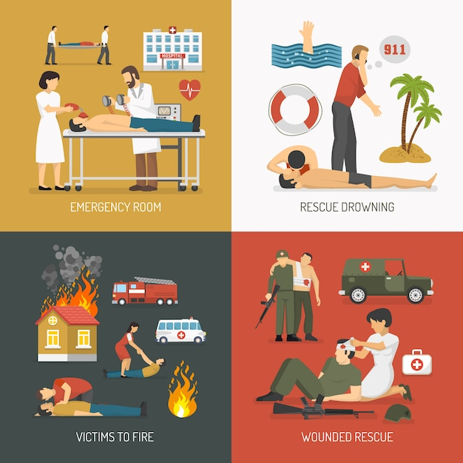
[急救动作相关表达]
8.进行心肺复苏
perform CPR
9.往下按压他的胸部中央
push down on the centre of his chest
10.在她背上拍打四五下
slap her four or five times on her back
11.捏鼻子
pinch one’s nose
12.在他的脚踝上敷上冰袋
put an ice pack on his ankle
13.把绷带盖在伤口上，然后按在上面
put a bandage over the wound and then
press on it
14.拍拍他们的脸/肩膀
pat their faces/shoulders

Slide 21
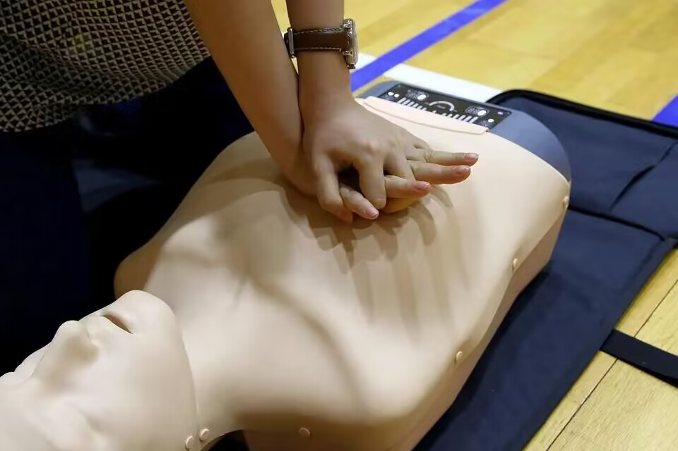

[急救动作相关表达]
2020年10月27日，一名15岁的学生在回家的路上发现一名晕倒在路边的老人，他果断地在等待救护车到来的5、6分钟时间内为老人进行了心肺复苏术，为老人赢得了宝贵的急救时间。
On October 27, 2020, a 15-year-old student found an elderly person who fainted to the ground at the street side on the way home, he decisively performed CPR during the period of waiting the arrival of the ambulance, which was about 5 or 6 minutes, and as a result, helping the elderly win valuable emergency treatment time.

Slide 22

delay/dɪˈleɪ/ v.推迟;延期;耽误 n.延误
1.我们向你方订购的家具应于一周前到达。交货的延误给我们带来了很大的不便。
The furniture we ordered from you should have reached us a week ago. The delay in delivery has put us to great inconvenience.
2.他没有马上把消息告诉她，等待合适的时机。
He delayed telling her the news, waiting for the right moment.
3.汽车突然在他面前停住了。“上车!”保罗对麦克大喊道。麦克从自行车上跳下来，毫不犹豫地进了车里，因为狼离他只有两步远，眼看就要把他撕成碎片了。真是死里逃生啊!_{2017年6月浙江高考读后续写“狼口脱险”}
The car abruptly stopped in front of him. “Get into the car.” Paul shouted at Mac. Mac jumped off the bike and slid into the car without delay as the wolf was just two steps away and was about ot tear Mac into pieces. What a narrow escape!

Slide 23
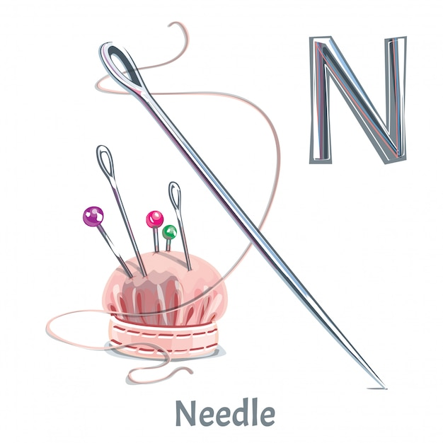

needle/ˈni:dl/ n.针;缝衣针;注射针;指针
1.寒风开始咆哮，像锋利的针一样刺痛我的脸。
The icy wind started howling, cutting my face like sharp needles.
2.我们焦虑不安，感觉如坐针毡。
We were anxious and restless, feeling like sitting on pins and needls.

Slide 24
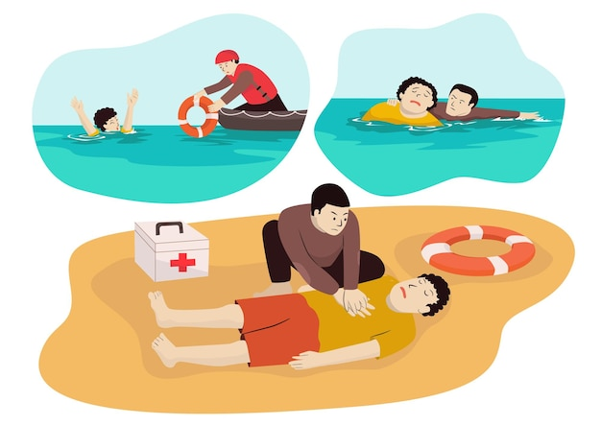

drown/draʊn/ vi.&vt.(使)淹死;溺死;浸泡
1.这张照片使她想起了溺死在海里的丈夫，她哭了。
The photo reminded her of her husband who had drowned at sea and she wept.
2.听到这个消息，他绝望地借酒浇愁。
Hearing the news, so desperate was he that he drowned sadness in wine.

Slide 25

bleed/bli:d/ vi.流血;失血
bleeding /ˈbli:dɪŋ/ n.流血;失血
1.约翰和他的父亲冲出去，发现他的邻居安妮·斯莱德被刺伤，躺在花园里流血不止。
Rushing out with his father, John found his neighbor Anne Slade stabbed and lying in the garden, bleeding heavily.
2.在警察和救护车到来之前，他一直按住伤口以减缓出血。
He slowed the bleeding by applying pressure to the wound
until the police and ambulance arrived.
3.莫莉看到玻璃门外的黑影,感觉体内的血液迅速凝固起来。
Molly felt that the blood in her body froze rapidly at the
sight of the dark figure outside the glass door.
4.看着北极熊的血盆大口,她几乎要吓死。
At the sight of the polar bear's bloody mouth, she was nearly dead with fright.

Slide 26
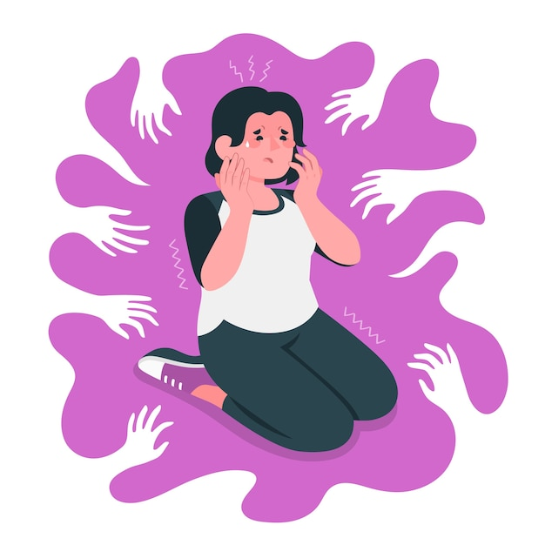
panic/ˈpænɪk/ vi.&vt.(使)惊慌 n.惊恐
1.“别慌!父亲递给他们每人一条湿毛巾，帮助他们迅速清理残局。_{2021年全国卷I读后续写“母亲节惊喜”}
“Don’t panic!” the father handed each one a wet towel, helping them to clean the mess quickly.
2.他惊慌失措。
He was seized with panic/He was panic-stricken.
3.恐慌在他心中涌起。
A wave of panic swept over him./Panic surged up within him.
4.随着一大群鱼的袭击，我们惊慌失措，心情低落到了极点。
我们的皮艇剧烈地摇晃着，我的心怦怦直跳，几乎要窒息了。
_{2023年4月浙江稽阳联谊学校高三联考读后续写“鲸口脱险”}
With the strike of the swarm of fish, we sank in a panic and
our kayak rocked violently while my heart was pounding with a beat that choked me.
5.我惊恐不已,我觉得两腿发抖,手心冒汗。
Extremely panicked, I felt my legs trembling and my palms sweating.
不规则变化：panic-panicked-panicked

Slide 27
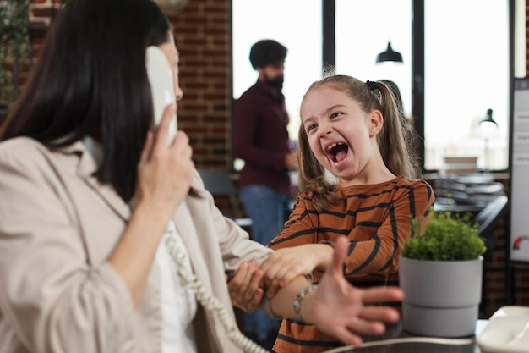
interrupt/ˌɪntəˈrʌpt/ vi.&v.打断;打扰 vt.使暂停
1.隔壁桌子客人的尖叫声打断男孩晚上的用餐。
The boy had his dinner interrupted when he
heard someone screaming from another table.
2.另一方面，在线学习对我们的视力构成威胁，
可能会分散我们对学习任务的注意力，因为像
弹出窗口这样的分散注意力的东西可能会
不时地打断我们。2021全国乙卷应用文 “Be smart online learners”
On the other hand, online learning poses threats to our eyesight and may distract our attention from learning tasks as the distraction like pop-ups, may interrupt from time to time.

Slide 28

scream/skri:m/ v.(因愤怒等)高声喊 n.尖叫
1.约翰鼓起最后一点力气，扯着嗓子尖叫起来。
John mustered the last of his strength and screamed out at the top of his lungs.
muster[ˈmʌstə]v. 集合；召集;集合，聚拢（牲口）;
2.一声尖叫刺破了教室的安静，伴随着大家的视线都被吸引到惊慌失措的身上。_{202302浙江十校联盟读后续写“愚人节的青蛙恶作剧”}
A high-pitched scream pierced the silence of the room, with everyone’s attention arrested to Stacey who was in a total panic. pierce[pɪəs]v.穿入；刺入；进入；透入
3.当他在眩目的雪地里摇摇晃晃时，风在他耳边尖叫，他整个身体都麻木了。
The wind screamed in his ears as he staggered through the blinding snow, his whole body was numb.stagger[ˈstæɡə]v.蹒跚；摇摇晃晃地走;犹豫；动摇;

Slide 29

【“大喊、大叫”的其他表达】
1.他举起相机，兴奋地对父亲喊道:“我拍到了。”
He raised his camera, yelling to his father excitedly, “ I got it.”
2.安妮后悔地叫了一声:“我真傻。”
Anne let out a cry of regret, “I’m so silly.”
3.“恭喜你!你来了!他发自内心地、自豪地喊道。
“Congratulations!You made it!” he exclaimed with genuine pride.
4.崇拜者大声叫好。
The fans roared out their approval.

Slide 30

【“说”表达】
表“说”的动词：
declare（表明，宣称）；admit（承认）；detail（详细解释道）；emphasize（强调）；comfort （安慰）； add （补充说，继续说）；continue（继续）；repeat（重说）；scream（尖叫，大声叫）；exclaim（惊叫，呼喊）；scold（责备）；laugh（发笑）；chuckle（低声 轻笑）；sneer（嘲笑，讥讽）；shout（大声说，怒骂）；reply（回答）；sob（啜泣）；demand（要求）；command（命令）；suggest（建议）；persist（坚持）；remark（说起，评论）； agree（同意）；beg（恳求， 哀求）；announce（宣布）；explain（解释）；sigh（叹息）；correct（纠正）；whisper（耳语；小声说）；grunt（咕哝）；mumble（口齿不清地说）；stammer（结结巴巴地说）；stutter（结结巴巴地说）；groan（发牢骚）；grumble（嘟哝；发牢骚）；mutter（嘀咕；发牢骚）；complain（抱怨）；murmur（喃喃细语）； moan（呻吟，抱怨）； gabble（急促而含混不清地说）；gasp（气喘吁吁地说）；snarl（不耐烦地说）；snap（厉声说，怒气冲冲地说）；bellow （怒吼）；growl（怒吼）等。

Slide 31

fellow/ˈfeləʊ/ a.同类的;同事的 n.男人
1.亲爱的同学们，是时候采取措施保护我们唯一的海洋了。
My dear fellow students, it is high time that something should be done to protect our only ocean.
2.尊敬的评委，亲爱的同学们，我很荣幸站在这里谈论“推广中国传统节日”。
Distinguished judges and dear fellow students, it is my honor to stand here and talk about “Promoting tradtional Chinese festivals.”

Slide 32
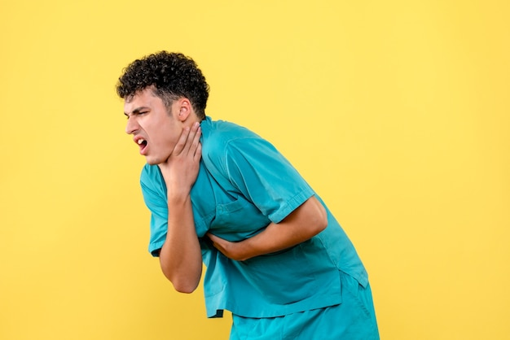
choke/tʃəʊk/ vi.&vt.(使)窒息;(使)哽咽
1.餐厅里的一个同学被牛排噎住了，他捂着喉咙，脸都红了。
A fellow student at the restaurant was choking on some steak, holding his throat with his face turning red.
2.“我受不了了。他哽咽着说。
“I can’t bear it.” he said in a choked voice.
3.看到爆米花都卖完了,他哽咽得说不出话来。
Seeing all the popcorn sold out, he was too
choked with emotion to speak.
4.我强忍着怒火，尽量平静地和父母说话。
Choking back my anger, I tried to speak calm with my parents.

Slide 33
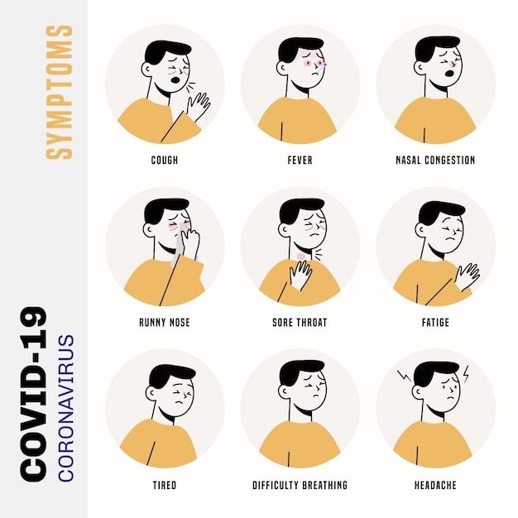
throat/θrəʊt/ n.咽喉;喉咙
1.症状包括发烧和喉咙痛。
Symptom include a fever and a sore throat.
2.站在队伍前面，艾米丽感到喉咙发紧，手心冒汗。
Standing in front of the line, Emily felt her throat tight
and her palms sweating.
3.她讲话急促，急的好像她的心跳到嗓子眼一样。
She spoke hurriedly, as if her heart had leaped into
her throat.
4.他眼里含着感激的泪水,哽咽着感谢这个过路人,“太感谢你了!”
With grateful tears in his eyes, he thanked the passer-by with a lump in his throat, “Thank you so much!” lump 肿块 lump in one's throat 因情绪激动而感到哽咽

Slide 34
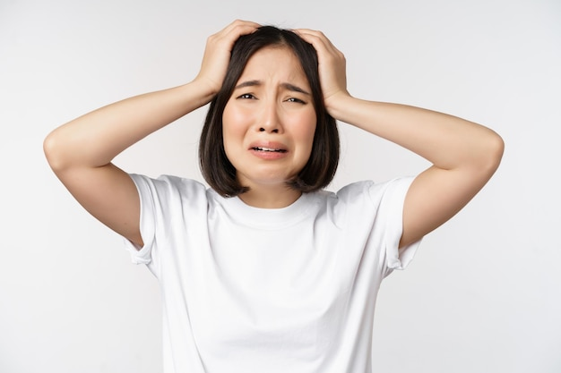
desperate/ˈdespərət/ adj.绝望的;孤注一掷的
1.尽管我们很绝望，但我们别无选择，只能留下来，和船一起沉没。
Desperate as we were, we had no choice but to stay, sinking with the boat.
2.洪水灾区的人们迫切需要帮助。
People in flood-struck areas are
in desperate need of help.
3.突然，她发现一架直升飞机朝她的方向飞来，
便拼命挥舞着黄衬衫求救，希望里面的人能看到她。
_{2016年浙江卷高考读后续写 “夫妻吵架森林迷路”}
Suddenly she found a helicopter flying in her direction and waved her yellow
shirt desperately for help, hoping the people inside could see her.
4.绝望中，我终于看到一些载着救生员的船向我们驶来。
In sheer desperation, I finally caught sight of some boats with lifeguards on them heading towards us in the distance.

Slide 35
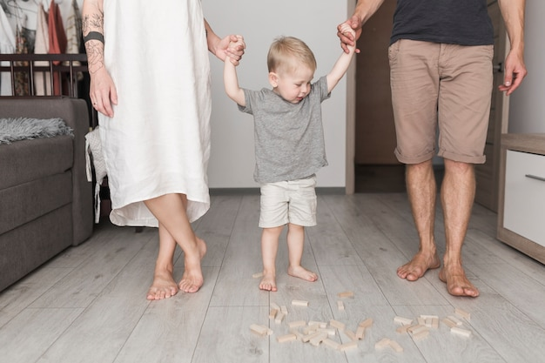
help sb to one’s feet 帮助某人站起身来
1.贝尔斯扶着那人站起来，沿着小路慢慢挪动。两人在眩目的雨夹雪中跌跌撞撞，但贝尔斯从未失去希望。
Bales helped the man to his feet and inched along the trail.The two stumbled throught the blinding sleet,but Bales never lost hope.
inch[ɪntʃ]v.缓慢移动;n.英寸;
2.突然，他跳了起来，喊道:“我有一个好主意。”
Suddenly, he sprang to his feet and cried,” I
had a great idea.”spring[sprɪŋ]v.突然跳起；突然跃起;弹开;突然到来；
3.他费力地双腿颤抖地站了起来。
With effort, he struggled to his feet on shaky legs.
4.确认他们已经走了，我向雷恩打了个手势，我们站起来，开始跑起来。
Confirming that they had gone, I signaled to Raine, and we rose to our feet and broke into a run.

Slide 36

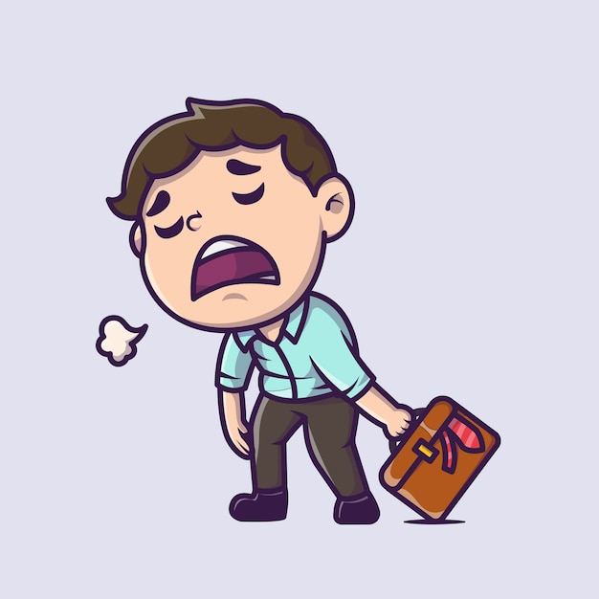
help sb to one’s feet 帮助某人站起身来
5.当她听到这个消息时,她跳了起来。
She jumped to her feet when she heard the news.
6.她爸爸皱着眉头不耐烦地跺着脚。
Her father frowned and tapped/stamped his feet impatiently.
7.她拖着脚步,很不情愿地跟随父母回了家。
She dragged her feet as she unwillingly followed her parents home.
8.一到家她就脱下鞋子,光着脚飞快地冲到自己卧室中。
On arriving home, she took off her shoes and dashed into her
bedroom in bare feet.

Slide 37


practical/ˈpræktɪkl/ a.切实可行的;实际的
1.除了实用技能外，培训课程还教授团队合作，鼓励自我价值和促进社区感。
In addition to practical skills, the training lessons teach team work, encourage self-worth and promote feeling of community.
2.这对帮助学生获得一些实际的社会经验，提高综合能力是有意义和有益的。
It is meaningful and beneficial in helping students gain some practical social experience as well as promote all-around ability.

Slide 38


fist/fɪst/ n.拳;拳头
1.握紧拳头并摇晃它几乎总是意味着某人生气并威胁另一个人。
Making a fist and shaking it almost always means that someone
is angry and threatening another person.
2.我攥紧拳头，咬紧牙关，鼓起了勇气。
Clenching my fists and gritting my teeth, I plucked up my courage.
3.看到冰淇淋车，马克斯哭了起来，向空中挥舞着拳头。
_{浙江名校新高考研究联盟202212读后续写“追赶冰淇淋车”}
Max cried at this sight of the ice-cream truck,
throwing a fist in the air.

Slide 39

grab/græb/ vt.抓住;攫取 n.抓取;抢夺
1.她抓起桌上的药盒，拿出一个棉签、酒精和创可贴。
She proceeded to grab the medicine box on the table and took out a cotton bud, alcohol and a woundplast.
2.爱瑞斯的叫声引起了她的注意。
The cry of Iris had grabbed her attention.
3.最吸引我的是，我可以通过不时地参考YOUTH来开阔
我的视野。_{2021全国卷I高考应用文“Youth and me”}
What grabs me most is that I can broaden my horizons
by referring to YOUTH from time to time.
4.一个巨浪抓住了爸爸，把他从甲板上卷了下来。一眨眼，他就被大海吞没了，永远消失了。
A rough wave grabbed hold of papa and swept him off the deck. In a blink, he was swallowed up by the sea and gone forever.

Slide 40

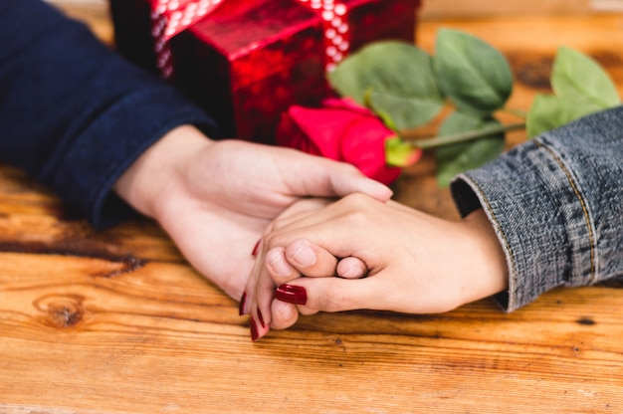
【“拿”“抓”的相关表达】
1.手里拿着钥匙
hold the key in his hand.
2.抓住绳子
grasp/grip the rope
3.抓起电话
grab the phone
4.抓住我的手
seize my hand
5.胳膊下夹着一只公文包
carry a briefcase under one’s arm
6.抓住我的手
take hold of my hand.

Slide 41


tight/taɪt/ a.牢固的;紧身的 ad.紧紧地
1.尽管预算紧张，人们还是被她的善良和这样一个小男孩
养家糊口的努力所感动，纷纷高兴地买一两个包。
Though on a tight budget, people were moved by her kindness
and such a little boy’s efforts to feed his family, buying a bag
or two with delight.
2.泪水几乎模糊了我的视线，我紧紧地拥抱着他。没有他的鼓
励，我不可能获奖。是他开辟了我的写作道路。_{2023年全国卷I读后续写“参加作文比赛”}
With tears almost blurring my vision, I hugged him tightly.
Without his encouragement, I wouldn’t have won the prize.
It was him that carved my writing path.
3.阵阵恐惧涌上我们的心头。我们喉咙发紧,膝盖发软。
Waves of fear flooded over us. Our throats tightened and
our knees felt weak.

Slide 42
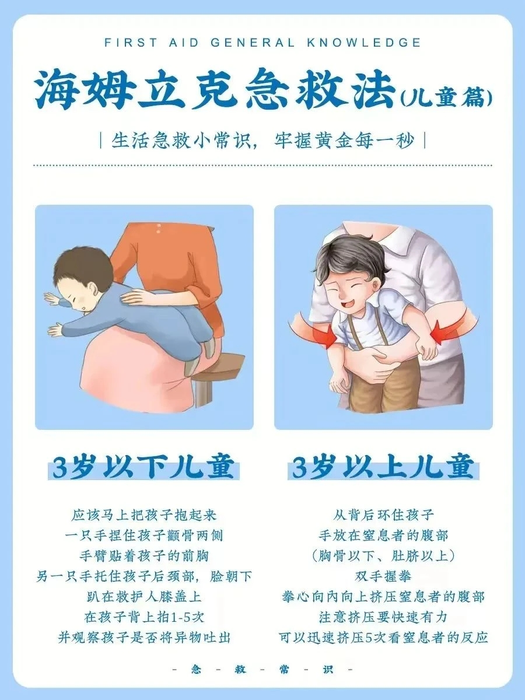
motion/ˈməʊʃn/ n.运动;移动
1.你可以实施海姆里希急救法：站在被噎着
的人后面，用双臂环抱其腰部。一只手握
拳，置于其上腹部。另一只手紧紧握住拳头，快速用
力向上往里挤压。重复上述动作直至异物
排出。
You can perform the Heimlich manoeuvre
by standing behind the choking person and
wrapping your arms around his waist. Make
a fist with one hand and place it in the upper
part of his stomach. Grabbing your fist with
your other hand tightly, push up and into his
stomach in one motion. Continue doing this
until the obstruction is forced out.

Slide 43
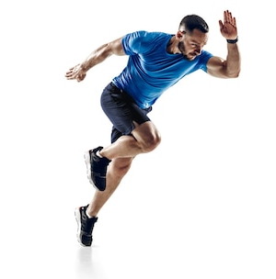
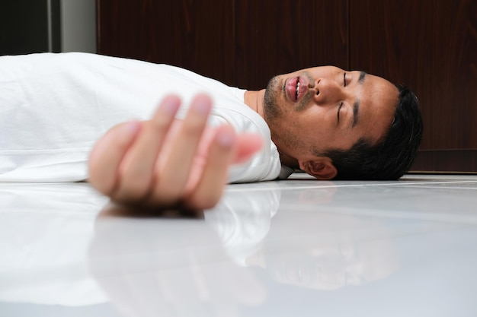
motion/ˈməʊʃn/ n.运动;移动
2.我掌心流汗，双腿颤抖，不能向舞台走一步。
My palms sweating and legs shaking, I could not motion a single step towards the stage.
3.他沉默不语，一动不动，就像一幅石刻的画。
He was as silent and motionless as a painting carved from stone.
4.突然，一个男孩从公共汽车后面摔了下来。他像一只断了翅膀的鸟一样被扔到路上，一动不动地躺在那里。
Suddenly, a boy fell off the back of the bus. He was tossed onto the road like a broken-winged bird and lay motionlessly.

Slide 44
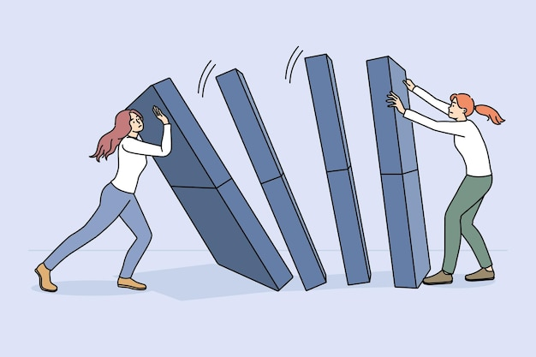
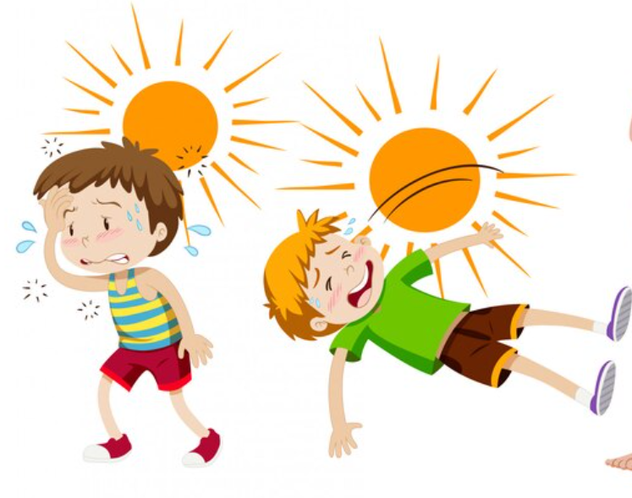
collapse/kəˈlæps/ vi.(突然)倒塌;(因病)昏倒
1.就在那一刻，我们之间的墙倒塌了，相反，
我们之间的纽带建立了起来。
It was at that moment that the wall standing
between us collapsed, instead, a bond was built.
2.走了大约二十分钟后，马克斯的信念在烈日
下开始动摇。他瘫倒在地，让疼痛的腿休息
一下，揉着疼痛的脚。_{浙江名校新高考研究联盟202212读后续写}
_{“追赶冰淇淋车”}
After about twenty minutes of walking, Max’s faith
started to get shaken in the burning sun. he collapsed,
resting his aching legs and rubbing his sore feet.

Slide 45
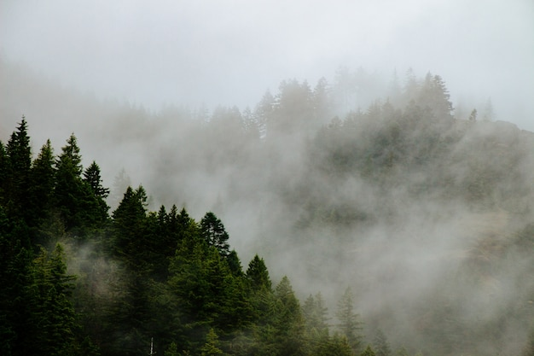
foggy/ˈfɒgi/ a.有雾的
1.天气寒冷多雾，地面湿透了，我们穿的单薄衣服不足以保暖。
It was freezing cold and foggy, the ground was soaking, and out thin dresses were not enough to keep us warm.
2.浓雾笼罩着田野，我几乎什么也看不见。
The thick fog blanketed the field and I could barely see anything.

Slide 46


http://www.sunedu.com
Thank You!

