Slide 1

感恩遇见，相互成就，本课件资料仅供您个人参考、教学使用，严禁自行在网络传播，违者依知识产权法追究法律责任。
更多教学资源请关注
公众号：溯恩高中英语
知识产权声明

Slide 2


选择性必修一Unit 1
People of Achievement
Workbook
Reading&Writing
诸暨中学暨阳分校 陈莹

Slide 3

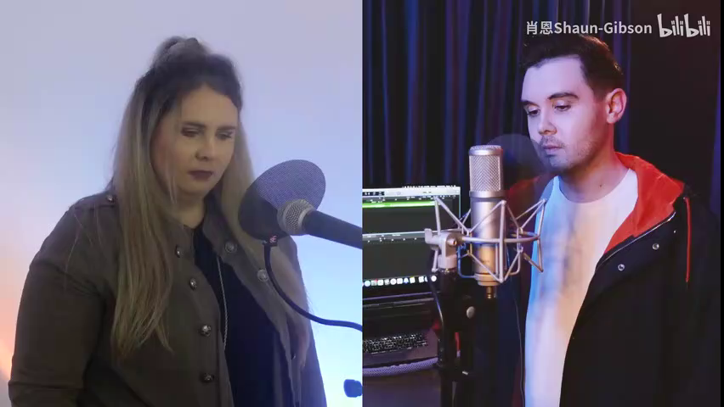
What is the song about?

Slide 4
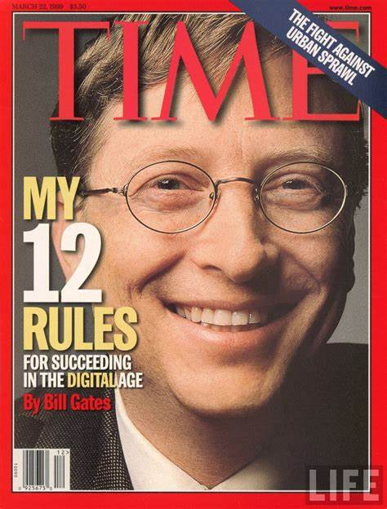
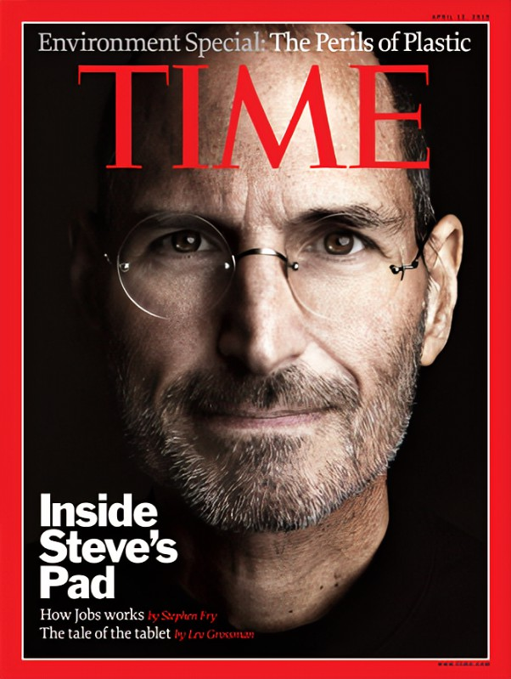
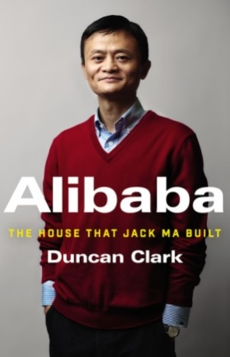
Identify the requirements
What is the magazine ususally about?
People who have helped to change the face of the world in recent years. Few would not recognise their names.
Notes:
have you read or come across this magazine? Exactly, it usually introduces influential people. however,the history is not simply shaped by those who change the face of the world. this issue focuses on sth different. let’s take a closer look at it.

Slide 5
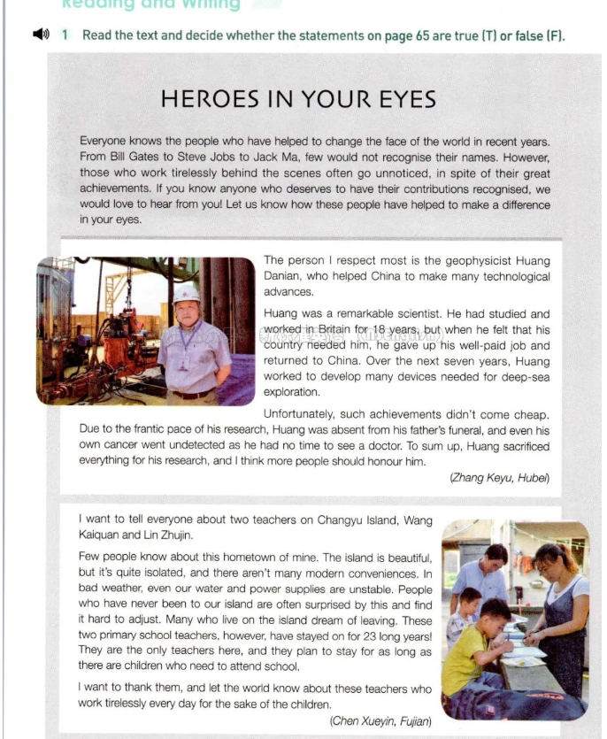
Identify the requirements
If you are to write, what will you include in your writing?
What is the theme?
How will you make your writing a good one?
Notes:
what kind of heroes? according to the requirements, If you are to write one who will you write about? what will you include in your writing?

Slide 6
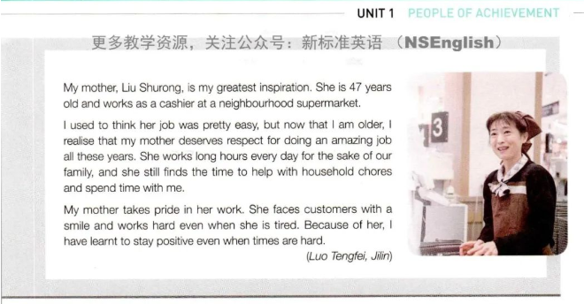
Check the predictions

Slide 7


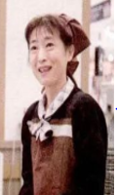
Design a form and complete it
Hero | Identity/Occupation | ... | ... | ...
geophysicist/scientist
teachers at primary school
mother/cashier
Notes:
Let’s read the articles selected from 3 contributors.

Slide 8

Analyze the qualities
Things are done quickly and in an energetic but disorganized way, because there’s every litttle time.
partiotic
selfless
committed

Slide 9
Analyze the qualities
tough
persistent
however
devoted
selfless

Slide 10
Analyze the qualities
committed
responsible
diligent
positive
Notes:
Do you know how hard it is to strike a balance between work and family? what do you think of your parents’ job? we should feel grateful. actually they sacrifice a lot of the sake of our family.

Slide 11
Design a form and complete it
Hero | Identity/ Occupation | ... | Personality | Influence
geophysicist/scientist
pariotic, selfless, committed
teachers at primary school
tough, pesistent,
devoted, selfless
mother/
cashier
committed, reponsible,
diligent, positive
Notes:
Let’s read the articles selected from 3 contributors.

Slide 12
Explore the influence
?
Because of..., I have learnt to...

Slide 13
Assess the passages
Which one impresses you most?
P3

Slide 14

Role play
Role-play an interview about unnoticed heroes in your eyes. Three questions are allowed in the interview. Take turns to play the different roles.
EXAMPLE:
Interviewer: Hello! Do you know anyone who deserves to have their contributions recognised yet doesn’t? And who is he/she?
Interviewee: The person I respect most is.../...is my greatest inspiration.
...

Slide 15
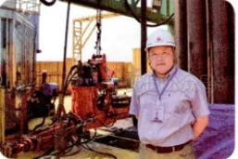
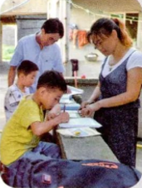
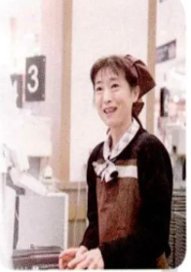

Think critically
Why does the editor select these heroes?
ordinary souls
Not every hero wears a gold crown or hears the sound of glory from the crowd.
extraordinary work
Notes:
the history is not simply shaped by those who change the face of the world. instead, it is built upon the foundations of ordiary people doing very extraordinary things. there’s always some people on whom the spotlight doesn’t shine so bright.

Slide 16
Think critically
What makes a hero in your eyes?
A hero is a man who does what he can.
—— Romain Roland

Slide 17
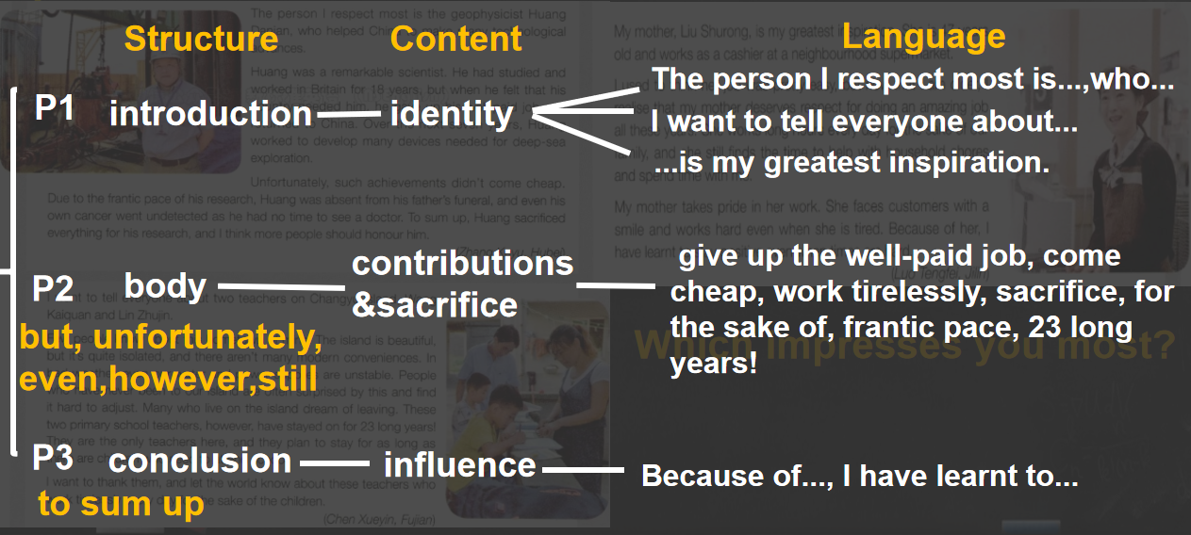
Assignment
Write an article with the title “The Hero in My Eyes”.

Slide 18
Sample
Liyi, one of the medical workers in our city, is my greatest inspiration. While he is not famous, he did something quite extraordinary. During the fight against COVID-19, he gave up the comfortable life and volunteered to go to Wuhan. While he was there, he worked tirelessly with little sleep or rest in between. Unfortunately, due to the frantic pace of his work, he collapsed from exhaustion. After recovery, he said, “I just did what was required of my job--to save lives.” What impressed me most was his sacrifice, dedication and persistence.
Because of him, I have learnt to strive to think of others more than myself and work hard to help people.

Slide 19
Thank You!

