Slide 1

感恩遇见，相互成就，本课件资料仅供您个人参考、教学使用，严禁自行在网络传播，违者依知识产权法追究法律责任。
更多教学资源请关注
公众号：溯恩高中英语
知识产权声明

Slide 2

活用教材词汇，靶向高考写作
B6U5单词拓展
武汉开发区汉阳三中：廖英

Slide 3


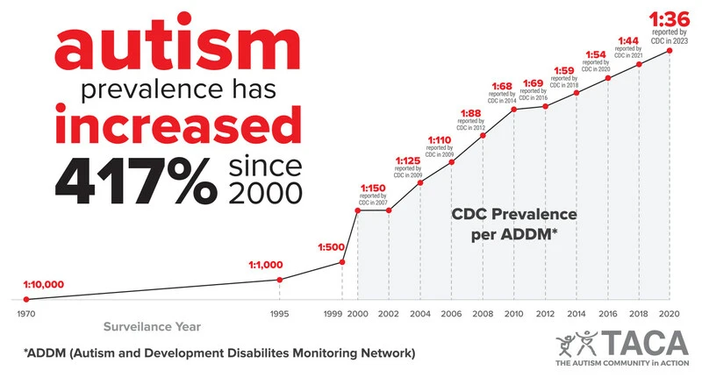
drama/ˈdrɑ:mə/ n.戏;剧;戏剧艺术
1.上周五举办了一场特别的英语戏剧节，旨在激发学生的兴趣，丰富我们的校园生活。
Last Friday witnessed an extraordinary English drama festival, which aims to stimulate students’ interest and enrich our school life.
2.在过去的十年里，选择网上购物的人数急剧上升。
The last decade saw a dramatic increase in the number of people opting for online shopping.

Slide 4

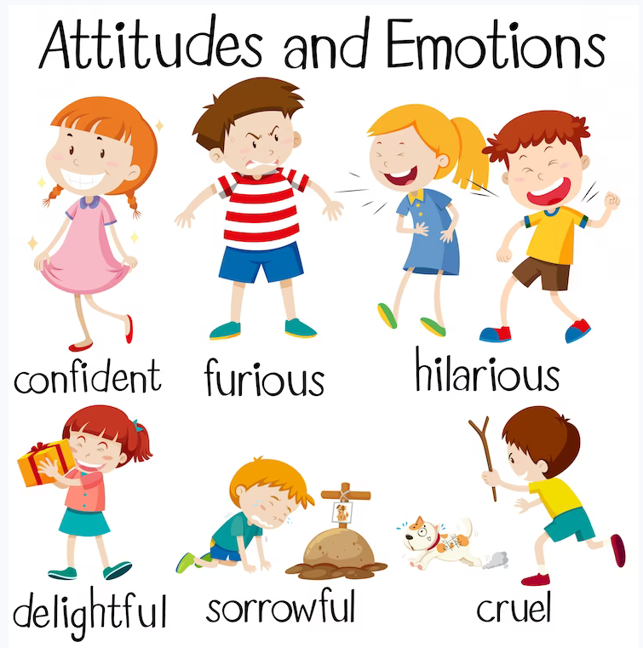
sorrow/ˈsɒrəʊ/ n.悲伤;悲痛 vi.感到悲伤
1. 毫无疑问，他们之间的隔阂被打破了，他们眼中的悲伤无处可寻。_{（2023武汉2月调考读后续写“鼓励转校生融入新环境”）}
Without doubt ,the barriers between them were broken and the sorrow in their eyes was nowhere to be found.
2. 听到这个消息，她陷入极度的悲伤之中。
Hearing the news, she fell into deep sorrow.
3. 她从学校慢慢地骑车回家，心难过到麻木了。
She rode home from school slowly, numb with sorrow.
4.悲伤的眼泪从的脸颊流下了，发出一阵痛苦的呻吟，
额头上满是冷汗。
Sorrowful tears rolling down Roy’s cheeks, Roy let out a sudden painful moan with cold sweat on his forehead.

Slide 5

literary/ˈlɪtərəri/ a.文学的;爱好文学的
1.它不仅为我们学生提供了进入英国文学神奇世界的机会，而且使我们具备了欣赏其文学魅力的能力。
Not only did it provide us students with access to the magical world of English literature, but also equipped us with the ability to appreciate its literary charm.
2.唐诗集韵味与文学之美于一身，是中国古典文学的精华，品味唐诗一定会激发你学习汉语的兴趣。
Tang poetry, a combination of rhyming charm and literary beauty, is the cream of Chinese classical literature, a taste of which will surely spark your interest in learning Chinese.

Slide 6
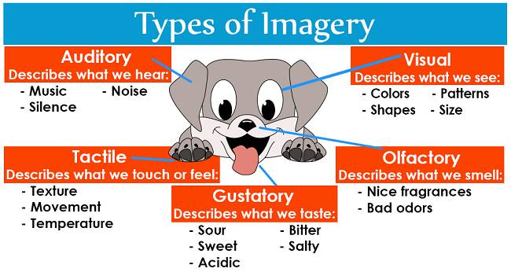
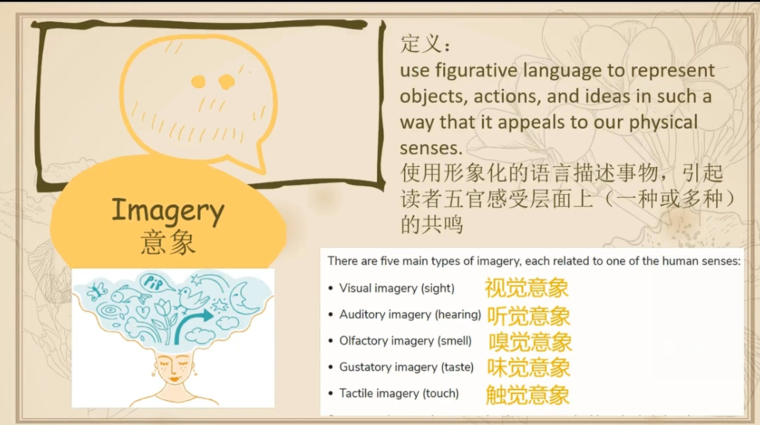
imagery/ˈɪmɪdʒəri/ n.形象的描述;意象;像
李白是中国唐代最伟大的诗人之一，以其深刻而抒情的诗句而闻名。他的诗歌充满了生动的意象和深刻的情感，超越了时间和空间，传达了自然之美和人类对自由的渴望的永恒主题。_{2023全国高考甲卷应用文“介绍中国历史人物”}
Li Bai, one of the greatest poets of China’s Tang Dynasty, is celebrated for his profound and lyrical verses. His poetry, filled with vivid imagery and deep emotions, transcends time and space, communicates universal themes of nature’s beauty and human longing for freedom.transcend[trænˈsend]v.超出；超越;（尤指神）超然存在于（物质世界）之外;

Slide 7
【修饰手法--意像：描述性语言，触动感官】
1.我享受春天的一天。我听鸟儿树上唱歌，树上开始冒出明亮的粉红色和白色的花蕾。大地上散发着清新的绿色气息，它终于随着生命的新季节而出现。
I enjoyed a spring day.I listened to the birds chirp and sing up in the trees_{(听觉意象)} that were beginning to burst out in brilliant pink and white buds_{（视觉意象）}.The earth smelled fresh with greenery_{(嗅觉意象）}that was finally emerging with the new season of life.
2.森林里很安静。我能感觉到阳光轻轻地抚摸着我的皮肤，我呼吸的空气中混合着青草和鲜花的芬芳。昆虫的嗡嗡声和鸟儿的啾啾声构成了森林里清晨的音乐。附近群山的宁静景色真是赏心悦目，绿色的草地上点缀着羊群和牛群。我被森林风景的美丽和宁静所吸引，以至于忘记了时间。
It was quiet in the forest. I could feel the sun gently touching my skin with the summer breeze caressing my face_{（触觉意象）}, and the air I breathed in was mixed with the sweet scent of grasses and fresh flowers_{（味觉意象）}. The buzz of insects and the tweet of birds_{（听觉意象）}made up the morning music of the forest. The peaceful landscape of the nearby mountains was a true feast for the eyes, with green meadows dotted with sheep and cattle_{（视觉意象）}. I was so absorbed in the beauty and tranquility of the forests scenery that I forgot about the time.

Slide 8
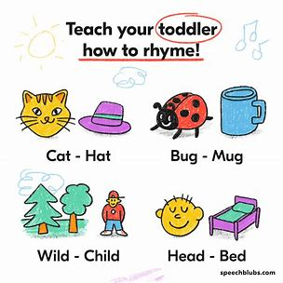
rhyme/raɪm/ n.押韵词;押韵诗 v.使押韵
1.格林教授是著名的英国文学专家，专门研究诗歌。他将通过分享
自己的诗歌，从结构、意象和押韵等方面阐述诗歌的内涵。我希望
所有出席会议的人都积极参与，并按照要求听从他的指示。
Professor Green is a renowned expert in English literature and
specializes in poetry. He will illustrate the connotations of poems in structure,imagery and rhyme by sharing his own poem. I hope all in attendance will participate positively and follow his instructions as requested.connotation[ˌkɒnəˈteɪʃən]n.内涵意义；隐含意义；
2.《此情可待》是一首典型的英式浪漫歌曲，同时，也是我最喜欢的一首诗。这首诗由10行押韵的诗句组成，诗句中有“day”和“insane”、“never”和“forever”的押韵词。“海洋”、“在线”等具体的意象词也有所使用，用来表现恋人之间的遥远的距离。每一个字都像是诗人的心里话。
Right here waiting is a typical English romantic song, meanwhile, it is my favorite poem. The poem consists of 10 lines which rhyme each other like “day” and “insane” , “ never” and “forever”. Some concrete images are used, such as “ocean” and “on line”, to present the picture of a long distance between the two lovers. Every word feels like spilling out from the poet’s heart.

Slide 9
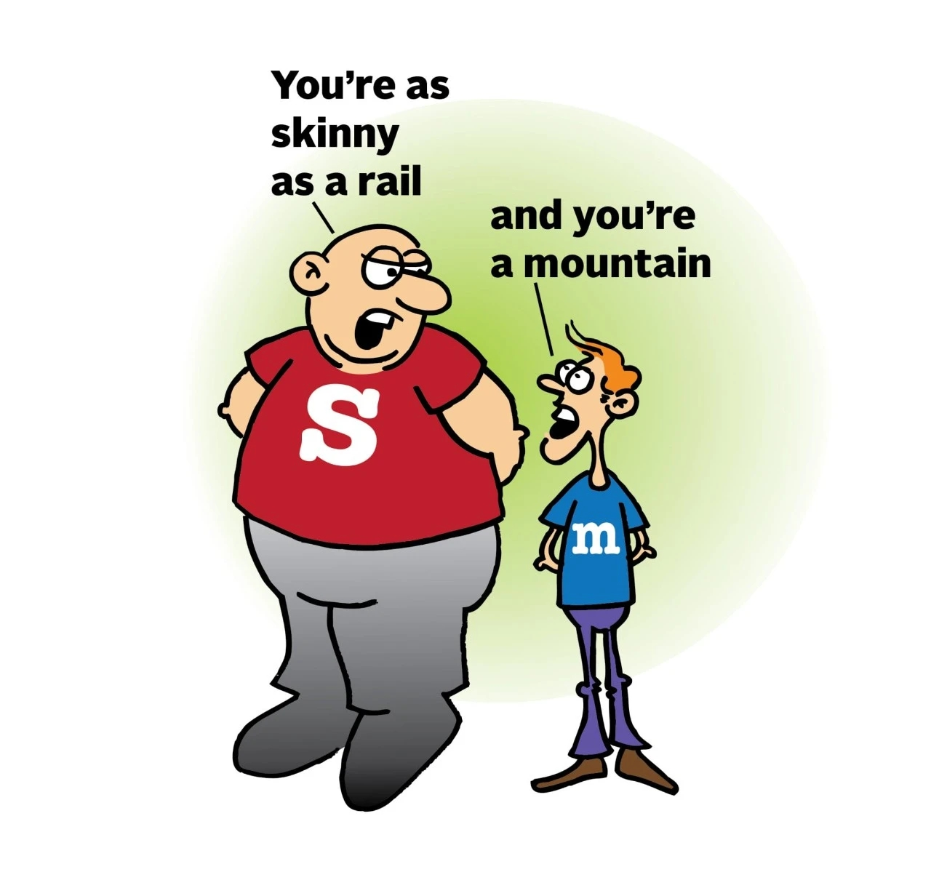
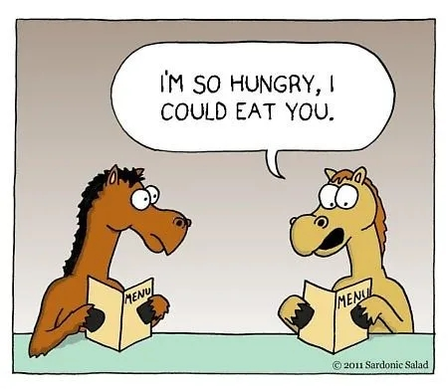

【其他常见修辞手法】
1.她的回答激起了他的愤怒，他像一个火山爆发了。（明喻：使用“像”或“如同”）
Her reply fuelled his anger and he erupted like a volcano.(simile)fuel[ˈfjuːəl]v.为…提供燃料；n.燃料;
2.今天的讲座给了我很多值得思考的东西。(暗喻：不使用“像”或“如同”）
Today’lecture gave me a lot of food for thought.(metaphor)
3.这景色简直让我震撼到窒息。(夸张：夸大的陈述或主张）
The scenery literally took my breath away.（hyperbole）
4.熊熊的火焰以飞快的速度烧毁了建筑物。(拟人：赋予非人物事物人类特点）
The hungry flames tear up the buildings faster than anything else.（personification)

Slide 10

【其他常见修辞手法】
5.井里的水涨了又降，涨了又降。 (反复：有意义的重复)
The water in the wells rose and fell, rose and fell.（repetition）
6.是你们，不顾设备的缺乏和感染的可能性，不顾一切地抢救那些感染者，但努力争取生命。也是你们用专业知识让我们对病毒有了新的认识，增强了我们战胜疫情的信心。是你值得所有的钦佩和爱!(排比：并列的有节奏感的结构)
It is you who, despite the lack of equipment and the potential of infection, desperately rescue those infected but striving for life. It is also you who have shed new light on the virus with expertise to build up our confidence to defeat it. It is you who deserve all the admiration and love!（parallelism）expertise[ˌekspɜːˈtiːz]n.专门技能；专门知识；
7.食物之于身体就像燃料之于发动机。(类比：不同事物共同点进行比较)
Food is to the body as fuel is to the engine.（analogy）
8.和风吹荡，水花四溅，船儿破浪前行。我们是这里的第一批来客，闯进这一片沉寂的海面。(头韵：辅音音素的重复)
The fair breeze blew, the White foam flew, the furrow followed free.We were the first that ever burst into that silent sea.（alliteration）英国“湖畔派诗人”之一塞缪尔·泰勒·柯尔律治（Samuel Taylor Coleridge）的经典诗作《古舟子咏》

Slide 11
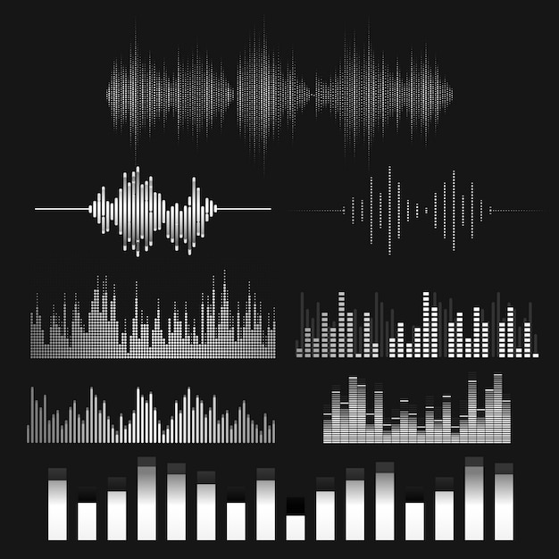

rhythm/ˈrɪðəm/ n.节奏;韵律;规律
1.这首诗行长度灵活，重复出现地短语赋予它某种模式和节奏。
It has a flexible line length and some repeated phrases, giving both a pattern and a rhythm to the poem.
2.钢琴手开始用有魔力的手敲击琴键，有节奏地点头。
The piano player began to beat the keys with magic hands, nodding his head in rhythm.

Slide 12

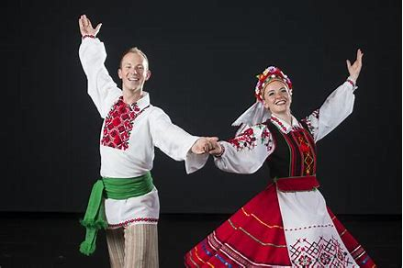
folk/fəʊk/ a.民间的;民俗的
1.我写信是想向您推荐西方社会艺术讲座的讲座内容。我一直以来期待着去了解西方国家的民间舞蹈，尤其是它们的起源、音乐特点以及相关的仪式。_{2019年天津卷书面表达“英国交流教师讲座内容的建议信”}
I am writing to express my recommendation when you deliver lecture on Arts of Western Society. It is my long expectation that I am crazy to learn more about the folk dances in western countries, especially their origination, music features and related ceremonies.

Slide 13
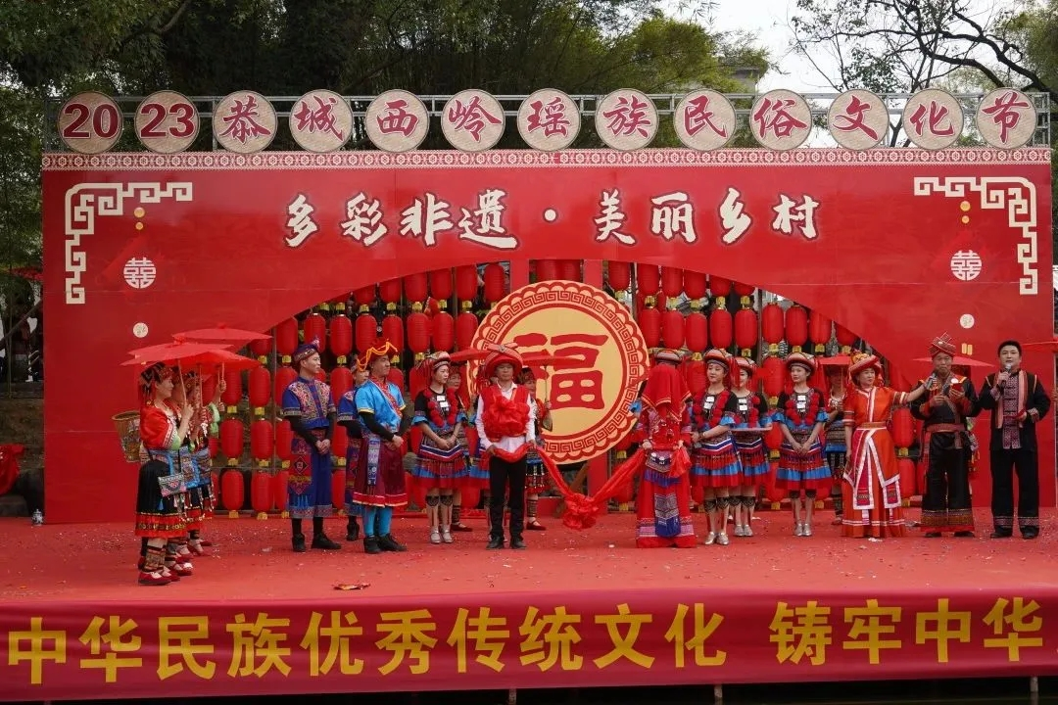

folk/fəʊk/ a.民间的;民俗的
2.按照计划，民俗文化节将于1月20日至26日持续一周，旨在宣传中国的传统食品和民俗文化。游客将品尝正宗的当地美食，欣赏饮食文化，体验民俗生活。
As scheduled, The Folk Festival will last one week from January 20th to 26th, aimed at advocating the traditional food and promoting folk culture in China. Visitors will enjoy authentic local cuisine, appreciate food culture and experience the folk life.

Slide 14

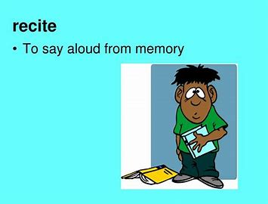
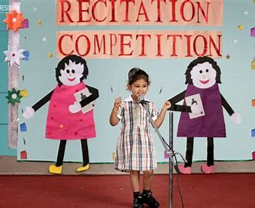
recite/rɪˈsaɪt/ vt.背诵;吟诵;列举
1.带着情感背诵对我来说有点挑战，所以我希望你能教我一些技巧。
Reciting with emotion is a little bit challenging to me, so I would like you to teach me some techniques for this.
2.我写信是想邀请你担任即将到来的英语诗歌朗诵比赛评委。
I am writing to invite you to be the judge at the coming English Poetry Recitation Contest.

Slide 15

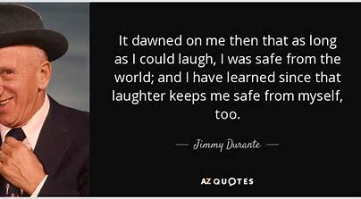
dawn/dɔ:n/ n.黎明;开端;萌芽
1.黎明时分，泰勒睁开睡眼，望着窗外雾蒙蒙的田野。
At dawn, Taylor opened her sleepy eyes and looked out of the window at the foggy field below.
2.当我被授予奖项时，我意识到是老师的鼓励和指导让我有了今天的成就。_{2023年全国卷I读后续写“参加作文比赛”}
When I was awarded the prize, it dawned on me that it was my teacher’s encouragement and guidance that made me where I am today.

Slide 16

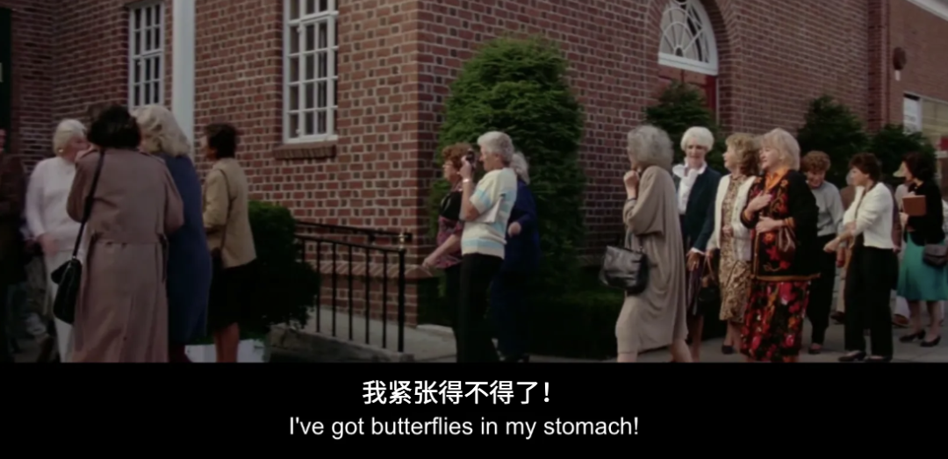
butterfly/ˈbʌtəflaɪ/ n.蝴蝶
1.站在这个宽阔的新公园里，彼得和伊莎贝尔都想起了他们快乐的童年。一只蝴蝶停在伊莎贝尔的肩膀上。
Standing in this broad new park, both Peter and Isabel were reminded of their happy
childhood. A butterfly rested on Isabel’s shoulder.
2.虽然彼得心里七上八下，但他仍然相信他们不断的努力会让他们的目标实现。彼得鼓起勇气发表了演讲。
Although he had butterflies in his stomach, Peter still believed that their constant painstaking efforts would let their goal come true. Gathering up his courage, Peter delivered his speech.

Slide 17

be made up of/bi meɪd ʌp əv/ 组成(构成)
1.唐诗，通常由几行诗句组成，并涉及押韵词。用最少的文字，他们可以以一种微妙而恰当的方式传达出强烈的画面和信息。
Tang poems,which is usually made up of few lines and involve rhyming words.With the bare minimum of words, They can convey a strong picture and message in a subtle and appropriate way.
2.只有一小部分学生通过读书和上网来学习，分别占18%和20%。2022年高考英语全国乙卷书面表达“Learning English beyond the classroom”调查结果短文投稿
Only a small percentage of students learn through reading books and looking through websites, which make up 18% and 20%.

Slide 18

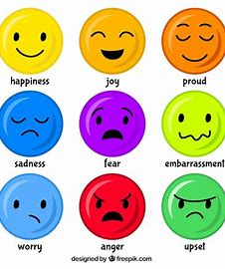
mood/mu:d/ n.情绪;心情;语气
1.她盛装打扮，兴致勃勃地去参加聚会。
She was dressed up and in a mood to party.
2.他工作还没完成，无心去看电影。
With his work unfinished, he was in no mood to see a film.
3.她情绪低落,拖着两条沉重的腿,疲惫不堪地回到了家。
In an unpleasant mood, she dragged her heavy legs back home, tired out.
4.见他闷闷不乐，我就问他为什么不愿意参加比赛。_{2022全国卷一续写续写 “脑疾孩子参加越野赛”}
Seeing that he was moody, I inquired him why he was unwilling to take part in the race.

Slide 19

tease/ti:z/ v.取笑(某人);揶揄;逗弄
1.他无情地取笑我。
He teased me mercilessly.
2.在他身后，他能听到无情的嘲笑，就像刀子扎进了他的心。
Behind him, he could hear merciless teasing, which was like knives sticking into his heart.

Slide 20
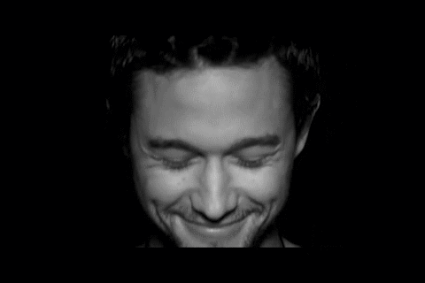


【各种各样的笑】
1.温暖的微笑是表示友善的通用语言。
A warm smile(微笑) is the universal language of kindness.
2.凯特笑了，幸福和希望在她心中涌动。
Kate laughed(出声的笑）, happiness and hope bubbling with her.
3.他们听到我们的消息时高兴地笑了。
They grinned（露齿而笑）with delight when they heard our news.
4.听了他的话，她高兴地笑了。
She beamed （笑容满面）with delight at his remarks.
5.一想起这些，她就轻轻地笑了。
She chukled（低声轻笑）at the memory.

Slide 21

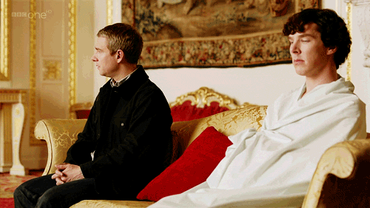
【各种各样的笑】
6.站在旁边的两个男人看着我，互相推了推，傻笑着。
Two men standing nearby looked at me, nudged each other and smirked（得意地笑）
7.他勉强板着脸呆了一分钟，然后大声大笑起来。
He managed to keep a straight face for a minute before he let loose with a loud guffaw(狂笑）
8.他们等待时候紧张地傻笑着。
They giggled（因紧张或有趣而咯咯笑、傻笑） nervously as they waited for their turn.
9.永远不要嘲笑别人的失败。
Never sneer at/mock at （嘲笑）others’s failure.

Slide 22


respectively/rɪˈspektɪvli/ ad.分别;各自;依次为
1.这首诗有四行，每行各有五个音节。此外，它还具有优美的韵律和节奏。
The poem consists of four lines, each containing five syllables respectively. In addtion, it possesses and elegant rhyme and rhythm.
2.根据调查显示，65%的学生会通过听音乐学习
英语，50%的学生会通过看英语电影学习英语，
而阅读英语书籍和浏览英语学习网站的比例
分别为18%和12%。
2022年高考英语全国乙卷书面表达“Learning English beyond the classroom”
_{调查结果短文投稿}
As is shown in the survey, 65% of students would
learn English by listening to music and 50% by
watching English movies, while reading English
books and browing English learning websites
account for 18% and 12% respectively.

Slide 23

blossom/ˈblɒsəm/ n.花朵;花簇
1.当彼得和伊莎贝尔再次进入公园时，他们闻到了花香，这让他们想起了在那里度过的童年。
When Peter and Isabel entered the park again, they sensed the fragrance of blossoms,
reminding them of their childhood spent there.
2.背衬着湛蓝的天空，绽放的樱花如一条星辰闪耀
的美丽银河。
The cherry blossom look like a galaxy of twinkling stars
against the backdrop of the blue sky.galaxy[ˈɡæləksɪ]n.星系;
3.这位诗人创作了不少以樱花为意象，描写人生悲欢
离合的诗歌。
The poet composed quite a few poems featuring the image of cherry blossoms, and describing the joys and sorrows of life.
4.不时地，鸟儿欢快地歌唱，花儿含笑地开放，孩子们沉浸在大自然的魅力中。
Now and then, pretty birds singing merry songs and flowers blooming with smiles made the kids immersed in the charm of nature.

Slide 24
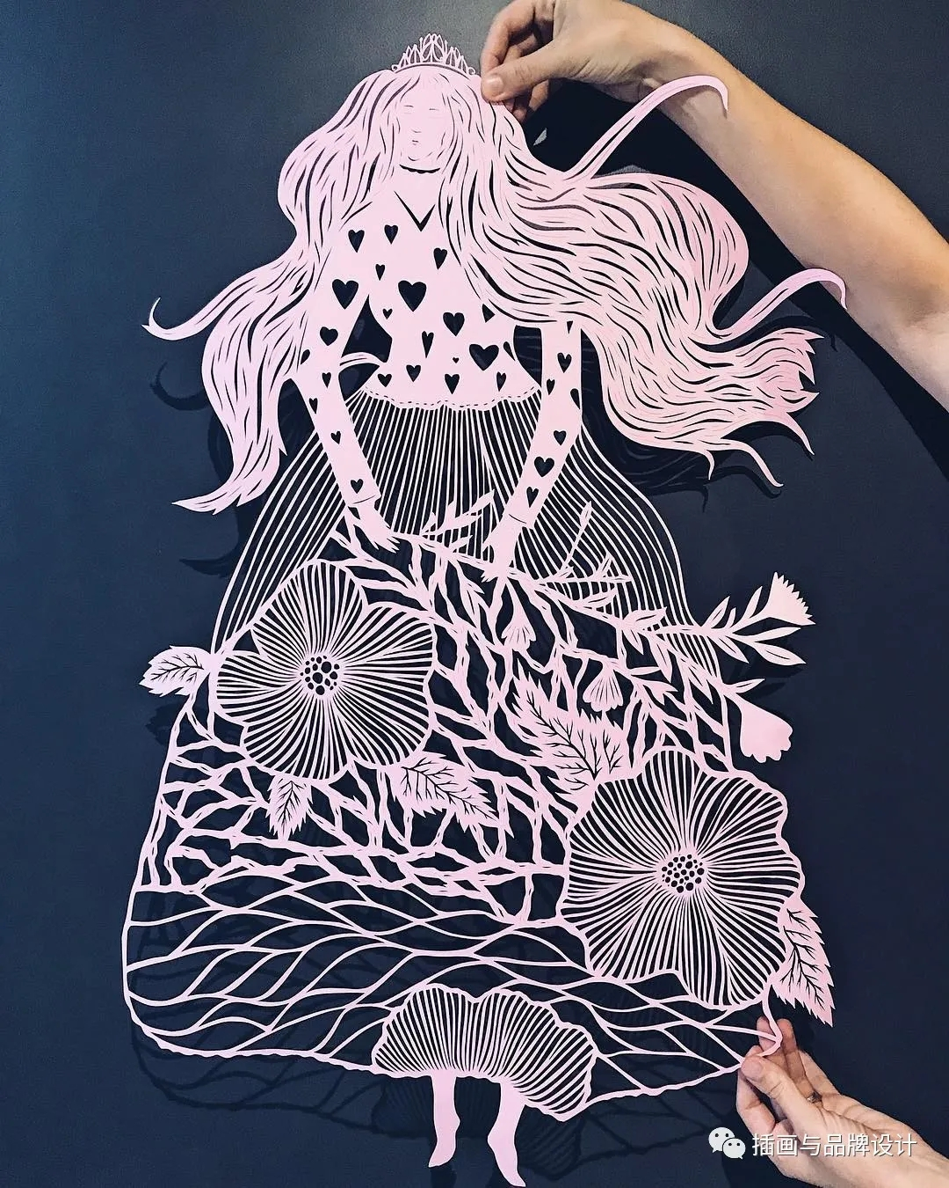
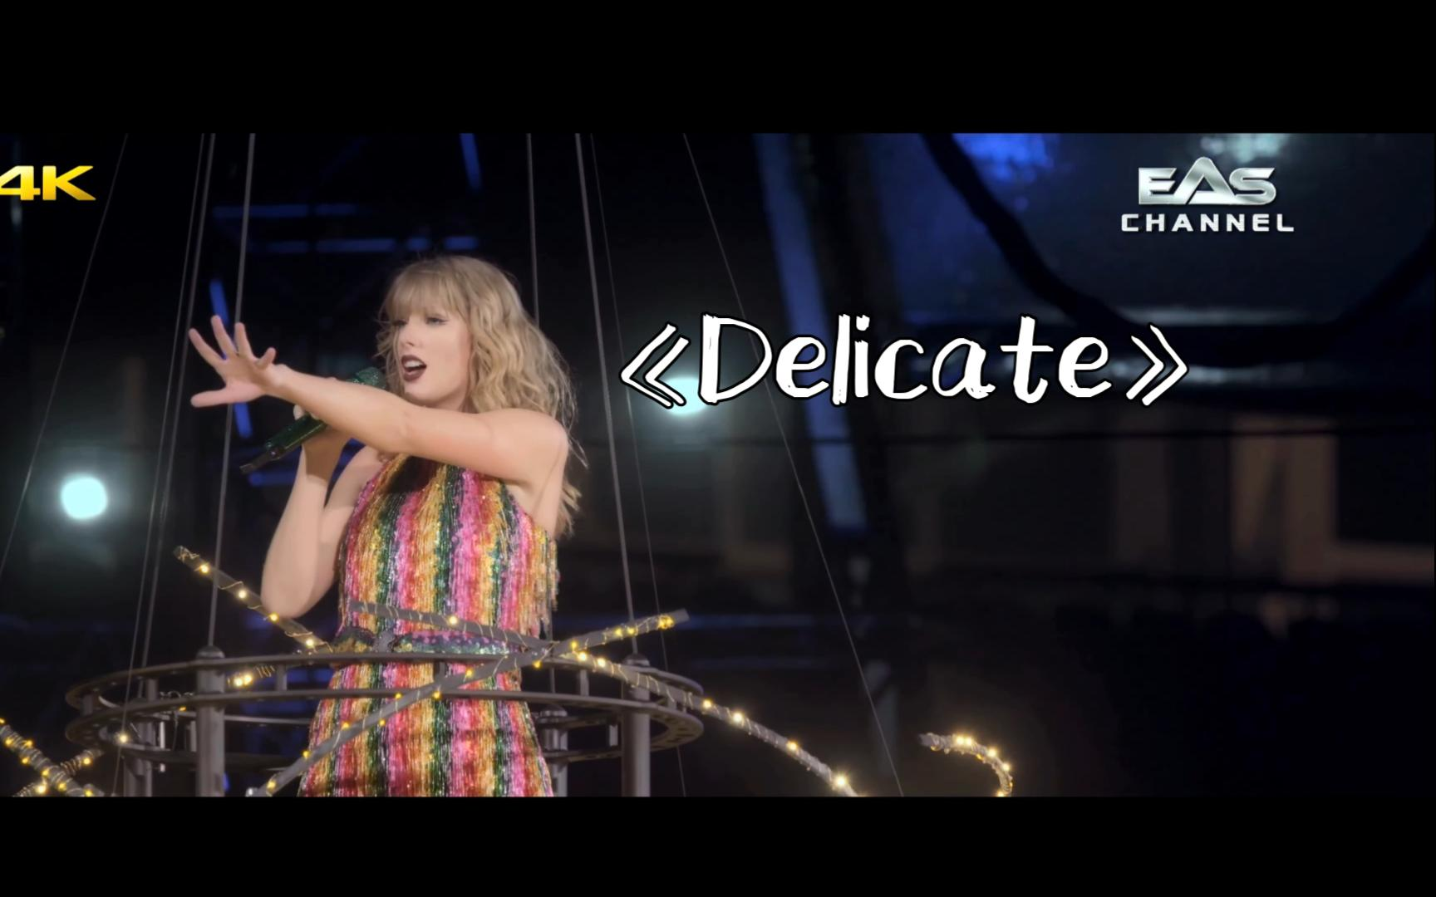
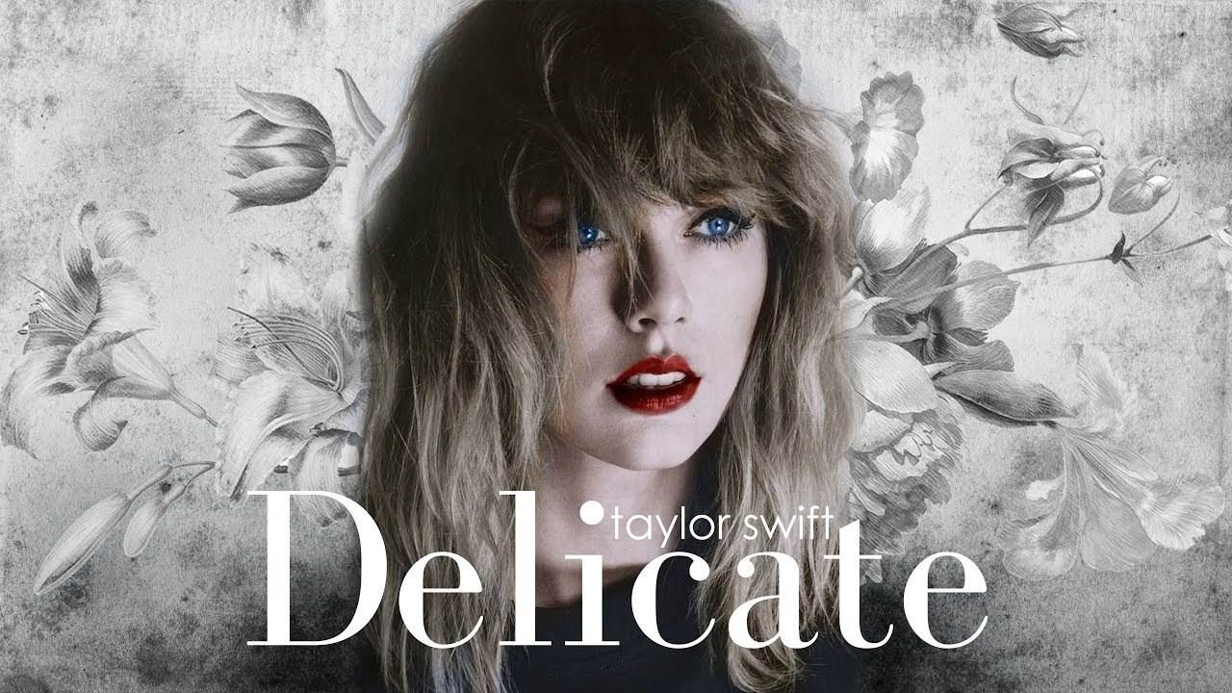
delicate/ˈdelɪkət/ a.精美的;精致的;脆弱的
1.我的第一个建议是旗袍，它是一件精美精致的中国传统服装，有着独特而迷人的设计。
My first suggestion is Qipao, a fine and delicate piece of traditional Chinese clothing with its unique and fascinating design.
2.我被姑姑精美的剪纸作品所吸引，有一种向她学习的强烈冲动。_{2023高考英语全国乙卷“学习新技能的经历投稿”}
Fascinated by the delicate paper cutting works of my aunt, I have a strong urge to learn it from her.

Slide 25


utter/ˈʌtə(r)/ vt.出声;说;讲 a.完全的
1.一看到那些精致菜肴，他就像在地上扎了根一样的一动不动，一句话也说不出来。
The instant he saw the elegantly cooked dishes, he was rooted to the ground, unable to utter any single word.
2.她仍然想念她的孩子。每当我带她到树林里散步时，她都会发出悲伤的嚎叫。
She still missed her kid. She would utter mournful howls whenever I took her out for walks in the woods.
3.他拿着那本破旧的日记本，仿佛又回到了过去的黄金时光。那时，他那充满爱心和耐心的父亲教他迈出第一步，一遍又一遍地学说第一句话。
Holding the old tattered diary, he seemed to be brought back to the golden old days when his caring and patient father taught him to make the first step and utter the first word over and over again.

Slide 26

comprehension/ˌkɒmprɪˈhenʃn/ n.理解力;领悟力;理解练习
1.为了培养学生对劳动的理解和热爱，我校将在下周五上午5点钟组织一次生活技能展示活动。
In a gesture to cultivate students’ comprehension and passion for labor, our school will launch a life-skill demonstration activity at 9:00 a.m. next Friday.
2.他的行为令人完全无法理解。
His behaviour was completely beyond comprehension.
3.一项全面的新方案得以启动，一系列致力于解决这些
问题的措施得以开展。
A compehensive initiative was started, with a number of
measures that addressed the issues.

Slide 27


shelf/ʃelf/ n.架子;搁板
1.墙上有架子，上面有玛利亚不认识的人的画像。
There were shelves along the walls, with framed pictures of people Mariam did not recognize.
2.检查完我脚上的水泡后，她去拿架子上的急救箱，又弯下腰来。
After examining the blister on my foot, she went to fetch the first-aid kit on the shelf and bend down again.

Slide 28



blank/blæŋk/ a.空白的;无图画 n.空白
1.她装出一副冷冰冰毫无表情的样子。
Her face was a cold blank mask.
2.虽然他已经练习了一百遍，但一看到人群，他的大脑就一片空白。
Although he had practised it for a hundred times, his brain just went blank at the sight of the crowd.
3.我呆坐在椅子上，眼神空洞地盯着他的背影。
I sat frozen in my seat, staring blankly after him.

Slide 29

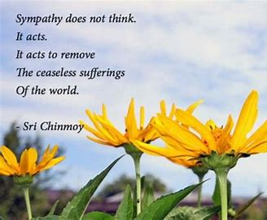
sympathy/ˈsɪmpəθi/ n.同情;赞同
sympathetic/ˌsɪmpəˈθetɪk/ a.同情的;有同情心的
1.在巨大的同情和善良的驱使下，她开始做一顿大餐。
Driven by enormous sympathy and kindness, she started to cook a big meal.
2.看到她的情况，我立刻对她产生了巨大的同情。它发自我的内心深处。
Seeing her conditions, I immediately felt sympathetic for her. It was coming deep from within my heart.

Slide 30

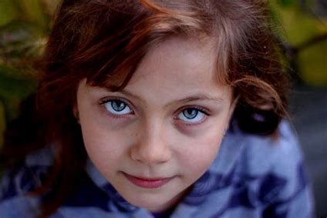
innocent/ˈɪnəsnt/ a.天真无邪的;无辜的
1.农夫非常害怕，他认为他会因为杀人而判处死刑，
但他是无辜的。
The farmer was very afraid, and he thought he would
be sentenced to death by killing people, but he was innocent.
2.天真的小女孩被妈妈抱着，心怦怦直跳，激动地尖叫着，
毫不犹豫地打开了她期待已久的精美礼盒。
With her heart beating wildly, the innocent girl, held
by her mom and screaming with excitement, unwrapped
her delicate gift box which she had been looking forward
to without any hesitation.

Slide 31
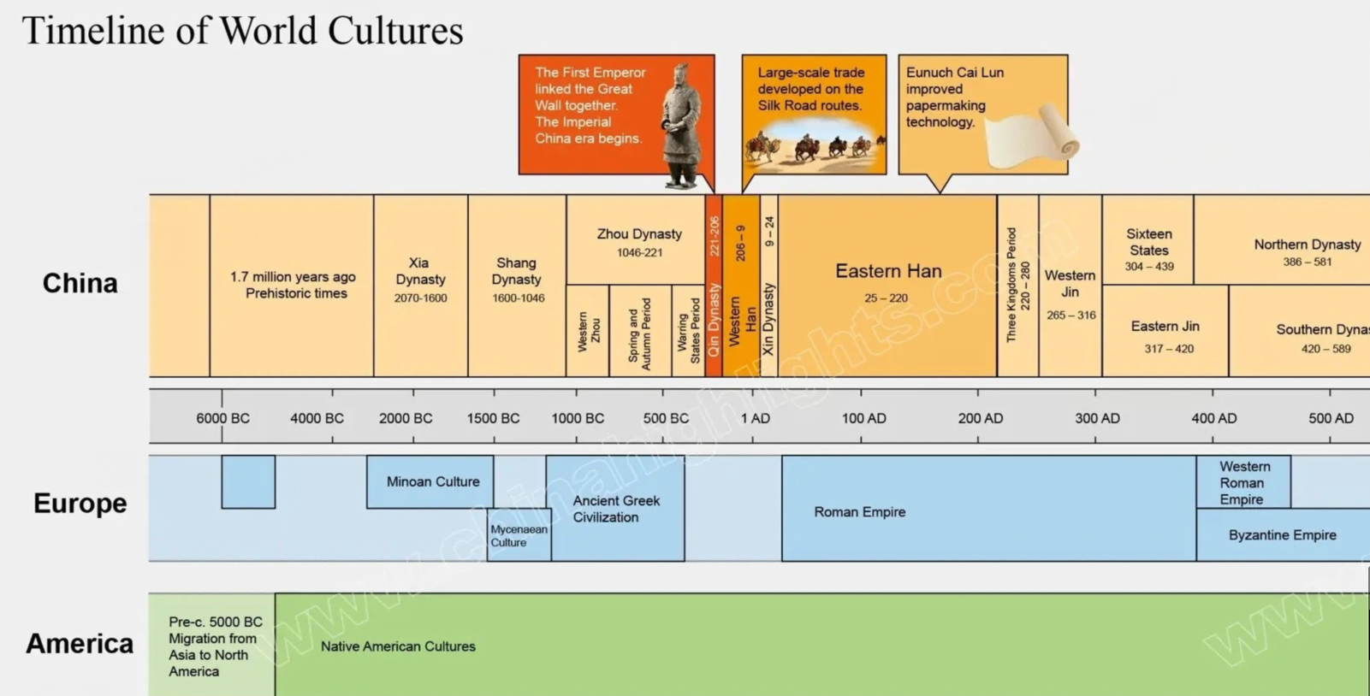
era/ˈɪərə/ n.时代;年代;纪元
1.生活在信息时代，我们可以轻松便捷地获取各种英语学习资源。2022全国乙卷应用文“Learning English beyond the classroom”调查结果短文投稿
Living in an information era, we have easy access and convenient access to various English learning resources.
2.诚然，我们这代人正处于一个新世纪，世界正经历着百年来的重大变化。巨大的变化带来了新的挑战和挑战的责任。作为新时代的学生，我们需要扫除校园里所有的不文明行为。2022武汉二月调考应用文“new era, new students征稿信”
Admittedly, we generations are in a new era when the world is undergoing major changes in a century.With great changes come new challenges and responsibilities.As students in the new era, we need to sweep away all the uncivlized behaviours in our campus.

Slide 32
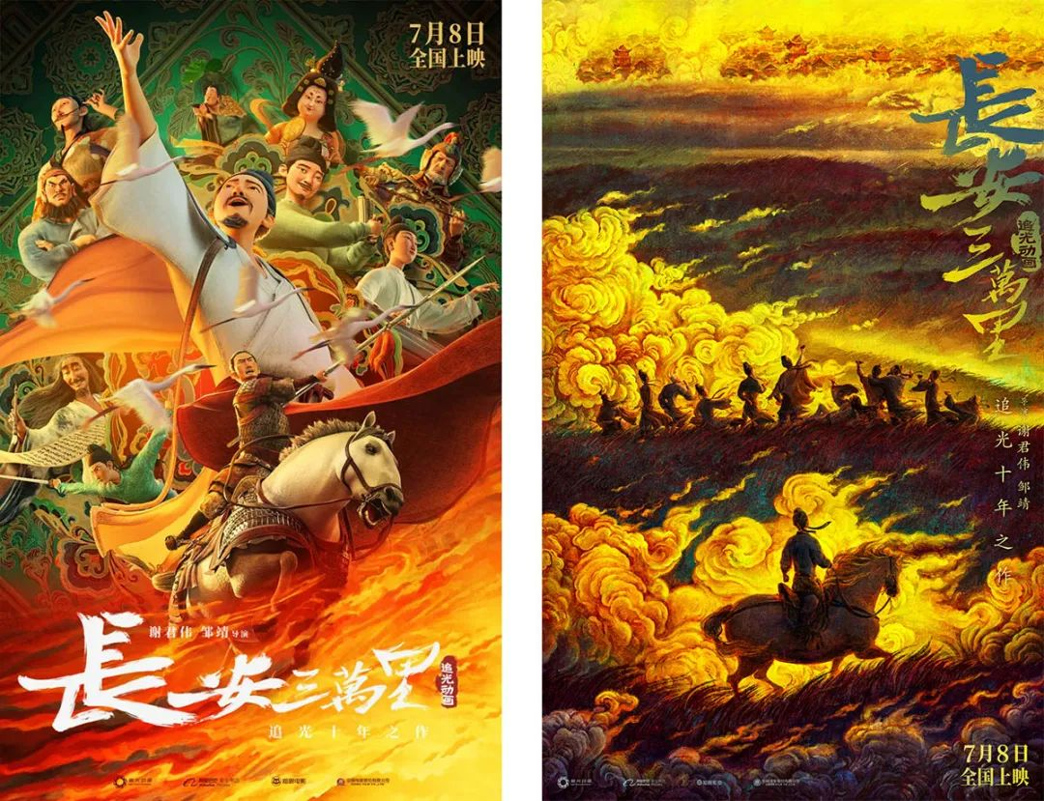
era/ˈɪərə/ n.时代;年代;纪元
3.从618年到907年，唐朝是中国历史上一个特别繁荣的时代。这部电影以唐朝为背景，描绘了这个时代最著名的一些诗人，包括李白、杜甫和高适——这些人在当代中国都是家喻户晓的名字，他们的诗歌是学校的必修课。
The film is set in the Tang dynasty, an especially prosperous era of Chinese history from 618 to 907, and depicts some of the era’s most famous poets including Li Bai, Du Fu, and Gao Shi — all household names in contemporary China, with the study of their poems mandatory at school.
depict[dɪˈpɪkt]v.描绘；描画；
mandatory[ˈmændətərɪ]adj.命令性的；指令的;

Slide 33

correspond/ˌkɒrəˈspɒnd/ vi.相一致;符合;相当于
1.衣服捐赠给人们，可以得到充分利用，符合环保政策。
Donated to people, the clothes can be put into full
display, which corresponds with the environmental- friendly policy.
2.他们之间频繁的私人通信显然有助于在两人之间播下爱情的种子。
Constant personal correspondence between them obviously helped sow the seeds of love between the two.

Slide 34
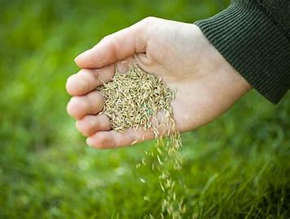
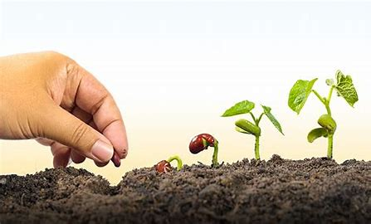
seed/si:d/ n.种子;起源;萌芽
1.这是一种有趣又富有创意地方式，可以通过种植种子和打理花园来获得亲身体验。_{2023年1月浙江英语首考应用文“认识身边的植物活动报道”}
It was a fun and creative way to have the opportunity to get hands-on experience by planting seed and tending to the garden.
2.我们种树的同时，播下了对未来希望的种子。
We planted trees and in the meantime, sowed seeds of hope for the future.

Slide 35

deadline/ˈdedlaɪn/ n.最后期限;截止日期
1.如果有兴趣，请将您的文章发送到Chinadaily@163.com，报名截止日期为7月20日。
If interested, please send your article to Chinadaily@163.com and the deadline for the entries is July 20th.
2.如果你的文章能在12月20日之前收到就更好了，400字左右就可以了。如果您认为最后期限不够，我们可以延长期限。
It would be better if we have your article before December 20th and about 400 words would be fine. We will extend the deadline if you consider the deadline is not enough.

Slide 36

contest/ˈkɒntest/ n.比赛;竞赛 vt.争取赢得
1.中文诗歌比赛定于下周六下午6点在我校3号楼一楼102室举行。（比赛时间地点）
A Chinese poetry Contest is scheduled to be held at 6 pm in Room102 on the first floor of No.3 building in our school next Saturday.
2.比赛由三个部分组成。首先，每位选手被要求在不参考笔记的情况下进行演讲，然后评委就演讲内容提出一些问题。最后，评委们对选手们的表现进行了深刻的评价，并在比赛结束后为优秀的选手颁发了奖项。（比赛过程）
The contest is made up of three parts. First of all, each contestant was
required to give his or her speech without referring to the notes and then the
judges asked some questions concerning the speech. Finally, the judges gave
some insightful remarks on the contestants’ performances and awards were
given to those excellent participants shortly after the contest.

Slide 37
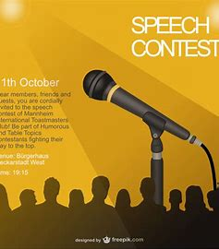
contest/ˈkɒntest/ n.比赛;竞赛 vt.争取赢得
3.因为我知道比赛的真正价值不只是赢，而是自我发现的旅程，自信的增长，以及一路上获得的新发现的激情。（比赛意义）_{2023年全国卷I读后续写“参加作文比赛”}
For I had known the true value of the contest was not just about winning, but the journey of self-discovery, the growth in confidence as well as the newfound passion I had gained along the way.

Slide 38


polish/ˈpɒlɪʃ/ vt.修改;润色 n.上光剂
1.不知您是否能抽出时间，帮我润色一下申请信和简历?
I wonder if you could spare some time and take the trouble to polish my application letter and resume.
2.为了提高我们的英语口语水平，你把我们学生随机分成两组。_{2023年全国卷I书面表达“随机分组的建议信”}
To polish up our spoken English, you grouped us students in pairs of two at random.

Slide 39


wherever/weərˈevə(r)/ conj.在任何地方 ad.在哪里
1.今后无论何时何地遇到困难，我决不向他们屈服。
Whenever and wherever I come across difficulties in the
future, never shall I submit to them.
2.无论她走到哪里，都有成群的人等着见她。
Wherever she goes, there are crowds of people waiting
to see her.

Slide 40
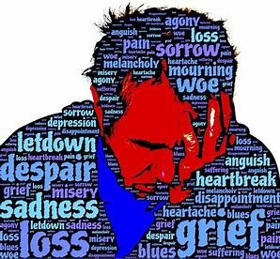
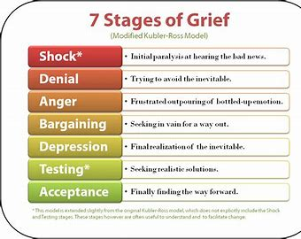
grief/gri:f/ n.悲伤;悲痛;伤心事
1.分享快乐,快乐就会加倍。分担悲伤，悲伤会减少。
Joy shared is joy increased. Grief shared is grief decreased.
2.我的悲伤吞噬了我，我觉得我是在一艘没有舵的船，航行在
迷雾中。我漫无目的地漂流着，对地平线之外的东西感到恐惧。
My grief consumed me and I felt like I was sailing through a fog in a rudderless boat. I was aimlessly drifting, fearful of what lay beyong the horizon.rudderless [ˈrʌdəlɪs] adj.无舵的;无方向舵的;
3.我感到非常悲伤，泪水涌上了我的眼睛，顺着我的脸流下来。_{浙江2021年6月高考“亲子关系”}
I felt so grieved that tears began to well up in my eyes and streamed down my face.

Slide 41

complicated/ˈkɒmplɪkeɪtɪd/ a.复杂的;难懂的
1.我猜你们中的大多数人现在都有复杂的感受:完成学位的骄傲，对即将到来的一切的兴奋，与好朋友告别的悲伤，对未知的焦虑。
I guess most of you now have complicated feelings: pride at having completed your degree, excitement about all that awaits you, sadness at having to say goodbye to good friends, anxiety about the unknown.
2.在我第一次成功地尝试了蝴蝶剪纸后，我尝试了一些更复杂的东西，比如汉字“福”和我自己的中国生肖“鸡”。_{2023高考英语全国乙卷“学习新技能的经历投稿”}
After my first successful attempt of a butterfly pattern in paper cutting, I tried something more complicated like Chinese character Fu and my own Chinese zodiac Rooster.

Slide 42


http://www.sunedu.com
Thank You!

