Slide 1

感恩遇见，相互成就，本课件资料仅供您个人参考、教学使用，严禁自行在网络传播，违者依知识产权法追究法律责任。
更多教学资源请关注
公众号：溯恩高中英语
知识产权声明

Slide 2
Good Habits for Listening
Good habits formed at youth make all the difference
------Aristotle
亚里士多德

Slide 3
一．Tick your answers
1.Did you feel noisy just now?
A.Yes B. No
2.Are you feeling focused now?
A.Yes B. A little C. Not at all
3.What do you think is the best state(状态) of doing listening exercise?
A. Focused and calm B. Not focused and distracted
4.Does the breathing practice help a little when you are trying to be focused ?
A.Yes B. No
Habit 1: Change your state for listening by doing deep breaths

Slide 4

1．What will the woman do this afternoon?（17年全国2卷）
A．Do some exercise. B．Go shopping. C． Wash her clothes.
2．Why does the woman call the man?
A ．To cancel a flight. B． To make an apology. C． To put off a meeting.
3．How much more does David need for the car? A．$ 5,000. B．$20,000. C．$25,000.
Habit 1: take deep breaths to change your state to be focused
Habit 2: read in advance and as fast as possible

Slide 5
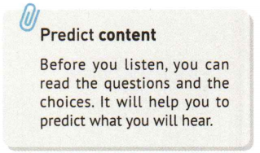
听下面一段较长对话，回答以下小题。(23年全国乙卷)
6. Which of the following does the woman dislike?
A. The bedroom. B. The sitting room. C. The kitchen.
7. What does the woman suggest they do next?
A.Go to another agency.
B.See some other flats.
C. Visit the neighbours.
听下面一段独白，回答以下小题。(23年全国乙卷)
17. Where was Open Tchaikovsky Competition held in 1986?
A. In Moscow. B. In Chelyabinsk. C. In Berlin.
18. What does Maxim say about the competition he attended at 10?
A. It inspired many young musicians.
B. It was the music event of his dreams.
C. It was a life-changing experience.
19. Which kind of music are the young players required to play?
A. Rock music. B. Pop music. C. Classical music.
20. What does Maxim value most in young players’ performance?
A. Expressiveness.表现力 B. Smoothness流畅度 C. Completeness完整性.
Habit 3:
Use the information for prediction(预测)

Slide 6
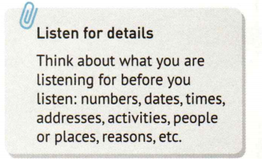
1．What will the woman do this afternoon?（17年全国2卷）
A．Do some exercise.
B．Go shopping.
C．Wash her clothes.
2．Why does the woman call the man?
A ．To cancel a flight.
B． To make an apology.
C． To put off a meeting. 3．How much more does David need for the car? A．$ 5,000. B．$20,000. C．$25,000.
锻炼/动
购物/买
洗衣服/洗/衣
取消/航班
Habit 4:
Circle the words and read the questions and focus on what you are listening for.
道歉/对不起
推迟/迟/会议/会
We read for what ?
1.Pronunciation
2. Meanning (How to understand it?)
Circle key words;
some of you may need some Chinese to reduce memory pressure.
3.Read the questions and focus on what you are listening for

Slide 7
1．What will the woman do this afternoon?（17年全国2卷）
A．Do some exercise.
B．Go shopping.
C．Wash her clothes.
2．Why does the woman call the man?
A ．To cancel a flight.
B． To make an apology.
C． To put off a meeting. 3．How much more does David need for the car? A．$ 5,000. B．$20,000. C．$25,000.
the woman’s activity
the woman’s calling reason/
the purpose of the woman’ calling
numbers
We read for what ?
1.Pronunciation
2. Meanning (How to understand it?)
Circle key words; some of you may need some Chinese to reduce memory pressure.
3.Read the questions and focus on what you are listening for

Slide 8
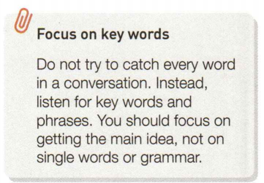
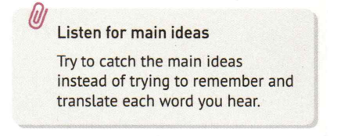
1．What will the woman do this afternoon?（17年全国2卷）
A．Do some exercise. B．Go shopping. C． Wash her clothes.
2．Why does the woman call the man?
A ．To cancel a flight. B． To make an apology. C． To put off a meeting.
3．How much more does David need for the car? A．$ 5,000. B．$20,000. C．$25,000.
4．What is Jane doing? A．Planning a tour. B．Calling her father. C．Asking for leave.
5 ．How does the man feel? A．Tired. B．Dizzy眩晕. C．Thirsty.
Jane’s activity
the man’s feeling

Slide 9
Text 1
M: Let’s go for a nice walk into the country this afternoon.
W: I certainly could enjoy the exercise, but I’ve agreed to go with Alice to buy some clothes.
Text 2
W: Hello, Mr. Smith. I’m afraid Dr. Brown won’t be able to see you today. He’s still waiting for a flight out of New York. He said he would meet you tomorrow afternoon. Is it OK?
M: Sounds good. Thank you for calling.
Text 3
W: David, have you saved enough for the car?
M: I have$20, 000 now. And the car costs 25, 000. My parents said they would like to help, but I don’t want to use their money.
Text 4
W: Dr. Block, I need to take a few days off, because my father is coming over to visit. And I need to show him around the city.
M: OK, Jane. But be sure to come back to work next week.
Text 5
M: Amy, my head is spinning. It must be a touch of the sun.
W: You’d better lie back still for a while. Take it easy for the rest of the day, and stay in the shade. It’s too hot today.
Habit 5:
1.Read the text of your wrong questions.
2. Understand new words and expressions

Slide 10
Good Habits for Listening
Self-assessment(自我评估)
1.Have you mastered how to change to the best state for listening？
2.Have you kept it in mind to read the questions in advance and as fast as possible?
3.Can you do the prediction ?
4. Have you learned to read the questions and choices for pronunciations and meanings?
5.Can you remember to check the texts to learn new words and read the texts?
Good habits formed at youth make all the difference
------Aristotle
亚里士多德

Slide 11
Text 6（66词）挑选公寓
W: What do you think, Terry?
M: Well, it has one more bedroom than the last flat and the sitting room is big.
W: But there is not enough cupboard space in the kitchen.
M: It’s cheaper than the last one we saw and it is in a good neighborhood.
W: Well, maybe we’ll have to see if the agent has anything else to show us.
【词汇】
agent n. （房产）中介

Slide 12
Text 10（190词）音乐比赛裁判讲演
M: Hello, I’m Maxim Vengerov, and I’m very happy to share with you my connection with open Tchaikovsky competition. It was June 1986 when I came to Moscow to participate in open Tchaikovsky competition at the age of 10 from Chelyabinsk. This was actually the turning point of my life. Then I attended a world music festival in Berlin. And it was interesting to say that a kid made his breakthrough already at the age of ten. And that was me. Now as a judge of the competition, I can see clearly the huge challenges facing the musicians in the competition. Where else can you see young players playing within ten days classical works and Russian traditional music before coming to the final stage? As a musician, it’s important to give maximum attention and time to your own reflections of your own feelings. So, what I’m really looking for in the competition is to meet someone who can touch me musically. I want to see the seed, at least the seed of the great tree that can grow. I would go for this violinist. I would go for this musician.
【词汇与句子】
open Tchaikovsky competition 柴可夫斯基公开赛
Chelyabinsk （俄罗斯）车里雅宾斯克
breakthrough 突破
go for 选择；偏好

