Slide 1

感恩遇见，相互成就，本课件资料仅供您个人参考、教学使用，严禁自行在网络传播，违者依知识产权法追究法律责任。
更多教学资源请关注
公众号：溯恩高中英语
知识产权声明

Slide 2

问题--解决型高考应用文写作深度学习与能力提升
2023年6月全国新课标I/II 卷应用文写作课堂实践与研讨
绍兴市上虞区丰惠中学 徐玉茹

Slide 3
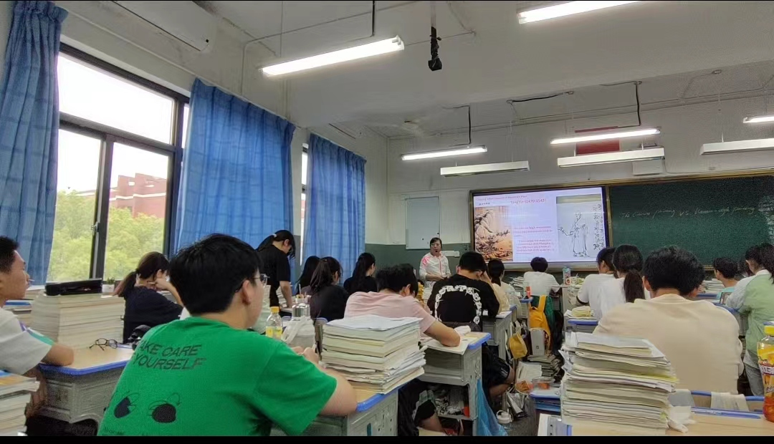

Activity 1 Speaking and Talking
As a Senior Three student, how should we learn English well?
……
……
……
Is it reasonable to be grouped in pairs randomly for the spoken English training?
Why or Why not?
Mr. Ryan, our English-speaking instructor
Please present your reasons.
……
……
……

Slide 4
高考真题再现 (2023年6月全国卷I/II)
假如你是李华, 外教Ryan准备将学生随机分为两人一组, 让大家课后练习口语, 你认为这样分组存在问题。请你给外教写一封邮件，内容包括：
说明问题；
提出建议。
Dear Ryan,
I’m Li Hua from Class 3.
Yours,
Li Hua

Slide 5
Activity 2 Making a question
Group two or four and have a discussion about how to structure this short passage. Then tell us which points are difficult to write.
Beginning: …
…
Structure
Body: …
Difficult points:
…
Ending: …

Slide 6
Activity 3 Find a problem
Analyse the problem
1.How to express key words?
外教Ryan准备将学生随机分为两人一组，让大家课后练习口语。
1.外教
Mr. Ryan
English-speaking instructor
foreign teacher
2. 随机
at random
randomly
in a random manner
group sb.in pairs
work in pairs
pair (sb) off
3. 两人一组
group of two
pair up
spoken English
verbal English
oral English
4. 口语

Slide 7
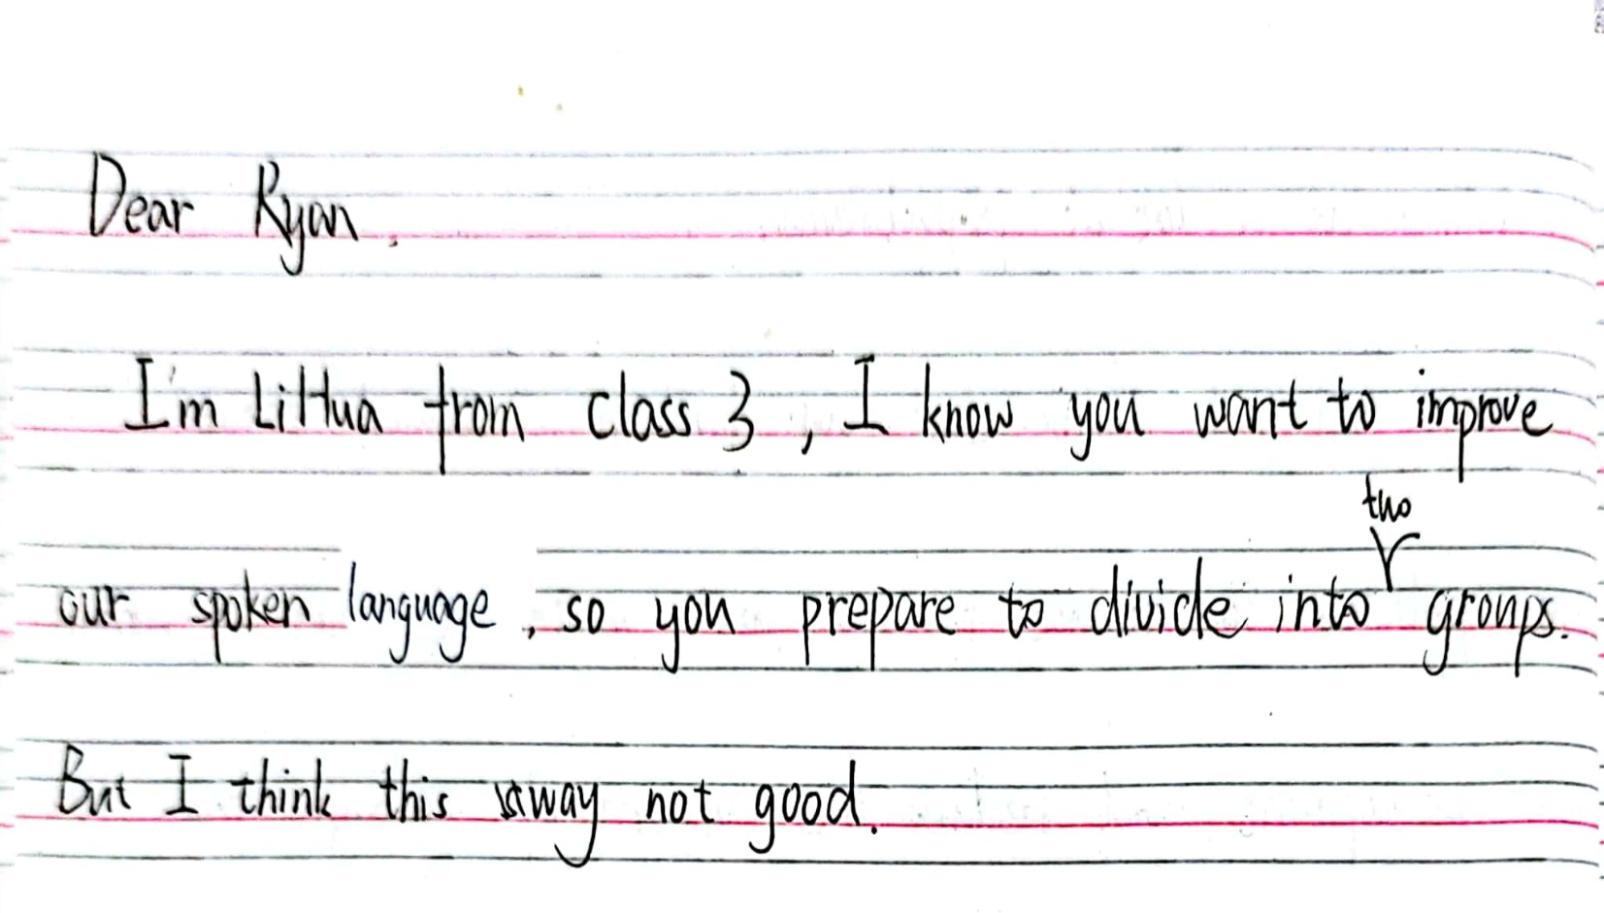
Activity 3 Find a problem
Analyse the problem
1.要点遗漏。
2.中式英语。
。
A 同学

Slide 8
Activity 4 Solve the problem
How to structure Beginning
Skill1：平铺直叙
(Background + Purpose)
得知(Learning that )你想把我们随机(randomly)两人分组(group us in pairs)进行课后口语训练(spoken English )，我不认为它是一个好主意。
Learning that you intend to randomly group us in pairs to practise spoken English after class, I don’t think it’s a good idea.
Skill2: 开门见山
我不认为以随机的方式( in a random way) 进行分组练习( work in pair)是个好主意。
I don’t think it’s a fantastic idea to work in pairs in a random way.

Slide 9
Skill3: 欲抑先扬，礼貌至上
我真的非常喜欢你的教学风格。但是，能做一些相关(relevant adjustments )
调整将再好不过。
I really appreciate your teaching style , but it would be better if some relevant adjustments could be made .
Skill4: 语气曲迂，语法妙用
我因占用（occupy）了你的宝贵(precious)时间而深感歉意(apologize to sb. for sth. )。如果我是你的话，我将做一些相应的调整(make some adjustments )。
I’d like to apologize to you for occupying your precious time. If I were you, I would make some adjustments accordingly.

Slide 10
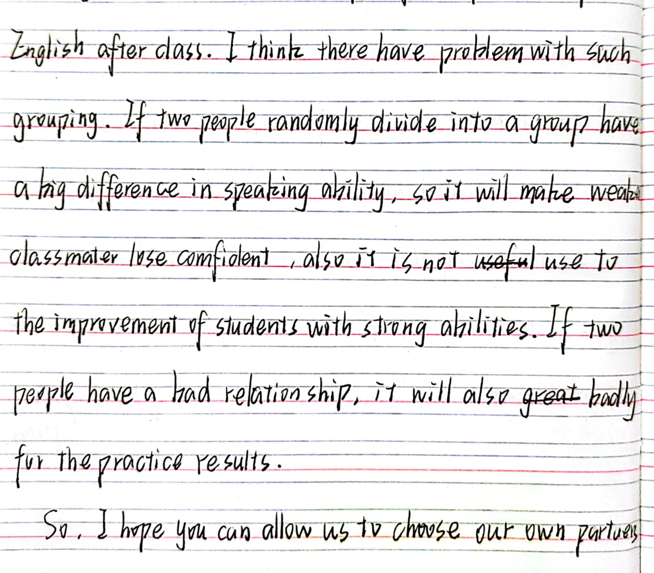
Activity 3 Find a problem
Analyse the problem
B同学: 1.就分组B提出了几个问题？
2.给了几个建议？
不会审题:
分析问题、解决问题表达不清

Slide 11
Part2. How to structure Body?
Activity 4 Solve the problem
(Problems + Proposals)
假如你是李华，外教Ryan准备将学生随机分为两人一组，让大家课后练习口语，你认为这样分组存在问题。请你给外教写一封邮件，内容包括：
说明问题
提出建议
unbalanced language abilities
人数太少
Problem1
随机分组
different interests and hobbies
Problem2:两人一组
话题有限
feel uncomfortable or less motivated
Proposals
1.兴趣分组
2.自愿分组
Proposals
1. 4~5人一组
2. 以优带弱

Slide 12
Problem1: 随机分组
1. 如果你一定要坚持随机分组（ working in pairs ）的话，学生会感到不舒服的。
If you insisted on working in pairs, students would feel uncomfortable.
2. 随意分组（ Randomly pairing up ）会使水平更高的同学（ the more advanced students ）在对话中占主导地位（ dominate the conversation ）。相反，有待提高的同学则处于不利地位（ be at a disadvantage ）。
Randomly pairing up will make the more advanced students dominate the conversation while the other students to be improved will be at a disadvantage.

Slide 13
Proposal 1
1.为什么不根据他们的爱好和语言水平（ language levels ）去分组（ group ）呢？
Why not group students according to their hobbies and language levels?
2.自由选择他们自己的伙伴（ partners ）既可以让他们在快乐的氛围中（ in a happy atmosphere ）学习又能提高学习效率（ learning efficiency ）。
Choosing their own partners freely not only allows them to learn in a happy atmosphere but also improves learning efficiency.

Slide 14
Problem2: 两人分组
1.不考虑到学生的兴趣和爱好(taking students' interests and hobbies into account )会难以取得良好的效果。
Not taking students' interests and hobbies into account will be difficult to have a good effect.
2.如果两人分组的话(are grouped in pairs)，万一没有共同爱好，他们的口语练习将会陷入无话可说的境地(sth. be left into a state of silence).
If they are grouped in pairs, their oral practice will be left into a state of silence without any common interest.
Imitation
如果随机进行分组的话，遇到困难他们将会不知所措（be at a loss ）的。
如果两人分组的话，缺乏共同的兴趣他们将会倍感尴尬（ be stuck in an awkward situation ）。

Slide 15
Proposal 2
1.我认为四到五人分组会更好，其中的口语大咖(a hot shot)可以帮助其他学生快速进步。
Personally, a group of four or five would be better. A hot shot of this group can help others make rapid progress.
2.多人组将会为学生提供更广泛的话题。
A group of multiple members will provide a wider range of topics.

Slide 16
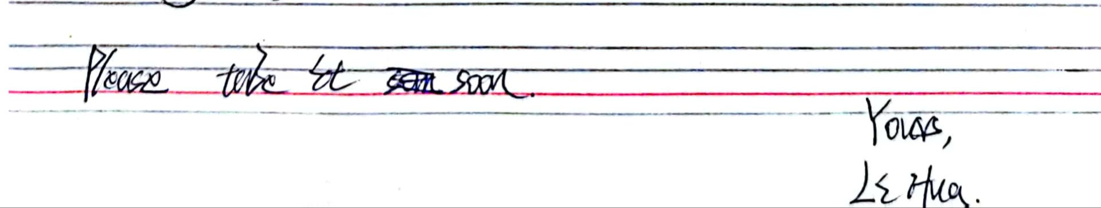
Activity 3 Find a problem
Analyse the problem
C 同学
Part3. How to structure Ending
Ending (Thanks +Wishes )
Solve the problem
如果你能考虑我的建议我将不胜感激。
I would appreciate it if you can consider my suggestion.
谢谢你考虑我的建议。我坚信如果采用自愿结合的方式，我们的口语将会变得更好。
Thank you for considering my suggestions. I firmly hold the belief that our spoken English will be better if we pair off voluntarily.

Slide 17
Activity 5 Appreciation
Dear Ryan,
I’m Li Hua from Class 3. Learning that you intend to randomly group us in pairs to practise spoken English after class, I don’t think it’s a good idea. The reasons are as follows.
To begin with, randomly pairing up will make the more advanced students dominate the conversation while the other students to be improved will be at a disadvantage. Besides, students may feel uncomfortable if paired with someone who don’t get along well with or have difficulty communicating with.
My suggestion is to group students based on their language abilities or to let students choose their own partners voluntarily. In this way, not only can everyone feel more comfortable but also improve their learning efficiency.
Thank you for considering my suggestions.
Yours sincerely,
Li Hua

Slide 18
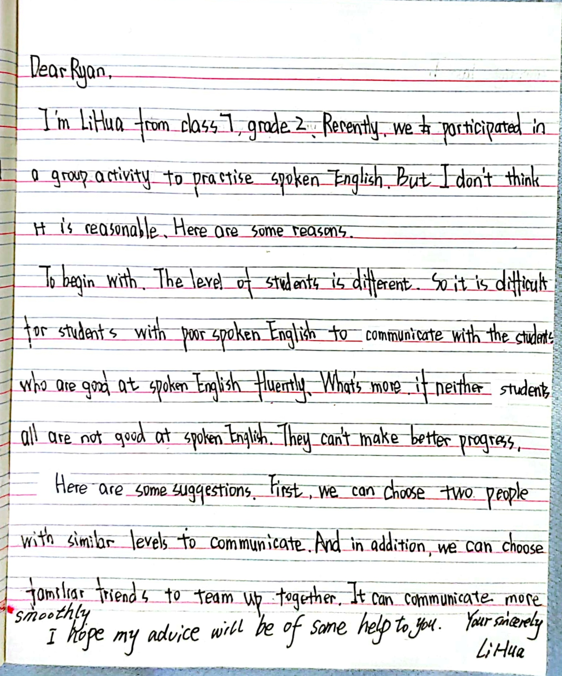


Homework
Please help Class D revise and polish this composition and write down your suggestions in the comments section below.
THE COMMENTS SECTION
D同学习作修改与润色

