Slide 1

感恩遇见，相互成就，本课件资料仅供您个人参考、教学使用，严禁自行在网络传播，违者依知识产权法追究法律责任。
更多教学资源请关注
公众号：溯恩高中英语
知识产权声明

Slide 2
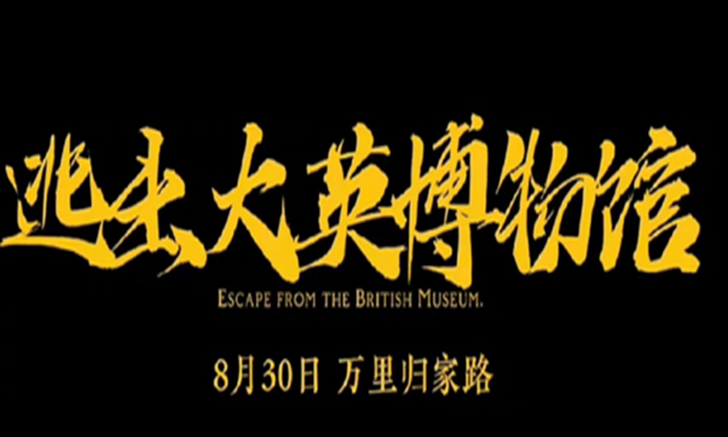
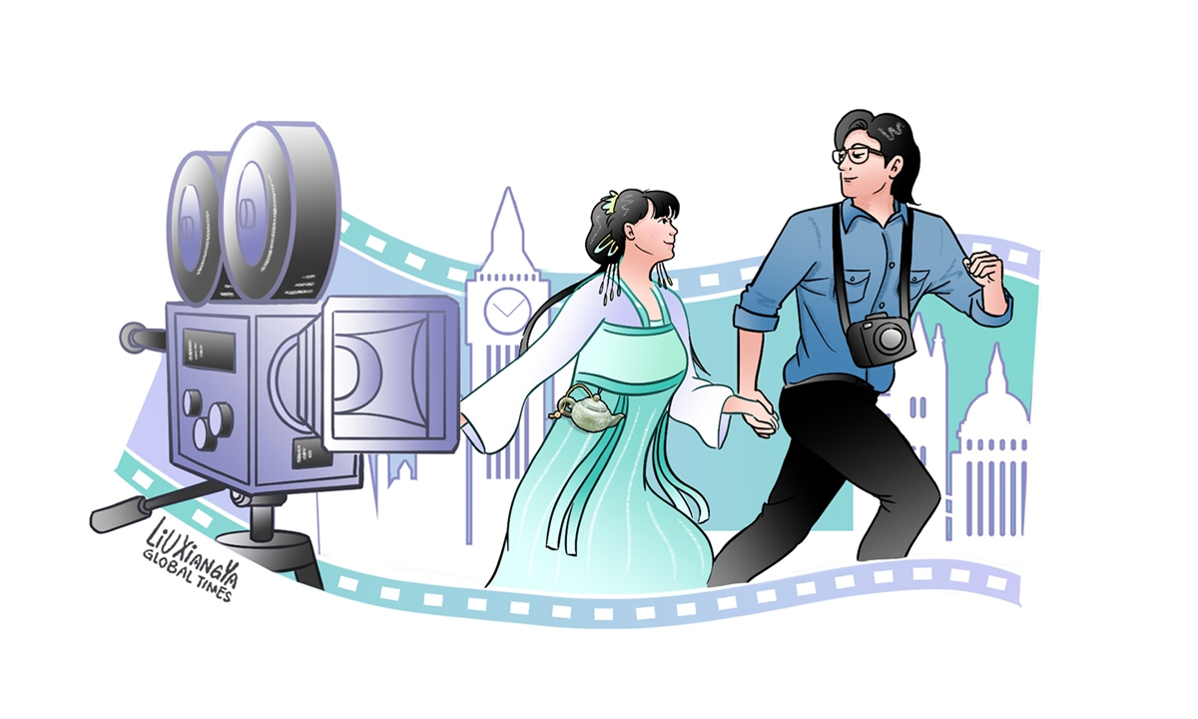
外刊 “逃出大英博物馆”
& 高三A9协作体应用文“遇见中国戏曲Meet the Chinese Opera”

Slide 3

spark: to cause sth. to start, especially suddenly
A video series named Escape from the British Museum will be released on Wednesday, with its trailer (预告) having sparked a lot of 1.___________ (discuss) in China’s social media recently.
Directed by two Chinese vloggers, the three-episode series tells the story of 2._______ a Chinese cultural relic escapes from the British Museum and finds its way back to China.
The trailer for the series has been trending online since it 3._____________ (release) on Sunday, sparking discussion about how the British Museum should return Chinese relics plundered (掠夺) by the UK. It has now been viewed on Sina Weibo more than 1.5 million times.
The Global Times published an editorial (社评) on Sunday night, 4.______ (urge) the museum to return Chinese relics 5.________ (acquire) through 6._________ (proper) channels to China free of charge.
The videos were inspired by a netizen who suggested making a video recording the ordeal (磨难;考验) of Chinese cultural relics returning home from the UK to celebrate the Chinese lunar New Year.
In the video series, a female vlogger plays the role of an ancient Chinese jade teapot, 7._____ her male partner is a journalist who helps the artifact return to China.
The duo (二人组) went to the UK in June and spent three months 8.___________ (shoot) the video. They said the story is based on 9._______(history) facts and aims to draw attention to the Chinese cultural relics held abroad.
Currently, the museum has a total of 23,000 Chinese relics, while about 2,000 Chinese relics are on long-term display. The Chinese objects, spanning (时间跨越) from the Neolithic age 10._____ the present, include paintings, prints, jade and ceramics.
discussion
how
was released
urging
acquired
improper
while
sth. created by humans remaining from a particular period
shooting
historic
famous or important in history
to

Slide 4

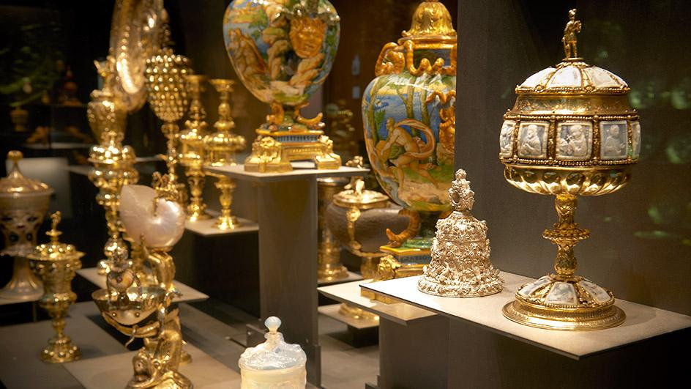
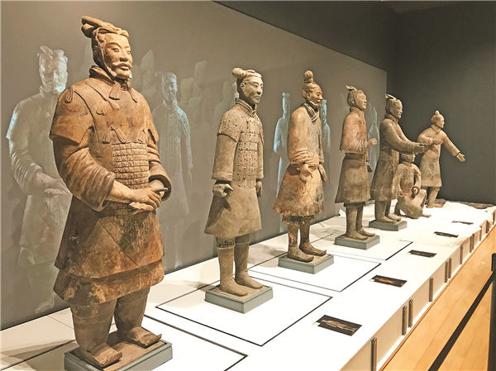
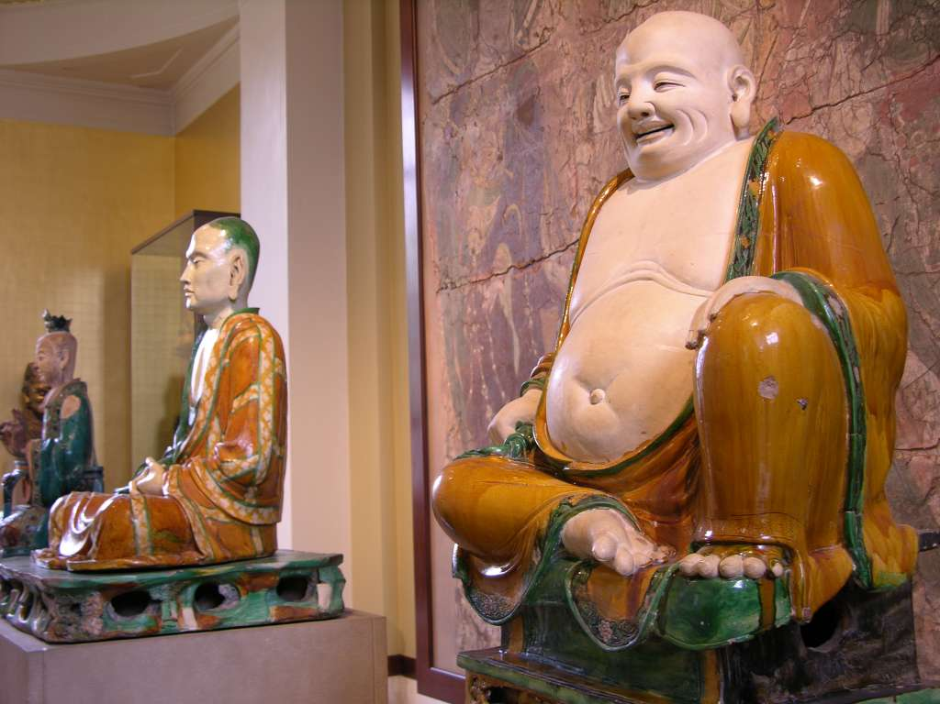
What’s the significance of the video series?
How are Chinese artifacts exhibited in the British Museum?
demonstrates the enthusiasm of young people for history and traditional culture, their emphasis on cultural inheritance and preservation
struck a chord in people’s hearts (引起共鸣) and reflects the deep patriotic sentiments
reflect Chinese people’s call/ yearning/ fervent (热烈的;炽热的) hope for return of lost artifacts/ cultural treasures/ cultural relics from the museum
Over 23,000 pieces are crammed and unprotected in the British Museum.

Slide 5
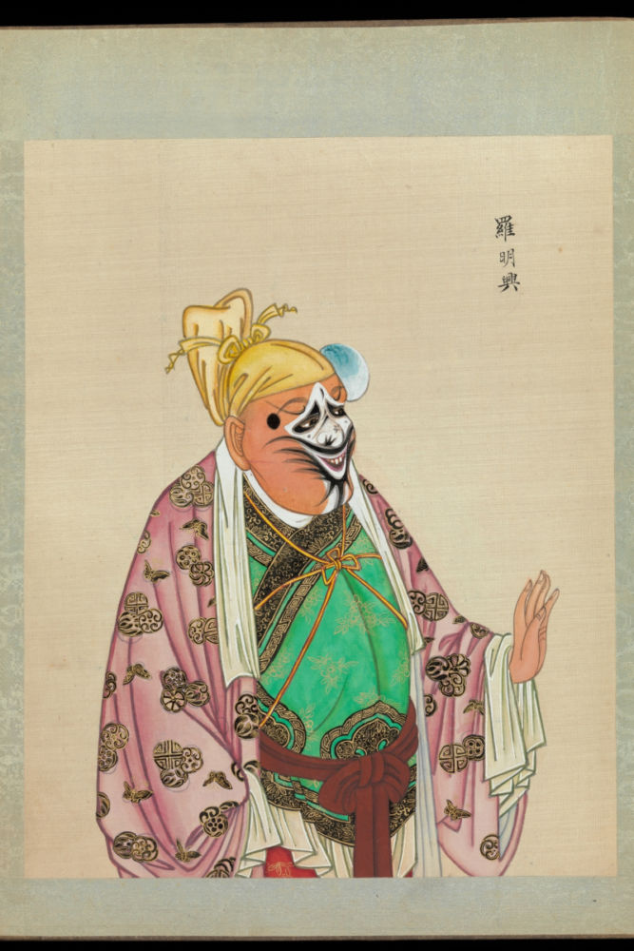
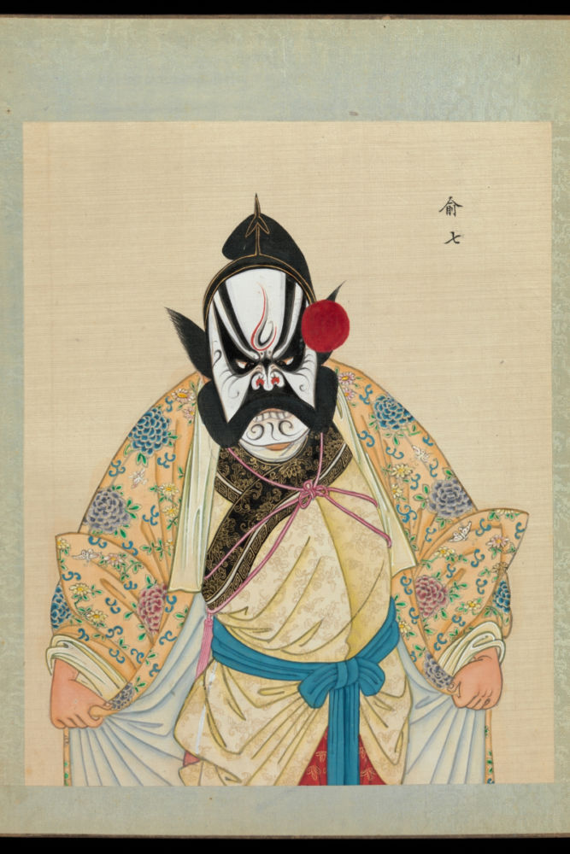
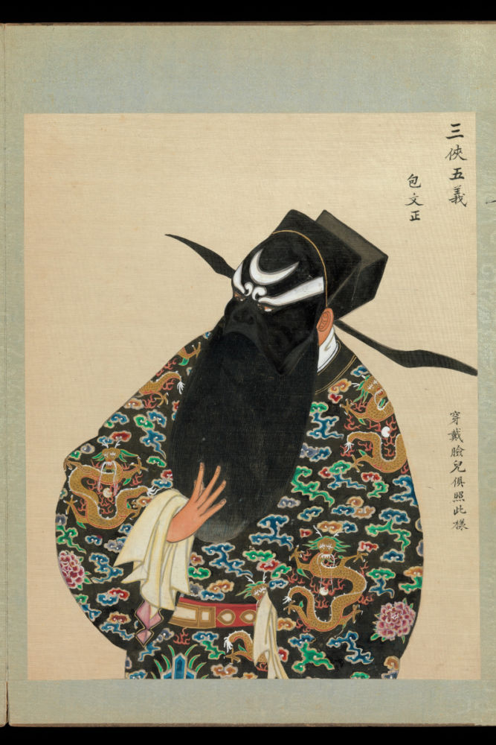
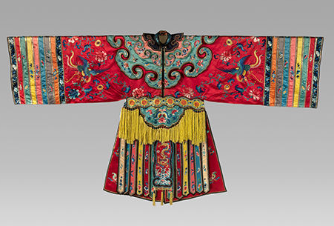
The Metropolitan Museum of Art (New York, USA)
“One hundred portraits of Peking opera characters”
“Chinese Opera Costumes of the 18th and 19th Centuries” Exhibition
What else can be on display?
Content: An introduction to the origin, history, differnt genres (类型;流派), theatrical characters, instruments, costumes, make-up/ masks, singing styles and techniques, gestures and movements, representatives...
Form: portraits, photos, paintings, audio-visual materials, scripts of lines (原稿;手稿)...

Slide 6
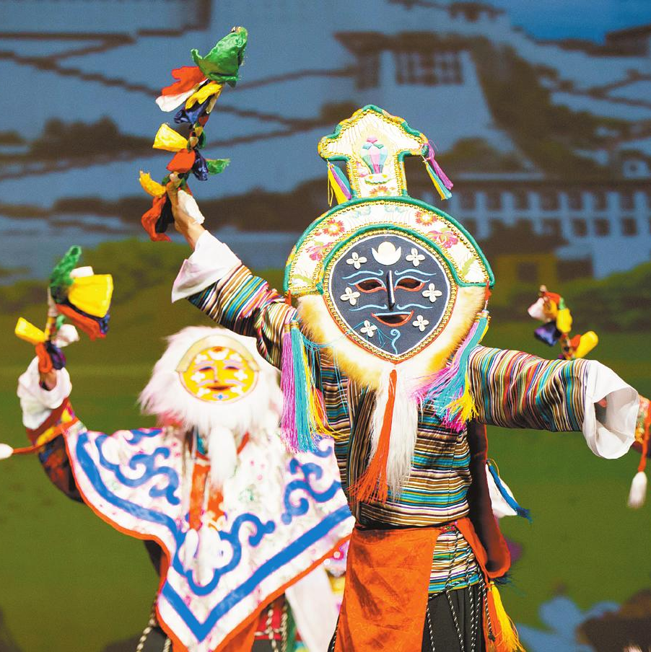
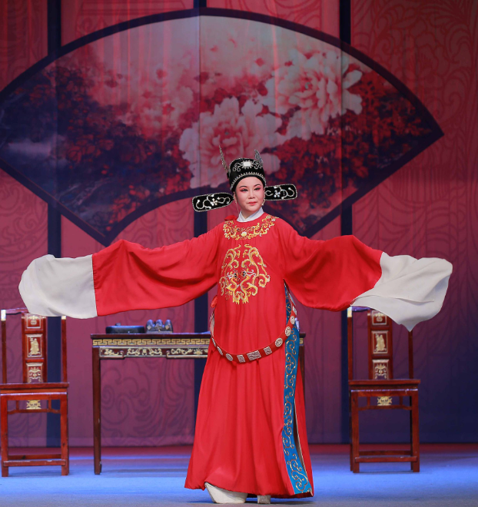
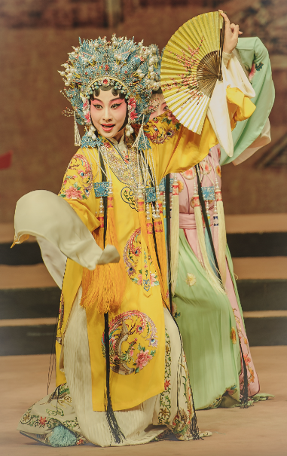
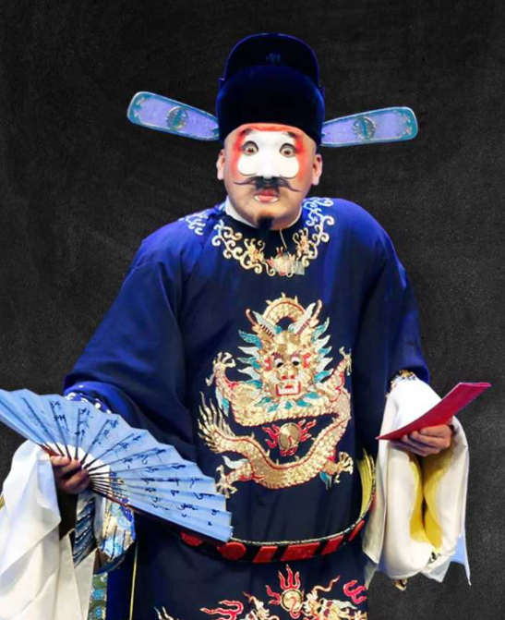
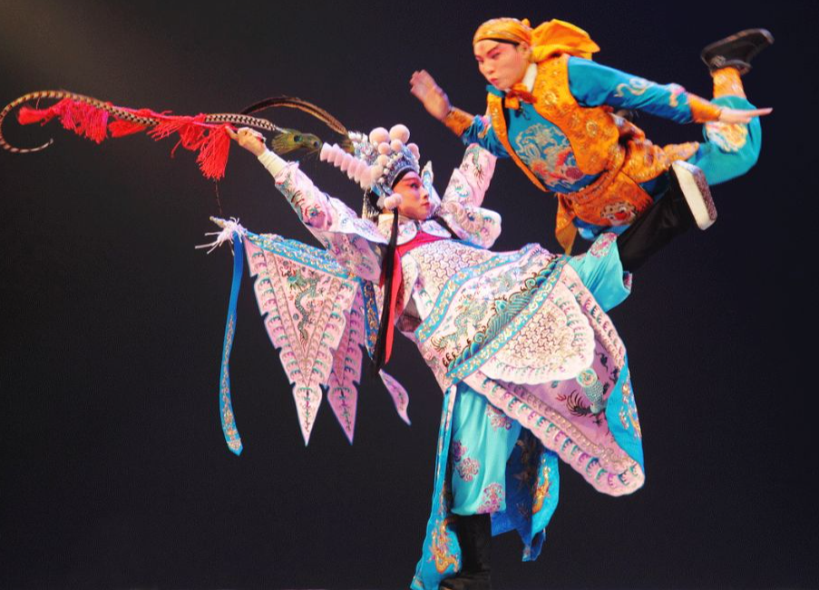
Consisting of ancient literature, traditional Chinese dance, music, fine arts, kung fu, acrobatics (杂技) and performance art, the Chinese opera boasts more than 360 genres, which co-exist in the vast land of the country.
Tibetan Opera
Huangmei Opera
Peking Opera
Kun Opera Intangible Cultural Heritage of Humanity in 2009
Wu Opera

Slide 7
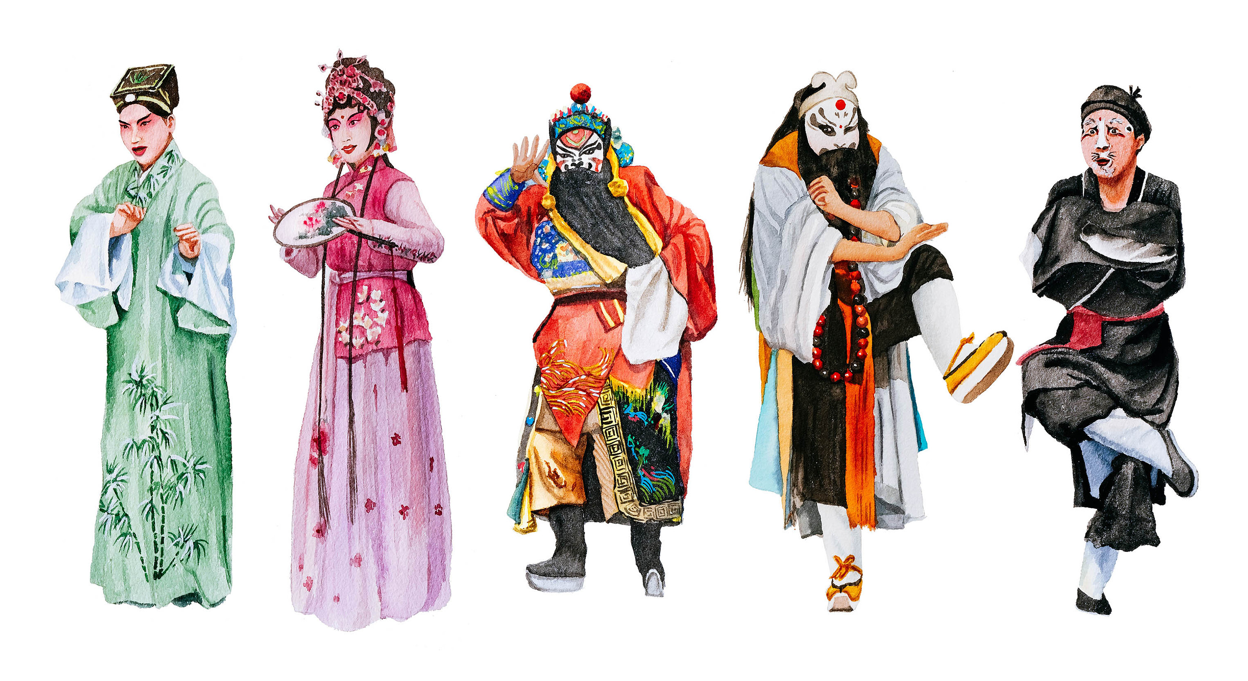
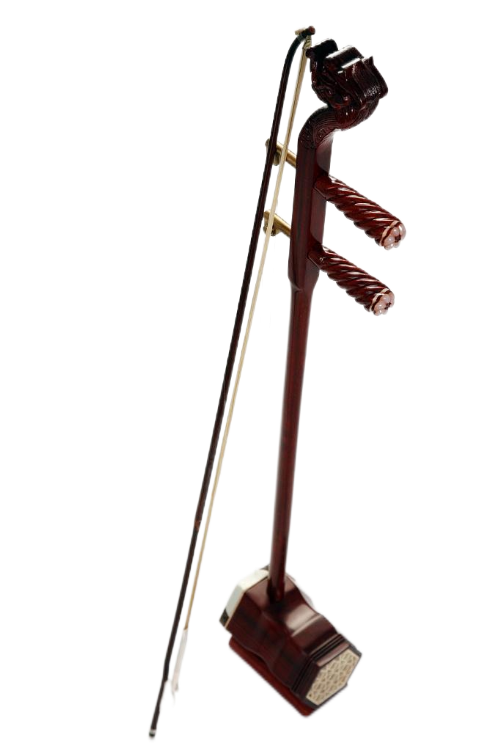
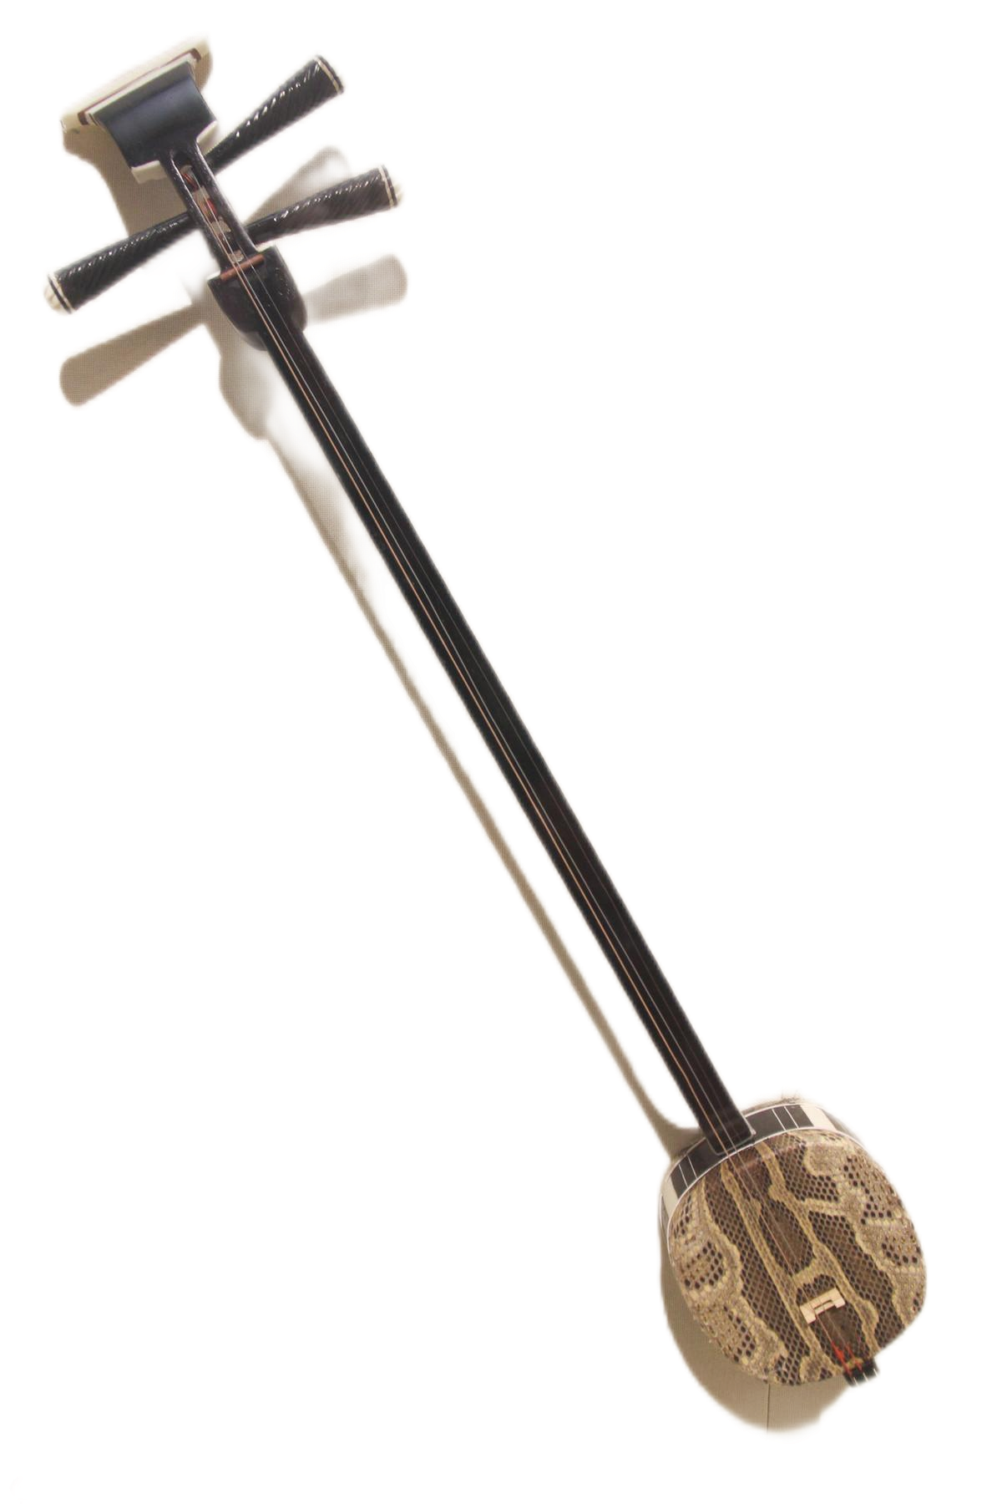
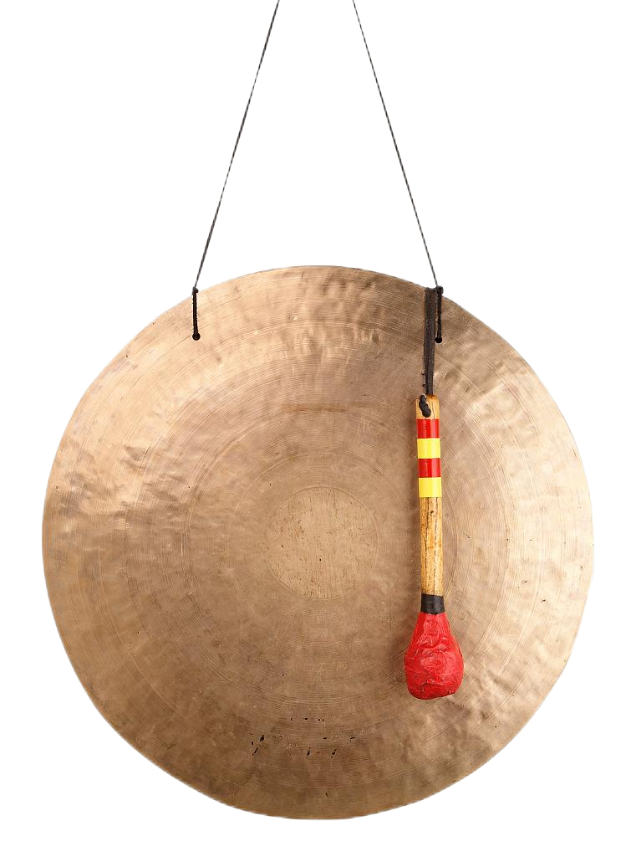
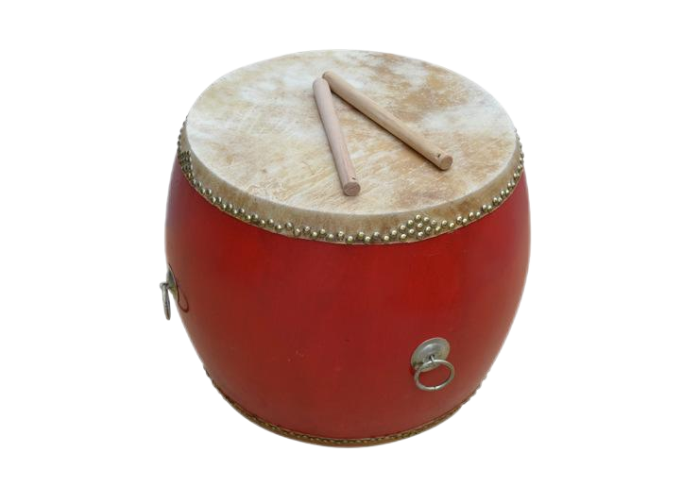
Types of theatrical characters: Sheng, Dan, Jing, Mo, Chou
Opera is a jewel on the crown of art.
Traditional musical instrument for Chinese Opera: erhu, gong (锣), sanxian, drum

Slide 8
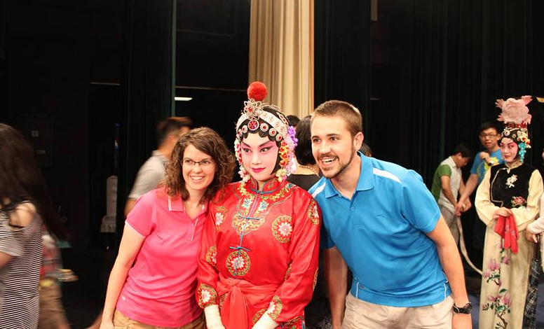
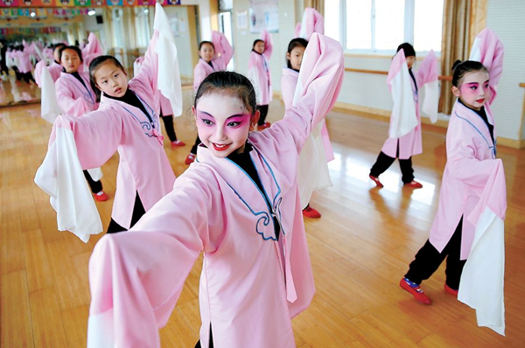
What’s the significance of holding this exhibition?
bring Chinese Opera to the attention of youths as well as a wider community in domestic China and the world.
help people gain a glimpse into the fascination/ charm of this special arm form which is a perfect blend of vocal music, kungfu and aesthetics/ which embodies the strong will and perseverance of the Chinese people.

Slide 9
假定你是李华，你在暑期里参观了市博物馆举办的一次“遇见中国戏曲(Meet the Chinese Opera)”的展览，请你为你校英文报写一则评论，内容包括：
1. 展览概况；
2. 观展感受；
3. 提出建议。

Slide 10
问题：
1. 人称：
Wandering beside the treasures, you will be immersed in such a fantastic art form and marvel at its elegant gestures and movements together with extraordinary singing styles and techniques.
2. 文体/ 格式
I’m writing to share with you some of my opinion.
Why not share some interesting...
3. 要点
4. 无关内容：
演出/表演合适吗？
What impressed me most was the engaging performance.
展览目的要不要写？
Aimed at provoking citizen’s passion for Chinese Operas and passing down the colorful traditional custom, the exhibition organized various shows with Chinese characteristics.
Aimed at improving the public’s passion for Chinese Operas and passing down this traditional heritage, the city museum brought various exhibitions about Chinese Operas to us.
5. 语言
By the way, I think if museum could add some immersing activities will be better, such as let visitor try those costumes and makeups.
Nothing is no better than publicize Chinese Operas through livestreaming.

Slide 11
词块勘误
1. 在暑假： in/ during the summer vacation/ holiday
2. 市博物馆：the city museum
3. 举办展览：hold/ host an exhibition 展览：exhibition/ show/ display
4. 展品：exhibits/ items on display/ artifacts 展厅：exhibition hall/ showroom
5. 让人印象深刻：leave a deep impression on me/ be impressive/ impress me deeply
6. 参与活动：engage in/ take part in/ get involved in activities
7. 展现……的美丽/魅力：unveil its beauty/ display its charm
8. 通过这种方式：in this way
9. 毫无疑问：Without doubt,/ Undoubtedly,/ There is no doubt that...
10. 很值得一游：sp. be well worth visiting/ a visit
11. 号召年轻人传承中国传统文化：call on/ appeal to/ advocate the youth/ youngsters to pass down/ inherit/ carry forward (发扬) traditional Chinese culture
12. 提升对本国文化的自豪感：feel prouder about / boost confidence in Chinese culture
13. 一次难忘的经历：an unforgettable experience
14. 增强我对……的理解：broaden my knowledge base about.../ enhance my understanding of .../ help me gain a deeper insight into/ have a bigger picture of ...
15. 增加对……的兴趣：ignite/ fuel my enthusiasm/ passion for sth.

Slide 12
开头段介绍：简短、奠定全文基调
The summer vacation witnessed an exhibition held by city museum on the theme of “Meet the Chinese Operas”, which endowed me with an exhilarating and enjoyable experience/ which showcased the dazzling/ awe-inspiring charm of Chinese Operas culture.
This summer vacation, a distinguished show with the topic of “Meet the Chinese Operas” unveiled/ revealed its beauty in the city museum.

Slide 13
概况：
展品（类型、数量、种类）；展览时间；展览（主题/意义）
Crammed with over 1000 pieces of cultural items like delicate robes, specially-designed masks, and even some priceless audio-visual materials of famous actors, this exhibition is no doubt/ undoubtedly a mecca/ a must-see place for Chinese Opera lovers and keeps all those present spellbound.
The show boasts a diversity of/ more than 1000 elaborately-selected exhibits, such as masks and costumes, musical instruments and written scripts of famous plays like Romance of the Western Chamber.
Fancy/ / Exquisite/ Delicate costumes, traditional musical instruments as well as historical scripts of lines are displayed in different parts/ sections, telling us the glorious past of these unique Chinese Operas. (无灵主语 +分词结构)
Also, many glorious and historical treasures are showcased, each narrating their unique tales throughout the ups and downs of Chinese Operas. (无灵主语+独立主格)

Slide 14
Varieties of Chinese Operas are introduced in detail, ranging from Peking Operas, Yue Operas, Kunqu, to Huangmei Operas, which enabled me to learn about their distinctive features and geographical distribution.
Ranging from the profound history to the representative Operas of different regions, some prestigious masters to classic works, this exhibition draws a comprehensive and fascinating picture for us visitors.
个人视角--阐述经历
Wandering in the museum, I felt like I was stepping/ embarking on a trip around China and experienced the beauty of cultures and customs on this vast land. The highlight of the exhibition was those stands offering us the chance to wear make-up like actors in the show, which makes it fun to engage in.
I was astonished by their smooth movements and exaggerated make-ups shown in the video, and was also immersed in the brilliance of Chinese civilization.

Slide 15
感受：
During the show, I was treated to a remarkable audio-visual feast with rich content and glorious history.
Not only did I harvest full relaxation and pleasure, but I gained deeper insights into the fantastic Chinese Operas and boost my cultural confidence/ national pride.
It was indeed instructive and rewarding, taking me on a magical trip to learn something beyond classroom and appreciate the wisdom of the Chinese people.
I think exhibitions like this can give us a glimpse into the essence of Chinese culture as well as a unique perspective to view traditional art.

Slide 16
建议：（角度自选）
对同龄人：了解戏剧、文化传承发展
So fascinating is the exhibition that I strongly suggest Chinese Operas fans/ lovers/ enthusiasts (should) don’t miss/ seize the chance and catch a glimpse of this intangible cultural heritage.
As this show will last till next month, I highly recommend you to take a glimpse of this perfect blend of vocal skills, Kungfu and aesthetics.
After years of decline, Chinese Operas has been slowly regaining its popularity. We students should also try our utmost to acknowledge, inherit and promote this precious art and other art forms as well.
In my opinion, the declining Chinese Operas should be brought to the attention of more youths and the world, otherwise, it will be something that can only be seen inside the museum.
Colorful as our culture is, only when we do our bit to pass it down can our extraordinary cultural treasure regain its vigor/ vitality and sustain/ guarantee a promising/ prosperous future.

Slide 17
对政府/学校
In order to gain a deeper insight into our traditional culture and thus improve our cultural confidence, it’s necessary for the Cultural Bureau/ Schools to host more exhibitions like this and I also suggest a live performance to provide us with a more immersive experience.
对举办方
By taking advantage of modern technology and social media, this exhibition can also be put online so as to make it accessible to a wider community both domestically and internationally.
Nothing is better than integrating some modern technologies which can certainly/ truly reform the visitors’ experience/ give a modern touch to the traditional art form.
utilize holographic image (全息影像) to revive the Chinese Operas classics or celebrities
apply AI/ VR-assisted technology to creating our own virtual characters for an immersive experience

Slide 18
A revised possible version:
This summer holiday, numerous visitors flocked to the “Meet the Chinese Opera” exhibition in the city museum. (首段简短清晰，介绍背景、奠定基调)
The museum exhibits many fantastic pictures and precious videos, ranging from Peking Opera, Shaoxing Opera to Kunqu Opera, bringing an audio-visual feast for the Chinese Opera lovers.(概况-形式、种类、特点) I enjoyed every second of the display and was particularly attracted by Peking Opera Legend of the White Snake. Exposed to the captivating plots, fancy colors and deep affection, I seemed to be personally on the scene (身临其境). (感受-结合内容)
Sincerely, I hope the display can last longer and more distinguished works can be displayed to satisfy our mounting zest for this unique cultural heritage. (建议-实用性、礼貌原则)

