Slide 1

感恩遇见，相互成就，本课件资料仅供您个人参考、教学使用，严禁自行在网络传播，违者依知识产权法追究法律责任。
更多教学资源请关注
公众号：溯恩高中英语
知识产权声明

Slide 2
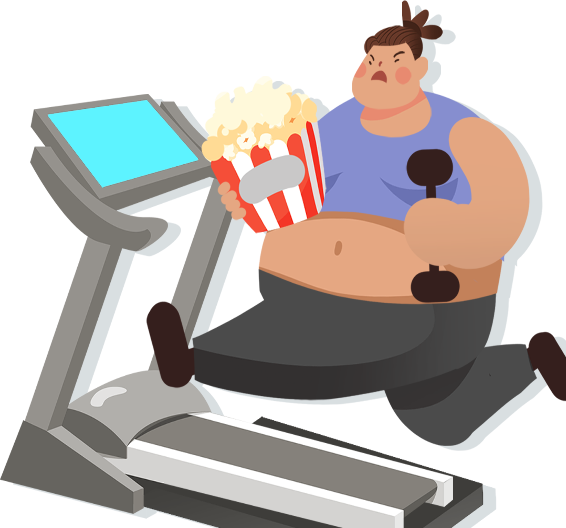
福州市2024届高三一模
读后续写讲评

Slide 3
Though I eat an apple almost every day, one month ago my doctor came to my house standing in front of me, not being kept away, due to my sudden illness.
“Well Jian, I think 1 need to have a strong talk with you. You are overweight. Have you ever heard about Body Mass Index (指数), BMI? Well, I've weighed you and measured your height and you have a BMI of 28.That is obese(肥胖的),” said the doctor.
I knew I was a little bit overweight but I didn't think it was that bad. He added that my name means healthy in Chinese and he thought it is time that l should become healthy. There is a direct link between my health and sport. So he asked me, “How much sport do you do every week?”
I told him that I go for a walk every weekend. Then he replied, “Hmm, that's not a lot. Sport and health go together. They affect your mental, physical and emotional health. For example, sport can improve your mental health, allowing your brain to think better and focus. It will help you to learn more easily. Is that clear, Jian?”
“I think so. I know it would be good to be able to concentrate better at school.” I said.
The doctor explained to me that from a physical point of view, sport makes us tired so helps us to sleep better. At the same time, sport burns off the calories that we have consumed. It builds muscle and improves our circulation. Sport helps to control our cholesterol count(胆固醇指标) and this is important to stop us having a heart attack. Additionally, it also keeps our blood pressure normal and strengthens our bones.
Para 1：The doctor's words left me lost in thought.
Para 2：“Exercising alone is hard. Why not: try some team sports?” the doctor suggested.

Slide 4
1
What are the most important aspects of a continuation writing?
theme
plot
language
consistency
Notes:
拼写改一下continuation

Slide 5
Theme
change
negative
positive
Notes:
此处请提供几种不同的theme的案例，最好结合文本的伏笔。

Slide 6
Though I eat an apple almost every day, one month ago my doctor came to my house standing in front of me, not being kept away, due to my sudden illness.
“Well Jian, I think 1 need to have a strong talk with you. You are overweight. Have you ever heard about Body Mass Index (指数), BMI? Well, I've weighed you and measured your height and you have a BMI of 28.That is obese(肥胖的),” said the doctor.
I knew I was a little bit overweight but I didn't think it was that bad. He added that my name means healthy in Chinese and he thought it is time that l should become healthy. There is a direct link between my health and sport. So he asked me, “How much sport do you do every week?”
I told him that I go for a walk every weekend. Then he replied, “Hmm, that's not a lot. Sport and health go together. They affect your mental, physical and emotional health. For example, sport can improve your mental health, allowing your brain to think better and focus. It will help you to learn more easily. Is that clear, Jian?”
“I think so. I know it would be good to be able to concentrate better at school.” I said.
The doctor explained to me that from a physical point of view, sport makes us tired so helps us to sleep better. At the same time, sport burns off the calories that we have consumed. It builds muscle and improves our circulation. Sport helps to control our cholesterol count(胆固醇指标) and this is important to stop us having a heart attack. Additionally, it also keeps our blood pressure normal and strengthens our bones.
Para 1：The doctor's words left me lost in thought.
Para 2：“Exercising alone is hard. Why not: try some team sports?” the doctor suggested.
Negative: I was overweight and had little knowledge about keeping fit.
Started the self-reflection
had desire to change
but hesitated
started a positive life attitude

Slide 7
主题类型 | 经典例题
改变类 From Negative to Positive | 2022年新高考全国1、2卷读后续写 David's run
冲突类 From Conflict/Problem to Solution | 2021年1月浙江卷读后续写 I got my head stuck in a pumpkin
脱险类 From Dangerous to safe | 2020年1月浙江卷读后续写 Face to face with the polar bear
过程类 From beginning to result | 2021年高考全国1、2卷读后续写 A mother’s day surprise

Slide 8
2022年新高考全国1、2卷读后续写 David's run 改变类 From Negative to Positive
It was the day of the big cross-country run. Students from seven different primary schools in and around the small town were warming up and walking the route through thick evergreen forest. I looked around and finally spotted David, who was standing by himself off to the side by a fence. He was small for ten years old. His usual big toothy smile was absent today. I walked over and asked him why he wasn’t with the other children. He hesitated and then said he had decided not to run. What was wrong? He had worked so hard for this event! I quickly searched the crowd for the school’s coach and asked him what had happened. “I was afraid that kids from other schools would laugh at him,” he explained uncomfortably. “I gave him the choice to run or not, and let him decide.” I bit back my frustration(懊恼). I knew the coach meant well—he thought he was doing the right thing. After making sure that David could run if he wanted, I turned to find him coming towards me, his small body rocking from side to side as he swung his feet forward. David had a brain disease which prevented him from walking or running like other children, but at school his classmates thought of him as a regular kid. He always participated to the best of his ability in whatever they were doing. That was why none of the children thought it unusual that David had decided to join the cross-country team. It just took him longer—that’s all. David had not missed a single practice, and although he always finished his run long after the other children, he did always finish. As a special education teacher at the school, I was familiar with the challenges David faced and was proud of his strong determination.
Para1: We sat down next to each other, but David wouldn’t look at me.
Para2: I watched as David moved up to the starting line with the other runners.
David’s negative attitude before the race.
Pay attention to the foreshadowing!
David’s negative attitude before the race.
Became positive again!

Slide 9
2021年1月浙江卷读后续写 I got my head stuck in a pumpkin 冲突类 From Conflict/Problem to Solution
Pumpkin carving at Halloween is a family tradition. We visit a local farm every October. In the pumpkin field, I compete with my three brothers and sister to seek out the biggest pumpkin. My dad has a rule that we have to carry our pumpkins back home, and as the eldest child I have an advantage — I carried an 85-pounder back last year.
This year, it was hard to tell whether my prize or the one chosen by my 14-year-old brother, Jason, was the winner. Unfortunately we forgot to weigh them before taking out their insides, but I was determined to prove my point. All of us were hard at work at the kitchen table, with my mom filming the annual event. I’m unsure now why I thought forcing my head inside the pumpkin would settle the matter, but it seemed to make perfect sense at the time.
With the pumpkin resting on the table, hole uppermost (向上), I bent over and pressed my head against the opening. At first I got jammed (塞住) just above my eyes and then, as I went on with my task, unwilling to quit, my nose briefly prevented entry. Finally I managed to put my whole head into it, like a cork (软木塞) forced into a bottle. I was able to straighten up with the huge pumpkin resting on my shoulders.
My excitement was short-lived. The pumpkin was heavy. “I’m going to set it down, now,” I said, and with Jason helping to support its weight, I bent back over the table to give it somewhere to rest. It was only when I tried to remove my head that I realized getting out was going to be less straightforward than getting in. When I pulled hard, my nose got in the way. I got into a panic as I pressed firmly against the table and moved my head around trying to find the right angle, but it was no use. “I can’t get it out!” I shouted, my voice sounding unnaturally loud in the enclosed (封闭的) space.
Problem: My head got stuck!

Slide 10
2021年1月浙江卷读后续写 I got my head stuck in a pumpkin 冲突类 From Conflict/Problem to Solution
Para1: It was five or six minutes though it felt much longer.
Para2: The video was posted online the Monday before Halloween.
Solution: How did I got my head out?

Slide 11
2020年1月浙江卷读后续写 Face to face with the polar bear 脱险类 From Dangerous to safe
One fall,my wife Elli and I had a single goal:to photograph polar bears.We were staying at a research camp outside"the polar bear capital of the world”－the town of Churchill in Manitoba, Canada.
Taking pictures of polar bears is amazing but also dangerous.Polar bears-like all wild animals－should be photographed from a safe distance.When I'm face to face with a polar bear,I like it to be through a camera with a telephoto lens.But sometimes,that is easier said than done.This was one of those times.
As Elli and I cooked dinner,a young male polar bear who was playing in a nearby lake sniffed, and smelled our garlic bread.
The hungry bear followed his nose to our camp,which was surrounded by a high wire fence.He pulled and bit the wire.He stood on his back legs and pushed at the wooden fence posts.
Terrified,Elli and I tried all the bear defense actions we knew.We yelled at the bear,hit pots hard, and fired blank shotgun shells into the air Sometimes loud noises like these will scare bears off.Not this polar bear though-he just kept trying to tear down the fence with his massive paws.
I radioed the camp manager for help.He told me a helicopter was on its way,but it would be 30 minutes before it arrived.Making the best of this close encounter(相遇），I took some pictures or the bear.
Eilt and I feared the fence wouldn't last through 30 more minutes of the bear's punishment.The camp manager suggested I use pepper spray.The spray burns the bears' eyes,but doesn't hurt them. So I approached our uninvited guest slowly and.through the fence,sprayed him in the face.With an angry roar(吼叫），the bear ran to the lake to wash his eyes.
Para 1: A few minutes later,the bear headed back to our camp.
Para 2: At that very moment,the helicopter arrived.
Danger: A hungry polar bear!
Safe at last!

Slide 12
2021年高考全国1、2卷读后续写 A mother’s day surprise 过程类 From beginning to result
The twins were filled with excitement as they thought of the surprise they were planning for Mother’s Day. How pleased and proud Mother would be when they brought her breakfast in bed. They planned to make French toast and chicken porridge. They had watched their mother in the kitchen. There was nothing to it. Jenna and Jeff knew exactly what to do.
The big day came at last. The alarm rang at 6 a.m. The pair went down the stairs quietly to the kitchen. They decided to boil the porridge first. They put some rice into a pot of water and left it to boil while they made the French toast. Jeff broke two eggs into a plate and added in some milk. Jenna found the bread and put two slices into the egg mixture. Next, Jeff turned on the second stove burner to heat up the frying pan. Everything was going smoothly until Jeff started frying the bread. The pan was too hot and the bread turned black within seconds. Jenna threw the burnt piece into the sink and put in the other slice of bread. This time, she turned down the fire so it cooked nicely.
Then Jeff noticed steam shooting out of the pot and the lid starting to shake. The next minute, the porridge boiled over and put out the fire. Jenna panicked. Thankfully, Jeff stayed calm and turned off the gas quickly. But the stove was a mess now. Jenna told Jeff to clean it up so they could continue to cook the rest of the porridge. But Jeff’s hand touched the hot burner and he gave a cry of pain. Jenna made him put his hand in cold water. Then she caught the smell of burning. Oh dear! The piece of bread in the pan had turned black as well.
Para1: As the twins looked around them in disappointment, their father appeared.
Para2: The twins carried the breakfast upstairs and woke their mother up.
They tried to make breakfast for their mother!
They created a mess!
How did they get the result they want?

Slide 13

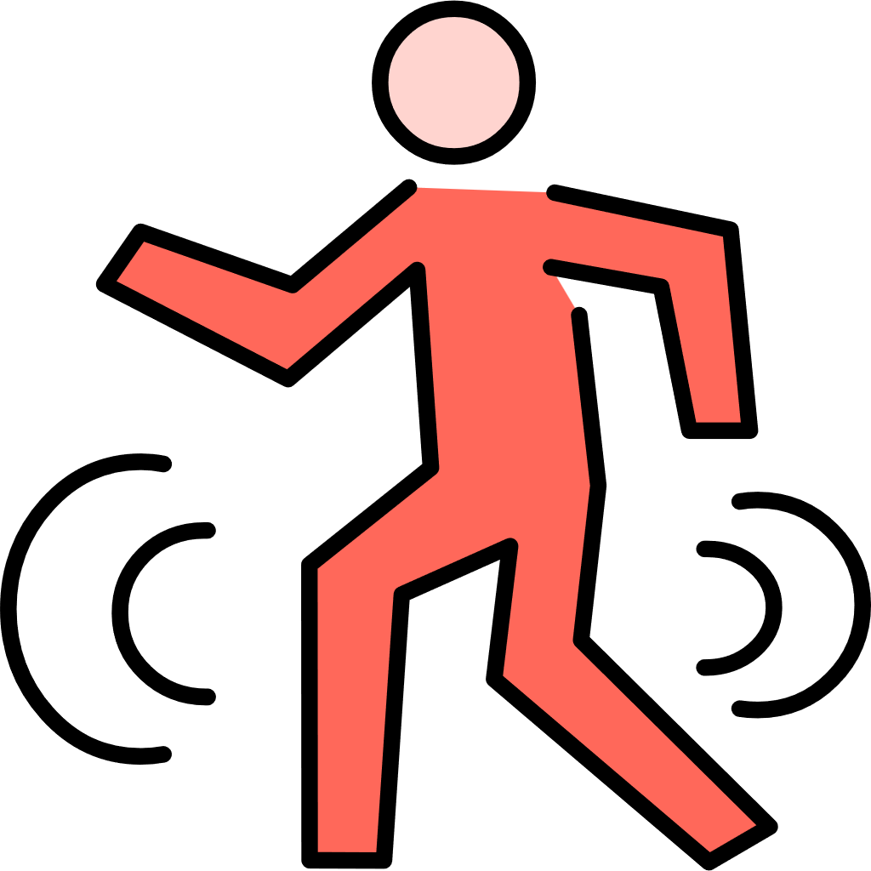
2
Read for the plot
who
I (named Jian); my doctor
one month ago
when
where
In my house
I was overweight which affected my health.
My doctor was trying to persuade me to do more sports.
what

Slide 14
3
Study the characters
I eat an apple almost every day.
l told him that I go for a walk every weekend.
had limited health habits
I knew I was a little bit overweight but I didn't think it was that bad.
I
satisfied with the status quo(现状)
“I think so. I know it would be good to be able to concentrate better at school.” I said.
knew little health knowledge

Slide 15
consistency
设问法
3
Plan your writing
Para 1: The doctor’s words left me lost in thought.
What did I think about?
Did the doctor find out my hesitation?
Did I want to change?
What was stopping me?
Para 2: “Exercising alone is hard. Why not: try some team sports?” the doctor suggested.

Slide 16
consistency
设问法
3
Plan your writing
Para 2: “Exercising alone is hard. Why not: try some team sports?” the doctor suggested.
How did I feel at the end ?
Did I want to join team sports?
Which team sport?
What’s the benefit?

Slide 17

要根据具体故事决定写作的重点
Langauage
1
action
本文续写部分主要是自己的内心活动和同医生的少量互动
2
response
3
emotion
4
inner monologue
Notes:
Response, emotion, inner monologue分别列举一些可能用到的表达，比如emotion: 自我怀疑，满足等情绪的不同表达。

Slide 18
4
Useful words and expressions: response
可以替换成其他内容换语境使用
迷茫
冷静下来
对...感兴趣
迫不及待,控制不住
My old habits started buzzing round in my head.
我的旧习惯一个个地在我的脑子里冒出来。
I was so stunned by what he’d said that I had to collect myself before I could reply.
他的话吓得我目瞪口呆，我定了定神才能答上话。
The idea of... sparked sb interests.
I couldn’t wait to do
I couldn’t help but do
Notes:
写作要点改为---写作语言要点

Slide 19
4
Useful vocabularies: emotion
羞愧
自我怀疑
后悔
犹豫
感激
充满希望
受启发的
shameful (adj.)
self-doubt (n.)
regretful (adj.)
hesitated (adj.)
thankful/grateful (adj.)
hopeful (adj.)
inspired (adj.)
Notes:
写作要点改为---写作语言要点

Slide 20
4
inner monologue -- 内心独白：可以通过以下句型呈现
句型 | 例句
陈述句(表示内心的语言、想法、决定)
感叹句
疑问句（表达内心的困惑或者犹豫）
What I did in the past was wrong. I had to change.
How lucky I was to have such a responsible doctor！
What if I couldn’t persist?
Notes:
写作要点改为---写作语言要点

Slide 21
4
写作语言要点 Para 1
控制不住做....
思考
...的重要性
融入，结合
身心健康
一想到...就畏惧
自我怀疑
couldn’t help but do
reflect on
the significance of
integrate
physical and mental well-being
flinch at the thought of...
self doubt
Notes:
写作要点改为---写作语言要点

Slide 22
4
写作语言要点 Para 2
引起了我的兴趣
结合A和B
社交
对...有吸引力
表达感激
开始一段...旅程
不辜负
spark my interests
combine A and B
social interaction
appeal to sb
express sb’s gratitude
embark on a... journey
live up to

Slide 23
5
下水文
Para 1: The doctor's words left me lost in thought. Apparently, what I did in the past was far from enough. I couldn't help but reflect on the significance of intergrating regular physical exercises into my daily routine, which could not only enhance my concentration at school but also benefit my overall physical and mental well-being. Tempting as it may seem, I still flinched at the thought of tough training alone, and started to doubt myself. The doctor stared at my face as if he had already read my mind.
Para 2: “Exercising alone is hard. Why not try some team sports?" the doctor suggested. “Team sports?” The idea of joining a team sport sparked my interest, since it seemed like a fantastic way to combine the physical workout with social interaction. The images of being part of a team and working shouder to shouder with my teammates towards a common goal really appealed to me. I stood up and gave him a hug, expressing my gratitude. l couldn't wait to embark on my new fitness journey and finally live up to my name which contained my parents high expectations.

Slide 24
5
下水文
句子副词开头
Para 1: The doctor's words left me lost in thought. Apparently, what I did in the past was far from enough. I couldn't help but reflect on the significance of intergrating regular physical exercises into my daily routine, which could not only enhance my concentration at school but also benefit my overall physical and mental well-being. Tempting as it may seem, I still flinched at the thought of tough training alone, starting to doubt myself. The doctor stared at my face as if he had already read my mind.
非限制性定语从句
让步状语从句倒装
非谓语动词表伴随状语
虚拟语气

Slide 25
5
下水文
Para 2: “Exercising alone is hard. Why not try some team sports?" the doctor suggested. “Team sports?” The idea of joining a team sport sparked my interest, since it seemed like a fantastic way to combine the physical workout with social interaction. The images of being part of a team and working shouder to shouder with my teammates towards a common goal really appealed to me. I stood up and gave him a hug, expressing my gratitude. l couldn't wait to embark on my new fitness journey and finally live up to my name which contained my parents high expectations.
引导原因状语从句
非谓语动词表伴随状语
定语从句
呼应原文父母取名的期待 —— 故事回环
Notes:
最后一句呼应原文，这里可以指出来。

Slide 26
Thanks

