Slide 1

感恩遇见，相互成就，本课件资料仅供您个人参考、教学使用，严禁自行在网络传播，违者依知识产权法追究法律责任。
更多教学资源请关注
公众号：溯恩高中英语
知识产权声明

Slide 2
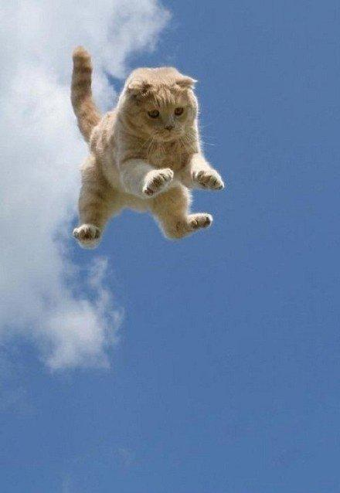
Lesson 9 Flying cats

Slide 3
Target vocabulary
1

Slide 4
Match each word with the best meaning.
1. _____ squirrel A. relating to or resembling a cat
2. _____ submissive B. as far as one knows or can see or can see
3. _____ apparently C. a tall building with many floors or levels
4. _____ feline D. the horizontal ledge at the bottom of a window
5. _____ paratrooper E. showing or expressing love, warmth, or fondness 6. _____ high-rise F. inclined or willing to submit to orders or authority
7. _____ windowsill G. a small, agile rodent with a bushy tail, typically found in trees 8. _____ suspicious H. the force that opposes the motion of an object through the air
9. _____air-resistance I. having or showing a cautious distrust of someone or something
10. ____ affectionate J. a member of a military airborne unit trained for parachute
operations
G
F
B
A
J
C
D
I
H
E

Slide 5
Reading the passage
2

Slide 6
Reading the passage
Cats never fail to fascinate human beings. They can be friendly and affectionate towards humans, but they lead mysterious lives of their own as well. They never become submissive like dogs and horses. As a result, humans have learned to respect feline independence. Most cats remain suspicious of humans all their lives. One of the things that fascinates us most about cats is the popular belief that they have nine lives. Apparently, there is a good deal of truth in this idea. A cat's ability to survive falls is based on fact.
Recently the New York Animal Medical Center made a study of 132 cats over a period of five months. All these cats had one experience in common: they had fallen off high buildings, yet only eight of them died from shock or injuries. Of course, New York is the ideal place for such an interesting study, because there is no shortage of tall buildings. There are plenty of high-rise windowsills to fall from! One cat, Sabrina, fell 32 storeys, yet only suffered from a broken tooth. 'Cats behave like well-trained paratroopers.' a doctor said. It seems that the further cats fall, the less they are likely to injure themselves. In a long drop, they reach speeds of 60 miles an hour and more. At high speeds, falling cats have time to relax. They stretch out their legs like flying squirrels. This increases their air-resistance and reduces the shock of impact when they hit the ground.

Slide 7
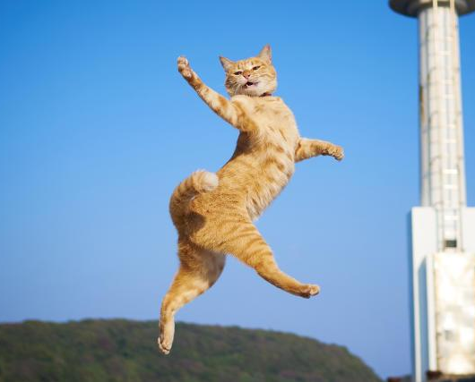
Question:
How do cats try to protect themselves when falling from great heights?
They stretch out their legs like flying squirrels to increase their air-resistence.

Slide 8
Reading comprehesion
3

Slide 9
Reading comprehension
1. We find cats endlessly fascinating because ______.
A. we feel there is a good deal we do not know about their lives
B. we believe that cats have nine lives
C. they are different from dogs and horses
D. they can reach a speed of 60 miles an hour while falling

Slide 10
Reading comprehension
2. A recent study of 132 cats in New York proved ______.
A. that it is true that cats have nine lives
B. that cats are related to flying squirrels
C. they are different from dogs and horses
D. that cats falling from great heights are seldom killed

Slide 11
Reading comprehension
3. Cats can survive great falls mainly because ______.
A. the further they fall, the less likely they are to injure
themselves
B. a cat's ability to survive is based on fact
C. a falling cat relaxes its legs and so increases its air-resistance
D. they are unlikely to exceed a speed of about 60 miles an hour

Slide 12
Structure imitation
4

Slide 13
Structure imitation
1. ...never fail to ..., but they ... as well
The breathtaking beauty of cherry blossoms in full bloom never fails to captivate visitors, but they scatter and fade away as well.
Books never fail to transport us to different worlds, but they also have the ability to teach us valuable life lessons as well.
Kindness never fails to touch our hearts, but it also has the ability to create a ripple effect of positivity in the world as well.

Slide 14
The old book I found buried in my grandmother’s attic at one time must have been a treasured possession, for it was adorned with a delicate cover of gold and precious jewels that shone brilliantly in the dim light.
Structure imitation
2. One of the things that ...most about ... is the popular belief that they ...
One of the things that fascinates historians most about ancient myths is the popular belief that they contain echoes of real historical events or figures.
One of the things that amazes people most about cats is the popular belief that they bring good luck and have the power to deter evil spirits.
One of the things that excites children most about birthdays is the popular belief that blowing out all the candles on the cake will make their wishes come true.

Slide 15
Structure imitation
3. ... is the ideal place for..., because there is no shortage of...
A library is the ideal place for expanding knowledge, because there is no shortage of books and resources to explore.
A park is the ideal place for outdoor activities, because there is no shortage of open spaces and recreational facilities to enjoy.
The bustling city is the ideal place for food enthusiasts, because there is no shortage of diverse culinary options and trendy restaurants.

Slide 16
Story telling
5

Slide 17
Story-telling
1. recently----New York----study of 132 cats----five months
2. all these cats ----one experience in common----fallen----high buildings----eight died
3. New York----ideal place----study----no shortage----high buildings
4. plenty----high-rise windowsills----fall from
5. one cat, Sabrina----32 storeys----broken tooth
6. ‘Cats----well-trained paratroopers’----doctor said
7. further they fall----less likely ----injure themselves
8. long drop----speeds 60 miles an hour and more
9. high speeds----time to relax
10. stretch out legs ----flying squirrels----air-resistance----reduces shock of impact

Slide 18
Summary writing
6

Slide 19

Answer the following questions with complete sentences.
1. How many cats did the New York Animal Medical Centre make a study of?
2. What had all these cats done?
3. How many of these cats had been killed?
4. What happened to a cat called Sabrina?
5. What do cats do when falling at speeds of 60 miles an hour or more?
6. What effect does this have?

Slide 20
1. How many cats did the New York Animal Centre make a study of?
The New York Animal Medical Centre made a study of 132 cats.
2. What had all these cats done?
All these cats had fallen off high buildings.
3. How many of these cats had been killed?
Eight of them died from shock or injures.
2+3
All these cats had fallen off high buildings, yet only eight had died from shock or injuries.

Slide 21
4. What happened to a cat called Sabrina?
One cat, Sabrina, had fallen 32 storeys but only suffered from a broken tooth.
5. What do cats do when falling at speeds of 60 miles an hour or more?
When falling at speeds up to 60 miles per hour, cats stretch out their legs.
6. What effect does this have?
This increases their air-resistance and reduces the shock of impact on hitting the ground.
4+5+6
When falling at speeds up to 60 miles per hour, cats stretch out their legs, which increases their air-resistance and reduces the shock of impact on hitting the ground.

Slide 22
A possible version:
The New York Animal Medical Centre recently made a study of 132 cats. All these cats had one thing in common: they had fallen off high buildings, yet only eight had died from shock or injuries. One cat, Sabrina, had fallen 32 storeys but only suffered from a broken tooth. When falling at speeds up to 60 miles per hour, cats stretch out their legs, which increases their air-resistance and reduces the shock of impact on hitting the ground.

Slide 23
Occasion describing
7

Slide 24
Occasion describing
Human beings like to keep dogs and ________________________________________. Dogs are _______________________, but cats like to _____________________________. Cats are especially lovable when they are still kittens. As kittens they _________________. That’s how they learn to _____________________________________________________. A lot of people keep cats so they ______________________________________________. As kittens grow into cats, they like to ___________________________________________. They like regular meal times and enjoy _________________________________________. However, they also __________________________________. During the day time and at night they like to _______________________________________. They often have fights with other cats. Sometimes during the night _____________________________________. Cats are very clean animals. You often see them __________________________________. Human beings _____________________________________________________________.

Slide 25
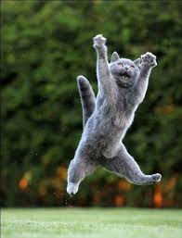
Occasion describing
cats
Human beings like to keep dogs and ____. Dogs are _________________________ ________________ but cats like to ______________. Cats are especially lovable when they are still kittens. As kittens they ________________________________________. That’s how they learn to __________________________________________. A lot of people keep cats so they ____________. As kittens grow into cats, they like to ___________. They like regular meal times and enjoy ________________________. However, they also ____________. During the day time and at night they like to _________. They often have fights with other cats. Sometimes during the night __________________________. Cats are very clean animals. You often see them _________________. Human beings _______________________________________________________________
are submissive and faithful to
and their masters
be independent
they like to play by chasing anything that moves
hunt mice, birds, insects and other small creatures
can have a pet
stay indoors
sleeping in front of a nice fire
like going out
go hunting
they have fights with other cats
washing themselves
are fascinated by their behaviour because cats are
are domestic animals, while at the same time they enjoy their independence.

Slide 26
Story development
8

Slide 27
Reading the passage
Cats never fail to fascinate human beings. They can be friendly and affectionate towards humans, but they lead mysterious lives of their own as well. They never become submissive like dogs and horses. As a result, humans have learned to respect feline independence. Most cats remain suspicious of humans all their lives. One of the things that fascinates us most about cats is the popular belief that they have nine lives. Apparently, there is a good deal of truth in this idea. A cat's ability to survive falls is based on fact.
Recently the New York Animal Medical Center made a study of 132 cats over a period of five months. All these cats had one experience in common: they had fallen off high buildings, yet only eight of them died from shock or injuries. Of course, New York is the ideal place for such an interesting study, because there is no shortage of tall buildings. There are plenty of high-rise windowsills to fall from! One cat, Sabrina, fell 32 storeys, yet only suffered from a broken tooth. 'Cats behave like well-trained paratroopers.' a doctor said. It seems that the further cats fall, the less they are likely to injure themselves. In a long drop, they reach speeds of 60 miles an hour and more. At high speeds, falling cats have time to relax. They stretch out their legs like flying squirrels. This increases their air-resistance and reduces the shock of impact when they hit the ground.

Slide 28
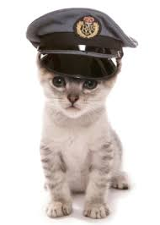
Para 1：
The study's amazing discoveries have made us
appreciate cats even more.
Para 2：
These findings go beyond just science.

Slide 29
One possible version:
The study's amazing discoveries have made us appreciate cats even more. Cats are naturally agile and have strong instincts. They can adapt to falling from great heights in an incredible way. Their graceful way of descending and their instinctive movements show an impressive level of precision and control. It's like watching a cat stretch its legs and glide through the air like a flying squirrel. It makes us feel amazed and fascinated by the wonders of nature.
These findings go beyond just science. They remind us that all living beings have the ability to be resilient and adaptable. Cats, with their natural survival instincts, remind us of the amazing capabilities we all have, as well as the other creatures we share the world with. Their ability to handle dangerous situations with grace and calmness inspires us to be resilient in the face of challenges and approach them with determination and confidence.

Slide 30
Vocabulary reiforcement
9

Slide 31
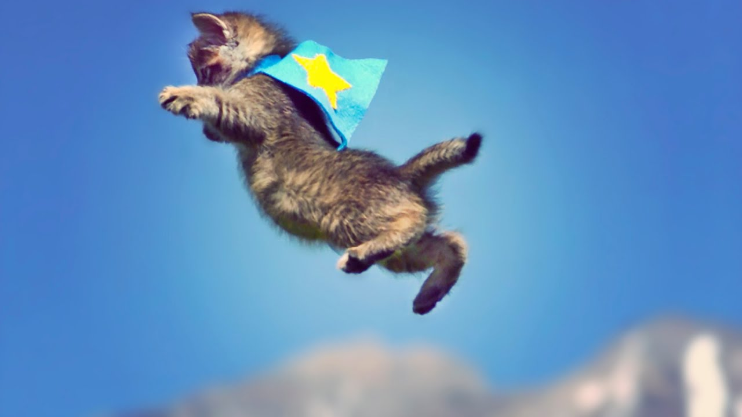
A. Word spelling
Perched on the windowsill of a h______ apartment, Whiskers, an affectionate f____, gazed out with curious eyes. The a__________ against her fur was apparent as she enjoyed the soft breeze. Though often s________ of strangers passing by, Whiskers remained s________ and longed for human companionship. One day, she noticed a p_________ of a different kind—a nimble s______ leaping from tree to tree. F________ by its acrobatics, Whiskers couldn't help but feel an affinity for the agile creature. Yet she restrained herself, content to observe from the safety of her perch. In this urban sanctuary, Whiskers found joy in merging her feline curiosity with an a_________ appreciation of the world beyond her w________.
igh-rise
eline
ir-resistance
uspicious
ubmissive
aratrooper
quirrel
ascinated
ffectionate
indowsill

Slide 32
B. Gap filling
creature stretch fail shortage unpredictability
suffer seek remain bond independence
Over a period of time, researchers made a study of feline ____________ and their unique behaviors. They discovered that some individuals ___ to be affectionate towards cats due to their independent nature. Despite this, there is no ________ of people who appreciate and value the companionship of these enigmatic ________. However, some individuals ______ suspicious of cats, attributing their independence to aloofness or _____________. It is important to understand that cats have their own ways of showing affection and may not always ____ constant attention. They _____ from stereotypes that overlook their ability to form deep _____ with their human counterparts. To truly appreciate their companionship, it is crucial to ______ out our understanding and embrace their unique nature.
independence
fail
shortage
creatures
remain
unpredictability
seek
suffer
bonds
stretch

