Slide 1

感恩遇见，相互成就，本课件资料仅供您个人参考、教学使用，严禁自行在网络传播，违者依知识产权法追究法律责任。
更多教学资源请关注
公众号：溯恩高中英语
知识产权声明

Slide 2

活用教材词汇，靶向高考写作
M5U4 Journey across A Vast Land

Slide 3
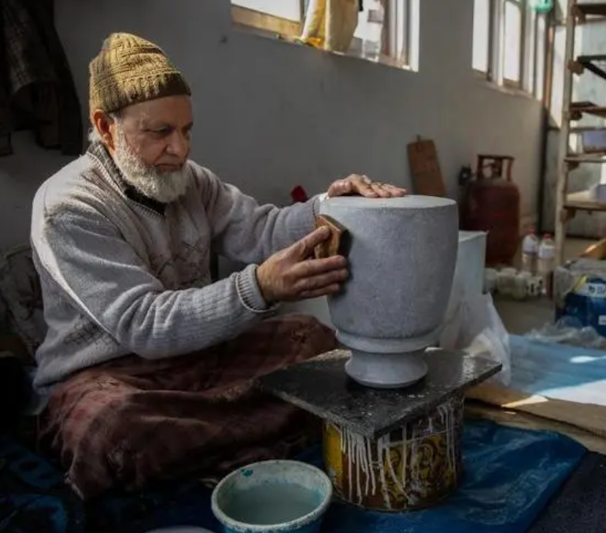
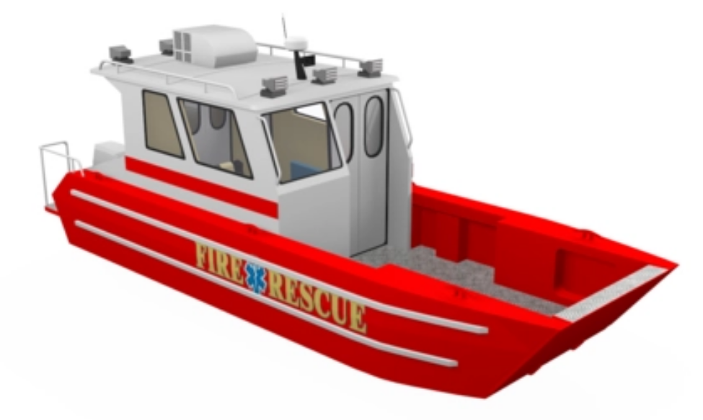
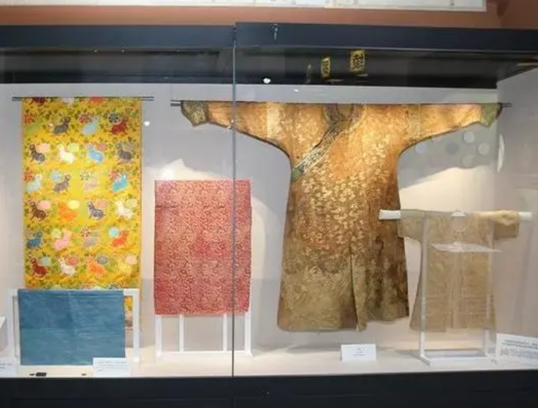
craft /krɑ:ft/ n.手艺;工艺;技艺
craft workers (= skilled workers)
熟練工人，工匠
a rescue craft
一艘救援船
这个节目展示了传统的乡村工艺品。 (应用文)
The show featured traditional country crafts.

Slide 4
pleasant /ˈpleznt/ a.令人愉快的;友好的
许多我们曾一起度过的愉快的回忆涌上我的心头。 (续写)
Many pleasant recollections of the time we spent together crowded in on me.
当地人非常友好和善良，使旅程变得更加愉快。(应用文)
The local people were very friendly and kind, making the journey more pleasant.
我很抱歉的告诉你一件令人不愉快的事。（应用文之投诉信）
I am sorry to inform you of the following unpleasant situation.

Slide 5
arise （arose arisen） /əˈraɪz/ vi.起身;出现;由…引起
如果出现任何问题，请告诉我，我会帮助你。(应用文)
出现了一个意想不到的困难。(续写)
大家都转过头来，教堂里响起一片低语声。(续写)
If any complications arise, let me know and I'll help.
An unforeseen difficulty has arisen.
Heads turned, and a murmur arose in the church.

Slide 6
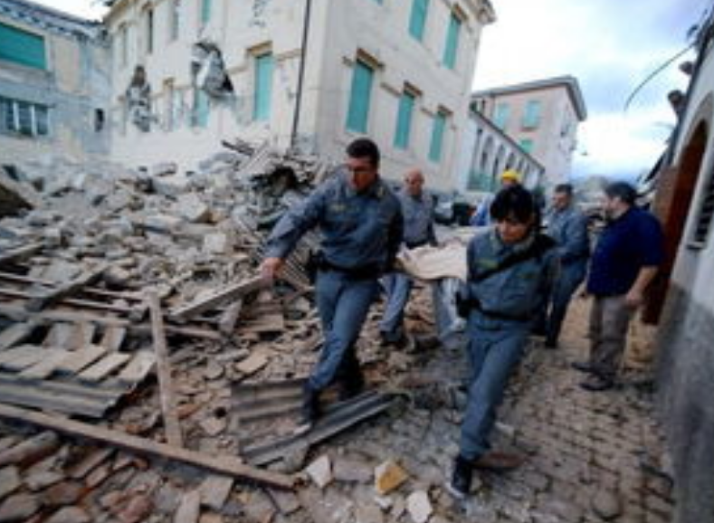
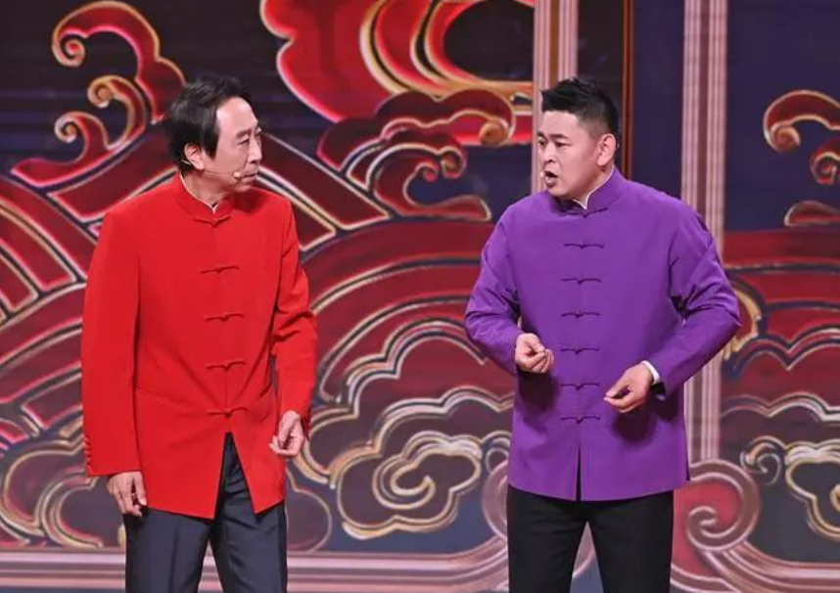
massive /ˈmæsɪv/ a.巨大的;非常严重的
1月22日爆发了一场严重的地震。
春节联欢晚会每年吸引了很多观众。(应用文)
A massive earthquake hit on Jan 22.
The Spring Festival Gala appeals to massive audiences every year.

Slide 7
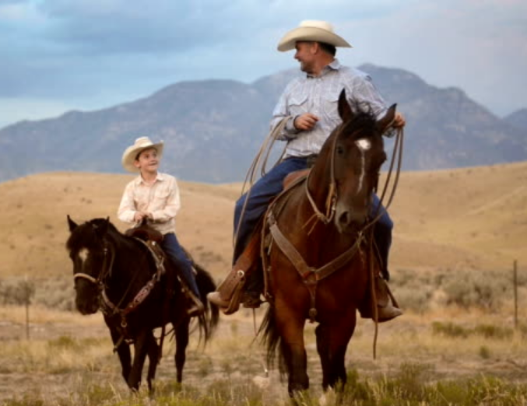
take sb's breath away 令人惊叹 (breathe v.)
从山顶眺望，景色美得会令你窒息。(应用文)
农场上的美景令我们惊叹。(续写之骑马森林迷路)
The view from the top will take your breath away.
The awesome scenery on the farm took our breath away.

Slide 8
（1）当他们仍上气不接下气、心跳飞快时，他们最终相信刚刚所发生的事是真实的。
As they were still ______________ and their heart beat wildly，they were finally convinced that what happened just now was true.
（2）我屏住呼吸，等着老师宣布考试的结果。
I _______________，waiting for the teacher to announce the results of the exam.
（3）爬到山顶他就喘不过气来了。
He climbed to the peak of the mountain and ______________.
（4）杰克深呼吸，然后潜入水中。
Jack ______________________ and then dived into the water.
（5）我气喘吁吁地坐在座位上，仍不敢相信。
I sat _________________ (breath) on my seat and still could not believe it.
out of breath
held my breath
lost his breath
took a deep breath
breathlessly

Slide 9
bound /baʊnd/ a.准备前往(某地);一定会
1. be bound to do...一定做……；有义务做……
我相信你一定会喜欢这些活动的。 (应用文)
伯纳德(Bernard) 挨家挨户去卖爆米花，他一定会赚些额外的钱。 (续写之助人为乐)
I’m sure you are bound to take an interest in these activities.
Bernard was bound to make some extra money by selling popcorn from door to door.
2. be bound for准备前往(某地)
我们正要前往我们采摘水果的农场。 (应用文)
We were bound for the farm where we would pick fruits.

Slide 10

3. bound +prep./adv. v. 跳跃着跑
杰克蹦蹦跳跳地进入了房间，满头大汗。(续写)
Jack came bounding into the room, beads of sweat dripped from forehead.

Slide 11
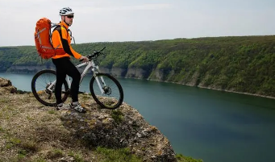
scenery /ˈsi:nəri/ n.风景;景色
这是一次充满挑战的旅行，但看到那令人叹为观止的风景便觉得一切都是值得的。(续写、应用文)
It was a challenging ride, but the breathtaking/ picturesque/jaw-dropping/spectacular / awesome scenery made it worthwhile.

Slide 12
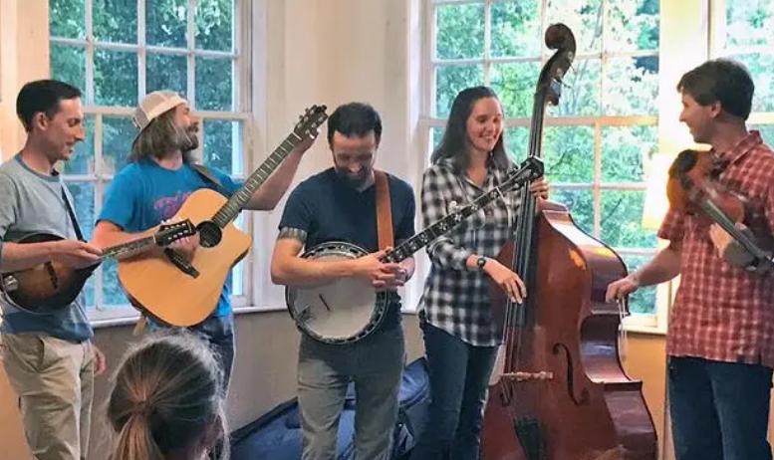
awesome /ˈɔ:səm/ a.令人惊叹的;可怕的
awesome scenery
An awesome challenge lies ahead of them.
Through music, we had made an awesome connection.
令人惊叹的景色(应用文、续写)
摆在他们面前的是令人望而生畏的巨大挑战。(续写)
通过音乐，我们建立了一种很棒的联系。(续写)

Slide 13

spectacular /spekˈtækjələ(r)/ a.壮观的;壮丽的;巨大的 n.壮丽场面
a spectacular view
After weeks of hard work and dedication, our team finally made a spectacular success.
蔚为壮观的景象
经过数周的努力和奉献，我们的团队终于取得了巨大的成功。(续写)

Slide 14

highlight /ˈhaɪlaɪt/ n.最好的部分 vt.突出;强调
这次郊游的亮点将是一场登山比赛，且到时将为获胜的队伍准备奖品。(应用文)
The highlight of this outing will be a mountain-climbing competition and the prize will be prepared for the winning team.

Slide 15
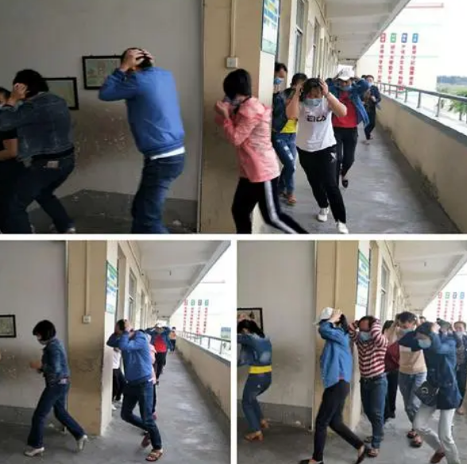
drill /drɪl/ vi.&vt.钻孔;打眼 n.钻头
上周，我们学校举行了一次防灾演习，旨在教我们如何在危险中逃生和保护自己。(应用文)
Last week witnessed a disaster prevention drill in our school which was meant to teach us how to escape and protect ourselves when in danger.

Slide 16
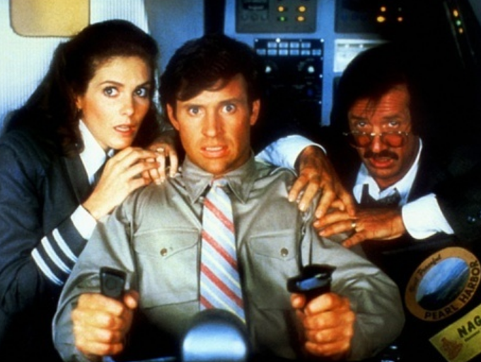
freezing /ˈfri:zɪŋ/ a.极冷的;冰冻的
frozen /ˈfrəʊzn/ a. 冻僵的；结冰的
freeze /fri:z/ (froze frozen) vi.&vt.结冰;(使)冻住
freezing cold
母亲和孩子在冰冷的水中浑身湿透，被送往医院接受治疗。
(续写)
Wet through __________________________, the mother and child were taken to hospital for treatment.
飞行员的脸因恐惧而僵住了。 (续写)
The pilot’s face ___________________.
极冷
in the freezing water
was frozen with fear.

Slide 17
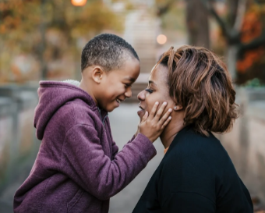
anticipate /ænˈtɪsɪpeɪt/ vt.预料;预见;期望
1. anticipate+v-ing
They anticipate having several applicants for the job.
他们预计会有几个人来应聘这份工作。
2. anticipate+n./n.短语
Tom had anticipated a sharp scolding but he would never have expected the comforting words from Mother. Hearing the warm words, Tom was not only relieved but also moved deeply.
汤姆本以为会受到严厉的斥责，但他从来没有想到母亲会说安慰的话。听到这些温暖的话语，汤姆不仅松了一口气，而且深受感动。 (续写)

Slide 18
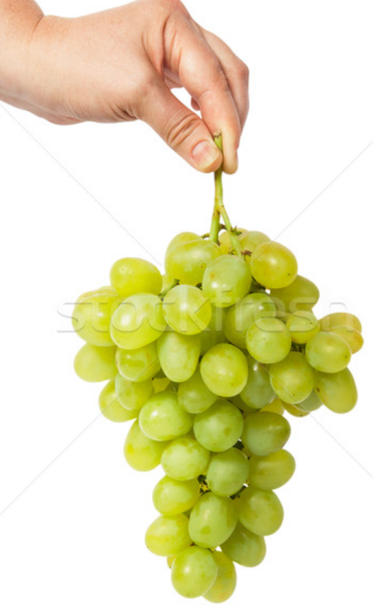

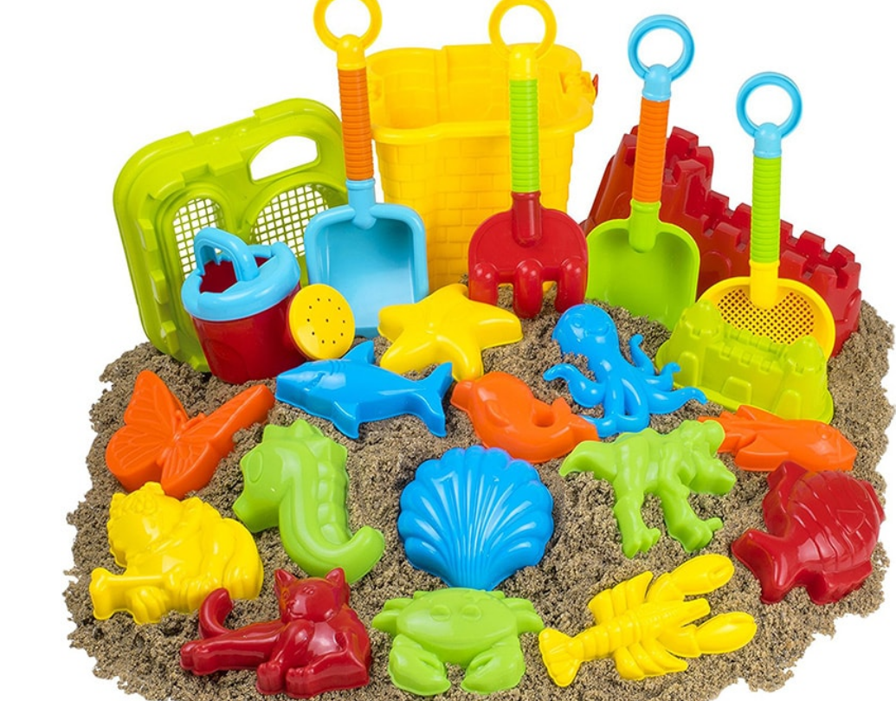

bunch /bʌntʃ/ n.束;串;捆
a bunch of 一束;一串;一群;大量
a bunch of flowers/toys/women/grapes
一束花/一堆玩具/一群女人/一串葡萄

Slide 19
thunder /ˈθʌndə(r)/ vi.打雷;轰隆隆地响 n.雷声
thunderous /ˈθʌnd(ə)rəs/ a. 强有力的; 打雷般的
The wind picked up. The tall pine trees surrounding the cottage swayed. White caps formed on the lake. Thunder boomed and echoed through the rolling hills.
The whole gymnasium thundered with the clapping, hollering, chanting, “Kevin! Kevin!”
The show ended to thunderous applause, with the kids bowing dramatically, accepting their praise for a job well done.
风刮了起来。小屋周围高大的松树摇摆着。湖面笼盖着一层白色的薄雾。雷声隆隆，响彻起伏的山。 (续写)
整个体育馆响起了雷鸣般的掌声，大家齐声一直喊“ “Kevin! Kevin!” (续写)
演出在雷鸣般的掌声中结束，孩子们深深地鞠躬，接受众人对其出色表演的称赞。 (续写)

Slide 20

frost /frɒst/ n. 霜;严寒天气 vt.使蒙上霜
frosty /ˈfrɒsti/ a. 严寒的，霜冻的；覆盖着霜的，结霜的
I noticed the modest houses frosted in sparkly snow.
我注意到那些简朴的房子在闪耀的雪中蒙上了一层霜。 (续写)
我送报纸的第一天是一个阴沉、冰冻的三月早晨。 (续写)
My first day of delivery was a dark, frosty March morning.

Slide 21
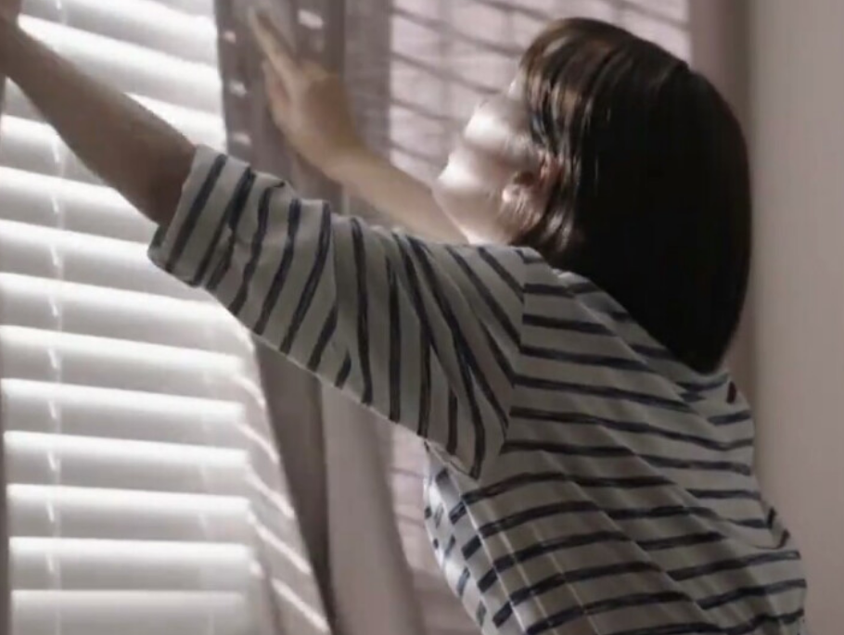
curtain /ˈkɜ:tn/ n.窗帘
draw the curtains 拉上窗帘
我试着从她的窗户往里看，但她的窗帘拉上了。 (续写)
I tried peeking through her window, but her curtains were drawn.

Slide 22
duration /djuˈreɪʃn/ n.持续时间;期间
该项目的持续时间为三个月，参与者在此期间将接受一些体能训练。（应用文）
The duration of the program is three months, during which participants will undergo some physical training.

Slide 23
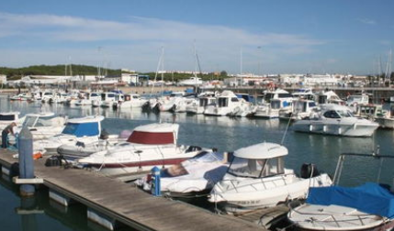
harbour /'hɑ:bə(r)/ n.(海)港;港口 v. 心怀......; 窝藏
The ships dock at the harbor.
She began to harbour doubts about the decision.
Police believe someone must be harboring the killer.
这些船都停靠在港口。
她开始怀疑这个决定。
警方相信定有人窝藏杀人犯。

Slide 24
enrol (或enroll) /ɪnˈrəʊl/ vi.&vt.(使)加入;注册;登记
在网上登记
enroll online
注册一门课程
enroll in a course
你必须在5月底前注册。（应用文）
You need to enroll before the end of May.

Slide 25
contrary /ˈkɒntrəri/ a.相反的 n.相反的事实
1. contrary to 相反的;相对立的
与在初中时我们看到的不一样，Vinnie几乎没有拉下一次作业。(续写)
Contrary to what we had seen in middle school, Vinnie rarely missed a homework assignment.
2. on the contrary 相反的
我认为我的描述有条理，但是恰恰相反，我的描述不合逻辑。(续写)
I thought that my description was coherent, but on the contrary, it was actually illogical.

Slide 26

alongside /əˌlɒŋˈsaɪd/ prep.在…旁边 ad.在旁边
突然，两个骑车人中较年轻的一个朝我的方向斜过来。他的自行车在我的车窗旁移动，男孩努力地控制它。(续写)
His bike
moved alongside my window
Suddenly, the younger of the two riders angled in my direction. _______
__________________________, the boy struggling to control it.

Slide 27
proceed /prəˈsi:d/ vi.行进;继续做
1. proceed with sth 继续进行某事
She decided not to proceed with the treatment.
她决定不继续治疗了。(续写)
2. proceed to do sth 继续做某事
He outlined his plans and then proceeded to explain them in more detail.
他简单介绍了他的计划，接着又进行了较详细的解释。(续写)
3. proceed +adv./prep 行进/前往......
他沿着街道缓缓行进。(续写)
He proceeded slowly along the street.

Slide 28

astonish /əˈstɒnɪʃ/ vi.使十分惊讶;使吃惊
astonished a. 感到惊讶的
astonishing a. 令人惊讶的
astonishment n. 惊讶
大多数猫在水里都会感到恐慌，但我们这只勇敢的小猫却令所有人吃惊。(续写)
Most cats panic if put in water, but our brave little cat _____________ everyone.
astonished
我惊讶得说不出话来，但我身边的年轻学生却不吃惊。(续写)
________________________________, but the young student beside me wasn’t.
I was too astonished to say anything
当这个人知道真相的时候，他非常惊讶，嘴巴还半张着。(续写)
So __________________________ when he knew the truth that his mouth remained half-open.
astonished was the man

Slide 29
1. be astonished at/by sth 因某事感到惊讶
听到这个突如其来的消息，我十分惊讶。(续写)
I was astonished at the unexpected news.
2. be astonished to do sth 对做某事感到惊讶
我惊讶地发现农场上壮观的景色让我们叹为观止。(续写)
I was astonished to find that the spectacular scenery on the farm took our breath away.
3. to one’s astonishment 让某人惊讶的是
令我们惊讶的是，他不顾身体不好，还是登上了顶峰。(续写)
To our astonishment, he reached the peak of the mountain regardless of his poor health.

Slide 30
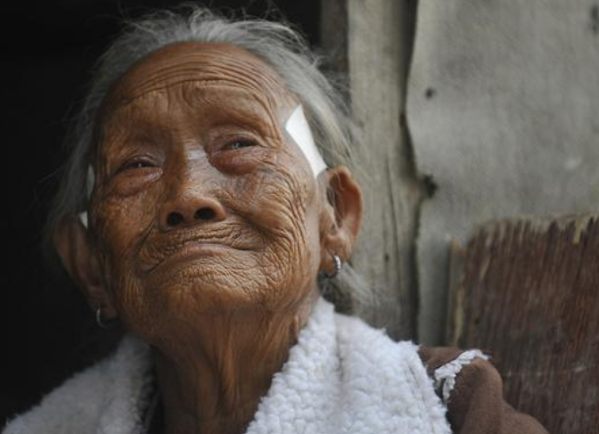
mist /mɪst/ n.薄雾;水汽
misty /ˈmɪsti/ a.多雾的;模糊的
We climbed onward and upward through the mist of rain until we came across an old man, maybe in his late sixties, who was moving slowly down the mountain.
我们在雨雾中向上爬，直到遇到一位老人，他可能快60岁了，正在慢慢下山。（续写）
当她走近时，我看到了她拿着的东西，眼泪开始在我眼里模糊。（续写）As she came closer, I saw what she held and tears ________________________
began misting in my eyes.
我看向老人，她泪眼模糊。（续写）
I looked over at the old woman and her eyes were misty..

Slide 31
steel /sti:l/ n.钢;钢铁工业 v. 使坚强地做/面对......
I slid into the seat next to him and steeled myself for what was to come.
我坐到座位上准备应付即将发生的事。（续写）

Slide 32
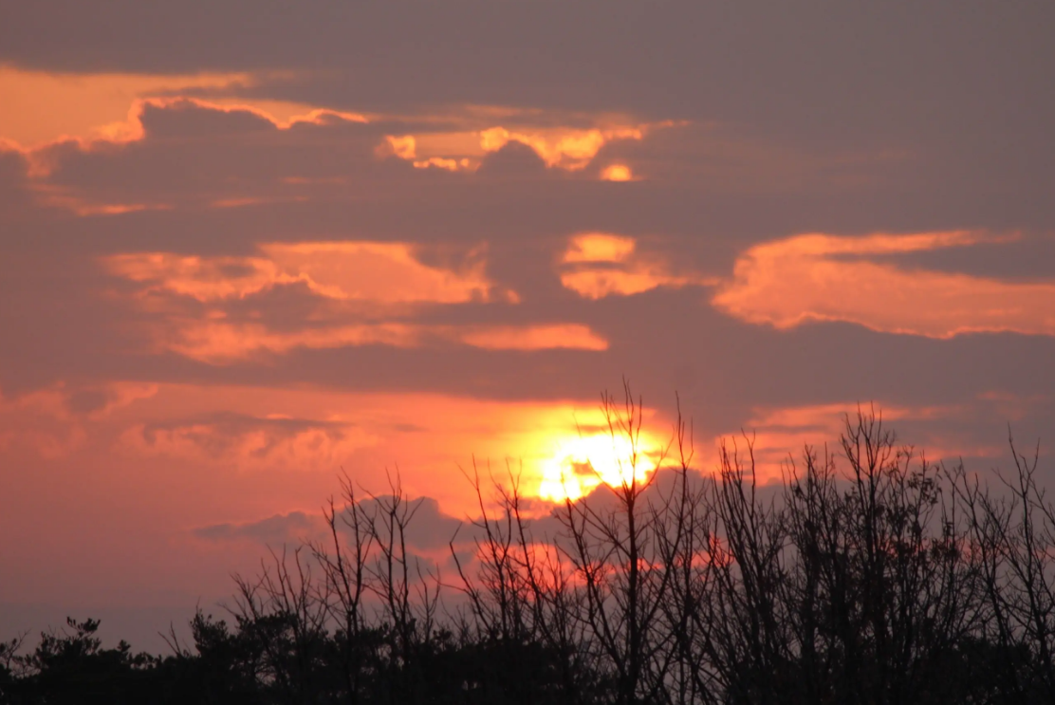
dusk /dʌsk/ n.黄昏;傍晚
Finally, with dusk approaching, Jim sent a four-wheel vehicle to transport Michelle and her family to the church.
最后，随着黄昏的临近，吉姆派了一辆四轮车把米歇尔和她的家人送到教堂。（续写）

Slide 33

advertisement /ədˈvɜ:tɪsmənt/ n.广告;启事
我从你登的广告中得知你需要志愿者，我想申请这个职位。(应用文)
I learnt from your advertisement that you are in need of volunteers , and I’d like to apply for the post.
我想申请你们今天刊登的广告中的职位。(应用文)
I’d like to apply for the post advertised in today’s newspaper.

Slide 34

owe /əʊ/ vt.欠(账、债、情等)
1. owing to 因为
由于上述原因，我将毫不犹豫地向您推荐这部电影。（应用文）
Owing to the reasons discussed above, I won’t hesitate to recommend this movie to you.
2. owe sb an apology 该向某人道歉
（owe sth to sb=owe sb sth）
我没能帮你，我写信向你道歉。（应用文）
I’m writing to owe you an apology for being unable to help you.

Slide 35
owe /əʊ/ vt.欠(账、债、情等)
3. owe...to... 把......归功于......
我们的成功应该归功于你。（应用文）
It’s you that we should owe our success to.

Slide 36
toast /təʊst/ n.烤面包片;干杯 vt.干杯
We partied in a big way that day. Mom and Dad celebrated 50 years of marriage, five children, nine grandchildren and one great-grandchild. But when I raised my glass in honor of the happy couple, in my heart it was the grit of two old Marines and the power of perseverance I toasted.
那天我们举行了盛大的聚会。父母庆祝结婚50周年，育有五个孩子、九个孙子和一个曾孙。但当我举杯向这对幸福的夫妇致敬时，在我心中，这是两位老海军陆战队队员的勇气和毅力。（续写）

Slide 37
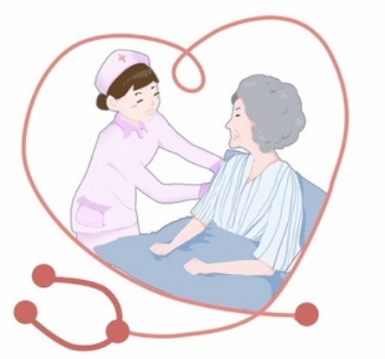
coherent /kəʊˈhɪərənt/ a.有条理的;清楚易懂的
She only became coherent again two hours after the attack.
她发病两小时之后才恢复了清楚说话的能力。(续写)

Slide 38
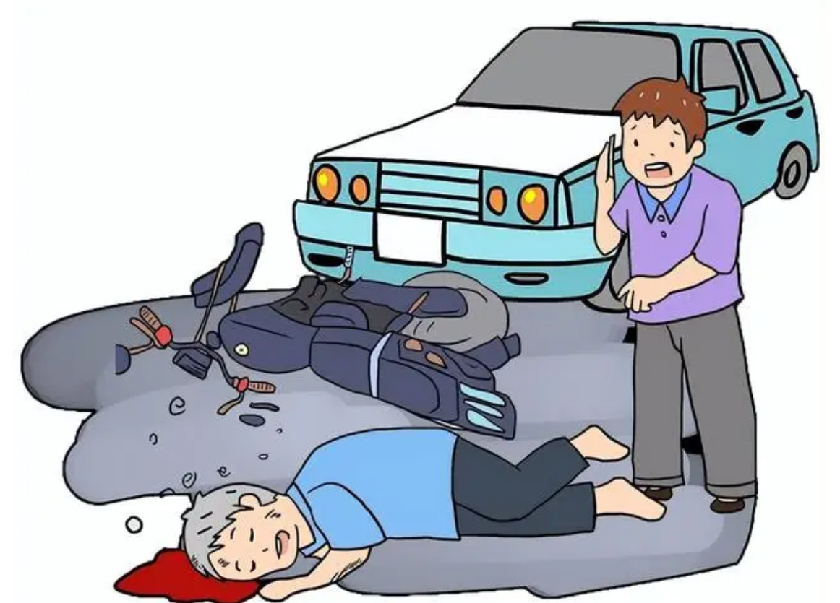
see sb/sth do/ doing/done 看到某人/物做了/正在做/被......
They were astonished to see misty clouds rising from the great Niagara Falls...
他们看到尼亚加拉大瀑布升腾而起的水雾惊叹不已......(课本原句)
过马路时，他看见一位老人被一辆冲过来的车撞倒了。(续写)
When crossing the street he saw an old man knocked down by a rushing car.

Slide 39

Thank you!

