Slide 1

感恩遇见，相互成就，本课件资料仅供您个人参考、教学使用，严禁自行在网络传播，违者依知识产权法追究法律责任。
更多教学资源请关注
公众号：溯恩高中英语
知识产权声明

Slide 2







活用教材词汇，靶向高考写作
M2U4单词拓展
History and Traditions

Slide 3



活用词汇
Confucius /kənˈfjuːʃəs/ n.孔子
1. 首先，展示一些书法和中国传统绘画作品将是一个不错的选择。此外，展示一些孔子的经典，如《论语》，也会吸引你的同学。（应用文之向正在策划校园文化节的孔子学院提建议）
First of all, it will be a good choice to put some works of calligraphy and traditional Chinese paintings on display. In addition, displaying some classics of Confucius such as Lunyu will also be attractive to your schoolmates.
2. 儒家风格 Confucian-style
首先，我们的校长真诚地祝贺我们长大成人。然后是儒家风格的成人礼——女孩的礼和男孩的礼。最后，我们郑重宣誓肩负起成年人的责任，这绝对是最精彩的一幕（应用文之 The Most Impressive School Activity）
First, our principal sincerely extended her congratulations on us becoming a grown-up. Then followed the Confucian-style coming-of-age ceremonies - Ji Li (for girls) and Guan Li (for boys). Finally, we made a solemn vow to shoulder the responsibilities of an adult, which was definitely the highlight

Slide 4
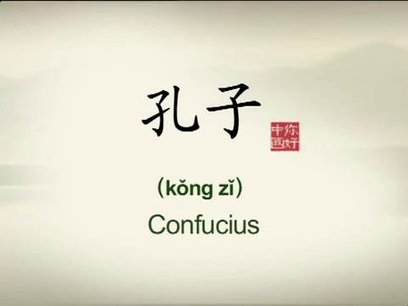
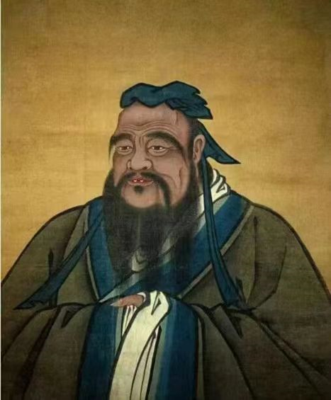
仁
与“孔子”相关表达
活用词汇
Key words about Confucius
孔夫子 Confucius
孔子学院 Confucius Institute
春秋时期 the Spring and Autumn Period
四书五经 the four books and the five classics
儒家思想 Confucianism
学者 scholar
和谐的 harmonious
东方的 oriental

Slide 5

活用词汇
descendant /dɪˈsendənt/ n.后裔;后代;子孙
1. descend v. 下来，下去，下降
(1)飞机开始降落。(续写)
The plane began to descend.
(2) 她缓慢地走下楼梯。(续写)
She descended the stairs slowly.
2. descend v. 下斜；下倾
小路从这里陡然而下。(续写)
At this point the path descends steeply.
3. descend v. 降临；来临
人群平静下来。(续写)
Calm descended on the crowd.

Slide 6
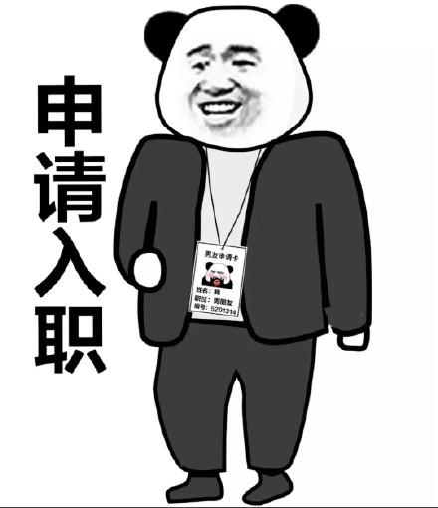

我们欢迎符合条件的个人前来申请。
活用词汇
individual /ˌɪndɪˈvɪdʒuəl/ adj.单独的;个别的 n.个人
1. individual n. 个人
我们欢迎符合条件的个人前来申请。(应用文)
We welcome applications from suitably qualified individuals.
2. individual adj. 单独的，个别的
大多数教授都愿意单独预约来帮助你。(应用文)
Most professors are willing to make individual appointments to help you out.

Slide 7

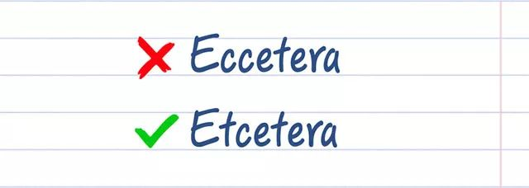
he
heel /hi:l/ n.足跟;(脚、袜子等)后跟
活用词汇
1. click one’s heels 鞋跟咔哒一并
中士将鞋跟咔哒一并，走了出去。(续写)
The sergeant clicked his heels and walked out.
2. at one’s heels 紧追不舍
他逃离了运动场，警察在后面紧追不舍。(续写)
He fled from the stadium with the police at his heels.
3. Achille’s heel 致命伤，弱点
拼写是我的致命伤。(续写/应用文)
Spelling is my Achille’s heel.

Slide 8
he
与“脚”相关表达
活用词汇
与“腿”、“脚”相关描述 | wander/stroll漫步闲逛； jog漫步； hurry/rush/dash匆匆而行； march坚定地进发； stride大步走； hobble 蹒跚； sneak/slide/slip溜走； pace踱步
 | jump/spring to one's feet 跳起来； stagger to one's feet 摇摇晃晃站起身来； rise to one's feet 站起来； tap/stamp one's feet 跺脚； hang around/about 闲荡； run quickly/swiftly 快速跑开； creep into one's tent 爬进帐篷； stand rooted to the spot站在原地不动； rush/dash/run like the wind 像风一样奔跑； slow one's stride 放慢脚步； creep/sneak up the stairs 蹑手蹑脚地上楼； on tiptoe 蹑手蹑脚； bounce up and down上蹿下跳； on one's knees 跪下； dash to 猛冲向； on tired/shaky legs用疲惫/颤抖的双腿； sink/collapse into one's seat瘫坐

Slide 9
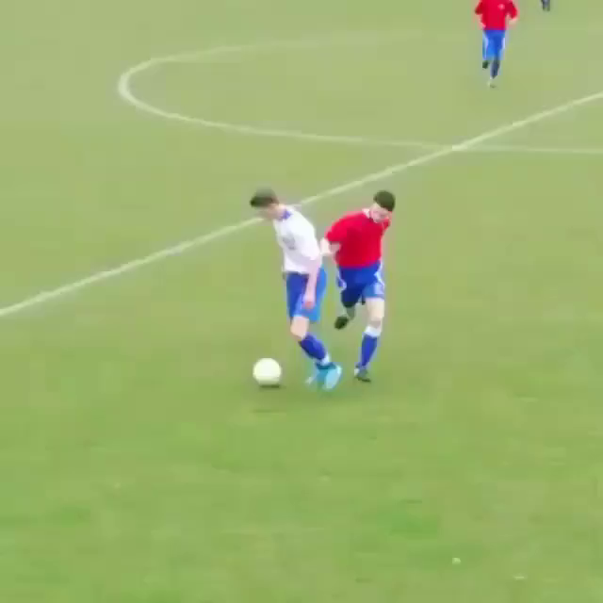
活用词汇
chief /tʃi:f/ adj.最重要的 n.(机构)首领
1. chief aim 主要目标
在足球场上他的主要目标是击败我。(续写)
His chief aim is to beat me on the football field.
2. army/industry/police chiefs
部队首长；行业巨擘；警察局长

Slide 10

活用词汇
puzzle /ˈpʌzl/ n.谜;智力游戏 vt.迷惑
1. puzzle sb. 让某人不解
我的妹妹常会让我不解，使我焦虑。(续写)
My sister puzzles me and causes me anxiety.
2. a puzzled look 迷惑的表情
她满面迷惑的表情。(续写)
She had a puzzled look on her face.
3. look puzzled 好像没懂
他好像没听懂，于是我把问题又重复了一遍。(续写)
He looked puzzled so I repeated the question.

Slide 11
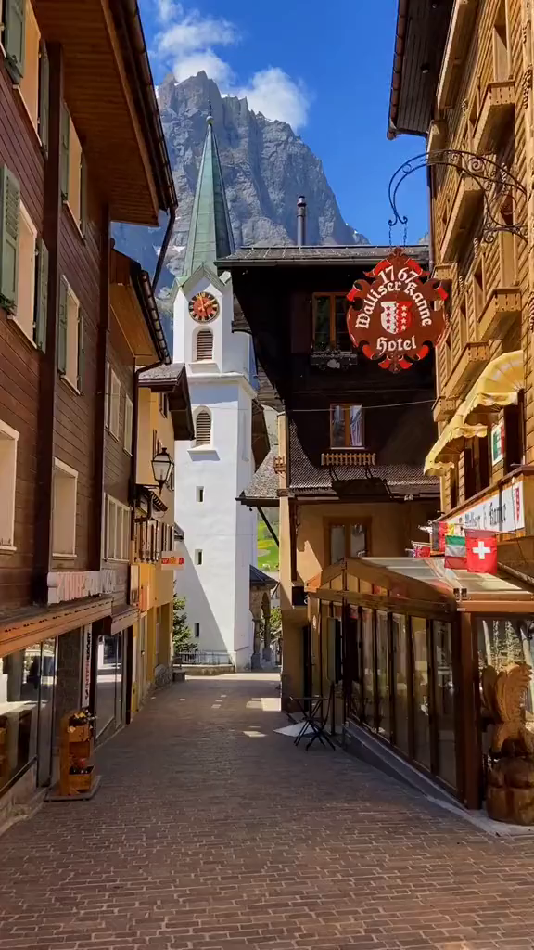
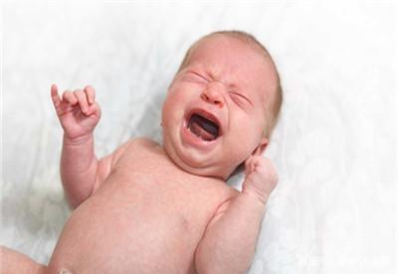
活用词汇
nearby /ˌnɪəˈbaɪ/ adj.附近的;邻近的
1. a nearby town 附近的一个小镇
她母亲住在附近一个小镇上。(续写)
Her mother lived in a nearby town.
2. nearby residents 附近的居民
附近的居民有些怨言。(续写)
There were complaints from nearby residents.
3. 附近床上 a bed nearby
躺在附近床上的小孩开始抽泣。(续写)
A child in a bed nearby began to whimper.

Slide 12
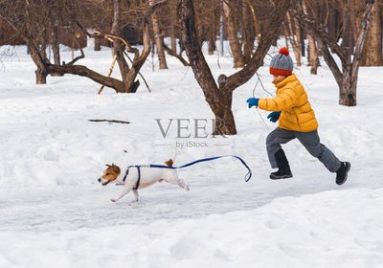
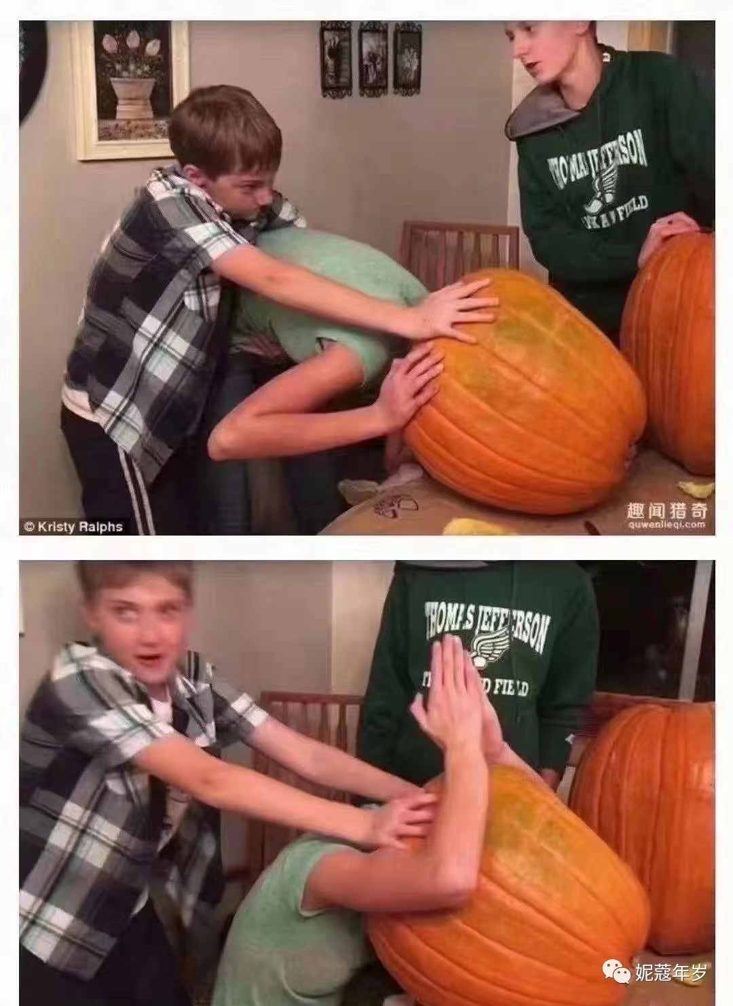
活用词汇
break away from ... /breɪk əˈweɪ frəm/ 脱离;背叛;逃脱
1. break away from sb. 挣脱某人
我的狗突然从我身边挣脱，冲到门口，开始狂吠起来。(续写)
My dog suddenly broke away from me, charged at the door and began to bark fiercely.
2. break away from ... 从...中出来
我父亲小心翼翼地把南瓜切开，于是我的头终于从南瓜中出来了。(续写)
My father carefully cut the pumpkin open, so I finally had my head break away from it.

Slide 13
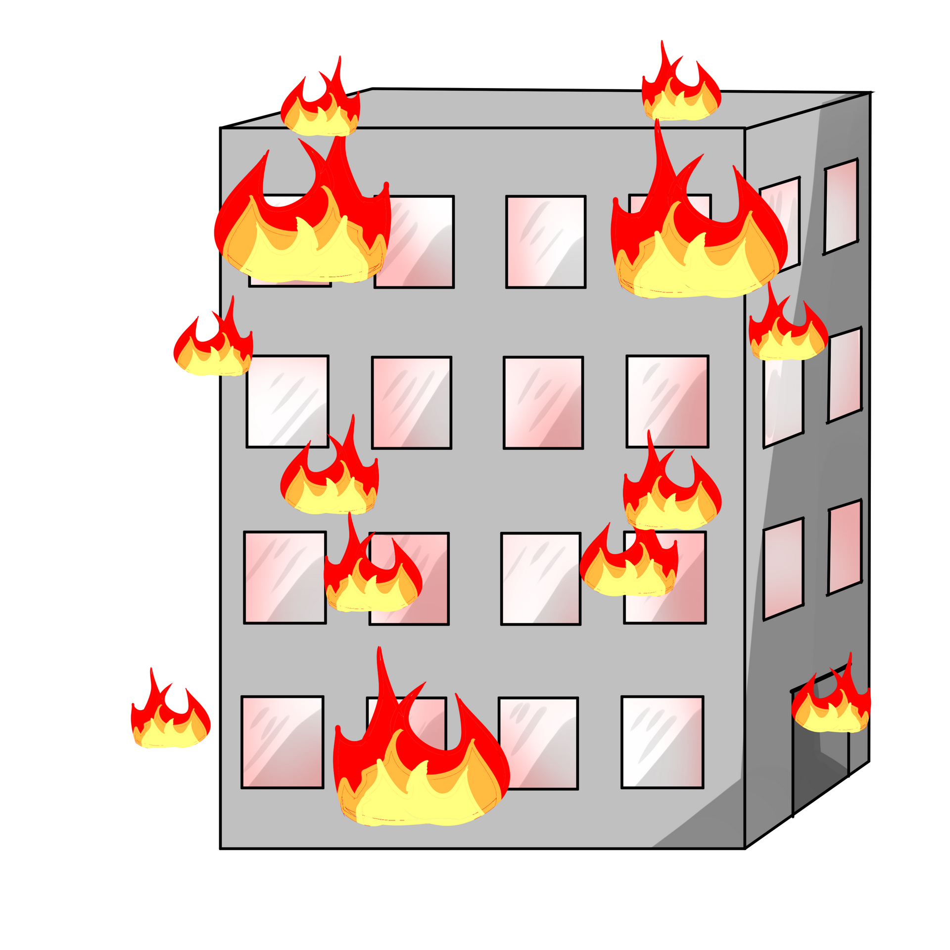

活用词汇
“break” 相关短语
1. break out （战争，火灾，洪水）爆发
火灾发生时他正在给手机充电。(续写)
2. break up 打碎，分裂，解体，结束，（关系等）破裂
弗雷德没有给我任何理由让我急于结束我们的友谊。(续写)
3. break down 垮掉，出故障，崩溃
听到这个消息，他崩溃了，眼泪顺着脸颊流了下来。(续写)
He was charging his mobile phone when the fire broke out.
Fred has given me no good reason for being eager to break up our friendship.
He broke down at the news, tears pouring down his checks.

Slide 14

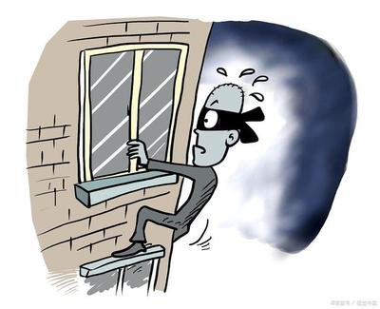
活用词汇
“break” 相关短语
4. break through 冲破，突破
午饭时分，太阳破晓。(续写)
5. break in 打断，插嘴；破门而入
(1)她插嘴说: “我没干那事！”(续写)
(2) 昨晚有人闯入了他的房子。(续写)
The sun broke through at around lunchtime.
“I didn’t do it!”she broke in.
His house was broken into last night.

Slide 15

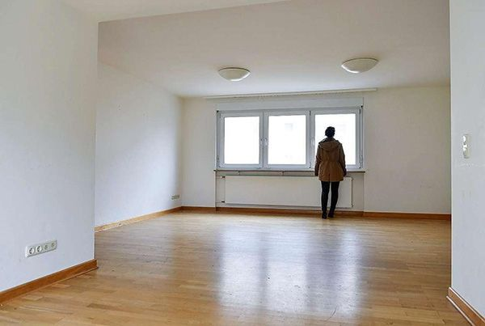
belong /bɪˈlɒŋ/ vi.应在(某处);适应
belong to /bɪˈlɒŋ tə/ 属于
活用词汇
1. belong to 属于
每个人都渴望成功，而成功只属于努力工作的人。(续写)
2. a sense of belonging 归属感
正是由于我慷慨善良的同学们我才有了归属感。(应用文)
Everyone has a desire for success while success only belongs to the hard-working people.
It is because of my generous and kind-hearted classmates that I feel a sense of belonging.
3. belongings 财产,所属物
他卖掉了大部分财产，房子里几乎什么都没有了。(续写)
Having sold most of his belongings, he almost had nothing left in the house.

Slide 16

活用词汇
a sense of 一种...感
认同与价值
● a sense / feeling of belonging 归属感
● a sense / feeling of identity 认同感
● a sense / feeling of self-worth 自我价值感
快乐与悲伤
● a sense / feeling of well-being 幸福感
● a sense / feeling of satisfaction 满足感
● a sense / feeling of relief 解脱感
● a sense / feeling of loneliness 寂寞感
● a sense / feeling of emptiness 空虚感
担心与歉咎
● a sense / feeling of panic 恐慌感
● a sense / feeling of shame 羞愧感
● a sense / feeling of guilt 内疚感
成功与挫败
● a sense / feeling of achievement 成就感
● a sense / feeling of pride 自豪感
● a sense / feeling of superiority 优越感
● a sense / feeling of defeat 挫败感
● a sense / feeling of frustration 沮丧感
● a sense / feeling of disappointment 失望感
天赋能力
● a sense of humor 幽默感
● a sense of balance 平衡感
● a sense of direction 方向感
● a sense of rhythm 节奏感

Slide 17

活用词汇
as well as /əz wel əz/ 同(一样也);和;还
1. 为了让学生们了解人工智能的最新发展及其对未来教育的影响，我们学校将于本周五下午2:00 - 3:00在学校大厅举办一场讲座。(应用文之关于“人工钓能与未来教育”的专题讲座活动的通知)
To inform students of the latest development in AI as well as its influence on tomorrow's education, our school will hold a lecture from 2:00 to 3:00 this Friday afternoon at the school hall.
2. 参加者将有机会了解丰富的编织历史和技术，并尝试制作自己的编织艺术品，旨在培养对我们独特行业的欣赏。(应用文之邀请外教体验编织 (weaving）艺术)
Participants will have the opportunity to learn about the rich history and techniques of weaving, as well as try their hand at creating their own woven artwork, which aims to foster appreciation for our unique traditions.

Slide 18

活用词汇
as well as /əz wel əz/ 同(一样也);和;还
3. 以前所有的担心都消失了。事实证明，老师的真正意图是让学生重视创造力。正是他对老师的尊敬和对待任务的认真态度使吉姆得了A。(续写)
All previous worries disappeared. It turned out that the teacher's real intention was to make students value creativity. It was his reverence for the teacher as well as a serious attitude towards tasks that got Jim an A.
4. 除了难以适应新的学校生活外，她还发现文化差异对她来说是另一个挑战。(续写)
As well as having difficulty adapting herself to the new school life, she found the culture difference was another challenge for her.
5. as well 也
她的泪如泉涌，心也要碎了。(续写)
Tears welled up in her eyes, and her heart seemed to be torn as well.

Slide 19

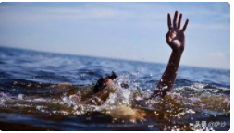
活用词汇
currency /ˈkʌrənsi/ 通货;货币
1. currently 目前，现在
我听说你现在正在学习中文，我想我应该推荐一系列很棒的英语短视频来帮助你。(推荐英语短视频系列 Chinese Idiom Stories (中华成语故事）)
I heard that you are currently studying Chinese and I thought I would recommend a great series of English short videos to help you along the way.
2. current （海洋或江河的）水流，潮流；气流
当弗兰克到达栏杆时，那个人正在水里挣扎，显然不会游泳当水流把他从岸边冲走时，他绝望地尖叫着求救。(续写)
When Frank reached the railing, the man was struggling in the water, clearly unable to swim. He screamed desperately for help as the current pulled him away from the bank.

Slide 20

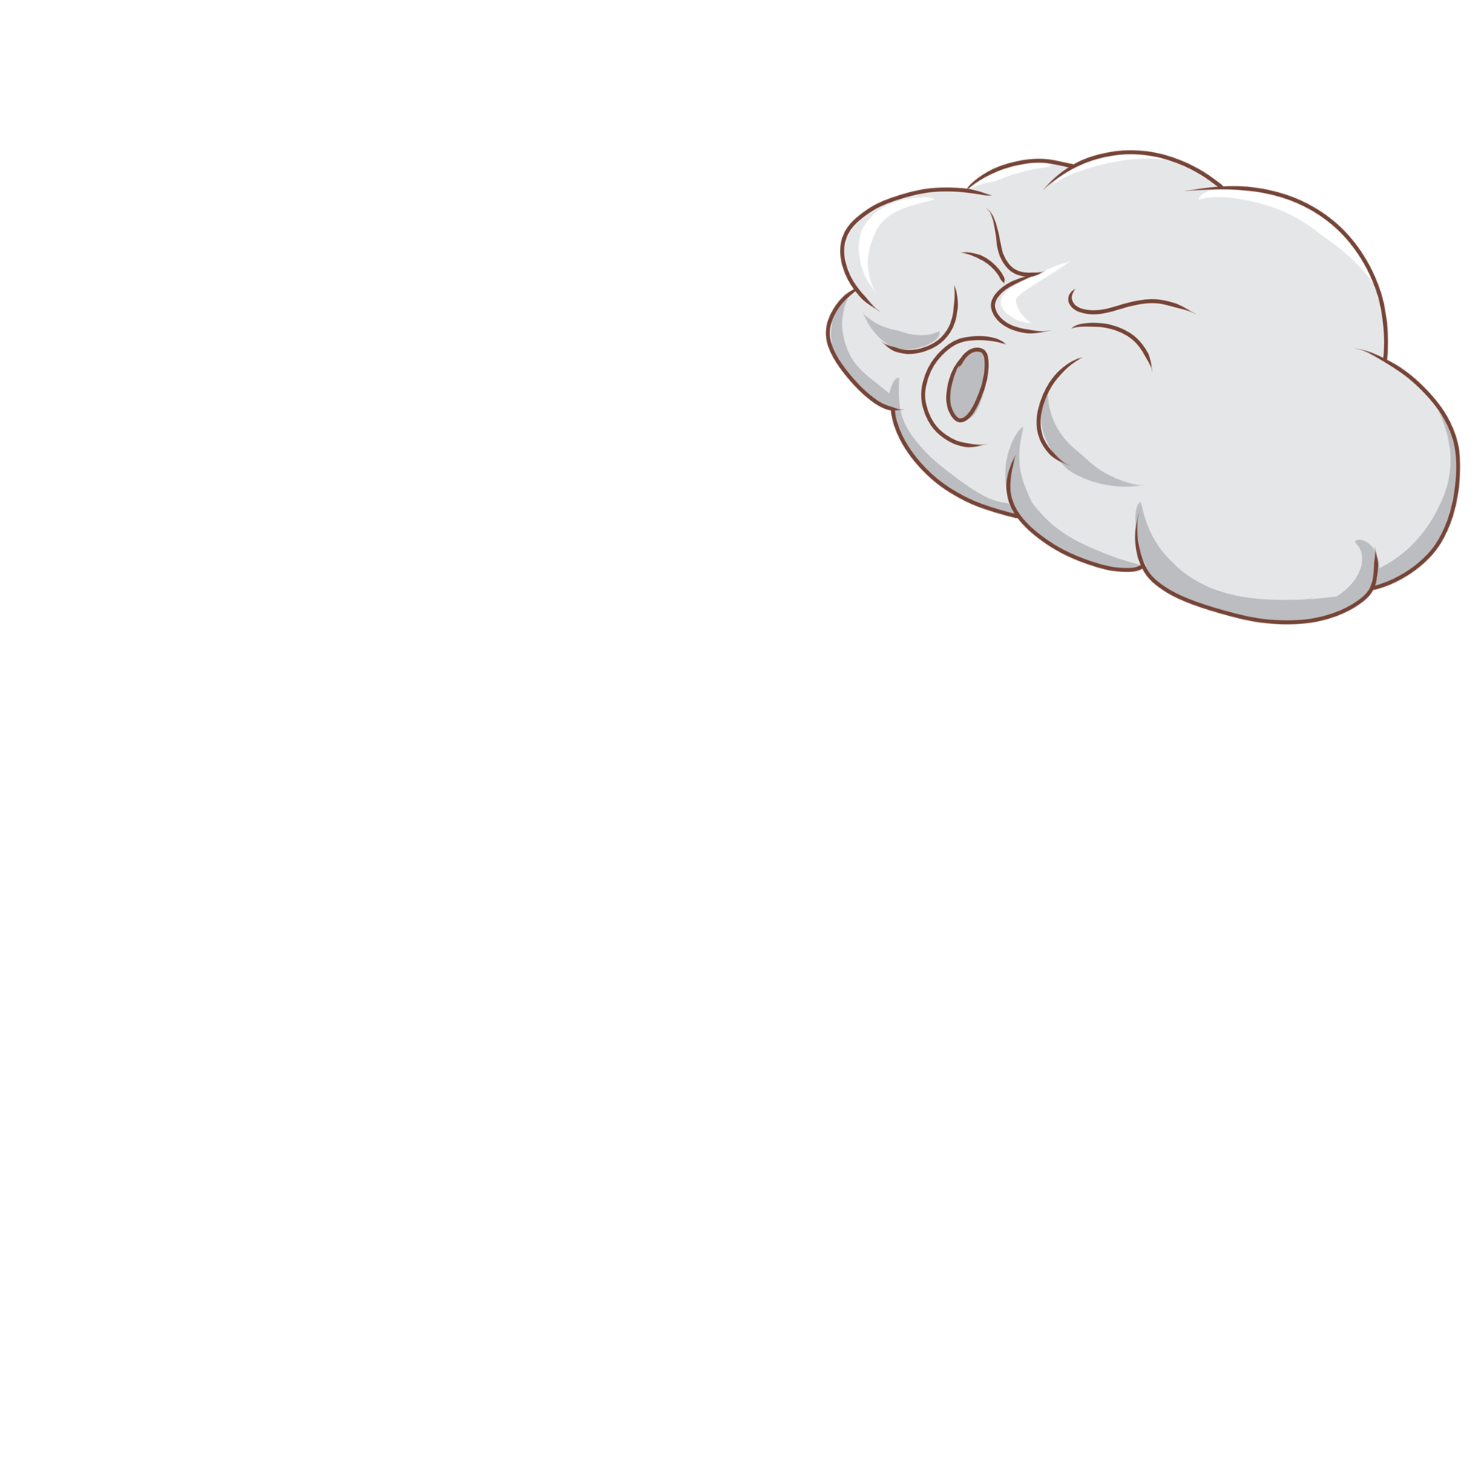
活用词汇
currency /ˈkʌrənsi/ 通货;货币
(2) a warm current 一股暖流
一股暖流涌上心头，他决定全身心地投入到书房里去。从那以后，他过着充实而忙碌的生活。(续写)
A warm current welling up in his heart, he determined to throw himself into his study. From then on, he lived a full and busy life.
3. a current of cool air一股冷空气
我感到一股凉气吹在脸上。(续写)
I felt a current of cool air blowing in my face.

Slide 21


活用词汇
surround /səˈraʊnd/ vt.围绕;包围
1. be surrounded with 被...围绕/环绕
(1) 在群山环绕的梅多布鲁克小村庄里，住着一对好奇又爱冒险的双胞胎，萨拉和萨姆。十二岁时，这对形影不离的双胞胎就一直在寻找新的冒险。(续写)
In the little village of Meadowbrook, surrounded with rolling hills, lived two curious and adventurous twins, Sarah and Sam. At the age of twelve, the inseparable twins were always seeking new adventures.
(2)绿树掩映，这个农场坐落于我们学校附近的山脚下，一条小河曲曲折折穿行其中。(2020全国II读后续写)
Surrounded by/with green trees, the farm is located at the foot of the hill neat our shcool. There is a samll river flowing through the farm.

Slide 22

活用词汇
surround /səˈraʊnd/ vt.围绕;包围
2. surroundings 环境
(1) 时间一分一秒地过去，仍然没有淘气先生的踪影。我们的担心和焦虑开始升级，我们决定将搜索范围扩大到附近的环境，但仍然没有运气。最后，我们拖着疲惫的身躯，心情沉重地回到院子里。(读后续写之寻找失踪的狗)
As time ticked by, there was still no sign of Mr. Naughty. Our worry and anxiety started to escalate, and we decided to expand the search range to the nearby surroundings, but still no luck. Finally, we dragged our tired bodies back to the yard with heavy hearts.
(2) 您可以给我一些关于如何适应陌生环境的有益的建议吗？(应用文写作之求助信)
Would you please offer me some beneficial advice on how to adapt to the unfamiliar surroundings.

Slide 23

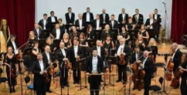
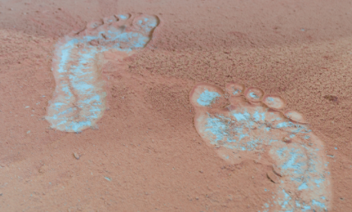
活用词汇
evidence /ˈevɪdəns/ n.证据;证明
1. evidence 证明
现代科学已经有清楚的证明吸烟会导致很多疾病。(应用文)
Modern science has given clear evidence that smoking can lead to many diseases.
2. with evident enjoyment 兴致勃勃
管弦乐队演奏得兴致勃勃。(续写)
The orchestra played with evident enjoyment.
3. evident 清晰可见的
他的脚印在厚厚的灰尘中清晰可见(续写)。
His footprints were clearly evident in the heavy dust.
4. It is evident that .....显然
很明显，在竞争的社会中有输家也有赢家。(续写)
It is evident that in competitive society there are both losers and winners.

Slide 24

活用词汇
achievement /əˈtʃi:vmənt/ n.成就;成绩;达到
1. make greater achievements 取得更大的成就
正是这段经历让詹姆斯意识到努力的价值，并激励他取得更大的成就。(续写)
It is this experience that reminds James of the value of hard work and inspires him to make greater achievements.
2. a sense of achievement 一种成就感
即便是小小的成功也给人一种成就感。(续写)
Even a small success gives you a sense of achievement (= a feeling of pride) .
3.swell with pride at one’s achievements 对...的成就感到骄傲
我为自己的成就感到无比自豪，父母欣喜若狂，贝斯纳小姐的笑容又回来了。(读后续写之获得成功后的喜悦)
I swelled with pride at my achievements, my parents were overjoyed, and Miss Beisner's smile returned.

Slide 25

活用词汇
achievement /əˈtʃi:vmənt/ n.成就;成绩;达到
4. achieve one’s goal 实现目标
我和我的队友在训练中相互支持和鼓励，推动我们自己做得更好，实现我们的目标。(续写)
My teammates and I supported and encouraged each other during training, pushing ourselves to do better and achieve our goals.
5. achieve success 获得成功
他终于获得了成功。
He had finally achieved success.
6. 这次烹饪经历告诉我，无论一项任务看起来多么具有挑战性，你都需要走出我们的舒适区，不断尝试。只有这样，你才能完成你想要实现的目标的经历。(2023年全国乙卷应用文之学习一项新技能)
This cooking experience taught me that however challenging a task might seem, you need to step out of our comfort zone and keep on trying. Only in this way can you accomplish whatever you want to achieve.

Slide 26
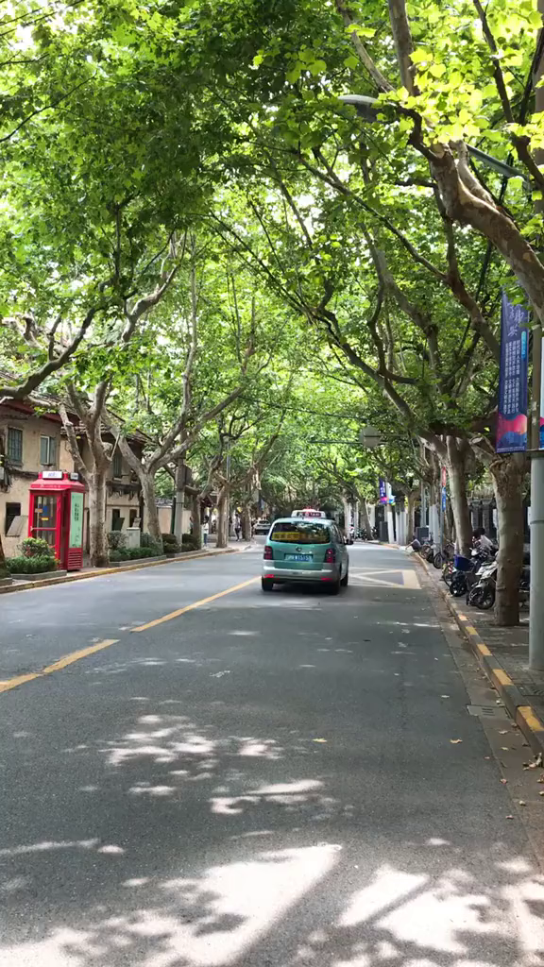
活用词汇
location /ləʊˈkeɪʃn/ n.地方;地点;位置
1. find a location 找一个地方
第一件事就是找个地方。我们原以为这个庇护所会很完美，但当我们问他们时，他们说这里不是用来举办活动的。图书馆、电影院和街角的咖啡馆也拒绝了。(读后续写之举办活动)
Number one on the list was finding a location. We thought the shelter would be perfect, but when we asked them, they said they weren't set up for events. The library, the movie theater, and the comer cafe said no too.
2. locate sb./sth 寻找某人某物
听到父亲尖叫后，费思转过身来，但找不到他的位置。当她沿着街道冲过去时，她发现乔治在越野车前面。(读后续之寻找父亲)
Faith turned around after hearing her father scream but couldn't locate him. When she dashed down the street, she found George in front of the SUV.

Slide 27
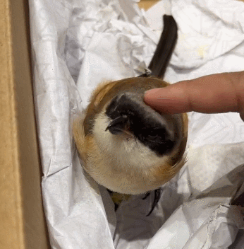
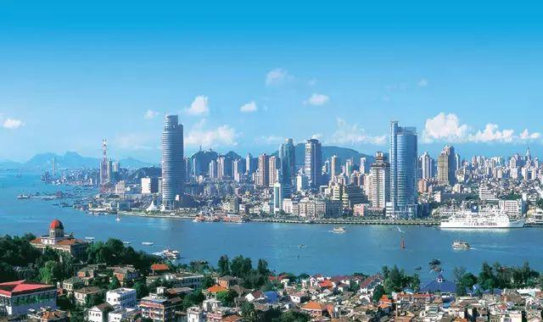
活用词汇
location /ləʊˈkeɪʃn/ n.地方;地点;位置
3. relocate sb/sth 重新安置...
最终，他们重新安置了鸟们。他们又累又担心，在爬虫馆里等着暴风雨停下来。(续写)
Eventually, they finished relocating the birds. Tired and worried, they waited inside the reptile house for the storm to stop.
4. be located in/on/to 坐落于,位于（in 范围之内，on接壤，to 有一定距离）
首先，请允许我给你一个基本的介绍我的家乡，连云港，一个城市的天气总是在夏天凉爽，位于江苏的东北部。(应用文之介绍家乡)
First and foremost, please allow me to give a basic introduction of my hometown to you, Lianyungang, a city where the weather is always cool in summer, is located in the north-east of Jiangsu.

Slide 28

活用词汇
location /ləʊˈkeɪʃn/ n.地方;地点;位置
5. 塔酒店是一家国际化的酒店，工作人员可以与外国游客进行流利的交流。我推荐您选择这家酒店的原因是它设备齐全。不仅到处都有免费Wi-Fi，而且还提供叫醒服务。更重要的是，酒店位于主干道上，离语言培训中心很近。(应用文之向外国朋友推荐住宿酒店)
Tower Hotel is an international hotel whose staff can communicate with foreign tourists fluently. The reason why I recommend you to choose the hotel is that it is well equipped. Not only 1s free Wi-Fi available everywhere, but also a wake-up call service is provided. More importantly, located on a main road, the hotel is close to the Language Training Center.

Slide 29

活用词汇
battle /ˈbætl/ n.战役;搏斗 v.搏斗;奋斗
1.那天下午，我意识到，当我努力相信抚养塔克是正确的事情时，塔克也在努力信任我。事实上，我收养的狗教会了我信任。(读后续写之收养狗狗之后的个人感悟)
That afternoon, I realized that while I was trying to trust that fostering Tuck was the right thing to do, Tuck was fighting a battle to trust me. My adopted dog, in fact, taught me a lesson in trust.
2. an inner battle 一场思想斗争
经过内心的斗争，安娜觉得自己的感受也很重要，于是她给塔利发了一封电子邮件，清楚地解释了她对甲虫的恐惧，希望死去的标本可以用来展示。(读后续写之克服自我恐惧)
After an inner battle, Anna felt her feeling also counted, so she sent Tali an email and clearly explained her fear of beetles, hoping dead specimens(标本）would be used for the display.

Slide 30

活用词汇
fascinating /ˈfæsɪneɪtɪŋ/ adj.极有吸引力的;迷人的
1. a fascinating aspect 一个迷人的方面
这个活动不仅介绍了中国工艺的迷人一面，也象征着我们文化的交融。编织这些结将帮助参与者欣赏中国文化的复杂性，加强相互理解和尊重。(应用文之参加英国学校Chineseworkshop活动意义)
This activity not only introduces a fascinating aspect of Chinese craftsmanship, but also symbolizes our intertwining cultures. Crafting these knots will help participants appreciate the intricacies of Chinese culture, strengthening mutual understanding and respect.
2. be fascinated by 被...所吸引，对...着迷
如果你想看的话，请在明天下午两点之前到112教室来，我将在那里上英语课。我相信你会被它吸引。如果你要去，请尽快给我答复。(应用文之邀请参加英语课活动)
If you want to enjoy it, please come to Room 112 before 2:00 tomorrow afternoon, where I will have English class. I have the confidence that you will be fascinated by it. Please give me an earliest reply if you intend to go.

Slide 31

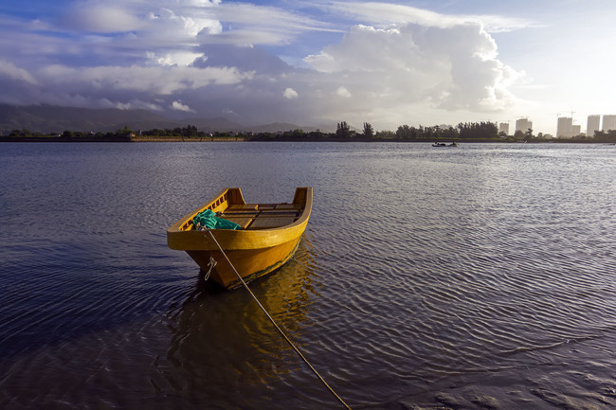
活用词汇
fascinating /ˈfæsɪneɪtɪŋ/ adj.极有吸引力的;迷人的
3. 我坐在楼梯上看得入了迷。(续写)
I sat on the stairs and watched, fascinated.
4. have a fascination with 对...着迷
我毕生都对海和小船有一份沉迷。(续写)
I've had a lifelong fascination with the sea and with small boats.
5. 网络游戏很吸引人，玩起来总是很刺激。(应用文)
The online games were fascinating and it was always exciting to play.

Slide 32
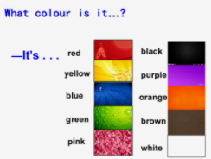
活用词汇
keep your eyes open for /ki:p jɔ:(r) 'aɪz ˈəʊpən fə(r)/ 留心;留意
1. keep an eye on 照看，照管，留心注意
我们已请邻居们在我们外出时替我们照看一下房子。(续写)
We have asked the neighbours to keep an eye on the house for us while we are away.
2.have an eye for 对...有判断力/鉴赏力
一个好的艺术家必须对色彩有鉴赏力。(续写)
A good artist must have an eye for colour.
3. catch sb’s eye 吸引某人的注意
当我打开门时，地板上的一个包裹引起了我的注意。(续写)
When I opened the door, a parcel on the floor caught my eye.

Slide 33


活用词汇
“eye”相关表达
one’s eyes are wide with horror 某人惊恐地瞪大了眼睛
one’s eyes shine with excitement 某人眼里闪烁着兴奋的光芒
one’s eyes filled with tears 某人的眼里充满泪水
one’s eyes fall on someplace 某人的目光落在. ..
look at sb straight in the eye 直视某人的眼睛
one’s eyes fix on . . . . . . 某人的目光紧盯着. . .
one’s eyes scan . . . 某人的眼睛扫视. . .
one’s eyes dropped to. . . 某人垂下眼睛看着. . .

Slide 34

活用词汇
charge /tʃɑ:dʒ/ n.收费;指控 vt.收费;控告
1. be in charge of/take charge of 主管，负责
我将负责一个主题班会，旨在向外国人介绍中国传统文化。(2021年全国甲卷应用文)
I will be in charge of/take charge of a theme class meeting designed to introduce traditional Chinese cultures to foreigners.
2. free of charge /for free 免费
(1)上周我们就市民是否可以免费试用科学博物馆展开了热烈的讨论。（应用文之关于免费使用科学博物馆的讨论）
Last week we had a heated debate about about whether citizens can access the Science Museum free of charge /for free.
(2) 他梦想成为一个像超人或蝙蝠侠那样的英雄。当然，他的梦想是疯狂的，但正如马克斯告诉自己的那样，梦想是免费的。(续写)
He dreamed of being a hero, like Superman or Batman Of course, his dreams were crazy but as Max told himself, dreams were free of charge.

Slide 35
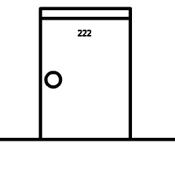

活用词汇
charge /tʃɑ:dʒ/ n.收费;指控 vt.收费;控告
3.charge through the door 破门而入
他破门而入，进了我母亲的办公室。
4. charge down the stairs 冲下楼梯
孩子们冲下了楼梯。
5. charge into my room 冲进房间
他冲进我的房间，要求知道发生了什么事。
He charged through the door to my mother's office.
The children charged down the stairs.
He came charging into my room and demanded to know what was going on.
6.charge at sb. 冲向某人
张着血盆大口，这只凶猛的饿狼突然跳起来，冲向我，就快要一口把我吃掉。(读后续写之动作链描写)
Opening its bloody mouth, the fierce hungry wold sprang to its feet suddenly, charged at me and was about to eat me up in one gulp.

Slide 36
活用词汇
announce /əˈnaʊns/ vt.宣布;通知;声称
1. announce the rules 宣布规则
在上午8点30分，裁判宣布了比赛规则，老师给了我们一些关于如何保护自己避免在比赛中受伤的指导。(应用文)
At 8:30 a.m., the referee announced the rules of the race and the teacher gave us some instructions on how to protect ourselves from injury during the race.
2. 门铃一响就知道杰克驾到。(续写)
A ring at the doorbell announced Jack's arrival.
3. announcer 播音员
我的梦想是在下学期成为一名播音员，这可以让我能够分享学生们的写作和我最喜欢的文章。(应用文)
My dream is to become an announcer in the next semester, which would entitle me to share the students’ writing and my favorite articles.

Slide 37
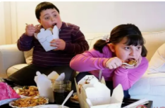

活用词汇
amount /əˈmaʊnt/ n.金额;数量
1. 青少年吃垃圾食品的数量逐年上涨，这逐渐损害了他们的健康。(应用文之饮食健康)
The amount of junk food teenagers eat goes up year by year, which gradually ruins their health.
2. amount to 等同于，总计为
暑假期间我总共挣了300美元，这笔钱可以帮助养活我的家人。(2021年浙江6月读后续写)
The money I earned during the summer holiday, amounted to 300 dollars, which could help suppor my family.

Slide 38

活用词汇
approach /əˈprəʊtʃ/ n.方法;途径 vt.接近;接洽
1. 我最尊敬的人是我的班主任，他总是为我们提供不同的解决困难的方法。(2020年全国卷I应用文)
The person I respect most is my headteacher who always offer us different approaches to handling our difficulties.
2. 随着汽车靠近Mike, Victor 浑身颤抖，如坐针毡。（读后续写之心理描写）
With the bus approaching Mike, Victor shook all over, feeling like sitting on pins and needles.
3. 简颤抖着站起来，向丈夫走去，扑进他的怀里，在他的肩膀上哭个不停。(读后续写之动作链描写)
Jane got to her feet shakily, approached her husband, and threw herself into his arms, sobbing uncontrollably on his shoulder.

Slide 39

活用词汇
ensure /ɪn'ʃʊə(r)/ vt.保证;确保;担保
1. ensure sb./sth, 保证某人/事
已采取所有必要措施来确保他们的安全。(续写)
2. ensure...from/against 确保...不受...伤害
我们应该想尽一切办法确保自己不受一切可能的危险。(续写、应用文)
All necessary steps have been taken to ensure their safety.
We should try all means to ensure ourselves from all possible risks.

Slide 40

活用词汇
generous /ˈdʒenərəs/ adj.慷慨的;大方的;丰富的
1.“你真是太慷慨了。我很乐意接受你的邀请。”我回答说。(续写)
“That’s very generous of you. I’d love to accept your invitation.” I replied.
2. 没有您的慷慨和鼓舞，我不会取得如此惊人的进步。(续写)
Without your generosity and inspiration, I would not have made such striking progress.

Slide 41
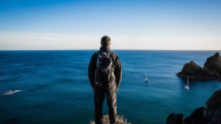
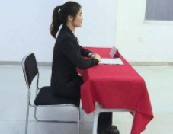
活用词汇
position /pəˈzɪʃn/ n.位置;姿态;职位
1. 他在悬崖之巅，海港景色一览无余。(续写)
From his position on the cliff top, he had a good view of the harbour.
2. 我胳膊疼了，所以稍微变了变姿势。(续写)
My arms were aching so I shifted (my) position slightly.
3. position oneself 摆好姿势
她迅速在桌子后面就位。(续写)
She quickly positioned herself behind the desk.

Slide 42
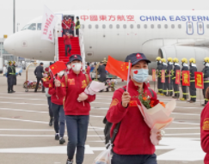

活用词汇
conquer /ˈkɒŋkə(r)/ vt.占领;征服;控制
1. conquering heroes 凯旋的英雄
队员像凯旋而归的英雄一样受到了人们的欢迎。(续写)
The team members were greeted like conquering heroes .
2. conquer a fear 克服恐惧
克服恐惧的唯一方法是正视恐惧。(续写)
The only way to conquer a fear is to face it.
3. conquer oneself 征服自己
这让他有了完成比赛的强烈愿望，并感受到征服自己的纯粹喜悦。(续写)
It empowered him to have a intense desire to finish the competition and feel the sheer exhilaration of conquering himself.

Slide 43
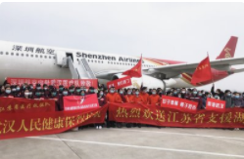
活用词汇
eager /ˈi:gə(r)/ adj.热切的;渴望的
1. 阿蒂对周围满脸热切的人们报以冷笑。(续写)
2. “那么你认为会发生什么事呢？” 他热切地问道。
3. with eagerness 激动地
她激动地气喘吁吁，狄肯也和她一样激动。(续写)
4. be eager to do sth. 渴望/急于做某事
Arty sneered at the crowd of eager faces around him.
"So what do you think will happen?" he asked eagerly.
She quite panted with eagerness, and Dickon was as eager as she was.
当得知武汉需要援助时，许多医护人员热切地冒着生命危险前往武汉。(应用文)
When knowing Wuhan was in need of help, many medical workers were eager to go to Wuhan at the risk of their lives.

Slide 44

活用词汇
feast /fi:st/ n.盛宴;宴会;节日
1. a feast of culture 文化盛宴
我相信这将是一场文化的盛宴，我真诚地希望你能记录下这场难忘的演出，并与我分享你的成就!(应用文之为”中文日”班级庆祝活动提建议)
I am sure this will be a feast of culture and I sincerely hope you could record this unforgettable show and share your achievement with me!
2. a feast of eyes 视觉盛宴
山上到山下，人文景观与大自然景观融为一体，既可以登高远望，又可林中寻幽。(续写)
The scenic spots and historical sites can be a feast of eyes, from the foot to the top, nature landscape and cultural landscape merged well from every angle.

Slide 45
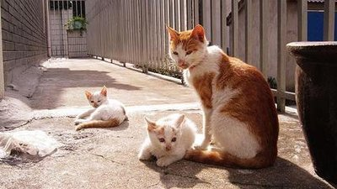

活用词汇
roll /rəʊl/ vi.(使)翻滚;(使)滚动
1. 那些小猫在阳光下嬉戏打滚。(续写)
The kittens were enjoying a roll in the sunshine.
2.我们注视着波浪涌向海滩。(续写)
We watched the waves rolling onto the beach.
3.roll one’s eyes 翻白眼
她翻着白眼。(续写)
She rolled her eyes upwards (= to show surprise or disapproval) .
4. roll over 翻身
她翻了个身，让太阳把她的背晒黑点。(续写)
She rolled over to let the sun brown her back.
5. 薄雾从海上涌来。(续写)
Mist was rolling in from the sea.

Slide 46


活用词汇
roll /rəʊl/ vi.(使)翻滚;(使)滚动
6. 她把牛仔裤卷到了膝盖处。(续写)
7. 他摇摇晃晃地走着。(续写)
8. 她感到眼泪流了下来。(续写)
She rolled her jeans to her knees.
He walked with a rolling gait.
She felt the tears roll down her cheeks.

Slide 47
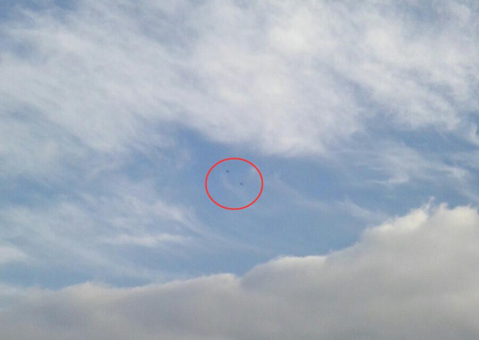
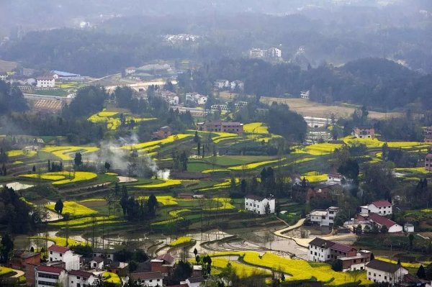
活用词汇
dot /dɒt/ n.点;小(圆)点 vt.加点
1. 直升机像两个小黑点出现在地平线上。(续写)
2. be dotted with 点缀着
乡间有星罗棋布的小村庄。(续写)
3. 小村庄星罗棋布于乡间。(续写)
The helicopters appeared as two black dots on the horizon.
The countryside was dotted with small villages.
Small villages dot the countryside.

Slide 48


活用词汇
roar /rɔ:(r)/ vi.&n.吼叫;咆哮
1. 我们听见了狮子的吼声。(续写)
2. roar (out) one’s approval 大声叫好
崇拜者大声叫好。(续写)
3. roar with laughter 开怀大笑
这使他们大笑起来。(续写)
We heard a lion roar.
The fans roared (out) their approval.
4. roar away 呼啸而去
踩下油门，车子呼啸而去。(续写)
It made them roar with laughter.
She put her foot down and the car roared away.
5. a roar of applause 一阵掌声
他的讲话引来了雷鸣般的掌声。(续写)
His speech was greeted by a roar of applause.

Slide 49

活用词汇
ocean /ˈəʊʃn/ n.大海;海洋
1. 在我看来，的确到了世界各地的海洋部门组织各种各样的志愿活动保护免受破坏的时候。(2022年全国甲卷应用文)
In my opinion, it is high time that the ocean departments from all over the world conducted various voluntary activities to preserve ocean from/against being destroyed.
2. 我们必须采取有效措施来保护海洋免受进一步的污染。(2022年全国甲卷应用文)
Effective measures must be taken to protect oceans from being further polluted.

Slide 50
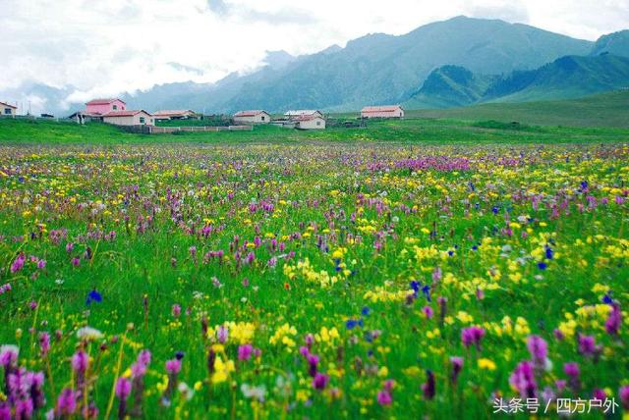

活用词汇
scent /sent/ n.气味;气息
1. 空气中弥漫着野花的芬芳。(续写)
2. 夜空中弥漫着玫瑰花香。(续写)
The air was filled with the scent of wild flowers.
Roses scented the night air.

Slide 51


活用词汇
greet /gri:t/ vt.问候;迎接
1. 她微笑着向我们打招呼。(续写)
2. 这消息受到热烈欢呼。(续写)
3. 她开开门，一片混乱不堪的景象呈现在她的眼前。(续写)
She greeted us with a smile.
Loud cheers greeted the news.
When she opened the door she was greeted by a scene of utter confusion.

Slide 52
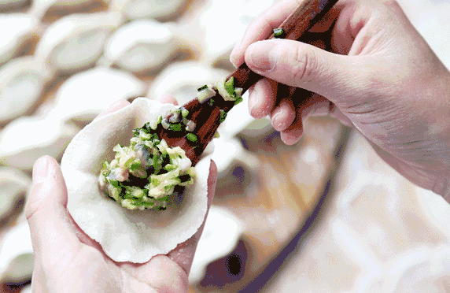
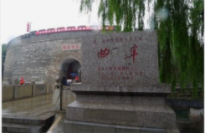
活用词汇
custom /ˈkʌstəm/ n.风俗;习俗;习惯
1. it is a custom to do sth. 做某事是一个习俗...
这一天的计划是这样的:首先，在那天吃饺子是一个习俗，所以我们会自己亲手做美味的饺子，而不是给他们买一些。(应用文)
The plan for the day is as follows: firstly, it’s a custom to have dumplings on that day, so we’ll make delicious dumplings with our own hands rather than buy some for them.
2. 由于孔子的缘故，许多人都渴望去曲阜旅游，曲阜的习俗简单，人民慷慨热情。(应用文)
Thanks to Confucius, many people are eager to visit Qufu, whose customs are simple and whose people are generous and enthusiastic.

Slide 53
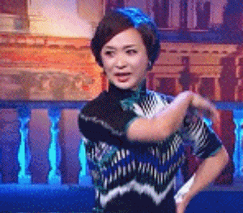

活用词汇
striking /ˈstraɪkɪŋ/ adj.引人注目的;显著的
1.strike sb./sth. 击中某人/某物
(1) 石头击中她的额头。(续写)
(3) 他用拳头打桌子。(续写)
The stone struck her on the forehead.
He struck the table with his fist.
(2)她掴了他一耳光。(续写)
She struck him in the face.
2. a thought struck sb. 一个念头闪过脑子
刚才我脑子里突然闪过一个可怕的念头。(续写)
An awful thought has just struck me.
3. it struck sb ...某人突然想到
我一下子明白我们如何能改善局面了。(续写)
It suddenly struck me how we could improve the situation.

Slide 54



活用词汇
striking /ˈstraɪkɪŋ/ adj.引人注目的;显著的
4. be struck by... 被...所迷住/触动
她年轻热情，把我迷住了。(续写)
I was struck by her youth and enthusiasm.
5. 阳光照得玻璃窗熠熠闪光。(续写)
The windows sparkled as the sun struck the glass.
6. 时钟刚刚敲过三点。(续写)
The clock has just struck three.
7. struck off across the fields 穿过旷野
我们下了公路，穿过旷野往前走。(续写)
We left the road and struck off across the fields.

Slide 55
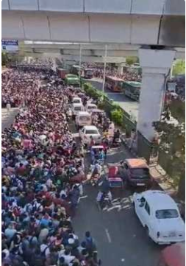
活用词汇
crowd /kraʊd/ n.人群;一群;民众 vt.挤满
1. the crowd 人群
他在人群中往前挤。(续写)
He pushed his way through the crowd.
2. crowds of people 人群
人们成群结队涌上街头。(续写)
Crowds of people poured into the street.
3. crowd the narrow streets 把狭窄的街道挤得水泄不通
成千上万的人把狭窄的街道挤得水泄不通。(续写)
Thousands of people crowded the narrow streets.
4. crowd one’s mind 用上心头
往事涌上他的心头(续写)。
Memories crowded his mind.
5. crowd in on sb 涌向某人
她心乱如麻。(续写)
Too many uncomfortable thoughts were crowding in on her.

Slide 56


活用词汇
with 复合结构
1. with+宾语+to do
有这么多工作要做，我焦虑得睡不着觉。(续写)
2. with+宾语+doing
汤姆扑进母亲的怀抱，羞愧和尴尬的泪水涌上了他的眼睛。（读后续写之兴奋心理描写）
With so much work to do, I was so anxious that I had trouble sleeping.
Tom threw himself into his mother’s arms, with tears of shame and embarrassment welling up in his eyes.
3. with+宾语+done
完成了所有的准备工作，他高兴地跳起来，严重闪烁着兴奋的光芒。(读后学写之兴奋心理描写)
With all the preparations made, he jumped with joy, his eyes glittering with excitement.

Slide 57
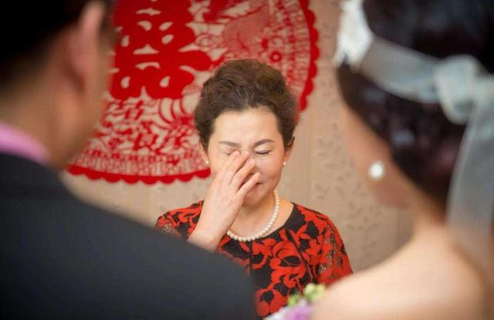
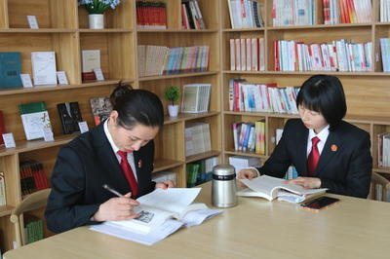
活用词汇
with 复合结构
4. with+宾语+介词短语/形容词/副词
(1) 她热泪盈眶地见证了女儿的婚礼。(续写)
With tears of joy in her eyes, she witnessed her daughter’s wedding.
(2)我有信心，有这样一位优秀的朋友在我身边，我会变得越来越好。(续写)
I have the confidence that, with such an excellent friend around me, I will become better and better.

Slide 58

活用词汇
if 的省略结构
1. if so 如果是这样的话... /if not 如果不这样的话
如果是这样的话，我真诚地邀请你和我的家人一起庆祝中秋节; 如果不的话，我会向你推荐一些附近的迷人景点。请提前告诉我你的决定以便我可以做出进一步的安排。（应用文之邀请信）
If so, I sincerely invite you to celebrate the Mid-Autumn Day with my family. If not, I recommend some nearby fascinating scenic spots to you. Please inform me of your decision in advance so that I can make further arrangements.
2. if possible 如果可能的话
如果可能的话，请提前告诉我你所需要的东西。(应用文)
If possible, please tell me what you need in advance.
3. if necessary 如果有必要的话
如有需要，我校将为学生提供语言培训课程。(应用文)
If necessary, our school will provide the students with the language training courses.

Slide 59

活用词汇
if 的省略结构
4. if any 如果有的话
如果有人要来的话，请让我知道有多少，我好做准备。(应用文)
Please let me know how many people are coming, if any, so that I can make preparations.
5. if ever 如果有过/发生过的话
如果曾经有过行动的时刻，那就是现在。(应用文)
If ever there was a time to act, it is now.

Slide 60

Thank YOU

