Slide 1

感恩遇见，相互成就，本课件资料仅供您个人参考、教学使用，严禁自行在网络传播，违者依知识产权法追究法律责任。
更多教学资源请关注
公众号：溯恩高中英语
知识产权声明

Slide 2

The World
September 16th-30th, 2023

Slide 3
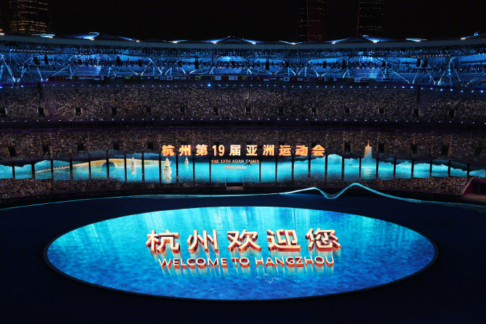
1. Enthralling ceremony opens innovative Games
杭州亚运会开幕式惊艳世界

Slide 4
语篇填空
（《中国日报》2023年9月25日 1页 ）
The spectacular opening ceremony of ____19th Asian Games on Saturday in Hangzhou, Zhejiang province, left the world marveling at the stunning combination of China’s rich cultural heritage and its remarkable ____________ (technology) advancements.
The two-hour show, themed “Tides Surging in Asia” was a seamless _________ (integrate) of glasses-free 3D technology, augmented reality and artificial intelligence with the real world, which impressed not only athletes, officials and the 50,000 spectators at the Hangzhou Olympic Sports Centre Stadium, but also billions of viewers across the globe.
As the athletes from 45 countries and regions _______ (step) into the venue amid the roll of drums and melodious Chinese folk music, the packed stadium burst into wild celebration, ________ (cheer) for every team. _____ the interplay of Chinese and Asian cultures, the parade highlighted the vision of building a community with a ______ (share) future.
The lighting of the cauldron, ______ displayed the integration of the virtual and real worlds for the first time at an international sporting event, was ___________ (doubt) the most glorious moment of the opening ceremony. Scores of people in Asia and beyond watched with fascination as over 100 million sparks, each representing a participant in the digital torch relay, converged over the Qiantang River _______ (form) a “digital torchbearer”.
the
technological
integation
stepped
cheering
With
shared
which
undoubtedly
to form

Slide 5
词汇讲解
1. interplay: the way in which two or more things or people affect each other 相互影响（或作用）
There’s a lot of wonderful interplay between the writer and his characters. 作者和他笔下的人物之间有很多精彩的互动。
2. converge: to move towards a place from different directions and meet 汇集；聚集；集中
Thousands of supporters converged on London for the rally. 成千上万的支持者从四面八方汇聚伦敦举行集会。
翻译句子
我们的个性是基因与环境之间相互影响的结果。
Our personalities result from the interplay between our genes and the environment.
翻译句子
预计有10万人聚集镇上庆祝节日。
100,000 people are expected to converge on the town for the festival.

Slide 6
句子翻译
The spectacular opening ceremony of the 19th Asian Games on Saturday in Hangzhou, Zhejiang province, left the world marveling at the stunning combination of China’s rich cultural heritage and its remarkable technological advancements.
上周六，第19届亚运会在浙江杭州盛大开幕，中国丰富的文化遗产和惊人的科技进步令人惊叹。
翻译
As the athletes from 45 countries and regions stepped into the venue amid the roll of drums and melodious Chinese folk music, the packed stadium burst into wild celebration, cheering for every team. With the interplay of Chinese and Asian cultures, the parade highlighted the vision of building a community with a shared future.
当来自45个国家和地区的运动员在鼓声和悠扬的中国民族音乐中步入会场时，拥挤的体育场爆发出疯狂的庆祝活动，为每一支球队欢呼。随着中国和亚洲文化的相互影响，游行突出了构建人类命运共同体的愿景。
翻译

Slide 7
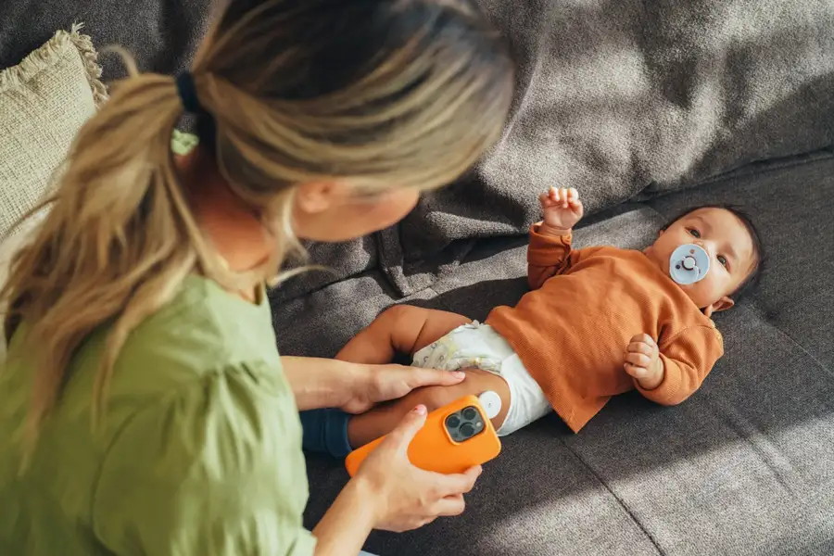
2. Covid-19 linked to higher risk of type 1 diabetes in children
Covid-19与儿童患1型糖尿病的风险较高有关
A baby wearing a sensor for measuring blood glucose levels, which are affected by type 1 diabetes

Slide 8
阅读理解
（《新科学家》 2023年9月16日版 11页 ）
Children between 4 months and 2 years old who have had covid-19 are more likely to have antibodies that attack cells that make insulin, a feature of type 1 diabetes.
Insulin, a hormone that regulates the body’s blood sugar levels, is made in the pancreas by cell clusters known as islets of Langerhans. In some cases, the body can develop an autoimmune response to these islets and produce auto-antibodies against them. Too many of these over time will kill enough islets to trigger type 1 diabetes, where the body can’t produce its own insulin.
“The presence of these auto-antibodies more or less means that there’s a 100 per cent path to [type 1 diabetes]” says Anette-Gabriele Ziegler at the Technical University of Munich in Germany.
One of the risk factors for type 1 diabetes is thought to be some viral infections, including SARS-CoV-2, the virus that causes covid-19. A rise in diabetes cases linked to covid-19 has been reported, but the mechanism behind it isn’t known.
To investigate, Ziegler and her colleagues monitored 885 children between the ages of 4 months and 2 years old, who were all identified as having at least a small risk of developing islet auto-antibodies. Of the cohort, 170 children had SARS-CoV-2 antibodies, suggesting they had previously had covid-19.
The children who had these antibodies were twice as likely to develop islet auto-antibodies as those who hadn’t been infected. Those who caught covid-19 before they were 18 months old had a 5 to 10 times higher risk of developing the auto-antibodies, making them the most at-risk group.
“We would love to see if vaccinating children from 6 months can prevent the autoimmunity that leads to type 1 diabetes,” says Ziegler.

Slide 9
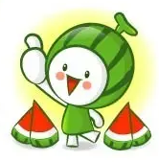
阅读理解
1.What does the underlined word “trigger” mean in Paragraph 2?
A.increase B. attract C. generate D.destroy
词义猜测
2.What can we know about type 1 diabetes?
A.The adults are less likely to have type 1 diabetes.
B.Auto-antibodies will help cure type 1 diabetes.
C.Some viral infections may lead to type 1 diabetes.
D.Type 1 diabetes occurs only in children.
推理判断
3.What is Zieger’s attitude to the the function of vaccination ?
A.favourable B. expectant C. critical D. indifferent
观点态度
4.What’s the best title for the text?
A.Covid -19 linked to higher risk of type 1 diabetes in children
B.Insulin regulating the body’s blood sugar levels.
C.Auto-antibodies killing islets of Langerhans.
D.SARS-CoV-2 causing widespread covid-19.
主旨大意
Notes:
【设计意图】通过阅读理解的形式帮助学生理解新闻的主要内容。该新闻主题语境是关于“人与社会”中“社会热点问题”这一子主题，通过学习让学生了解威尔士禁止体罚孩子的法律。

Slide 10
词汇讲解
1. regulate: to control something, especially by making it work in a particular way控制，管理，调节，调整
The activities of credit companies are regulated by law. 信贷公司的业务受法律的制约。
2. mechanism: a method or a system for achieving sth 方法；机制
There’s no mechanism for punishing arms exporters who break the rules. 对于违反规定的军火出口商还没有惩罚机制。
翻译句子
旅游业是由一套指导方针管理的。
The travel industry is regulated by a set of guidelines.
翻译句子
疼痛算是一种自然防护机制的作用。
Pain acts as a natural defence mechanism.

Slide 11
句子翻译
In some cases, the body can develop an autoimmune response to these islets and produce auto-antibodies against them. Too many of these over time will kill enough islets to trigger type 1 diabetes, where the body can’t produce its own insulin.
在某些情况下，身体会对这些胰岛产生自身免疫反应，并产生针对它们的自身抗体。随着时间的推移，过多的抗体会杀死足够多的胰岛，从而引发1型糖尿病，即身体不能自己产生胰岛素。
翻译
One of the risk factors for type 1 diabetes is thought to be some viral infections, including SARS-CoV-2, the virus that causes covid-19. A rise in diabetes cases linked to covid-19 has been reported, but the mechanism behind it isn’t known.
1型糖尿病的风险因素之一被认为是一些病毒感染，包括导致covid-19的病毒SARS-CoV-2。据报道，与covid-19相关的糖尿病病例有所增加，但其背后的机制尚不清楚。
翻译

Slide 12
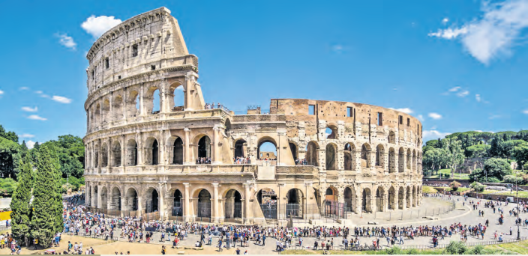
3. Ticketing nightmare in amphitheatre of dreams
梦幻圆形剧场的售票噩梦

Slide 13
语篇填空
（《泰晤士报》2023年9月18日 35页）
Staged battles have returned to the Colosseum as touts defy officials to sell tickets to the amphitheatre at inflated prices. Scalpers _______________ (use) autonomous online programmes to snap up tokens as soon as they emerge. Tickets to the ancient Roman theatre of grand spectacles _________ (official) cost €16 but touts are selling them on websites for up to €80.
Reports suggest that for the past seven months official _______ (ticket) have been difficult to find online.
Alessandro Onorato, Rome’s tourism chief, called on Gennaro Sangiuliano, Italy’s culture minister, to intervene. A source at the culture ministry said the government planned ___________ (introduce) named tickets for visitors, _____ would have to produce photo ID.
____ similar measure is used to combat football touts. In a further measure, the insider said tickets could be reserved ____ who sale at booths.
The Colosseum, completed by the emperor Titus in AD80, draws about 20,000 visitors a day and _______ (earn) €63 million in ticket sales last year. A study by Deloitte found the site contributed €1.4 billion to _______ (Italy) economy in 2022.
The problem of web touts arose ______ ticket sales moved online during the pandemic. The ticket office reopened in May.
have been using
officially
tickets
to introduce
who
A
for
earned
Italy’s
when

Slide 14
熟词生义
1. defy: to refuse to obey or show respect for sb in authority, a law, a rule, etc. 违抗；反抗；蔑视
Hundreds of people today defied the ban on political gatherings.
今天有数百人违抗禁止政治集会的规定。
2. combat: fighting or a fight, especially during a time of war 搏斗；打仗；战斗
Chip and PIN is designed to combat credit card fraud.
智能卡系统是专为防止信用卡诈骗设计的。
翻译句子
我可不敢不听老师的话。
I wouldn’t have dared to defy my teachers.
翻译句子
政府正在采取措施，打击滥用毒品。
The government is taking action to combat drug abuse.

Slide 15
句子翻译
Staged battles have returned to the Colosseum as touts defy officials to sell tickets to the amphitheatre at inflated prices.
斗兽场又上演了一场闹剧，票贩子不顾官员的反对，以高价出售圆形剧场的门票。
翻译
The Colosseum, completed by the emperor Titus in AD80, draws about 20,000 visitors a day and earned €63 million in ticket sales last year.
翻译
罗马斗兽场由罗马皇帝提图斯(Titus)于公元80年建成，每天吸引约2万名游客，去年的门票收入为6300万欧元。

Slide 16
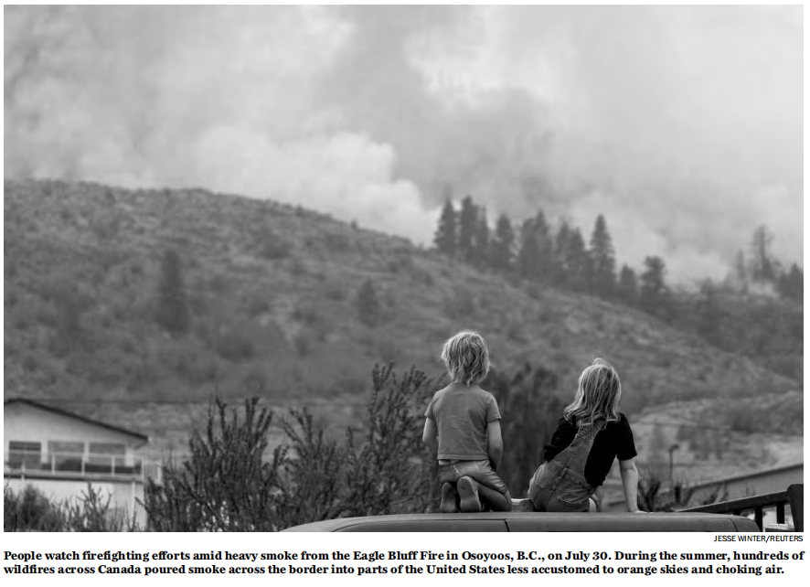
4. Wildfires eroding decades of air quality progress in U.S.
野火频发 美国几十年来的空气质量改善功亏一篑

Slide 17
语篇填空
（《华盛顿邮报》2023年9月21日 A3 版面）
In more than a half century since the Clean Air Act was enacted, there ___________ (be) dramatic improvements in air quality in the United States. But a big chunk of recent air quality progress has been rolled back for one reason — wildfire smoke — and it’s happening far beyond the smoldering forests of Western states.
Over the past two decades, air quality improvements have slowed or been reversed in most of the country, _______ (erode) about a quarter of the recent gains, according to a new study in the journal Nature. The new study seeks _________ (answer) the question: What has all this wildfire smoke done to overall air pollution levels? _____ they found was sobering.
Data _____ air quality sensors around the country had been showing steady improvement since 2000 in most states. ____ around 2016, the trend broke. Since then, air quality progress has ___________ (significant) slowed in 30 states. In 11 others, it began to reverse.
One of the main reasons is wildfire smoke. The statistical ________ (analyse) through 2022 found that wildfire smoke significantly influenced air quality ______ (trend) in 35 of the contiguous states. States that are still improving would have done so _____ (fast) without smoke. In some Western states, air quality that otherwise would have kept improving is now getting worse because of that smoke.
have been
eroding
to answer
What
from
But
significantly
analysis
trends
faster

Slide 18
词汇讲解
1. smo(u)lder: 1) to burn slowly without a flame （无明火地）阴燃，闷燃
2) to be filled with a strong emotion that you do not fully express （感情）郁积，压在心头
The bonfire was still smouldering the next day. 到了第二天，篝火还在闷燃。
2. sober: to make sb behave or think in a more serious and sensible way; to become more serious and sensible （使）变得持重，变得冷静
The bad news sobered us for a while.
坏消息使我们冷静了一会儿。
翻译句子
Peter开车回家吃午饭的路上，心里一直憋着一团火。
Peter smouldered as he drove home for lunch.
翻译句子
他突然严肃起来。
He suddenly sobered.

Slide 19
句子翻译
Over the past two decades, air quality improvements have slowed or been reversed in most of the country, eroding about a quarter of the recent gains, according to a new study in the journal Nature.
《自然》杂志上发表的一项新研究显示，在过去20年里，美国大部分地区的空气质量改善速度放缓，甚至出现逆转，最近取得的进步大约有四分之一被侵蚀。
翻译
The statistical analysis through 2022 found that wildfire smoke significantly influenced air quality trends in 35 of the contiguous states. States that are still improving would have done so faster without smoke. In some Western states, air quality that otherwise would have kept improving is now getting worse because of that smoke.
翻译
截至2022年的统计分析发现，野火烟雾显著影响了35个相邻州的空气质量趋势。如果没有烟雾，那些空气质量仍在改善中的州会改善地更快。在西部的一些州，原本会持续改善的空气质量现在因为烟雾而变得更糟。

Slide 20
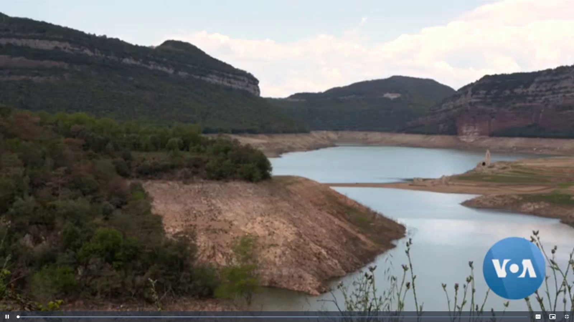
5. VOA 09/26/2023

Slide 21

听力填空
It’s the worst _______ Spanish farmers have experienced in their lifetime. Combined with deadly __________ and wildfires across Europe, climate change is affecting the weather and not in a good way, scientists and leaders worldwide say. “And we saw the _____ and carnage of extreme weather from Slovenia to Bulgaria and right across our Union. This is the reality of ______________.”
This extreme weather is _________ olive oil production in Spain, the world’s largest producer, which provides about half of the world’s supply. The country combines traditional olive growing methods with ________________, resulting in high-quality oils that are _________ worldwide.
Last year was Spain’s hottest year on record and the past two harvests have been half of those of _____________. The drought has worried producers who have little hope next year’s harvest will be _________. The price of Spanish olive oil has _______ in the past two years due to a supply shortage.
drought
heat waves
chaos
a boiling planet
disrupting
modern innovation
consumed
previous years
any better
doubled

Slide 22
词汇讲解
1. carnage: the violent killing of a large number of people 大屠杀
Reporters described the highway accident as a scene of carnage.
记者们把这次公路事故描述为一场大屠杀。
2. disrupt: to make it difficult for sth to continue in the normal way
扰乱；使中断；打乱
Anti-war protesters disrupted the debate.
反战示威者们打断了辩论。
翻译句子
多年的暴力和屠杀使这个国家沦为一片废墟。
Years of violence and carnage have left the country in ruins.
翻译句子
旱灾已严重影响了农业生产。
The drought has severely disrupted agricultural production.

Slide 23
句子翻译
It’s the worst drought Spanish farmers have experienced in their lifetime. Combined with deadly heat waves and wildfires across Europe, climate change is affecting the weather and not in a good way, scientists and leaders worldwide say.
翻译
这是西班牙农民一生中经历的最严重的干旱。世界各地的科学家和领导人表示，加上欧洲各地致命的热浪和野火，气候变化正在影响天气，而且是负面的影响。
The country combines traditional olive growing methods with modern innovation, resulting in high-quality oils that are consumed worldwide.
该国将传统的橄榄种植方法与现代创新相结合，生产出供世界各地消费的高品质橄榄油。
翻译

