Slide 1

感恩遇见，相互成就，本课件资料仅供您个人参考、教学使用，严禁自行在网络传播，违者依知识产权法追究法律责任。
更多教学资源请关注
公众号：溯恩高中英语
知识产权声明

Slide 2
Practical Writing Analysis
2023年6月新高考Ⅰ&Ⅱ卷应用文分析
Lea

Slide 3
1
Read for structure
假定你是李华，外教Ryan准备将学生随机分为两人一组，让大家课后练习口语，你认为这样分组存在问题。请你给外教写一封邮件，内容包括：
1.说明问题
2.提出建议
STRUCTURE:
Dear Ryan,
Para 1:
self-inroduction+background+purpose
para 2: problem(s) and suggestion(s)
para 3: expectation
Yours,
Li Hua
建议信
外教 （语气委婉）
I, you, students
一般现在时为主
体裁
交际对象
人称
时态

Slide 4
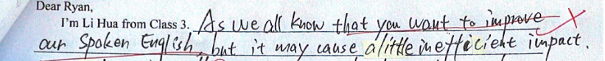

2
Read for key points
Para 1: self-inroduction+background+purpose
practice spoken English after class
randomly/at random
假定你是李华，外教Ryan准备将学生随机分为两人一组，让大家课后练习口语，你认为这样分组存在问题。请你给外教写一封邮件，内容包括：
1.说明问题
2.提出建议
divide...into pairs
1
VS
2

Slide 5

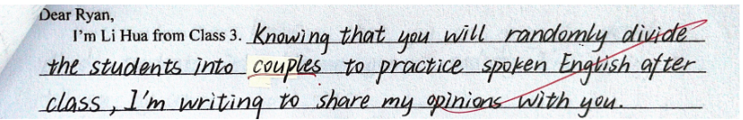
specific background and accurate purpose
Para 1: self-inroduction+background+purpose
practice spoken English after class
randomly/at random
假定你是李华，外教Ryan准备将学生随机分为两人一组，让大家课后练习口语，你认为这样分组存在问题。请你给外教写一封邮件，内容包括：
1.说明问题
2.提出建议
divide...into pairs
my concerns
1
VS
2

Slide 6
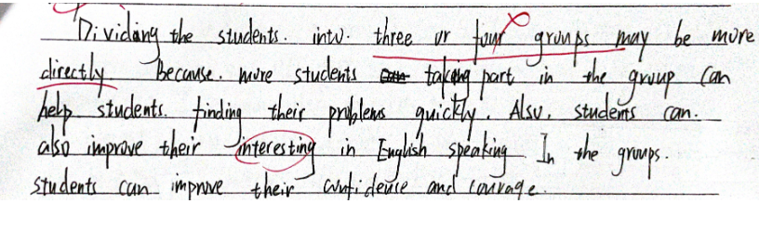
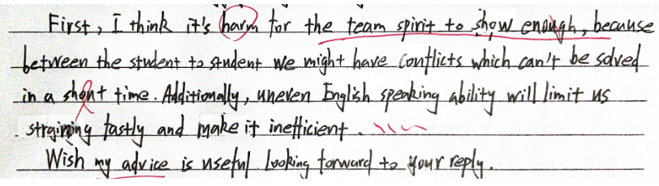
Para 2: problem(s) and suggestion(s)
all suggestions, no problems
1
VS
all problems,
no suggestions
2

Slide 7
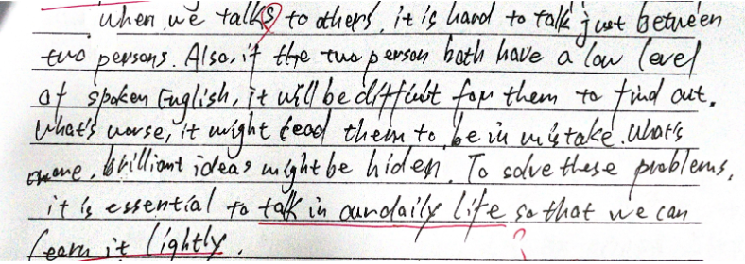
Para 2: problem(s) and suggestion(s)
3
unrelated problems & suggestions

Slide 8
reasonable problems and matched suggestions
Para 2: problem(s) and suggestion(s)
假定你是李华，外教Ryan准备将学生随机分为两人一组，让大家课后练习口语，你认为这样分组存在问题。请你给外教写一封邮件，内容包括：
problem 1
divide Ss randomly
→
affect the output of the group practice
↑
different English capacity of each group
freely
accordingly
suggestion
→
improve practice effciency
problem 2
divide Ss into pairs
→
discourage Ss from expressing themselves
↑
inactive atmosphere
larger groups with leaders
stimulate students’ motivation
make progress together
suggestion
→

Slide 9
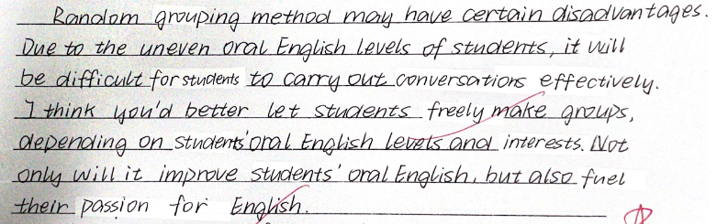
divide Ss randomly
lead to
problem 1
affect the output of the group practice
due to
To solve this
different English capacity of each group
freely
accordingly
suggestion
improve practice effciency
in which case

Slide 10
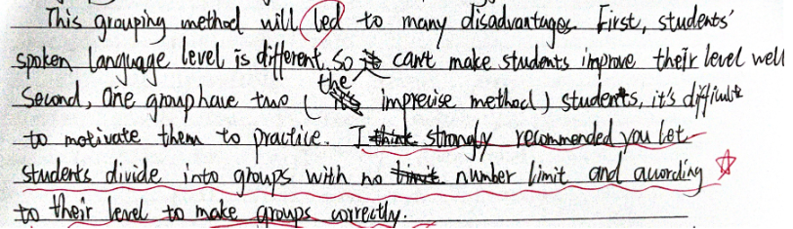
coherent phrases
problem 2
divide Ss into pairs
→
discourage Ss from expressing themselves
↑
inactive atmosphere
larger groups with leaders
stimulate students’ motivation
make progress together
suggestion
→

Slide 11


polite tone
Para 3: expectation
假定你是李华，外教Ryan准备将学生随机分为两人一组，让大家课后练习口语，你认为这样分组存在问题。请你给外教写一封邮件，内容包括：
1.说明问题；2.提出建议。

Slide 12
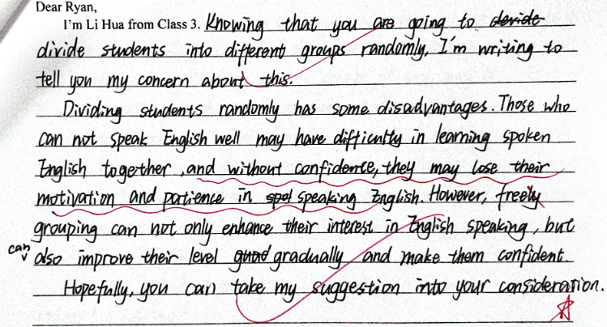
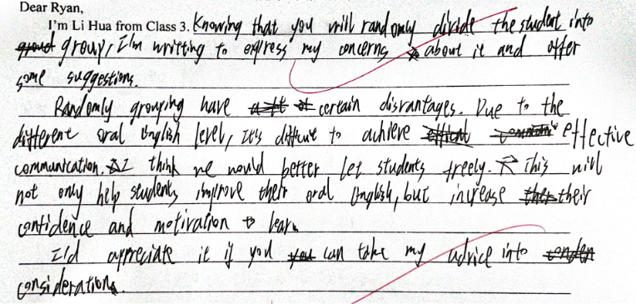
neat handwriting
If you were the grader, how would you rate them?
VS

Slide 13
3
Summary
A good letter of suggestion requires:
1
2
3
4
5
specific background & accurate purpose
reasonable problems & matched suggestions
coherent phrases
polite tone
neat handwriting

Slide 14
4
Appreciation
Dear Ryan, I’m Li Hua from Class 3. Knowing that you will randomly divide the students into pairs to practice oral English after class, I’m writing to express my concerns about this grouping method and sincerely offer my suggestions.
Random grouping may have certain disadvantages. Due to the uneven English capability of students, it’s challenging for those with a low proficiency in English to carry out effective oral communication and achieve good practice results. Thus, I think you'd better let students form groups of different numbers freely according to their English competence and interest. Not only will this help students improve their oral English, but also their confidence can be boosted and their motivation to learn can be increased.
I'd appreciate if you could take my advice into consideration.
Yours sincerely, Li Hua

Slide 15
5
Consolidation
（2023.09名校协作）假定你是某国际学校的学生李华，最近你校举办了一年一度的“英语周”活动，请你给活动负责人Mr Ryan写一封邮件，内容包括:
1.评价活动；2.提出建议。
Dear Mr Ryan,
I’m Li Hua from Class 1 Grade 3. Having experienced the annual “English Week”, I’m writing to give my feedback and provide some suggestions.
Admirably, with such a great diversity of activities, ranging from English dubbing competitions to talent shows, many students extinguished themselves with a high level of English competence. Besides, the carefully selected prizes for the winners literally amazed everyone present. However, I have noticed that there are some students who are unable to participate in any of the activities. Thus, I think it would be better if there could be some activities less competitive or of pure fun, allowing everyone an opportunity to get involved, such as English corner and appreciating English movies.
Your consideration of my suggestions will be highly appreciated. Wish the event a greater success next year.
Yours,
Li Hua

