Slide 1

感恩遇见，相互成就，本课件资料仅供您个人参考、教学使用，严禁自行在网络传播，违者依知识产权法追究法律责任。
更多教学资源请关注
公众号：溯恩高中英语
知识产权声明

Slide 2
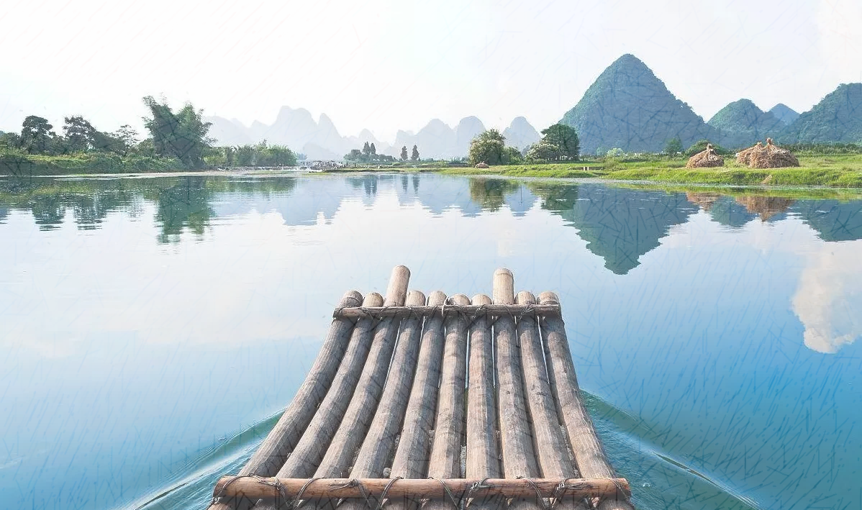
Xu Xiake’s Guilin

Slide 3
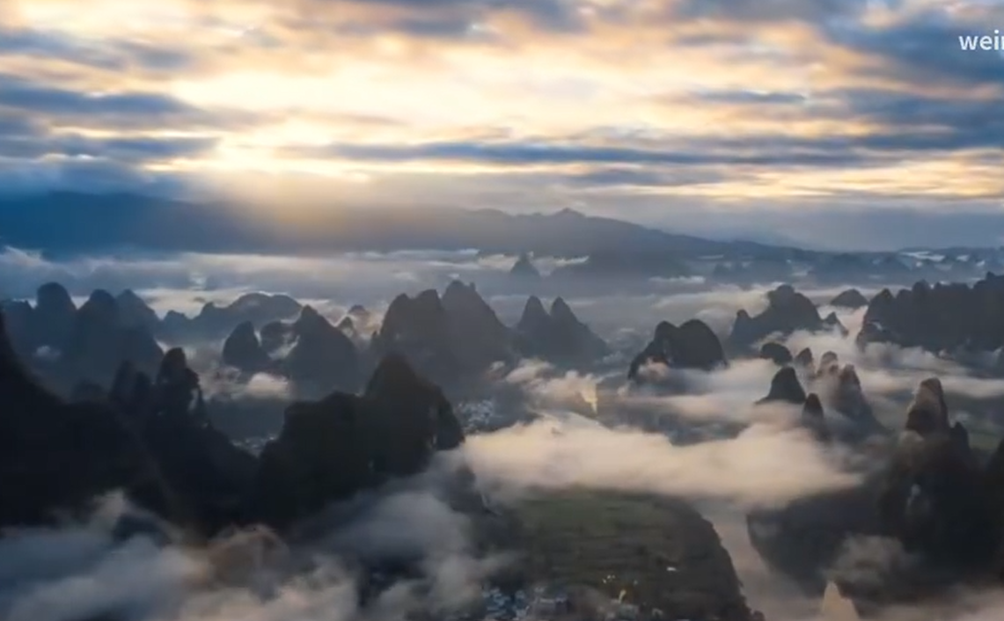
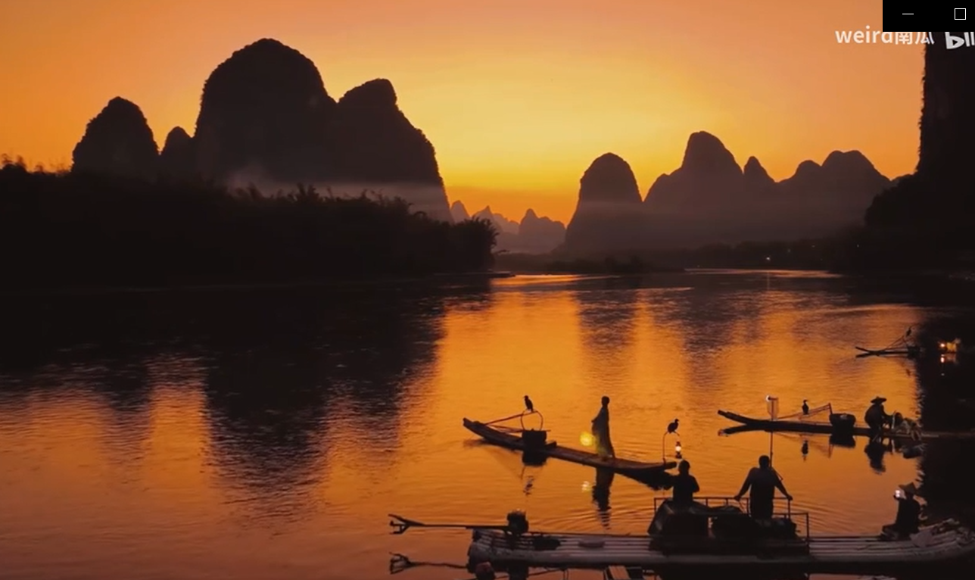
The landscape of Guilin is second to none.
桂林山水甲天下
What impresses you the most in the video?

Slide 4
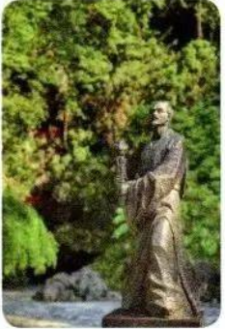
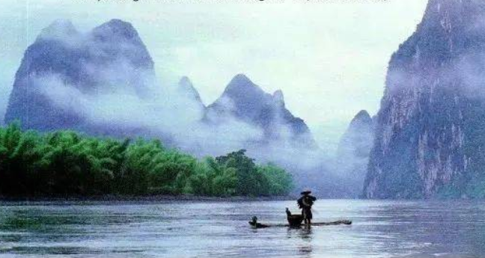
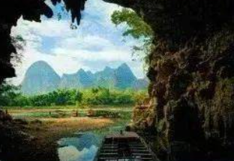
While-reading
Look at the title and the pictures in page 85.
What do you want to learn from the text?
Xu Xiake’s Guilin

Slide 5

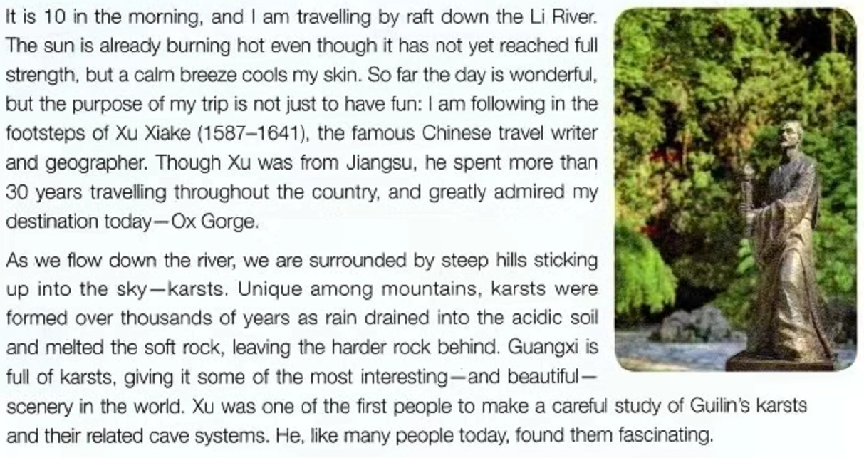
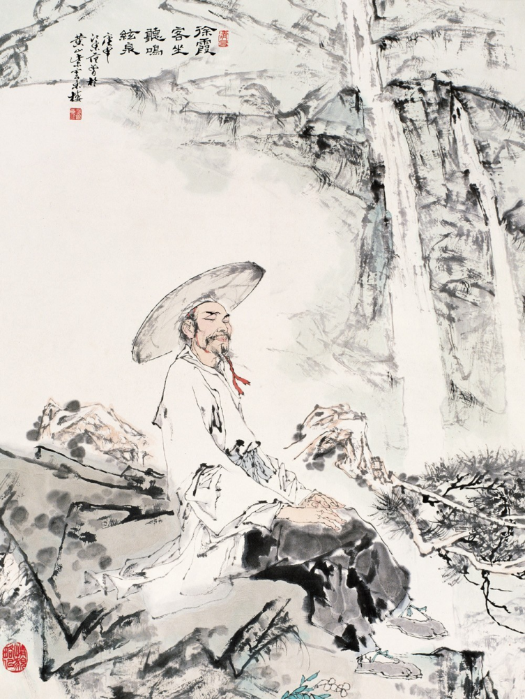
Read para. 1 and find out what information you can learn from it.
Information | Details
transportation | by raft
weather | burning hot but still pleasant
route | travel down the Li River towards Ox Gorge
purpose | not only to have fun but also follow the footstep of Xu Xiake.

Slide 6
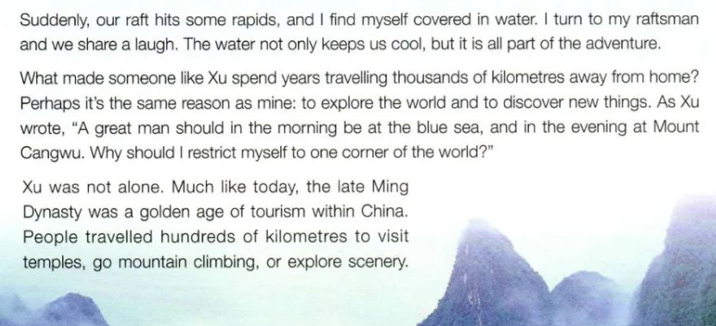
Why does the author follow the footstep of Xu to visit Guilin? Please read the rest of the passage to find out the reason.
(Para. 4)
explore the world & discover new things

Slide 7
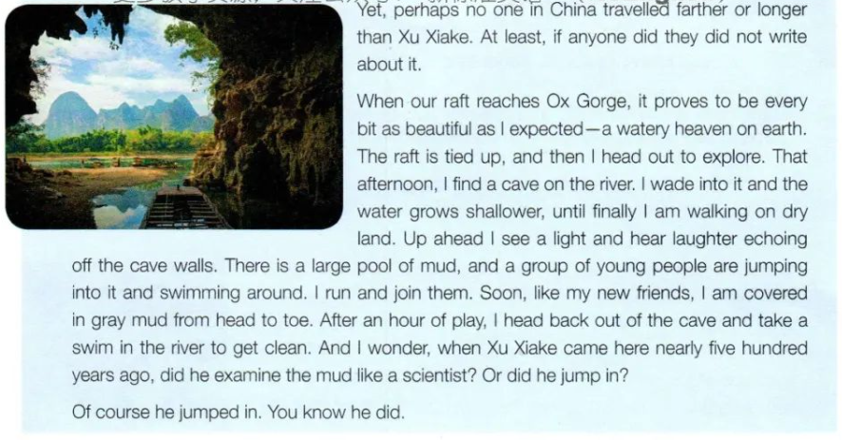
What new things does the author discover?
What does the author do to explore?

Slide 8
descriptive words
What new things does the author discover?
What does the author do to explore?
verb phrases
Following in the footsteps of Xu Xiake enables us to explore/discover karsts.
As we ___________(v.) the river, we _______________(v.) the ______________(adj.) karsts ____________________, which give Guangxi some of the most ___________________________(adj.) scenery in the world.
flow down
are immersed in
unique/steep
sticking up into the sky
interesting/beautiful/fascinating

Slide 9
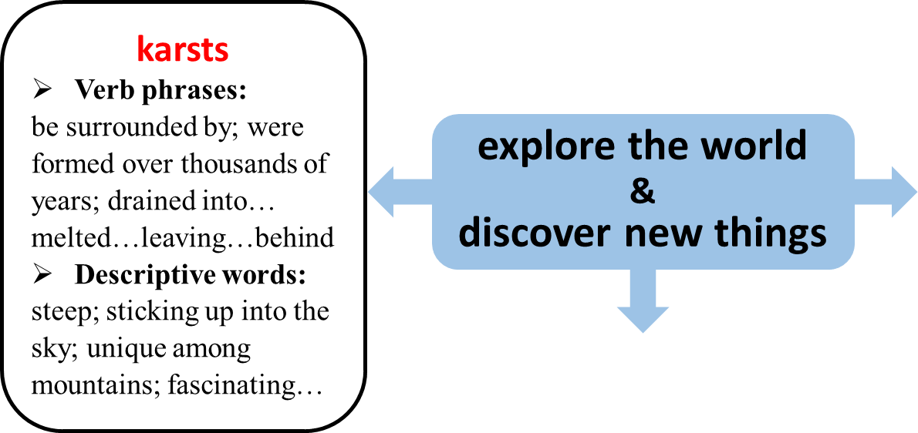
Discuss in group of four:
What new things does the author discover? What does the author do to explore?
Find details from para.3-7 and finish the mind map on the worksheet.
Sentence pattern:
Following in the footsteps of Xu Xiake enables us
to explore/discover _____(what). ________(details)

Slide 10
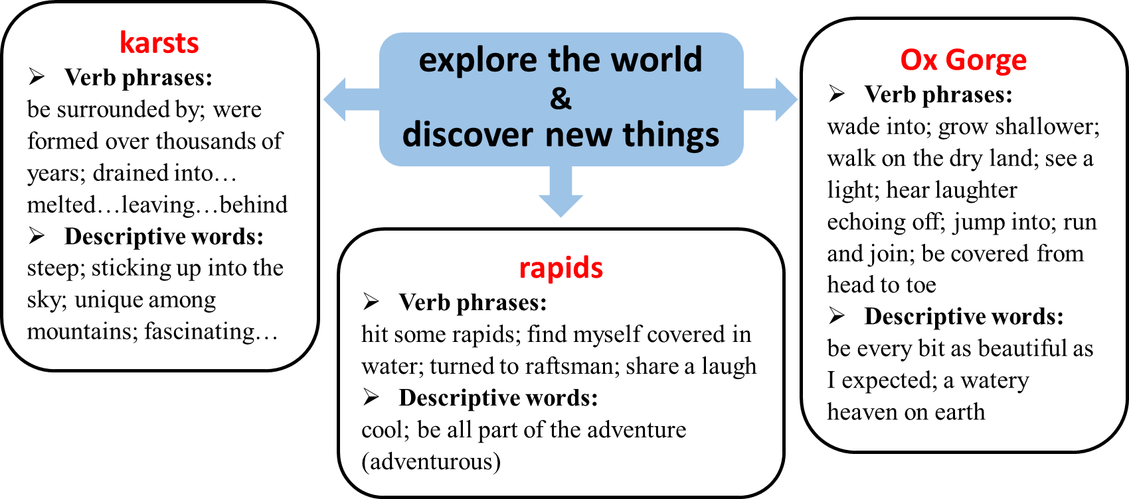
What new things does the author discover? What does the author do to explore?
How does the author write about them?

Slide 11
Thinking
Focus on the ending. Do you also think Xu Xiake jumped in the pool and examine the mud?
Why does the author use the title?
Xu Xiake’s Guilin

Slide 12
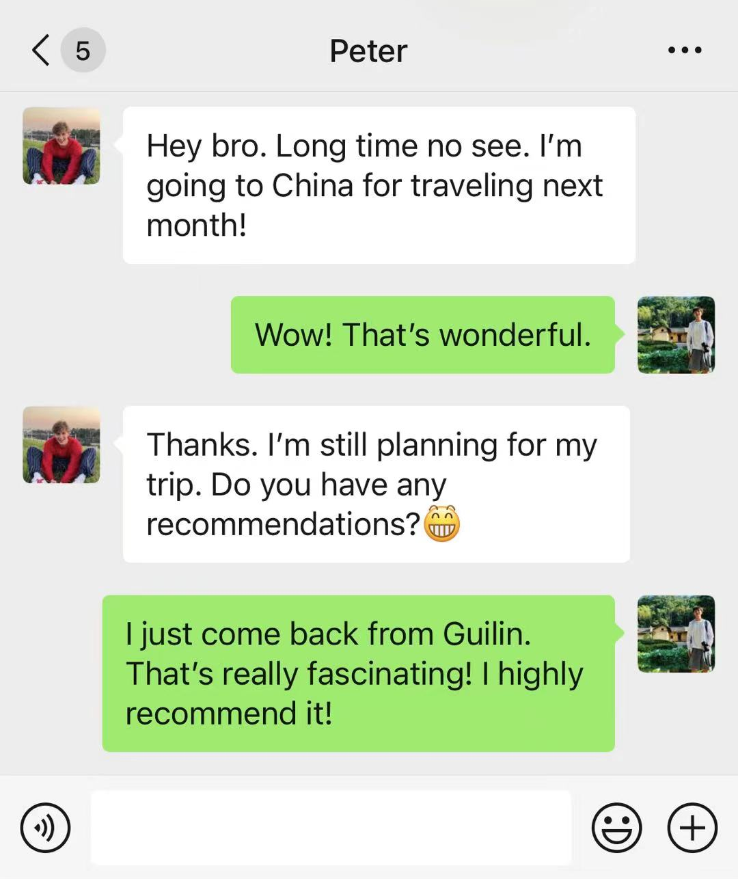

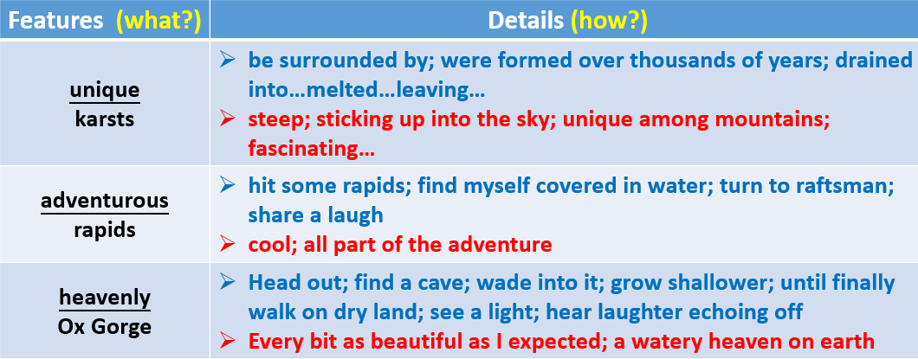

Post-reading
I believe that Guilin is a second-to-none choice for you!
For one thing,…/For another,…/Best of all,… (reasons).
I surely believe this trip will live up to your expectation.

Slide 13
Possible version
Dear Peter,
How’s everything going? Glad to hear that you’re traveling to China, I’m writing to make recommendation to you.
I’m convinced that Guilin is a second-to-none choice for you! For one thing, in Guilin you’ll find yourself surrounded by the unique karsts, a kind of steep hills sticking up into the sky formed over thousands of years. For another, a raft trip down the Lijiang River will take you on an thrilling journey to immerse yourself in the spectacles of Guilin with the raft hitting the rapids and your feet covered in the cool water. Best of all, you will also head out for an adventure to the heavenly Ox Gorge that proves to be every bit as beautiful as you may expect. You can wade into the shallow water, have fun in the pool of mud as well as see a flash of light up ahead and hear laughter echoing off the cave walls. I surely believe this trip will live up to your expectation.
Yours,
Li Hua

Slide 14
“A great man should in the morning be at the blue sea, and in the evening at Mount Cangwu. Why should I restrict myself to one corner of the world?”
-- Xu Xiake

