Slide 1

感恩遇见，相互成就，本课件资料仅供您个人参考、教学使用，严禁自行在网络传播，违者依知识产权法追究法律责任。
更多教学资源请关注
公众号：溯恩高中英语
知识产权声明

Slide 2
浙江强基联盟2023学年高三10月联考
读 后 续 写
浙江省衢州第一中学 徐荣仙

Slide 3
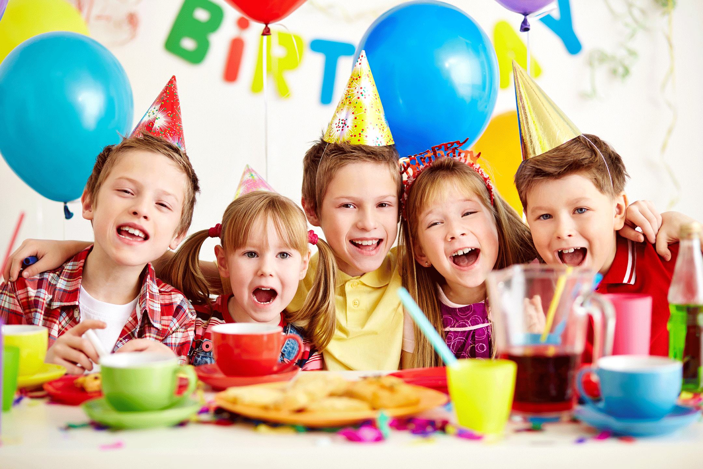
Lead in
An Unexpected Party
Q: How do you usually celebrate your birthday?
Q: Who do you usually celebrate your birthday with?
Q: What do you usually receive on your birthday?
Q: What kind of birthday celebration is your favourite？

Slide 4

Sally's birthday was approaching, and the excitement that usually filled her heart was now replacedwith disappointment and stress. Turning eleven was a big deal, and she had always celebrated it with a grand party surrounded by her friends. However, this year was different. The burden of excessive homework and her parents' struggling business weighed heavily on her, forcing Sally to make the difficult decision of not having a birthday party, even though it was an event she enjoyed dearly every year.
One day, during break, her best friend, Jane, with a curious look in her eyes, approached.“Are yougoing to have a birthday party this year?”Jane asked, sensing Sally's sadness.
“No,”Sally sighed and replied sadly,“There's just too much going on and my parents are going throughfinancial difficulties.”
She smiled weakly, trying to conceal her immense disappointment and stress, but Jane saw throughher pretence(假装) easily. Jane nodded thoughtfully and did not say anything. After the break, Sally saw her talking to one of their classmates, Sarah, secretively. Curious, Sally went over to them, but as soon as Jane saw her, she quickly walked away. Sally was startled by Jane's strange actions and turned towards Sarah.
“What did she say?”Sally asked.

Slide 5
However, Sarah simply shrugged and walked away with Jane, leaving Sally standing there, feeling leftout and anxious.
What is happening? Sally wondered anxiously. Are they keeping something from me?
As Sally’s birthday drew nearer, Jane was often found chatting softly with her other classmates.Whenever Sally went over to them, they would just walk away or tell her that they were talking about a secret which Sally was not allowed to know. Jane has never kept secrets from me before, Sally thought. Her heart fell. Even her friends were distancing themselves from her! She swung between confusion and sadness with each passing moment, desperately trying to figure out what was happening. Why were her friends distancing themselves from her? And what were they hiding?
On the day of Sally’s birthday, she went to school and found her classroom in total darkness.
Tears sprang from Sally’s eyes and her face broke into a radiant smile.

Slide 6
Read for vocabulary
with Sally’s birthday approaching
the excitement was replaced with disappointment and stress
mingled with
a big deal
be surrounded by
struggling business
go through financial difficulties
随着Sally生日的临近
激动变成了失望与压力
混杂着
一件重要的事情
被......包围着
生意很难
经历金融困难

Slide 7
Read for vocabulary
conceal her immense disappointment and stress
shrug one’s shoulders
feel left out
chat softly with
keep...from...
Her heart fell/sank.
in total darkness
break into a radiant smile
隐藏她巨大的失望和压力
耸肩
感觉被冷落
悄悄地交流
远离.......
心凉了
漆黑
露出灿烂的笑容

Slide 8
Read for 5W+1H
Her expectation to have a birthday party could be ruined
Why
before her birthday
at school
Where
When
Sally
classmates
Jane
How
What
Who
sincere friendship
arrange a birthday party secretively

Slide 9

Read for basic information
Q: Why is this year’s birthday different from her previous ones?
Q: What’s Sally’s expectation
towards this year’s birthday ?
the burden of excessive homework
family’s financial difficulties
No birthday party.

Slide 10
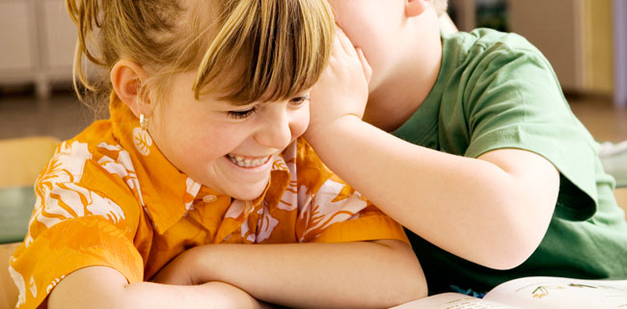

Read for further information
Q: Did Sally know what her friends were chatting secretly?
Q: Why did they hide the issue that they were discussing from Sally?
Q: How did Sally feel about it?
No.
Maybe the secret had something to do with Sally.
confused, sad, curious

Slide 11
Read for emotion changes
stages | supporting details | emotions
Background /Setting
Rising action
Climax
Sally's birthday was approaching, and the excitement that usually filled her heart was now replacedwith disappointment and stress.
disappointed
stressed
“No,”Sally sighed and replied sadly,“There's just too much going on and my parents are going throughfinancial difficulties.”
She smiled weakly, trying to conceal her immense disappointment and stress
sad
helpless
Curious, Sally went over to them, but as soon as Jane saw her, she quickly walked away. Sally was startled by Jane's strange actions and turned towards Sarah.
curious
anxious
extremely sad
confused
“What did she say?”Sally asked.
However, Sarah simply shrugged and walked away with Jane, leaving Sally standing there, feeling leftout and anxious.
Jane has never kept secrets from me before, Sally thought. Her heart fell.
She swung between confusion and sadness with each passing moment, desperately trying to figure out what was happening. Why were her friends distancing themselves from her? And what were they hiding?

Slide 12
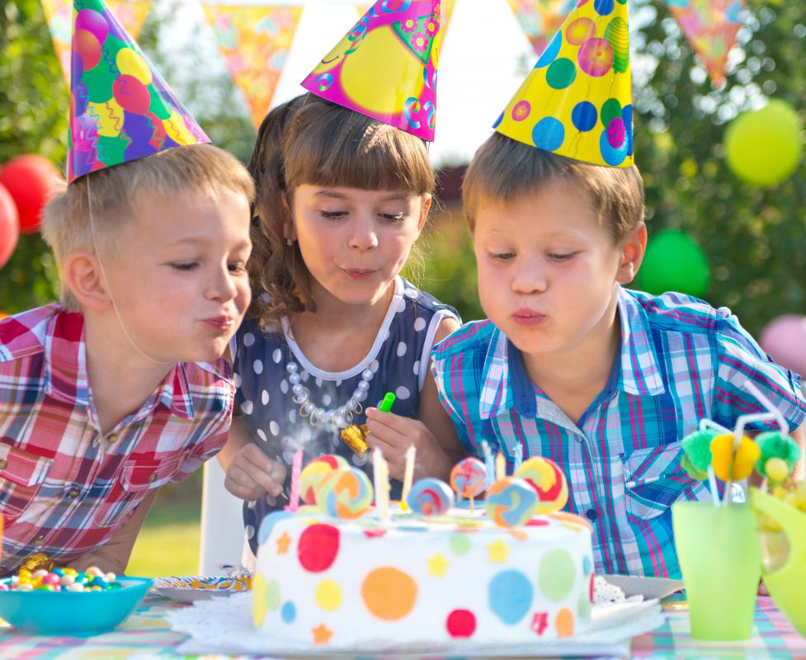
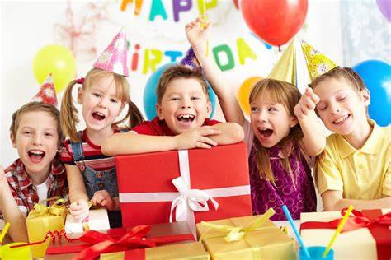
2
Read for possible plots
part1
Q: What happened in the darkness?
Q: Who were they?
Q: What did they do for Sally?
...
Thinking
Q: Is it necessary for Sally’s friends expalin what had happened?
Q: Is it reasonable to focus a lot on her emotions in para2?
part2
Q: How did she react to the situation?
Q: What would her friends explain?
Q: What impression did it leave on her?
...

Slide 13
Possible Appealing Endings
通过点明主题，进一步深化主题。在前面叙述的基础上发表评论和感悟，使文章主旨凸显。语言上具有哲理性。经常可以是自己的有感而发，也可以引用经典语录、俗语等。
1. A philosophical ending（Show the main character's growth）
At that precious moment, I was unexpectedly overwhelmed by profound emotions. It was then that a revelation struck me like a bolt of lightning, enlighting me to the omnipresence of warmth.
自然式结尾是顺着原文故事自然发展的趋势结束全文，结尾自然，单纯明快。也可以是跨越时空的回溯，场景再现。
2. A narrative ending
An Ending with what happened later
Many years later, I steadfastly maintain the belief that it stands unrivaled as the utmost cherished recollection in my personal archives.

Slide 14
Possible Appealing Endings
3. An echoing ending
Echo an earlier incident or thought
呼应式结尾，针对所给文本里面出现的画面，情节，语言，思维进行呼应，使情节出现同一场景不同效果的反转。有时候也会应用在同一画面定格，但人物心情，气氛不同，以进行对比和烘托。
In the dark moments of her life, she perceived a radiant beam of illumination permeating her very being. With unwavering reverence, she would hold dear this profound recollection, propelling her towards an expanse of flourishing prospects awaiting in the days ahead.
Their genuine smiles gradually warmed the once cold heart. Obviously, their heartfelt friendship dispelled the unpleasantness and desolation brought by financial hardships and arduous assignments, bringing forth a sense of breaking through the clouds and glimpsing the blue sky.

Slide 15
Possible Version
On the day of Sally's birthday, she went to school and found her classroom in total darkness. A wave of confusion washed over her as she stepped hesitantly into the room, her heart pounding. She reached for the light switch, but before her hand could find it, a chorus of voice s broke the silence. "Surprise!", her classmates, led by Jane, jumped out from all sorts of hiding places. As the room flooded with light, Sally's eyes widened in surprise and disbelief. The classroom decorated with balloons and streamers, a beautiful cake sat on the teacher's desk, and in the corner, a pile of presents waited to be unwrapped.
Tears sprang from Sally's eyes and her face broke into a radiant smile. She turned towards Jane,who was grinning from ear to ear. "We knew you couldn't have a party this year, so we decided to bring the party to you," Jane said, her eyes twinkling with mischief. The cloud of confusion lifted from Sally's mind as she realized that her friends hadn't been distancing themselves from her, they were planning this surprise all along. The sadness that had been looming over her birthday disappeared, replaced with joy and gratitude. As she cut the cake and opened her presents, Sally realized that this was indeed a grand birthday party, just like the ones she used to have.

Slide 16
On the day of Sally's birthday, she went to school and found her classroom in total darkness. A wave of confusion washed over her as she stepped hesitantly into the room, her heart pounding. She reached for the light switch, but before her hand could find it, a chorus of voices broke the silence. "Surprise!", her classmates, led by Jane, jumped out from all sorts of hiding places. As the room flooded with light, Sally's eyes widened in surprise and disbelief. The classroom was decorated with balloons and streamers, a beautiful cake sat on the teacher's desk, and in the corner, a pile of presents waited to be unwrapped.
范文点评
本范文与所给短文的开头语衔接自然，内容丰富，能丰富并准确的应用语法结构和词汇，上下文连贯性好。
Para1写作技巧：
1. 无灵主语的使用：A wave of confusion washed over her as...；
..., a chorus of voice s broke the silence.
2. 独立主格的使用： her heart pounding；The classroom decorated with balloons and streamers, ...
3. 非谓语的使用："Surprise!", her classmates, led by Jane, jumped out from all sorts of hiding places; a pile of presents waited to be unwrapped.

Slide 17
Tears sprang from Sally's eyes and her face broke into a radiant smile. She turned towards Jane,who was grinning from ear to ear. "We knew you couldn't have a party this year, so we decided to bring the party to you," Jane said, her eyes twinkling with mischief. The cloud of confusion lifted from Sally's mind as she realized that her friends hadn't been distancing themselves from her, they were planning this surprise all along. The sadness that had been looming over her birthday disappeared, replaced with joy and gratitude. As she cut the cake and opened her presents, Sally realized that this was indeed a grand birthday party, just like the ones she used to have.
范文点评
段首与第一段结尾衔接自然，整篇文章在思维、语言与结构与所给文本吻合度高。
Para2写作技巧：
1. 无灵主语的使用：The cloud of confusion lifted from Sally's mind as...; a chorus of voice s broke the silence.
2. 独立主格的使用：Jane said, her eyes twinkling with mischief.
3. 定语从句、非谓语的使用：The sadness that had been looming over her birthday disappeared, replaced with joy and gratitude.
4. 使用拟人修辞手法，增加了语言的灵动感和文章的活力。如：washed over, broke, flooded with, waited, broke into a radiant smile, lifted, looming over

Slide 18
Thank You

