Slide 1

感恩遇见，相互成就，本课件资料仅供您个人参考、教学使用，严禁自行在网络传播，违者依知识产权法追究法律责任。
更多教学资源请关注
公众号：溯恩高中英语
知识产权声明

Slide 2


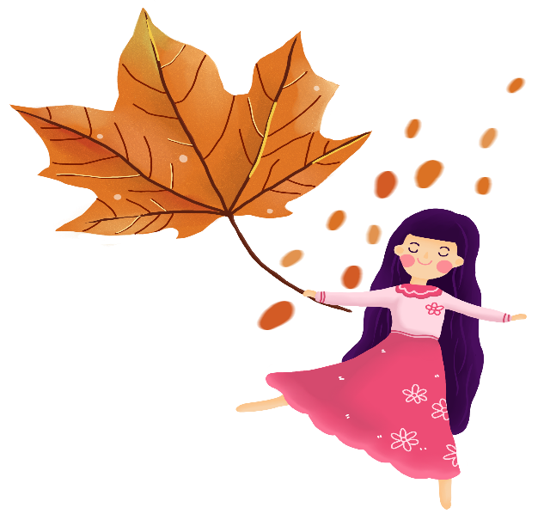
Unit 4 Discovering Useful Structures
The infinitives---attribute+adverbial
------谢耀玲

Slide 3
Warm-up
to do
非谓语动词
doing
done

Slide 4




Lead-in Let’s enjoy a video.
What can you learn from the video?

Slide 5

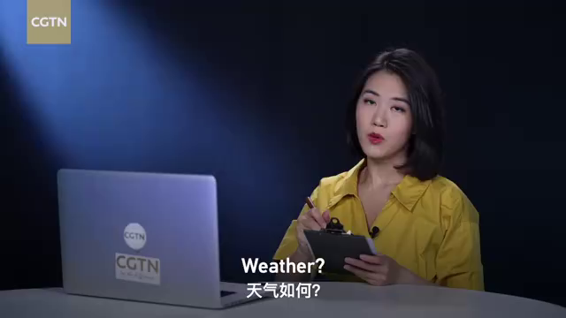

Slide 6
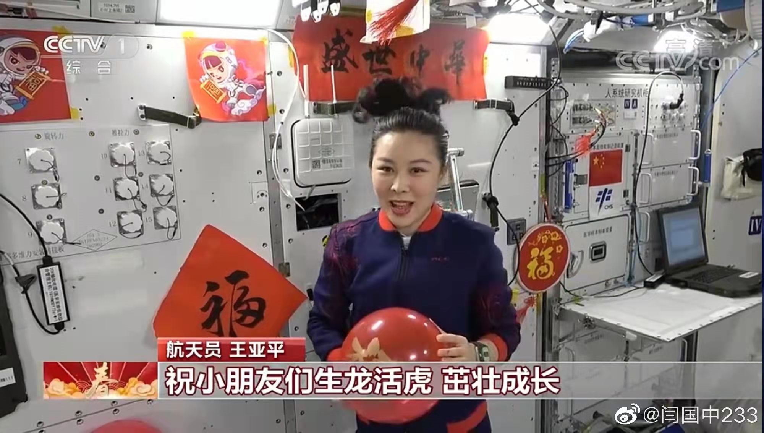
Presentation
1. 动词不定式作定语放在名词或不定代词something, nothing, anything等后面作后置定语。
Wang Yaping’s partners give her something red （play） .
to play

Slide 7
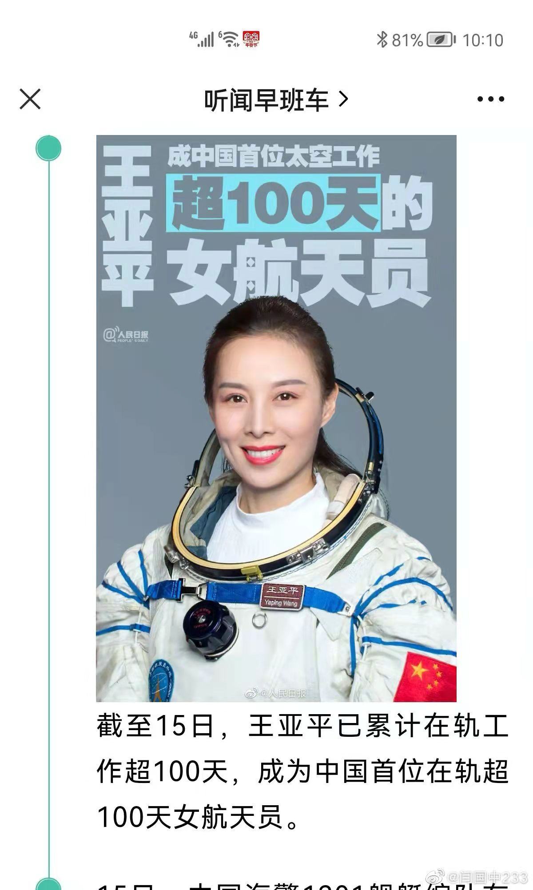
2.当修饰的名词前有the only, the next, the best, the first, the last, 以及由序数词或形容词最高级修饰的名词常常用不定式作定语。
to go
Wang Yaping is the first female （go）into the space.

Slide 8
3. 当修饰的名词是ability, ambition, attempt, chance, courage,
desire, decision, effort, failure, moment, promise, …
Wang Yaping has the ability and courage (go) into the space.
to go

Slide 9


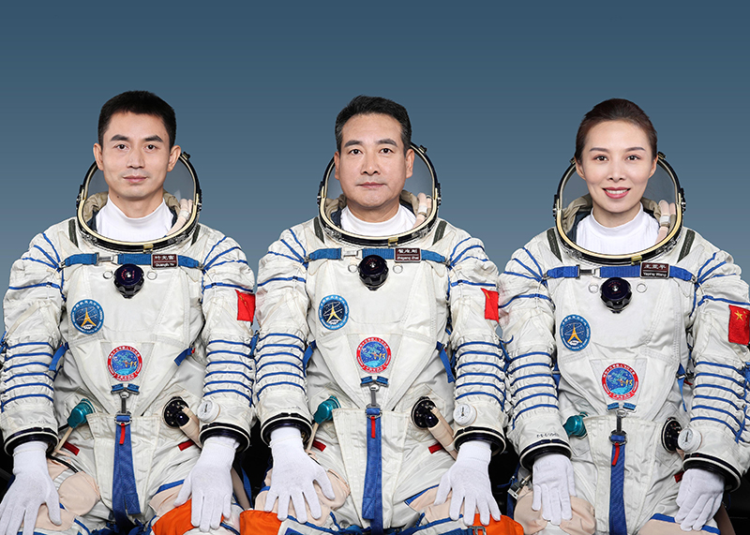
4. 名词与定语之间存在动宾，主谓，同位关系。
Shenzhou XIII astronauts have a lot of mental and physical training (attend).
They’re the excellent people (finish) the the mission.
They had the mission （carry out） in space.
to attend
to finish
to carry out
Notes:
1.做定语的主被动问题也请老师补充完整，后面相关题目，尤其是不定式的被动。
2. 不及物动词做定语时，后面的介词问题也可以补充。

Slide 10
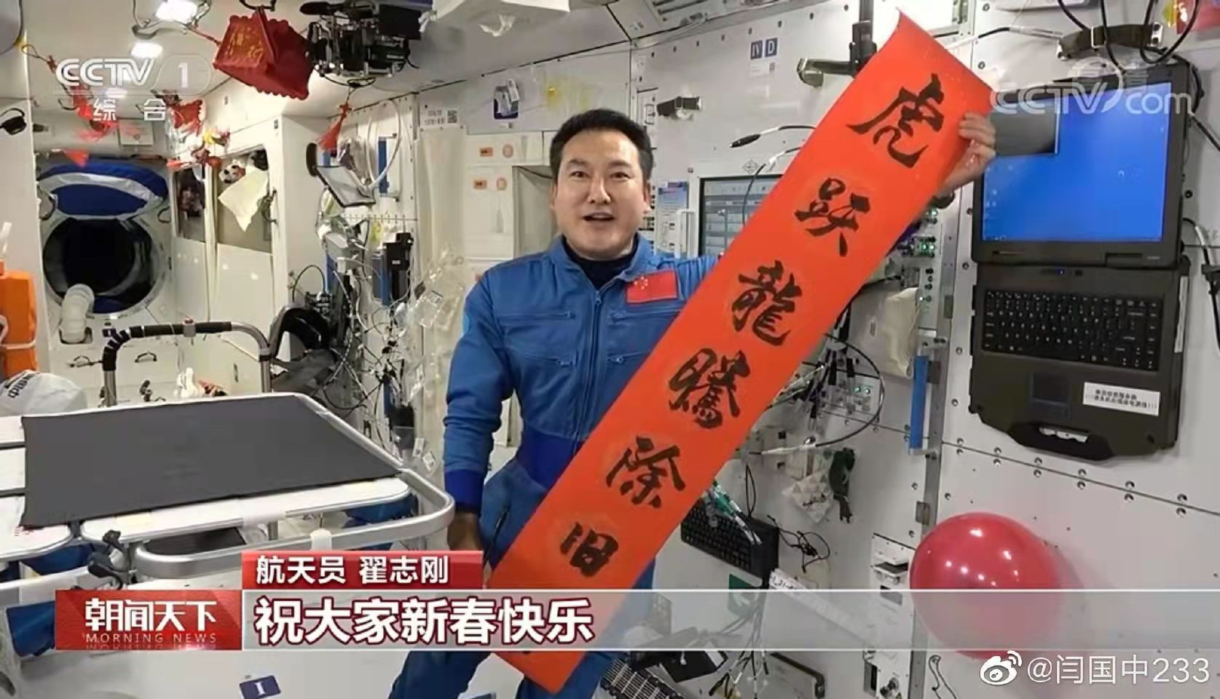
注意:若不定式动词为不及物动词，则该动词必须与介词连用，组成及物的动词短语。
on
Please pass me some paper to write ____.
5. 定语表示未来的还没被完成的动作。
The matter of the space to be discussed tomorrow is important.
Notes:
1.做定语的主被动问题也请老师补充完整，后面相关题目，尤其是不定式的被动。
2. 不及物动词做定语时，后面的介词问题也可以补充。

Slide 11


Fill in the blank.
1. The airport __________ (complete) next year will
help promote tourism in this area.
2. Do you have something _______ (finish) tonight?
3. The best way _______ (improve) your English is to join
an English club.
4. Yang Liwei was the first Chinese astronaut (go) into the space in 2003
to be completed
to finish
to improve
to go

Slide 12
5. Carol was happy that she had the chance _____________ (experience) the life in the city.
6. These courses offer us opportunities__________ (improve) our abilities to appreciate art.
to experience
to improve

Slide 13

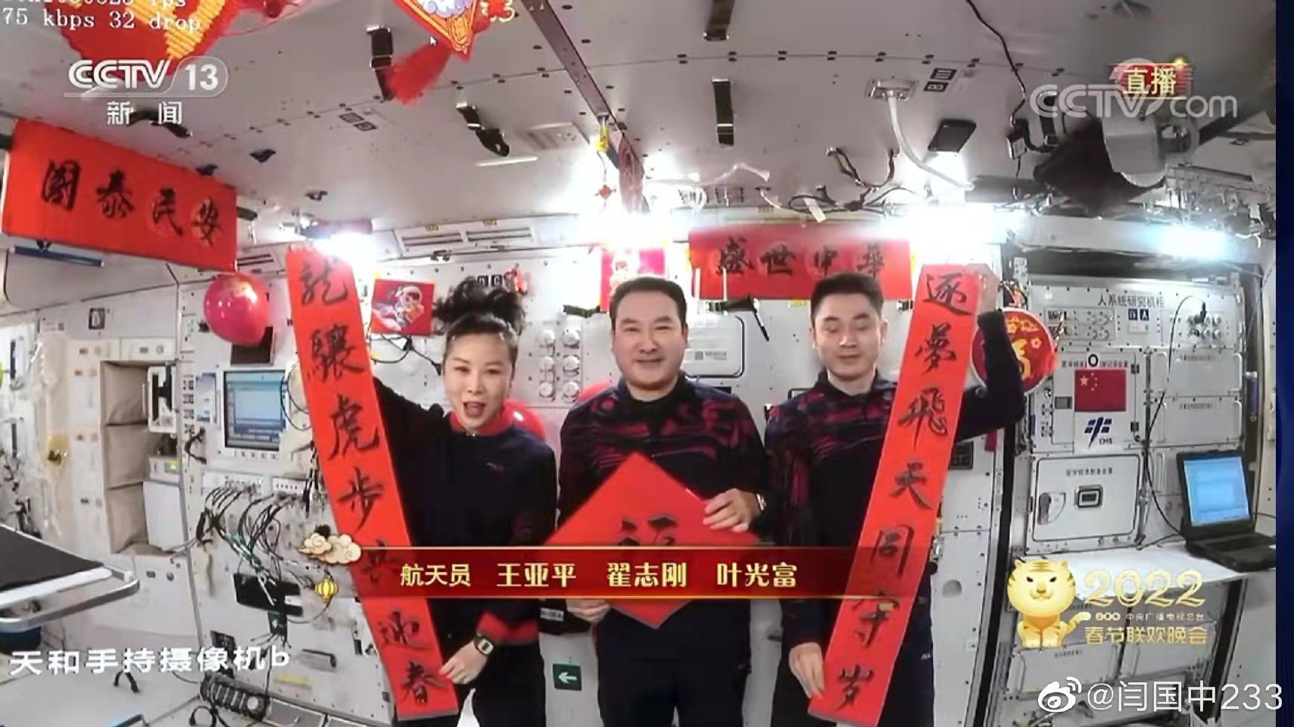
目的状语：置于句首或句末，为加强语气，常与in order或so as组成短语。
Zhai Zhigang, Wang Yaping and Ye Guangfu got together (paste) couplets.
celebrate the year of the tiger, Zhai Zhigang, Wang Yaping and Ye Guangfu got together to paste couplets.
to paste
In order to

Slide 14
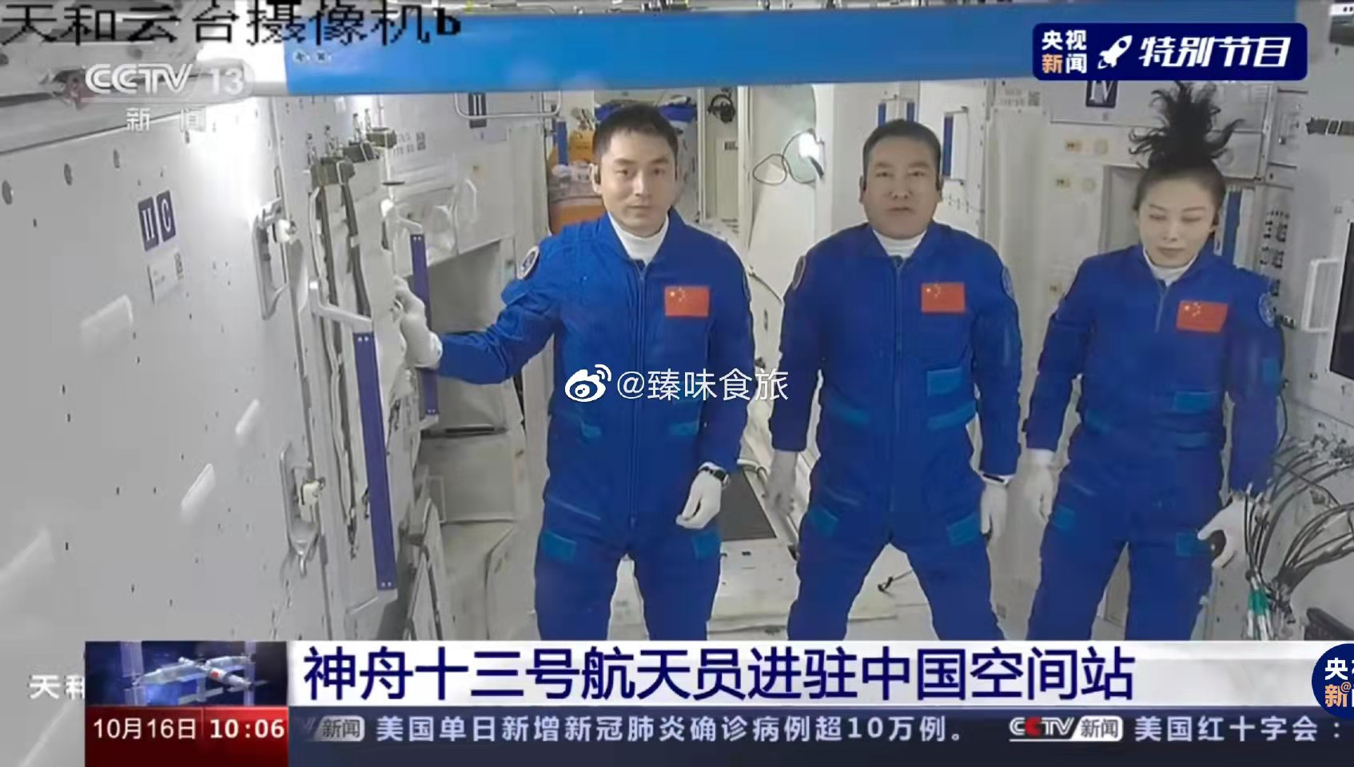
（1）不定式作目的状语可转换为so that/in order that引导的
目的状语从句
They studied very hard in order to be
the very elite in their scientific fields.
They studied hard they could be very elite in their scientific fields.
=They studied very hard they could be very elite in their scientific fields.
so
that
in order that

Slide 15
2.不定式作原因状语和结果状语
（1）原因状语：多用于“sb.+be+adj.+to do”句型中。
to finish
He was delighted (finish) couplets.
（2）结果状语：多见于“too...to（太...以不能）”；“enough to...”；“only to do”; “so/such...as to（如此...以至于）句型中。
He was outstanding enough to finish couplets.

Slide 16
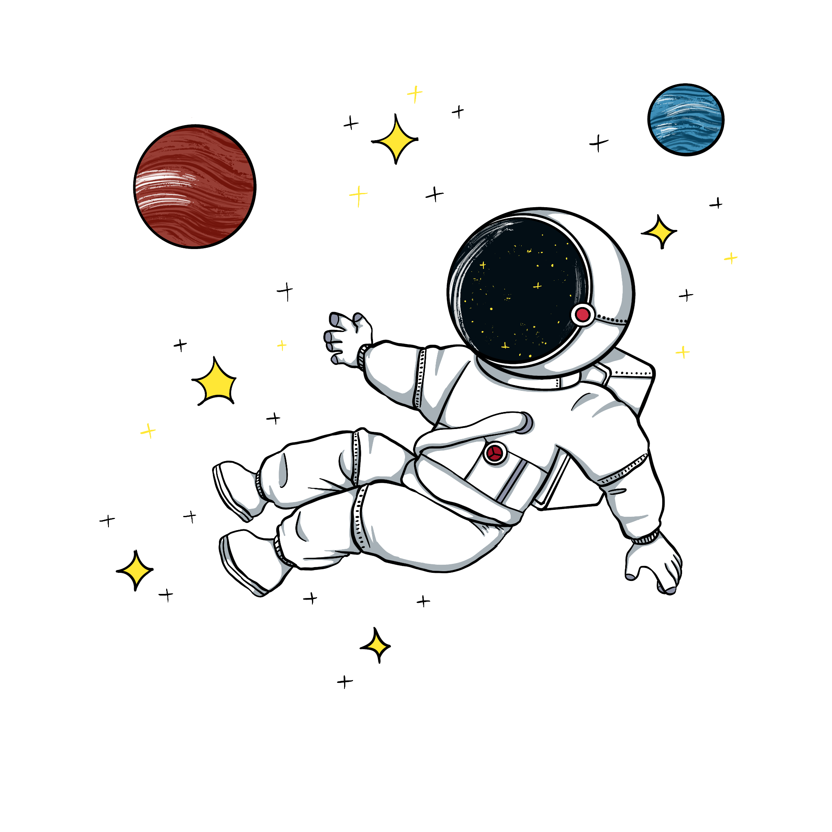
高考链接：不定式和现在分词作结果状语的区别
(1)The astronaut landed on the moon only (find)that he floated.
(2)There’s no gravity on the moon, (leave) the ball float around.
to find
only to do 出乎意料
leaving
顺其自然

Slide 17
Task 1
Look at the following sentences and focus on the italicised infinitives. In pairs, discuss their functions and meanings.
I trained for a long time to fly airplanes as a fighter pilot.
adverbial
As we all know, an astronaut needs to be healthy and calm in order to work in space.
adverbial
First of all, you must be intelligent enough to get a related college degree.
adverbial

Slide 18
Some scientists were determined to help humans realise their dream to explore space.
attribute
On 12 April 1961, Yuri Gagarin became the first person in the world to go into space.
attribute

Slide 19
Task 2
Complete the passage with the correct forms of the verbs in brackets.
Sending people to other planets or even beyond the solar system is not an easy goal_________ (achieve). One of the problems is that the trip would take a very long time. For example, _______ (use) current technology, it would take over two years _____ (get) to the closest planet, Mars, and back. Although light is the fastest thing______ (know)in the universe, it could take more than four years to reach the nearest star system. Will scientists figure out a way ________ (store) sufficient food and water for the long journey?
to achieve
using
to get
known
to store

Slide 20
Is it possible to travel faster than light? No one knows the answers yet. However, space scientists never give up. They are experimenting with growing crops in space so as _______ (help) astronauts get enough food on longer journeys through space.
to help

Slide 21
Task 3 高考链接:
1. Picking up her “Lifetime Achievement” award, proud Irene declared she had no plans ______ (retire) from her 36-year-old business. (2019·全国II卷)
2. Modem methods of tracking polar bear populations have been employed only since the mid-1980s, and are expensive _________ (perform) consistently over a large area. (2019·全国I卷)
3. The project_________________ (accomplish) by the end of 2021, will expand the city's telephone network.
to retire
to perform
to be accomplished

Slide 22
to complete
4. I have a lot of readings (complete) before the end of this term. (2010 山东)
5. The ability (express) an idea is as important as the idea itself. (2011 湖南)
to express
6. ________ (learn) more about China, don’t hesitate to contact us and be the first ________ (sign) up for the activity.
To learn
to sign
7. They make vehicles (to carry) brave people into space to find out the secrets of the universe.
to carry
inspiring
8．(2021·河南)The teen’s act soon spread quickly, (inspire)kids and adults worldwide to take action．

Slide 23
Summarize
1. (抽象名词 &不定代词)后置定语
2. 序数词、最高级修饰
3. 尚未发生的动作
attribute
定语
to do
目的状语:
to do, in order to (句首句中),
so as to (句中)
adverbial
状语
原因状语:
sb＋be＋adj. ＋to do ...
结果状语:
enough to ; too...to
so/such... as to
Notes:
对本课件使用有任何疑问，请联系小助手：naodong12
更多优质内容，请关注微信公众号【脑洞英语课堂】

Slide 24
Assignment
假定你是李华,最近你班举行了一次班会，班会的主题是:太空探险意义。请结合以下内容,用英语给校报写一篇文章,客观地介绍讨论的情况并表达你自己的观点。
赞同者 | 反对者
1.获得新的知识; | 1.耗资巨大;
2.从太空取得新资源; | 2.宇航员的安全问题。
3.扩大人类的生存空间。
注意:1.词数80左右，至少用上2-5个非谓语表达句子，涉及 to do, doing和done的用法。
2.可适当增加细节,以使行文连贯。

Slide 25
Assignment
Dear Editor,
We had a discussion over whether it's necessary to carry out the outer space explorations at a class meeting the other day.
Some of us think it important to research the outer space. First, people carry out their explorations so as to get a better understanding of the outer space. Second, new resources can be found there for humans to use, facilitating human’s life. However, others don't believe so. In their opinion, not only does this kind of exploration cost too much money, but also it’s very dangerous for astronauts to do such work.
All in all, I think such explorations into the outer space are worth trying out.

Slide 26
Self, Peer and Teacher’s Evaluation
Content& Illustration
Assessment
( 15 points)
Language
Coherence
Pronunciation

Slide 27


Thanks!

