Slide 1

感恩遇见，相互成就，本课件资料仅供您个人参考、教学使用，严禁自行在网络传播，违者依知识产权法追究法律责任。
更多教学资源请关注
公众号：溯恩高中英语
知识产权声明

Slide 2

The World
October 1st-15th, 2023

Slide 3
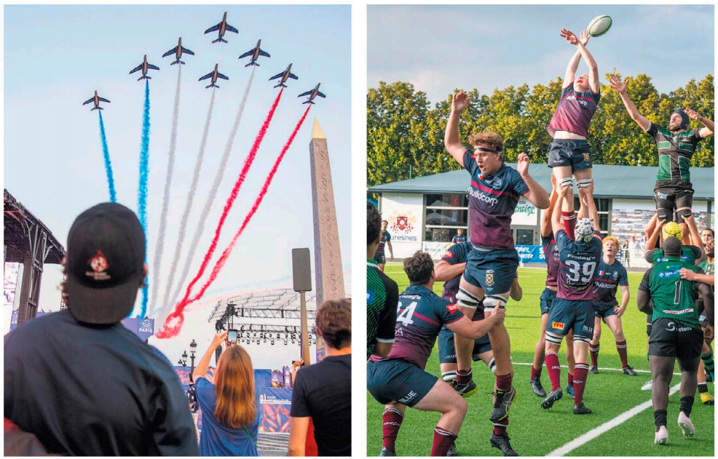
1. In France, the World Cup Takes the Spotlight
法国橄榄球世界杯激情开赛
An aeronautical team streaked the sky with the colors of the French flag. left.
Outside the World Cup, lower-level rugby continued around Paris. right.

Slide 4
语篇填空
（《纽约时报》2023年10月2日 44页 ）
Rugby fans love their game. ____ most of the time it is overshadowed by the behemoth that is soccer. So once every four years, when the two-month-long Rugby World Cup gets underway, it’s ___ rare chance for rugby to bask in the sports spotlight.
This year the Cup is being held in France, and fans packed the Place de la Concorde on Sept.8 ________(watch) the opening game. One of the sites of a guillotine during the French Revolution was now a fan zone, with four vast screens ________ (provide) to watch France take on New Zealand, a three-time Cup winner.
A mostly French crowd survived the humid evening - temperatures were in the upper 80s - by jumping under cooling mist guns. And they ____ (get) the result they came for, as France ground out a 27-13 win, _______ (raise) hopes that the team could lift the trophy for the first time.
Also in the mix this year is South Africa, ______ fans still have fond memories of Nelson Mandela handing the trophy ____ the 6-foot-3 captain Francois Pienaar in 1995. (In the movie “Invictus”, it was Morgan Freeman handing it to the ________ (rough) 5-10 Matt Damon.). Ireland, another team aiming for a first trophy, is off to a good start, and its 13-8 defeat of South Africa on Saturday was one of the tournament’s best _______ (match).
But
a
to watch
provided
got
raising
whose
to
roughly
matches

Slide 5
词汇讲解
1. behemoth: something that is extremely large and often extremely powerful
The city is a sprawling behemoth with no heart. 这座城市像缺失中心的庞然大物向外延伸。
2. bask in: to enjoy the good feelings that you have when other people praise or admire you, or when they give you a lot of attention 沉浸，沐浴（在赞美、关注等中）
He has spent a month basking in the adulation of the fans back in Jamaica. 他一个月里都陶醉在牙买加崇拜者的吹捧之中。
翻译句子
我参观了一家在新西兰成长为巨头的公司。
I visited a company that grew into a behemoth in New Zealand.
翻译句子
他一直沉浸在父母的呵护中。
He had always basked in his parents’ attention.

Slide 6
句子翻译
But most of the time it is overshadowed by the behemoth that is soccer. So once every four years, when the two-month-long Rugby World Cup gets underway, it’s a rare chance for rugby to bask in the sports spotlight.
但大多数时候，它都被足球这个庞然大物所掩盖。因此，每四年一次，当为期两个月的橄榄球世界杯开始时，这是一个难得的机会，让橄榄球沐浴在体育聚光灯下。
翻译
Ireland, another team aiming for a first trophy, is off to a good start, and its 13-8 defeat of South Africa on Saturday was one of the tournament’s best matches.
另一支志在首夺冠军的球队爱尔兰，开局不错，周六以13比8击败南非，是本届世界杯最好的比赛之一。
翻译

Slide 7
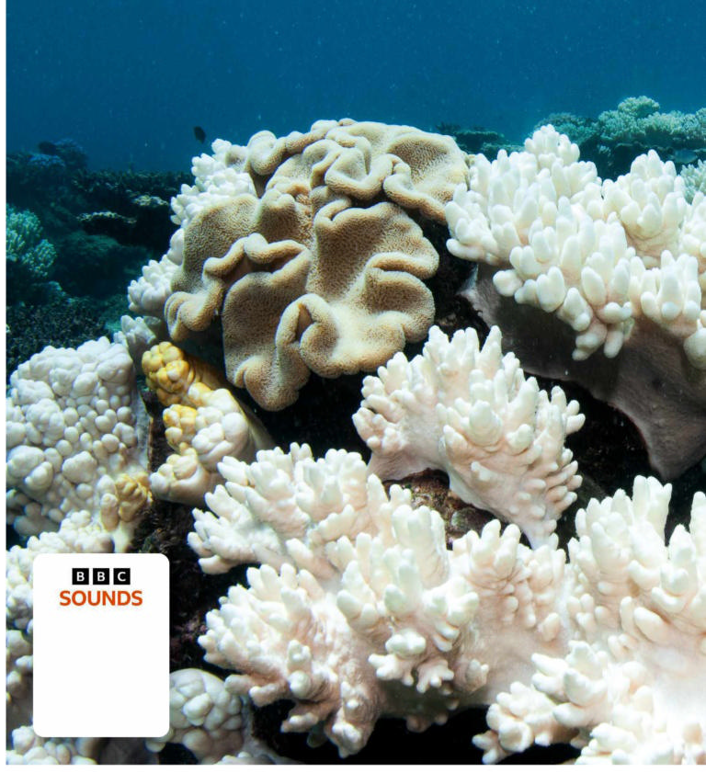
2. Highest ever ocean temperatures recorded
有史以来最高的海洋温度
An adverse change in temperature can cause coral to bleach.

Slide 8
语篇填空
（《BBC野生生物》2023年10月刊 13页 ）
As the climate crisis continues to escalate, the surface temperature of the world’s oceans has reached its _______ (high) ever level. Researchers at the EU’s Copernicus Climate Change Service (C3S) found that in July 2023 the global average daily sea surface temperatures reached 20.96 ℃, ________ (break) the previous record of 20.95°C set back in 2016. “Global temperatures are ________ (normal) at their peak in March after the southern hemisphere summer, as there is more ocean in the southern hemisphere,” says Samantha Burgess, deputy director of C3S. “Seeing a new record during the northern hemisphere summer ___ (be) unusual.” Warmer oceans not only have ___ impact on the global climate, resulting in a warmer atmosphere and more potential energy for hurricanes, for example, ____ they also affect marine animals, causing heat stress, deoxygenation ______ (event) and mass mortality. “This summer we have already seen a record-breaking marine heatwave off the UK and Irish coasts, and now the hottest average daily global sea surface temperature ever ________ (record),” says Jeff Knott from the RSPB. “Seabirds are a vital indicator of the health of our seas and our concern is ____ these unprecedented climate change-related events could increase the ________ (press) on already fragile populations of seabirds.”
highest
breaking
normally
is
an
but
events
recorded
that
pressure

Slide 9
词汇讲解
1. escalate: to become or make sth greater, worse, more serious, etc. （使）逐步扩大，不断恶化，加剧
Both unions and management fear the dispute could escalate. 各工会与资方都害怕争端会加剧。
2. unprecedented: that has never happened, been done or been known before 前所未有的；空前的；没有先例的
The mission has been hailed as an unprecedented success. 这次使命已被宣布为一次空前的成功。
翻译句子
这场交战逐步扩大为全面战争。
The fighting escalated into a full-scale war.
翻译句子
这种情况在现代还没有出现过。
The situation is unprecedented in modern times.

Slide 10
句子翻译
Warmer oceans not only have an impact on the global climate, resulting in a warmer atmosphere and more potential energy for hurricanes, for example, but they also affect marine animals, causing heat stress, deoxygenation events and mass mortality.
海洋变暖不仅会对全球气候产生影响，例如导致大气变暖，飓风的潜在能量增加，而且还会影响海洋动物，造成热应激、脱氧事件和大规模死亡。
翻译
Seabirds are a vital indicator of the health of our seas and our concern is that these unprecedented climate change-related events could increase the pressure on already fragile populations of seabirds.
海鸟是海洋健康状况的重要指标，我们担心的是，这些前所未有的与气候变化有关的事件可能会增加本已脆弱的海鸟种群的压力。
翻译

Slide 11
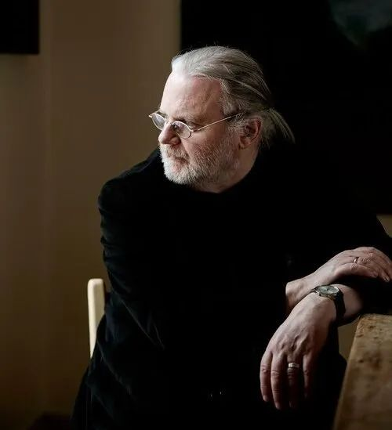
3. Nobel for literature goes to Norwegian minimalist 诺贝尔文学奖授予挪威极简主义者

Slide 12
语篇填空
（《泰晤士报》2023年10月6日 13页）
The Norwegian author Jon Fosse ________________ (award) the Nobel Prize in Literature “for his innovative plays and prose which give voice to the unsayable”.
The writer, 64, ___________ (drive) in the countryside north of Bergen when he was informed of the news. He said he was “overwhelmed and somewhat ________ (frighten)”. “I see this as an award to the literature _________ first and foremost aims to be literature, without other considerations,” Fosse said in ___ statement.
“You don’t read my books for the _____ (plot),” Fosse said in an interview with the Financial Times in 2018. “But it’s not because I want to be a difficult writer. I’ve never tried to write in a complicated way. I always try to write as ________ (simple) and, I hope, as deeply as I possibly can.”
Anders Olsson, the Nobel committee chairman, praised Fosse’s early work, ________ (describe) how his first play — Someone Is Going to Come Home — produced in 1996, reflected the writer’s distinctiveness. “_____ its themes of fearful anticipation and crippling jealousy, Fosse’s singularity is fully evident. In his radical reduction of language and dramatic action he exposes human anxiety _____ ambivalence at its core,” Olsson said.
has been awarded
was driving
frightened
that/which
a
plots
simply
describing
With
and

Slide 13
词汇讲解
1. anticipation: a feeling of excitement about sth (usually sth good) that is going to happen 期盼；期望
Discouraging the students' anticipation for easy rewards is matter of urgency.
打消学生对轻松奖励的期待是当务之急。
2. crippling: to have a very serious, harmful effect 极有害的
Arthritis and rheumatism are prominent crippling diseases. 关节炎和风湿病是常见致残的疾病。
翻译句子
法庭上人们满怀期望的心情。
The courtroom was filled with anticipation.
翻译句子
高资本成本对许多小公司有着极坏的影响。
The high cost of capital has a crippling effect on many small firms.

Slide 14
句子翻译
Anders Olsson, the Nobel committee chairman, praised Fosse’s early work, describing howhis first play — Someone Is Going to Come Home — produced in 1996, reflected the writer’s distinctiveness.
翻译
诺贝尔奖委员会主席安德斯•奥尔森赞扬了福西的早期作品，并描述了他1996年的第一部戏剧《有人要回家》是如何反映了这位作家的独特性。
In his radical reduction of language and dramatic action he exposes human anxiety and ambivalence at its core,” Olsson said.
翻译
奥尔森说:“在他对语言和戏剧动作的彻底减少中，他暴露了人类焦虑和矛盾心理的核心。”

Slide 15
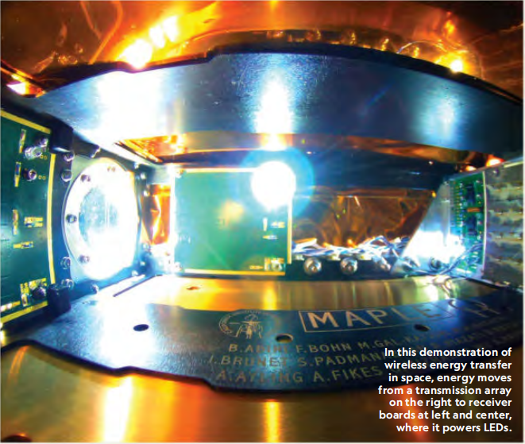
4. Solar Power from Space 来自太空的太阳能

Slide 16
语篇填空
（《国家地理》2023年10月刊 EXPLORE版面）
Though it was fantasy just a few decades ago, space-based solar power may soon be reality—and a _________ (renew) energy breakthrough: accessible anytime, unlike ground-based solar panels _______ (limit) by darkness, and available anywhere on Earth, even if infrastructure is ______ (lack).
How would it work? Enormous space-based structures would support photovoltaic panels that collect sunlight and convert ___ into radio signals for transmission to Earth. This type of space mission is “one of the most complex engineering problems that we have in front of us,” says Mamatha Maheshwarappa, ___ payload systems lead at the UK Space Agency, ______ is helping fund project research and development. The mission also will be pricey, projected to cost tens of billions of dollars.
And at Caltech, researchers _______ (recent) reported significant progress with their Space Solar Power Demonstrator. The craft ________ (be) in orbit since January 2023, testing materials and electronics, ____ has successfully transmitted wireless energy in space ____ the first time. “This is a step in a long journey,” says the Caltech team’s codirector, Ali Hajimiri. And like any good story, he says, “it will probably have many turns and twists.”
renewable
limited
lacking
it
a
which
recently
has been
and
for

Slide 17
词汇讲解
1. infrastructure: the basic systems and services that are necessary for a country or an organization to run smoothly, for example buildings, transport and water and power supplies （国家或机构的）基础设施；基础建设
The infrastructure, from hotels to transport, is old.
从宾馆到交通，所有的基础设施都已陈旧。
2. payload: The payload of an aircraft or spacecraft is the amount or weight of things or people that it is carrying. （飞机、飞船等的）商载，有酬载荷
With these very large passenger payloads one question looms above all others — safety. 客载量这么大，有一个问题非常突出——安全。
翻译句子
政府鼓励对基础设施的投资。
The government encourages investment in infrastructure.
翻译句子
巨大的载荷将影响航天器的性能。
A giant payload will affect the spacecraft’s performance.

Slide 18
句子翻译
Though it was fantasy just a few decades ago, space-based solar power may soon be reality—and a renewable energy breakthrough: accessible anytime, unlike ground-based solar panels limited by darkness, and available anywhere on Earth, even if infrastructure is lacking.
翻译
尽管在几十年前还只是幻想，但太空太阳能发电可能很快就会成为现实——而且是可再生能源的突破：随时可以使用，不像地面太阳能电池板受黑暗的限制，即使缺乏基础设施，也可以在地球上的任何地方使用。
The craft has been in orbit since January 2023, testing materials and electronics, and has successfully transmitted wireless energy in space for the first time.
翻译
该飞船自2023年1月以来一直在轨道上运行，测试材料和电子设备，并首次成功地在太空中传输无线能量。

Slide 19
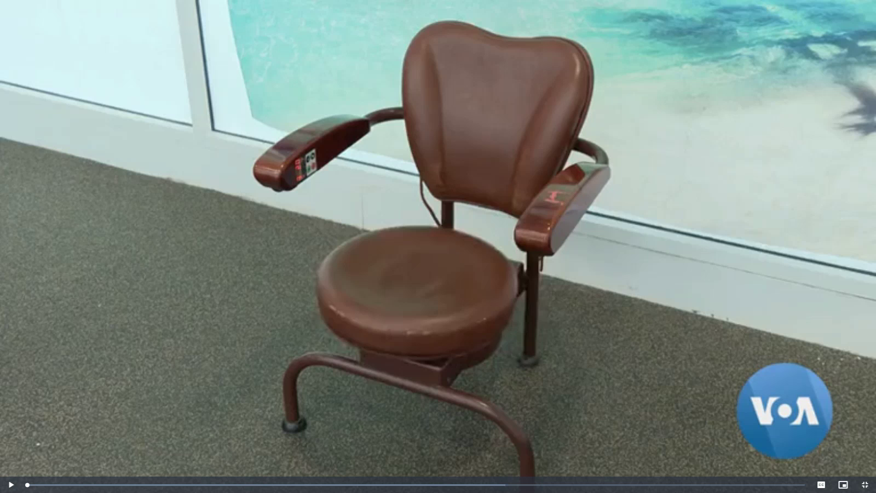
5. VOA 10/03/2023

Slide 20

听力填空
A chair inspired by the hula hoop was supposed to help you ________ while at the office, but simply made people _____. A bicycle made of plastic wobbled and flopped when in use. A doll designed to _____ plastic food was also capable of nibbling children’s fingers. These are just a few examples of the more than 150 failed products that are currently __________ at the Museum of Failure in Washington.
Samuel West is its founder. “It’s products and services that people who invested money and resources into them had ____________________ that good things would happen. And things did not ________ the way they planned.”
The objects represent a range of industries from disasters at sea to impractical pricey and dangerous modes of _________ on land. West says some are downright senseless. “Yeah, a face mask that gives your face ______________ to make you look more beautiful. A golf club that you urinate into so that you don’t have to go to the bathroom when you play golf.”
West, who’s a psychologist ________, says failure is important for ________, so part of the museum’s goal is to destigmatize failure.
exercise
dizzy
chew
on display
very high expectations
turn out
transport
electric shocks
by trade
progress

Slide 21
词汇讲解
1. downright: used as a way of emphasizing sth negative or unpleasant
（强调反面的或令人不快的事物）彻头彻尾的，十足的，完全的
There was suspicion and even downright hatred between them.
他们之间相互怀疑甚至极度仇恨。
2. stigmatize: to treat sb in a way that makes them feel that they are very bad or unimportant 使感到羞耻；污蔑
Children in single-parent families must not be stigmatised.
单亲家庭的孩子们不应该受到歧视。
翻译句子
她常对他十分粗鲁。
She was often downright rude to him.
翻译句子
这场运动可能会让医生蒙受污蔑。
The campaign could stigmatize doctors.

Slide 22
句子翻译
A chair inspired by the hula hoop was supposed to help you exercise while at the office, but simply made people dizzy. A bicycle made of plastic wobbled and flopped when in use. A doll designed to chew plastic food was also capable of nibbling children’s fingers.
翻译
一种受呼啦圈启发的椅子本应帮助你在办公室锻炼身体，但却让人头晕目眩。一辆由塑料制成的自行车在使用时摇摇晃晃。一个设计用来咀嚼塑料食品的娃娃也能咬孩子的手指。
The objects represent a range of industries from disasters at sea to impractical pricey and dangerous modes of transport on land. West says some are downright senseless.
翻译
这些物品代表了从海上灾难到陆上不切实际、昂贵且危险的运输方式等一系列行业。韦斯特说，有些产品毫无意义。

