Slide 1

感恩遇见，相互成就，本课件资料仅供您个人参考、教学使用，严禁自行在网络传播，违者依知识产权法追究法律责任。
更多教学资源请关注
公众号：溯恩高中英语
知识产权声明

Slide 2


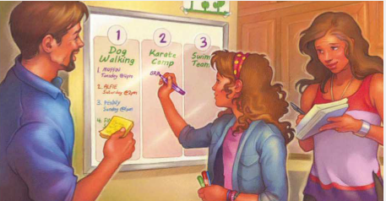
读后续写
浙江省新阵地教育联盟2024届第二次联考

Slide 3
Read and find the required information:
I; Ollie (a friend); my mom
in summer
a beyond-busy summer experience
Who:
When:
What:
1. Why did I have a beyond-busy summer?
2. How did I feel about doing all the stuff at first? What about my mother?
3. How did the whole process actually go? （underline the related information）
4. Which sentence(s) could be related to the theme?

Slide 4
1. Why did I have a beyond-busy summer?
2. How did I feel about doing all the stuff at first? What about my mother?
I have three things to do: a junior teacher for the Little Dragons Karate (空手道) Camp; do summer swim team; our dog-walking business for two customers.
自不量力
“You might be biting off more than you can chew,” my mom said with a warning glimpse when I talked to her about it and announced, “I want to do everything!”
“Don’t worry.” I grinned. “I have strong teeth!”
My mom smiled back. “In this case, it’s your organizational skills, not your teeth, that need to be strong.” I didn’t take it to my heart.
confident
?
I ignored my mom’s advice

Slide 5
3. How did the whole process actually go?
And the first week really was no problem. My friend Ollie was out of town and karate camp hadn’t started, so my swim stuff was all I needed to worry about. The next week was great too. I swam, and a Little Dragon at karate camp told me I was his favorite teacher ever!
I did learn, though, that staying organized with two activities was harder. My backpack was already stuffed with a towel and swim things, so I needed another for my karate clothing. Riding my bike from karate camp to the pool with two backpacks was a challenge. But I still had it under control until Ollie got back.
“We’re late getting our business together!” he said. “We’ll have to spend every spare minute preparing.”
“But I don’t have any spare minutes!” I said.
“Did you forget we agreed to walk Alfie every Saturday? And Muffin on Tuesdays at 4:00?” Ollie asked. I couldn’t let Ollie down, so I took out a third backpack and filled it with dog toys, treats, and plastic bags. I thought I was all set.
But I was wrong! It didn’t take long for my dog-walking stuff and karate stuff and swim stuff to get all mixed up, forgotten, or lost. One day, I forgot my karate backpack and had to borrow Emma’s extra outfit, which was too tight. The next day, I remembered my karate stuff but forgot my swimsuit, so I had to help out in the snack shop and stay out of the pool all afternoon. …
One problem
My stuff got all mixed up and I always forgot to take what I
actually needed even though I had three backpacks.

Slide 6

4. Which sentence(s) could be related to the theme?
I knew I would have a beyond-busy summer.
My mom smiled back. “In this case, it’s your organizational skills, not your teeth, that need to be strong.” I didn’t take it to my heart.
Can you suggest a title to the story?
Other possible ones:
How I learned organizational skills in a beyond-busy summer
…

Slide 7
keep informed about sb/sth
Paragraph 1: Worse still, I had to keep track of all the special times.
Paragraph 2: Luckily, I, with my parents, came up with a solution to get organized.
衔接 1：
What are the special times?
✔
Which ones are coherent(连贯的) with the given sentences?
I had to teach the Karate Camp at 8:00 am from Monday to Friday. I had to do the swim team in three afternoons…
I had to arrive early for the karate test on Monday. I had to stay later to help with swimming pool cleanup on Friday.
The jobs made me really tired and I suddenly found I didn’t have strong teeth…
One day, I went to the swimming pool only to find there was nobody. “Oh, god, today is Friday. I should go to the Karate camp.”
I found that it was hard for me to remember the correct times/ And I always mixed them up…
I had to remember to take all the things needed in different places…
✔
How did I feel and what did I do eventually?
on the verge of breaking down; I went for my parents for help.
衔接 2：
衔接 3：

Slide 8
Paragraph 1: Worse still, I had to keep track of all the special times.
Paragraph 2: Luckily, I, with my parents, came up with a solution to get organized.
keep informed about sb/sth
Another problem
I can’t balance all the stuff because of the special times.
衔接 1：
What were the special times?
What problem occurred? (in chaos-lost track of time-received complaints)
How did I feel and what did I do eventually?
(on the verge of breaking down; I asked my parents for help.)
衔接 2：
asking parents to do some
making a schedule
giving up some
✔
衔接 3：
What was the solution?
What was the result?
What did I learn? (organizational skills)

Slide 9
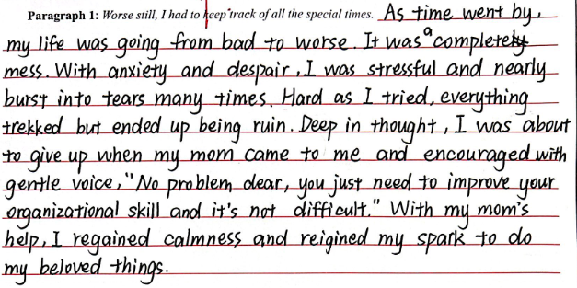
Make a comment on the coherence
未聚焦讲special times; 情节发展太快，以至于后面没内容写。
结尾With my mom’s help,与第二段所给句不连贯。
Paragraph 2: Luckily, I, with my parents, came up with a solution to get organized.

Slide 10
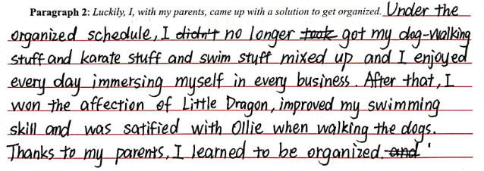
本段重心未抓住，未展开写solution，以至于后面没内容写，字数不足。

Slide 11
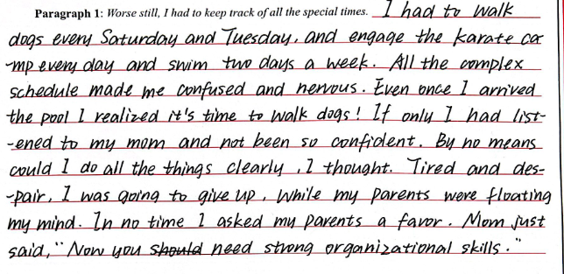
展开讲special times，与首句连贯。
最后一句有点多余，以倒数第二句话结尾就可以。
Paragraph 2: Luckily, I, with my parents, came up with a solution to get organized.

Slide 12
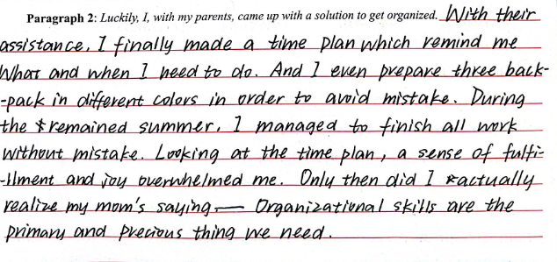
具体展开讲solution，可以接受。最开始的“with their assistance”有点多余。

Slide 13
Exercise: translation Para.1
“千头万绪，无法应付”的表达
1. 一切一团糟, 我在奔溃的边缘。(独立主格)
2. 同时应对这么多事使我无法承受。（sth is more than I could bear.）
3.同时应对这么多事让我手忙脚乱（run around like a chicken with its head off ）。
4. 就在那时我回想起我妈妈的警告。(强调句)
5. 迫切地想从这篇混乱中走出来，我必须向我父母求助。

Slide 14
“千头万绪，无法应付”
1. 一切一团糟, 我在奔溃的边缘。
(With) Everything in a tangle/ in chaos/ in a mess, I was on the verge of breaking down.
2. 同时应对这么多事使我无法承受。（sth is more than I could bear.）
Dealing with the all the stuff at the same time/ Juggling all the stuff was more than I could bear.
Juggling (juggle v. 同时应付) all the work felt like trying to balance on a wobbly(adj.摇晃的) log in a stormy sea, with each wave threatening to knock me off balance.
3.同时应对这么多事让我手忙脚乱（run around like a chicken with its head off ）。
Juggling all the work made me run around like a chicken with its head off .

Slide 15
4. 就在那时我回想起我妈妈的警告。
It was then that I recalled my mother’s warning.
5. 迫切地想从这篇混乱中走出来，我必须向我父母求助。
Desperate to go out of this sea of chaos, I had to turn to my parents for help.

Slide 16
Worse still, I had to keep track of all the special times. I had to arrive early for the karate test on Monday. I had to stay later to help with swimming pool cleanup on Friday. I had to pick up Alfie 15 minutes early on Saturday. Juggling (juggle v. 同时应付) all the work made me run around like a chicken with its head off (手忙脚乱). Gradually, things went from bad to worse and one time I even lost track of time for the karate test, leaving the camp in chaos. With everything in a tangle, I was on the verge of breaking down. It was then that I recalled my mother’s warning. Desperate to go out of this sea of chaos, I had to turn to my parents for help. / Although embarrassed beyond words, I worked up the nerve (鼓起勇气) and walked to my parents, making a clean breast of(坦白) my trouble and calling for backup(增援;支持).

Slide 17
Luckily, I, with my parents, came up with a solution to get organized. We started with a daily pocket calendar that had room to write all my tasks. Then we found three drawstring bags(抽绳袋) that fitted into one big backpack, each labelled with its purpose respectively(分别地), so I could keep my stuff separated but still in one place. We also put a whiteboard in the kitchen with brightly colored reminders and a checklist to make sure I could make it to the certain place punctually(=on time) and had everything I needed. From then on, my beyond-busy summer was smooth sailing(一帆风顺). I learned an important lesson: If you tried to use the dog’s rope as your karate belt, it’s time to improve your organizational skill.

