Slide 1

感恩遇见，相互成就，本课件资料仅供您个人参考、教学使用，严禁自行在网络传播，违者依知识产权法追究法律责任。
更多教学资源请关注
公众号：溯恩高中英语
知识产权声明

Slide 2




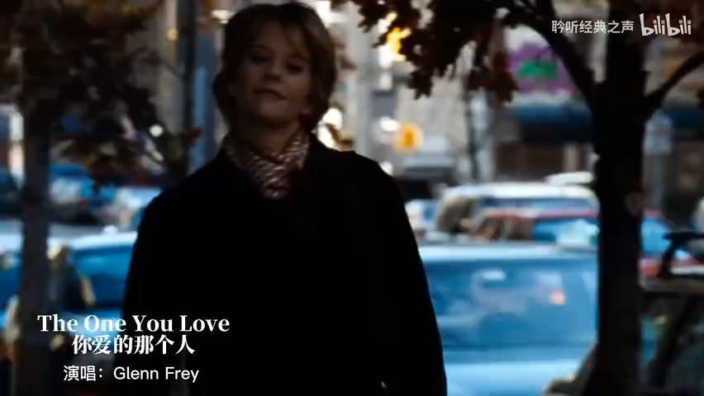

Make use of the clues of affect and attitude
In a cloze
How to
choose the one?
Zi Gang High School
Fay

Slide 3



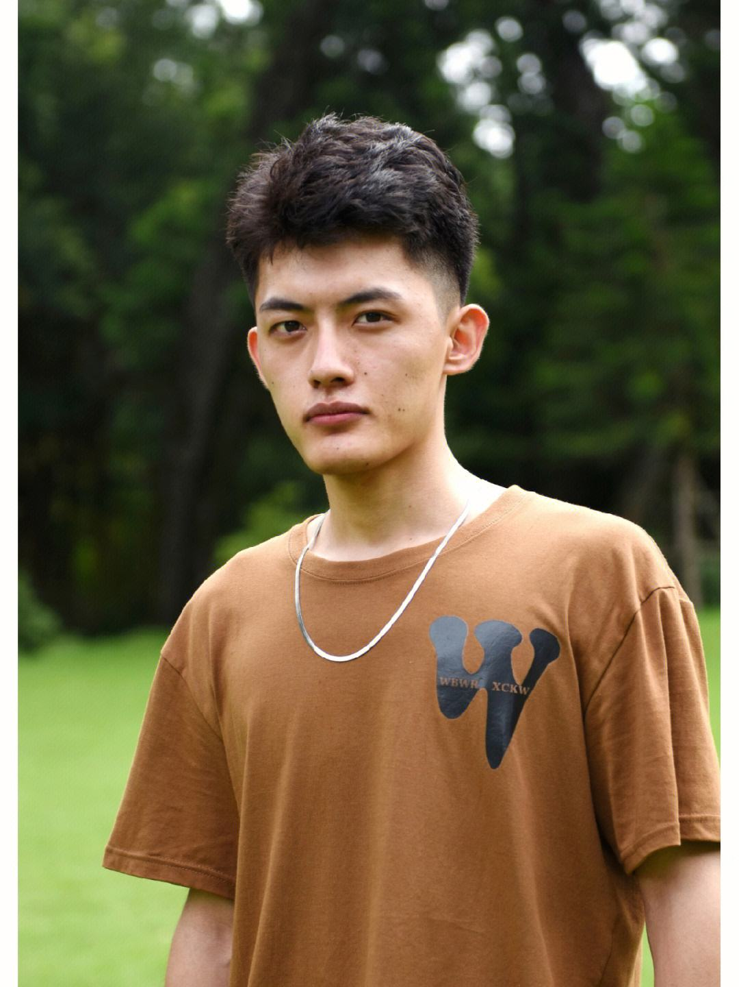

Big eyes
The one I choose
Objective requirements should not be replaced by subjective assume.
tall
Perfect match
Nice character
affect and attitude
in a cloze
University degree
Words &sentences
Micro perspective
Macro perspective
Paragraphs & passage

Slide 4

☺Aged seven, she was ___1___,
sweet-natured and well-trained
1.A. negative B. graceful C. pitiful D. aggressive
☻ I was now in a condition that means it’s difficult or ___2___ to receive and produce language.
2.A.practical B. absurd C. impossible D. innocent
☺I was super__3___ to ride a camel for the first time and spent a night in a tent in the desert.
3.A.alarmed B. optimistic C . rigid D. excited
Optimistic is expecting the best in all possible ways while excited is having great enthusiasm.
lue
Clues between words/句内线索
(adjs)
语句逻辑标志
affect and attitude

Slide 5
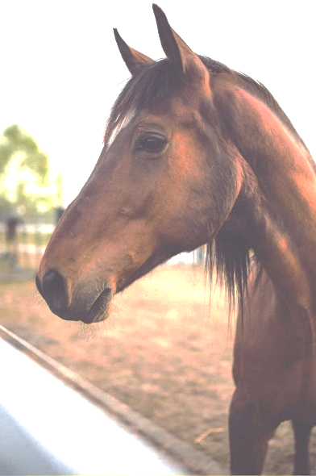
☺Unexpectedly, Holly was firmly___1__, ears forward. With the snake in her sight, she was no longer worried.
1.A. sealed B. planted C. fastened D. frozen
freeze is to prevent the movement while plant is to place sth. or yourself firmly in a place or position.
Eg : She planted her feet wide and bent her knees slightly.
她双脚大步稳稳分开，双膝微微弯曲。
☺ Tidying your desk , watering your plants, folding clothes – these household chores are hardly the height of pleasure.
Yet ,
I often find
myself __2___ these little tasks.
2.A. ignoring B. enjoying C. avoiding D. simplifying
☺ What a __3__! Sleep was no longer a problem.
lue
3.A. shame B. mess C. coincidence D. surprise
Clues between sentences/句组线索
(adjs+advs)
语句逻辑标志+特殊符号
affect and attitude

Slide 6

☺Another important lesson I learned in high school was the ___1__ of hard work. I had always been a good student, but in high school, I was challenged to __2___ myself even further and strive for __3__ in everything I did. Whether it was a difficult math problem or a challenging essay, I learned to __4__ the struggle and persevere through difficult tasks. This __5__ and way of work would serve me well in college and beyond.
☺Another important lesson I learned in high school was the ___1__ of hard work. I had always been a good student, but in high school, I was challenged to __2___ myself even further and strive for __3__ in everything I did. Whether it was a difficult math problem or a challenging essay, I learned to __4__ the struggle and persevere through difficult tasks. This __5__ and way of work would serve me well in college and beyond.
Deduction and summary 总分总
General -----specific------conclusion
Deduction 总分；induction 分总
努力！
1.A. problem B. value C. future D. burden
2.A. blame B. delay C. push D. research
3.A. curious B. drawbacks C. highlights D. excellence
Push:If you push someone to do something or push them into doing it, you encourage or force them to do it.鼓励，逼迫
Embrace:to accept or support (a belief ,theory, or change) willingly and enthusiastically. 欣然接受
4.A. reject B. embrace C. avoid D. recognize
5.A. determination B. escape C. trick D. advice
lue
Clues between paragraphs 段落线索
(adj.s+adv.s+verb.s)
语句逻辑标志+特殊符号+段落结构
affect and attitude

Slide 7
☺I was both excited and ___1___.
I didn’t know anyone, and I wasn’t sure how
I would __2__. But little did I know, my high school experience would end up being one of the most transformative times in my life.（首段）
1.A. sad B. lazy C. nervous D. calm
2.A. get up B. give away C. break down D. fit in
☺I was __3__ to new ideas and perspectives through my classes and extracurricular activities, and these experiences helped shape my __4__ and values.（尾句）
Be exposed to :接触；暴露；露于某种环境、物质或情况中，可能产生影响或风险（处于危险；感染疾病等）
3.A. assigned B. closed C. exposed D. put
4.A.figure B. fortune C. puzzle D. worldview
lue
Clues in the text 语篇线索
(adj.s+adv.s+verb.s+noun.s)
语句逻辑标志+特殊符号+段落结构+语篇结构（首尾）
affect and attitude

Slide 8
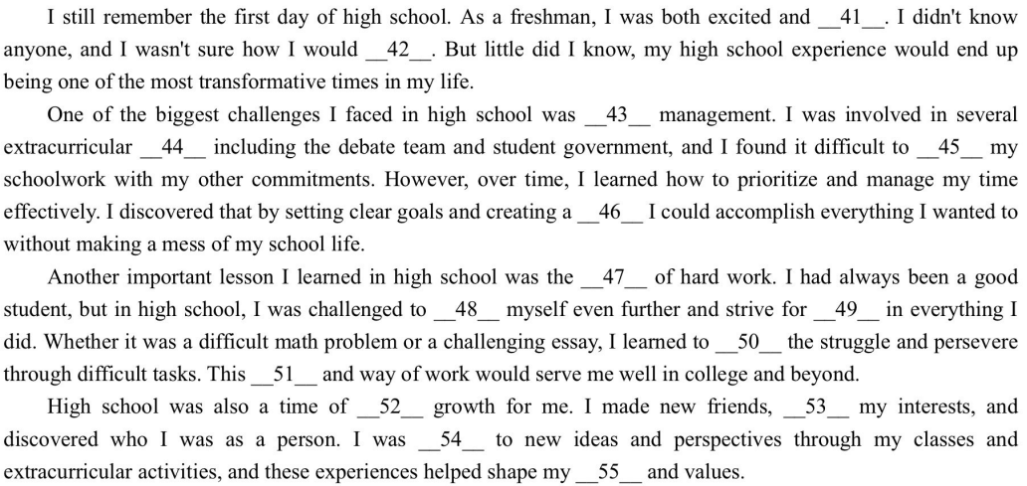
Narration and comments
Introduce topics
Present opinions
Draw conclusions
夹叙夹议类
讲事情
抒观点
得结论
Clarify the attitude from the text structure.
lue
语句逻辑标志+特殊符号+段落结构+语篇结构（首尾）
affect and attitude

Slide 9
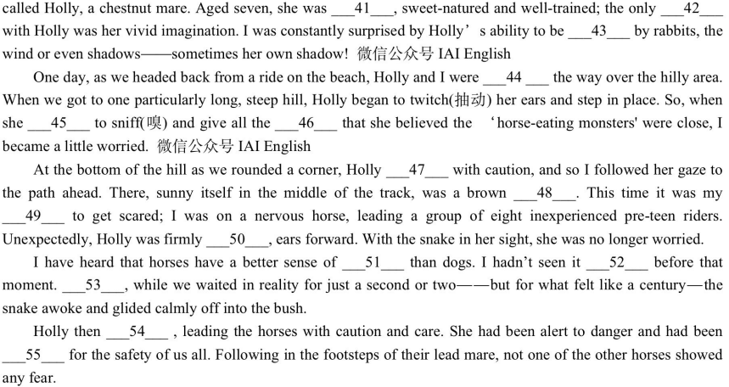
Narration
Track the emotional changes of main characters
记叙类
起承
转合
Argumentation
Present the view
List the evidence
Come to a conlusion
议论文
提论点
列论据
得结论
lue
Clarify the affect and attitude from the text structure.
affect and attitude
语句逻辑标志+特殊符号+段落结构+语篇结构（首尾）

Slide 10

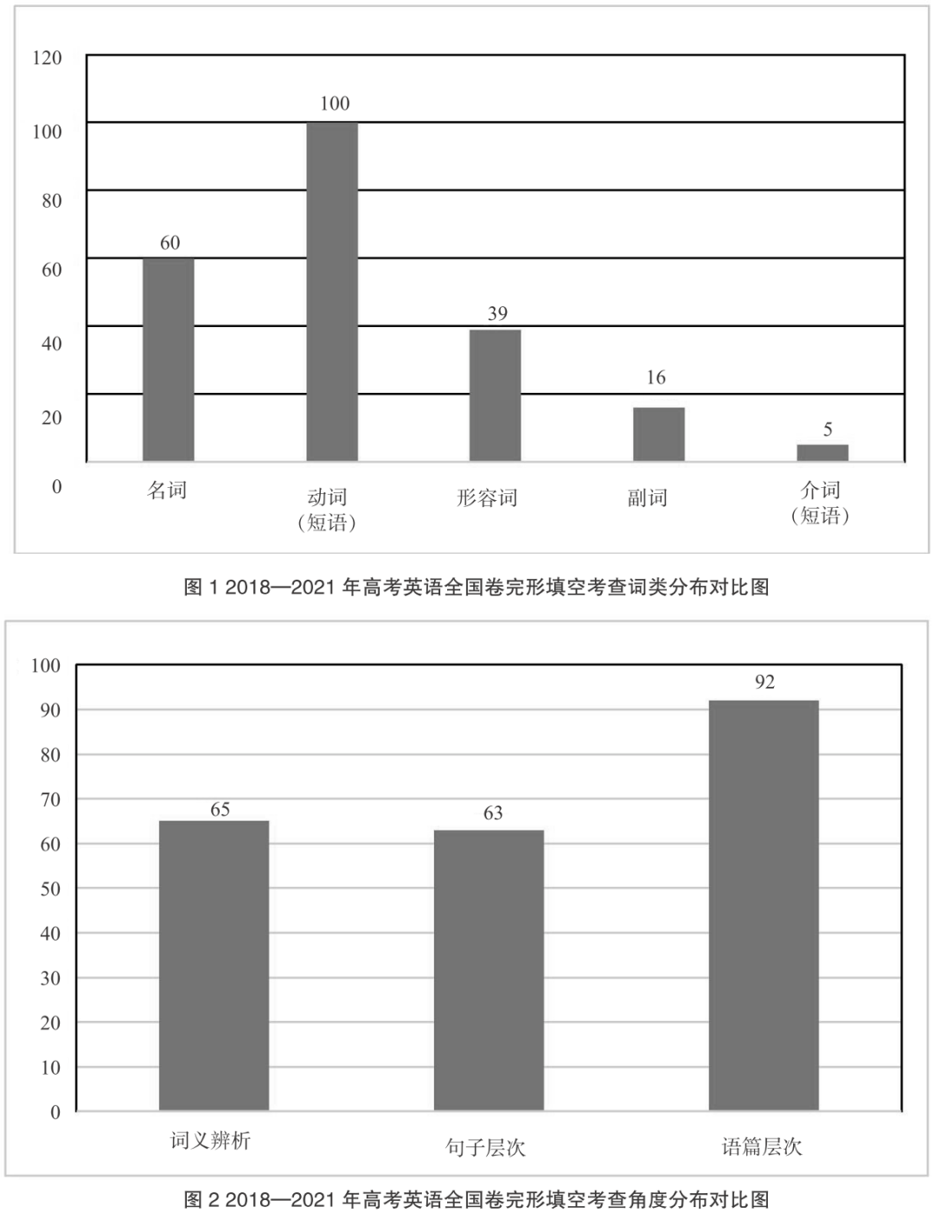


How to get hold of clues of affect and attitude in a cloze?
There is no love/answer without reason!
条件
因果
转折
并列
递进
顺序
归纳
让步
解释
…..
1.关联词汇:adj,adv,verb,noun
2.逻辑判断:so,but,and,first,…
3.语境提示:上下文，主客观因素
4.特殊符号
1.句内：左顾右盼
2.句组：上下兼顾
3.语篇：统览段落/全文/文体
4.标题
Focus on the objective clues.
Text-based
Perfect match

Slide 11
广州高三阶段训练
The 8-year-old boy across the street stormed in and out of his own house very often. A neighbor, William Dunn, _41_what was going on in his life, So Dunn asked him.
"He told me that he didn't have a_42_, " says Dunn, now 58, "and I realized there was_43_I could do for him. " That something was_44_, a passion Dunn's father had shared with him.
Dunn has taken groups of kids out almost every _45_to fish. Most didn't have father figures in their lives and had never fished. "They'd been through a lot, and their lives were_46_,” Dunn says. "But when they were fishing, all of that_47_. Out on the boat, they'd be smiling, and even_48_.”
Jayden, now 13, has become a devoted fisherman and_49_ Dunn with helping him mature. "I hope he knows I mean it when I say thank you, ” he says.
Just as_50_as the fishing are the_51_Dunn forms with the kids. "When Jayden was going through a_52_period recently in study—I let Dunn know that his grades were suffering and he had a little talk with Jayden, " Jayden's mother says. To her delight, Jayden's grades_53_improved in the next exam.“
There is nothing like seeing a_54_light up with a smile, " Dunn says. "I feel lucky to_55_that every weekend. "
Storm : behave violently
Eg:After a bit of an argument, he stormed out.
一次小小的争吵之后，他就气冲冲地走出去。
through : experience
Dunn’s attitude : always willing to provide help!
语句逻辑标志+特殊符号+段落结构+语篇结构（首尾）
affect and attitude
Boys’/family’s attitude : thankful/grateful/change for better

Slide 12


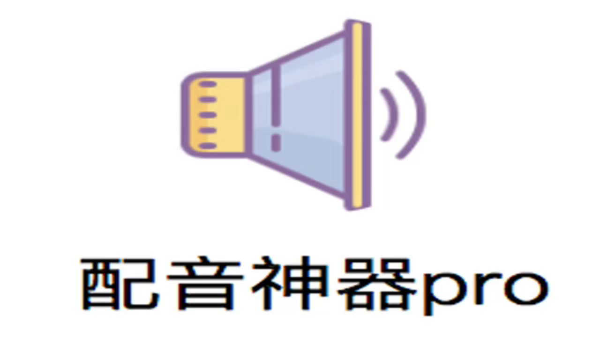
Check your answers in groups and make sure each one own its evidences/clues!
41. A. revealed B. explained C. doubted D. wondered
42. A. mother B. father C. brother D. sister
43. A. something B. nothing C. anything D. everything
44. A. camping B. boating C. fishing D. running
45. A. day B. month C. year D. weekend
46. A. different B. difficult C. disciplined D. dynamic
47. A. went away B. broke out C. came about D. took over
48. A. studying B. sailing C. singing D. speaking
49. A. charges B. entertains C. rewards D. credits
50. A. important B. promising C. interesting D. complex
51. A. circles B. habits C. impressions D. relationships
52. A. rough B. long C. meaningful D. productive
53. A. hardly B. nearly C. genuinely D. accidentally
54. A. fisherman B. kid C. parent D. neighbor
55. A. dream B. expect C. witness D. receive

Slide 13
Check your answers in groups and make sure each one own its evidences/clues!
Keep an eye on the answers.
Clarify your reason for the wrong choice.
List your reason for the wrong choice.
There is no answer without reason/evidence/clue.
V
N
Pron
V
N
Adj
V
V
V
V
N
Adj
Adv
N
V
41. A. revealed B. explained C. doubted D. wondered
42. A. mother B. father C. brother D. sister
43. A. something B. nothing C. anything D. everything
44. A. camping B. boating C. fishing D. running
45. A. day B. month C. year D. weekend
46. A. different B. difficult C. disciplined D. dynamic
47. A. went away B. broke out C. came about D. took over
48. A. studying B. sailing C. singing D. speaking
49. A. charges B. entertains C. rewards D. credits
50. A. important B. promising C. interesting D. complex
51. A. circles B. habits C. impressions D. relationships
52. A. rough B. long C. meaningful D. productive
53. A. hardly B. nearly C. genuinely D. accidentally
54. A. fisherman B. kid C. parent D. neighbor
55. A. dream B. expect C. witness D. receive
因果逻辑正
词汇复现
词汇复现
词汇复现
词汇复现
并列逻辑负
转折逻辑
credit : credit A with B or credit B to A
认为是…的功劳；把…归功于
你还知道credit 的其他意思与用法吗？
Genuinely:的确；真诚地
递进逻辑正
因果逻辑正
并列逻辑正
同级比较
转折逻辑负
搭配正
词汇复现
上文总结

Slide 14
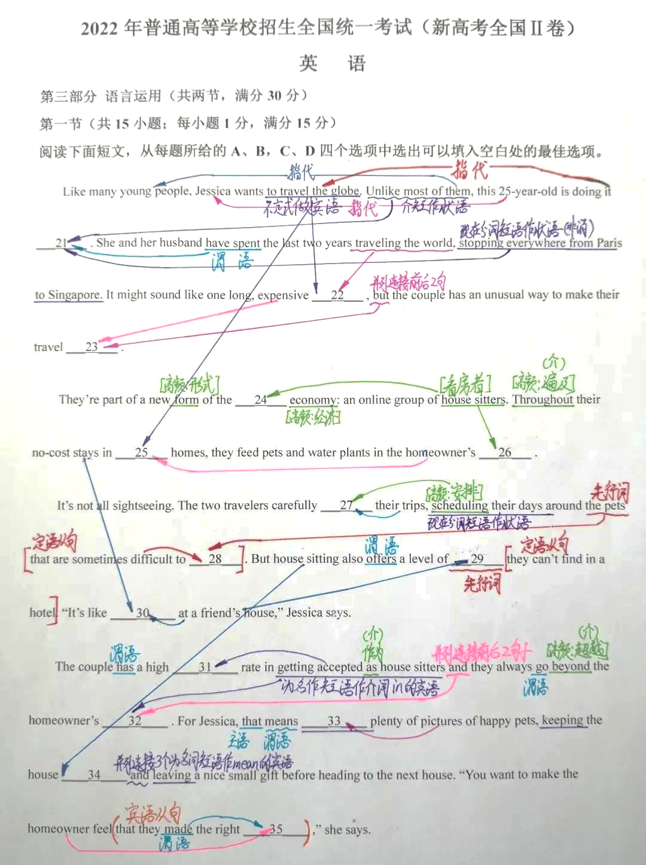
There is no answer without reason/evidence/clue.
词汇理解: 词汇复现；近义词复现；上下义复现；固定搭配；背景常识；
主题理解: 情感转变；正负态度；
篇章理解：段落结构；篇章结构；
逻辑理解：因果逻辑；条件逻辑；转折逻辑等；
☼ Check your answers and fill the checklist with the specific reason
Our dilemma :
Checklist 浙南完形
题目 | 错误纠因 | 题目 | 错误纠因
41 | Rigid 不认识 | 47 | Vital不认识 but没注意
42 | Nevertheless不会用 | 48 | 词组都不认识
43 | Upside down不会翻 | 49 | Shaking 和aching不会区分
44 | 逻辑顺序搞不清楚 | 50 | 已理解
45 | Desperately不认识 | 51 | Appetizing不认识
46 | Let out词组不认识 | 52 | Station做V不认识
词汇未过关
固定搭配太多记不住
熟词生义不懂：一词多义，一词多性
忽略语境：逻辑关系，词汇复现等
缺乏语篇意识：段落、语篇结构
缺乏文化背景常识

Slide 15










Learn with Fay
There is no love without reason, nor the answer in a cloze!
没有无来由的爱，亦没有毫无理由的完形答案
Thanks !

Slide 16



心想事成 万事胜意
以梦为马
把握生命的每一分钟，全力以赴......
Heart 心中的
梦
高考加油！
of the dream
乾坤未定，你我皆黑马……
不负韶华
高考……谁怕谁……
THANK YOU
I CAN DO IT I CAN D0 IT I CAN DO IT I CAN DO IT I CAN DO IT I CAN DO IT I CAN DU IT I CAN DU IT
I CAN DO IT I CAN DO IT I CAN DO IT I CAN DO IT I CAN DO IT I CAN DU IT I CAN DU IT I CAN DO IT
高考加油！

Slide 17

1.速读全文，把握主旨
2.上下连贯，先易后难
3.复读全文，核查答案
解题步骤
完
形
填
空
1.句内：左顾右盼
2.句组：上下兼顾
3.语篇：统览段落/全文/文体
考察角度
1.关联词汇
2.逻辑判断
3.语境提示
4.背景常识
5.情感态度
解题技巧
lue
Perfect match

