Slide 1

感恩遇见，相互成就，本课件资料仅供您个人参考、教学使用，严禁自行在网络传播，违者依知识产权法追究法律责任。
更多教学资源请关注
公众号：溯恩高中英语
知识产权声明

Slide 2
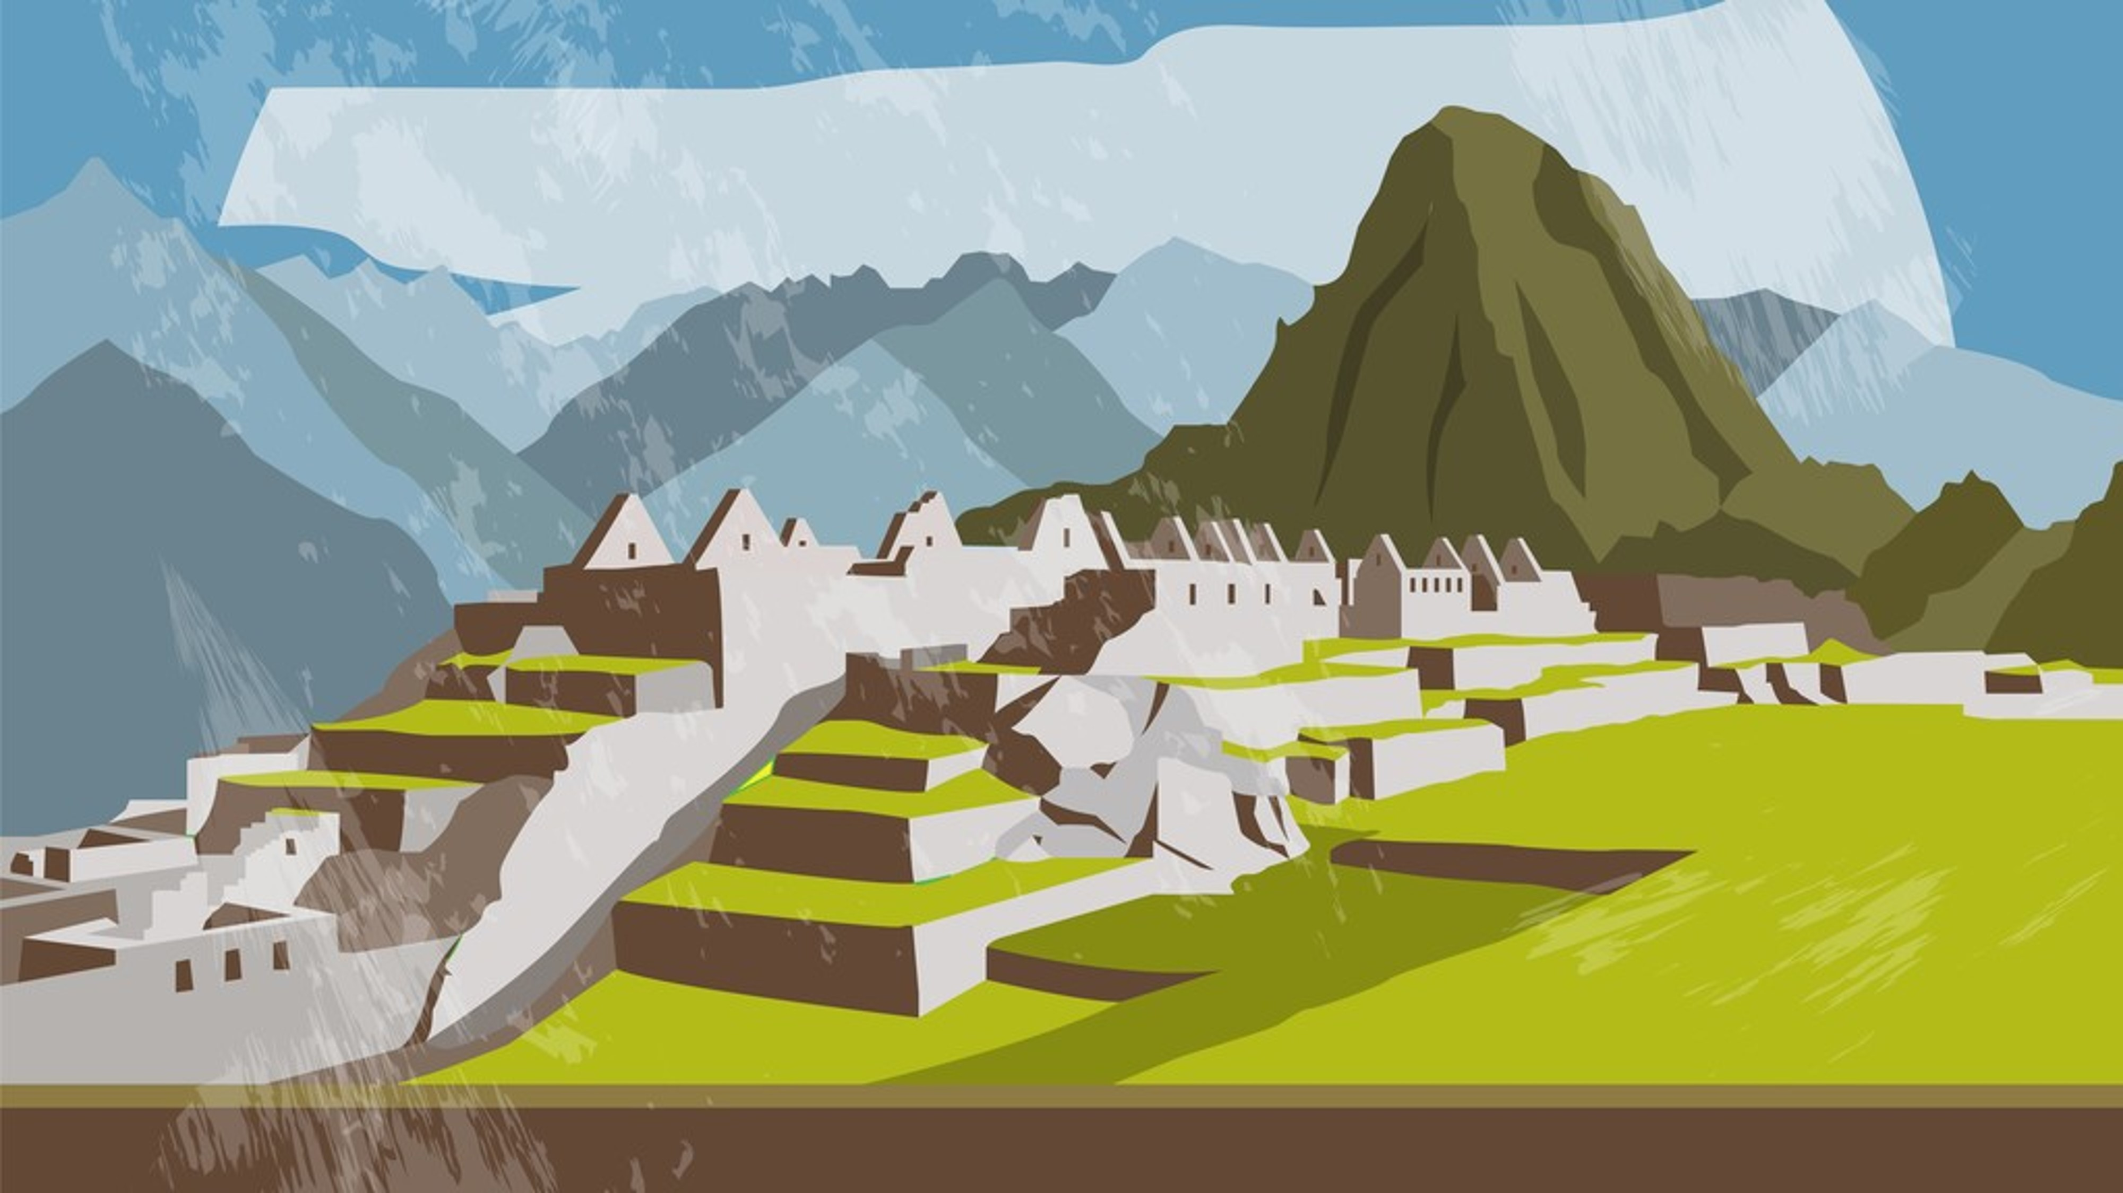
What impresses you most?

Slide 3
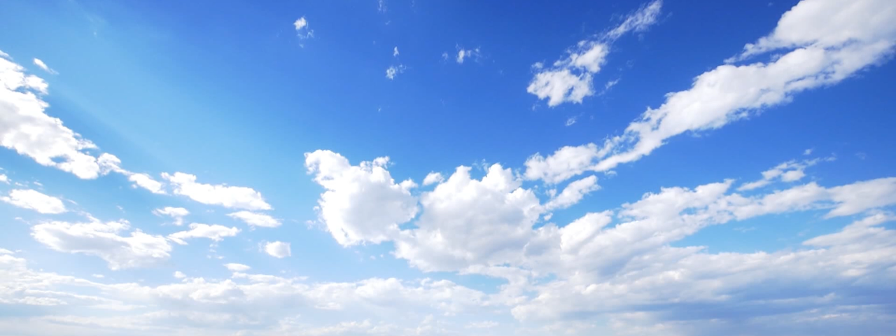
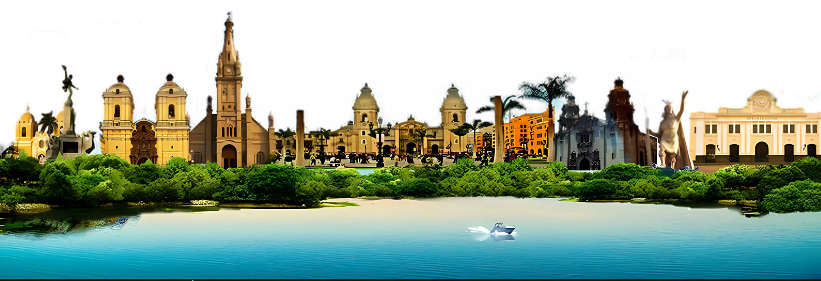
Unit 2
Unit 2
Travelling Around
Travelling Around
Reading and Thinking
by Feng Yiwa
Explore Peru

Slide 4
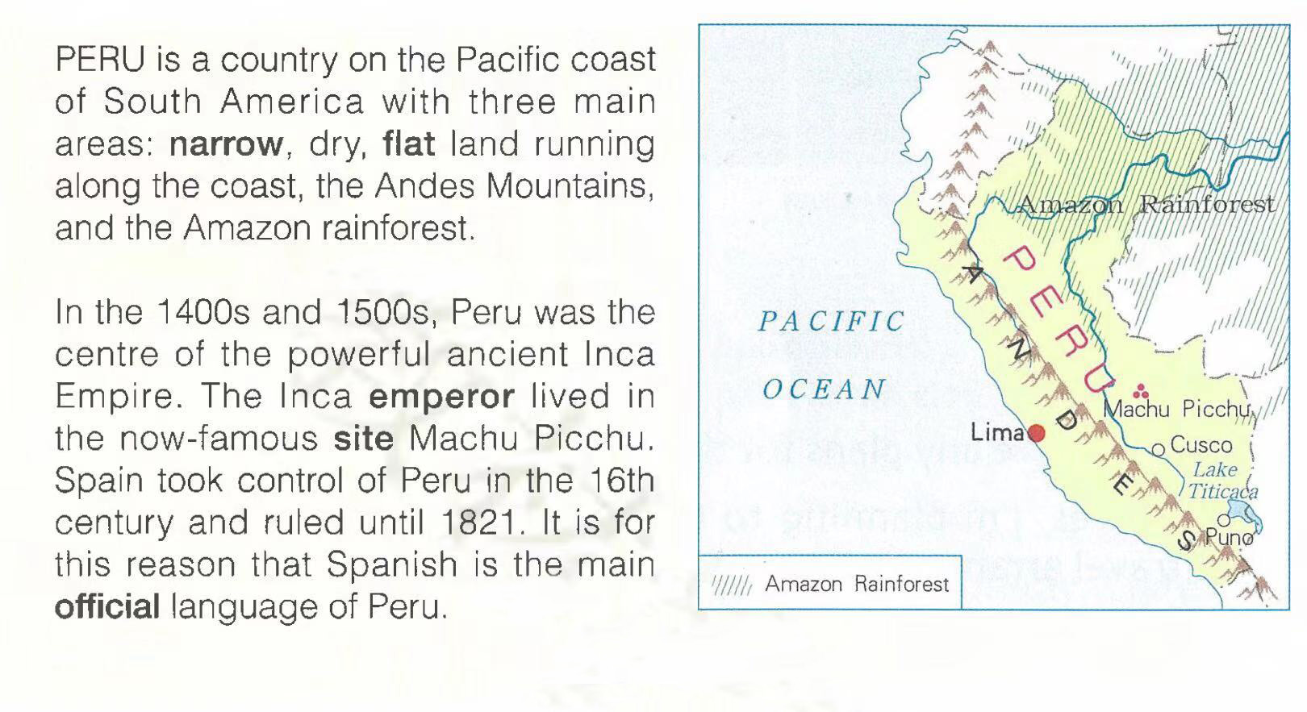


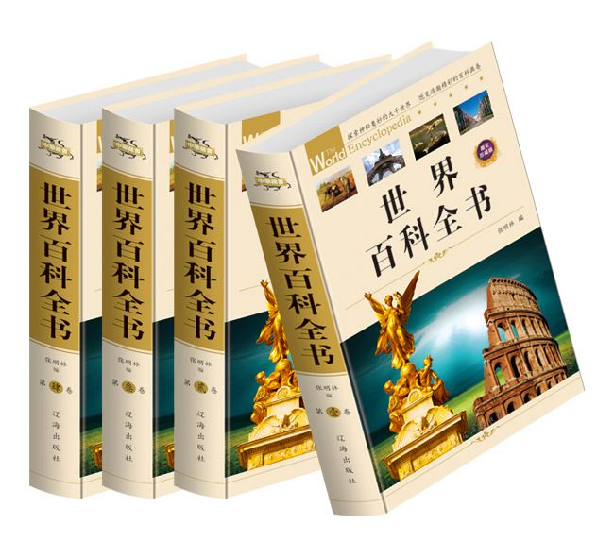
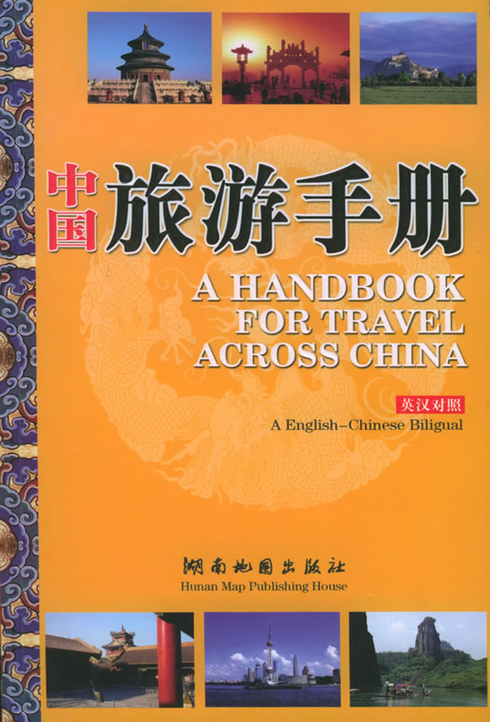
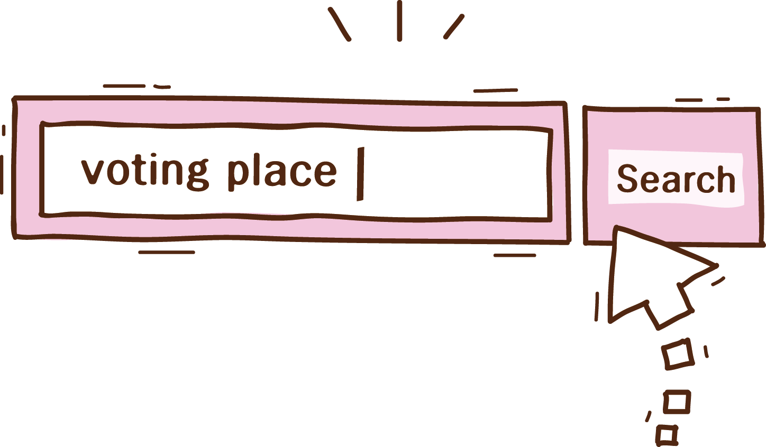
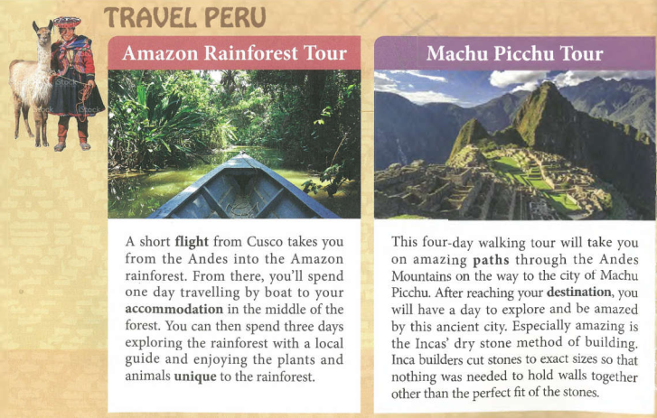
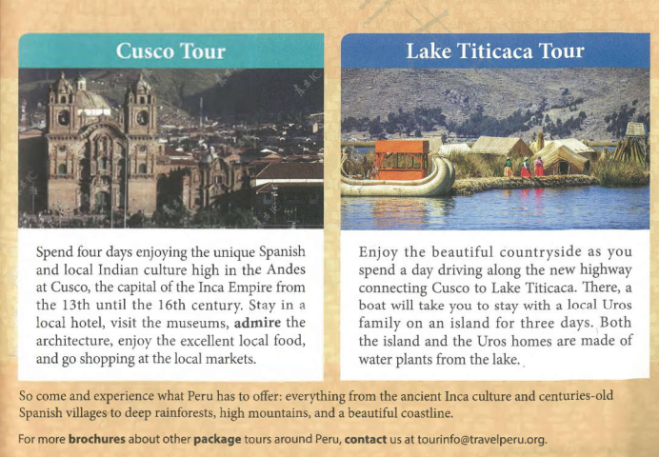
Lead-in
How will you know about Peru?
A promotional website
Check the advertising website
Read others’ travel journals
A travel journal
My travel journal
Peru
Look up in an encyclopedia
An encyclopedia
Read travel brochures
A travel brochure
……

Slide 5


Pre-reading
What types of text are they?
An advertising website
A travel journal
An encyclopedia
An encyclopedia
By looking through the text quickly for titles, headers , pictures and charts , you can tell the type of the text quickly.
A travel brochure
A travel brochure

Slide 6

While-reading
Read text 1 and finish the mind map.
geographic characteristics
location
3
the land
the Andes Mountains
the Amazon rainforest
Pacific coast
____ main areas: ___________________________________________________
on the _________ of ___________
South America
history
In the 1400s and 1500s：_________________
in the 16th century:
______
ancient Inca Empire
language
Spain
Spanish
_________

Slide 7
While-reading
What information do you get from 4 travel brochures (P27)?
 | Amazon rainforest | Machu Picchu | Cusco | Lake Titicaca
Number of days
Transport
Accommodation |  |  |  | local home
Activity | boating, hiking, exploring nature
A Tour of _______
A Tour of _______
A Tour of _______
A Tour of _______
Adventure
History
Culture
Nature
4 days
4 days
4 days
4 days
boat, flight
walking
/
car, boat
in the middle
of the forest
local hotel
/
visiting the museums,
admiring the architecture, enjoying the local food, and shopping at the local markets
enjoying the beautiful countryside, staying with local family
walking in the Mountains, exploring the
ancient city

Slide 8
Post-reading
Compare the two texts according to the following aspects.
 | Text 1 (encyclopedia) | Text 2 (travel brochure)
Language features
Content features
Design
Comparison

Slide 9
Post-reading
 | Text 1 (encyclopedia)
Language features
Content features
Design
simple concise
information of nature and culture
objective truth
ordinary design
(simple maps, no pictures)

Slide 10
Post-reading
 | Text 2 (travel brochure)
Language features
Content features
Design
v.
spend
stay
enjoy
admire
appreciate
explore
adj.
unique
amazing
excellent
beautiful
exact
perfect
… …
descriptive/impressive/attractive (v. & adj.)
subjective description
clear structure
detailed arrangement
conclusion & further information
beautiful design
(eye-catching pictures)

Slide 11
Appreciation
You can explore ... and enjoy ...
This four-day walking tour will take you on amazing paths...
You'll be amazed by ...
Enjoy the beautiful countryside as you spend a day driving along ...
Stay in a local hotel, visit the museums, admire the architecture, enjoy the excellent local food, and go shopping at the local markets.
So come and experience…
Especially amazing is the Incas' dry stone method of building.
accessible
Expressions to introduce
imperative sentence
inversion

Slide 12
Post-reading
From there, you’ll spend …traveling by boat to your accommodation
You can then spend three days exploring the rainforest … and enjoying… unique to the rainforest.
After reaching your destination, you have a day to explore and be amazed by this ancient city.
Enjoy the beautiful countryside as you spend a day driving along the new highway…
detailed arrangement
conclusion & further information

Slide 13
Summary
Language
Genre
Content
Purpose
objective truth
natural and cultural introduction
general
simple
concise
encyclopedia
to inform
clear structure
detailed arrangement
conclusion & further information
subjective description
descriptive
impressive
attractive
(v. & adj.)
specific
brochure
to attract

Slide 14
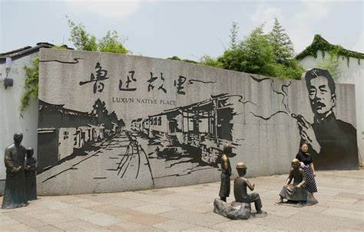
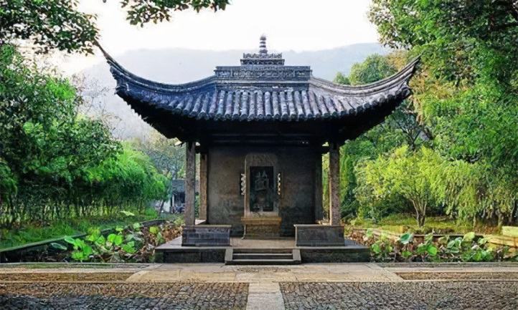
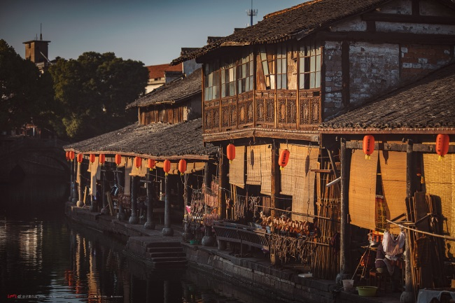
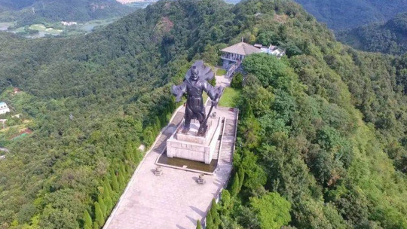

Assignment: Make a travel brochure for Shaoxing
Luxun Native Place
3-4 students in one group
1 student takes notes and get ready to present
Points to be included
Title/Header (A Tour of ____)
Basic and detailed information (number of days, transport, accommodation, activity…)
Language and content features
Orchid Pavilion
Anchang Ancient Town
Kuaiji Mountain

Slide 15
Assignment: Make a travel brochure for Shaoxing
Tourist attractions: ①Luxun Native Place ②Orchid Pavilion
③Anchang Ancient Town ④Kuaiji Mountain
3-4 students in one group
1 student takes notes and get ready to present
Points to be included
Title/Header (A Tour of ____)
Basic and detailed information (number of days, transport, accommodation, activity…)
Language and content features
You can explore ... and enjoy ...
This four-day walking tour will take you on amazing paths...
You'll be amazed by ...
Enjoy the beautiful countryside as you spend a day driving along ...
Stay in a local hotel, visit the museums, admire the architecture, enjoy the excellent local food, and go shopping at the local markets.
So come and experience…
Especially amazing is the Incas' dry stone method of building.
accessible
imperative sentence
inversion

Slide 16
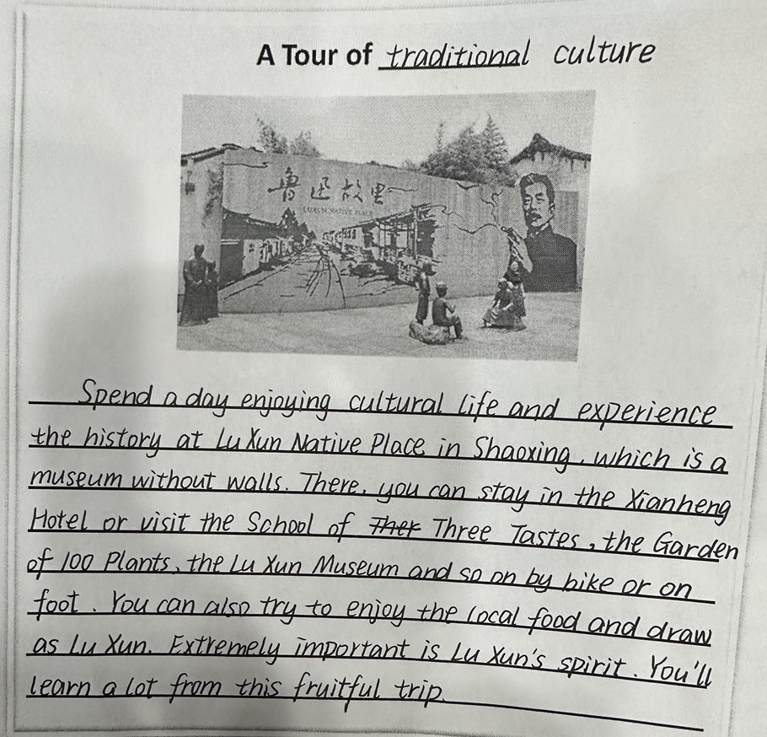
Assignment: One sample

Slide 17
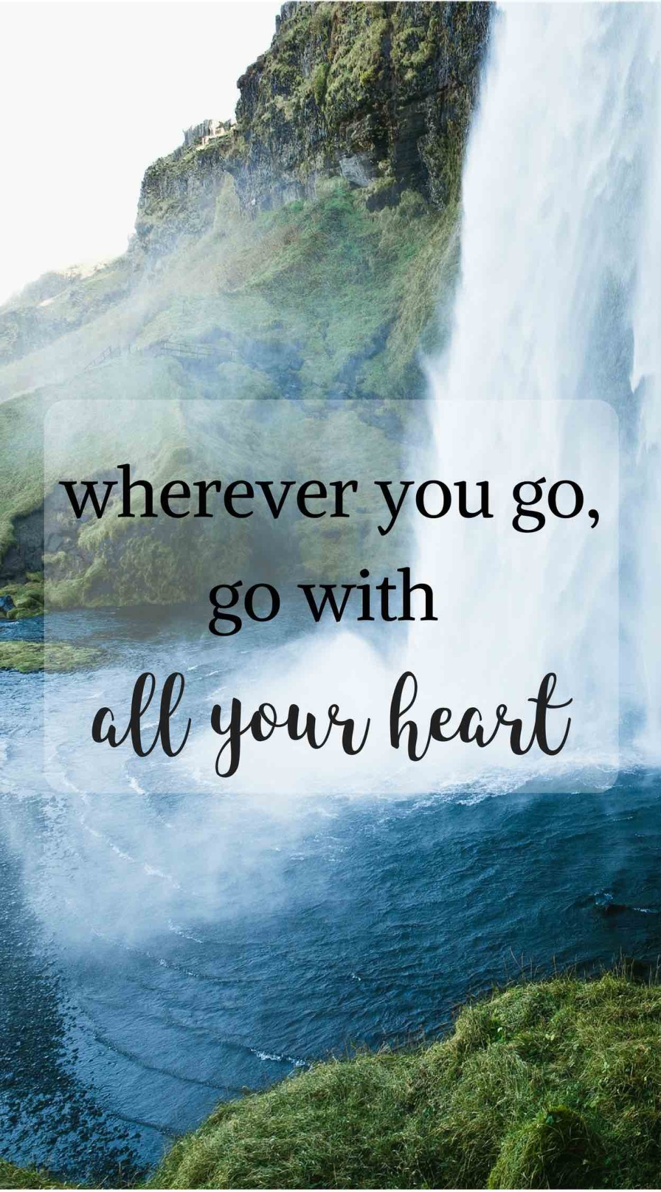


Inspiration

Slide 18
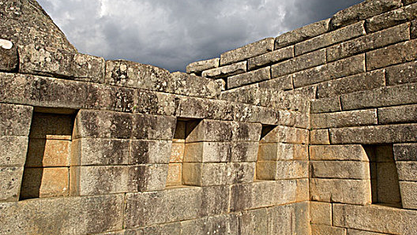
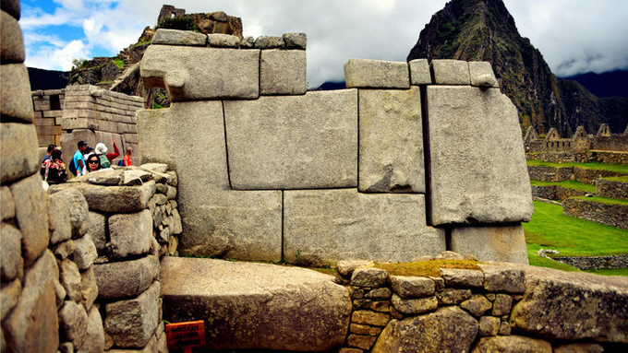
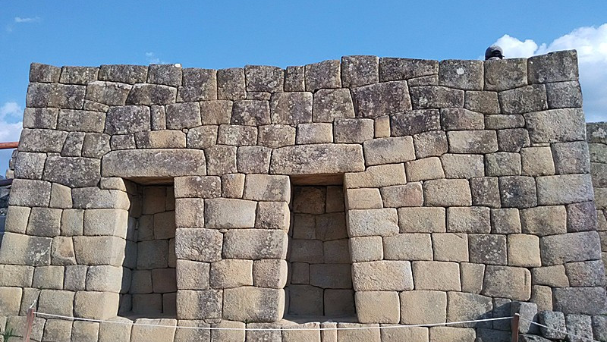
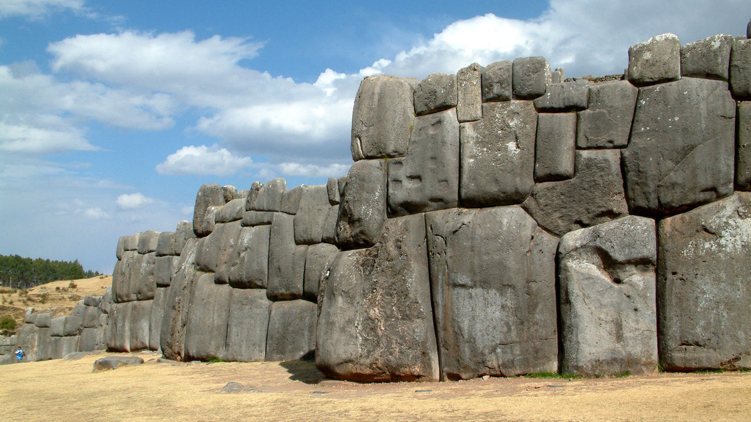
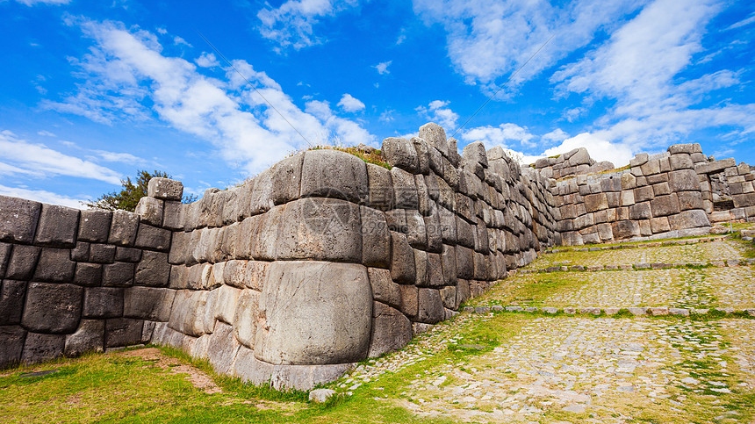
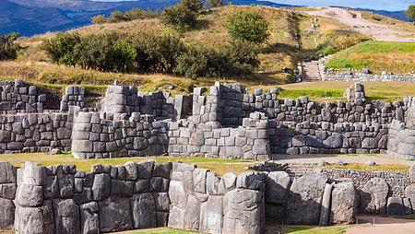
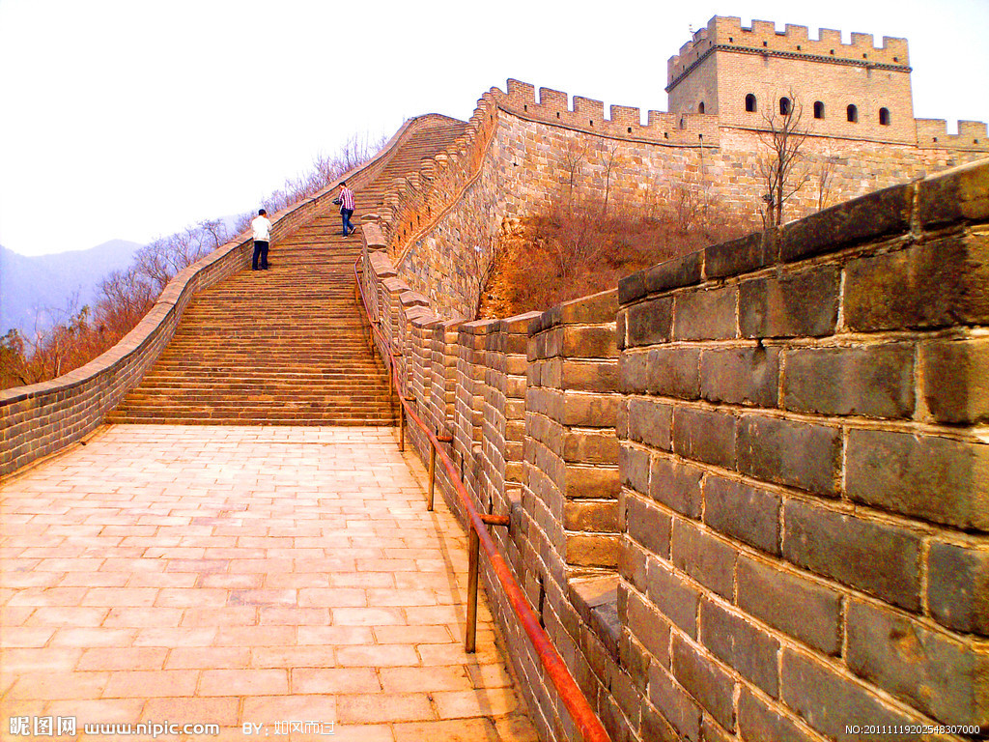
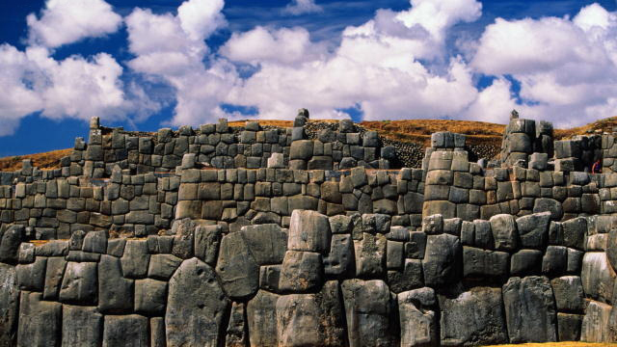
Incas' dry stone method of building
“Inca builders cut stones to exact sizes so that nothing was needed to hold walls together other than the perfect fit of the stone.”

