Slide 1

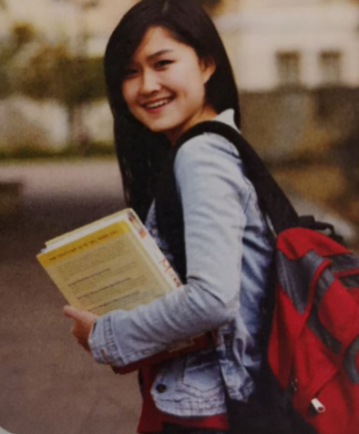
Unit 2 Bridging Cultures
Welcome, Xie Lei
Business Student Building Bridges
人教版选择性必修二U2 reading and thinking
泰顺县育才高级中学 曾而飞

Slide 2


Learning objectives:
By the end of the class, students will:
1. get to know Xie Lei’s challenges and solutions in the UK;
2. trace the changes of Xie Lei’s feelings;
3. introduce the four stages that Xie Lei experienced.

Slide 3
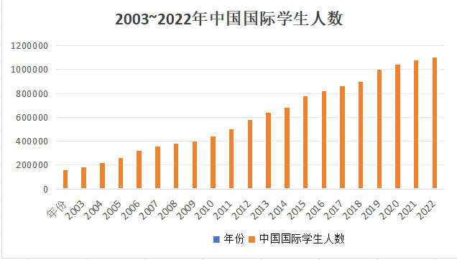
Chinese students choose to study abroad

Slide 4


Cambridge University

Slide 5


Question:
Have you ever wondered what challenges or difficulties you will encounter when you come to a completely new country ?

Slide 6
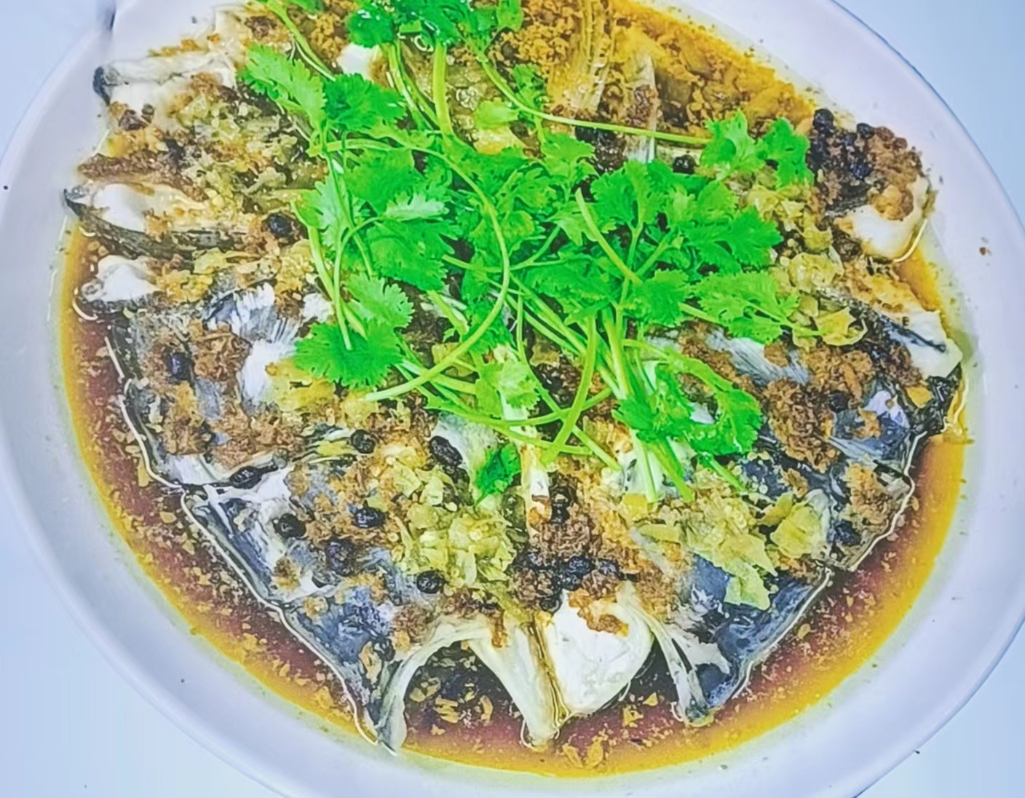
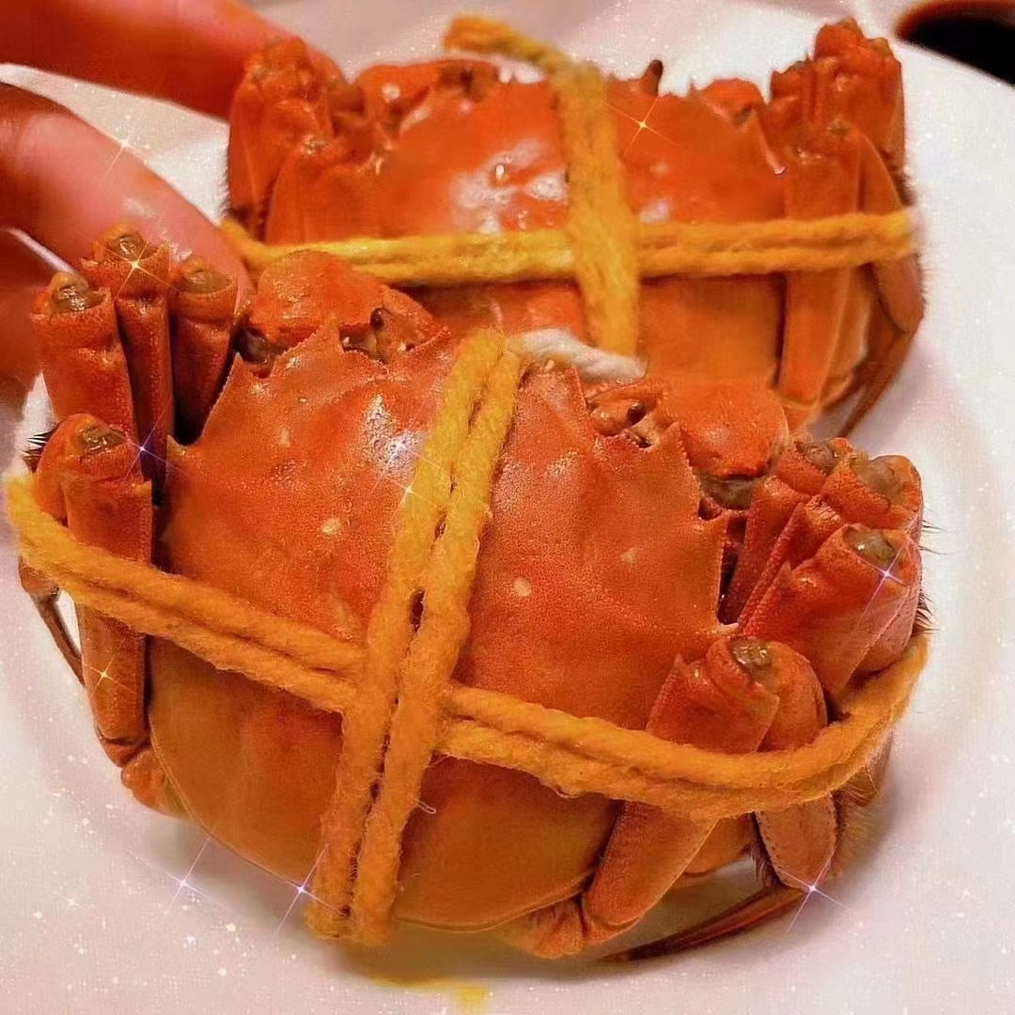
diet

Slide 7
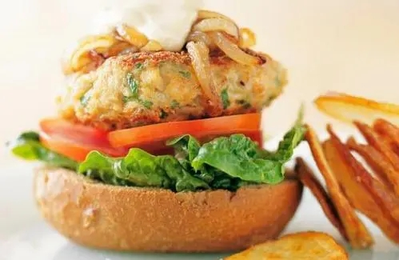
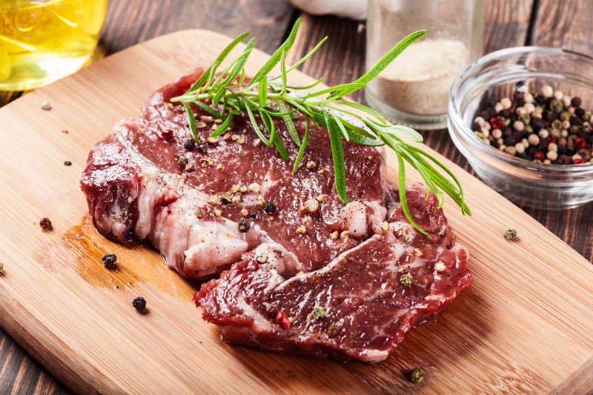

Slide 8

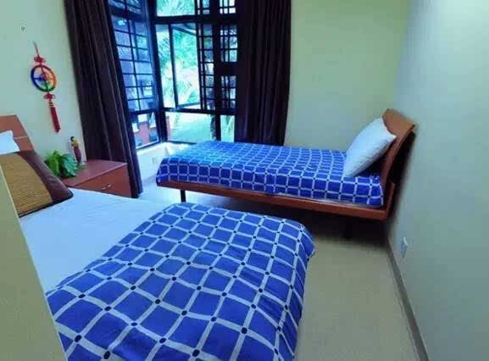
accommodation

Slide 9

language barrier

Slide 10
Welcome, Xie Lei
Business Student Building Bridges

Slide 11


Activity 1: Listening: Draw the words or expressions that describe time in the text
Title,subtitle, picture, and the last para
where do you think the text is from?
A. a science magazine
B. a school newspaper
C. a travel journal
D. an advertisement brochure

Slide 12
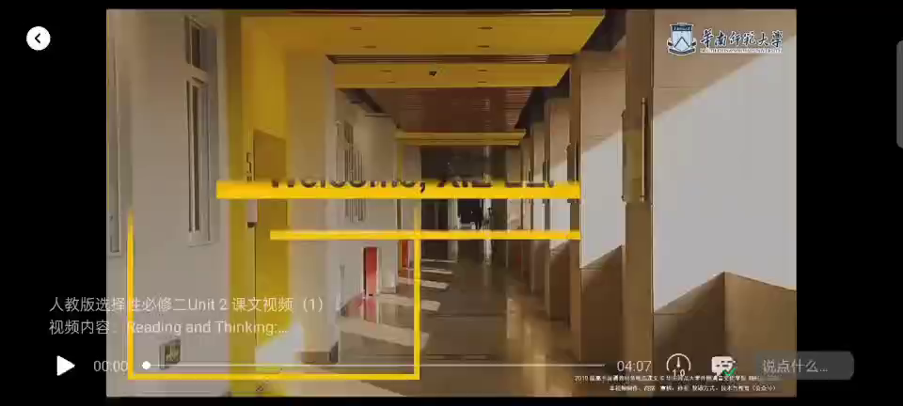

where do you think the text is from?
A. a science magazine
B. a school newspaper
C. a travel journal
D. an advertisement brochure

Slide 13
Six months ago, 19 year-old Xie Lei said goodbye to her family
At first, Xie Lei had to adapt to life in a different country.......
.
.
.
...... she found herself speaking up in class after just a few weeks.
.
.
.
Now halfway through her exchange year, XieLei feels much more at home in the UK.
We will follow XieLei’s progress in later editions, but for now, we wish her all the best.
written in order of time

Slide 14
1
Six months ago, 19-year-old Xie Lei said goodbye to her family and friends and boarded a plane for London. It was the first time that she had left China. “ I was very excited but also quite nervous. I didn’t know what to expect.
Xie Lei is studying for a business qualification at a university in China and has come to our university on a year-long exchange programme. “ I chose the exchange programme because I wanted to learn about global business and improve my English. My ambition is to set up a business in China after graduation”, she explained.
Honeymoon stage 留学蜜月期
2
when: who: how (she felt):
what: why:
an experience
excited,nervous
six months ago
XieLei
boarded a plane for London
for a year-long exchange programme
uncertain/adventurous

Slide 15
Question:
Is it easy for XieLei to adapt to the lives in the UK?

Slide 16

All things are difficult before they are easy.
Growth is a life-long journey but not a predictable destination.
---Dr Thomas Fuller

Slide 17
3
At first, Xie Lei had to adapt to life in a different country. “You have to get used to a whole new life.” she said. I had to earn how to use public transport and how to ask for things I didn’t know the English names for. When I got lost, I had to ask passers-by for help, but people here speak fast and use words I’m not familiar with. I ask them to repeat themselves a lot!”
Another challenge for Xie Lei is the academic requirements. The first time that she had to write an essay, her tutor explained that she must acknowledge what other people had said if she cited their ideas, but that he mainly wanted to know what she thought! Xie Lei was confused because she thought she knew less than other people. Her tutor advised her to read lots of information in order to form a wise opinion of her own.
Discomfort stage 留学不适期
5

Slide 18
4
Although some foreign students live in campus accommodation, Xie Lei chose to live with a host family，who can help with her adaptation to the new culture. When I miss home, I feel comforted to have a second family， Xie Lei said “When there’s something I don’t know or understand I can ask them. They are also keen to learn about China. Laura, the daughter of my host family, wants to study in China in the future. We take turns to cook each evening. They really love my stir-fried tomatoes and eggs! Laura says she always feels hungry when she smells it, so I taught her how to cook it, too.
Recovery stage 留学恢复期

Slide 19
6
Xie Lei also found many courses included students’ participation in class as part of the final result. Students need to generate ideas, offer examples, apply concepts, and raise questions, as well as give presentations. At first, Xie Lei had no idea what she should say, but what surprised her was that she found herself speaking up in class after just a few weeks. “My presentation on traditional Chinese art was a great success, which boosted my confidence,” she said. “I’ll use these skills back home for presentations. They 'll help me build a strong business in the future.”
Recovery stage 留学恢复期
to be an a learner
utonomous

Slide 20
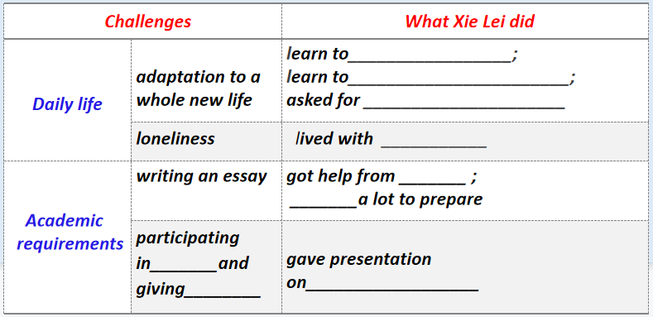
Activity 2: Read for detailed information
Scan Para3 and 5 carefully and fill in the table.

Slide 21
 | adaptation to a whole new life | learn to_________________; learn to_______________________; asked for _____________________
 | loneliness | lived with ___________
 | writing an essay | got help from _______ ; _______a lot to prepare
 | participating in_______and giving________ | gave presentation on__________________
Challenges
What Xie Lei did
use public transport
ask for things she didn't know the English names for
Daily life
help from passers-by when I got lost
a host family
her tutor
read
Academic
requirements
class
presentation
traditional Chinese art

Slide 22
Critical thinking, logical thinking
Success factors:
external factors:
1. living with a host family
2. having a tutor’s guidance

Slide 23
internal factors:
Para2: “My ambition is to set up a business in China after graduation” she explained.
ambitious
Para3: At first, XieLei had to adapt to life in a different country. “You have to get used to a whole new life,” she said.
adaptable
Para3: “ I had to learn how to use public transport and ......,I ask them to repeat themselves a lot!”
independent
Para4: We take turns to cook each evening. They really love my stir-fried tomatoes and eggs!
capable
Para6: What surprised her was that she found herself speaking up in class after just a few weeks.
capable, strong-willed, determined
Para6: “My presentation on traditional Chinese art was a great success, which boosted my confidence,” she said.
capable, persistent
Para7: “As well as studying hard, I’ve been involved in social activities.
hard-working, active

Slide 24
Question: which is more important? external factors or internal factors?
The internal cause is the root of the development of things, and the external cause acts through the internal cause.
---Philosophical statement
内因是事物发展的根源，外因通过内因起作用。
---哲学观点

Slide 25
7
Now halfway through her exchange year, Xie Lei feels much more at home in the UK. What seemed strange before now appears quite normal to her. "Engaging in British culture has helped, she said. "As well as studying hard, I've been involved in social activities. British people are fascinated by our culture and eager to learn more about it, so I’m keen to share my culture with them. While I‘m learning about business I'm also acting as a cultural messenger building a bridge between us.
Adaptation stage 留学适应期

Slide 26
Activity 3: Read to analyze
Since XieLei left China, she has experienced mixed feelings during her one year-long exchange programme. Actually, her feelings changed little by little. Let’s circle the words to trace the changes of Xie Lei’s feelings.

Slide 27
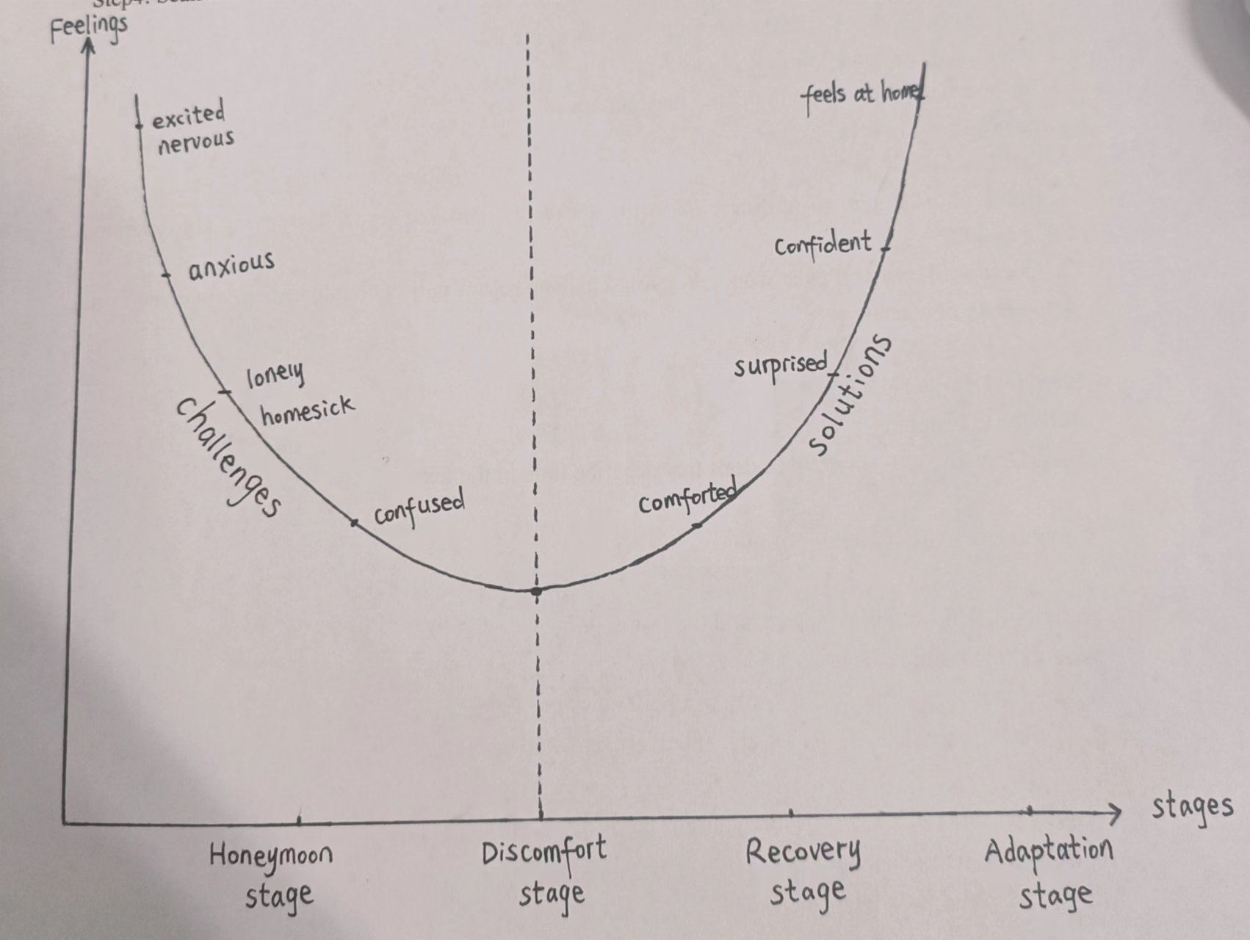

Slide 28

Question: why did XieLei experience discomfort stage?
Culture Shock 文化冲击
Homesickness
Culture shock is a natural phenomenon that occurs when one has a cross-cultural experience.Culture shock may cause homesickness. This refers to the feeling of longing for one's home.

Slide 29
Unit 2 Bridging Cultures
Welcome, Xie Lei
Business Student Building Bridges
what bridges?
a bridge of culture: shared Chinese culture
(Chinese cuisine and art) and learnt foreign culture (global business, English and social activities)

Slide 30



cultural exchange: A cultural messenger

Slide 31
deep thinking
XieLei experienced the four stages of studying abroad. When you go from middle school to senior school, do you have similiar experiences?Please make a dialogue with your partner based on the four stages ,you can refer to the expressions in BOOK 1 Welcome unit.

Slide 32
S1:Hello, do you remember how you felt on your first day in senior school?
S2: I was very excited but also quite nervous. I painted a beautiful picture, I wonder if I can make some new friends ? What if no one talked to me?
S1: Haha! Excited and nervous, just like the honeymoon stage.
S2:Yes, but pretty soon, I discovered that I can’t adapt to the fast pace of life in senior school, sometimes I miss home very much because it was the first time for me to choose campus accommodation.
S1:Yes, this is the period when you felt the most uncomfortable because it’s the discomfort stage.
S2:Right, but soon I found most of my classmates and teachers friendly and helpful, and I even won first prize in a speech contest shortly after I started senior school.
S1: Congratulations! This is called recovery stage. After this stage, you can quickly adapt to high school life. That is what we call adaptation stage.
S2: Yes, I felt much more at ease later.

Slide 33

Culture is the soul of a country and a nation. Culture revitalizes the country and the nation is strong. Without a high degree of cultural confidence, without the prosperity of culture, there will be no great revitalization of the Chinese nation.
---President Xijinping
文化是一个国家、一个民族的灵魂。文化兴国运兴，文化强民族强。没有高度的文化自信，没有文化的繁荣兴盛，就没有中华民族的伟大复兴.
---习近平

Slide 34
T: With the improvement of China’s national strength and opening-up, as well as the formation of world economic integration, I strongly encourage you to have the opportunity to go abroad and study overseas. Before you study abroad, Let’s remember president Xijinping’s remarks above. Therefore, studying abroad is so much more than improving your own future, it’s also about shaping the future of our motherland--China, and the world we all share, that is, build a community with a shared future of mankind.

Slide 35
Homework
Reporter: I want to go to China for further study next year, but I feel confused about what challenges I will encounter and how I can handle them. Would you please give me some suggestions?
XieLei:......
Please write a short article for XieLei to reply the reporter and offer him some suggestions.

Slide 36
Thanks

